Slide 1

Department of Computer Science & Engineering Course Title: Electronic Devices and Circuit & Pulse Techniques Course Code: EEE-203 Section: DB Presentation On : MOD-4 Synchronous Up-Counter
Presentation By:
Rittik Halder (213902069)
Md. Sohanur Rahman (213902106)
Presentation To:
Monjila Afrin Dorothi
Lecturer of EEE
Department of EEE, GUB

Slide 2
Design Steps
Determine No. of Flip Flop
Create Excitation Table
Draw State Diagram
Create State Table
Function Simplification (K-Map)
Circuit Connection

Slide 3
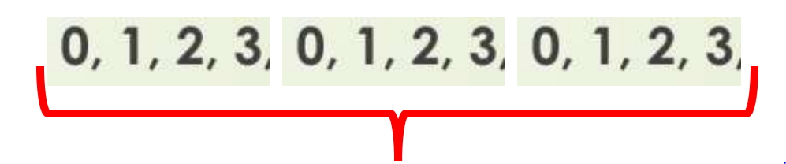
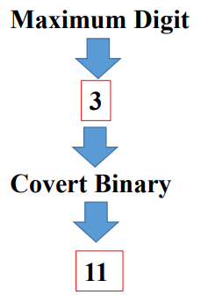

Step-1: Determine No. of Flip Flop

Slide 4
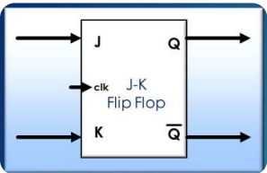
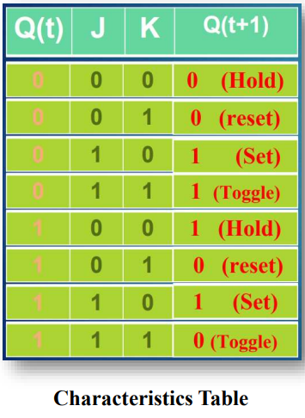
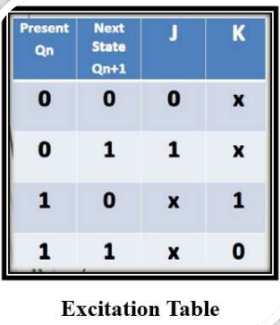
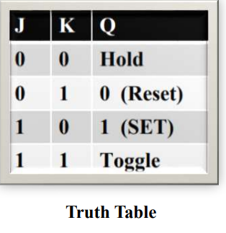
Step-2: Create Excitation Table

Slide 5
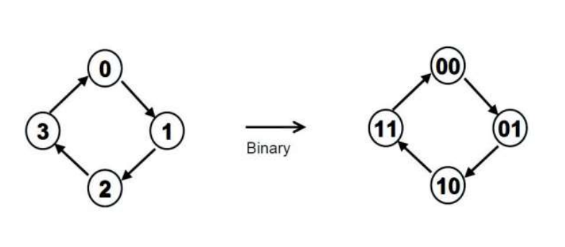
Step-3: Draw State Diagram

Slide 6
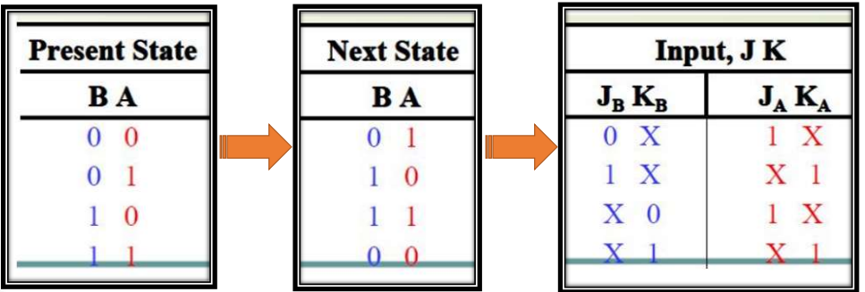
Step-4: Create State Table

Slide 7
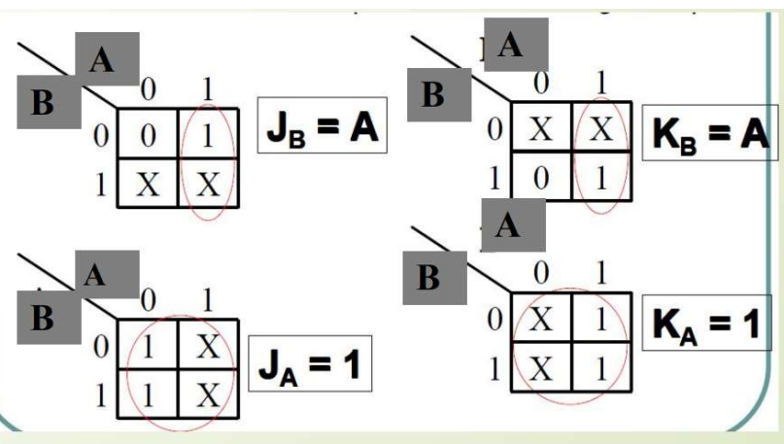
Step-5: Function Simplification (K-Map)

Slide 8
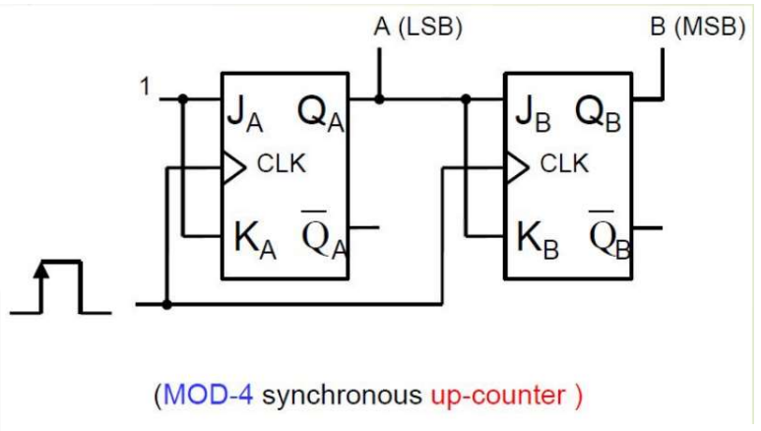
Step-6: Circuit Connection

Slide 9
Thank You

