Slide 1
Job Shop Scheduling Problem Simulated Annealing
Problem Solving and Search in Artificial Intelligence
Sohee Kim, Shaonty Dutta
International Center for Computational Logic
Dresden, 21th January 2020

Slide 2
Outline
Job Shop Scheduling Problem
Simulated Annealing
Represent
Constraints
Neighborhood
Representation Solution
Conclusion
Notes:
Sohee
We will present the presentation as the following table of contents.

Slide 3
What is a solution
Job Shop Scheduling Problem?
Makespan:
the length of time from earliest start time of the jobs to the latest end time
Ex)
 | O1 |  | O2 |  | O3
 | M | T | M | T | M | T
J1 | 0 | 4 | 1 | 3 | 2 | 5
J2 | 2 | 4 | 1 | 3 | 0 | 4
J3 | 0 | 6 | 2 | 3 | 1 | 3
 | 1 | 2 | 3 | 4 | 5 | 6 | 7 | 8 | 9 | 10 | 11 | 12 | 13 | 14 | 15 | 16 | 17 | 18
M0 | J1, O1 |  |  |  | J3, O1 |  |  |  |  |  | J2, O3
M1 |  |  |  |  | J1, O2 |  |  | J2, O2 |  |  |  |  |  |  |  | J3, O3
M2 | J2, O1 |  |  |  |  |  |  | J1, O3 |  |  |  |  | J3, O2
Notes:
Sohee
The main objective of the JSSP is to find a schedule of operations that is the completed time of carrying total operations out in the schedule for n jobs and m machines.
The aim is to minimizes the finish time of the last operation, namely, the makespan

Slide 4
Simulated Annealing Algorithm
Step1. Get an initial solution S
Step2. Set an initial temperature, T> 0.
Step3. While not frozen do the following:
Step3.1 . Do the following L times:
Step3.1.1. Sample a neighbour S’ from S.
Step3.1.2. Let delta = cost (S’) – cost(S) .
Step3.1.3. If delta=0
then ( i.e . Down hill move) set S =S’
else ( i.e . uphill move )
set S =S’ with the probability of exp(-delta/T) .
Step3.2. Set T = r x T, where r is the reduction factor.
Step4. Return S
Notes:
Sohee
We try to solve the problem by Simulated Annealing algorithm
From now on, We will explain the code we implemented.

Slide 5
constraints
There is an order of precedence in the operations of a job.
An operation that has already started cannot be interrupted.
No machine may process more than one job at a time.
No job may be processed by more than one machine at a time
All jobs must be processed in each machine only one time
Notes:
Sohee
There are some constraints before we solve this problem.:
There is an order of precedence in the operations of a job.
An operation that has already started cannot be interrupted.
No machine may process more than one job at a time.
No job may be processed by more than one machine at a time
All jobs must be processed in each machine only one time

Slide 6
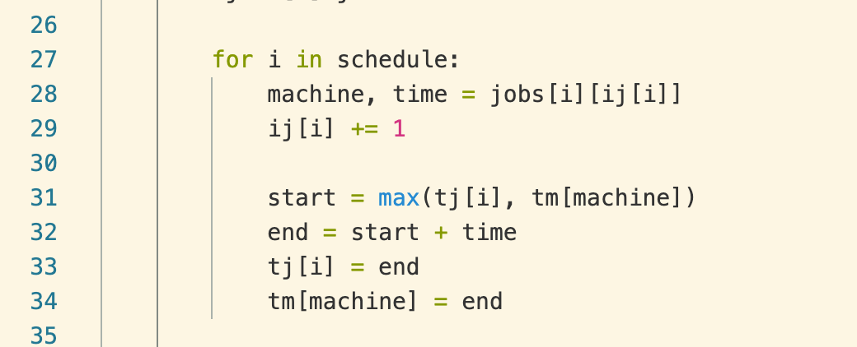
Formulate constraints
Precedence Constraints :
For any two consecutive tasks in the same job, the first must be completed before the second can be started.
Ex.
t(1,1)+4≤ t(1,2)+3 ≤ t(1,3)
t(2,1)+4≤ t(2,2)+3 ≤ t(2,3)
t(3,1)+4≤ t(3,2)+3 ≤ t(3,3)
No Overlapping Constraints:
- A machine can't work on
two tasks at the same time
Notes:
Shaon
These constraints are implemented in our code as follows: A machine can't work on two tasks at the same time. So in code I put flag for machine and after calculating cost I just store the end time for this machine.

Slide 7
Neighborhood
Randomly selects a solution close to the current one
Measures its quality
Decides to move or stay
Notes:
Sohee
At each time step, the algorithm randomly selects a solution close to the current one, measures its quality, and then decides to move to it or to stay with the current solution based on either one of two probabilities between which it chooses on the basis of the fact that the new solution is better or worse than the current one.

Slide 8
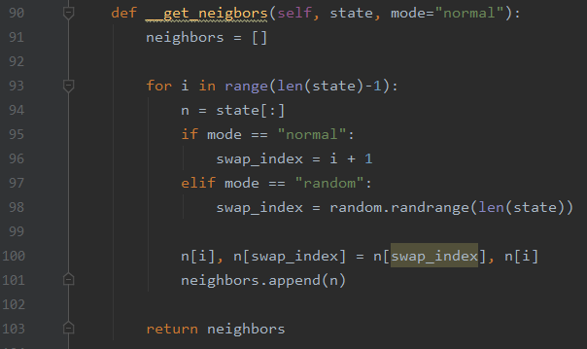
Neighborhood
Selection mode
Normal
Random
Notes:
Shaon
These neighborhood functions are implemented in our code as follows: There are two modes to select neighbor. Normal and random. In normal mode it will select immediate next state and in random mode it will select randomly any state. After that all state just shuffles and stores in neighbors array.

Slide 9
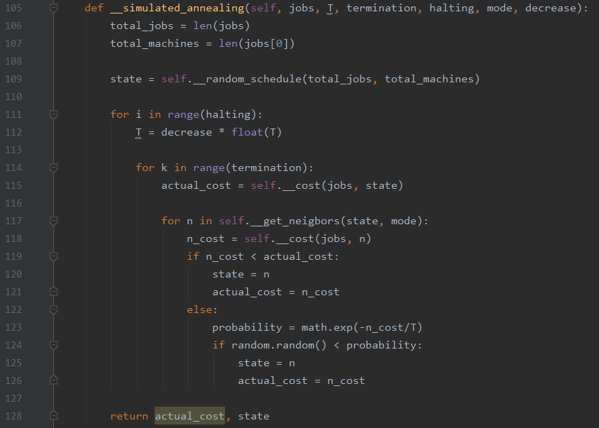
Simulated Annealing
Initial Temperature (T)
Termination
Reduction factor
Notes:
Shaon
These neighborhood functions are implemented in our code as follows: Here we set a termination time. For this termination time `actual cost` first calculate the state cost then visit every neighbor and calculate neighbor state cost. If neighbor cost is less then the state jump that neighbor and hold that state cost. Otherwise line 72 it will calculate probability and select the next state. Every time it will also calculate the reduction factor in line 61. After finishing termination time this function return actual cost and the state.

Slide 10
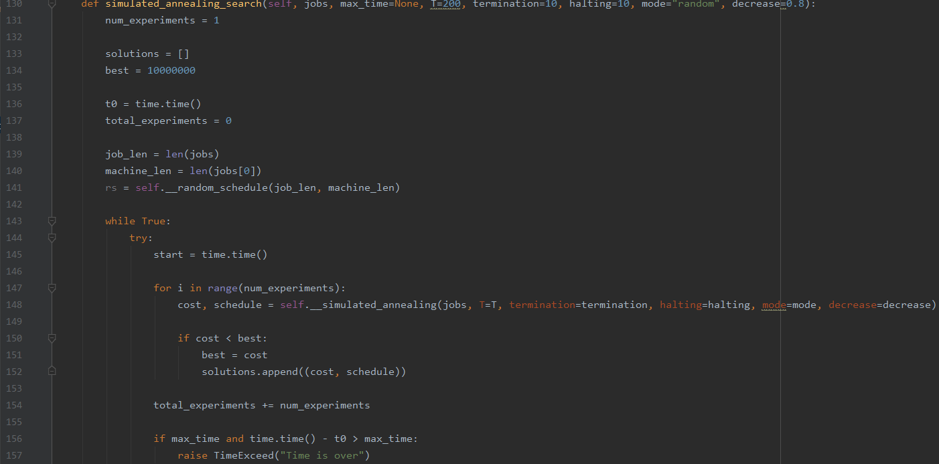
Simulated Annealing Experiment
New Try to check the best solution
Notes:
Shaon
These Simulated Annealing search function experiment a couple of solution to identify it is best cost or not.

Slide 11
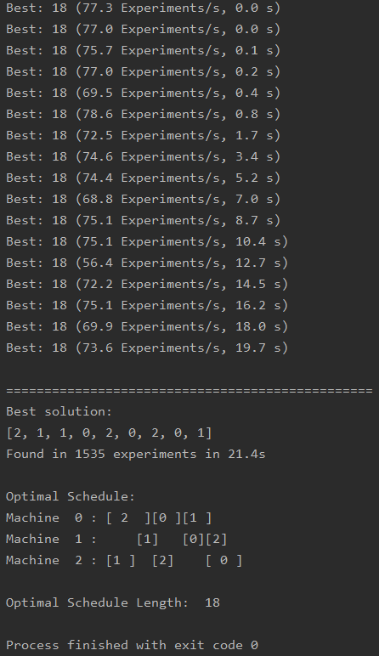
Representation of solution
Example:
 | O1 |  | O2 |  | O3
 | M | T | M | T | M | T
J1 | 0 | 4 | 1 | 3 | 2 | 5
J2 | 2 | 4 | 1 | 3 | 0 | 4
J3 | 0 | 6 | 2 | 3 | 1 | 3
Notes:
Shaon
Running the code using the example data from the previous example gave the following results:
Sorting the problem according to the machine (constraints provided) in the table.

Slide 12
Conclusion
Not the fastest method
More efficiently to carry out a bigger search in the solution space of the problem, in a shorter period of time, obtaining better solutions in JSSP.
Notes:
Sohee
The Simulated Annealing algorithm is pretty effective but not the fastest method of solving the Jobshop problem.
the SA works more efficiently to carry out a bigger search in the solution space of the problem, in a shorter period of time, obtaining better solutions in JSSP.

Slide 13
Thank you.
Job Shop Scheduling Problem with Simulated Annealing
Problem Solving and Search in Artificial Intelligence
21th January 2020
Notes:
Thank you for your attention.

