Slide 1
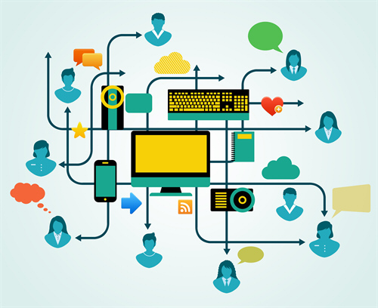
Information and Communications Technologies
final project
Members :
Messekher Younes
Morsli mahdi
Touil Soheib
Angar Yacine
Douaouria Rassim Amine

Slide 2


What are TIC
1.1 Introduction:
Information and Communications Technologies or TIC for short are the infrastructures and components that enable modern computing.
1.2 The importance of TIC in modern society:
Information and Communications Technology (TIC) plays a pivotal role in our daily lives, revolutionizing the way we access information and connect with others. Online newspapers enable us to stay updated locally, while electronic communication tools
The integration of digital computers and networks has transformed our economic landscape, creating a boundary-free economy where transactions occur seamlessly across time and space

Slide 3
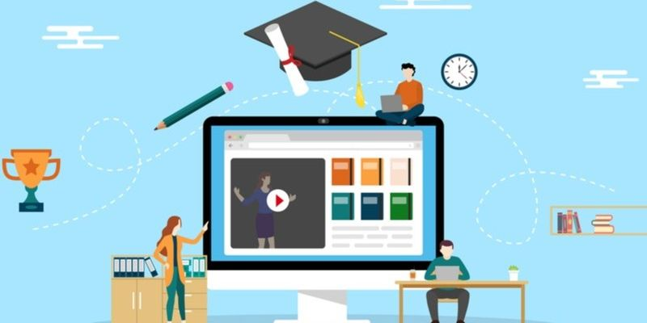
2. TIC in education:
The emergence of modern technologies in our daily lives has significantly elevated the integration of Information and Communications Technology (ICT) in education over the recent years. ICTs have become increasingly significant in our surroundings, offering a diverse range of applications across various sectors
2.1. The benefits and negatives of TIC in education:
2.1.1. Benefits:
The integration of new technological tools in academic settings brings about innovation, accelerating information transfer, increasing student engagement
, and automating processes. These tools not only enhance concentration and comprehension through digital and interactive activities but also promote flexibility and autonomy in learning, allowing students to progress at their own pace with the flexibility provided by digitalization and connectivity.

Slide 4
2.1.2. Negatives:
While technologies offer numerous benefits to education, they come with notable drawbacks. The accessibility of diverse online resources poses the risk of distractions, diverting attention away from the subject matter. Excessive and inappropriate use of technology can lead to a compulsive relationship, negatively impacting students' health, social life, and academic performance. Moreover, the widespread adoption of digitization in academic institutions may hinder the development of essential skills such as writing, public speaking, and reasoning, as highlighted by a recent study from the University of California.
3. Skills used in TIC:
To master TIC many skills are required some are skills we use in everyday life and others are skills required for computer work.
3.1. Computer skills:
3.1.1. Technological knowledge:
Working in ICT demands an understanding of a company's technology preferences for daily tasks, encompassing general proficiency with computers, mobile devices, and basic operations. This knowledge extends to maintaining and updating technology to enhance overall efficiency.
3.1.2. Online research:
Online research is the process of gathering information from the internet, utilizing search engines and educational websites for research purposes. It involves establishing methods to accumulate data, which may include customer surveys, online interviews, and the collection of metric data.

Slide 5

3.1.3. Netiquette:
Netiquette refers to a set of guidelines designed to promote respectful online communication. These rules apply across various internet platforms, including email, messaging forums, and video/audio chats.
3.1.4. Data management
Data management is the systematic process of gathering, organizing, and storing large volumes of business metrics for analysis and future decision-making. It encompasses the management of database and spreadsheet software, organizing data for clarity, and handling files and folders within an organization's network.
3.1.5. Desktop publishing:
Desktop publishing involves creating documents using software that prepares digital information for transition to a physical medium, such as webpages, postcards, brochures, business cards, or labels. It enables companies to use marketing information to craft visually appealing displays to attract customers.

Slide 6

Word processing:
Word processing refers to the creation and manipulation of text on a computer using specialized software. It involves preparing documents for various purposes by typing written content and formatting it according to organizational specifications.
3.2. Social skills:
3.2.1. Problem-solving:
Problem-solving skills enable individuals to identify the source of an issue and devise effective solutions. This process typically involves analysis, active listening, research, and decision-making. Individuals with strong problem-solving skills may specialize in researching, analyzing, and organizing data
3.2.2 Collaboration:
Collaboration involves working with others to achieve a common task or project. Technology professionals leverage their collaboration skills to assist coworkers with technological challenges, including teaching new software or resolving issues

Slide 7
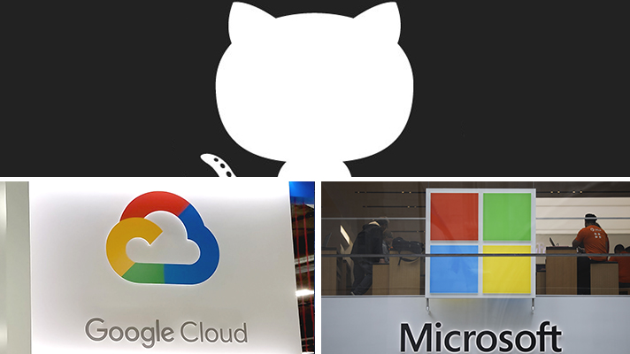
3.2.3. Organization:
Organizational skills involve effectively managing time, workspace, and energy to ensure the completion of tasks. This includes digital schedule management, organizing files for easy access, and optimizing technology for efficiency.
4.1. Technologies related to TIC:
4.1.1. Some technlogies related to TIC:
Tool | Date of creation | Users | Creator
Google services | September 4, 1998 | 4.3 billion | Larry Page and Sergey Brin
Git | April 7, 2005 | 100 million | Linus Torvalds and Junio C Hamano
GitHub | 100 million |  | Tom Preston-Werner, Chris Wanstrath, P. J. Hyett
Microsoft Tools | 1990 | 1.2 billion | Bill Gates and Paul Allen

Slide 8


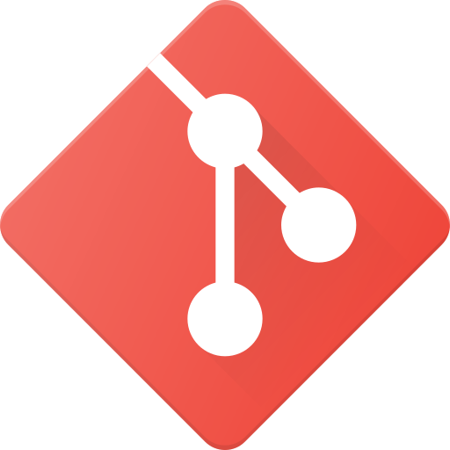
Google, Microsoft, Git, and GitHub represent pivotal pillars in the realm of technology, each playing a distinctive role in shaping the digital landscape. Google, a tech behemoth, dominates the search engine domain, revolutionizing how information is accessed globally. Its innovative products, from Android to Google Workspace, redefine the way individuals and businesses interact with technology.
Git, a distributed version control system, emerges as a linchpin in software development, providing a robust framework for collaborative coding. Developers leverage Git to track changes, coordinate workflows, and facilitate seamless collaboration across diverse teams. GitHub, a platform built atop Git, amplifies these capabilities by offering a centralized hub for hosting, sharing, and collaborating on code repositories.
In essence, Google and Microsoft shape our daily digital interactions, while Git and GitHub empower the collaborative spirit that propels software development into new frontiers

