Slide 1
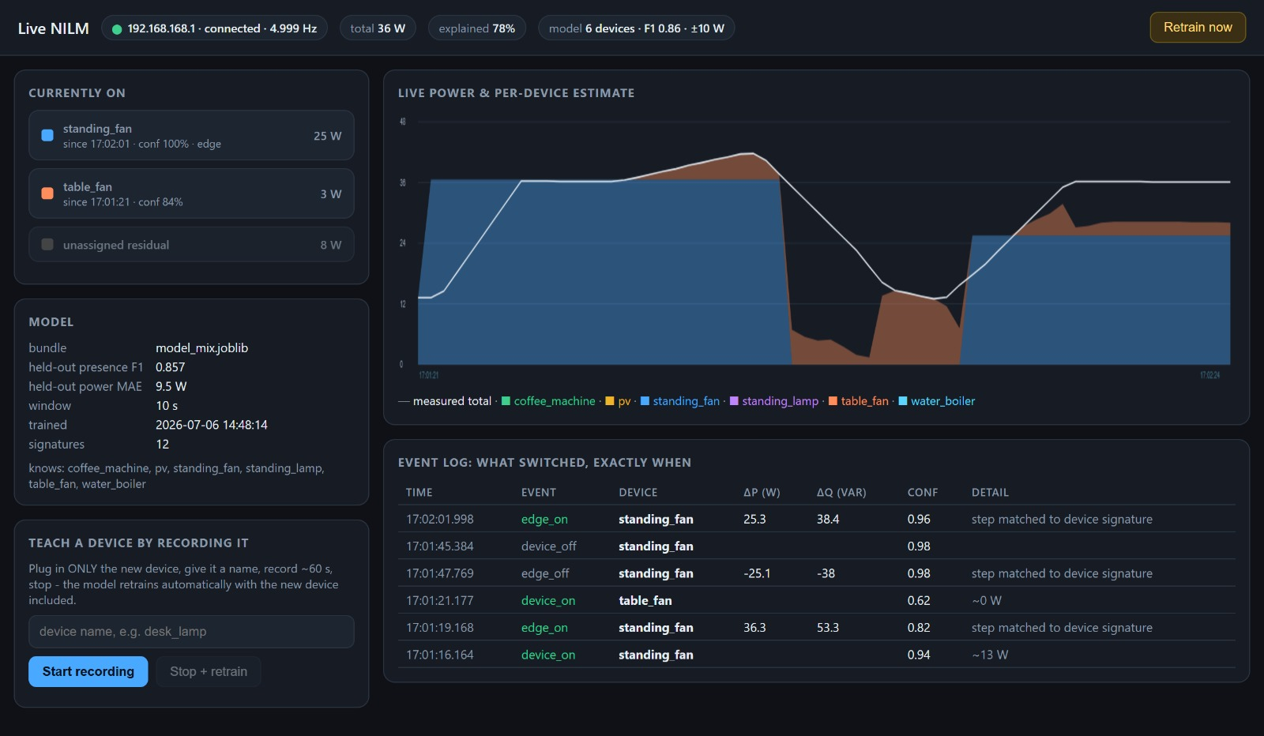
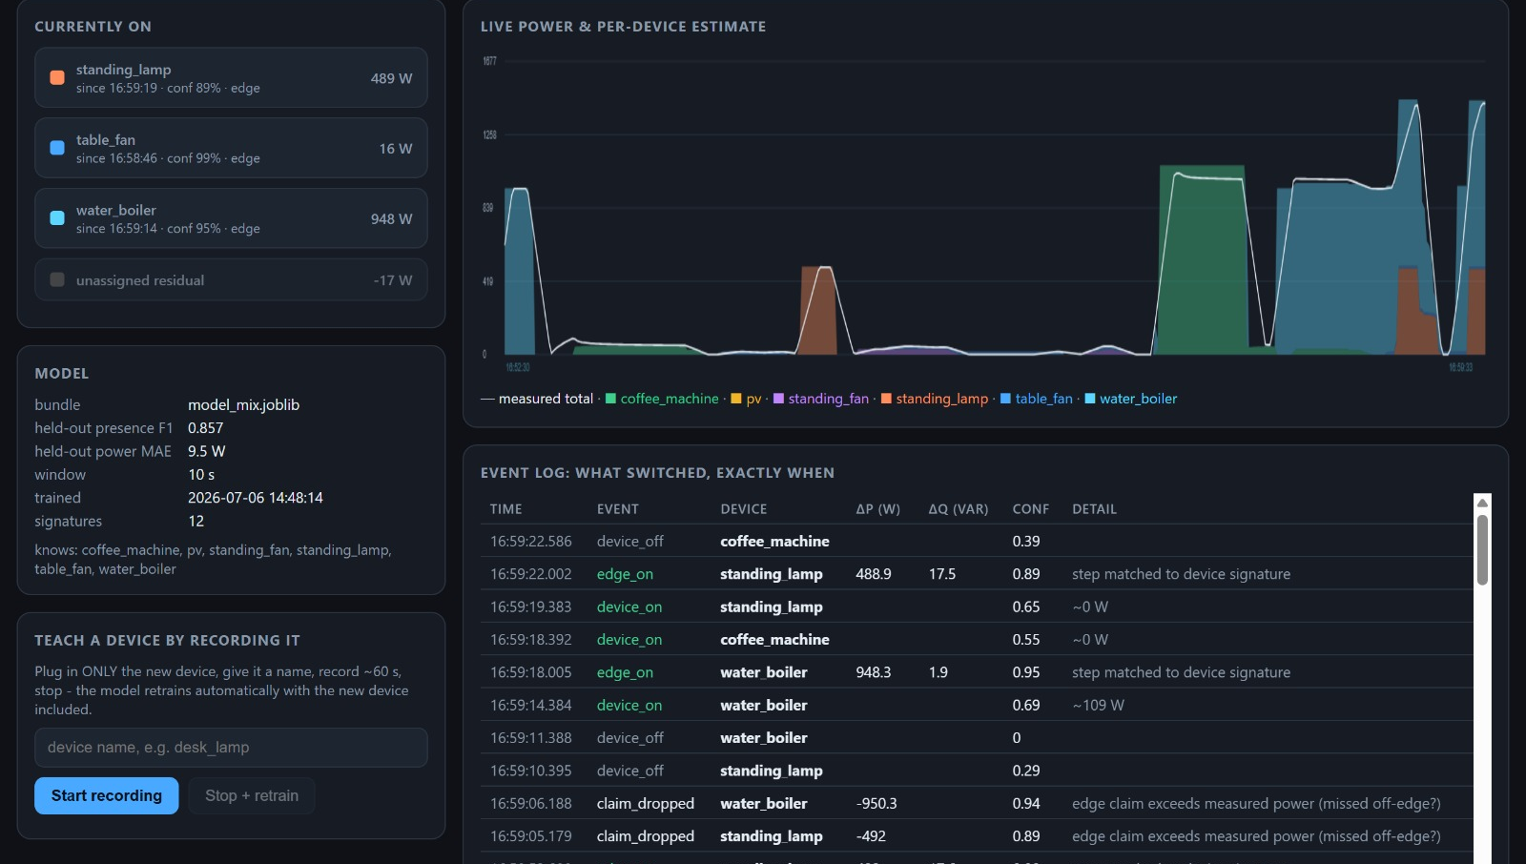
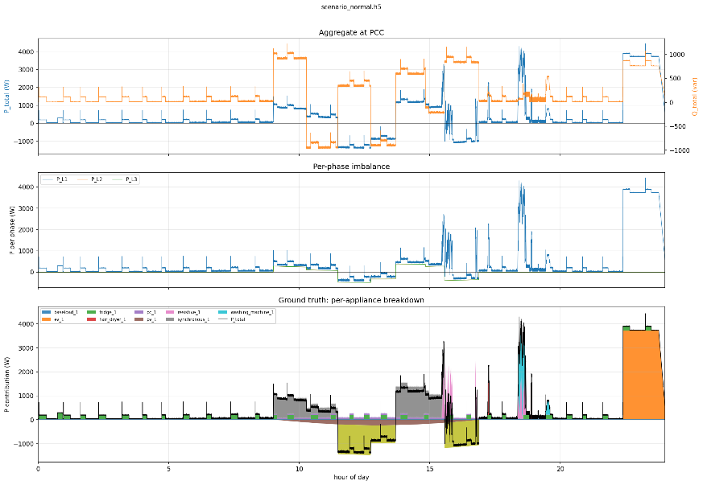
Non-Intrusive Load Monitoring
with Harmonic Feature Fusion
and Live On-the-Go Learning
Modeling, Simulation and Automation of Electrical Energy Systems
TH Koeln | Soheil Ayati, Marc Steffgen
A complete laboratory NILM workflow: PAC4200 acquisition, HDF5 ground-truth scenarios, physics-aware PCC aggregation, a deployable Random Forest presence/power mix model, residual-aware live inference, and guided retraining for unknown devices.
Why we built it
Implementation focus
Results and limits
NILM estimates appliance activity from one aggregate measurement at the point of common coupling.
The practical challenge is overlap: several devices run at once, similar loads share the same P range, and PV can mask consumption by driving signed power toward zero.
The project therefore uses every measurable low-frequency signature: active/reactive power, power factor, THD, per-order harmonics and switching edges.
0.916
2.9 W
0.955
Mix presence
macro-F1
Gated power
MAE
Identify
macro-F1
1920 measured
windows
10 s, 7 families
Presence-gated
watts shown in
the dashboard
Real active
windows
row split caveat
What worked
End-to-end loop works: record, aggregate, train RF mix bundle, infer live, detect unknowns and retrain.
The central technical pair is aggregator + RF mix model: the aggregator creates a physically meaningful PCC view with ground truth; the RF bundle maps 17 aggregate features to presence and watts.
Live validation detected an unknown residual after 8 s, retrained in 26 s, then re-recognised the taught device with 0.95 confidence and 97.9% explained power.
The high-load test split about 1.44 kW into water boiler, standing lamp and table fan with about 99% explained power.
Loads
+ PV
PAC4200
5 Hz
NILM
who + watts?
Figure 3: Live dashboard: current devices, confidence, residual, per-device power and edge events.
Figure 1: Single-meter NILM objective under overlapping loads and PV-aware signed power.
The system is intentionally source-agnostic: after acquisition, synthetic scenarios, measured single-device recordings and semi-synthetic measured mixes enter the same loader, feature builder, training code and inference path.
Aggregation and data path
Random Forest mix model
All sources are normalized to one HDF5 layout: UTC microsecond timestamps, float32 measurement channels, metadata and optional ground truth, LZF-compressed for long recordings.
Synthetic traces provide exact per-sample P/Q/state labels; measured PAC4200 single-device recordings provide real signatures; the mixer loops measured recordings into labelled multi-device scenarios.
The aggregator forms the PCC signal physically: single-phase loads land on L1-L3, balanced devices are split, signed PV can drive net P below zero, and totals P/Q/S/PF/THD are recomputed.
Current harmonics are summed as complex vectors per phase for orders 2..40, then stored as magnitude/phase; this preserves cancellation/reinforcement that magnitude addition would destroy.
Real PAC4200 harmonics come from Modbus FC 0x14 file records (L1 current file 113 verified); real harmonic phases are unavailable and marked as such.
The mix model answers two questions per 10 s aggregate window: which appliances are ON and how many watts each one contributes.
Presence is a MultiOutput RandomForestClassifier; power is a MultiOutputRegressor with one RF regressor per appliance family.
At inference, presence gates watts (OFF -> 0 W), so the dashboard reports plausible device power and leaves the rest as residual.
Its 17 features combine steady-state power, phase split, harmonics, context and event cues; the bundle stores the exact feature contract for live slicing.
Why RF: robust on small measured datasets, fast enough for teach-loop retraining, and transparent enough to debug features, vocabulary and metrics.
Training-on-the-go
Figure 4: Live high-load dashboard from the paper; water boiler, standing lamp and table fan are split with about 99% explained power.
Residual monitor flags unexplained power above max(30 W, 15% of total) for 8 s.
The UI then asks for a device name and records OFF baseline, isolated ON operation and OFF tail, giving the new label one clean signature.
Measured scenarios are rebuilt; mix and identify bundles retrain in the background, then the live engine hot-reloads the bundle.
Stored feature lists preserve compatibility with older model bundles.
What can be improved
Record real PV during actual generation; current PV recordings contain almost no generated power.
Measure several sessions per device and more variants of small fans, then use grouped evaluation by session.
Run ablations for common vs harmonic features and with/without event features; report gains only once measured.
Harmonic phases are synthetic-only because the PAC4200 does not expose them over Modbus; transferable deployment models must avoid synthetic-only phase inputs.
Use CNN/LSTM or seq2point for long appliance cycles such as washing machines.
Validate real simultaneous multi-device physics, because measured training mixes currently loop isolated recordings with random schedules.
Edge detection in detail
Edges are computed from raw live P/Q samples before the 10 s RF window has fully settled.
Using the last 8 s, the detector compares settled pre/post medians, rejects noisy states and emits dP, dQ and timestamp.
A matched ON edge claims the device with its own watt step; a matched OFF edge releases it, so the UI reacts immediately.
RF presence probabilities are median-smoothed and passed through hysteresis (about 0.55 ON / 0.45 OFF); final state merges RF predictions, edge claims and residual power.
Figure 2: Paper Fig. 2(b): 24 h PCC aggregate and hidden per-appliance ground truth; the model sees only the aggregate signal.
Conclusion
Evaluation protocol
Technically, the project is not just a classifier. It is a data contract plus a deployable inference loop: HDF5 scenarios carry aggregate signals and ground truth, the aggregator preserves signed power and harmonic physics, the RF mix bundle turns 17 window features into ON/OFF and watts, and the live layer adds edge timing, residual honesty and retraining.
Key implementation artifacts
Mix evaluation: 1920 measured-scenario windows, 10 s windows, 5 W ON threshold and seven-device vocabulary.
Metrics: presence macro-F1 for ON/OFF; raw power MAE is tracked, but gated MAE is the deployed dashboard number (2.9 W).
Identify: 171 active real-device windows with common plus harmonic features; row split is useful but optimistic.
Remaining risk: repeated sessions and true simultaneous recordings are needed for leakage-free validation.
pac_reader.py: one persistent Modbus TCP connection, 5 Hz polling, session HDF5 writer and harmonic file-record acquisition.
aggregator.py: phase allocation, signed P/Q summation, synthesized voltage/frequency, complex harmonic summation and ground-truth tensors.
mix_measured_scenarios.py: turns isolated real device recordings into labelled multi-device measured scenarios.
nilm_pipeline.py: common loaders plus 17 append-only AGG_FEATURES; model bundles store their feature list for compatible inference.
train.py/live.py: RF mix training, presence-gated power output, edge claims, residual monitor and teach/retrain hot reload.
Sources
Sources: project paper; Docs/01_data_format.md; Docs/09_design_rationale.md; Docs/MS3 notes; aggregator.py, nilm_pipeline.py, train.py, live.py, pac_reader.py; Hart, Reddy, Papageorgiou, Siemens PAC4200 manual.
Poster focus: paper-grounded summary plus reflection on the two central engineering pieces: physics-aware aggregation and the RF presence/power mix model.

