Slide 1
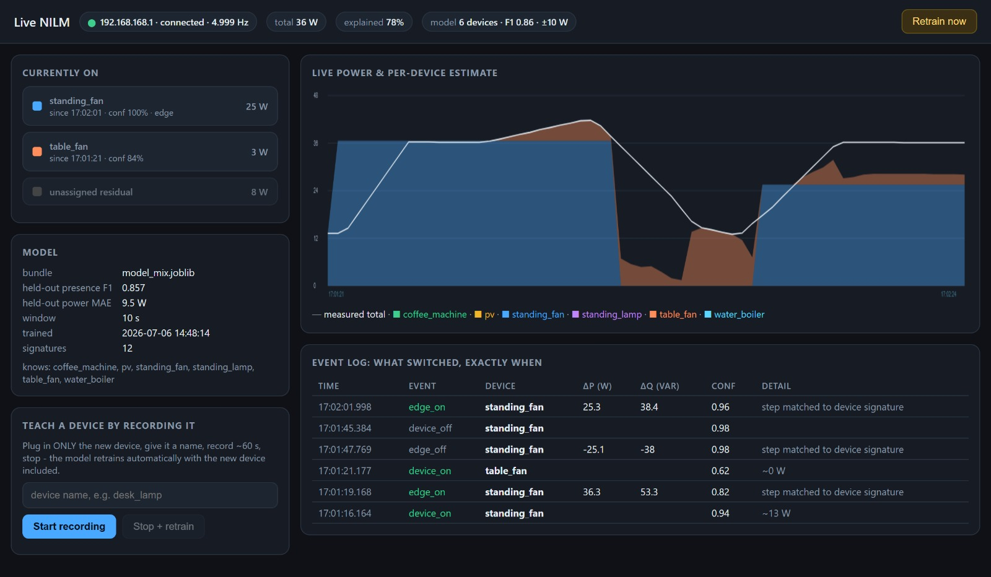
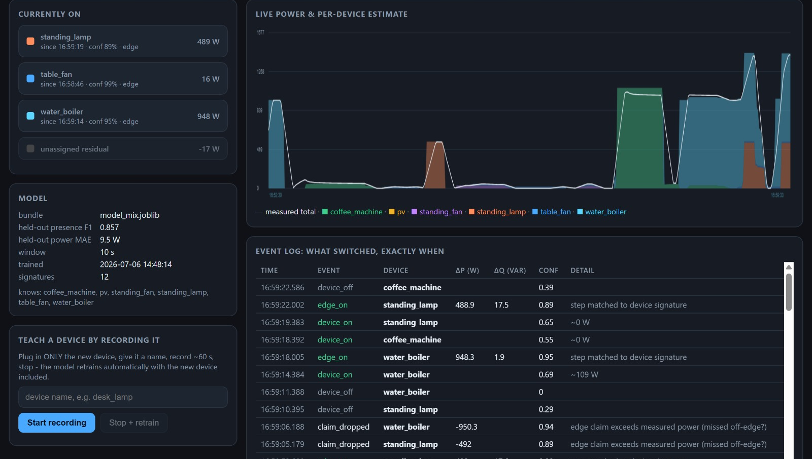
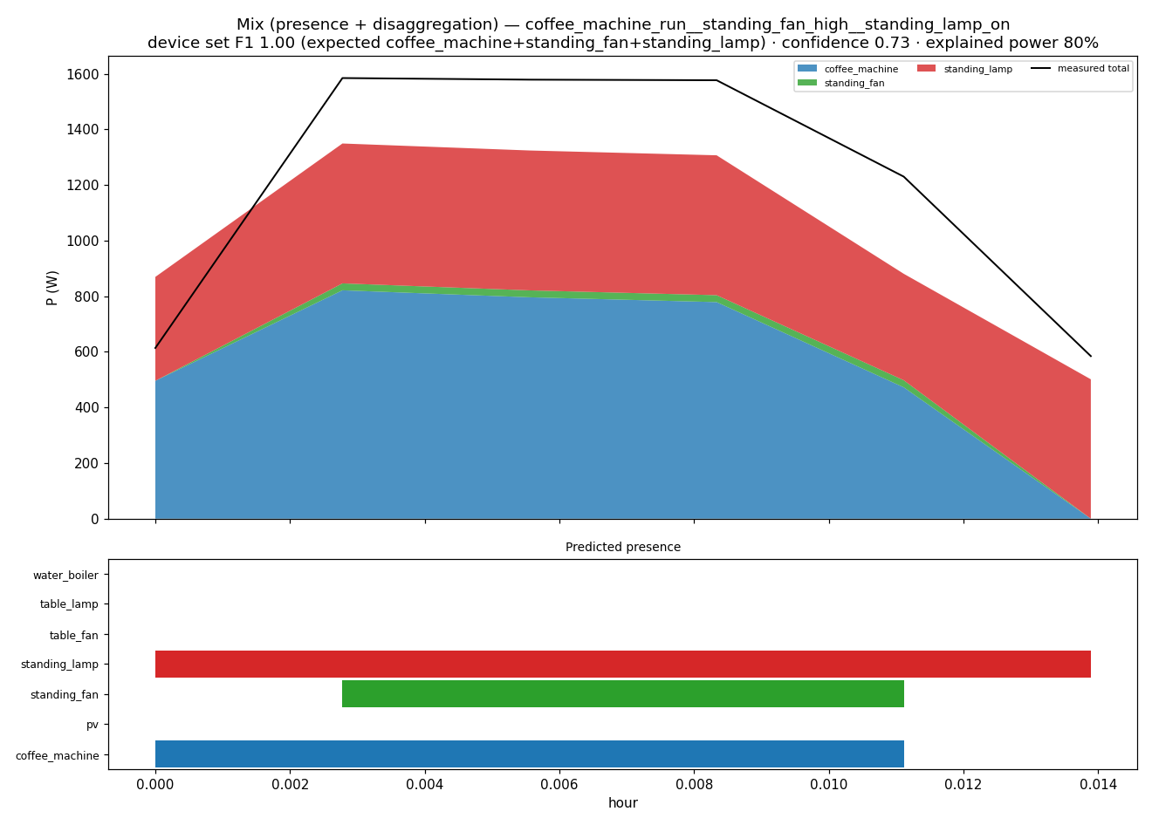
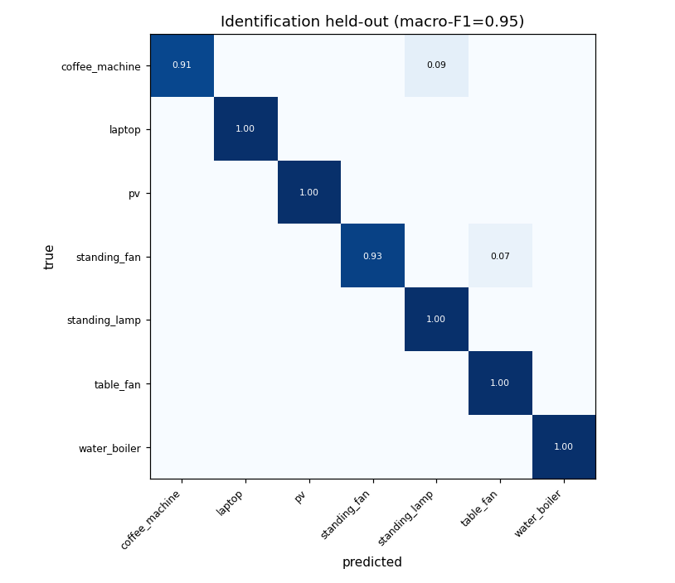
Non-Intrusive Load Monitoring
with Harmonic Feature Fusion
and Live On-the-Go Learning
Modeling, Simulation and Automation of Electrical Energy Systems
TH Koeln | Soheil Ayati, Marc Steffgen
A complete laboratory NILM pipeline: one PAC4200 meter, synthetic and measured ground truth, a 17-feature RF mix model, edge-based live recognition, and training-on-the-go for unknown devices.
Why we built it
Implementation focus
Results and limits
NILM estimates appliance activity from one aggregate measurement at the point of common coupling.
The practical challenge is overlap: several devices run at once, similar loads share the same P range, and PV can mask consumption by driving signed power toward zero.
The project therefore uses every measurable low-frequency signature: active/reactive power, power factor, THD, per-order harmonics and switching edges.
0.916
2.9 W
0.955
Mix presence
macro-F1
Gated power
MAE
Identify
macro-F1
1920 held-out
windows
7 families
Presence-gated
watts shown in
the dashboard
Real active
windows
row split caveat
Loads
+ PV
PAC4200
5 Hz
NILM
who + watts?
Figure 3: Live dashboard: current devices, confidence, residual, per-device power and edge events.
Figure 1: Single-meter NILM objective under overlapping loads and PV-aware signed power.
The system is intentionally source-agnostic: after acquisition, synthetic scenarios, measured single-device recordings and semi-synthetic measured mixes enter the same loader, feature builder, training code and inference path.
Data path
17-feature RF mix model
Synthetic generator: eight appliance models plus baseload, PV and four-quadrant machine behavior; exact per-sample ground truth.
Aggregator: phase-wise P/Q summation, synthesized voltage/frequency, and complex vector summation of current harmonics (orders 2-40).
PAC4200 reader: persistent Modbus TCP acquisition, 5 Hz samples, session recorder, harmonic file-record probing and HDF5 output.
Measured scenario mixer: loops real single-device recordings with random ON/OFF schedules to create labelled multi-device training mixes.
Steady state: Ptot mean/std/min/max, Qtot mean/std, Q/P ratio and Stot mean.
Phase/context: L1-L3 active power, PF, THD_I and file-relative hour.
Edge features: Pstep_max, Qstep_at_Pstep, n_steps.
Bundle: presence classifier + power regressor; watts are gated by predicted presence before display.
Figure 4: Live high-load dashboard from the paper; water boiler, standing lamp and table fan are split with about 99% explained power.
What worked
End-to-end loop works: record, mix, train, infer, run live, detect unknowns and retrain.
Live validation detected an unknown residual after 8 s, retrained in 26 s, and re-recognised the taught device with 0.95 confidence.
The high-load test split about 1.44 kW into water boiler, standing lamp and table fan with about 99% explained power.
Event features improved the measured-data mix model compared with the earlier frozen bundle.
Edge detection in detail
The live engine scans the last 8 s of P/Q samples and compares settled medians before and after the strongest jump.
An edge counts only above thresholds (about 8 W or 16 var), after quiet-state checks and a debounce interval.
Each edge is matched to single-device signatures in dP/dQ space; matched edges claim devices ON/OFF with exact timestamps.
Residual power is not forced into known classes: sustained unexplained power triggers the unknown-device teaching workflow.
What can be improved
Record real PV during actual generation; current PV recordings contain almost no generated power.
Measure several sessions per device and more variants of small fans, then use grouped evaluation by session.
Run feature ablations: common vs harmonic, 14 vs 17 aggregate features, and with/without edge features.
Use sequence models (CNN/LSTM or seq2point) for long appliance cycles such as washing machines.
Validate on true simultaneous multi-device recordings, not only semi-synthetic measured mixes.
Training-on-the-go
Figure 2: Mix-model inference on a real three-device recording; stacked predicted power is compared with measured total power.
1. Unknown residual appears in the live dashboard.
2. User names the device and records an isolated OFF-ON-OFF sequence.
3. Measured scenarios are rebuilt automatically.
4. Mix and identify models retrain in the background and hot-reload.
5. New device vocabulary is stored in the model bundle; no code change is required.
Conclusion
Key implementation artifacts
A 5 Hz industrial power meter is enough for a useful NILM laboratory system when its processed channels are fused deliberately. The current implementation is not just an offline classifier: it is a deployable workflow with measured data ingestion, RF presence/power inference, edge-aware live events, residual honesty, guided learning for unknown loads, and hot-reload retraining during operation.
Scripts/PAC4200_reader/pac_reader.py: Modbus acquisition, dashboard, HDF5 recorder.
Scripts/Aggregator/mix_measured_scenarios.py: real recordings to labelled training mixes.
Scripts/MS2_Pipeline/nilm_pipeline.py: loaders, feature extraction and 17-feature AGG_FEATURES.
Scripts/MS2_Pipeline/train.py: RF/LGBM/MLP tasks; mix bundle stores features, devices and metrics.
Scripts/MS2_Pipeline/live.py: live inference, edge claims, residual monitor and teach/retrain loop.
Evaluation protocol
Mix model: grouped held-out split over measured scenarios, ON threshold 5 W.
Metrics travel with the model bundle: feature list, appliance vocabulary, F1 and MAE.
Real mixed recordings without per-sample ground truth are evaluated as expected device sets parsed from filenames.
The poster reports tracked metrics from output/train_mix_metrics.json and output/train_identify_metrics.json.
Sources
Hart (1992) Nonintrusive appliance load monitoring; Reddy et al. (2020) and Papageorgiou et al. (2022) on feature fusion and harmonic NILM; Siemens SENTRON PAC4200 system manual; project docs 01-09; tracked model metrics in Scripts/MS2_Pipeline/output. Figures are generated from repository artifacts and live-system screenshots.
Repository focus: reproducible synthetic corpus, measured PAC4200 recordings, semi-synthetic measured mixes, RF/LGBM/MLP training paths and Streamlit/Flask live interfaces.

