Slide 1


Slide 2

Tracking and Analyzing different aspects of DVD Rental Business
-By Harshpreet Singh
Soheil Rezaei
Sayyedbehzad Hashemian
Mona Khosro Abadi
April 20th, 2023

Slide 3
Table of Contents
Overview of the database
Entity Relation Diagram
Business Requirements
Designing the star schema
ETL & SSIS
CUBE & SSAS
MDX Queries
Machine Learning
Database Project

Slide 4

Overview of the database
Database Project

Slide 5
Overview of the database
Sakila is a sample database created by MySQL that provides a schema for a DVD rental store.
The database is designed to mimic a real-world scenario for a DVD rental business, with tables and columns that reflect the typical data found in such a business.
It contains information about customers, films, actors, rentals, payments, and more.
Database Project

Slide 6
Entity Relation Diagram
Database Project

Slide 7
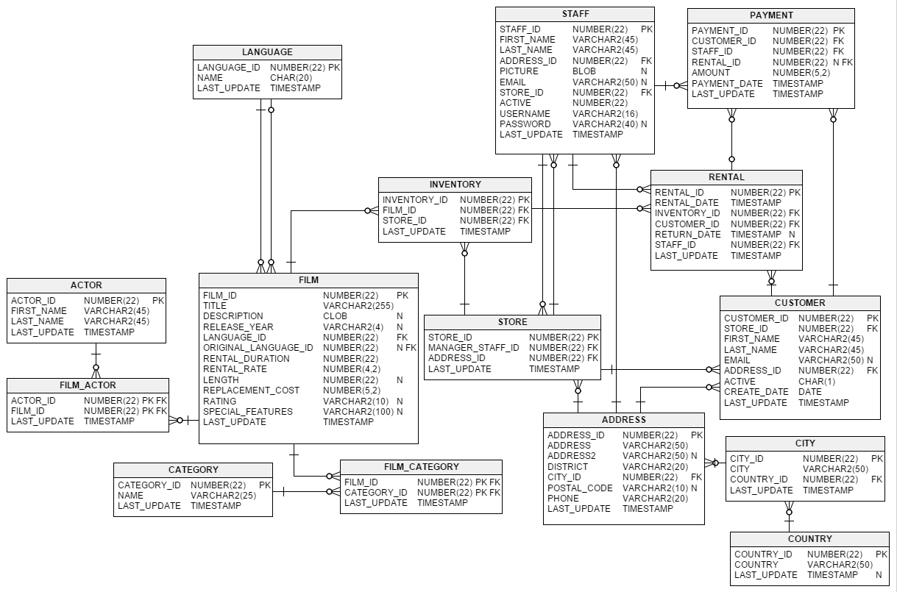
Database Project

Slide 8
Business Requirements
Database Project

Slide 9
Business Requirements
The company wants to analyze its customer base by various attributes such as city, country, and active status to identify trends and patterns in customer behavior.
The company wants to analyze its stores' performance by location and store managers' performance by their names.
The company wants to analyze its staff performance by location, start and end dates to determine trends and identify potential staffing needs.
The company wants to analyze its film catalog based on language, category, and rating to identify popular genres and actors.
Database Project

Slide 10
Business Requirements
The company wants to analyze its rental trends based on various attributes such as the customer's name, staff's name, rental and return dates, film titles, and actors to identify popular films and actors, optimize inventory, and track revenue.
The company wants to analyze its business by time periods such as year, month, and day to identify trends in performance and identify seasonal patterns.
The company wants to analyze the cost of rentals, total days a product is rented to identify opportunities for cost savings and improve profitability.
Database Project

Slide 11
Designing the Star Schema
Database Project

Slide 12
Designing the Star Schema
Deciding the dimensions and measures.
Based on the determined business requirements, the following dimensions were created Customer dimension → analyze customer behavior. Store dimension → analyze performance of stores & managers by locations & identify areas of improvement. Staff dimension → to determine trends and identify potential staffing needs and performance. Film dimension → to analyze the popularity of their films based on language, category, and rating. Actor dimension → analyze customer behavior. Date dimension → analyze based on time aspects. Rental Fact → to enable the company to track revenue, optimize inventory, and identify popular films and actors. Measures → Total cost of rentals & total days of rental.
Database Project

Slide 13
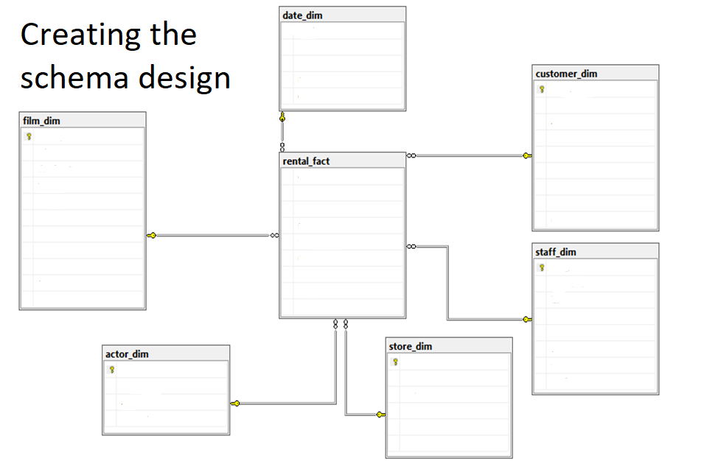
Designing the Star Schema
Database Project

Slide 14
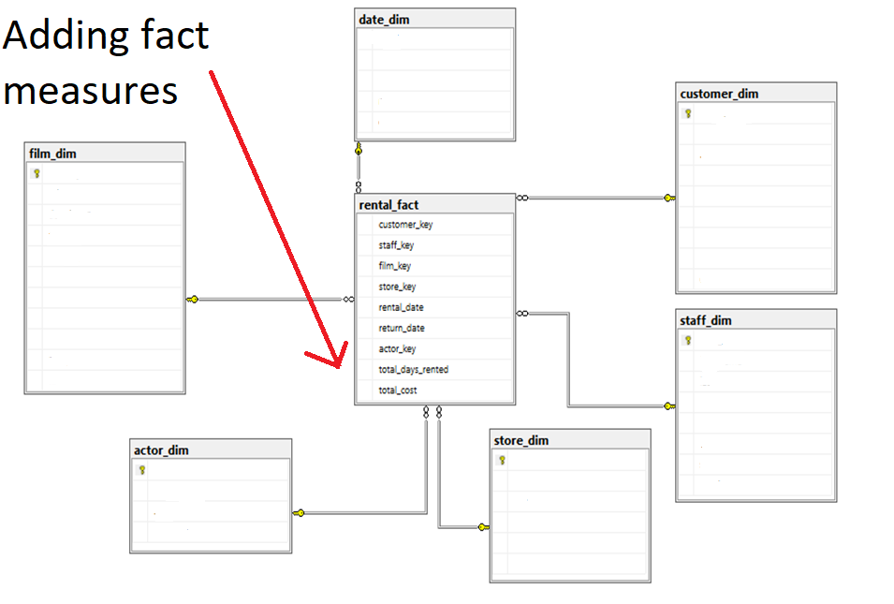
Designing the Star Schema
Database Project

Slide 15
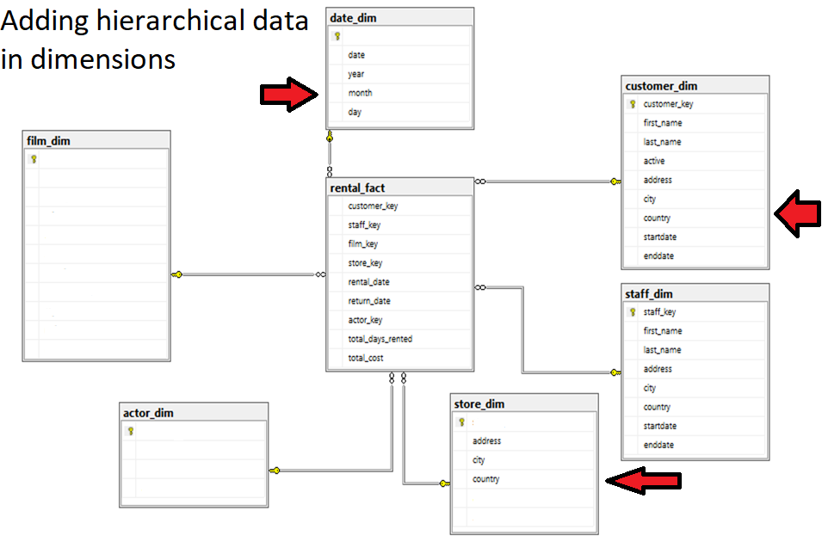
Designing the Star Schema
Database Project

Slide 16
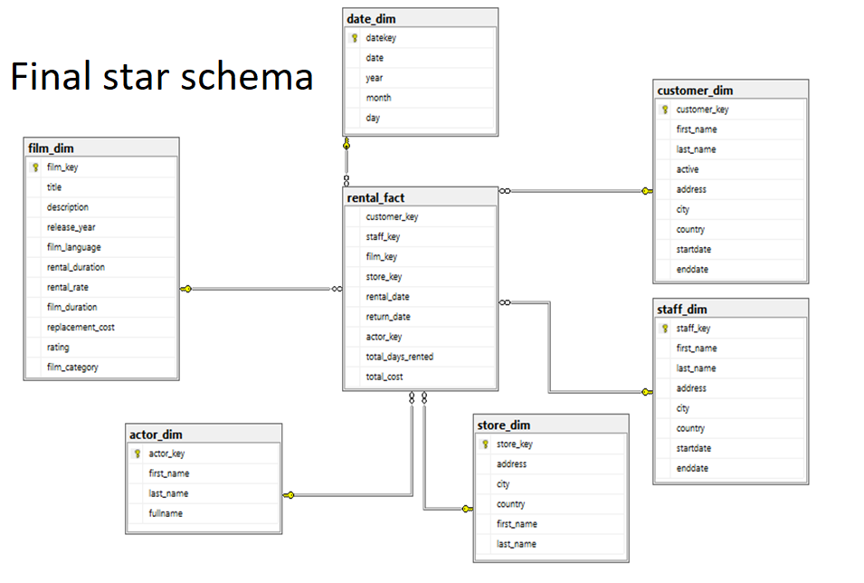
Designing the Star Schema
Database Project

Slide 17
ETL & SSIS
Database Project

Slide 18
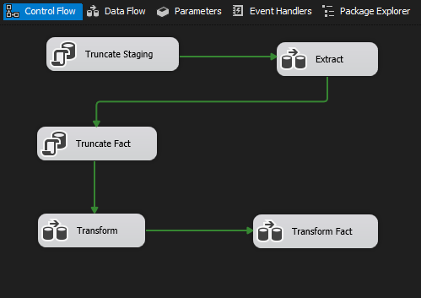
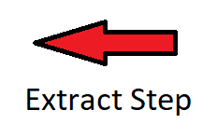
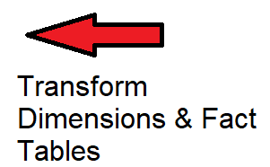
ETL Model Diagram
Summary of the ETL steps in SSIS

Slide 19
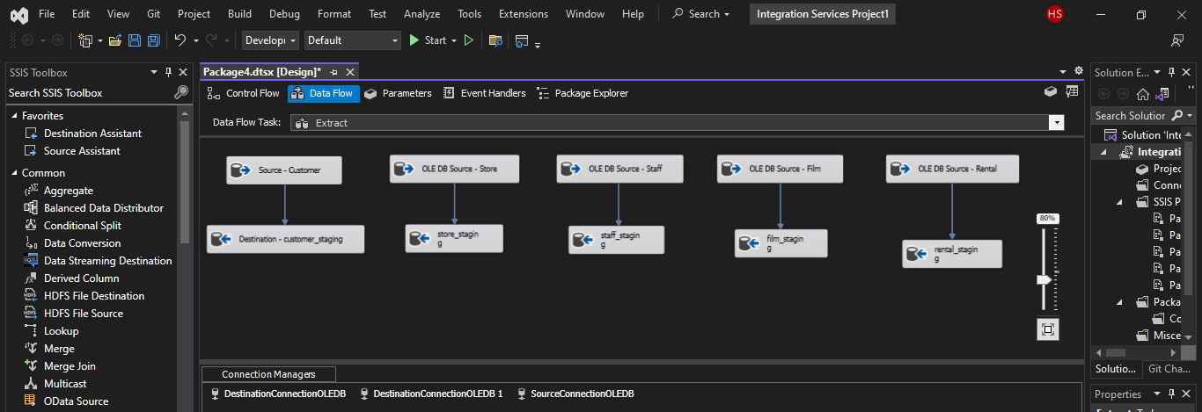
ETL Process and SSIS – Extract Step
To achieve this, a staging table was created for each of the dimension & fact tables with required attributes. This table serves as a temporary storage for dimension data before it is transformed and loaded into the corresponding dimension table.
Database Project

Slide 20
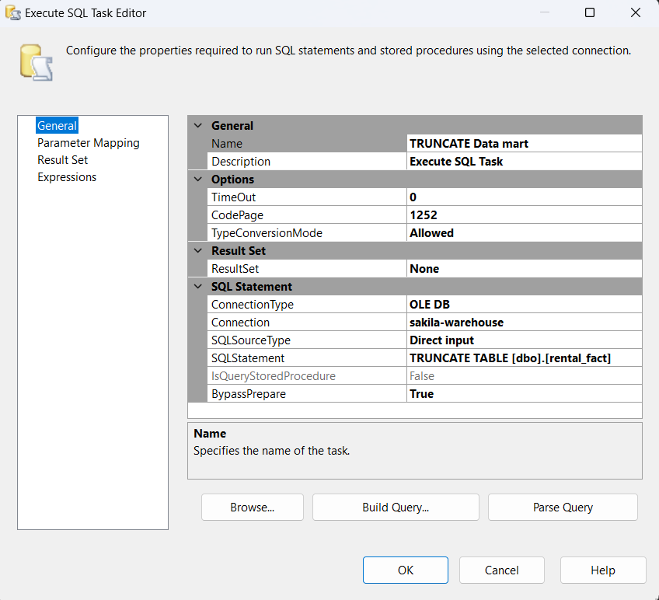
TRUNCATING FACT
Before starting transform stage we have to truncate the fact table

Slide 21
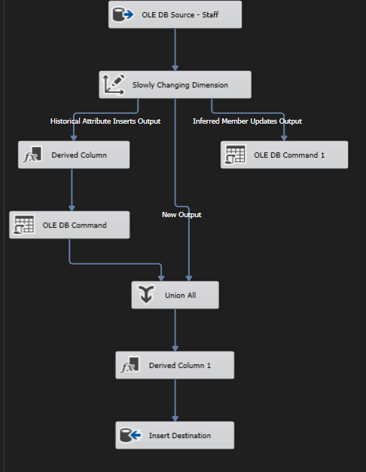
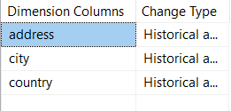
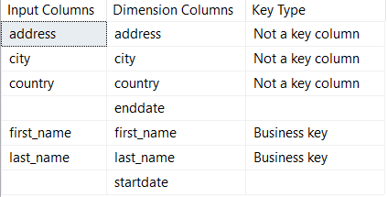
Staff Transform
Staff dim is SCD 2
Business keys: firstname and lastname of staff

Slide 22
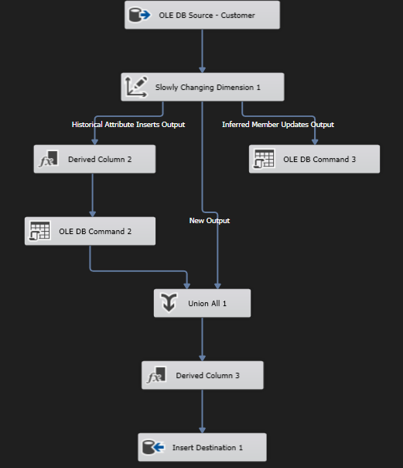
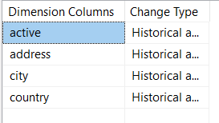
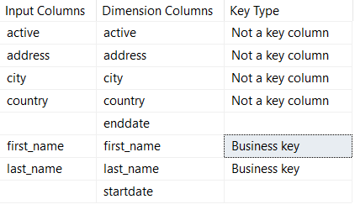
Customer Transform
Customer is SCD 2
Business keys: firstname and lastname of customer

Slide 23
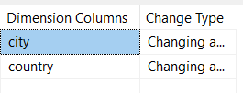
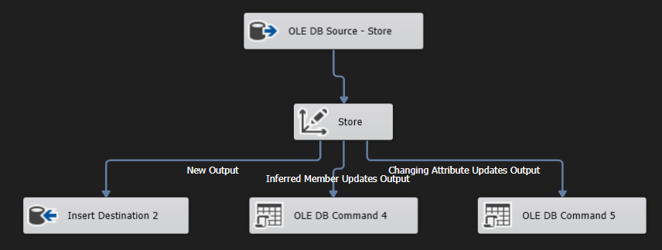
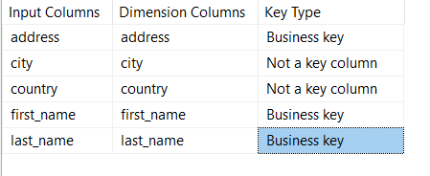
Store Transform
Store is SCD 1
Business keys : Address of the store and firstname and lastname of manager

Slide 24
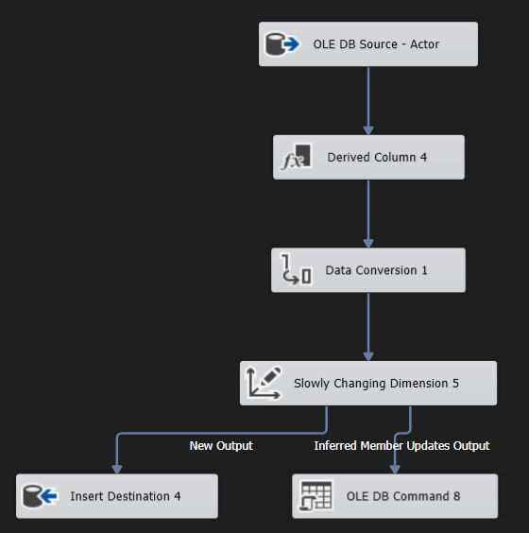

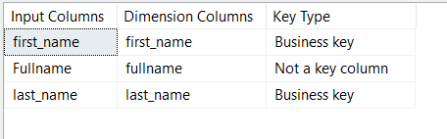
Actor Transform
Actor is SCD 0
Business keys : first name and lastname of actor

Slide 25
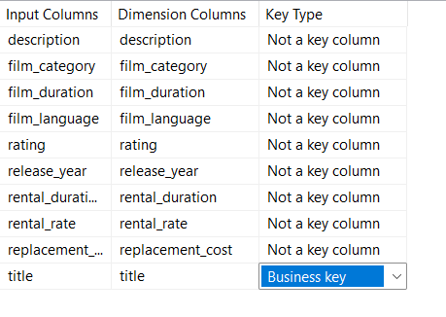
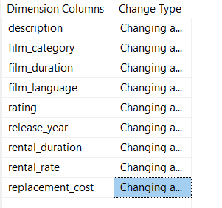
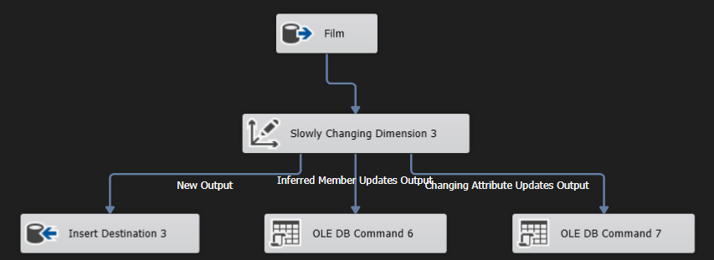
Film Transform
Film is SCD 1
Business keys: Title of the film

Slide 26
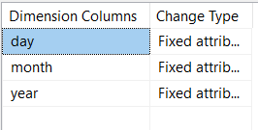
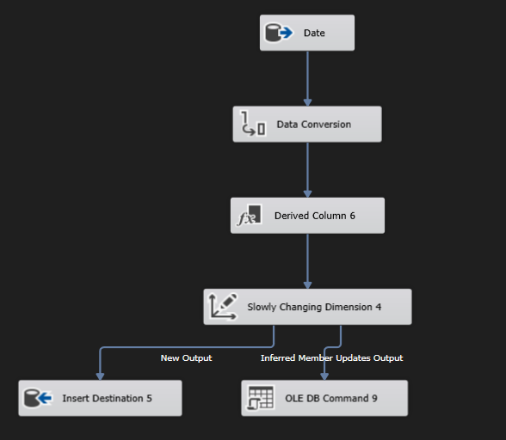
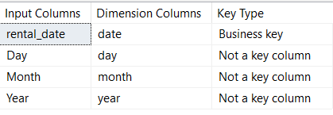
Date Transform
Date is SCD 0
Business key : date

Slide 27
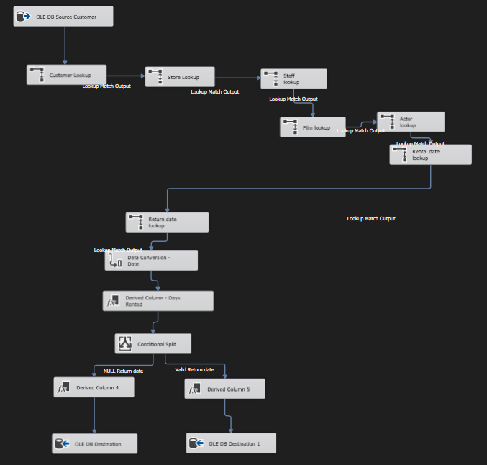
Fact Transform
Before populating fact table, we have to create lookups for dimension tables to get an id for each business key

Slide 28
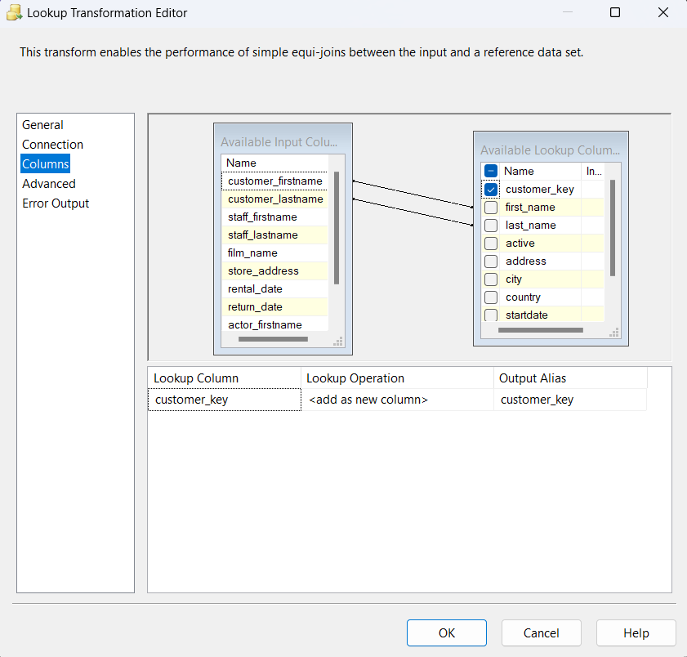
Customer lookup

Slide 29
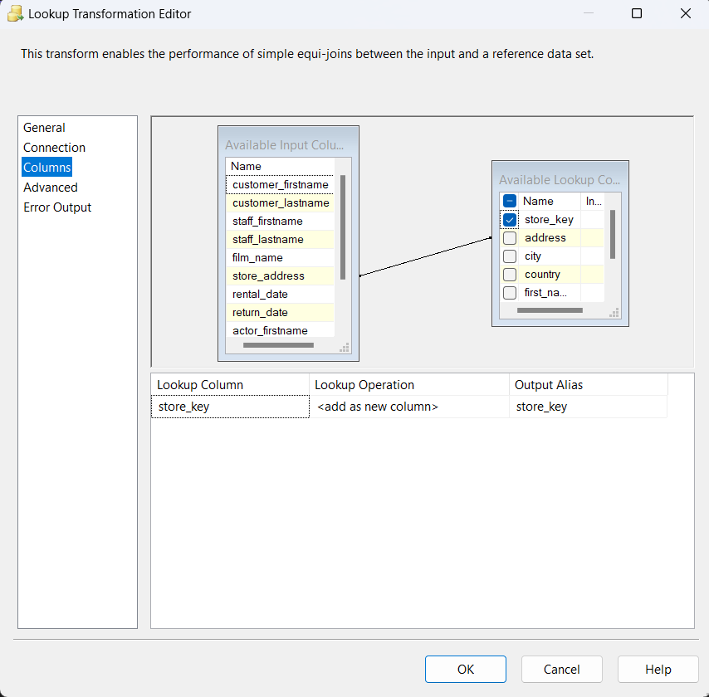
Store lookup

Slide 30
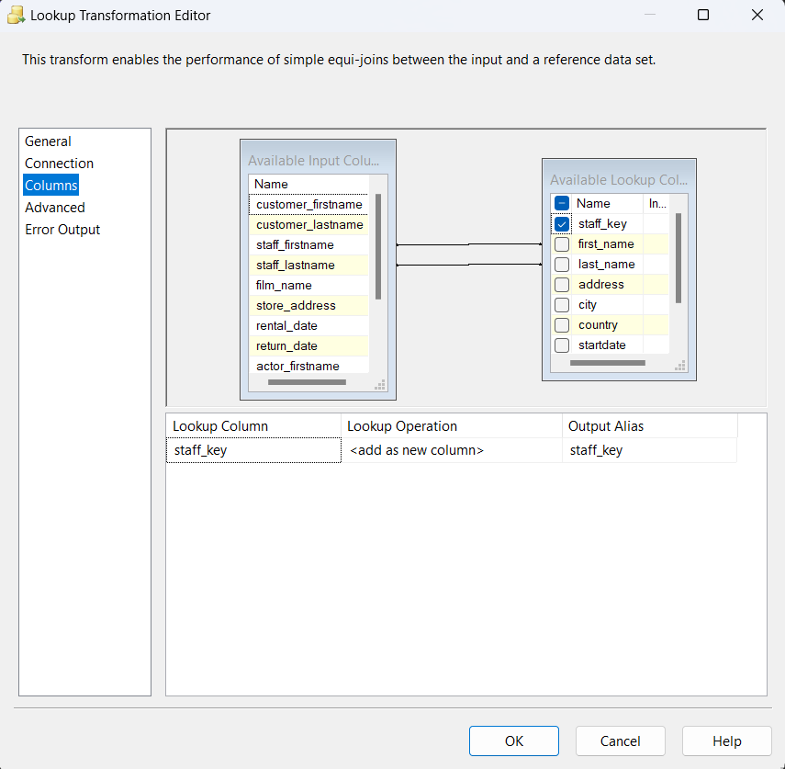
Staff lookup

Slide 31
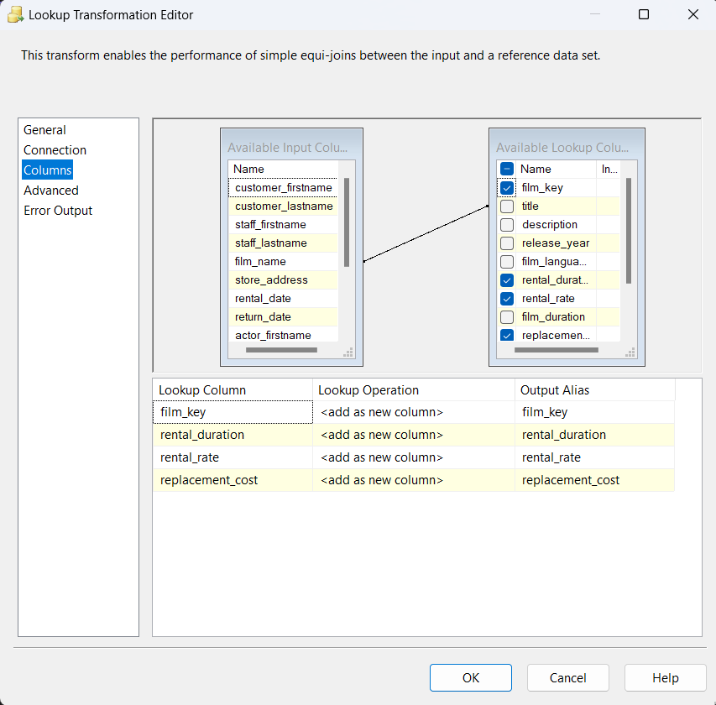
Film lookup

Slide 32
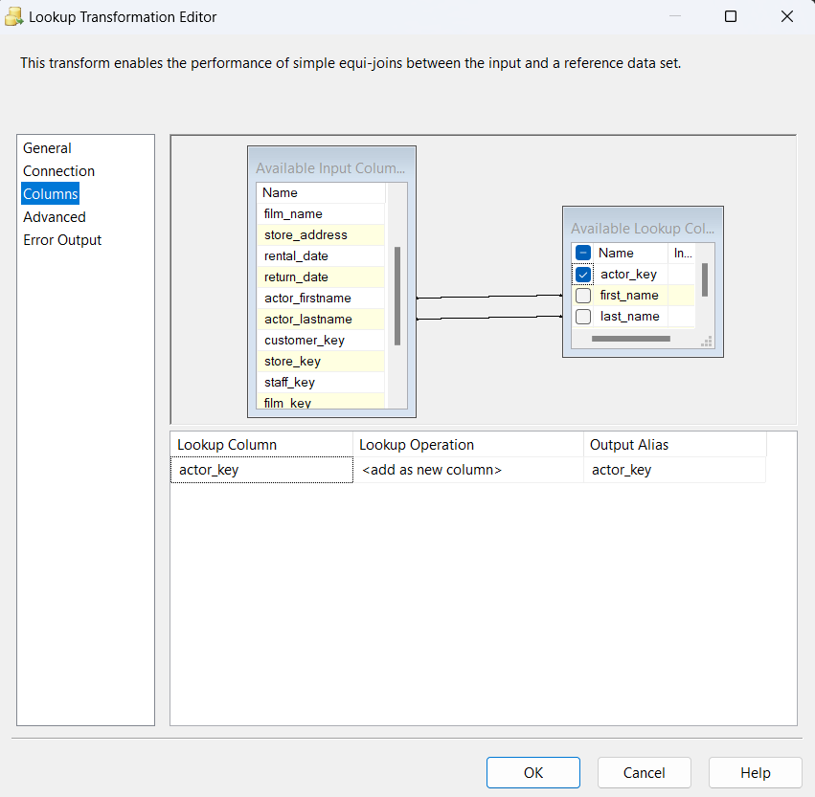
Actor lookup

Slide 33
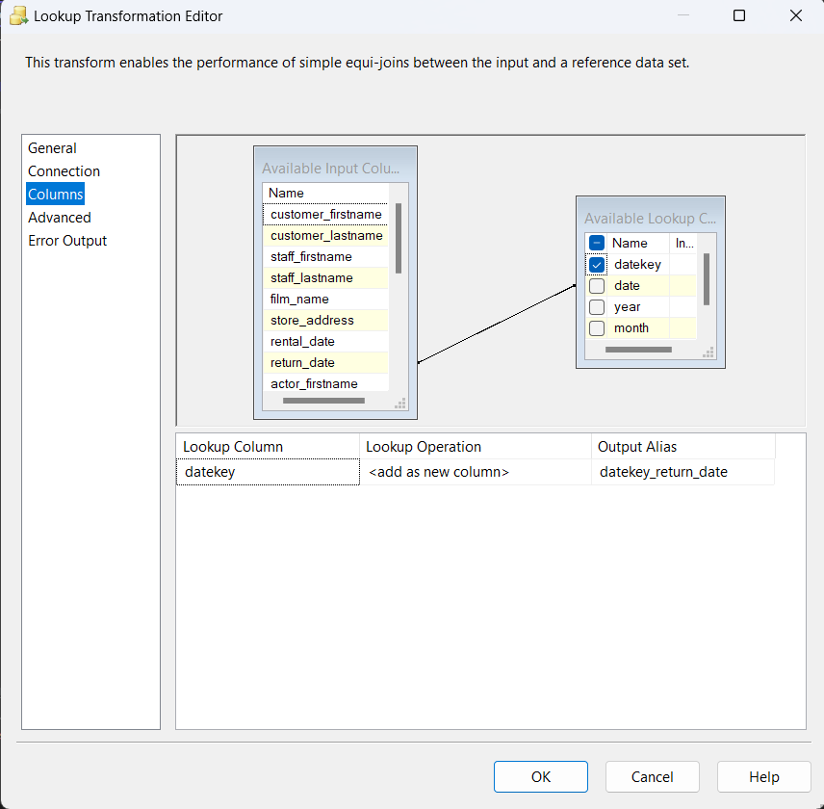

Date lookup

Slide 34
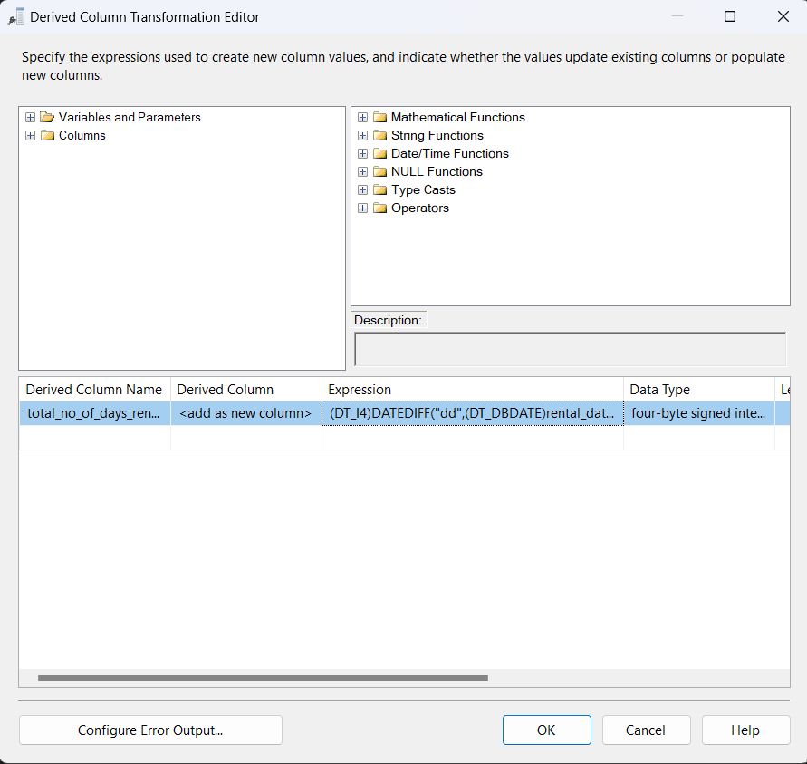
Calculating measures
To calculate total number of day, we subtract return date and rental date

Slide 35
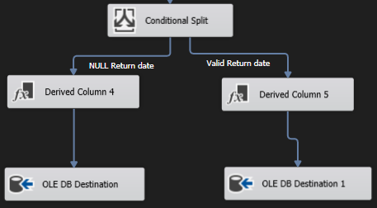
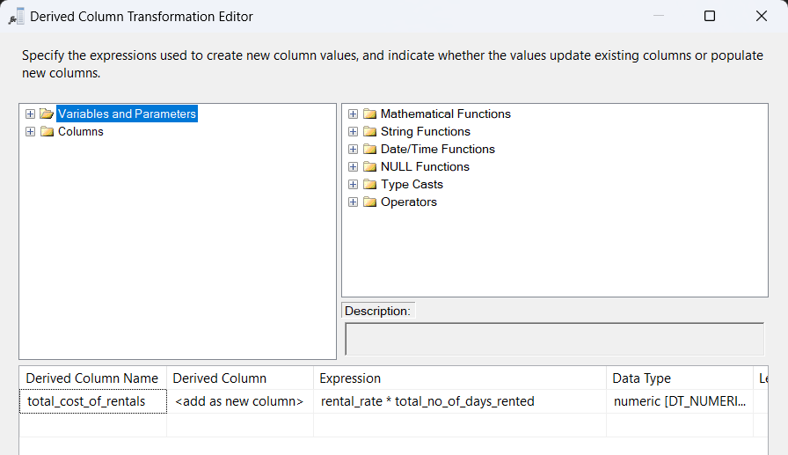
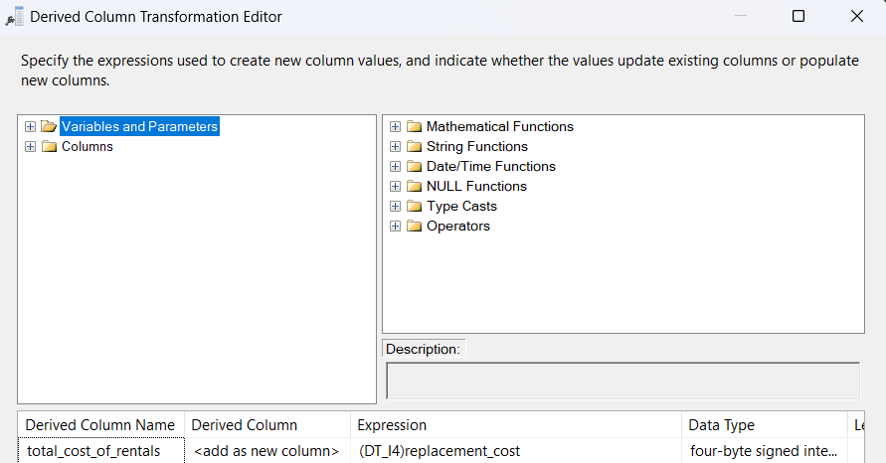
Calculating measures
Two type of data:
1.With return date
2.Without return date
We used replacement cost for records that do not have return date

Slide 36
CUBE & SSAS
Database Project

Slide 37
First, we must choose the newly populated Datawarehouse as a source for our SSAS Data Source
From there we go on and create a view of our Datamart
Since we have already ran the queries in SSMS to create the fact and dimensions in the Datawarehouse before the ETL & SSIS, we can simply import the dimensions from the Data Source we have provided

Slide 38
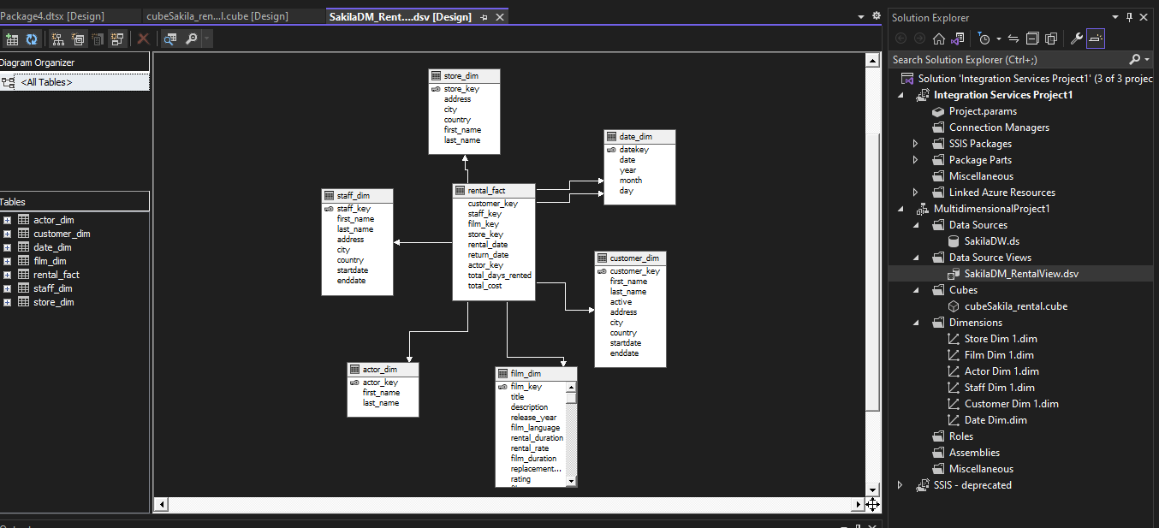
Datawarehouse View

Slide 39
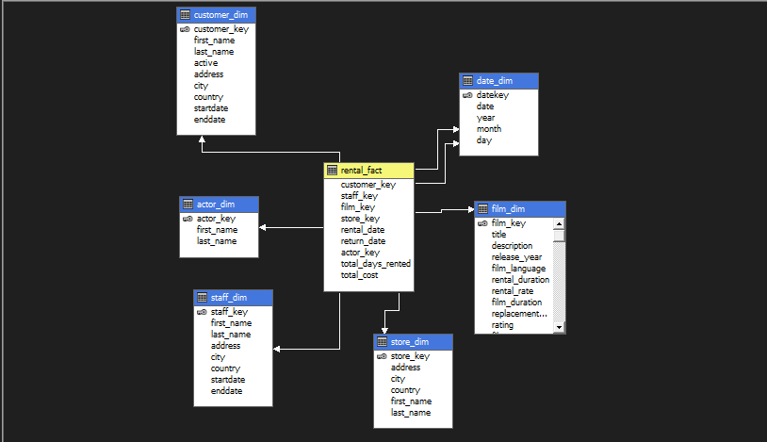
Our next step is to create the OLAP Cube, Build, Process and finaly deploy it to our SSMS Analysis Local Server
We're going to have our fact table measure the total days a customer have held on to a rented DVD and the total Cost that rental costed the Customer

Slide 40
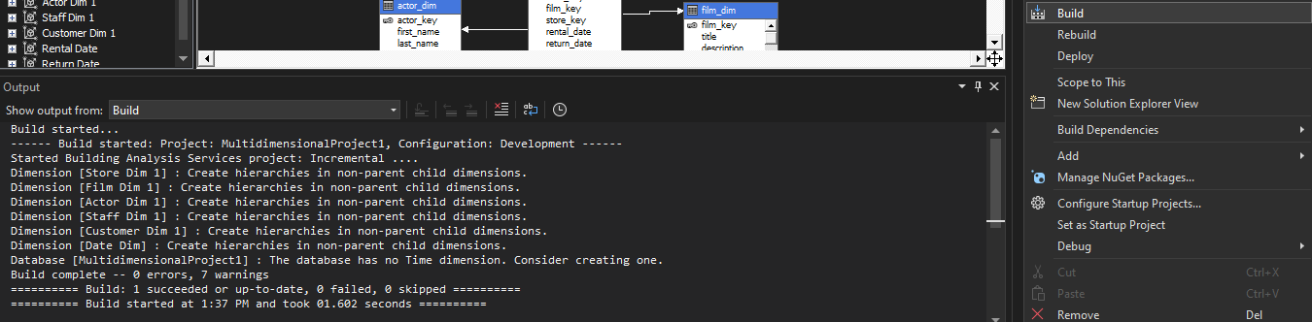
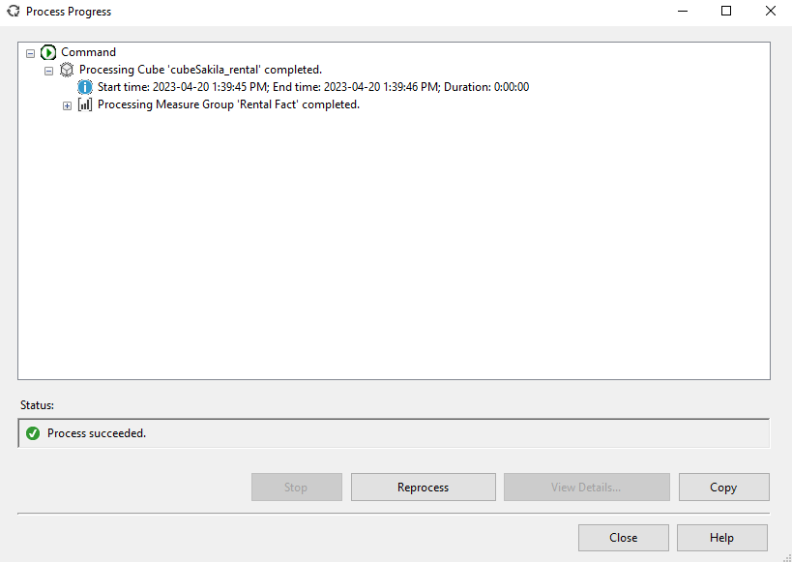
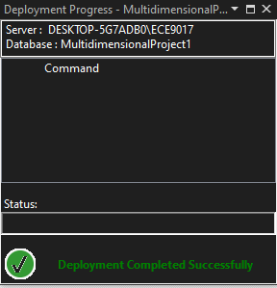
Successfully Built – Processed - Deployed

Slide 41
MDX Queries
Database Project

Slide 42
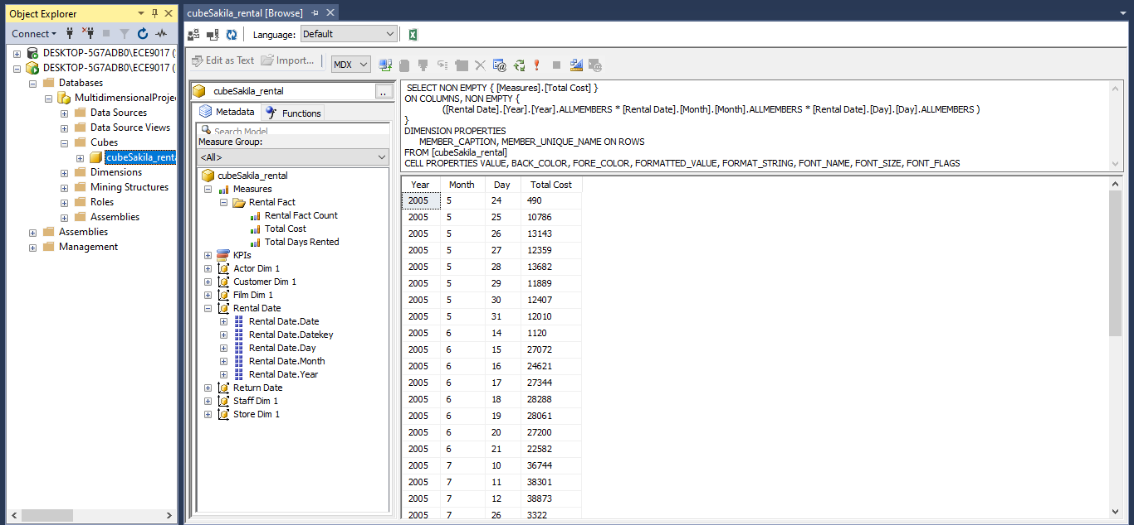
Revenue generated based on day, month, year

Slide 43
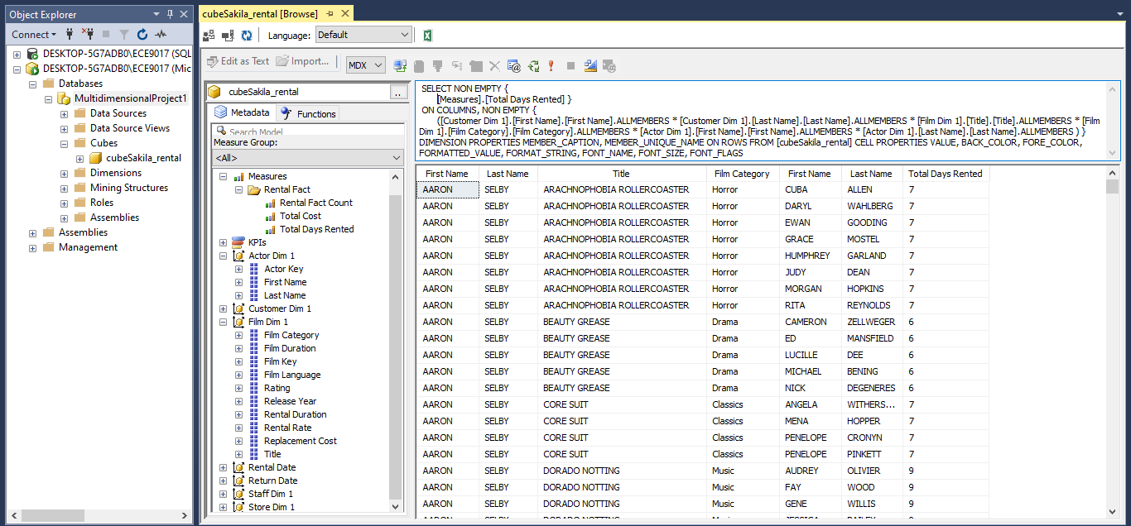
Rental Trends based on customer and movie actor and Genres

Slide 44
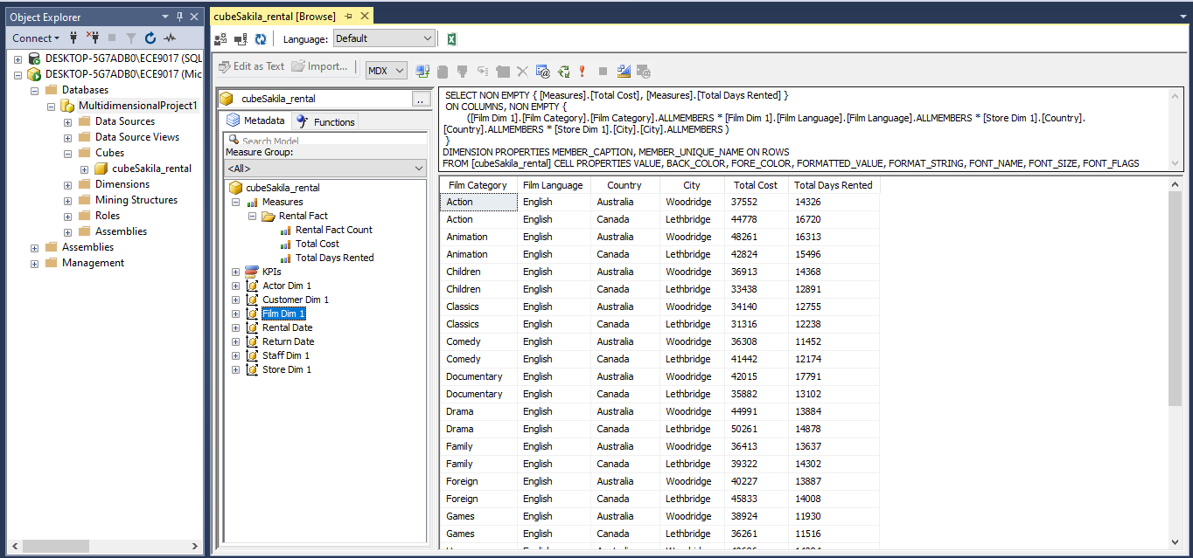
Rental Trends based on film category and genre and store location

Slide 45
Machine Learning
Database Project

Slide 46
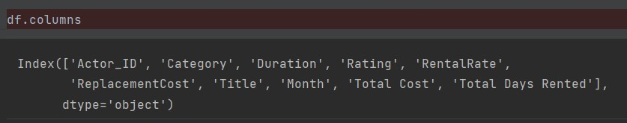
What are we trying to predict?
The goal of this project is to build machine learning models that can predict the total number of days that a movie will be rented based on the features shown below.
First, We read the dataset and use Pandas inbuilt functions to visualize the data.
There are several categorical variables that need to be encoded before we can use them as input features.
Database Project

Slide 47
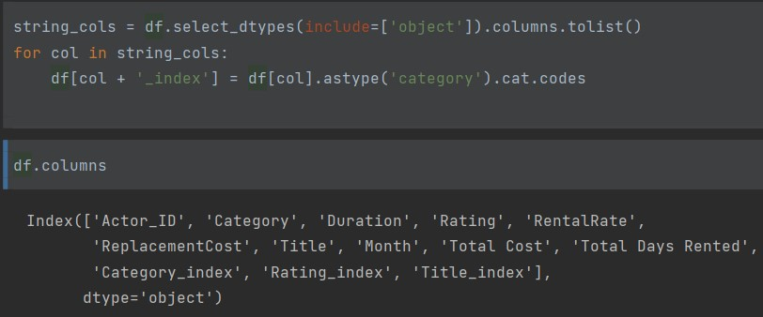
We use the cat.code method to convert these variables into numerical and add them as new columns to the data frame.

Slide 48
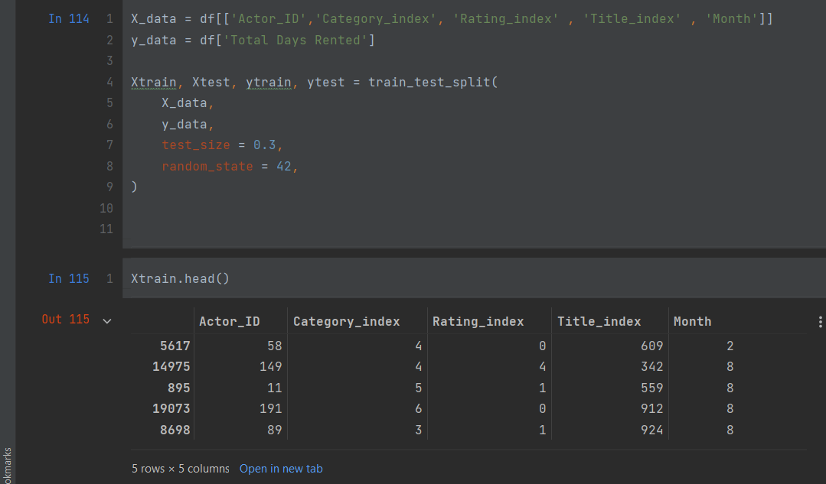
Next, we split the dataset into training and testing sets. We select specific columns to use as input features (X_data) and target variable (y_data) for the regression model.

Slide 49
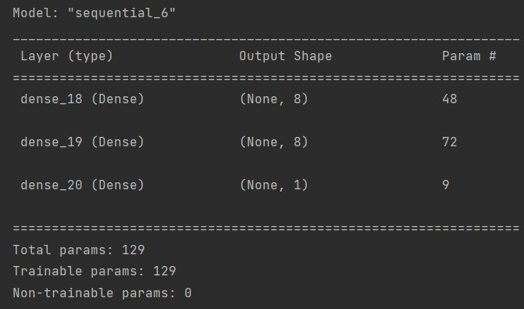
Using Sequential API to define a deep learning model with three fully connected layers. The first two layers have eight neurons and use the ReLU activation function, and the last layer has one neuron and no activation function.

Slide 50

After performing the training, the Plotted training loss against the number of epochs is shown below.

Slide 51

We also train and evaluate a linear regression model on the same data and compare its performance with the neural network model.

