Slide 1
Introduction to nodejs

Slide 2
What’s this node thing?
Notes:
Nodejs is a server side use of the V8 engine which is the same very fast javascript engine found in chrome. In and of itself that isn’t all that intersting but it does enable a different programming paradigm: “event driven single threaded application making use of non-blocking IO”

Slide 3
Node enables
Event-driven single-threaded applications making use of non-blocking I/O

Slide 4

Break it down

Slide 5
Single threaded? Like DOS?
No, you could multi-thread DOS, at least more recent versions of DOS

Slide 6
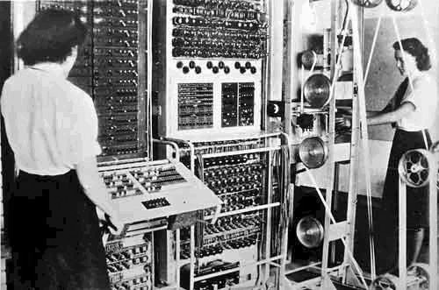
Okay you pedantic, over-stuffed turkey, like Colossus?
Notes:
Colossus was certainly single threaded but it wasn’t a general purpose computer and wasn’t turing complete. It also wasn’t used to decode enigma but rather a radio teleprinter messages encrypted by Lorenz inline encryption hardware.

Slide 7
Blocking

Slide 8
Event loop
Notes:
Demonstrate with golf balls or something. line them up and throw them to people. Get them to hold onto them for 10 seconds then give them back. Demonstrate the different models of IIS and nodejs
IIS is a thread per connection – fails to scale well
LOKAD

Slide 9
Simple is beautiful
Scales
On you machines
In your brain

Slide 10
Being Asynchronous
Set timeout
Defer to end of event loop
Events

Slide 11
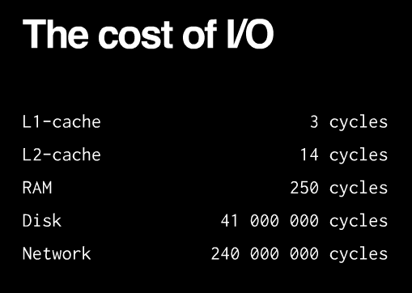
http://blog.mixu.net/2011/02/01/understanding-the-node-js-event-loop/

Slide 12
Disk IO
Notes:
Reading and writing to a disk is a pretty slow activity. You don’t think about it too much because the APIs in most language environments are synchronous in design.

Slide 13
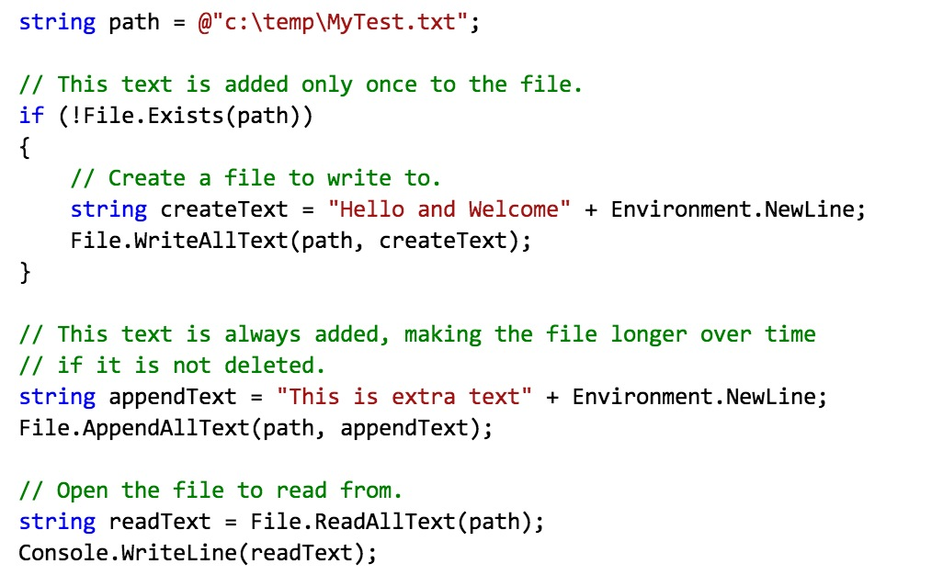
Write to a file in C#
Notes:
Notice how this code is synchronous and blocking. We’re reading and writing without there being a hint that it takes a long time. This is one of the issues, in my mind, with the C# api: it carries the abstraction over writing files too far. It is true of all I/O.

Slide 14
Write to a file in node

Slide 15
Network IO
Notes:
Writing to the network is even slower and it remains painfully abstracted.

Slide 16
Fallacies of distributed computing
The network is reliable.
Latency is zero.
Bandwidth is infinite.
The network is secure.
Topology doesn't change.
There is one administrator.
Transport cost is zero.
The network is homogeneous.
Notes:
Network IO falls pray to the fallacies of distributed computing, specifically the latency is zero one. The reason this is so

Slide 17
What about CPU intensive activities?
Yeah, that’s a problem.
Don’t do computation in the event loop
Notes:
It is the same thing as javascript in a browser. Let’s show what happens by opening up the fib code and trying to run it

Slide 18
Installing nodejs
Notes:
Let’s try installing nodejs on OS X it can be installed using brew with
brew install node
On windows we can simply download the package from the nodejs website or install it via the webinstaller
You can run node as a service on windows by using one of the many service wrappers for it.
OR you can run it directly on azure. There is a talk on that which you should all attend.

Slide 19
Blocking the event loop
Notes:
Drop out to the demo of the fibonacci module

Slide 20




What sort of people use node?
Hipsters

Slide 21
But seriously
New York Times
Yahoo!
LinkedIn
Ebay
Dow Jones
Groupon
…
Notes:
There are some legitimate users but not a huge number

Slide 22
Simple HTTP
Notes:
Building a simple

Slide 23
Modules

Slide 24
Simple static web server

Slide 25
All very well but can you build real apps?

Slide 26
Numerous frameworks
Express
Tower
Geddy
Sail.js
Meteor
http://nodeframework.com/
Notes:
There are tons of frameworks everything from sinatra like systems to fuller stack ones

Slide 27
REST/API frameworks
actionHero.js
Frisby
Notes:
Another place where node really shines is in creating APIs or RESTful services

Slide 28
Express
Notes:
Show running express to generate an app. Run the app with

Slide 29
Tooling
npm
Grunt
Testing

Slide 30
NPM
Node package manager
Notes:
The node package manager is your best friend while using node. It is to node what nuget is to the .net framework or what CPAN is to perl. But not only does npm allow you to install local packages but also global packages. You can even use npm to install executables.

Slide 31

Grunt
Notes:
Grunt can be used to build your javascript. Seems a bit weird to you? It isn’t that strange. You can do a wide variety of thing with grunt, enough that an entire talk could be done on it. In fact…

Slide 32
Grunt
Go to Dave Mosher’s talk “Frontend Workflows with Grunt”
Notes:
Just in case you’re busy during that time let’s talk a bit about

Slide 33
Express

Slide 34
Full stack JavaScript

Slide 35
Databases
Redis
Mongo
Traditional SQL

Slide 36
Is this fast?
Oh yeah
Break out ab
Notes:
Ulimit –n 10000
ab -n 5000 -c 100 http://127.0.0.1:1337/

