Slide 1
Attendance Management System Web Portal
STUDENT
MOHD SOHEL UMAR SHAIKH
SEAT NUMBER
Seat No. 3014822
BACHELOR OF SCIENCE (INFORMATION TECHNOLOGY)
COLLEGE
Navneet College of Arts, Science & Commerce
GUIDE
Academic Presentation Deck
Mr Harishankar Mishra
Attendance Management System

Slide 2
02
Introduction
Overview
Overview
Manual registers replaced
Real-time record access
Lower attendance errors
Faster academic tracking
The project replaces manual registers with a web-based attendance workflow.
It reduces time spent on daily attendance handling and improves record accuracy.
Teachers can mark attendance and monitor summaries from one dashboard.
Students can check history, percentage, and subject-wise attendance in real time.
Attendance Management System

Slide 3
03
Project Objectives
Key Goals
Key Goals
Daily process automation
Teacher and student dashboards
Duplicate entry prevention
Quick report generation
Digitize attendance marking for classroom use with a simple teacher workflow.
Provide separate dashboards for teacher and student access based on login role.
Prevent duplicate attendance records for the same class, subject, date, and time.
Generate attendance summaries, reports, and dashboard-level insights quickly.
Attendance Management System

Slide 4
04
Technology Stack
Tech Stack
Tech Stack
HTML, CSS, Bootstrap UI
JavaScript interactions
Flask backend logic
PostgreSQL + SQLAlchemy
Frontend uses HTML5, CSS3, Bootstrap, JavaScript, and icon-based UI components.
Backend uses Python Flask for routing, session management, and attendance logic.
PostgreSQL stores student details, attendance records, notices, fees, and rewards data.
SQLAlchemy handles database operations and integrates smoothly with analytics-ready data.
Attendance Management System

Slide 5
05
Functional Modules
Modules
Modules
Secure login flow
Teacher attendance tools
Student dashboard access
Reports and analytics
Login module authenticates teacher and student access through the web portal.
Teacher module supports attendance marking, summary viewing, notices, fees, and support handling.
Student module supports dashboard analytics, attendance history, notices, tickets, and rewards.
Reporting module provides summary views, dashboard data, and export-oriented attendance outputs.
Attendance Management System

Slide 6
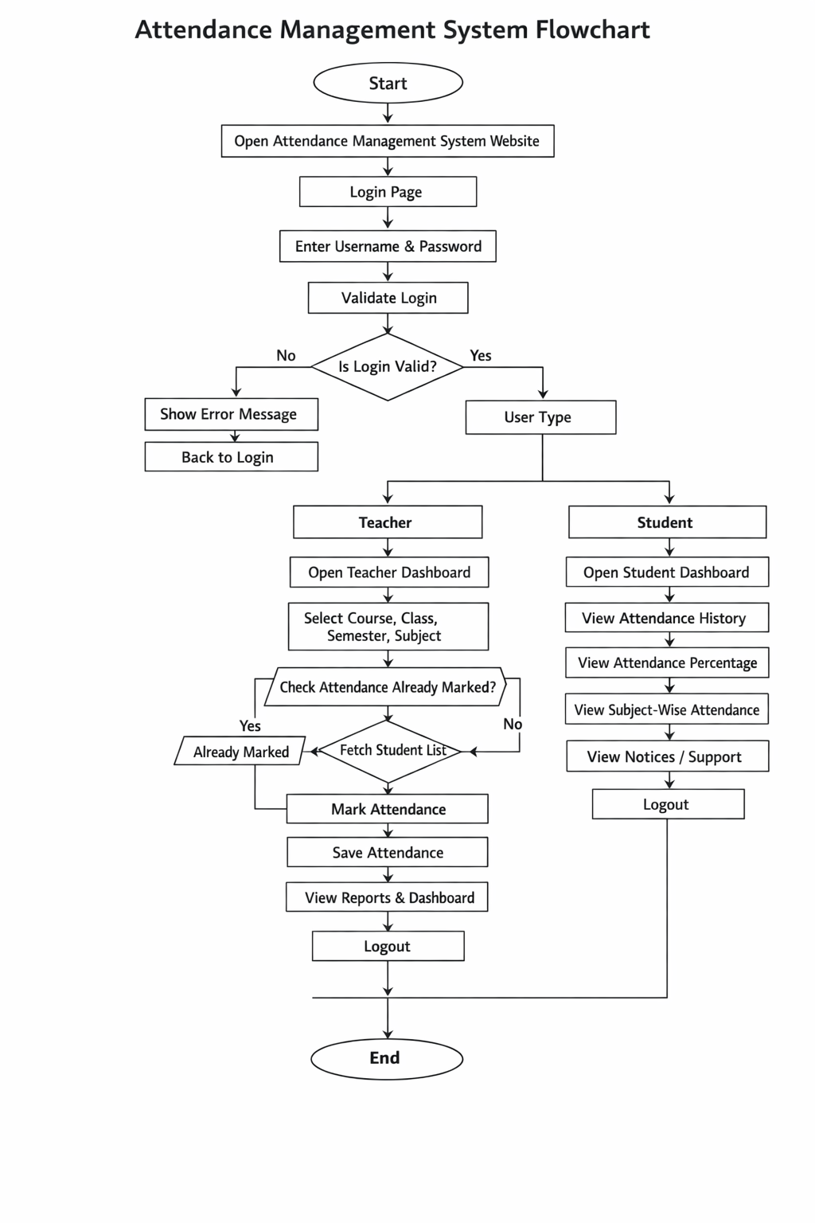
06
System Flowchart
Actual Project Flow
Attendance Management System

Slide 7
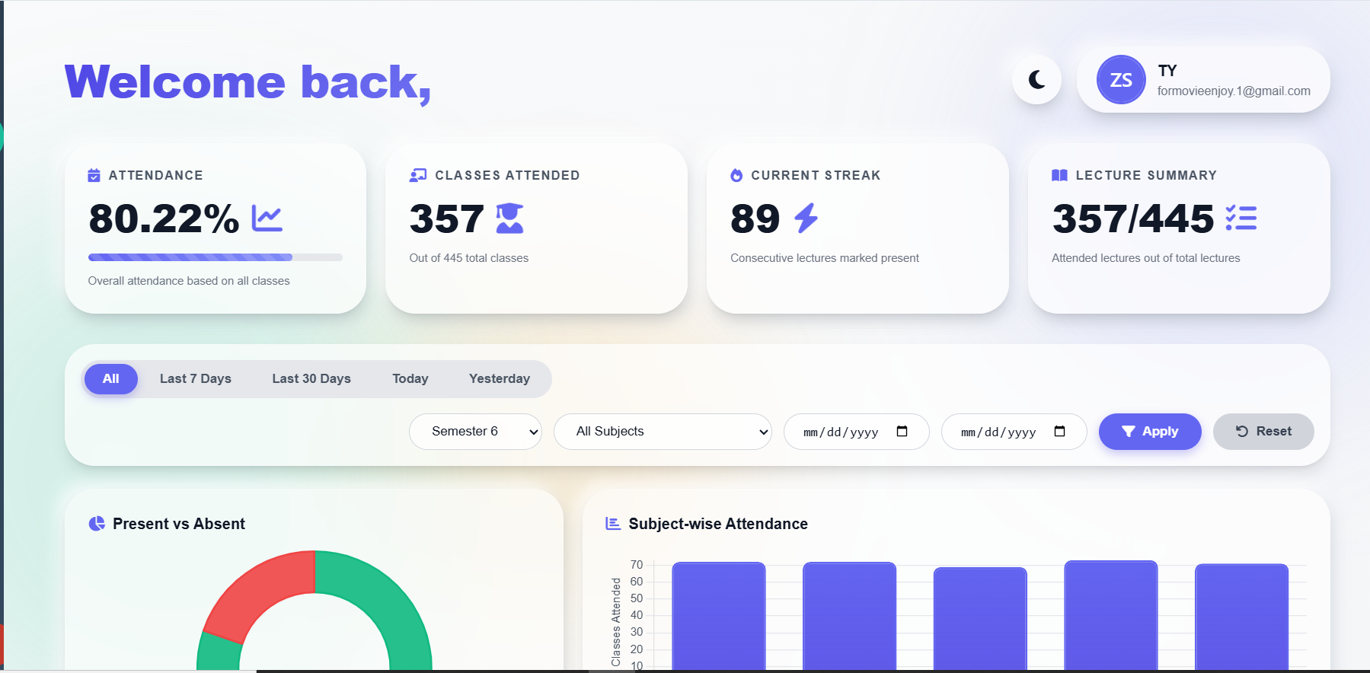
07
UI: Student Dashboard
Student Interface
Attendance Management System

Slide 8
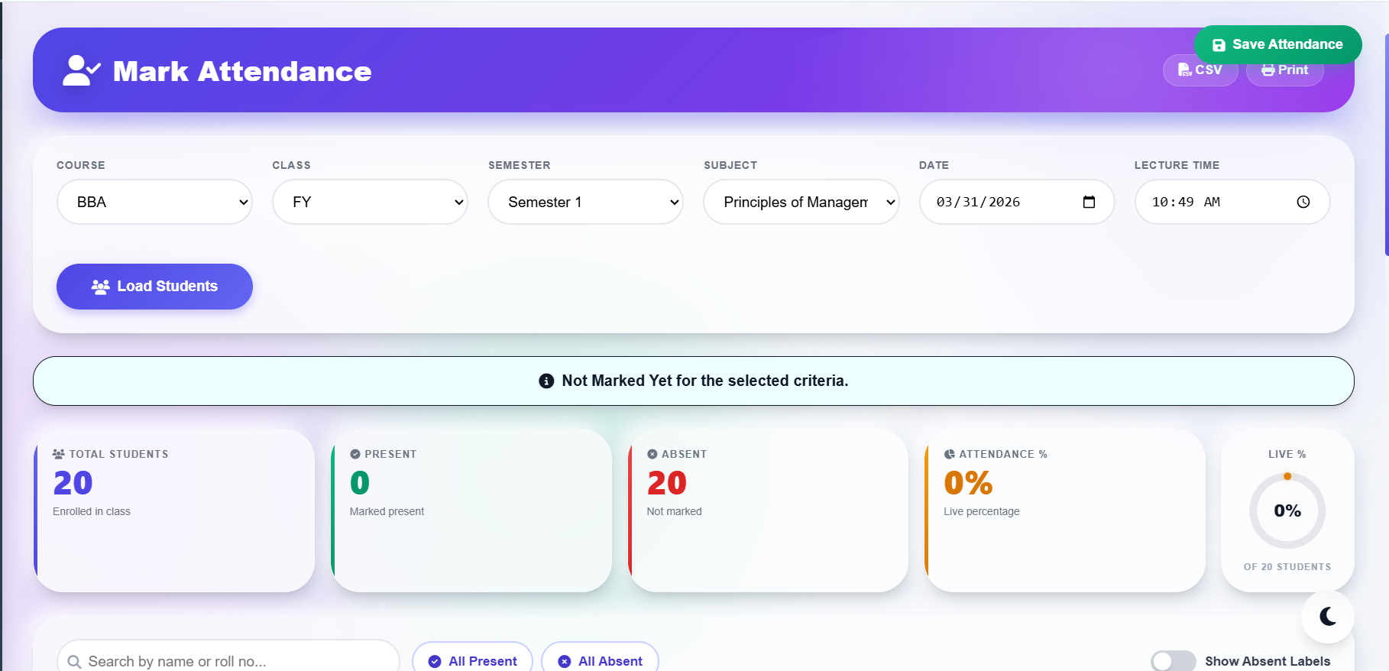
08
UI: Teacher Attendance Module
Teacher Interface
Attendance Management System

Slide 9
09
Implementation and Testing
Implementation Review
Attendance flow was implemented with class, semester, subject, date, and time selection.
Duplicate marking checks were added before saving attendance records.
Dashboard pages were verified for data retrieval, filters, and summary calculations.
The presentation now uses real project visuals instead of mixed placeholders.
Attendance Management System

Slide 10
10
Results and Discussion
Project Results
The project successfully records attendance and keeps teacher and student workflows separate.
The student dashboard presents percentage, streak, lecture summary, and subject-wise insights.
The teacher module supports loading students, marking attendance, and reviewing summaries.
The updated PPT now highlights the actual flowchart and UI in a cleaner professional format.
Attendance Management System

Slide 11
11
Conclusion and Future Scope
Final Takeaway
The system improves attendance management by making the process faster, clearer, and more reliable.
It delivers a practical web solution for attendance tracking in an academic environment.
Future scope can include biometric integration, mobile support, automated notifications, and deeper analytics.
The architecture is suitable for further expansion into a broader campus management platform.
Attendance Management System

Slide 12
12
Thank You
Presentation Complete
THANK YOU
Attendance Management System Web Portal
MOHD SOHEL UMAR SHAIKH | Seat No. 3014822
Thank You

