Slide 1
Abstraction
~Ganesh Jadhav

Slide 2
Abstraction
Abstraction is a process of hiding the implementation details and showing only functionality to the user.
Another way, it shows only essential things to the user and hides the internal details, for example, sending SMS where you type the text and send the message. You don't know the internal processing about the message delivery.
An Abstraction is a process of exposing all the necessary details and hiding the rest.
In Java, Data Abstraction is defined as the process of reducing the object to its essence so that only the necessary characteristics are exposed to the users.
Abstraction defines an object in terms of its properties (attributes), behavior (methods), and interfaces (means of communicating with other objects).

Slide 3
How to Achieve Abstraction in Java?
In Java, we can achieve Data Abstraction using
Abstract classes
interfaces
Abstract classes allow 0 to 100% abstraction (partial to complete abstraction) because abstract classes can contain concrete methods that have the implementation which results in a partial abstraction.
Interfaces allow 100% abstraction (complete abstraction).
Interfaces allow you to abstract the implementation completely.

Slide 4
Abstract class in Java
A class which is declared with the abstract keyword is known as an abstract class.
It can have abstract and non-abstract methods (method with the body).
An instance of an abstract class can not be created.
It can have constructors and static methods also.
It can have final methods which will force the subclass not to change the body of the method.
We can have an abstract class without any abstract method.
If there is an abstract method in a class, that class must be abstract.
If you are extending an abstract class that has an abstract method, you must either provide the implementation of the method or make this class abstract.

Slide 5
There is no need for implementing the method in the parent class thus, we can declare these methods as abstract in the parent class.
Making these methods as abstract will enforce all the derived classes to implement these abstract methods otherwise, there will be a compilation error in your code.
Why can’t we create an object of an Abstract Class?
You might be wondering why can’t we instantiate an abstract class or create an object from it?
Suppose, if Java allows you to create an object of the abstract class and use this object.
Now, if someone calls the abstract method through the object of the abstract class then what would happen? There would not be any actual implementation of the called method.
Also, an abstract class is like a guideline or a template that must be extended by its child classes for the implementation.

Slide 6
Why do we need Abstract Classes in Java?
If we can’t create an object from abstract classes and neither can’t use them, then what is the need for abstract classes?
To answer this question, let’s take a situation where we want to create a class that just declares the general form or structure or guidelines of a particular idea, without giving a complete implementation of every method.
And we want that this generalized form or structure of the class can be used by all its child classes, and the child classes will impose these guidelines by fulfilling all the implementation details according to the need.

Slide 7
Abstract class having constructor, data member and methods
An abstract class can have a data member, abstract method, method body (non-abstract method), constructor, and even main() method.
Can we define a parameterized constructor in an abstract class in Java?
Yes, we can define a parameterized constructor in an abstract class.
Conditions for defining a parameterized constructor in an abstract class
We need to make sure that the class which is extending an abstract class have a constructor and it can call the superclass parameterized constructor.
We can call the superclass parameterized constructor in a subclass by using super() call.
If we are not placing super() call in the subclass constructor, a compile-time error will occur.

Slide 8
Interface
An interface in Java is a blueprint of a class.
It has static constants and abstract methods.
The interface in Java is a mechanism to achieve abstraction.
There can be only abstract methods in the Java interface, not method body.
In other words, you can say that interfaces can have abstract methods and variables. It cannot have a method body.
Java Interface also represents the IS-A relationship.
It cannot be instantiated just like the abstract class.

Slide 9
Why use Java interface?
It is used to achieve abstraction.
By interface, we can support the functionality of multiple inheritance.
How to declare an interface?
An interface is declared by using the interface keyword.
It provides total abstraction; means all the methods in an interface are declared with the empty body, and all the fields are public, static and final by default.
A class that implements an interface must implement all the methods declared in the interface.
Internal addition by the compiler
The Java compiler adds public and abstract keywords before the interface method. Moreover, it adds public, static and final keywords before data members.

Slide 10
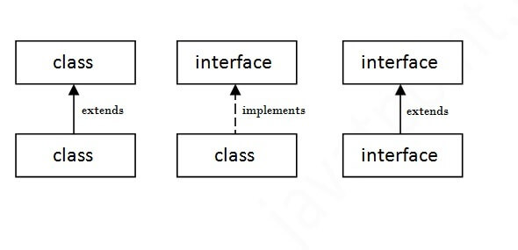
The relationship between classes and interfaces
As shown in the figure given below, a class extends another class, an interface extends another interface, but a class implements an interface.

Slide 11
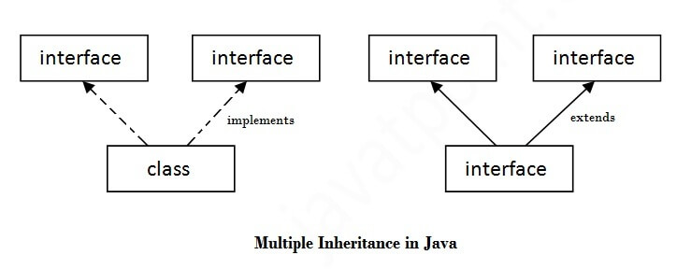
Multiple inheritance in Java by interface
If a class implements multiple interfaces, or an interface extends multiple interfaces, it is known as multiple inheritance.

Slide 12
Q) Multiple inheritance is not supported through class in java, but it is possible by an interface, why?
Multiple inheritance is not supported in the case of class because of ambiguity.
However, it is supported in case of an interface because there is no ambiguity.
It is because its implementation is provided by the implementation class.
Java 8 Default Method in Interface
Since Java 8, we can have method body in interface. But we need to make it default method
Java 8 Static Method in Interface
Since Java 8, we can have static method in interface.

