Slide 1


Slide 2
Introduction
Array is an index collection of fixed number of homogeneous data elements.
Array are fixed in size.
Array can hold only homogeneous datatype.
Main advantage of array is we can represent huge number of value by using single variable so that readability of the code will be improved.
Array index always start with zero & index never will be negative.
Types of Arrays in Java
Single Dimensional Array
Multidimensional Array

Slide 3
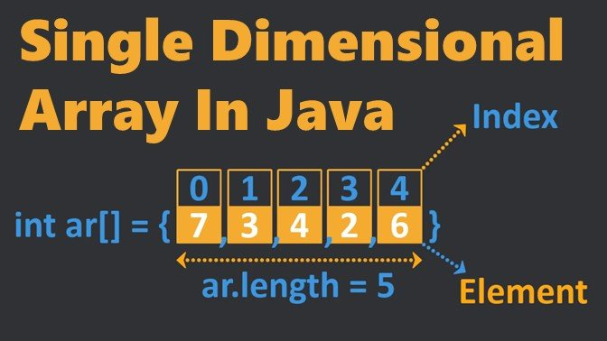

Slide 4
Single Dimensional Array
A single or one-dimensional array means it has only one value for every index. i.e., memory location.
One Dimensional Array Declaration : int[] x; -> recommendable (Because name is clearly separated from type)
int []x; int x[];
Q. How to pronounced int[] x?
X is one dimensional int Array
Int[] x; int[6] x;-> false
Int Array[]; //declaring array
intArray = new int[20]; // allocating memory to array
int[] intArray = new int[20]; // combining both statements in one

Slide 5
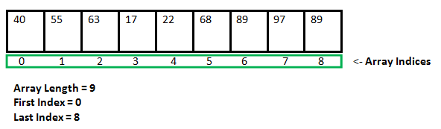

Slide 6
The elements in the array allocated by new will automatically be initialized to zero (for numeric types), false (for boolean), or null (for reference types).
Refer Default array values in Java
Obtaining an array is a two-step process.
First, you must declare a variable of the desired array type.
Second, you must allocate the memory to hold the array, using new, and assign it to the array variable.
Array Literal
In a situation where the size of the array and variables of the array are already known, array literals can be used.
int[] intArray = new int[]{ 1,2,3,4,5,6,7,8,9,10 }; // Declaring array literal

Slide 7
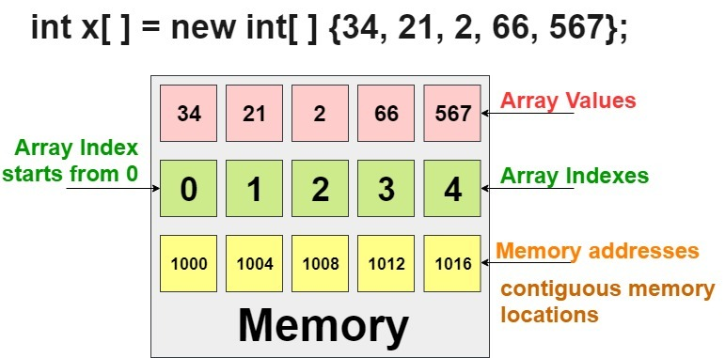

Slide 8
Accessing Java Array Elements using for Loop
Each element in the array is accessed via its index.
The index begins with 0 and ends at (total array size)-1.
All the elements of array can be accessed using Java for Loop.
Accessing the elements using simple for loop
for (int i = 0; i < arr.length; i++) {
System.out.println("Element at index " + i + " : "+ arr[i]); }

Slide 9
Arrays of Objects
An array of objects is created like an array of primitive type data items in the following way.
Student[] arr = new Student[7]; //student is a user-defined class
The studentArray contains seven memory spaces each of the size of student class in which the address of seven Student objects can be stored.
The Student objects must be instantiated using the constructor of the Student class, and their references should be assigned to the array elements

Slide 10
How to find out size of an array?
With the help of length variable, we can be able to find out the size of array.
Length keyword we must use if we want to find the size of an array.
What happens if we try to access elements outside the array size?
JVM throws ArrayIndexOutOfBoundsException to indicate that the array has been accessed with an illegal index.
The index is either negative or greater than or equal to the size of an array.

Slide 11
Array Creation
Every array in java is an object only. Hence, we can create arrays by using new operator. Ex. Int[] a = new int[3]
For every array type corresponding classes area available & these classes are part of java language & not available to programmer level.
Int[] x = new int[3];
Sop(x.getClass().getName()); o/p :- [I
Every time when you create an array then it should be mandatory for providing the size of an array otherwise you will get compile time error.
int[] x = new int[] -> wrong
int[] x = new int[6] -> correct
int[]x = new int[0] -> correct we can define an array with size zero
int[] x = new int[-3]; -> we will get a runtime exception

Slide 12
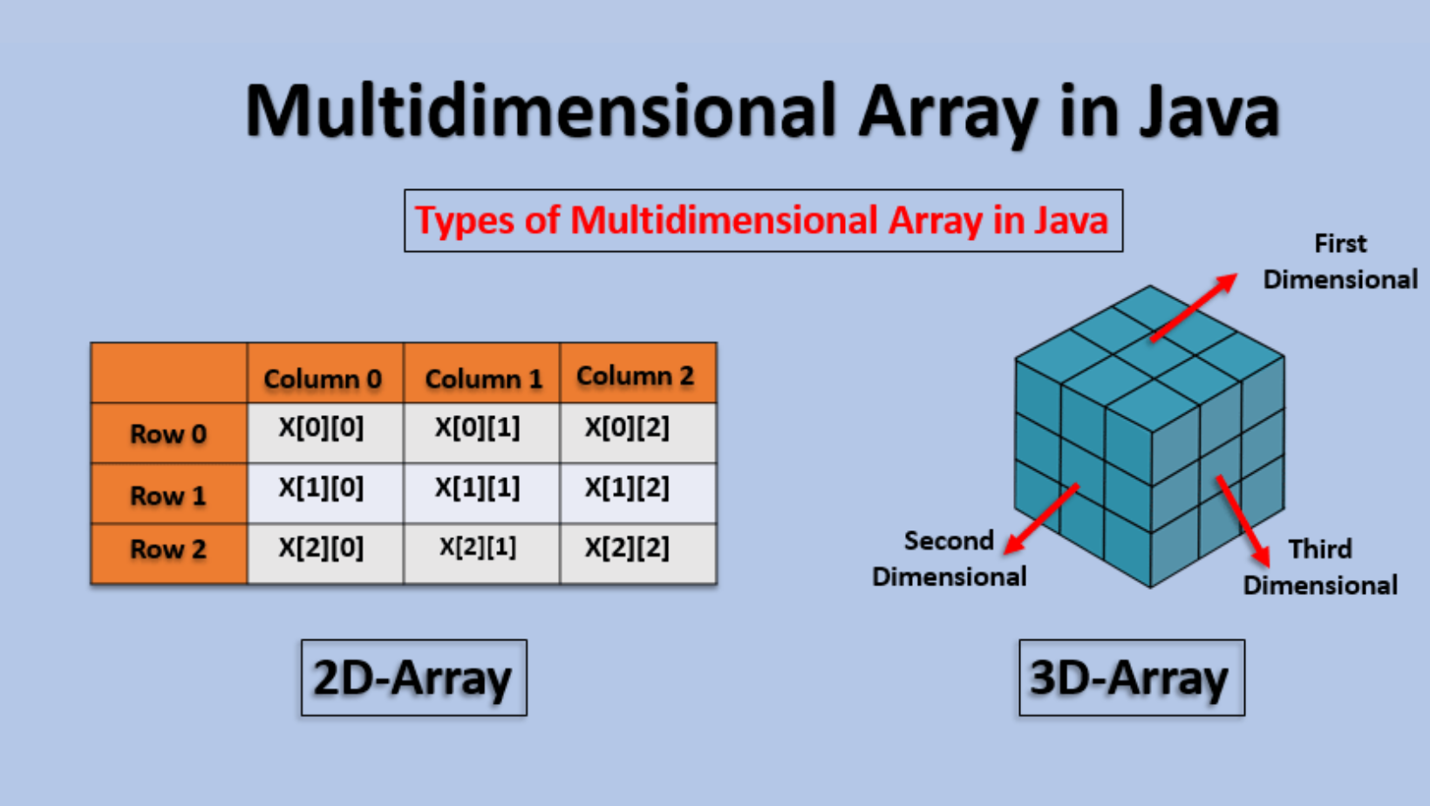

Slide 13
Multidimensional Array
We can say that a 2d array is an array of array.
A multidimensional array is mostly used to store a table-like structure.
2-dimensional Array has two pairs of square brackets.
The first one for the row and the second one for the column.
Remember that if we need to get any value in the array, we are using the index number associated with it.
Two-Dimensional Array Declaration
If we want to specified dimension before the variable that facility is applicable only for first variable in your declaration. If we are trying to applied for next variable, we will get compiled time error.
Int [][] x; int[] []x;
Int [][] x; int[] x[]
Int x[][]; int []x[]
Int[] []a, []b - compilation error

Slide 14
How 2D Arrays Defined in Java?
Int[][] name = new int[2][2]
int name[2][2] = {{“a”,”b”,”c”},{”a1”,”b1”,”c1”}}
How to Create 2D Arrays in Java?
we have two index values for a 2d array. One is for a row, and another is for the column.
Row Size
Rows are the elements in an array that can store horizontally.
For example, Row Size is equal to 4, then the array will create with 4 rows.
Column Size
Columns are the elements in an array that can store vertically.
For example, Column Size is equal to 2, then an array that can have 2 Columns in it.

Slide 15
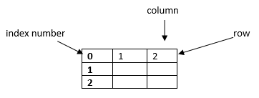

Slide 16
Difference between length & Length()
Length() is final method application for string objects. Length() method returns number of characters present in the string.
Note : length variable applicable for array but not for string objects where as length() method applicable for string objects but not for array.
String s = {“A”, “AA”, “AAA”};
Sop(s.length); -> output 3
Sop(s.length()); -> error
Sop(s[0].length()); -> error
Sop[s[0].length]; -> 1

