Slide 1
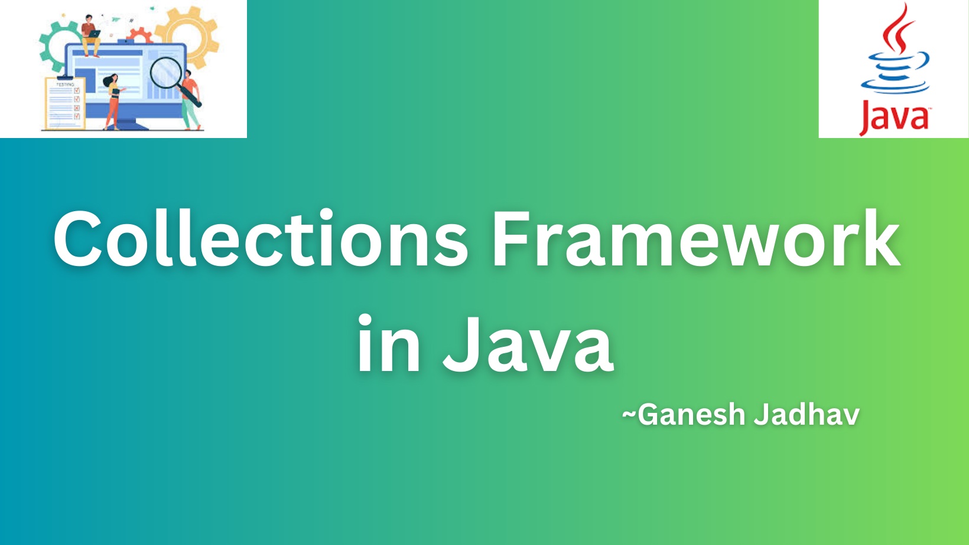

Slide 2
What is a framework in Java?
A framework is a set of classes and interfaces which provide a ready-made architecture.
It represents a set of classes and interfaces.
The java.util package contains all the classes and interfaces for the Collections framework.

Slide 3
What is collections in Java?
In Java, a separate framework named the “Collection Framework” has been defined in JDK 1.2 which holds all the collection classes and interface in it.
The Collections in Java is a framework that provides an architecture to store and manipulate the group of objects.
Java Collections can achieve all the operations that you perform on a data such as searching, sorting, insertion, manipulation, and deletion.
In Java, Collection interface (java.util.Collection) and Map interface (java.util.Map) are the two main “root” interfaces of Java collection classes.
Java Collections framework provides many interfaces (Set, List, Queue, Deque) and classes.

Slide 4
What is the need for a separate collection's framework?
Before the Collection Framework(or before JDK 1.2) was introduced, the standard methods for grouping Java objects (or collections) were Arrays or Vectors, or Hash tables.
All these collections had no common interface.
Therefore, though the main aim of all the collections is the same, the implementation of all these collections was defined independently and had no correlation among them.
It is very difficult for the users to remember all the different methods, syntax, and constructors present in every collection class.

Slide 5
None of these collections(Array, Vector, or Hashtable) implements a standard member access interface.
It was very difficult for programmers to write algorithms that can work for all kinds of Collections.
Another drawback is that most of the ‘Vector’ methods are final, meaning we cannot extend the ’Vector’ class to implement a similar kind of Collection.
Therefore, Java developers decided to produce a common interface to deal with the above-mentioned problems and introduced the Collection Framework in JDK 1.2 post which both, legacy Vectors and Hashtable were modified to conform to the Collection Framework.

Slide 6
Disadvantages of arrays
Deleting or inserting
Increasing size
Modifying elements

Slide 7
Advantages of the Collection Framework
Consistent API
Reduces programming effort
Increases program speed and quality

Slide 8
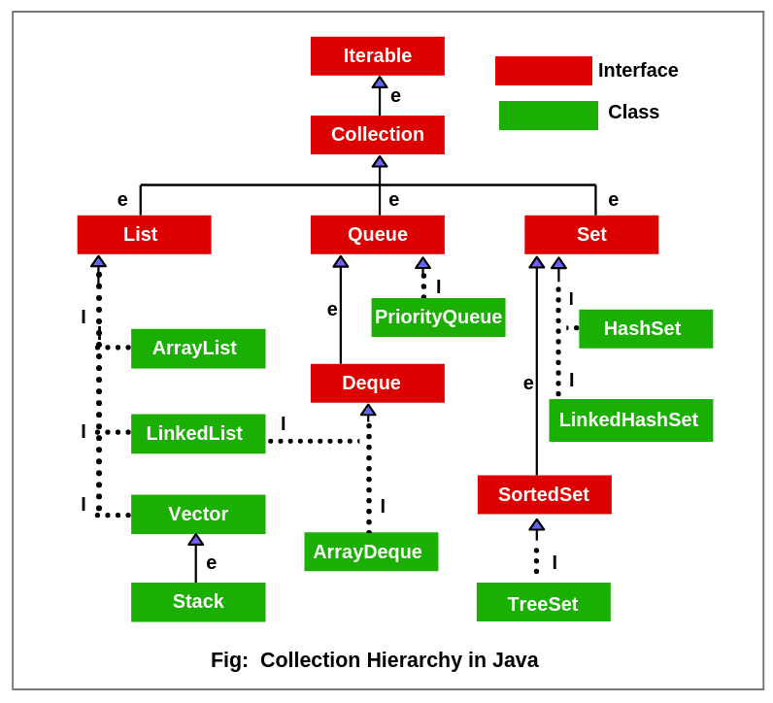

Slide 9
Iterable interface
The Iterable interface is the root interface for all the collection classes.
The Collection interface extends the Iterable interface and therefore all the subclasses of Collection interface also implement the Iterable interface.
Iterable interface provides the facility of iterating the elements in a forward direction only.
No. | Method | Description
1 | public boolean hasNext() | It returns true if the iterator has more elements otherwise it returns false.
2 | public Object next() | It returns the element and moves the cursor pointer to the next element.
3 | public void remove() | It removes the last elements returned by the iterator. It is less used.

Slide 10
Collection Interface
The Collection interface is the interface which is implemented by all the classes in the collection framework.
It declares the methods that every collection will have.
In other words, we can say that the Collection interface builds the foundation on which the collection framework depends.
This interface extends the iterable interface and is implemented by all the classes in the collection framework.
This interface contains all the basic methods which every collection has like adding the data into the collection, removing the data, clearing the data, etc.

Slide 11
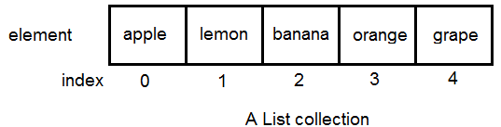
List Interface
List interface is the child interface of Collections interface.
It inhibits a list type data structure in which we can store the ordered collection of objects.
It can have duplicate values.
List interface is implemented by the classes ArrayList, LinkedList, Vector, and Stack.

Slide 12
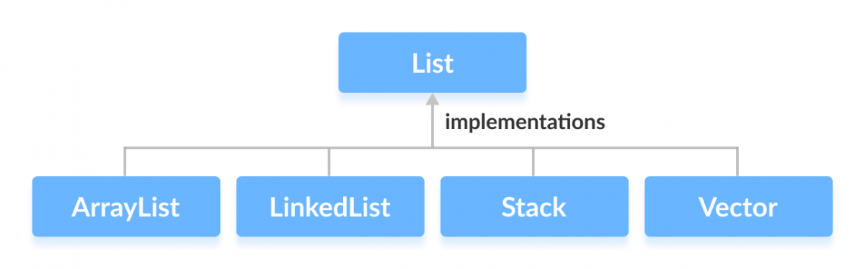

Slide 13
ArrayList
ArrayList provides us with dynamic arrays in Java.
Java ArrayList allows us to randomly access the list.
ArrayList can not be used for primitive types, like int, char, etc.
We will need a wrapper class for such cases.
Create an empty arraylist object with default initial capacity 10.
Duplicates are allowed
Insertions order are preserved
Heterogeneous are allowed
Null insertion is possible
Arraylist is best choice if our frequent operation is retrieval operation.

Slide 14
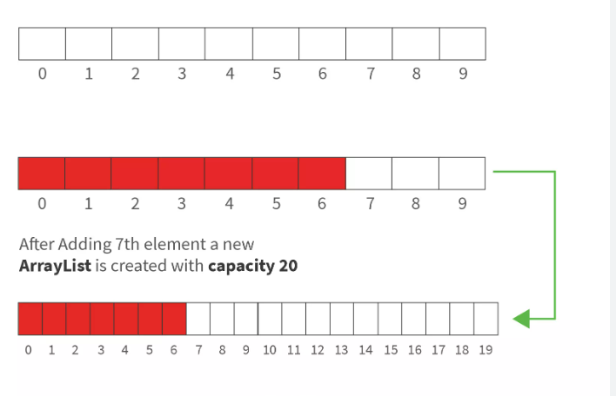

Slide 15
add(Object) | This method is used to add an object to the collection.
addAll(Collection c) | This method adds all the elements in the given collection to this collection.
clear() | This method removes all of the elements from this collection.
contains(Object o) | This method returns true if the collection contains the specified element.
containsAll(Collection c) | This method returns true if the collection contains all of the elements in the given collection.
isEmpty() | This method returns true if this collection contains no elements.
iterator() | This method returns an iterator over the elements in this collection.

Slide 16
remove(Object o) | This method is used to remove the given object from the collection. If there are duplicate values, then this method removes the first occurrence of the object.
removeAll(Collection c) | This method is used to remove all the objects mentioned in the given collection from the collection.
size() | This method is used to return the number of elements in the collection.

Slide 17


Slide 18
The Java Generics programming is introduced in J2SE 5 to deal with type-safe objects. It makes the code stable by detecting the bugs at compile time.
Before generics, we can store any type of objects in the collection, i.e., non-generic. Now generics force the java programmer to store a specific type of objects.
ArrayList<String> list=new ArrayList<String>();

Slide 19
Collections class in Java is one of the utility classes in Java Collections Framework.
The java.util package contains the Collections class in Java.
Java Collections class is used with the static methods that operate on the collections or return the collection.
All the methods of this class throw the NullPointerException if the collection or object passed to the methods is null.

Slide 20
Advantage of Java Generics
No scarification of type-safety
No requirement of type-casting
Compile-time checking
Code reusability and improved performance

Slide 21
LinkedList
LinkedList class is an implementation of the LinkedList data structure which is a linear data structure where the elements are not stored in contiguous locations and every element is a separate object with a data part and address part.
The elements are linked using pointers and addresses. Each element is known as a node.
Insertion ordered is preserved
Duplicate object are allowed.
Heterogeneous object are allowed.
Null insertion are possible
Likedlist is best option if our frequent operation is insertion or deletion on middle.
Likedlist is worst choice if our frequent operation is retrieval operation.
Linkedlist Method : addFirst(), addLast(), getFirst(), getLast(), removeFirst(), removeLast().

Slide 22
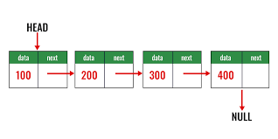

Slide 23
ArrayList | LinkedList
1) ArrayList internally uses a dynamic array to store the elements. | LinkedList internally uses a doubly linked list to store the elements.
2) Manipulation with ArrayList is slow because it internally uses an array. If any element is removed from the array, all the other elements are shifted in memory. | Manipulation with LinkedList is faster than ArrayList because it uses a doubly linked list, so no bit shifting is required in memory.
3) An ArrayList class can act as a list only because it implements List only. | LinkedList class can act as a list and queue both because it implements List and Deque interfaces.
4) ArrayList is better for storing and accessing data. | LinkedList is better for manipulating data.
5) Generally, when an ArrayList is initialized, a default capacity of 10 is assigned to the ArrayList. | There is no case of default capacity in a LinkedList. In LinkedList, an empty list is created when a LinkedList is initialized.
6) To be precise, an ArrayList is a resizable array. | LinkedList implements the doubly linked list of the list interface.

Slide 24
Vector
A vector provides us with dynamic arrays in Java.
Though, it may be slower than standard arrays but can be helpful in programs where lots of manipulation in the array is needed.
This is identical to ArrayList in terms of implementation.
However, the primary difference between a vector and an ArrayList is that a Vector is synchronized and an ArrayList is non-synchronized.

Slide 25
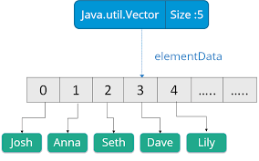

Slide 26
Stack
Stack class models and implements the Stack data structure.
The class is based on the basic principle of last-in-first-out.
In addition to the basic push and pop operations, the class provides three more functions of empty, search and peek.
The class can also be referred to as the subclass of Vector.

Slide 27
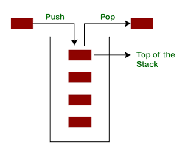

Slide 28
add(Object) | This method is used to add an object to the collection.
addAll(Collection c) | This method adds all the elements in the given collection to this collection.
clear() | This method removes all the elements from this collection.
contains(Object o) | This method returns true if the collection contains the specified element.
containsAll(Collection c) | This method returns true if the collection contains all of the elements in the given collection.
equals(Object o) | This method compares the specified object with this collection for equality.
hashCode() | This method is used to return the hash code value for this collection.
isEmpty() | This method returns true if this collection contains no elements.
iterator() | This method returns an iterator over the elements in this collection.

Slide 29
max() | This method is used to return the maximum value present in the collection.
remove(Object o) | This method is used to remove the given object from the collection. If there are duplicate values, then this method removes the first occurrence of the object.
removeAll(Collection c) | This method is used to remove all the objects mentioned in the given collection from the collection.
retainAll(Collection c) | This method is used to retain only the elements in this collection that are contained in the specified collection.
size() | This method is used to return the number of elements in the collection.
toArray() | This method is used to return an array containing all of the elements in this collection.

Slide 30
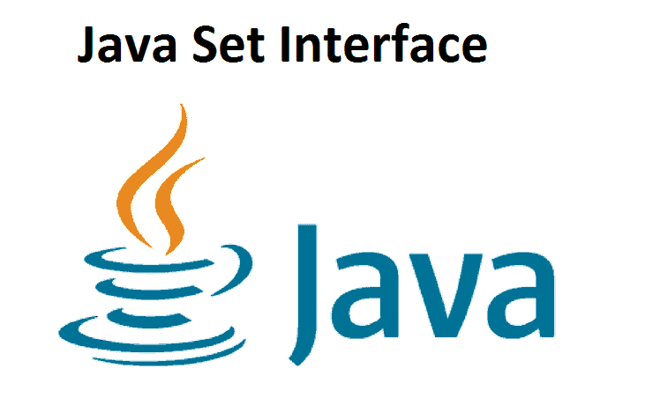

Slide 31
Set
A Set is a Collection that cannot contain duplicate elements.
The Set interface contains only methods inherited from Collection and adds the restriction that duplicate elements are prohibited.
Set also adds a stronger contract on the behavior of the equals and hashCode operations, allowing Set instances to be compared meaningfully even if their implementation types differ.

Slide 32
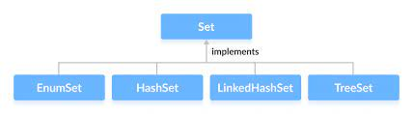

Slide 33


Slide 34
HashSet
The HashSet class is an inherent implementation of the hash table data structure.
The objects are inserted based on their hashcode.
Duplicate objects are not allowed.
Insertion ordered is not preserved.
Null insertion is possible but only once
Heterogeneous object are allowed.
Hashset is best choice if our frequent operation is search.
In Hashset duplicates are not allowed if we are trying to insert duplicate then we won’t get any compilation & runtime error & add method simply return false result.
Default initial capacity size is 16.

Slide 35
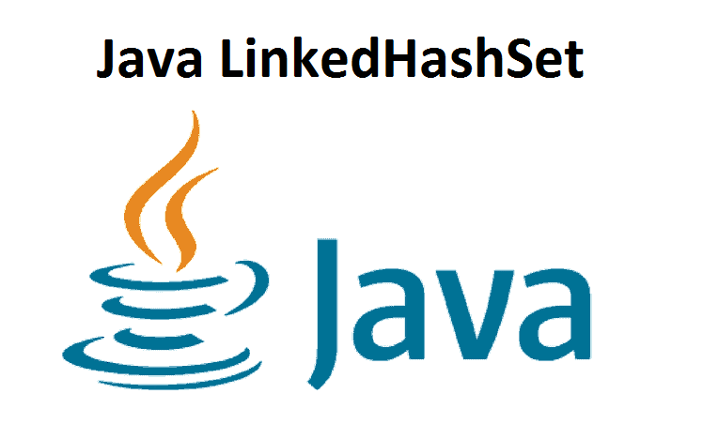

Slide 36
LinkedHashSet
A LinkedHashSet is very similar to a HashSet.
The difference is that this uses a doubly linked list to store the data and retains the ordering of the elements.
HashSet | LinkedHashSet
It uses a Hashtable to store the elements. | It uses a HashTable and doubly linked list to store and maintain the insertion order of the elements.
Insertion order is not preserved. | Insertion order is preserved.
It allows only one null element. | It also allows only one null element.
It requires less memory. | It requires more memory than HashSet.
It provides slightly faster performance than LinkedHashSet | It provides low performance than HashSet

Slide 37
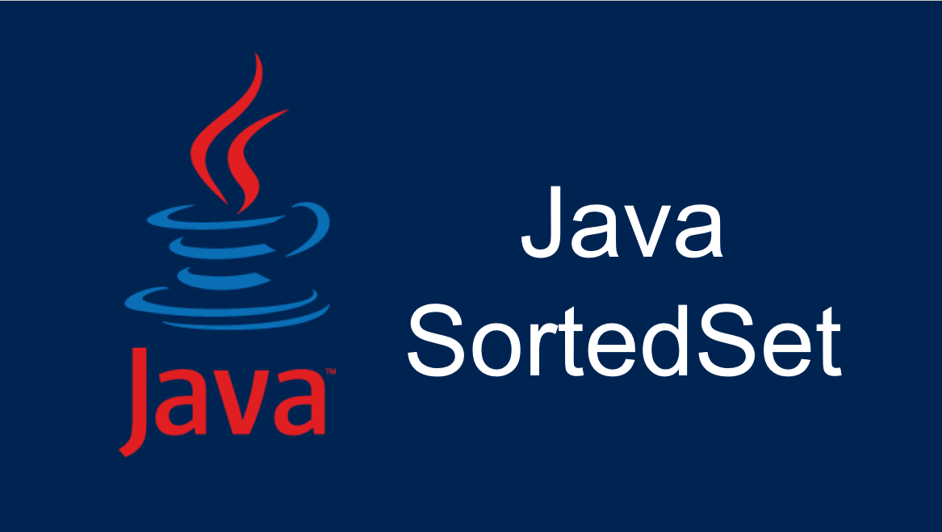

Slide 38
Sorted Set Interface
This interface is very similar to the set interface.
The only difference is that this interface has extra methods that maintain the ordering of the elements.
The sorted set interface extends the set interface and is used to handle the data which needs to be sorted.
The class which implements this interface is TreeSet.
Since this class implements the SortedSet, we can instantiate a SortedSet object with this class.
SortedSet<T> ts = new TreeSet<> ();

Slide 39
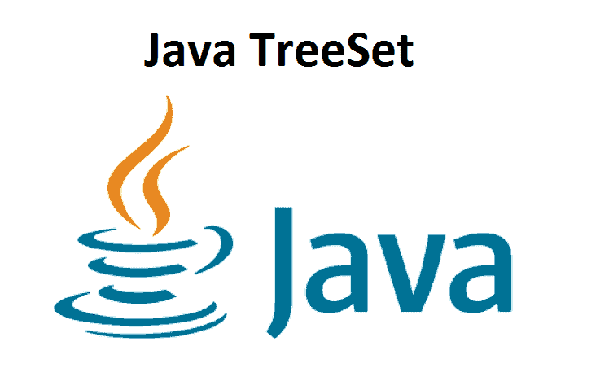

Slide 40
TreeSet
The TreeSet class uses a Tree for storage.
The ordering of the elements is maintained by a set using their natural ordering whether an explicit comparator is provided.
This must be consistent with equals if it is to correctly implement the Set interface. It can also be ordered by a Comparator provided at set creation time, depending on which constructor is used.
Insertion order is not preserved.
Duplicates objects are not allowed.
Heterogeneous object are not allowed otherwise we will get an exception.
Null insertion is not possible.

Slide 41
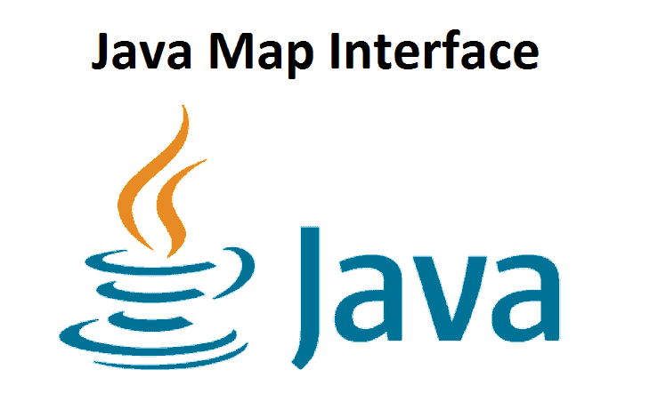

Slide 42
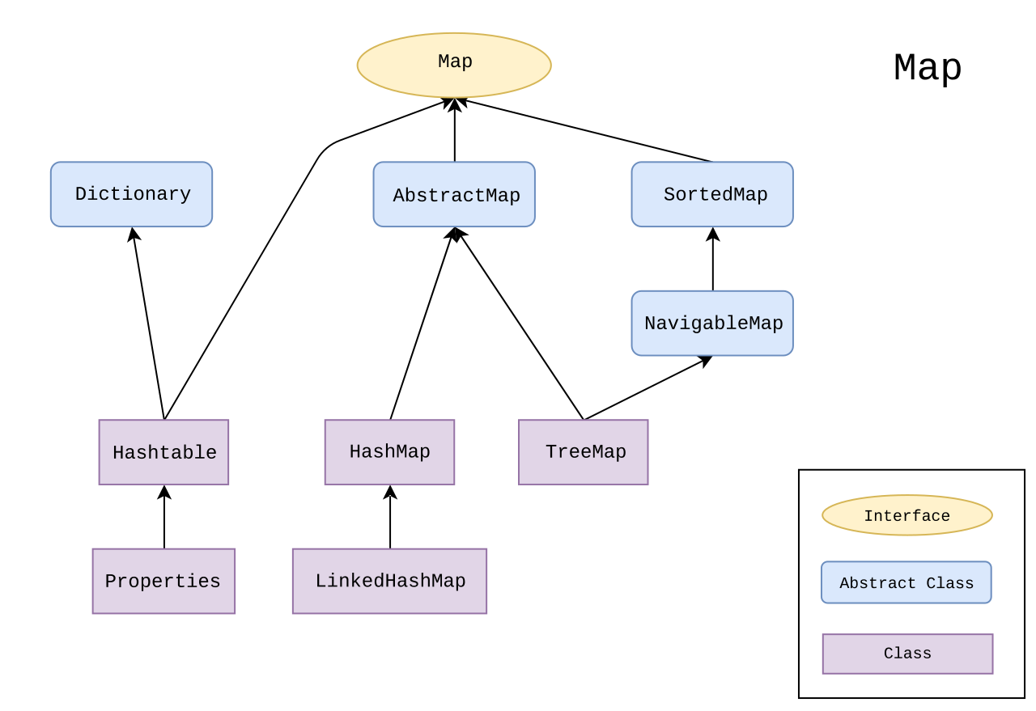

Slide 43
Map Interface
A map is a data structure that supports the key-value pair mapping for the data.
This interface doesn’t support duplicate keys because the same key cannot have multiple mappings.
A map is useful if there is data, and we wish to perform operations based on the key.
This map interface is implemented by various classes like HashMap, TreeMap.
Since all the subclasses implement the map, we can instantiate a map object with any of these classes.
If the key is already present, then old values will be replaced with new values & return old values.

Slide 44
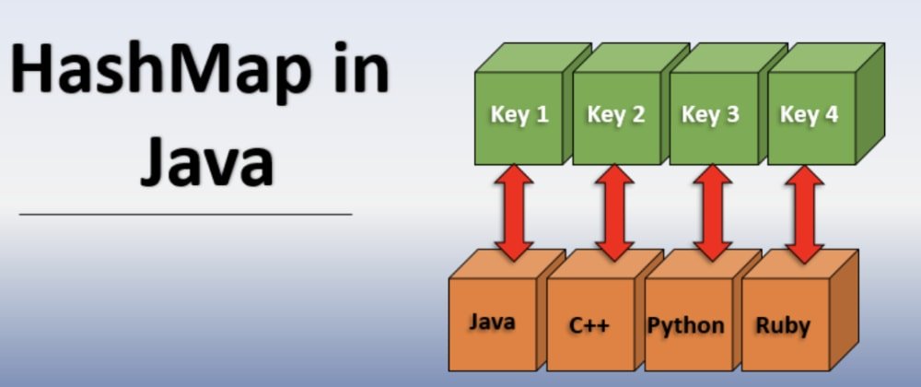

Slide 45
HashMap
HashMap provides the basic implementation of the Map interface of Java.
It stores the data in (Key, Value) pairs.
To access a value in a HashMap, we must know its key.
HashMap uses a technique called Hashing.
Hashing is a technique of converting a large String to a small String that represents the same String so that the indexing and search operations are faster.

Slide 46
Sr.No. | Method & Description
1 | clear( ) Removes all objects from the collection.
2 | contains( ) Returns true if a specified object is an element within the collection.
3 | isEmpty( ) Returns true if the collection has no elements.
4 | iterator( ) Returns an Iterator object for the collection, which may be used to retrieve an object.
5 | remove( ) Removes a specified object from the collection.
6 | size( ) Returns the number of elements in the collection.

Slide 47
HashTable
The Hashtable class implements a hash table, which maps keys to values.
It is like HashMap but is synchronized.
Hashtable stores key/value pair in hash table.
Hashtable doesn’t support null value
The initial default capacity of Hashtable class is 11.

Slide 48
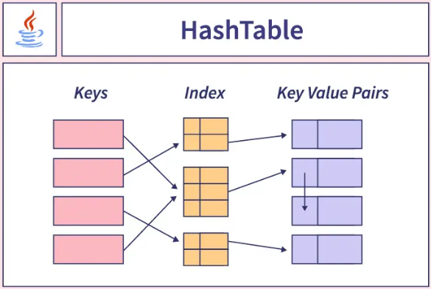

Slide 49
Properties Class in Java
The Properties class represents a persistent set of properties.
The Properties can be saved to a stream or loaded from a stream.
It belongs to java.util package.
Features of Properties class
Properties is a subclass of Hashtable.
It is used to a key is a string, and the value is also a string i.e; it can be used to store and retrieve string type data from the properties file.
Advantage of a Properties file
If any data is changed from the properties record, you don’t have to recompile the java class.
It is utilized to store data that is to be changed habitually.
Properties p = new Properties();

