Slide 1
Smart Agent System for Efficiently Monitoring and Preventing Kidnap Activity
Name : Hossain , Md. Zahid (16-31628-1) Name : Arif Ahmed (18-37994-2)
Name : Abir Md Hassibul Hassan(16-31123-1) Name : Sohelee Sen (18-38045-2)
Name :Samsuzzaman Tanvir (17-35608-3) Name : Mahbubul Alam Rifat (18-36330-1)

Slide 2



Introduction
Manmade disaster is also thoughtful like natural disaster.
Intelligent agent system to avoid kidnapping.
App for awareness.

Slide 3
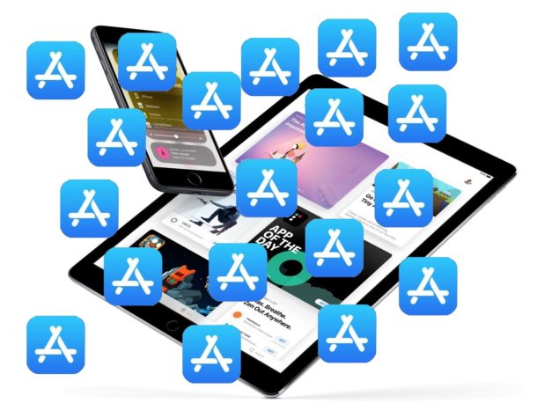

Summary : Our modern smart system is to safeguard women community. Constructive planning is essential to completely get rid such kind of crimes in future. As only implementation has been done, we have planned to do hardware also.

Slide 4

Problems
Money: Holding a person for ransom
Sexual: Transporting the victim without their consent for the purpose of sex
Political: To force political change
Thrill Seeking: The thrill of controlling others

Slide 5
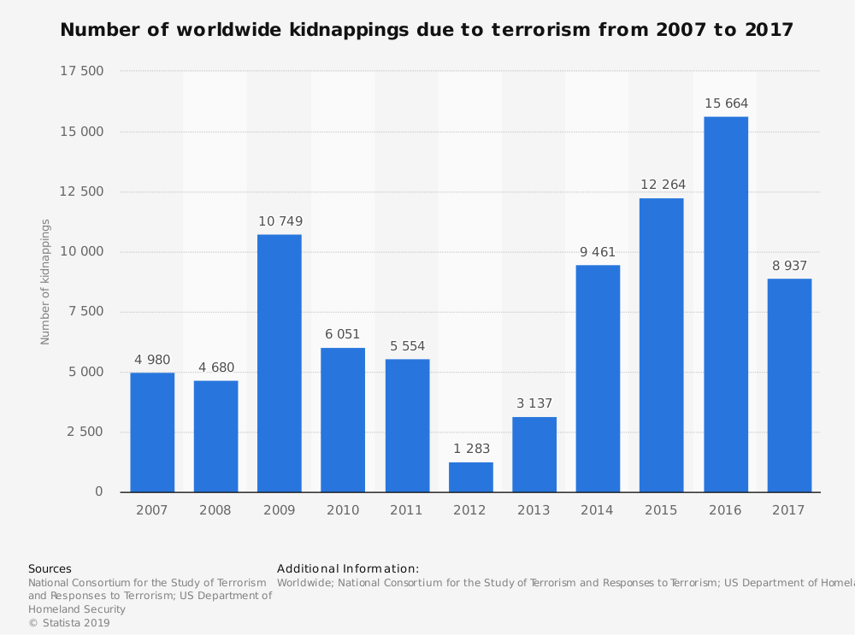
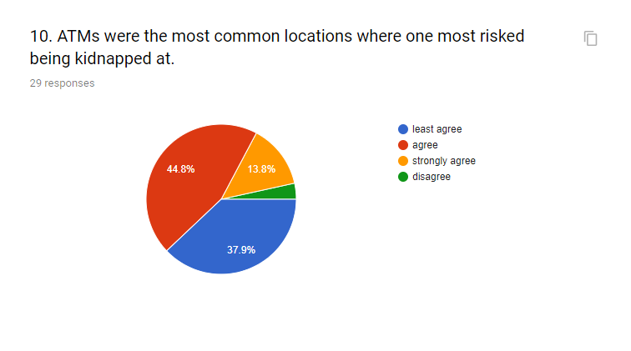
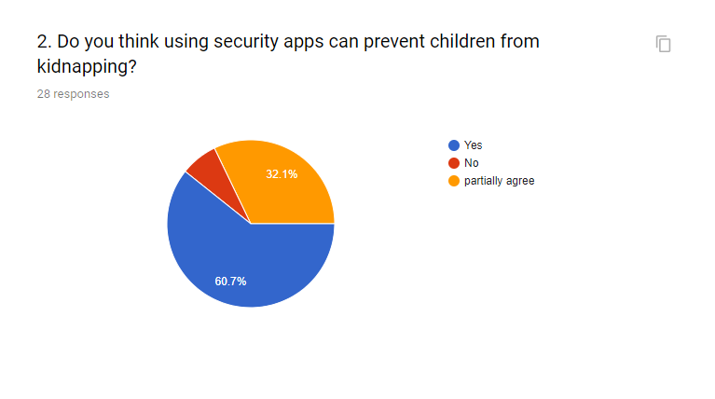
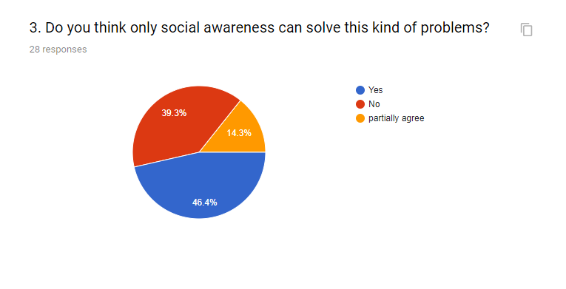
Problems
Some statical analysis on kidnapping

Slide 6
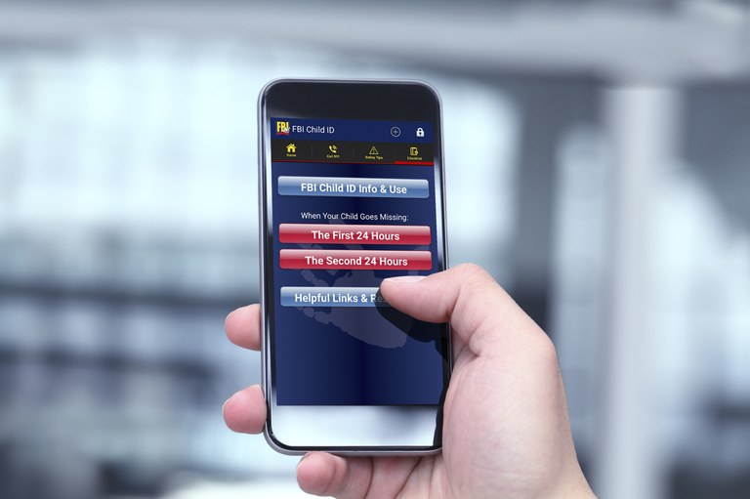
Implementation
Using app is the most easiest way to prevent this
> Emergency contacts
Emergency buttons in mobile devices

Slide 7
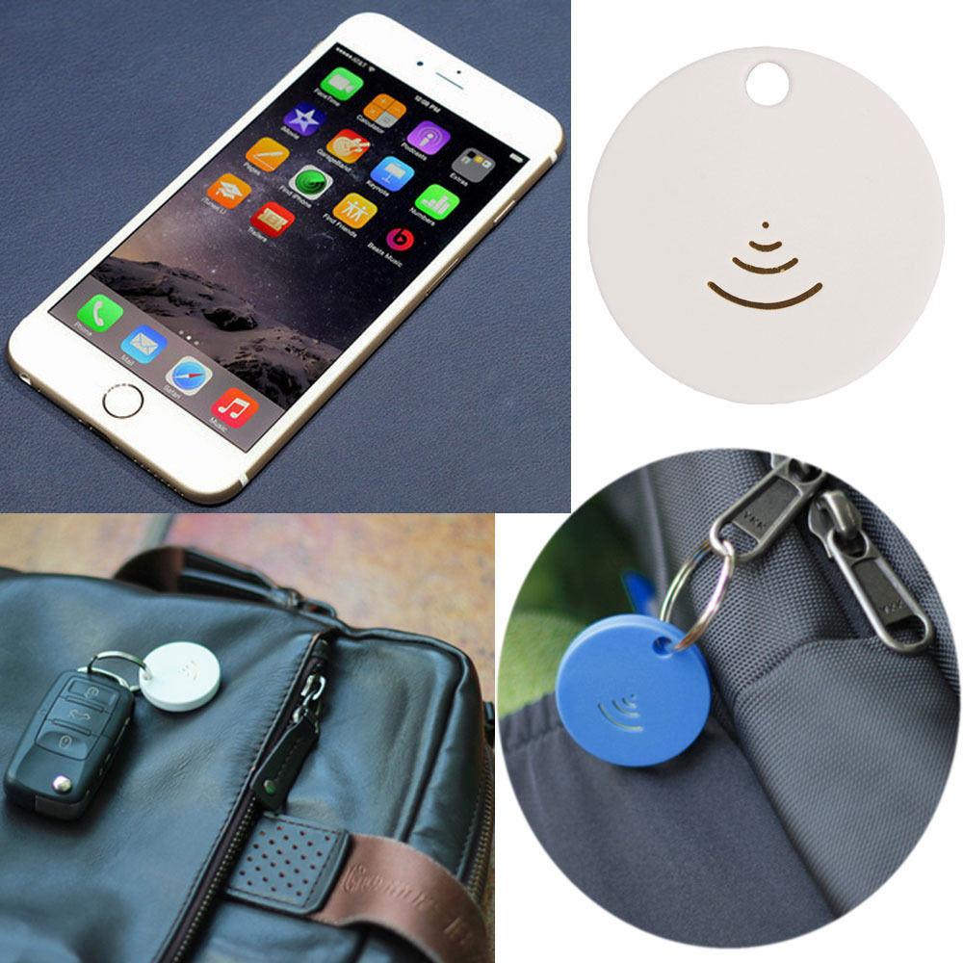
Implementation
GPS tracker
Social awareness

Slide 8
Limitations
operating hours count
System Restart
Drawbacks of users
Smart agent for alerting event

Slide 9
Limitations
Total operating hours counter. Counts the number of hours the module has been run in minute On-time minutes counter. Counts the seconds since last system start.
System Restart Cause. Power loss, BIOS Fail, Watchdog, Internal Reset, External Reset.
The proposed application works both online and offline, which processes irrespective of any signal strength and is also available in the play store. The victim can't contact more than 3 persons at once.
In such environment the role of CBI agent, which is a set of team member is vital. By clicking on this particular application, a message will be sent to this agent too. Sometimes the agent are late to reach at the crime point. GPS and traffic may cause this late arrival which may lead to criminal incident.

Slide 10
Advantages
User advantage
User friendly interface
Ensure security of users
Easy alert system

Slide 11
Advantages
Alert time advantage
Real time alert System
Live Location using GPS

Slide 12
Disadvantage
Mobile tracking
The major drawback of this service is its concern for privacy. Mobile phone companies can exploit the information that they gather and get a peek of the private lives of their customers. That information is liable to be sold to other companies for money which can be misused. But every mobile user can disable the location service so that the data is not available to mobile companies

Slide 13
Disadvantage
But it is recommended that you enable the location tracking service when you are in an isolated area or use a tracking service like the find my friend so that you are in touch with your friends or colleagues. Even if you disable the location service, the police and other emergency services can track you down to the location of the phone.

Slide 14
Thank you

