Slide 1

Directed Graph using
Adjacency Matrix
in C Language
Section : 20
Course : CSE106
Group : 1
STUDENT ID​ ​ | NAME​
2024-3-60-416​ | Rijona Rahman Orthy​
2024-3-60-338​ | Sumiya Akter Shomapti​
2024-3-60-394​ | Sahidul Islam​
2024-3-60-709​ | Monjurul Hasan​
2024-3-60-719​ | Samir Sarower Anin​
Presented to:
Sadia Nur Amin​
Lecturer, Department Of CSE​
East West University​

Slide 2
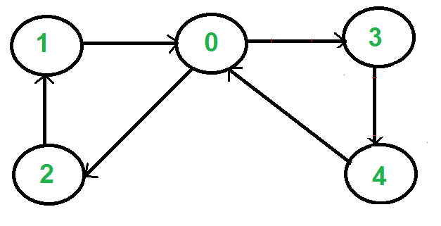
Directed Graph
A directed graph is defined as a type of graph where the edges have a direction associated with them.
E1
E2
V3
V1
V2
E6
E3
E5
E4
V5
V4

Slide 3
Representing Graphs
Graphs can mainly be represented in 2 ways. They are:
Adjacency List
Adjacency Matrix
Adjacency List : One way to represent a graph is to use adjacency lists, which specify the vertices that are adjacent to each
vertex of the graph.
Adjacency Matrix: Adjacency matrix, uses a square matrix to represent a graph by indicating whether pairs of vertices are adjacent.

Slide 4
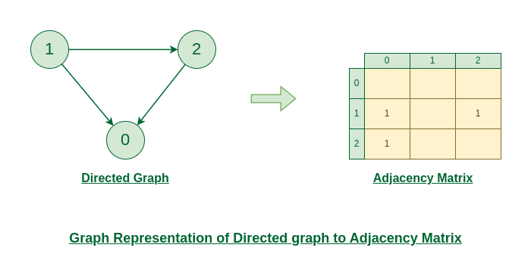
Adjacency Matrix
Here, rows represent the initial vertices and columns represent terminal vertices.
E1
0
0
0
E3
E2
0
0
0

Slide 5
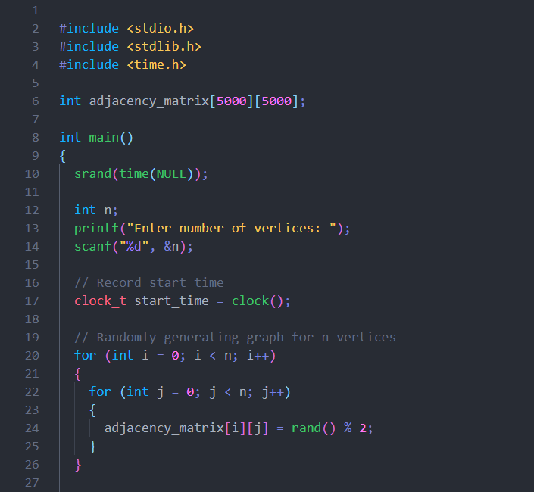
Source Code

Slide 6
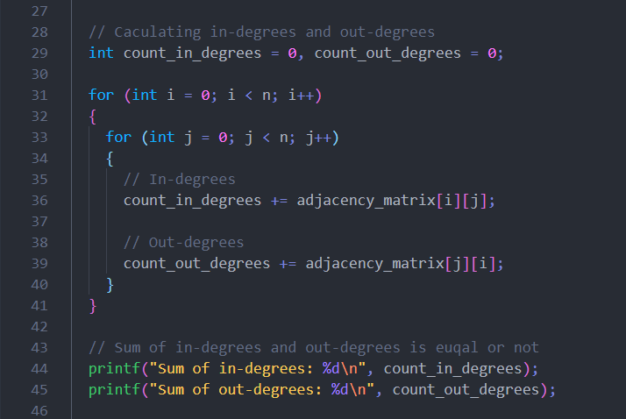
// Caculating in-degrees and out-degrees
int count_in_degrees = 0, count_out_degrees = 0;
for (int i = 0; i < n; i++)
{
for (int j = 0; j < n; j++)
{
// In-degrees
count_in_degrees += adjacency_matrix[i][j];
// Out-degrees
count_out_degrees += adjacency_matrix[j][i];
}
}
// Sum of in-degrees and out-degrees is euqal or not
printf("Sum of in-degrees: %d\n", count_in_degrees);
printf("Sum of out-degrees: %d\n", count_out_degrees);
Source Code

Slide 7
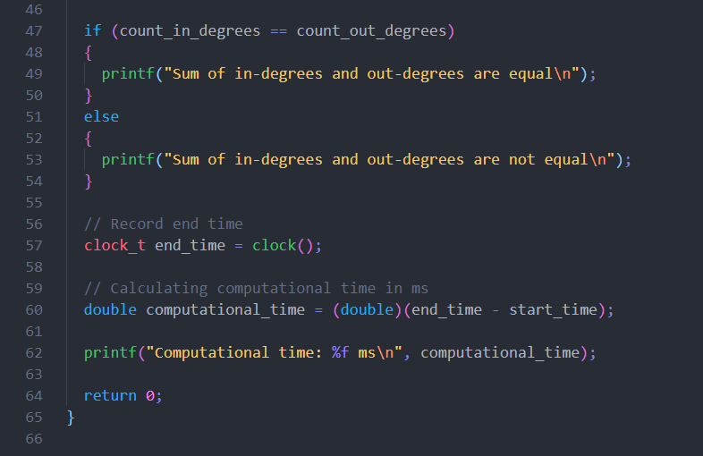
Source Code

Slide 8



Output

Slide 9


Output

Slide 10
Computational time VS Number of vertices

Slide 11
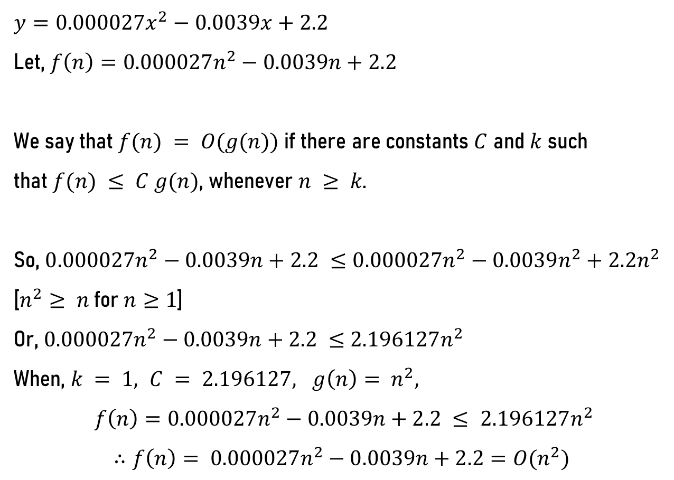
Time Complexity Determination (Practical)
$$y=0.000027x^{2}−0.0039x+2.2$$
Let, $f\left(n\right)=0.000027n^{2}−0.0039n+2.2$
We say that $f(n) = O(g(n))$if there are constants $C$ and $k$ such
that $f(n) ≤ C g(n)$, whenever $n ≥ k$.
So, $0.000027n^{2}−0.0039n+2.2 ≤0.000027n^{2}−0.0039n^{2}+2.2n^{2}$
[$n^{2}≥ n$for $n≥1$]
Or, $0.000027n^{2}−0.0039n+2.2 ≤$ $2.196127n^{2}$
When, $k = 1, C = 2.196127, g\left(n\right)= n^{2},$
$$f\left(n\right)=0.000027n^{2}−0.0039n+2.2 ≤ 2.196127n^{2}$$
$$∴f\left(n\right)= 0.000027n^{2}−0.0039n+2.2=O(n^{2})$$

Slide 12
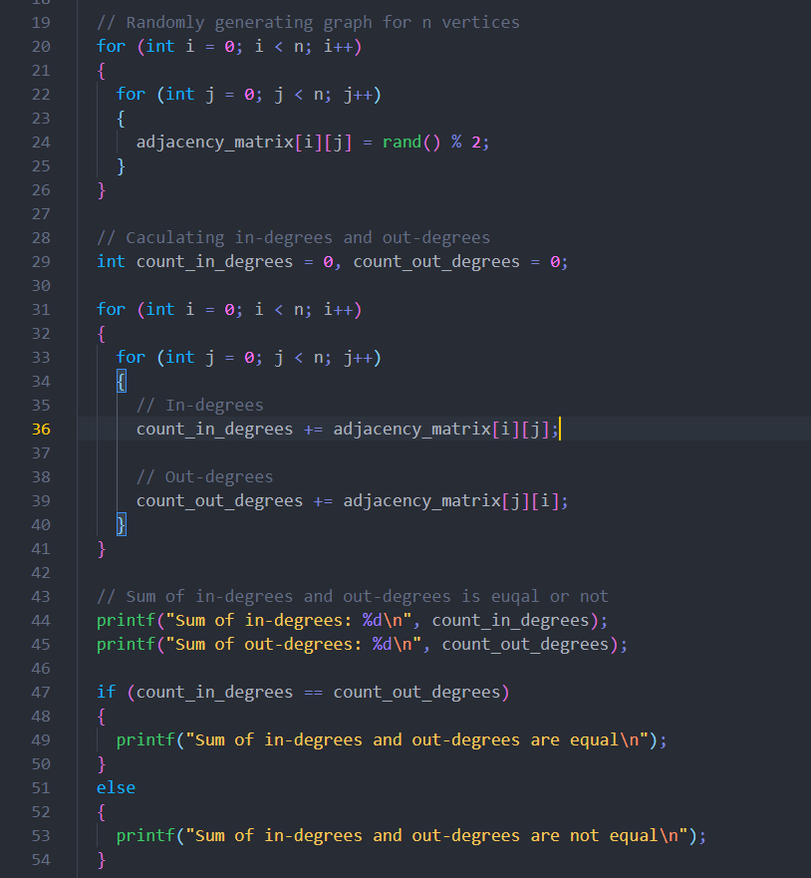
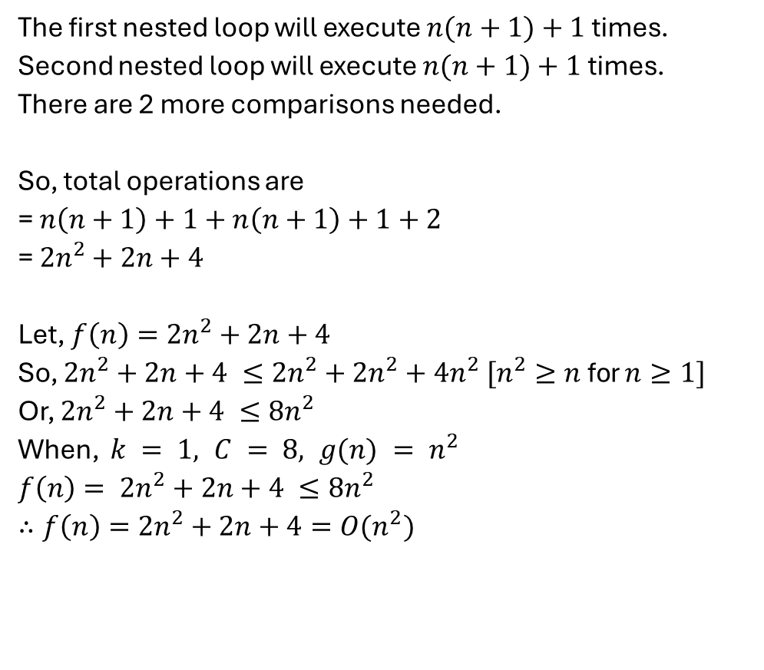
Time Complexity Determination (Theoretical)
The first nested loop will execute $n(n+1)+1$times.
Second nested loop will execute $n(n+1)+1$times.
There are 2 more comparisons needed.
So, total operations are
= $n\left(n+1\right)+1+n\left(n+1\right)+1+2$
= $2n^{2}+2n+4$
Let, $f\left(n\right)=2n^{2}+2n+4$
So, $2n^{2}+2n+4 ≤2n^{2}+2n^{2}+4n^{2} [n^{2}≥n$for $n≥1]$
Or, $2n^{2}+2n+4 ≤8n^{2}$
When, $k = 1, C = 8, g(n) = n^{2}$
$$f\left(n\right)= 2n^{2}+2n+4 ≤8n^{2}$$
$∴f\left(n\right)=2n^{2}+2n+4=O(n^{2})$

Slide 13
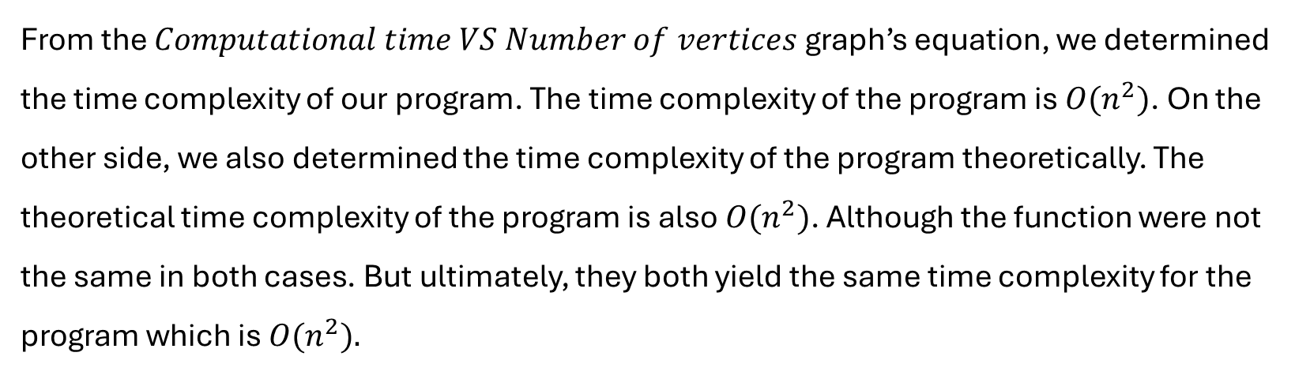
Comparison
From the $Computational time VS Number of vertices$ graph’s equation, we determined the time complexity of our program. The time complexity of the program is $O(n^{2})$. On the other side, we also determined the time complexity of the program theoretically. The theoretical time complexity of the program is also $O(n^{2})$. Although the function were not the same in both cases. But ultimately, they both yield the same time complexity for the program which is $O(n^{2}).$

Slide 14
Future Work
Optimize Algorithm:
Explore more efficient algorithms, such as adjacency lists for sparse graphs.
Scalability Analysis:
Evaluate scalability for datasets with millions of vertices.
Parallel Processing:
Implement parallel computation to speed up processing for large graphs.
Dynamic Graph Support:
Extend the program to handle dynamic graphs, enabling edge addition or removal without recomputation.
Alternative Applications:
Investigate adjacency matrix performance in network analysis and pathfinding

Slide 15
Conclusion
Summary:
The adjacency matrix is an effective representation for directed graphs, especially for dense graphs.
Computational time increases as the number of vertices grows, consistent with theoretical expectations.
Key Findings:
Practical time complexity aligns with the expected O(n²) due to nested iterations in the adjacency matrix.
Results validate the efficiency of the implemented algorithm for small-to-medium-sized graphs.
Future Prospects:
Optimizing the algorithm can significantly reduce processing time for larger datasets.
Exploring alternative representations like adjacency lists for sparse graphs is a promising direction.

Slide 16
Thank you for your attention!

