Slide 1
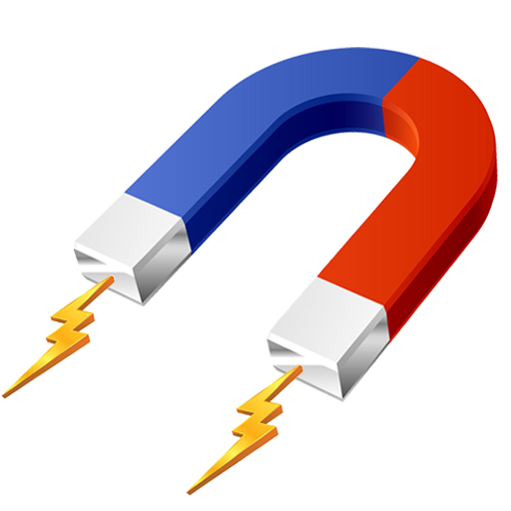



The role of electricity and magnetism in
Wireless communication
MD.Sahidul Islam 2024-3-60-394
Mohammad Mijan 2024-3-60-550
Nafisa Tasnim 2024-3-60-562
MD.Rahad Hasan Asif 2024-3-60-657
Presented to :
Dr. Sonia Akter Ema
Lecturer, Dept of MPS
East West University

Slide 2
1
What is Electricity and Magnetism
Electricity is the flow of electric charges, and magnetism is the force created by moving electric charges; together, they produce electromagnetic waves used in wireless communication.
2
How Electricity and Magnetism Work Together
Changing electric and magnetic fields create electromagnetic waves. These waves carry signals without wires..
Contents of this Presentation
What is Wireless Communication
Wireless communication is the transfer of information between two or more points without using wires or cables.
3
Real Life use of Wireless Communication
These waves are used in many wireless technologies like mobile phones, Wi-Fi, and radio broadcasting.
4
Presented to,
Sonia akter ema
Lecturer, dept of mps
East west university
md. Sahidul islam 2024-3-60-394
Mohammad mijan 2024-3-60-550
Nafisa tasnim 2024-3-60-562
md. Rahad hasan asif 2024-3-60-657
Conclusion
Electricity and magnetism create electromagnetic waves that make wireless communication possible in phones, Wi-Fi, and radio.
5

Slide 3









What is Electricity ?
Electricity is the flow of electric charges
usually electrons.
It moves through conductors like copper wires.
It can produce light, heat, motion, or signals.
Used in almost all modern devices and
communication systems.

Slide 4

What is Magnetism
Magnetism is a force produced by moving electric charges.
It can attract or repel certain materials like iron.
Every electric current creates a magnetic field around it.
Magnetism plays a key role in motors, generators, and wireless systems.

Slide 5




Magnetism X Electricity
When electric charges move, they create a magnetic field. When a magnetic field changes, it can create an electric current.
This interaction is called electromagnetism. Electromagnetism produces electromagnetic waves.
These waves can travel through space and carry signals — without wires.
This is how wireless communication becomes possible.

Slide 6
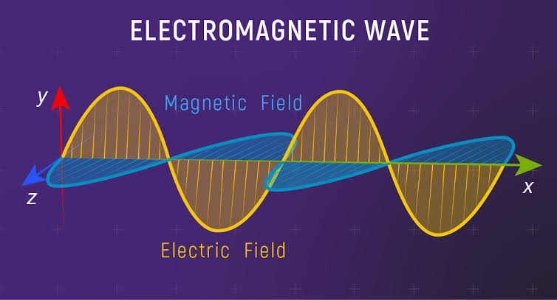
Magnetism X Electricity

Slide 7


What is Wireless communication
It is the transfer of data or signals without using wires or cables.
It uses electromagnetic waves (like radio, microwave, infrared).
These waves carry signals through the air or space.
Wireless systems include phones, Wi-Fi, Bluetooth, and radios.
It allows fast and remote communication over short and long distances.

Slide 8

Wireless Communication Example
Mobile Phones
How Mobile Phones Use Electromagnetic Waves
Phones use radio waves to send and receive signals.
When you call or text, your phone turns your voice or message into signals.
These signals travel as electromagnetic waves to the nearest cell tower.

Slide 9
Role of Electricity & Magnetism
Inside the phone, electricity moves through circuits.
This movement produces magnetic fields.
Together, they create radio waves that carry the message.

Slide 10
Wi-Fi
What is Wi-Fi ?
Wi-Fi is a wireless network technology that connects devices to the internet.
It uses radio waves to send data between devices and routers.
This allows devices like phones, laptops, and tablets to connect without cables

Slide 11
How Electricity & Magnetism Help Wi-Fi !!
Inside the Wi-Fi router, electric currents create changing magnetic fields.
These changing fields produce electromagnetic waves.
These waves carry data to and from your devices.
Why Wi-Fi is Important ??
Wi-Fi allows fast and easy internet access anywhere within range.
It helps connect many devices at once without wires.
This makes working, learning, and entertainment more convenient

Slide 12
Radio
What is Radio Broadcasting ??
Radio broadcasting sends audio signals wirelessly through radio waves.
Radio stations convert sound into electrical signals.
These signals are sent as electromagnetic waves through antennas.

Slide 13
Role of Electricity & Magnetism
Electric currents in the antenna create magnetic fields.
Changing electric and magnetic fields produce radio waves.
These waves travel long distances through the air
How Radios receive signals !!
Radios have antennas that catch radio waves.
These waves are converted back into electric signals.
The radio turns these signals into sound for you to hear.

Slide 14
Conclusion
Electricity and magnetism work together to create electromagnetic waves.
These waves carry information without wires.
Wireless communication includes mobile phones, Wi-Fi, and radio.
Thanks to electromagnetism, we can connect and communicate quickly and easily every day.

Slide 15
Thank you

Slide 16
Thank you

