Slide 1

HIGH CLOUDS AIRLINES ANALYSIS
Sohil Nadaf

Slide 2
CONTENTS
INTRODUCTION
BUSINESS OVERVIEW
PROJECT SCOPE
DATA MODEL CHALLENGES
DASHBOARD OVERVIEW
SUGGESTIONS AND COMMENTS

Slide 3

OBJECTIVE OF PROJECT
TO GAIN COMPREHENSIVE UNDERSTANDING OF “HIGH CLOUD AIRLINES ” OPERATIONS THROUGH DATA ANALYSIS.
INVOLVE INVESTIGATING LOAD FACTOR
IDENTIFYING TOP CARRIER NAMES BASED ON PASSENGER PREFERENCE
ANALYZING POPULAR ROUTES
EXPLORING OTHER KEY METRICS

Slide 4
Introduction
To revolutionize the airline industry through data driven insights and optimization and make data user-friendly .
High cloud airlines project aims to enhance the overall customer experience by delivering personalized services.
High clouds embraces innovation and modern technology to enhance operational efficiency and stay at the fore front of aviation landscape.

Slide 5
BUSINESS OVERVIEW
Data analysis plays a critical role in optimizing operations and maximizing profitability in todays competitive airline industry.
High cloud airlines can gain valuable insights into various aspects to make data driven decisions that can lead to :
IMPROVED LOAD FACTOR
ENHANCED PASEENGER EXPERIENCE
OPTIMISED RESOURCE ALLOCATION
DATA DRIVEN DECISION MAKING

Slide 6

PROJECT SCOPE
The specific scope of this project is focused on analyzing key performance indicators (KPIs) to gain a deeper understanding of :
LOAD FACTOR
PASSENGER PREFERENCES
POPULAR ROUTES
OPERATIONAL EFFICIENCY

Slide 7

DATA MODEL CHALLENGES Throughout our analysis we encountered many challenges in handling data
DATA VOLUME : Managing and processing large datasets efficiently
DATA QUALITY : Ensuring accuracy and reliability of data
COMPLEX RELATIONSHIP : Establishing connections between different data points

Slide 8
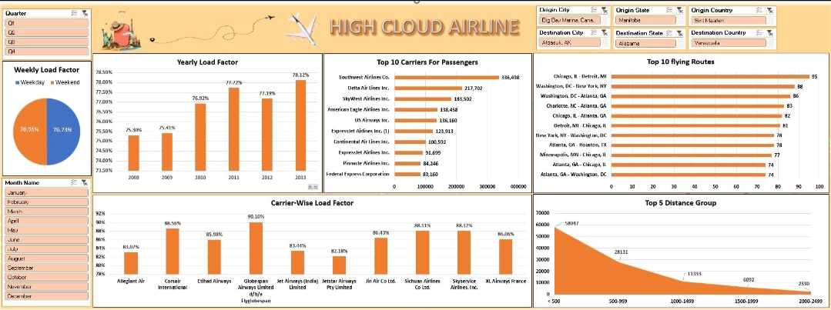
DASHBOARD 1: MS EXCEL

Slide 9
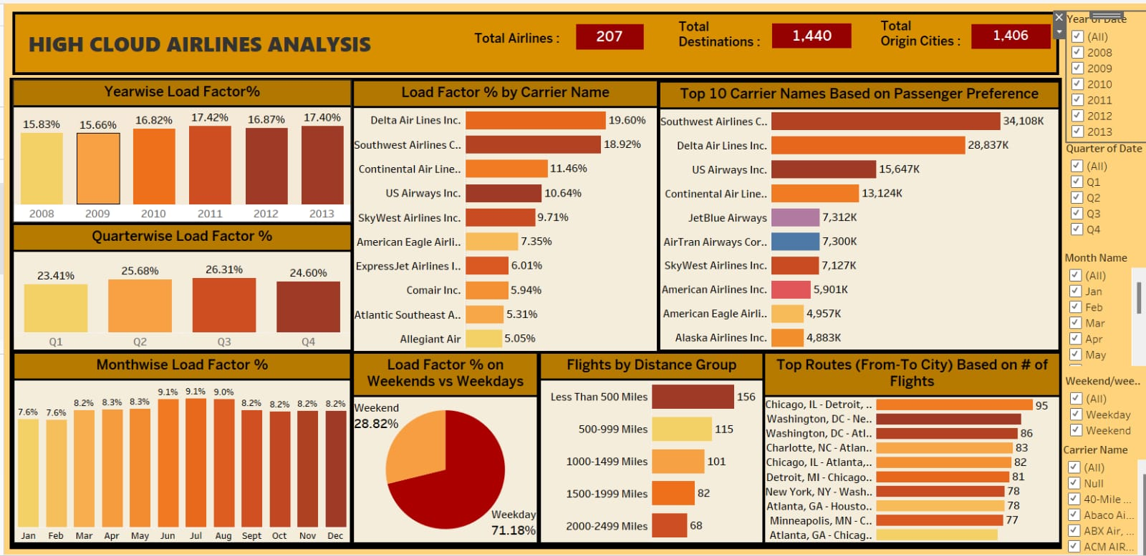
DASHBOARD 2 : TABLEAU

Slide 10
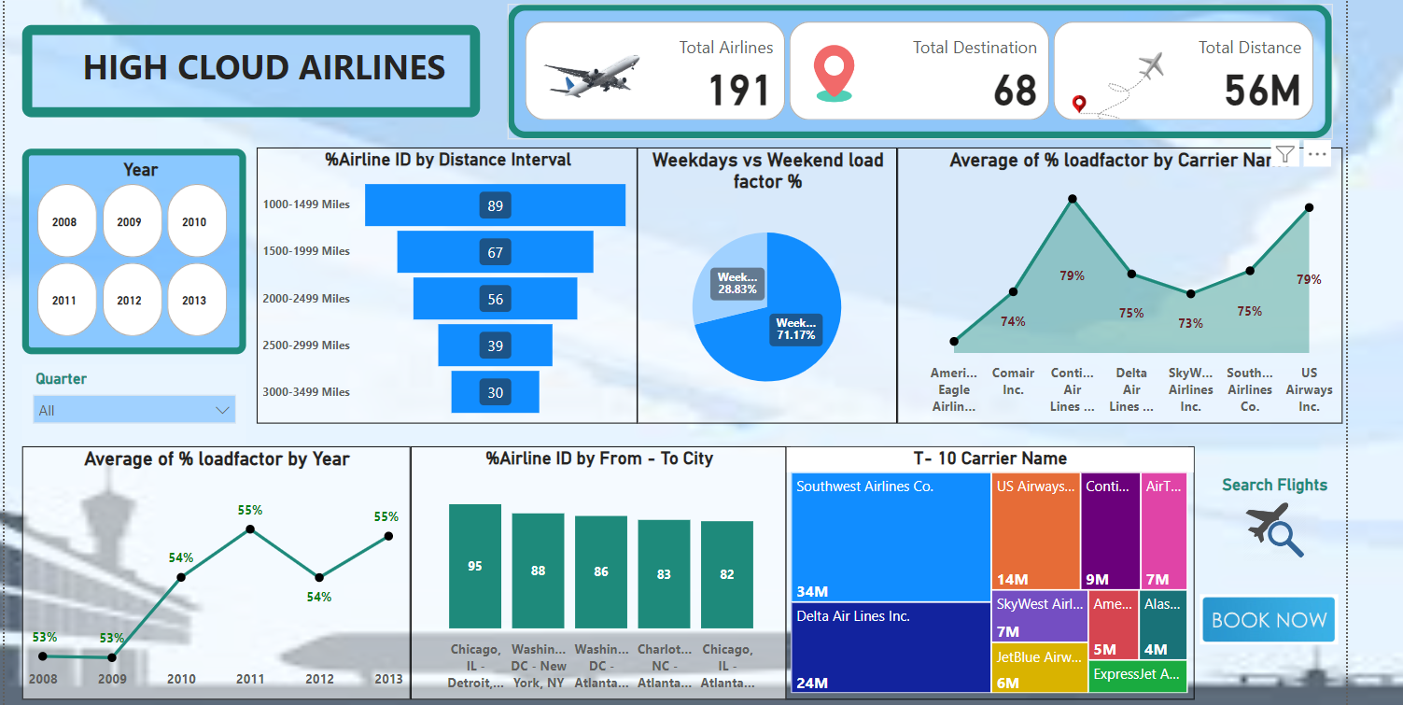
DASHBOARD 3: POWERBI

Slide 11
Dashboard Overview
Load factor is a key metric used for benchmarking an airline’s performance against competitors. Airlines may compare there load factor with industry averages to assess their relative position in the market.
Airlines uses load factor for strategic planning ,route optimization, and fleet management.
As per the analysis 2013 (17.40 ) has the highest load factor and 2009(15.66 )has the lowest load factor which impacts the airline financial performance .
Operating with consistency low load factor may lead to financial loses ,while maintain a high load factor contributes to profitability.
Also ,Delta airlines Inc. has the highest load which is 19.60 % with 28837k transported passengers and Southwest Airlines co has transported 34.108k with 18.92 % load factor.
Airlines known for consistently high load factor may be perceived as operationally efficient and capable of maximizing revenue through effective capacity utilization and can be the successful in revenue generation.
Passengers always associate crowded flights with popular routes and may choose carriers with higher load factors for a sense of reliability.

Slide 12
SUGGESTIONS AND COMMENTS
ROUTE OPTIMIZATION
CUSTOMER EXPERIENCE
SAFETY AND COMPLIANCE
SUSTAINABILITY INITIATIVES
MARKET EXPANSION
DIGITAL TRANSFORMATION

Slide 13
Conclusion
Analyzing airline data is pivotal for driving strategic decision making enhancing operational efficiency ,and ultimately ,fostering the overall success and competitiveness of the airlines industry .
By harnessing data analytics techniques ,airlines can extract valuable insight from diverse sources such as passengers booking ,flights performance metrics ,and customer feedback.
These insights inform decisions across various domains including route optimization ,pricing strategies ,fllet management.

Slide 14


