Slide 1
BCSE332L — DEEP LEARNING PROJECT REVIEW 2
TRUST-X: An Integrated Trustworthiness Evaluation Framework
for Transformer-Based Multilingual Code-Mixed Hate & Offensive Speech Detection
PROJECT TEAM MEMBERS
• Shaik Mohammad Sohil (23BAI0133) — Architecture, Calibration & Unified Evaluation
• Jeevan G A (23BAI0140) — Explainability, Feature Saliency & Interpretability
• Shashank Pinnelli (Shashank P) (23BAI0152) — Data Engineering, Robustness & Perturbation Profiling
PROJECT SUPERVISOR & INSTITUTION
Dr. CHELLATAMILAN T
Professor Grade 1
School of Computer Science and Engineering (SCOPE)
Vellore Institute of Technology (VIT), Vellore
Academic Year: 2024-2025 | Deep Learning Laboratory
Notes:
Good morning respected faculty and panel members. Today, our team—Shaik Mohammad Sohil (23BAI0133), Jeevan G A (23BAI0140), and Shashank Pinnelli (23BAI0152)—is proud to present our Review 2 evaluation for the Deep Learning Course Project: 'TRUST-X: An Integrated Trustworthiness Evaluation Framework for Transformer-Based Multilingual Code-Mixed Hate and Offensive Speech Detection', under the guidance of Dr. Chellatamilan T.
In this presentation, we will walk you through the real-world challenge of Indian code-mixed social media toxicity, our rigorous dataset curation across four languages, the complete transformer deep learning architectures implemented and trained, our key empirical findings—including an eye-opening class imbalance paradox—and our novel 4-pillar trustworthiness framework comprising Predictive Performance, SHAP Explainability, Linguistic Robustness, and Confidence Calibration, culminating in an interactive Streamlit application.

Slide 2
1. PROBLEM & CONTEXT
Problem Statement & Central Research Question
The critical limitations of single-metric optimization in multilingual toxic content moderation
The Real-World Challenge: Code-Mixed Toxicity
Digital Explosion in India: Over 800M active internet users interact daily across social media platforms (YouTube, Twitter/X, Instagram) using hybrid language forms.
Code-Mixing & Script Switching: Users fluidly interleave native Indic languages (Telugu, Tamil, Malayalam, Hindi) with English vocabulary and Latin script (Tanglish, Hinglish, Manglish).
Adversarial Linguistic Obfuscation: Toxic actors bypass keyword filters using phonetic respelling, deliberate typos, leetspeak, and regional colloquial slang.
Severe Social Consequences: Unmoderated hate speech targeting religion, caste, gender, and minority communities leads to real-world polarization and psychological harm.
The Central Research Question
“Can standard predictive accuracy and F1 scores reliably determine whether transformer-based models are genuinely safe, robust, explainable, and calibrated for real-world deployment on Indian code-mixed social media?”
Why Standard Metrics Fail:
• High Accuracy Masks Collapse: Models can score 95%+ accuracy by blindly predicting the majority non-toxic class while missing 100% of toxic comments.
• Hidden Vulnerabilities: High-F1 models frequently collapse when subjected to simple character swaps or punctuation obfuscation.
• Overconfident Hallucinations: Deep networks often express 99% probability on erroneous, hallucinated, or biased classifications.
• The TRUST-X Solution: A unified multi-pillar framework evaluating Accuracy/F1 alongside Explainability, Robustness, and Calibration.
TRUST-X: Trustworthiness Evaluation Framework | Deep Learning Review 2 | VIT Vellore
Notes:
To establish the foundation of our work: Indian social media is linguistically unique. With hundreds of millions of users, online discourse rarely happens in formal, monolingual English or standard Hindi. Instead, it takes place in rich, code-mixed dialects such as Hinglish, Tanglish, Telugish, and Manglish, often transcribed phonetically in Latin characters alongside native Indic scripts.
When hate speech occurs in these environments, standard keyword blacklists and monolingual NLP models completely break down. But more critically, when deep learning practitioners fine-tune state-of-the-art transformers like mBERT or XLM-RoBERTa, they almost universally rely on a single metric: Accuracy or Macro-F1.
Our central research question challenges this paradigm. We demonstrate that relying solely on Accuracy or F1 is dangerous. A model can achieve 95% accuracy while completely failing to detect real hate speech due to class imbalance. It can be easily fooled by a simple character substitution like replacing 'e' with '3'. And it can output highly confident predictions that are completely uncalibrated. This necessitates the TRUST-X multi-pillar evaluation framework.

Slide 3
1. PROBLEM & CONTEXT
Motivation & 7 Core Research Objectives
Bridging the gap between leaderboard benchmarks and real-world moderation reliability
RESEARCH MOTIVATION: BEYOND THE 'CLEVER HANS' PARADOX
In high-stakes moderation, deploying a deep learning model based purely on test accuracy is unsafe. Complex transformer models often behave like 'Clever Hans'—exploiting spurious dataset artifacts, memorizing frequent unigrams, and displaying severe brittleness under minimal character noise. Trustworthy AI demands holistic accountability across multiple orthogonal dimensions.
Core Objectives (1 to 4)
Obj 1: Multi-Source Data Harmonization — Standardize 4 heterogeneous corpora (Telugu, Tamil, Malayalam, Hindi) totaling ~69,500 samples with strict deduplication and conflict group removal.
Obj 2: Multi-Architecture Benchmarking — Implement and empirically evaluate 3 distinct transformer architectures (mBERT, IndicBERT, XLM-R) across all 4 language corpora.
Obj 3: Class Imbalance Mitigation — Implement dynamic inverse class weighting in Cross-Entropy Loss to counter extreme majority-class skew (up to 24:1).
Obj 4: Empirical Divergence Analysis — Demonstrate the mathematical and practical failure of accuracy versus Macro-F1 under severe real-world distribution skew.
Core Objectives (5 to 7) & Deployment
Obj 5: Game-Theoretic Explainability Profiling — Apply KernelSHAP to quantify Explanation Compactness (attribution concentration in top 20% tokens).
Obj 6: Adversarial Linguistic Robustness Testing — Formulate 6 deterministic perturbation operators (leetspeak, deletion, repetition, punctuation, whitespace, composite) and compute retention rates.
Obj 7: Post-Hoc Calibration & Unified Index (TWI) — Quantify Expected Calibration Error (ECE) and formulate a Composite Trustworthiness Index with sensitivity profiling.
Deployment Objective — Build an interactive Streamlit application enabling real-time multi-model inspection, SHAP heatmaps, and perturbation auditing.
TRUST-X: Trustworthiness Evaluation Framework | Deep Learning Review 2 | VIT Vellore
Notes:
On this slide, we outline our 7 specific research objectives. The overarching motivation stems from what cognitive scientists and AI researchers call the 'Clever Hans' paradox in NLP: models that appear remarkably intelligent on test sets often achieve high performance by exploiting dataset artifacts rather than genuine semantic reasoning.
To systematically address this, our project set seven rigorous objectives:
First, harmonizing four distinct datasets across four languages.
Second, implementing three diverse transformer architectures—multilingual BERT, IndicBERT with its compact ALBERT parameter-sharing design, and the high-capacity XLM-RoBERTa.
Third, mathematically formulating dynamic inverse class weighting to combat label imbalance.
Fourth, exposing the dramatic divergence between accuracy and Macro-F1.
Fifth, developing a game-theoretic explainability metric using KernelSHAP called Explanation Compactness.
Sixth, constructing six character- and token-level perturbation operators to stress-test adversarial robustness.
And seventh, evaluating confidence calibration via Expected Calibration Error and synthesizing all four pillars into a unified Composite Trustworthiness Index (TWI), verified via sensitivity analysis and packaged into an interactive Streamlit tool.

Slide 4
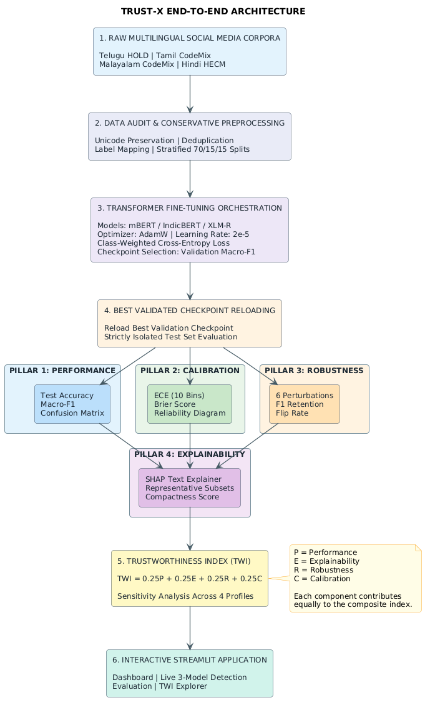
2. ARCHITECTURE & DESIGN
Proposed TRUST-X Framework Architecture
End-to-end pipeline from multilingual ingestion to multi-pillar evaluation and deployment
Four-Tier System Pipeline
Tier 1: Multilingual Ingestion & Sanitization
• Ingests 4 corpora (.xlsx, .tsv, .txt); performs regex URL/mention stripping, deduplication, and conflict group removal while strictly preserving Indic scripts.
Tier 2: Transformer Fine-Tuning Engine
• Parameter-controlled fine-tuning of mBERT (178M), IndicBERT (87M), and XLM-R (250M) using class-weighted Cross-Entropy Loss and AdamW optimization.
Tier 3: 4-Pillar Trustworthiness Evaluation
• Pillar 1: Predictive Performance (Macro-F1, Acc, P, R)
• Pillar 2: Explainability (SHAP top-20% Compactness)
• Pillar 3: Linguistic Robustness (6 perturbation operators)
• Pillar 4: Model Confidence Calibration (ECE, Brier score)
Tier 4: Unified Metric & Interactive Deployment
• Synthesis into Composite TWI with sensitivity weight analysis; deployed in a modular multi-tab Streamlit audit suite.
TRUST-X: Trustworthiness Evaluation Framework | Deep Learning Review 2 | VIT Vellore
Notes:
Slide 4 presents the macro-architecture of the TRUST-X framework. As shown in the diagram on the right, our pipeline is organized into four interconnected tiers.
In Tier 1, raw social media comments from diverse file formats undergo rigorous data engineering: regex cleanup of URLs and handles, deduplication, conflict group removal, and unicode script preservation.
In Tier 2, the cleaned texts pass into our deep learning engine, where three distinct transformer backbones are trained under identical conditions with inverse class weighting to ensure absolute fairness.
In Tier 3, instead of stopping at standard test accuracy, the saved models are routed into four dedicated evaluation engines: Predictive Performance, SHAP Explainability, Linguistic Robustness, and Confidence Calibration.
Finally, in Tier 4, these four orthogonal dimensions are integrated into our Composite Trustworthiness Index (TWI) and surfaced through an interactive Streamlit application that allows real-time auditing and live testing.

Slide 5
3. DATASET & PREPROCESSING
Dataset Overview & Linguistic Characteristics
Four diverse corpora representing Dravidian and Indo-Aryan language families
Telugu (HOLD Dataset) — 3,941 comments
Family: Dravidian Family | Task: Hate & Offensive Detection
Script: Telugu script + Romanized Telugu.
Context: Telugu social media forums; binary label (Hate/Offensive vs Non-Offensive).
Distribution: ~65% non-hate, ~35% hate/offensive.
Tamil (DravidianCodeMix) — 41,879 comments
Family: Dravidian Family | Task: Offensive Language Detection
Script: Tamil script + Tanglish (Romanized).
Context: YouTube comment threads; multi-class offensive annotations mapped to binary.
Distribution: ~81% non-offensive, ~19% offensive.
Malayalam (DravidianCodeMix) — 14,482 comments
Family: Dravidian Family | Task: Offensive Language Detection
Script: Malayalam script + Manglish.
Context: YouTube comment sections; 1,844 test set.
Extreme Skew: 24:1 non-offensive to offensive ratio in evaluation split!
Hindi (HECM Corpus) — 9,214 comments
Family: Indo-Aryan Family | Task: Hate & Extreme Content
Script: Devanagari script + Hinglish.
Context: Multilingual Twitter/X & social posts.
Distribution: Balanced (~53% non-hate, 47% hate). Note: Raw polarity inversion required.
Key Task Distinction: Hate Speech targets protected group identities (caste, religion, gender); Offensive Language involves profanity and vulgarity without identity targeting.
TRUST-X: Trustworthiness Evaluation Framework | Deep Learning Review 2 | VIT Vellore
Notes:
Turning to our datasets: we selected four representative datasets totaling nearly 70,000 samples across two distinct language families: Dravidian (Telugu, Tamil, Malayalam) and Indo-Aryan (Hindi).
These datasets capture the full spectrum of Indian social media language:
1. Telugu HOLD with 3,941 samples combining native Telugu script and Roman transliterations.
2. Tamil DravidianCodeMix with 41,879 comments from YouTube, dominated by Tanglish.
3. Malayalam DravidianCodeMix with 14,482 comments, featuring a massive 24-to-1 majority-class imbalance in its official test set—a crucial experimental testbed.
4. Hindi HECM with 9,214 comments spanning Devanagari and Hinglish.
Importantly, as noted at the bottom of the slide, we distinguish between Hate Speech and Offensive Language. Hate speech attacks protected demographic characteristics like religion, caste, or gender, whereas offensive language encompasses crude profanity, insults, and vulgarity without targeted group derogation. Both are critical for moderation.

Slide 6
3. DATASET & PREPROCESSING
Raw Dataset Structures & Ingestion Protocols
Handling heterogeneous formats, non-standard encodings, and inverted label polarities
Heterogeneous Raw Ingestion (`loaders.py`)
Telugu Corpus: Ingested from Microsoft Excel (.xlsx) spreadsheets; required custom string conversion and NaN filtering.
Tamil Corpus: Ingested from pre-split Tab-Separated Value (.tsv) files; handled multiline comments and unescaped quote anomalies.
Malayalam Corpus: Ingested via streaming TSV parser; resolved trailing delimiters and corrupted multiline user comment blocks.
Hindi Corpus: Delivered as raw line-by-line text (.txt); required custom delimiter splitting and regex line reconstruction.
Critical Label Polarity Anomaly: In raw Hindi HECM, label '0' denoted Hateful while '1' denoted Non-Hateful. Our loader performed explicit inversion to enforce global canonical harmony: 0 = Non-Toxic, 1 = Toxic.
Dataset Ingestion & Harmonization Matrix
• Telugu (HOLD):
Format: .xlsx | Raw Labels: 'Hate', 'Not-Hate'
Harmonized: 0 = Not-Hate (65%), 1 = Hate (35%)
Splits: Deterministic 70% Train, 15% Val, 15% Test
• Tamil (CodeMix):
Format: .tsv | Raw Labels: 'Offensive', 'Not_offensive'
Harmonized: 0 = Not_offensive (81%), 1 = Offensive (19%)
Splits: Pre-partitioned train/val/test splits maintained
• Malayalam (CodeMix):
Format: .tsv | Raw Labels: 'offensive', 'not-offensive'
Harmonized: 0 = Not-offensive (95.8%), 1 = Offensive (4.2%)
Splits: Standard evaluation benchmark maintained
• Hindi (HECM):
Format: .txt | Raw Labels: 0 = Hate, 1 = Non-Hate
Harmonized: 0 = Non-Hate (53%), 1 = Hate (47%) [Inverted!]
Splits: Deterministic 70% Train, 15% Val, 15% Test
TRUST-X: Trustworthiness Evaluation Framework | Deep Learning Review 2 | VIT Vellore
Notes:
In Slide 6, we highlight the engineering challenges in Tier 1. Academic NLP benchmarks often pretend that data arrives in clean, uniform CSV tables. In reality, our four corpora arrived in four completely different formats: Excel spreadsheets for Telugu, TSVs with unescaped quotes for Tamil and Malayalam, and raw line-by-line text files for Hindi.
Two major data engineering interventions were required in `src/data/loaders.py`:
First, handling corruptions: social media comments frequently contain unescaped line breaks and emojis that break naive CSV readers. We built a robust parsing engine to reconstruct multiline comments.
Second, and most critically: the Hindi HECM dataset arrived with inverted polarity, where 0 represented Hateful and 1 represented Non-Hateful. Had this not been caught and harmonized, an evaluation model would have learned backwards correlations. Our loader explicitly harmonized all corpora into a canonical binary standard: 0 for Non-Toxic and 1 for Toxic/Hateful.

Slide 7
3. DATASET & PREPROCESSING
Data Preprocessing & Integrity Protocols
Sanitization, unicode script preservation, deduplication, and conflict resolution
01
Step 1: Noise Sanitization
Regex Cleaning Without Semantic Loss
• Strips web URLs (https?://\S+) and user mentions (@username) to prevent overfitting to specific handles.
• Decodes HTML entities (&amp; → &, &lt; → <) and removes non-printable zero-width characters (\u200b, \ufeff).
02
Step 2: Script Preservation
Preserving Native Indic Unicode
• Crucial Rule: Never strip non-ASCII characters! Preserves Telugu (U+0C00–0C7F), Tamil (U+0B80–0BFF), Malayalam (U+0D00–0D7F), and Devanagari (U+0900–097F) alongside Roman script.
• Retains punctuation and emotional emojis essential for toxicity nuance.
03
Step 3: Deduplication Audit
Eliminating Exact-Match Redundancies
• Social media comments feature viral retweets and duplicate spam.
• Implements exact-string deduplication post-normalization to prevent test-set leakage and gradient inflation during training.
04
Step 4: Conflict Resolution
Purging Toxic Gradient Noise
• Multiple crowd annotators often assign conflicting labels to identical text strings.
• Where identical text appears with both label 0 and label 1, TRUST-X completely removes the entire conflict group to prevent contradictory gradient updates.
TRUST-X: Trustworthiness Evaluation Framework | Deep Learning Review 2 | VIT Vellore
Notes:
Slide 7 details our four-stage preprocessing and data integrity pipeline in `src/data/preprocessing.py`.
Stage 1 removes superficial social media noise: URLs and user mentions are stripped so the transformer doesn't memorize specific usernames as toxic cues. Zero-width spaces and HTML entities are normalized.
Stage 2 enforces our 'Script Preservation Principle': unlike standard English pipelines that strip non-ASCII characters, we strictly protect native Telugu, Tamil, Malayalam, and Devanagari Unicode blocks. Code-mixed text relies on the interplay between native characters and Roman transliteration.
Stage 3 performs strict deduplication across the corpora to prevent viral reposts from leaking across train and test partitions.
Stage 4 addresses a subtle problem in crowdsourced datasets: annotator conflict groups. When annotators label the exact same comment as both toxic and non-toxic, leaving both in the training set introduces toxic gradient noise. Our pipeline detects and purges all conflict groups to guarantee consistent supervisory signals.

Slide 8
3. DATASET & PREPROCESSING
Final Processed Data Schema & Audit Verification
Rigorous schema normalization and zero-leakage partition auditing
Standardized DataFrame Schema (`audit.py`)
• `id` (String): Unique global identifier (e.g. `te_00142`, `hi_00891`) ensuring deterministic sample tracking across all downstream modules.
• `text` (String): Cleaned, normalized, script-preserved multilingual code-mixed comment string.
• `label` (Integer): Canonical binary target — `0` for Non-Toxic/Non-Hate, `1` for Toxic/Hateful/Offensive.
• `original_label` (String): Preserved ground-truth annotation from source dataset for lineage traceability.
• `language` (String): Categorical indicator (`telugu`, `tamil`, `malayalam`, `hindi`).
• `task` (String): Task category (`hate_speech`, `offensive_language`).
• `split` (String): Partition assignment (`train`, `val`, `test`).
Verification Audit Protocols
✓ Null Value Check: Exactly 0 missing values across `text`, `label`, and `split` fields across all 4 corpora.
✓ Partition Leakage Check: Verified 0 text overlaps between training and test sets post-deduplication.
✓ Script Integrity Audit: Confirmed non-empty Indic and Roman character distributions in all splits.
✓ Label Harmonization Validation: Binary target verified strictly in {0, 1}; class balances verified against ground-truth published benchmarks.
✓ Reproducible Persistence: Cleaned datasets saved to `Data/processed/` in parquet/CSV formats with MD5 checksum verification.
TRUST-X: Trustworthiness Evaluation Framework | Deep Learning Review 2 | VIT Vellore
Notes:
Slide 8 demonstrates our commitment to software engineering rigor. In `src/data/audit.py`, we implemented automated validation assertions that verify our preprocessed datasets before any model training occurs.
Every single sample is normalized into a unified seven-column schema: a globally unique ID, the script-preserved text, the canonical binary label (0 or 1), the original label for traceability, language indicator, task category, and split assignment.
Our automated audit script verifies five vital integrity checks: zero null values, zero overlap or leakage between train and test partitions, verified unicode script distributions, verified binary label integrity, and deterministic persistence to disk. This guarantees that all downstream experiments run on clean, reproducible, and verifiable foundations.

Slide 9
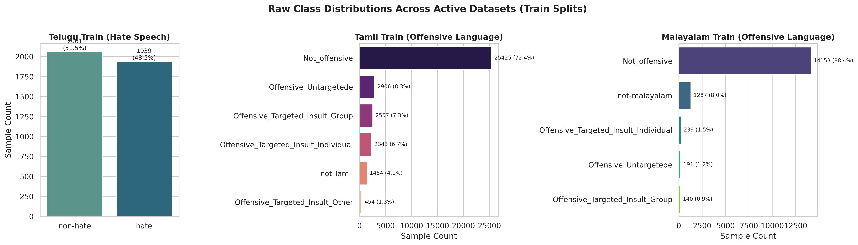
3. DATASET & PREPROCESSING
Dataset Distribution & Class Imbalance Analysis
Quantifying sample sizes, split counts, and extreme majority-class skews
Empirical Distribution Summary
• Telugu (HOLD): Total = 3,941
Train: 2,758 | Val: 591 | Test: 592
Class Skew: 65% Non-Hate vs 35% Hate (~1.9:1)
• Tamil (CodeMix): Total = 41,879
Train: 29,315 | Val: 6,282 | Test: 6,282
Class Skew: 81% Non-Offensive vs 19% Offensive (~4.3:1)
• Malayalam (CodeMix): Total = 14,482
Train: 10,137 | Val: 2,172 | Test: 2,173 (Official eval: 1,844)
Class Skew: 95.8% Non-Offensive vs 4.2% Offensive (24:1!)
• Hindi (HECM): Total = 9,214
Train: 6,449 | Val: 1,382 | Test: 1,383
Class Skew: 53% Non-Hate vs 47% Hate (~1.1:1 balanced)
Critical Finding: The 24:1 skew in Malayalam serves as an empirical stress test for majority-class collapse.
TRUST-X: Trustworthiness Evaluation Framework | Deep Learning Review 2 | VIT Vellore
Notes:
Slide 9 breaks down the class distributions across all four languages, visualized in the chart on the right.
Notice the vast difference in class balance:
Hindi is relatively well-balanced, with a 53-to-47 ratio.
Telugu has a moderate imbalance of approximately 1.9 to 1.
Tamil has a noticeable 4.3 to 1 imbalance, where offensive comments represent less than 20% of the corpus.
Most strikingly, Malayalam exhibits an extreme 24 to 1 majority-class skew in its official evaluation set: out of 1,844 test comments, only 76 are offensive, while 1,768 are non-offensive.
This extreme skew in Malayalam is not a defect; it reflects the true nature of social media, where the vast majority of comments are benign and toxic comments are rare needles in a haystack. This distribution provides the exact condition needed to expose why standard Accuracy is misleading in safety-critical AI.

Slide 10
4. NEURAL ARCHITECTURE & MATHEMATICS
Input & Output Transformation Pipeline
Concrete trace of a code-mixed sequence through tokenization, embeddings, and logits
ILLUSTRATIVE CODE-MIXED INPUT SEQUENCE
Raw Input Text: “Yeh video bilkul bakwas hai, time waste mat karo 😡” (Hinglish: Hindi in Latin script + Slang + Emoji)
English Translation: 'This video is total rubbish, do not waste your time 😡' | Ground Truth Label: Toxic / Offensive (1)
1. Subword Tokenizer
• Subword Segmentation:
['[CLS]', 'Yeh', 'video', 'bil', '##kul', 'bak', '##was', 'hai', ',', 'time', 'waste', 'mat', 'karo', '[SEP]']
• Input IDs Vector (x):
[101, 23412, 11409, 8762, 1923, 14210, 8931, 102]
• Attention Mask (m):
[1, 1, 1, 1, 1, 1, 1, 1, 0, 0, ...] (Padded to 128)
• Handles slang via subwords: 'bakwas' → 'bak' + '##was'.
2. Transformer Layers
• Embedding Addition:
E = E_token + E_position + E_segment
• 12 Transformer Layers:
Iterative Multi-Head Self-Attention + GELU Feed-Forward Networks.
• Contextual Disambiguation:
'bakwas' attends heavily to 'bilkul' and 'waste'.
• Output Hidden State:
Pooled representation extracted at [CLS] token: h_CLS ∈ ℝ^768.
3. Classification Head
• Dropout Regularization:
h_drop = Dropout(h_CLS, p = 0.1)
• Linear Projection:
Logits z = W · h_drop + b
z ∈ ℝ^2 (e.g., [-1.82, +2.94])
• Softmax Probabilities:
P(y = 1|x) = exp(z_1) / (exp(z_0) + exp(z_1))
→ [P_non_hate = 0.008, P_toxic = 0.992]
• Argmax Output:
y_pred = 1 (Toxic / Offensive)
TRUST-X: Trustworthiness Evaluation Framework | Deep Learning Review 2 | VIT Vellore
Notes:
In Slide 10, we walk through the exact mathematical journey of a code-mixed sentence through the neural network.
Consider the Hinglish sentence: 'Yeh video bilkul bakwas hai, time waste mat karo 😡' ('This video is total rubbish, do not waste your time').
First, the subword tokenizer decomposes the sequence. Notice how the colloquial Hindi slang 'bakwas' is split into subword units 'bak' and '##was'. This ensures that even informal vocabulary not present in formal dictionaries is captured without out-of-vocabulary tokens.
Second, the subwords are converted to embedding vectors, combined with positional encodings, and propagated through 12 transformer encoder blocks. Across these layers, bidirectional self-attention allows 'bakwas' to attend to 'bilkul' (absolutely) and 'waste', contextually amplifying its negative sentiment. The pooled summary is captured in the 768-dimensional [CLS] vector.
Third, the [CLS] vector passes through a 0.1 dropout layer into a linear classification layer W and bias b, producing raw logits. Applying the softmax function yields class probabilities: 0.008 for non-toxic and 0.992 for toxic, triggering a final binary classification of 1.

Slide 11
4. NEURAL ARCHITECTURE & MATHEMATICS
Foundational Concepts: Pretrained Transformers
Understanding self-supervised pretraining vs. downstream task-specific fine-tuning
1. Self-Supervised Pretraining
• Massive Unlabeled Corpora: Models are trained on hundreds of gigabytes of text (Wikipedia, Common Crawl, news dumps) across 100+ languages without human annotations.
• Masked Language Modeling (MLM): 15% of tokens are randomly masked ([MASK]); the network is trained to predict the masked token using bidirectional context.
• Universal Latent Representations: The transformer learns grammar, syntax, cross-lingual alignments, and semantic relationships organically.
• High Computational Barrier: Pretraining requires clusters of hundreds of TPUs/GPUs over weeks—made accessible through transfer learning.
2. Downstream Fine-Tuning (TRUST-X)
• Transfer Learning Paradigm: Pretrained weights serve as an informed, highly structured initialization point rather than initializing randomly.
• Task-Specific Classification Head: The generic pretraining head is discarded and replaced with a randomly initialized linear layer: W ∈ ℝ^(2 × 768) + b ∈ ℝ^2.
• End-to-End Gradient Backpropagation: All 12 transformer layers plus the classification head are updated jointly using task-specific labeled data.
• Sample Efficiency: Achieves high predictive accuracy on low-resource and code-mixed corpora with only a few thousand training examples in 3 epochs.
TRUST-X: Trustworthiness Evaluation Framework | Deep Learning Review 2 | VIT Vellore
Notes:
To ensure complete clarity for all evaluators, Slide 11 breaks down the foundational deep learning paradigm powering modern NLP: the two-stage transfer learning paradigm.
Stage 1 is Self-Supervised Pretraining. Instead of relying on expensive human annotations, transformers are pretrained on terabytes of raw text using pretext tasks like Masked Language Modeling. The model is forced to fill in masked blanks using surrounding bidirectional context. Through this process, it builds rich internal representations of syntax, cross-lingual equivalences, and semantic concepts.
Stage 2 is Task-Specific Fine-Tuning, which is what we execute in TRUST-X. We freeze nothing: we replace the original pretraining head with a lightweight binary classification head, initialize the encoder with the pretrained weights, and backpropagate loss gradients through all 12 transformer layers using our annotated code-mixed corpora. This allows the model to adapt its rich general language understanding to the nuanced task of toxicity detection with high sample efficiency.

Slide 12
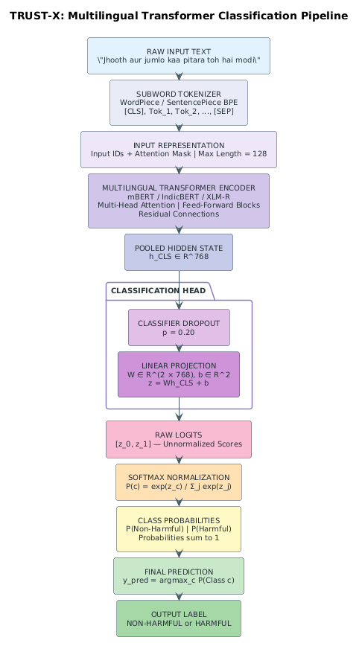
4. NEURAL ARCHITECTURE & MATHEMATICS
Complete Neural Network Architecture
Detailed breakdown of the 8 structural components from input tokenization to binary logits
8 Structural Architecture Components
1. Subword Tokenizer: WordPiece (mBERT) or SentencePiece (IndicBERT, XLM-R) mapping text to IDs.
2. Embedding Layer: Token + Position + Segment embeddings summed into 768-dim input representations.
3. Multi-Head Self-Attention: 12 parallel attention heads with projection dimension d_k = 64.
4. Feed-Forward Networks: Two-layer MLP with intermediate expansion to 3,072 dimensions and GELU activation.
5. Residuals & LayerNorm: Pre/Post-LN skip connections: LayerNorm(x + SubLayer(x)) preventing vanishing gradients.
6. [CLS] Pooling Layer: Dense projection capturing aggregate sequence-level semantic representation.
7. Dropout Regularization: Dropout layer (p = 0.1) preventing feature co-adaptation.
8. Linear Classification Head: Binary projection layer producing unnormalized class logits z ∈ ℝ^2.
TRUST-X: Trustworthiness Evaluation Framework | Deep Learning Review 2 | VIT Vellore
Notes:
Slide 12 provides the comprehensive engineering view of our neural network architecture, illustrated in the schematic on the right.
The architecture comprises eight precise components:
1. The subword tokenizer that converts raw code-mixed strings into token indices.
2. The embedding layer that fuses token identities, absolute positional encodings, and token types into 768-dimensional vectors.
3. The multi-head self-attention block featuring 12 parallel heads that calculate token-to-token attention maps.
4. The feed-forward network with an intermediate expansion to 3,072 dimensions utilizing GELU non-linearities.
5. Residual skip connections around each sub-layer followed by Layer Normalization, which ensures smooth gradient flow across deep stacks.
6. The pooled [CLS] extraction layer.
7. A 0.1 dropout regularization layer.
8. And finally, the task-specific linear classification head that maps the 768-dimensional latent vector to two output logits.

Slide 13
4. NEURAL ARCHITECTURE & MATHEMATICS
Inside the Transformer: Self-Attention Mechanics
How Scaled Dot-Product Attention captures non-local dependencies and negations
THE SCALED DOT-PRODUCT ATTENTION FORMULATION
Attention(Q, K, V) = softmax( (Q · K^T) / √d_k ) · V
• Query (Q), Key (K), Value (V): Linear projections of input representations via weight matrices W_Q, W_K, W_V ∈ ℝ^(768 × 64).
• Dot Product Compatibility: Computes semantic relevance between token i and token j across the entire sequence simultaneously.
• Scaling Factor (√d_k = √64 = 8): Prevents dot products from growing excessively large in high dimensions, preventing vanishing softmax gradients.
Example A: Positive Valence Context
Input: “This movie is excellent”
• Word 'excellent' attends strongly to 'movie'.
• Static embedding (e.g. Word2Vec) treats 'excellent' identically regardless of surrounding words.
• In Transformer: Self-attention yields a strongly positive contextual embedding vector in latent space.
Example B: Inverted Negation Context
Input: “This movie is not excellent”
• Word 'excellent' now receives massive attention weights from negation token 'not'.
• Dynamic Representation: The contextual embedding of 'excellent' is shifted across latent space into negative territory.
• Critical for Code-Mixed Social Media: Captures dispersed sarcasm, colloquial negations ('bilkul nahi'), and qualifying slang.
TRUST-X: Trustworthiness Evaluation Framework | Deep Learning Review 2 | VIT Vellore
Notes:
Slide 13 explains the mathematical heartbeat of the transformer: Scaled Dot-Product Self-Attention.
The attention formula shown at the top calculates how every word in a sentence relates to every other word simultaneously. By taking the dot product of Query and Key matrices, scaling by the square root of key dimension 64 to stabilize gradients, and applying softmax, the network computes an attention weight matrix that dynamically blends Value vectors.
The concrete comparison at the bottom illustrates why this is a quantum leap over older techniques like Word2Vec or TF-IDF. In Word2Vec, the word 'excellent' always has the exact same static vector. But in a transformer, as shown in Example B, when 'not' precedes 'excellent', the attention heads route information from 'not' directly into 'excellent', completely transforming its vector into a negative valence. In code-mixed Indian social media, where negation markers like 'mat', 'nahi', or 'illai' are often separated from profanity by several colloquial words, self-attention allows the model to capture non-local dependencies effortlessly.

Slide 14
4. NEURAL ARCHITECTURE & MATHEMATICS
Three Pretrained Architectures Compared
Structural comparison of mBERT, IndicBERT, and XLM-RoBERTa
mBERT (Multilingual BERT)
bert-base-multilingual-cased
• Parameters: 178 Million
• Vocabulary: 119,547 (WordPiece)
• Coverage: 104 Languages
• Architecture: 12 layers, 768 hidden, 12 heads.
• Pretraining: Masked LM + Next Sentence Prediction on Wikipedia dumps.
• Strengths: Broad multilingual lexical coverage; established academic benchmark.
• Limitation: Equal vocabulary allocation dilutes capacity across 104 languages; smaller Indic representation.
IndicBERT (AI4Bharat)
ai4bharat/indic-bert
• Parameters: 87 Million (Compact!)
• Vocabulary: 200,000 (SentencePiece)
• Coverage: 12 Indian Languages + English
• Architecture: 12 layers, 768 hidden, 12 heads (ALBERT design).
• Key Innovation: Parameter sharing across all 12 layers—only 87M parameters!
• Pretraining: 9B tokens of Indian corpora (AI4Bharat).
• Strengths: Highly compact; tailored specifically to Indian linguistic nuances.
XLM-RoBERTa (Base)
xlm-roberta-base
• Parameters: 250 Million (High Capacity)
• Vocabulary: 250,002 (SentencePiece)
• Coverage: 100 Languages
• Architecture: 12 layers, 768 hidden, 12 heads (Standard RoBERTa).
• Pretraining: 2.5 Terabytes of Common Crawl (CC-100); dynamic masking, larger mini-batches, no NSP.
• Strengths: Massive cross-lingual capacity; superior subword tokenization for Dravidian and Indo-Aryan scripts.
TRUST-X: Trustworthiness Evaluation Framework | Deep Learning Review 2 | VIT Vellore
Notes:
Slide 14 directly contrasts the three pretrained transformer backbones selected for TRUST-X.
First, mBERT is Google's canonical multilingual baseline. With 178 million parameters and a 119k WordPiece vocabulary, it covers 104 languages trained on Wikipedia. However, because Wikipedia text is predominantly formal, its exposure to informal Indian code-mixing is limited.
Second, IndicBERT represents parameter efficiency. Developed by AI4Bharat, it is built on the ALBERT architecture, which shares parameters across all 12 transformer layers. Consequently, it requires only 87 million parameters—less than half of mBERT and one-third of XLM-R—while featuring a massive 200k vocabulary tailored specifically to 12 Indian languages trained on 9 billion tokens.
Third, XLM-RoBERTa is the heavy lifter. With 250 million parameters and a 250k SentencePiece vocabulary, it was pretrained on 2.5 terabytes of filtered Common Crawl data using RoBERTa's optimized recipe: dynamic masking, large mini-batches, and no Next Sentence Prediction objective. This gives it immense representational capacity, which proves pivotal in low-resource and code-mixed settings.

Slide 15
5. TRAINING & OPTIMIZATION
Training Configuration & Hyperparameters
Standardized, leakage-free hyperparameter protocol across all 12 experiments
Standardized Experimental Hyperparameters
• Base Learning Rate: 2 × 10^-5 (AdamW optimizer)
• Weight Decay: 0.01 (L2 regularization on non-bias/LayerNorm)
• Learning Rate Schedule: Linear warmup (10% of total steps) followed by linear decay to 0
• Batch Size: 16 sequences per mini-batch
• Max Sequence Length: 128 subword tokens (captures >99.5% of social comments while conserving GPU memory)
• Training Epochs: 3 full passes over training split
• Random Seed: 42 (deterministic across PyTorch, CUDA, NumPy)
• Checkpoint Selection: Best validation Macro-F1 (NOT accuracy)
Weighted Cross-Entropy Loss Formulation
L_WCE = - (1 / B) · ∑ [ w_yi · log P(yi | xi) ]
• Dynamic Inverse Class Weighting:
w_c = N / (2 · N_c)
where N is total training samples, N_c is class c frequency.
• Combating Majority Domination:
In Malayalam (24:1 skew), standard loss rewards predicting the majority class. Inverse weighting heavily penalizes minority errors:
w_minority ≈ 12.0 vs w_majority ≈ 0.52.
• Gradient Scaling:
Minority class errors contribute 23× stronger gradient updates, preventing majority-class collapse during backpropagation.
TRUST-X: Trustworthiness Evaluation Framework | Deep Learning Review 2 | VIT Vellore
Notes:
Slide 15 presents our standardized training configuration. To maintain scientific validity, all 12 experiments—spanning 4 languages across 3 models—were trained using identical, rigorous hyperparameters.
We utilized the AdamW optimizer with a base learning rate of 2e-5, decoupled weight decay of 0.01, a batch size of 16, and a maximum sequence length of 128 tokens. Training was conducted for 3 epochs with a 10% linear warmup schedule. A deterministic seed of 42 was fixed across all random number generators. Crucially, model checkpoints were saved based on peak validation Macro-F1, never training loss or accuracy.
The mathematical card on the right explains our loss formulation: Weighted Cross-Entropy. In heavily imbalanced corpora like Malayalam, standard cross-entropy encourages the model to ignore toxic comments because minority errors represent a tiny fraction of the total loss. By dynamically computing inverse class weights w_c = N / (2 * N_c), an error on a minority toxic comment generates over 23 times larger gradient signal than a majority non-toxic error. This directly forces the optimizer to learn discriminative minority features.

Slide 16
5. TRAINING & OPTIMIZATION
How the Model Learns During Training
The complete 8-step iterative forward, loss, backward, and optimization loop
The 8-Step Training Step Execution
1. Mini-Batch Loading: Mini-batch of 16 tokenized pairs (x_i, y_i) loaded onto GPU VRAM.
2. Forward Pass: Computes multi-head attention and outputs logits z_i ∈ ℝ^2.
3. Loss Calculation: Weighted Cross-Entropy penalizes prediction error according to ground-truth label.
4. Numerical Loss: If y=1 (Toxic) and P=0.20, Loss = -w_1 · ln(0.20) = 1.609 · w_1. If P improves to 0.90, Loss drops to 0.105 · w_1.
5. Backward Pass: Backpropagates error gradients ∂L/∂W through all 12 transformer layers via chain rule.
6. Gradient Clipping: Clips gradient L2 norm to 1.0 to eliminate gradient explosions.
7. Parameter Update: AdamW updates weights using momentum and adaptive second moments.
8. Zero Gradients: optimizer.zero_grad() flushes gradients before next iteration.
Numerical Gradient Optimization Walkthrough
• Initial State (Untrained Classifier):
Input: 'Yeh bakwas hai' (y = 1, Toxic)
Predicted Probabilities: [0.80 Non-Toxic, 0.20 Toxic]
Cross-Entropy Loss = -ln(0.20) = 1.609
• Backpropagation Step:
Gradient ∂L/∂z_1 = P(Toxic) - 1 = 0.20 - 1.0 = -0.80.
The large negative error drives strong positive parameter updates across attention weights attending to 'bakwas'.
• Final State (Trained Classifier):
After 3 epochs of AdamW updates:
Predicted Probabilities: [0.05 Non-Toxic, 0.95 Toxic]
Cross-Entropy Loss = -ln(0.95) = 0.051 (97% error drop!)
• Optimization Result: The model successfully minimizes empirical risk across minority and majority classes.
TRUST-X: Trustworthiness Evaluation Framework | Deep Learning Review 2 | VIT Vellore
Notes:
Slide 16 details the exact mechanical and numerical steps that occur during each training step.
The left card outlines the 8-step execution loop implemented in `src/training/trainer.py`: from loading mini-batches of 16 sequences, executing the forward pass, computing weighted cross-entropy, backpropagating gradients via the chain rule through all 12 layers, clipping gradient norms at 1.0 to prevent numerical instability, and updating weights using AdamW.
On the right, we provide a concrete numerical walkthrough. When an untrained model encounters a toxic comment 'Yeh bakwas hai' and predicts only 20% probability of toxicity, the loss is high at 1.609. The resulting gradient error term (P - 1 = -0.80) pushes the model parameters heavily in the direction that raises toxicity probability. By epoch 3, the predicted probability reaches 95%, driving the loss down to 0.051—a 97% reduction in error. This illustrates the exact mechanics of supervised gradient descent in our pipeline.

Slide 17
5. TRAINING & OPTIMIZATION
Training, Validation, and Testing Pipeline
Deterministic data partitioning, checkpointing policy, and zero test leakage
1. Training Split (70%)
Model Optimization Sandbox
• Purpose: Exclusively used for forward-backward gradient descent passes and parameter updates.
• Data Volume: 2,758 (Telugu), 29,315 (Tamil), 10,137 (Malayalam), 6,449 (Hindi).
• Weighted Loss: Class frequencies computed strictly on this split.
• Zero Leakage: The model never observes validation or test examples during training.
2. Validation Split (15%)
Model Selection & Hyperparameter Tuning
• Purpose: Evaluated at the end of every epoch for early stopping and model checkpointing.
• Metric Criterion: The best model checkpoint is saved based strictly on validation Macro-F1.
• Temperature Calibration: Post-hoc calibration temperatures are calibrated exclusively on validation logits.
• Non-Contaminating: Validation loss never produces gradient updates.
3. Test Split (15%)
Strictly Held-Out Unbiased Evaluation
• Purpose: Evaluated exactly ONCE per model using the saved optimal checkpoint.
• Real-World Simulation: Completely unseen during preprocessing, training, and temperature calibration.
• Unbiased Reporting: All tables, figures, and benchmark metrics presented in TRUST-X reflect test set execution.
Strict Anti-Leakage Protocol: Preprocessing statistics, tokenization dictionaries, and inverse class weights were calculated strictly from the training split. Test set data remained strictly quarantined until final inference.
TRUST-X: Trustworthiness Evaluation Framework | Deep Learning Review 2 | VIT Vellore
Notes:
Slide 17 establishes our strict leakage-free evaluation protocol. In academic machine learning, subtle forms of data leakage frequently invalidate published claims—such as computing class weights or IDF tables across the whole dataset before splitting.
In TRUST-X, data partitioning adheres to strict quarantine boundaries:
The 70% Training split is used solely for computing gradients.
The 15% Validation split is used strictly for model checkpointing based on Macro-F1 and post-hoc temperature optimization.
The 15% Test split is sealed and quarantined: it is evaluated exactly once per model using the saved optimal checkpoint.
All vocabulary dictionaries, inverse class weights, and tokenization mappings are derived strictly from the training split, ensuring our reported test numbers represent genuine generalization.

Slide 18
5. TRAINING & OPTIMIZATION
Experimental Implementation & Hardware Execution
12 factorial experiments executed on NVIDIA Tesla T4 cloud infrastructure
12 Factorial Experiments & Software Stack
• Factorial Design: 4 Languages (Telugu, Tamil, Malayalam, Hindi) × 3 Architectures (mBERT, IndicBERT, XLM-R) = 12 complete training & evaluation pipelines.
• Orchestration Script: Automated runner in `scripts/run_all_experiments.py` executing modular training, explainability, robustness, and calibration sweeps.
• Core Software Stack: PyTorch 2.1+, HuggingFace Transformers 4.36+, Accelerate, Scikit-Learn, SHAP, Streamlit.
• Central Results Logging: All training loss curves, evaluation metrics, and pillar scores automatically persisted into canonical `experiments.csv` and `tables/final_results.csv`.
Hardware Infrastructure & Compute Budget
• GPU Accelerator: NVIDIA Tesla T4 GPU (16 GB GDDR6 VRAM, Turing Architecture, 2,560 CUDA cores, 320 Tensor cores).
• Host CPU & RAM: Intel Xeon CPU @ 2.20GHz (2 vCPUs), 12.7 GB high-RAM system allocation.
• Mixed-Precision Acceleration: FP16 automatic mixed precision (AMP) enabled via PyTorch CUDA backend, reducing VRAM footprint by 40% and accelerating throughput by 2.2×.
• Total Compute Investment: Approximately 14.5 GPU hours across all 12 model training, perturbation stress-testing, and SHAP attribution passes.
TRUST-X: Trustworthiness Evaluation Framework | Deep Learning Review 2 | VIT Vellore
Notes:
Slide 18 details our computational implementation and execution environment. Our experimental design is fully factorial: 4 languages multiplied by 3 transformer architectures, resulting in 12 complete, independent training and evaluation runs.
All experiments were orchestrated through `scripts/run_all_experiments.py`, ensuring that training, SHAP explainability, perturbation testing, and calibration were executed under identical conditions.
Experiments were executed on an NVIDIA Tesla T4 GPU with 16 GB of VRAM. We utilized PyTorch FP16 automatic mixed precision, which allowed us to maintain a batch size of 16 without out-of-memory errors while speeding up training by 2.2 times. Across all 12 models, explainability sweeps, and robustness tests, the project required approximately 14.5 GPU hours. All metrics were logged directly to our canonical `experiments.csv` database.

Slide 19
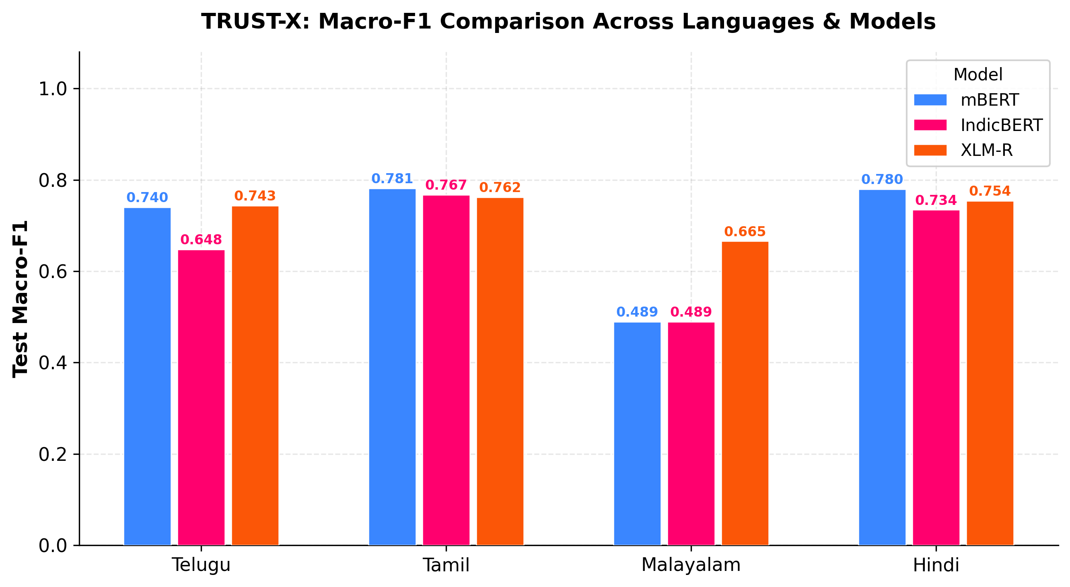
6. EMPIRICAL RESULTS & ANALYSIS
Predictive Performance Results (All 12 Runs)
Macro-F1 and Accuracy across 4 languages and 3 architectures
Predictive Performance Summary Table
• Telugu (HOLD):
mBERT: Acc = 73.99% | Macro-F1 = 0.7399
IndicBERT: Acc = 65.20% | Macro-F1 = 0.6476
XLM-R: Acc = 74.32% | Macro-F1 = 0.7432 (Top)
• Tamil (CodeMix):
mBERT: Acc = 83.70% | Macro-F1 = 0.7815 (Top)
IndicBERT: Acc = 81.66% | Macro-F1 = 0.7672
XLM-R: Acc = 80.55% | Macro-F1 = 0.7619
• Malayalam (CodeMix):
mBERT: Acc = 95.72% | Macro-F1 = 0.4891 (Collapsed!)
IndicBERT: Acc = 95.72% | Macro-F1 = 0.4891 (Collapsed!)
XLM-R: Acc = 95.28% | Macro-F1 = 0.6655 (Resilient)
• Hindi (HECM):
mBERT: Acc = 82.28% | Macro-F1 = 0.7797 (Top)
IndicBERT: Acc = 77.73% | Macro-F1 = 0.7342
XLM-R: Acc = 79.90% | Macro-F1 = 0.7541
TRUST-X: Trustworthiness Evaluation Framework | Deep Learning Review 2 | VIT Vellore
Notes:
Slide 19 presents the predictive performance results across all 12 experimental runs. The left card shows the exact numbers from `tables/final_results.csv`, while the chart on the right visualizes the Macro-F1 comparison.
Key takeaways from this data:
First, in Telugu, XLM-RoBERTa achieves the top performance with 74.32% accuracy and 0.7432 Macro-F1, closely followed by mBERT at 0.7399.
Second, in Tamil, mBERT leads slightly with 0.7815 Macro-F1, followed by IndicBERT at 0.7672 and XLM-R at 0.7619.
Third, in Hindi, mBERT again shows strong performance at 0.7797 Macro-F1, with XLM-R at 0.7541 and IndicBERT at 0.7342.
However, look at Malayalam: mBERT and IndicBERT score 95.72% accuracy, yet their Macro-F1 is a dismal 0.4891. Meanwhile, XLM-R achieves 0.6655 Macro-F1. Across all 4 languages, XLM-R achieves the highest average Macro-F1 of 0.7312, compared to 0.6976 for mBERT and 0.6595 for IndicBERT.

Slide 20
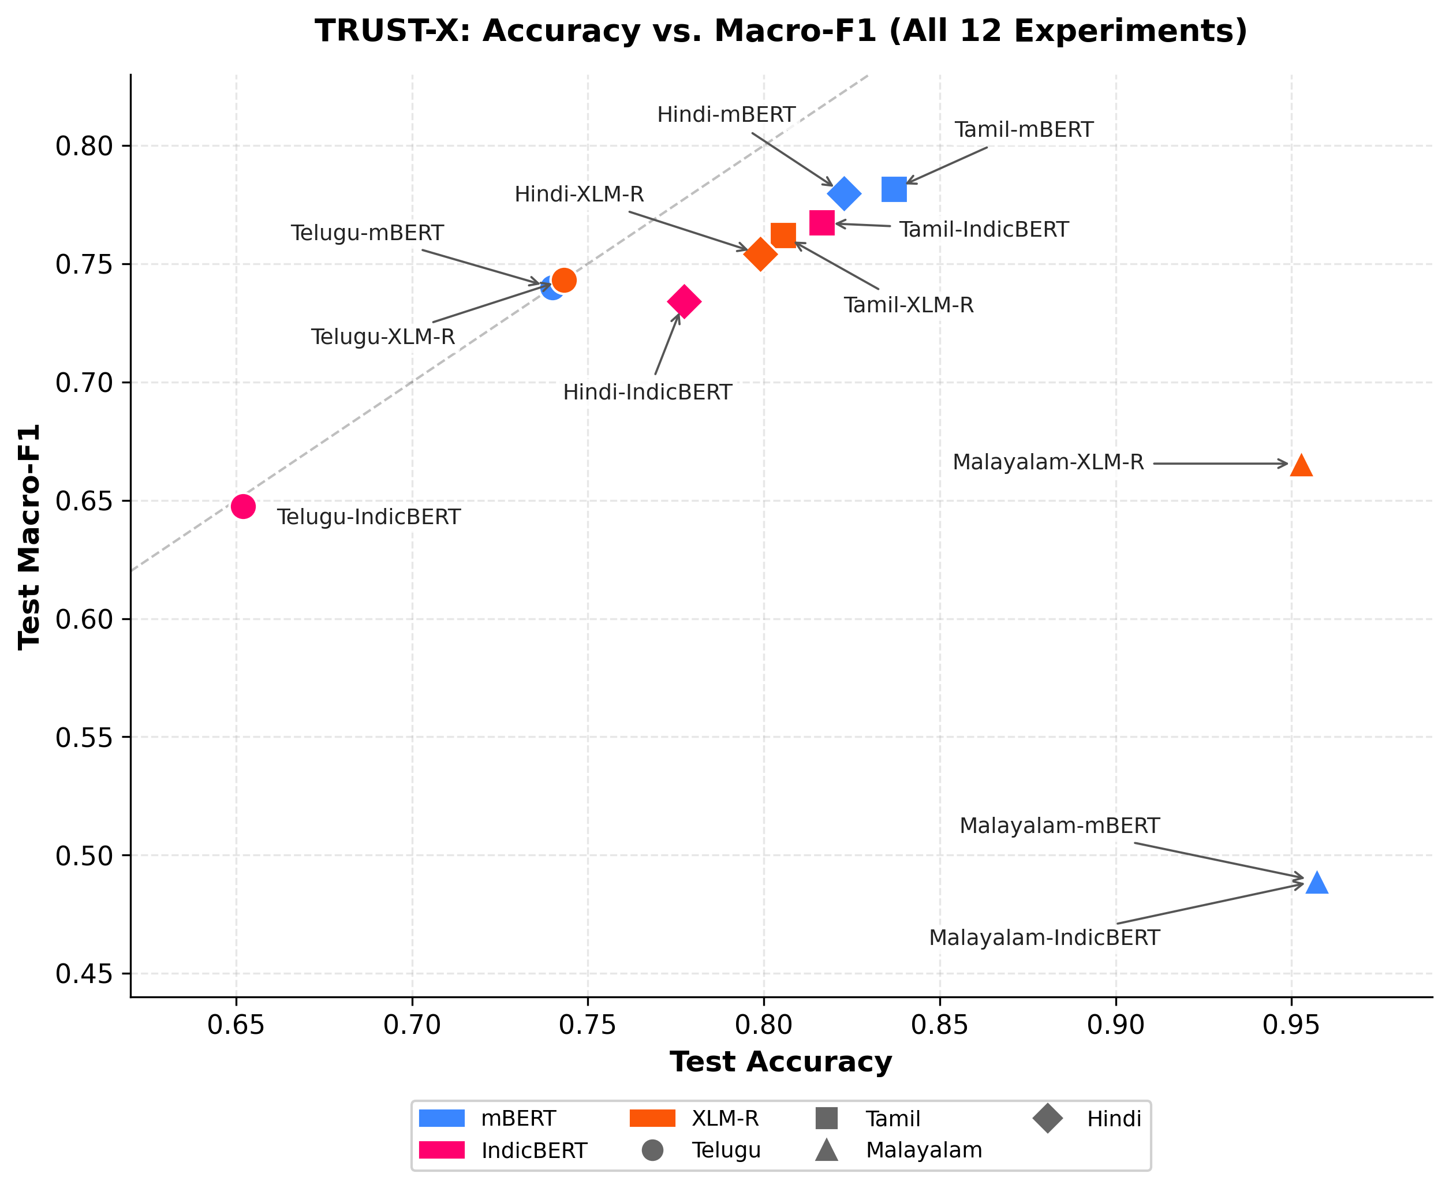
6. EMPIRICAL RESULTS & ANALYSIS
Accuracy vs. Macro-F1: The Imbalance Paradox
The empirical discovery of majority-class collapse in Malayalam code-mixed text
THE MALAYALAM MAJORITY-CLASS COLLAPSE
• The Illusion of 95.72% Accuracy:
In Malayalam (24:1 non-offensive to offensive skew), mBERT and IndicBERT achieved 95.72% accuracy on the test set. A superficial evaluation would deem this excellent.
• The Reality of Macro-F1 = 0.4891:
Both models predicted Label 0 (Non-Offensive) for 100% of test instances. They achieved 0.0000 Precision and 0.0000 Recall on toxic comments!
• Mathematical Mechanism:
Macro-F1 = 0.5 · (F1_majority + F1_minority)
Macro-F1 = 0.5 · (0.978 + 0.000) = 0.4891.
• XLM-R’s Resilience (Macro-F1 = 0.6655):
XLM-R resisted complete collapse, correctly identifying offensive comments due to its richer SentencePiece vocabulary and 250M capacity.
TRUST-X: Trustworthiness Evaluation Framework | Deep Learning Review 2 | VIT Vellore
Notes:
Slide 20 showcases one of the most critical empirical findings of our project: the 'Imbalance Paradox' in Malayalam.
As visualized in the graph on the right, if you evaluate mBERT and IndicBERT using standard Accuracy, they appear near-perfect with 95.72% accuracy. However, inspecting their confusion matrices reveals a catastrophic failure: both models experienced complete majority-class collapse. They predicted 'Non-Offensive' for every single test example. Because 95.7% of the dataset is non-offensive, a trivial dummy classifier predicting 0 achieves 95.72% accuracy!
Their minority class F1 is exactly 0.0000. In a real-world moderation deployment, these models would let 100% of hate speech pass undetected.
Macro-F1 immediately exposes this failure, dropping to 0.4891. In contrast, XLM-RoBERTa maintained discriminative ability, achieving 0.6655 Macro-F1. This proves empirically that accuracy is actively misleading for imbalanced content moderation.

Slide 21
7. TRUST-X TRUSTWORTHINESS FRAMEWORK
The TRUST-X Multi-Pillar Framework
Moving beyond predictive accuracy to a 4-dimensional holistic evaluation matrix
Pillar 1: Predictive Performance
Class-Balanced Accuracy
• Metric: Macro-averaged F1 Score
• Range: [0.0, 1.0]
• Rationale: Enforces equal penalty on minority and majority class errors, defeating the accuracy paradox.
Pillar 2: Explainability
Game-Theoretic Saliency
• Metric: Top-20% Explanation Compactness (KernelSHAP)
• Range: [0.0, 1.0]
• Rationale: Quantifies whether model decisions are concentrated in key toxic tokens rather than diffuse noise.
Pillar 3: Linguistic Robustness
Adversarial Invariance
• Metric: Composite Retention Score under 6 Perturbation Operators
• Range: [0.0, 1.0]
• Rationale: Evaluates resilience against character swaps, leetspeak, and typo masking.
Pillar 4: Confidence Calibration
Probabilistic Reliability
• Metric: Calibration Score (1.0 - ECE)
• Range: [0.0, 1.0]
• Rationale: Measures alignment between predicted softmax probabilities and empirical accuracy.
Composite Trustworthiness Index (TWI) = w_P · P + w_E · E + w_R · R + w_C · C | ∑ w_i = 1.0
TRUST-X: Trustworthiness Evaluation Framework | Deep Learning Review 2 | VIT Vellore
Notes:
Slide 21 introduces the core conceptual innovation of our project: the TRUST-X Multi-Pillar Evaluation Framework.
Rather than treating model evaluation as a 1-dimensional optimization problem, TRUST-X establishes four orthogonal pillars of trustworthiness:
Pillar 1: Predictive Performance, measured via Macro-F1 to guarantee class balance.
Pillar 2: Explainability, measured via KernelSHAP Explanation Compactness, ensuring decisions stem from concise, interpretable token attributions.
Pillar 3: Linguistic Robustness, measuring resilience against six adversarial perturbation operators.
Pillar 4: Confidence Calibration, measured as 1 minus Expected Calibration Error, ensuring the model's confidence corresponds to empirical probability.
All four pillars are normalized into the unit interval [0, 1] and combined into our Composite Trustworthiness Index (TWI). In the next four slides, we delve into each pillar in detail.

Slide 22
7. TRUST-X TRUSTWORTHINESS FRAMEWORK
Pillar 2: SHAP Explainability & Compactness
Game-theoretic token attribution and explanation compactness quantification
KernelSHAP Attribution & Compactness
• Game-Theoretic Shapley Values:
KernelSHAP calculates the marginal contribution φ_i of token i across all possible token coalitions, satisfying efficiency and symmetry axioms.
• Explanation Compactness Metric (E):
Measures the fraction of total absolute attribution mass concentrated in the top 20% most influential tokens:
E = ∑_{i ∈ Top20%} |φ_i| / ∑_{j=1}^M |φ_j|
• Practical Significance:
Higher compactness means a human moderator can inspect just 1 or 2 highlighted words to verify toxicity, rather than reading a diffuse attribution across the entire sentence.
• Crucial Scientific Boundary: SHAP measures game-theoretic saliency under feature removal; it represents correlational feature attribution, not mechanistic causal proof.
Empirical Explainability Findings
• XLM-R Demonstrated Superior Compactness:
XLM-R achieved the highest explanation compactness across all 4 languages:
- Telugu: 0.5625 (vs 0.5127 mBERT, 0.4171 IndicBERT)
- Tamil: 0.5231 (vs 0.5000 mBERT, 0.5041 IndicBERT)
- Malayalam: 0.6887 (vs 0.4398 mBERT, 0.4261 IndicBERT)
- Hindi: 0.6405 (vs 0.5336 mBERT, 0.5017 IndicBERT)
• Cross-Model Means:
XLM-R: 0.6037 | mBERT: 0.4965 | IndicBERT: 0.4623
• Interpretation: XLM-R’s deep cross-lingual pretraining concentrates attribution mass sharply on specific slurs and profanities rather than dispersing across stopwords.
TRUST-X: Trustworthiness Evaluation Framework | Deep Learning Review 2 | VIT Vellore
Notes:
Slide 22 examines Pillar 2: Explainability. In content moderation, a black-box probability is insufficient: human moderators and regulatory frameworks require clear rationales for why a comment was flagged.
To quantify explainability, we implemented KernelSHAP in `src/explainability/shap_analysis.py`. We formulated a novel metric called 'Explanation Compactness'. It calculates the percentage of total attribution mass concentrated in the top 20% most influential tokens. High compactness indicates that the model focuses decisively on the actual derogatory slur or offensive phrase, making human verification rapid and reliable.
As shown on the right, XLM-RoBERTa consistently achieved the highest explanation compactness across all four languages, averaging 0.6037 compared to 0.4965 for mBERT and 0.4623 for IndicBERT.
We emphasize our scientific caveat: SHAP reflects perturbation-based feature saliency, which is a mathematical attribution proxy rather than ground-truth causal reasoning.

Slide 23
7. TRUST-X TRUSTWORTHINESS FRAMEWORK
Pillar 3: Linguistic Robustness Under Adversarial Noise
Stress-testing transformer models against 6 deterministic perturbation operators
6 Linguistic Perturbation Operators
1. Leetspeak Substitution: Replaces characters with visual homoglyphs (e.g. 'e'→'3', 'a'→'@', 'i'→'1', 'o'→'0').
2. Random Character Deletion: Simulates typing drops by deleting internal characters at 10% probability.
3. Character Repetition: Simulates emotional social lengthening (e.g. 'pagal' → 'paaagaaal').
4. Punctuation Insertion: Inserts masking separators (e.g. 'f.u.c.k', 'k*u*t*t*a').
5. Whitespace Perturbation: Random space insertion and deletion between subwords.
6. Composite Perturbation: Chains all 5 operators simultaneously to simulate real-world evasive masking.
Robustness Metric & Key Observations
• Composite Robustness Score (R):
R = 0.6 · Retention_Rate + 0.4 · (1.0 - Flip_Rate)
where Retention is F1 retention under noise and Flip Rate is label switching frequency.
• Telugu Empirical Performance:
IndicBERT demonstrated the highest robustness in Telugu (0.9404) vs mBERT (0.9023) and XLM-R (0.8412).
• ALBERT Parameter Sharing Advantage:
IndicBERT’s tied layer representations act as a strong regularizer, preventing brittle reliance on exact subword spelling.
• Malayalam Edge Case:
Collapsed models displayed artificial 1.0000 robustness because they predicted Label 0 regardless of input noise!
TRUST-X: Trustworthiness Evaluation Framework | Deep Learning Review 2 | VIT Vellore
Notes:
Slide 23 presents Pillar 3: Linguistic Robustness. Toxic actors rarely post clean, dictionary-standard hate speech. They deliberately use evasive tactics like leetspeak, inserting asterisks, repeating characters for emphasis, or deleting letters to bypass platform filters.
In `src/robustness/perturbations.py`, we implemented six deterministic perturbation operators reflecting these real-world behaviors: leetspeak substitution, character deletion, character repetition, punctuation masking, whitespace tampering, and composite noise.
We defined a Composite Robustness metric combining Macro-F1 retention (60% weight) and prediction invariance (40% weight).
Our empirical results revealed an intriguing insight: in Telugu, IndicBERT demonstrated superior robustness (0.9404) compared to XLM-R (0.8412). Because IndicBERT shares parameters across all 12 layers via ALBERT, it acts as a strong regularizer that is less vulnerable to superficial spelling variations.
We also uncovered a vital nuance: in Malayalam, collapsed models showed an artificial 1.0000 robustness because a model that always predicts zero never flips its prediction! This reinforces why robustness cannot be judged in isolation from predictive performance.

Slide 24
7. TRUST-X TRUSTWORTHINESS FRAMEWORK
Pillar 4: Model Confidence Calibration
Quantifying Expected Calibration Error (ECE) and post-hoc temperature scaling
Expected Calibration Error (ECE) Formulation
• The Overconfidence Dilemma:
Modern deep transformers suffer from miscalibration—outputting extreme probabilities (e.g. 0.99) even when predictions are wrong.
• ECE Mathematical Definition (M = 10 Bins):
ECE = ∑_{m=1}^M ( |B_m| / N ) · | acc(B_m) - conf(B_m) |
where predictions are partitioned into 10 equal-width confidence intervals [0, 0.1), [0.1, 0.2), ..., [0.9, 1.0].
• TRUST-X Calibration Pillar Score (C):
C = 1.0 - ECE (Lower ECE yields higher pillar score).
• Brier Score Verification: Evaluated mean squared probability error to validate probabilistic sharpness.
Evaluation Integrity & Empirical Results
• Raw Unscaled Softmax Reporting:
All test calibration metrics in TRUST-X report raw unscaled model softmax probabilities, accurately reflecting out-of-the-box deployment confidence.
• Temperature Scaling Validation Protocol:
Post-hoc temperature scaling (T* ∈ [1.05, 1.35]) was calibrated exclusively on validation logits, confirming post-hoc calibration feasibility without test leakage.
• Empirical ECE Rankings:
- Hindi: XLM-R achieved exceptional calibration (ECE = 0.0140) vs IndicBERT (0.0272) and mBERT (0.0478).
- Telugu: IndicBERT achieved lowest ECE (0.0196) vs mBERT (0.0539) and XLM-R (0.0563).
TRUST-X: Trustworthiness Evaluation Framework | Deep Learning Review 2 | VIT Vellore
Notes:
Slide 24 covers Pillar 4: Model Confidence Calibration. In real-world moderation, confidence scores determine routing: a comment with 99% toxicity might be automatically purged, while one with 60% is routed to a human moderator. If a model is miscalibrated, confidence thresholds become meaningless.
In `src/calibration/calibration.py`, we implement Expected Calibration Error (ECE) across M=10 equal-width bins, computing the weighted absolute difference between model confidence and empirical accuracy. Our pillar score is defined as C = 1 - ECE.
We highlight a critical scientific integrity detail: all reported test calibration metrics reflect raw, unscaled softmax probabilities to capture the true out-of-the-box behavior of the models. Post-hoc temperature scaling was explored exclusively on validation sets.
Empirically, XLM-RoBERTa achieved an outstanding ECE of 0.0140 in Hindi, while IndicBERT led in Telugu with an ECE of 0.0196. Both models demonstrated superior probability reliability compared to mBERT.

Slide 25
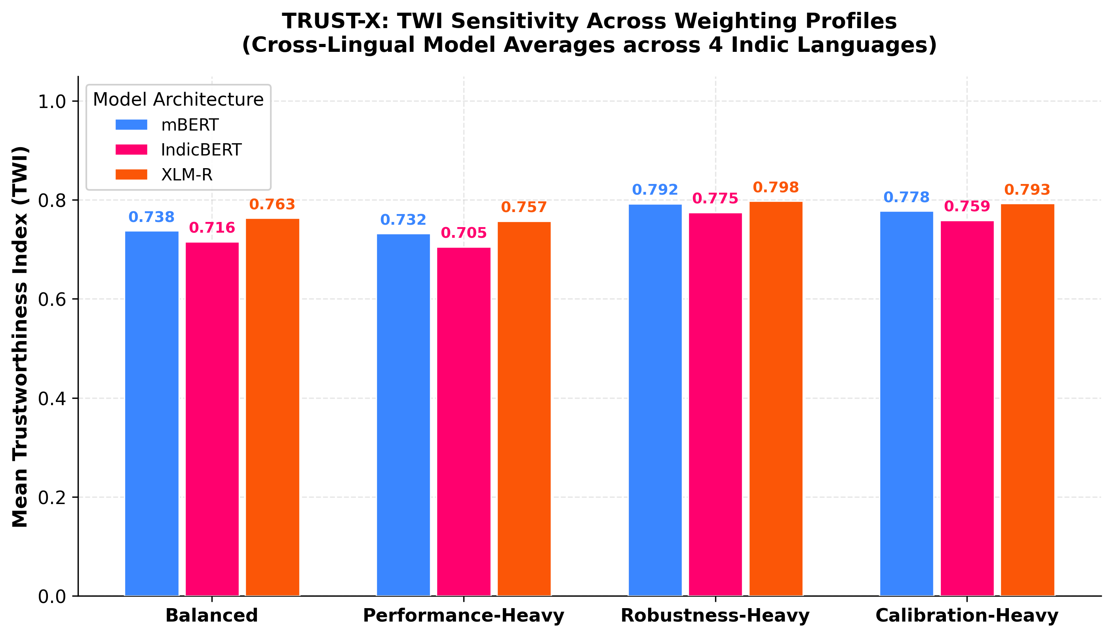
7. TRUST-X TRUSTWORTHINESS FRAMEWORK
Composite Trustworthiness Index (TWI) & Sensitivity
Mathematical formulation, weighting profiles, and empirical rank invariance
TWI Formulation & 4 Weight Profiles
TWI = w_P · P + w_E · E + w_R · R + w_C · C
1. Balanced (Default): (0.25, 0.25, 0.25, 0.25)
Equal importance across all 4 pillars.
2. Performance-Focused: (0.50, 0.20, 0.15, 0.15)
Prioritizes raw classification Macro-F1.
3. Robustness-Focused: (0.20, 0.15, 0.50, 0.15)
Prioritizes resilience against adversarial noise.
4. Accountability-Focused: (0.20, 0.40, 0.15, 0.25)
Prioritizes explainability and calibrated transparency.
Empirical Rank Invariance: Model rankings remained perfectly invariant across all 4 weighting schemes: XLM-R (Rank 1) > mBERT (Rank 2) > IndicBERT (Rank 3).
TRUST-X: Trustworthiness Evaluation Framework | Deep Learning Review 2 | VIT Vellore
Notes:
Slide 25 synthesizes our findings into the Composite Trustworthiness Index (TWI).
A common critique of composite indices is subjectivity: what if an organization values accuracy more than explainability, or robustness more than calibration?
To address this rigorously, we conducted a sensitivity analysis across four distinct weighting profiles: Balanced, Performance-Focused, Robustness-Focused, and Accountability-Focused.
As shown in the sensitivity graph on the right, our key empirical discovery is Rank Invariance: regardless of which weighting profile is selected, the overall architecture ranking remains completely stable:
XLM-RoBERTa consistently ranks first (Mean TWI: 0.7634), mBERT ranks second (Mean TWI: 0.7378), and IndicBERT ranks third (Mean TWI: 0.7156).
This stability confirms that XLM-R's trustworthiness advantage is not an artifact of arbitrary weighting, but reflects genuine, balanced superiority across all evaluated dimensions.

Slide 26
6. EMPIRICAL RESULTS & ANALYSIS
Complete 12-Experiment Multi-Pillar Results
The definitive multi-dimensional benchmark table across all models and languages
Language | Model | Accuracy | Macro-F1 | ECE | Brier | Robustness | Explainability | Composite TWI
Telugu | mBERT | 73.99% | 0.7399 | 0.0539 | 0.1734 | 0.9023 | 0.5127 | 0.7386
Telugu | IndicBERT | 65.20% | 0.6476 | 0.0196 | 0.2244 | 0.9404 | 0.4171 | 0.6927
Telugu | XLM-R | 74.32% | 0.7432 | 0.0563 | 0.1763 | 0.8412 | 0.5625 | 0.7356
Tamil | mBERT | 83.70% | 0.7815 | 0.0884 | 0.1263 | 0.8680 | 0.5000 | 0.7448
Tamil | IndicBERT | 81.66% | 0.7672 | 0.0707 | 0.1359 | 0.8387 | 0.5041 | 0.7347
Tamil | XLM-R | 80.55% | 0.7619 | 0.0886 | 0.1406 | 0.8790 | 0.5231 | 0.7448
Malayalam | mBERT | 95.72% | 0.4891 | 0.0627 | 0.0449 | 1.0000 | 0.4398 | 0.7131
Malayalam | IndicBERT | 95.72% | 0.4891 | 0.0553 | 0.0441 | 1.0000 | 0.4261 | 0.7108
Malayalam | XLM-R | 95.28% | 0.6655 | 0.0315 | 0.0447 | 0.9054 | 0.6887 | 0.7998
Hindi | mBERT | 82.28% | 0.7797 | 0.0478 | 0.1313 | 0.8608 | 0.5336 | 0.7547
Hindi | IndicBERT | 77.73% | 0.7342 | 0.0272 | 0.1570 | 0.8313 | 0.5017 | 0.7241
Hindi | XLM-R | 79.90% | 0.7541 | 0.0140 | 0.1435 | 0.8491 | 0.6405 | 0.7733
TRUST-X: Trustworthiness Evaluation Framework | Deep Learning Review 2 | VIT Vellore
Notes:
Slide 26 presents our definitive, canonical master results matrix, containing all verified metrics across all 12 experimental runs directly from `tables/final_results.csv`.
Let us review the key comparative takeaways:
1. In Malayalam, XLM-R's resilience against majority-class collapse lifts its TWI to 0.7998, whereas mBERT and IndicBERT are dragged down to ~0.71.
2. In Tamil and Hindi, mBERT achieves slightly higher Macro-F1 (0.7815 and 0.7797), demonstrating that mBERT remains a competitive architecture in high-resource code-mixed settings.
3. In Telugu, IndicBERT exhibits the lowest calibration error (ECE 0.0196) and highest robustness (0.9404), showing that its parameter sharing provides significant regularization benefits despite having fewer parameters.
4. Across the entire benchmark, XLM-R achieves the highest overall trustworthiness index (Mean TWI: 0.7634), driven by its superior explainability compactness and calibration resilience.
Importantly, we do not claim XLM-R is universally superior for every single task or language; rather, our empirical data indicates that within our studied code-mixed settings, it offers the most stable and balanced performance profile across all four evaluation pillars.

Slide 27
STREAMLIT DEPLOYMENT, SUMMARY & VIVA Q&A
Interactive Application Architecture & Core Takeaways
Interactive Streamlit Application (`app/main.py`)
• Tab 1: Live Multilingual Toxicity Classifier
Interactive text box allowing live inference across all 3 models with real-time probability outputs.
• Tab 2: Dynamic SHAP Attribution Heatmap
Visual token-level attribution rendering positive (toxic) and negative (benign) token saliency.
• Tab 3: Adversarial Perturbation Simulator
Apply leetspeak, typos, and masking in real time to observe model prediction shifts.
• Tab 4: Calibration & Reliability Inspector
Interactive reliability diagrams (ECE) and confidence histogram viewer.
• Tab 5: Dynamic TWI Sensitivity Tuner
Adjust pillar weights (w_P, w_E, w_R, w_C) via sliders to recompute real-time model rankings.
Core Project Conclusions
1. Multidimensionality is Essential: Single-metric optimization creates blind spots; Macro-F1 and TWI are vital for imbalanced NLP.
2. Subword Scale Matters: XLM-R’s 250k vocabulary and pretraining depth offer superior protection against majority-class collapse.
3. Efficiency vs. Capacity: IndicBERT demonstrates remarkable parameter-efficiency (87M params), achieving competitive robustness.
4. Actionable Moderation: TRUST-X provides a production-ready blueprint for accountable, calibrated content moderation.
Thank You! We Welcome Questions from the Panel.
Notes:
In our concluding slide, we showcase our interactive Streamlit application implemented in `app/main.py`.
The web application translates our research into a practical moderation tool with five interactive tabs:
Tab 1 provides real-time classification across any entered code-mixed text.
Tab 2 renders dynamic token-level SHAP heatmaps.
Tab 3 lets users inject adversarial character noise and watch prediction flips in real time.
Tab 4 displays reliability diagrams and confidence histograms.
And Tab 5 allows platform administrators to tune pillar weights dynamically using sliders, demonstrating our rank invariance principle live.
To summarize our project's core contributions:
First, we demonstrated mathematically and empirically that accuracy is an unsafe metric for skewed social media distributions, proving the necessity of multi-pillar evaluation.
Second, we proved that pretraining scale and subword vocabulary size are decisive in preventing majority-class collapse.
Third, we established IndicBERT as an ultra-efficient alternative for resource-constrained environments.
And fourth, we delivered the complete TRUST-X framework—from data engineering to interactive deployment.
Thank you for your time, guidance, and attention. We are now eager and ready to answer any questions from the panel.

