Slide 1

Customer Shopping Behavior Analysis
Uncovering insights from 3,900 customers to guide strategic business decisions

Slide 2

Dataset Overview
3,900
18
37
Total Customers
Data Columns
Missing Values
One row per customer
Demographics & purchase behavior
Only in Review Rating column

Slide 3
Data Preparation Process
01
02
03
Data Loading
Initial Exploration
Missing Data Handling
Imported dataset using pandas
Structure check and summary statistics
Imputed Review Rating with median values
04
05
Feature Engineering
Database Integration
Created age groups and purchase frequency
Connected to PostgreSQL for analysis

Slide 4
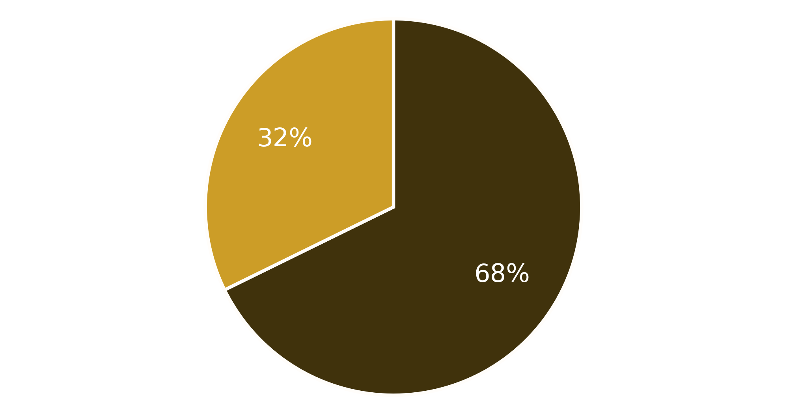

Revenue by Gender Analysis
Key Insight
Male customers generate $157,890 in revenue vs $75,191 from female customers
Female average order is higher ($60.25 vs $59.54) on under half the volume
Male
Female

Slide 5

High-Value Discount Users
839 customers used a discount and still spent above the $59.76 average
Smart Shoppers
They average $79.79 per order and contribute $66,942 of revenue
Strategic Opportunity
Half of all discount users did not need the discount to spend

Slide 6



Top-Rated Products
3.86
3.84
3.82
Gloves
Sandals
Boots
Highest average rating (n=137)
Second highest rated (n=159)
Third highest rated (n=143)

Slide 7
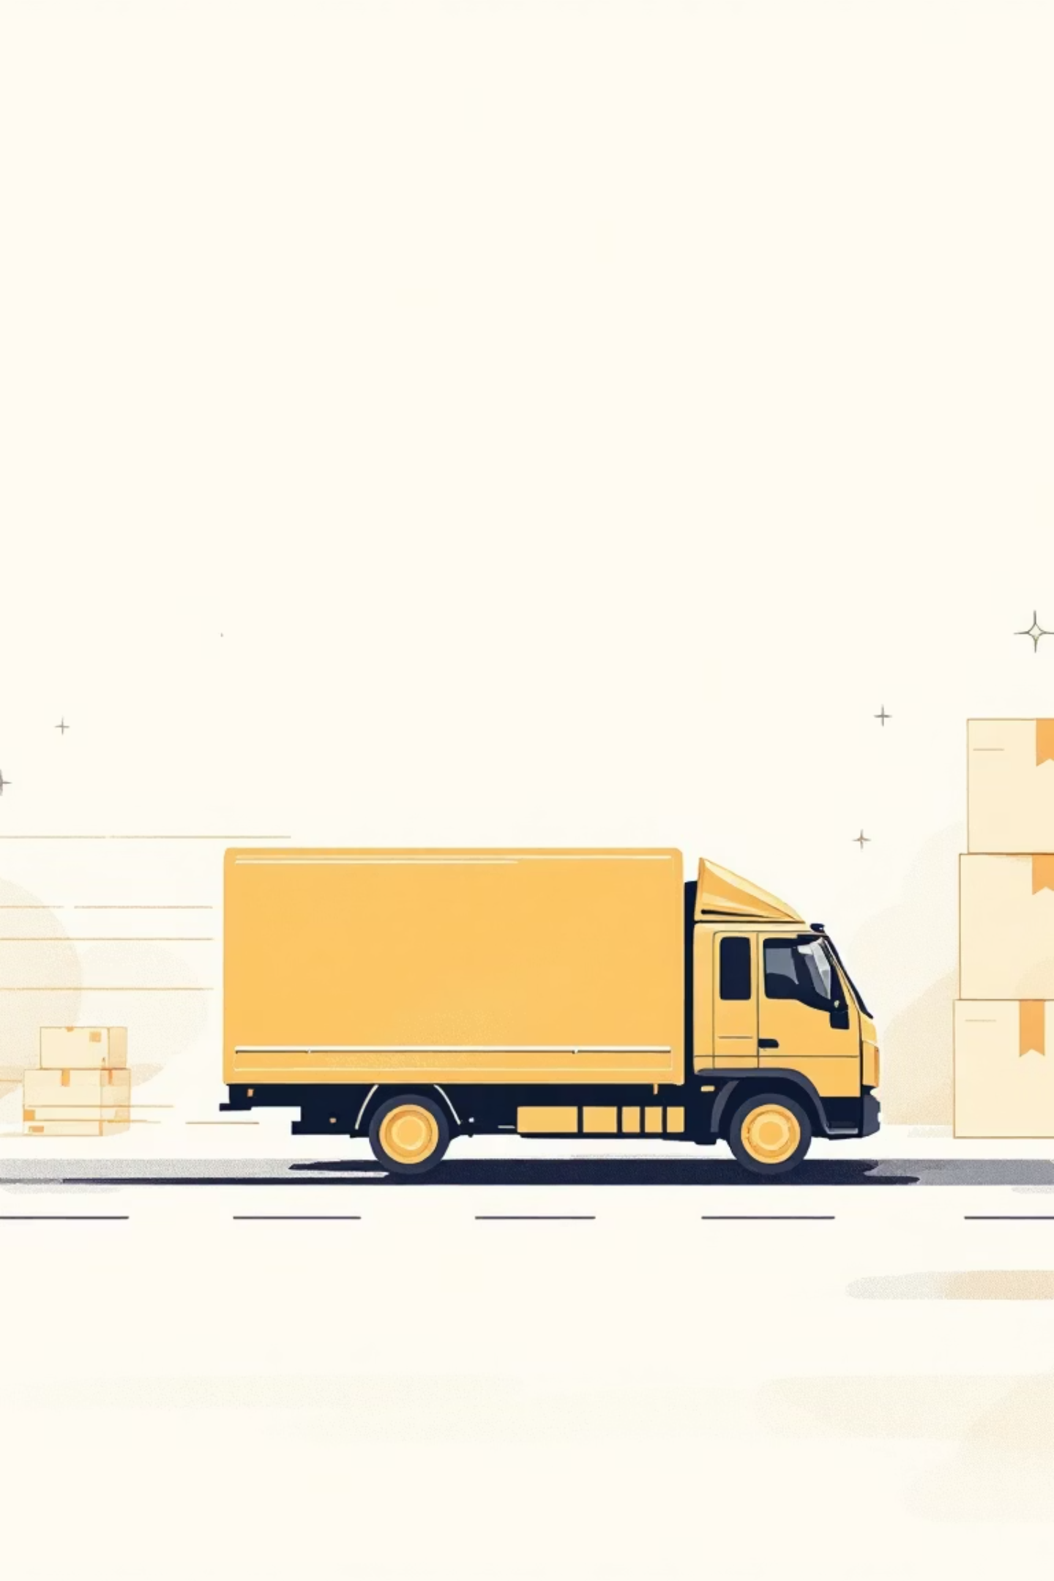
Shipping Preferences Impact
Express Shipping
Standard Shipping
$60.48
$58.46
Average purchase amount
Average purchase amount
Express customers spend 3.4% more; every shipping type falls within $58-61

Slide 8

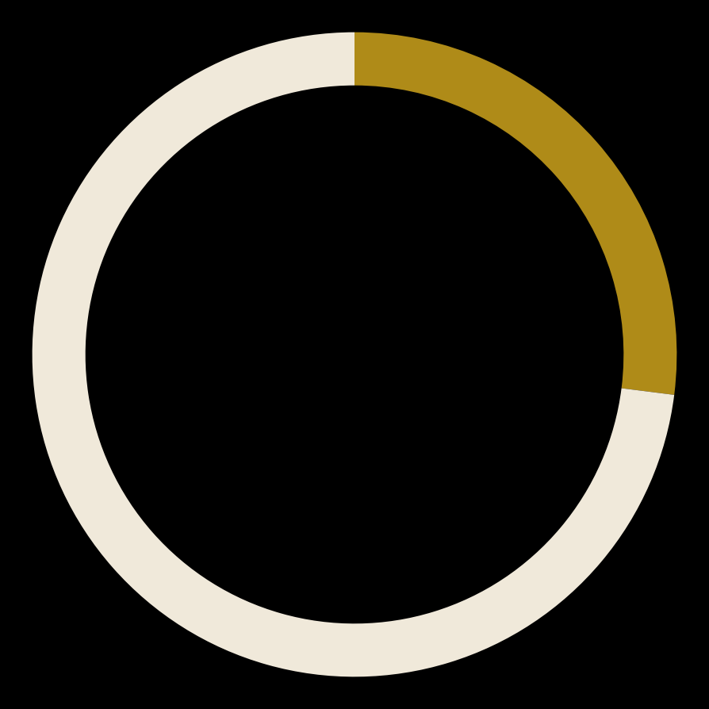

Subscription Impact
100%
27%
99%
Get a Discount
Revenue Share
Relative Spend
Every subscriber, vs 22% of others
$62,645 of $233,081 total revenue
$59.49 vs $59.87 — no lift

Slide 9



Customer Segmentation
New
1
11% - 0 to 5 previous purchases
Returning
2
29% - 6 to 20 previous purchases
Loyal
3
60% - 21+ previous purchases
Segmented on previous_purchases; 60% of customers are already repeat buyers

Slide 10





Strategic Recommendations
Re-price Subscriptions
Subscribers get a blanket discount but spend no more
Grow Order Frequency
Average order is flat at $58-61 across every segment
Targeted Marketing
Clothing and Accessories drive 76% of revenue
Product Positioning
Ratings cluster at 3.7-3.9; no product stands out

