Slide 1
Cricket world cup 2023 analysis
BY: SOHINI ROY CHOWDHURY
BATCH: MIP-ML-08

Slide 2
AGENDA
Project Overview
Dataset Overview
EDA
Data Preprocessing
Solution to given tasks

Slide 3

PROJECT OVERVIEW
The Cricket World Cup 2023 data analysis aims to delve into the cricketing world, specifically focusing on the performance of teams and players during the prestigious tournament. The dataset provided encapsulats a comprehensive array of features, offering an opportunity for us to conduct a thorough exploratory data analysis and extract valuable insights.

Slide 4
Dataset overview
The dataset comprises of the following columns:
team
player
bat_or_bowl
bb_bf (balls bowled or balls faced)
runs
wkts (wickets)
wicketball_prob
runs_per_ball
opposition
ground

Slide 5
Dataset overview
Dataset overview
The dataset comprises of the following columns:
start_date
overs
mdns (maidens)
econ (economy rate)
inns (innings)
4s (fours)
6s (sixes)
sr (strike rate)l
not out
mins (minutes)

Slide 6
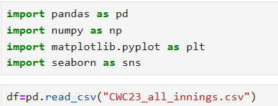
Importing essential libraries
Essential libraries are imported
Dataset is read from the stored location.
6

Slide 7
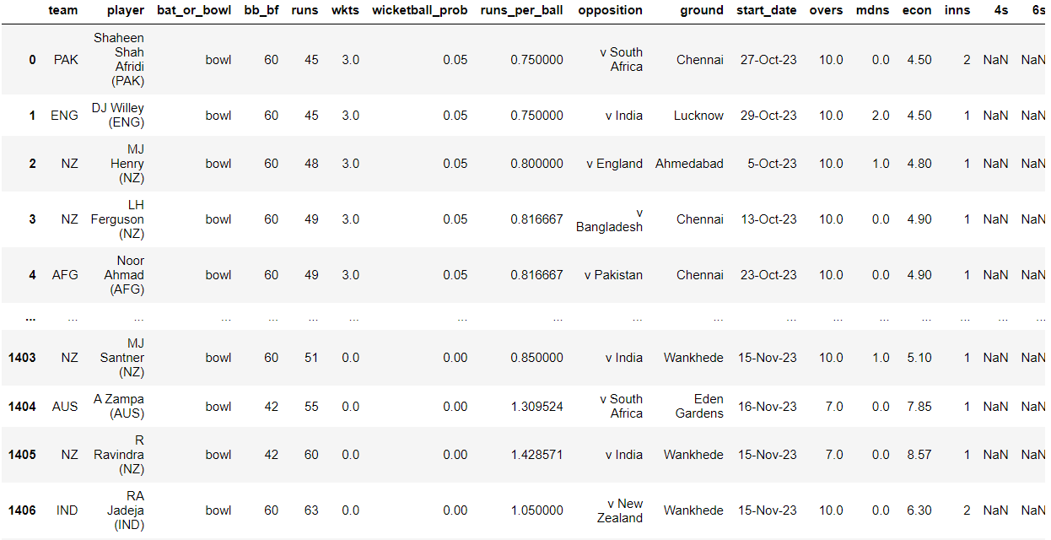
Provided dataset
The dataset provided has 1408 rows and 20 attributes.
Few of the Attributes are:
team
player
4s
wkts

Slide 8
EDA
In EDA, we'll observe the information and statistical.

Slide 9
Dataset description
We can observe the statistical measures like mean, standard deviation, maximum and minimum values along with various quartile ranges for our dataset.

Slide 10
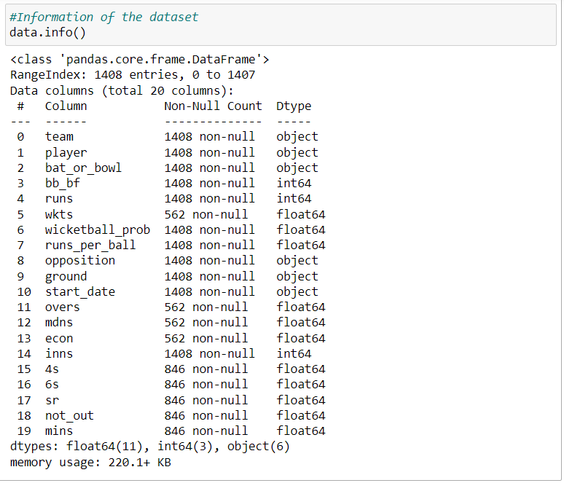
Dataset information
We can observe the information of the dataset like RangeIndex, Number of columns, data types, non-null count and the number of records of each attribute.

Slide 11
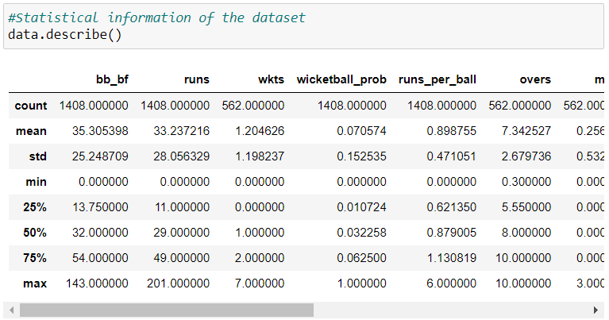
Dataset description
We can observe the statistical measures like mean, standard deviation, maximum and minimum values along with various quartile ranges for our dataset.

Slide 12
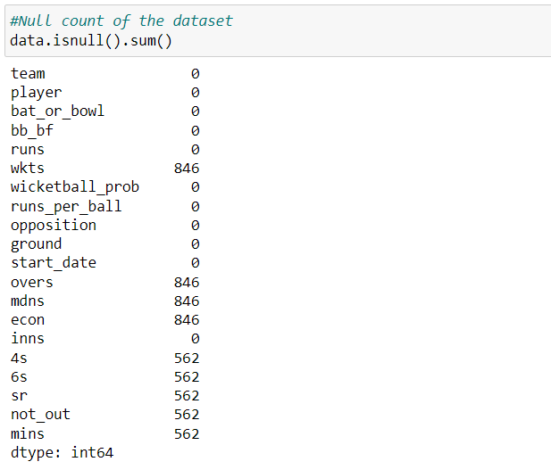
Null count of each attributes
Here we see the null count of:
'wkts': 846
'overs': 846
'mdns': 846
'econ': 846
'4s': 562
'6s': 562
'sr': 562
'not_out': 562
'mins': 562
All other attributes have zero null values

Slide 13
Data preprocessing
We'll transform the raw data into an understandable form for suitable analysis.

Slide 14
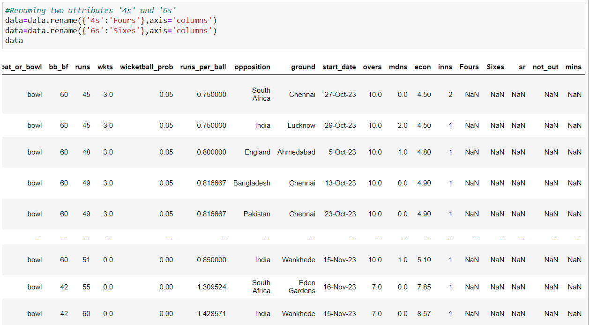
Data cleaning
Renaming the two attributes '4s' and '6s' with 'Fours' and 'Sixes' respectively.

Slide 15
Team performance analysis
This is our first task to perform, where we'll explore team-wise performance metrices, analyze runs scored, wickets taken and identify the top-performing teams.

Slide 16
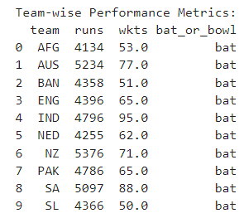
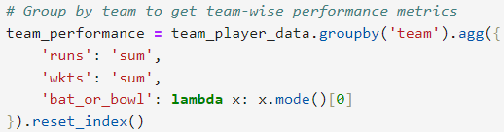
Explore team-wise performance metrics

Slide 17
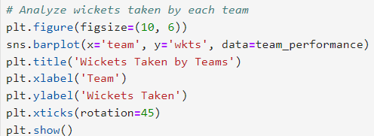
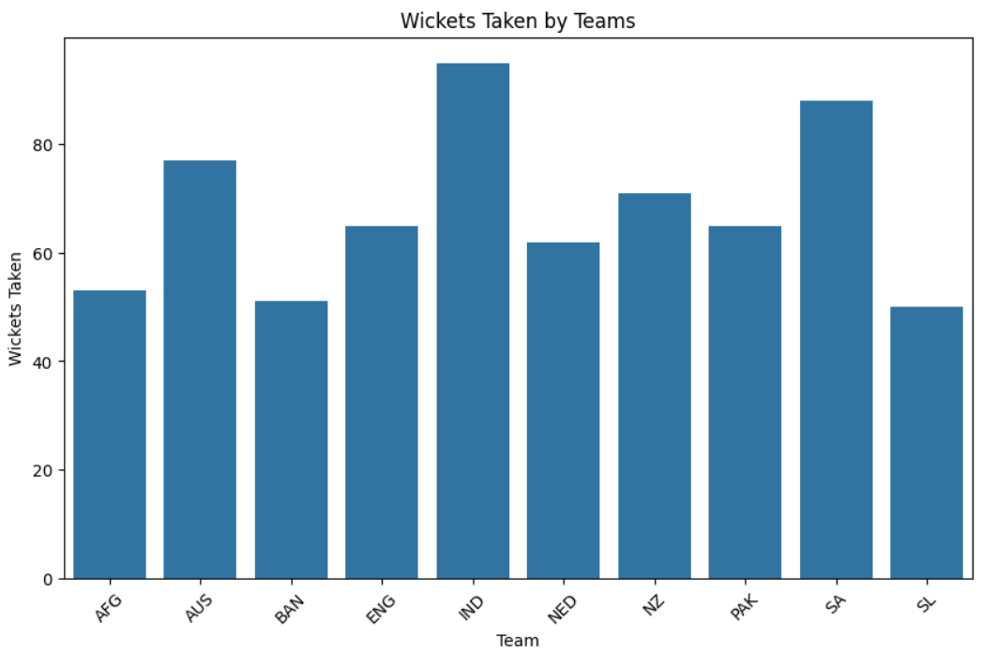
Team which took highest wickets
Using the barplot, we observe that the highest wicket-taking team is India with 94 wickets.

Slide 18
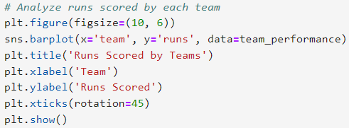
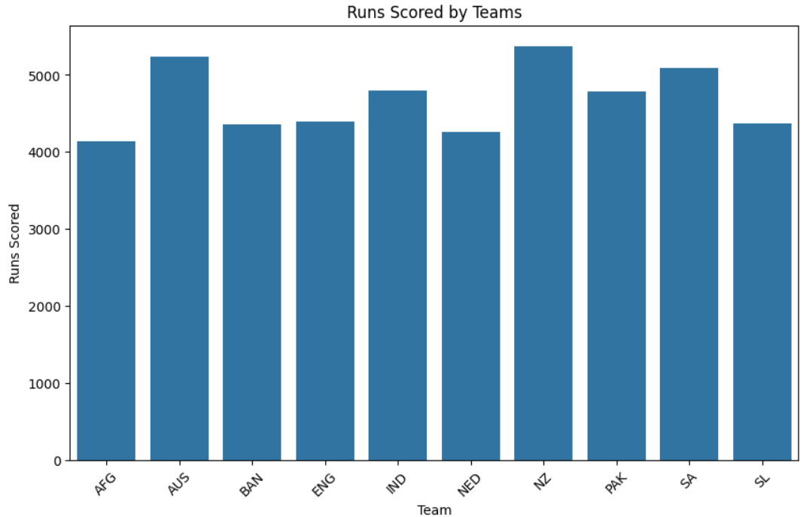
Team with highest Runs
Using the barplot, we observe that the team with highest runs is New Zealand(NZ) with 5376 runs.

Slide 19
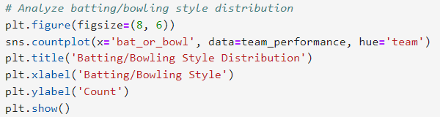
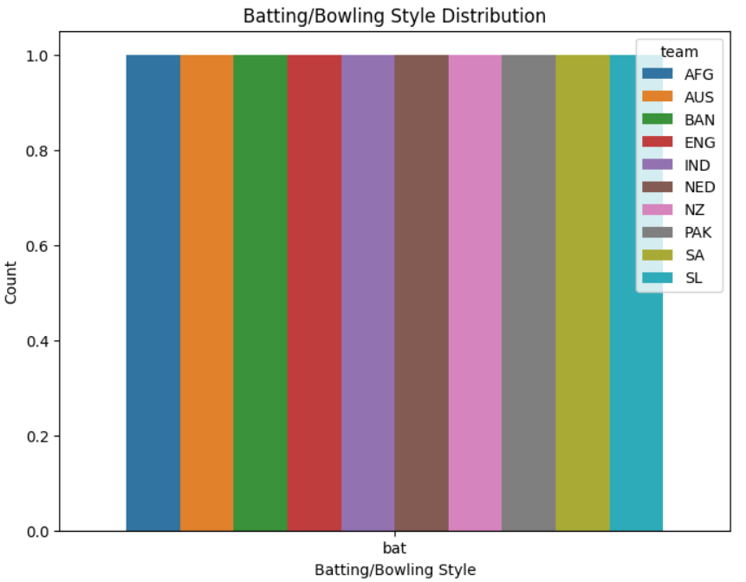
Teams with batting/bowling styles
Using the countplot, we observe that the top-team performing teams has more batting style.

Slide 20
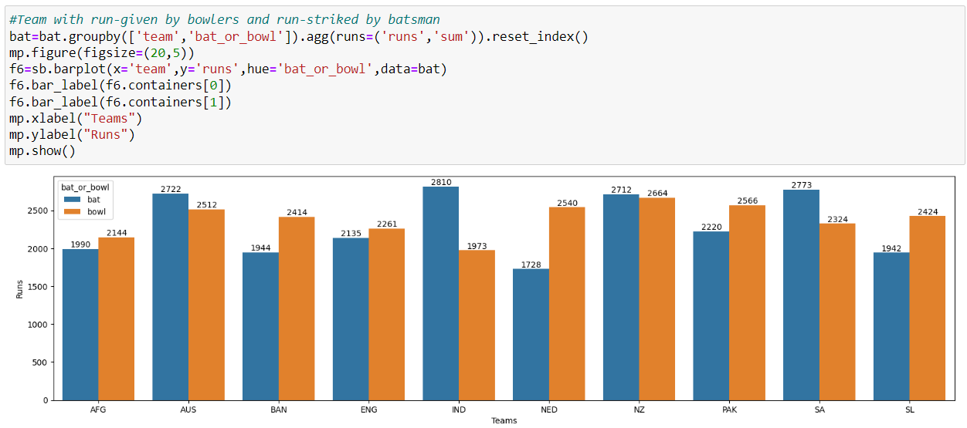
Team with maximum run-given and run-scored
Using the barplot, we observe that the team with best performance in batting and bowling both is team India.

Slide 21
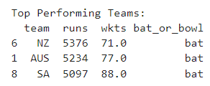
Team with top performance
We can observe that the team with top performance is team New Zealand in runs and South Africa in Wickets.

Slide 22
Player performance analysis
This is our second task to perform, where we'll explore player-wise statistics for both bowling & batting, identify leading run-scorers and wicket-takers, along with their impact on team's performance .

Slide 23
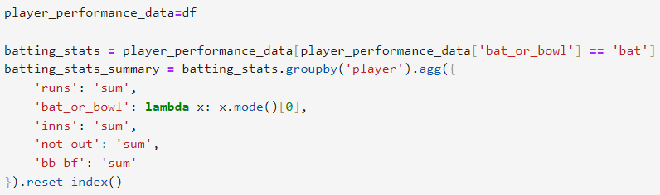
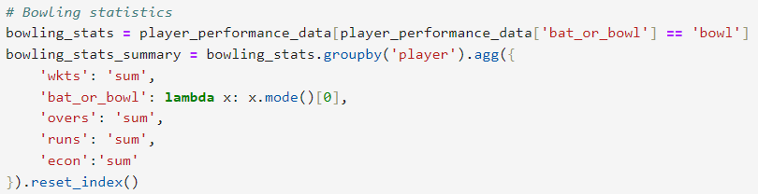
For Player wise statistics for both batting & bowling
We're using groupby function to group out According to Players

Slide 24
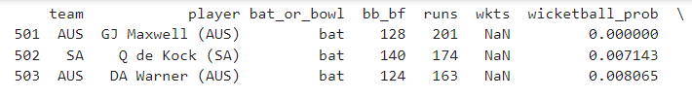





FOR BATTING
FOR BOWING

Slide 25
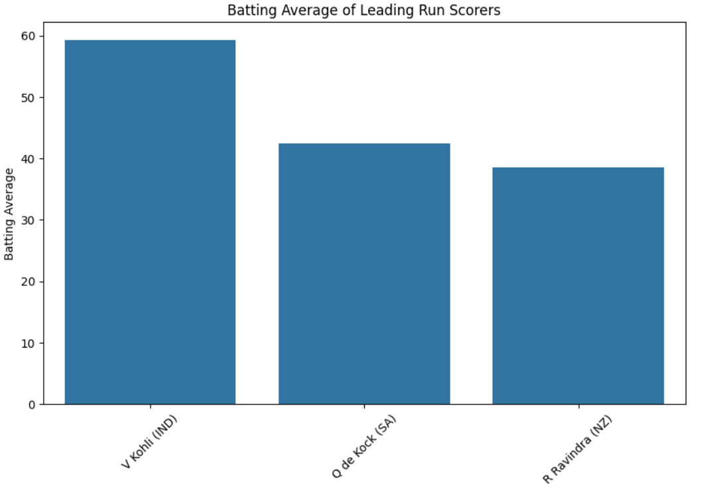

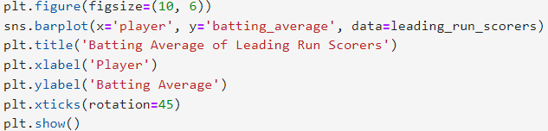
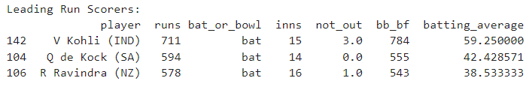
Identify leading run-scorers

Slide 26
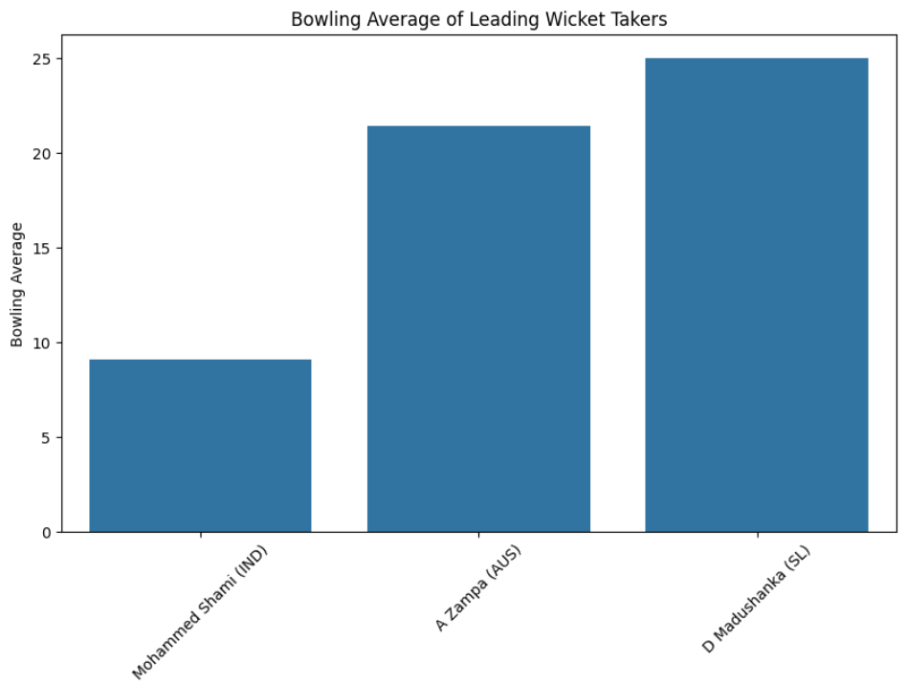
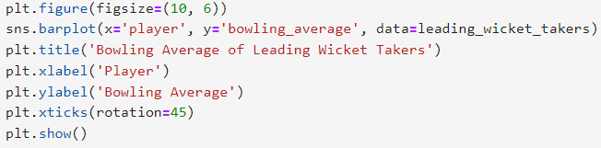
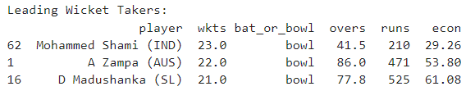

leading wicket-takers

Slide 27
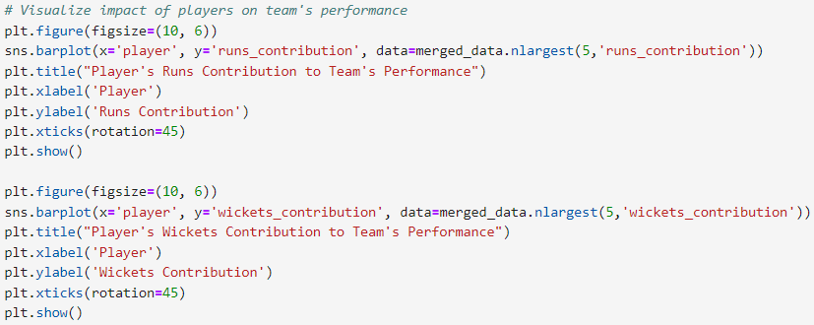
Assess the impact of players on their team's performance

Slide 28
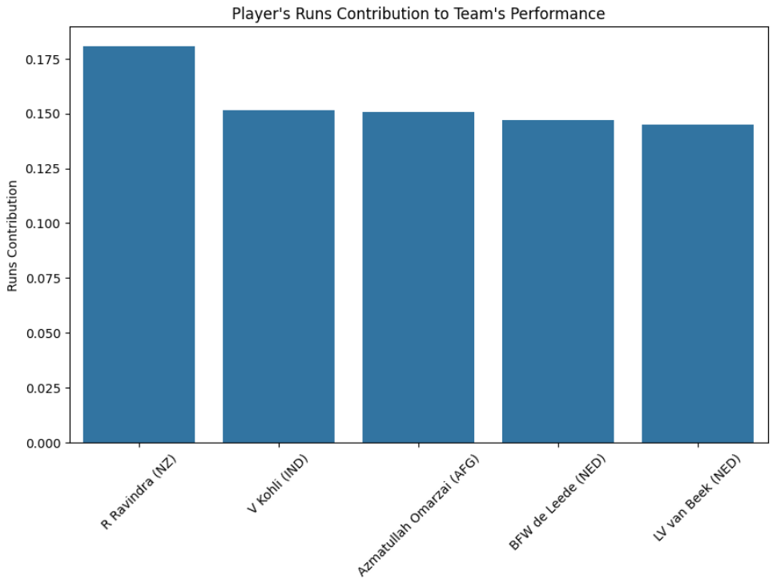
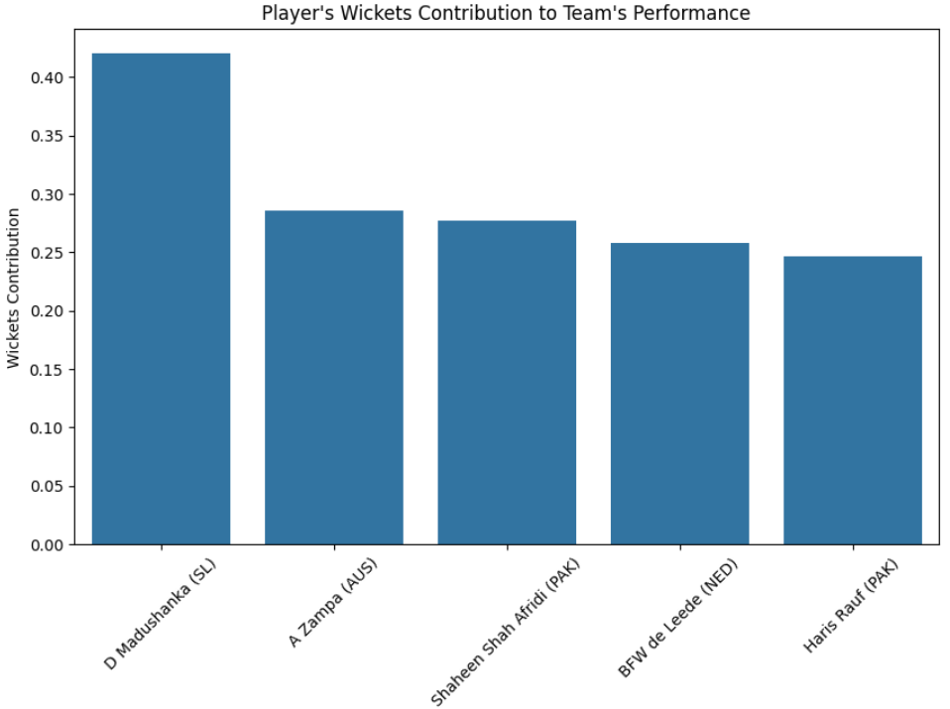

Slide 29
Opposition and ground analysis
This is our third task to perform, where we'll explore how teams perform against opposition, examine their performance variation amongst various grounds, and identify the strength of the team on certain conditions .

Slide 30
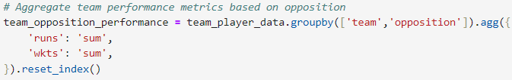
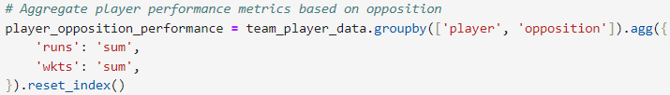
Investigate how teams and players perform against different oppositions

Slide 31
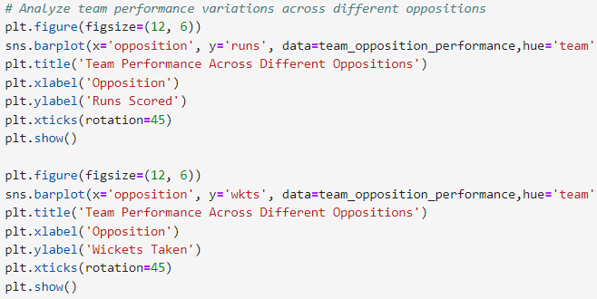
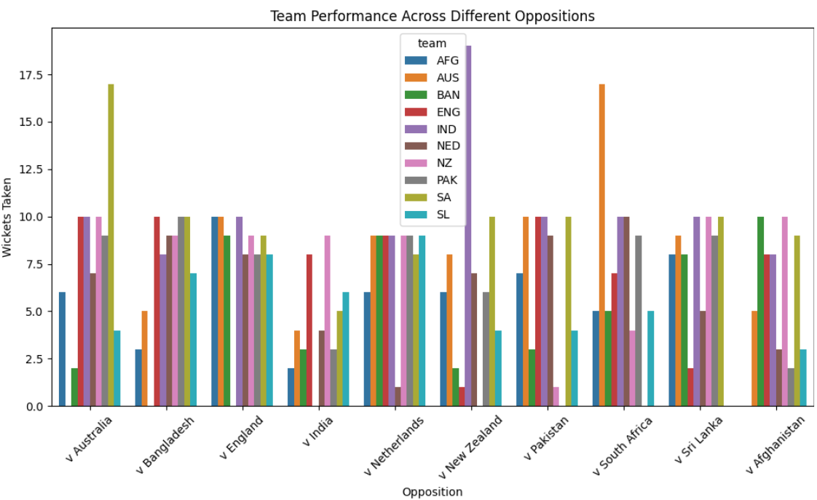
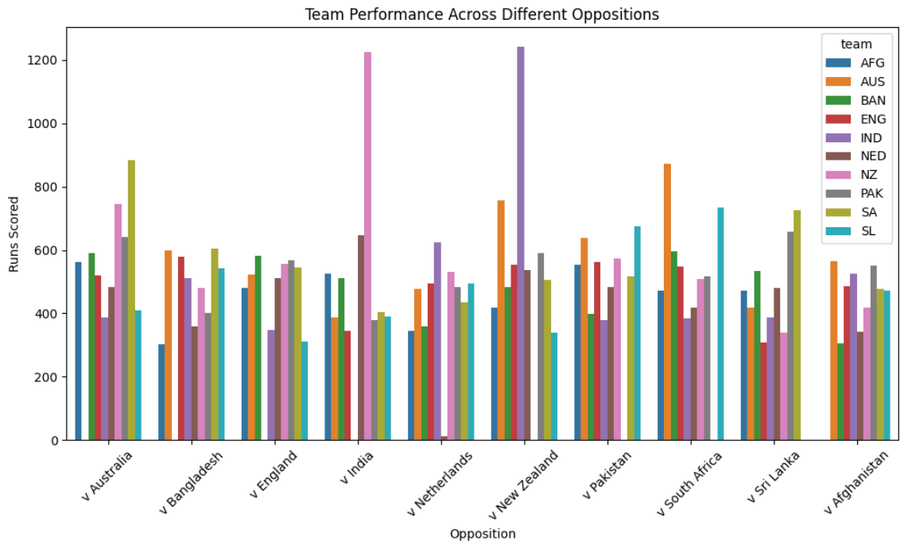

Slide 32
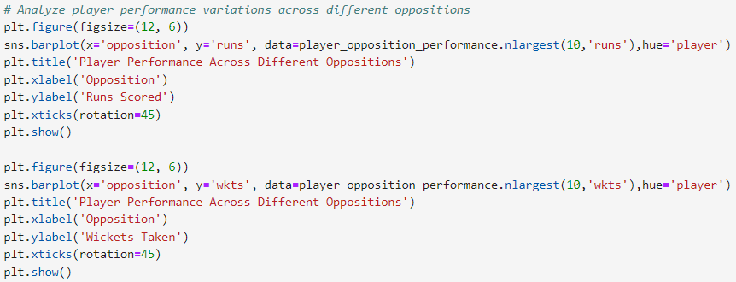
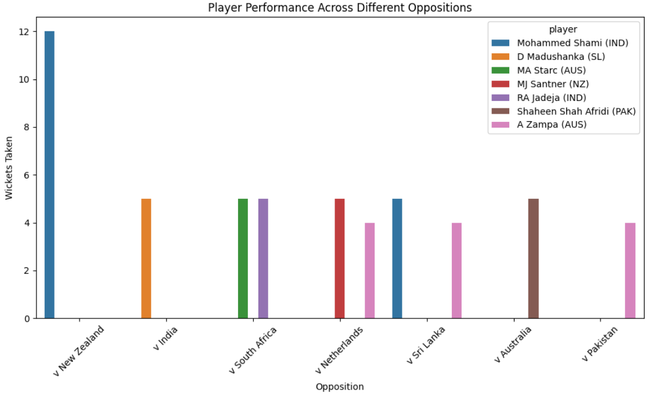
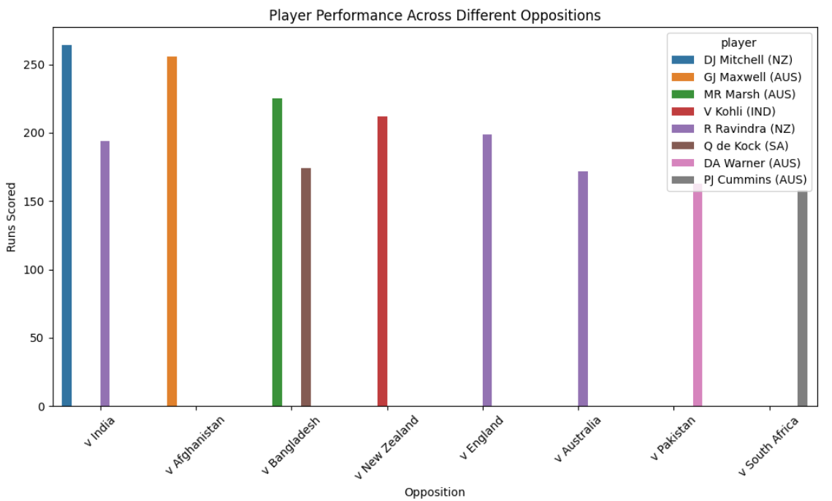

Slide 33
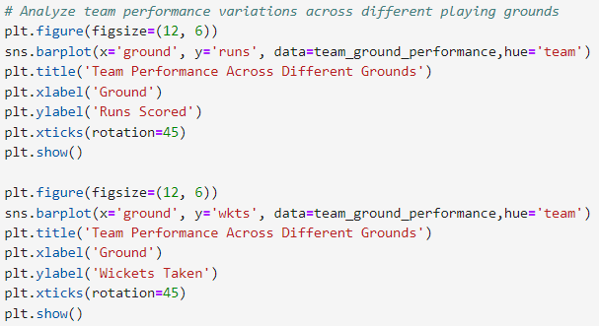
Examine performance variations across different playing grounds

Slide 34
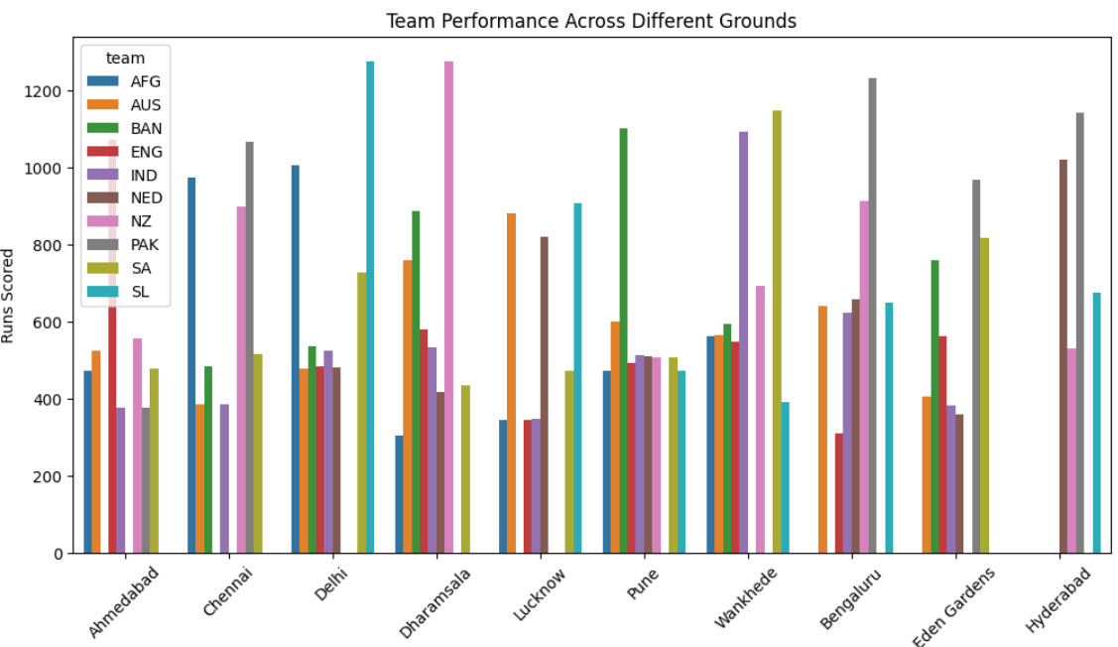
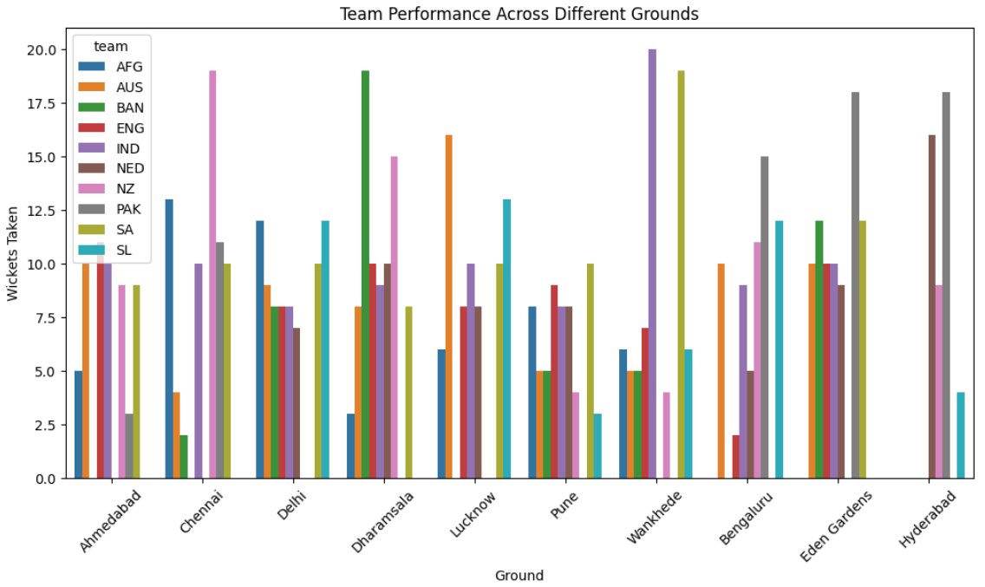

Slide 35
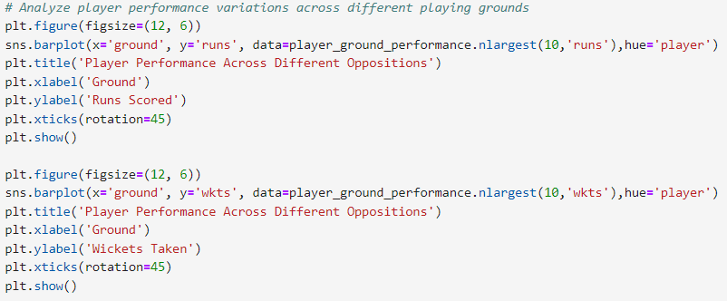
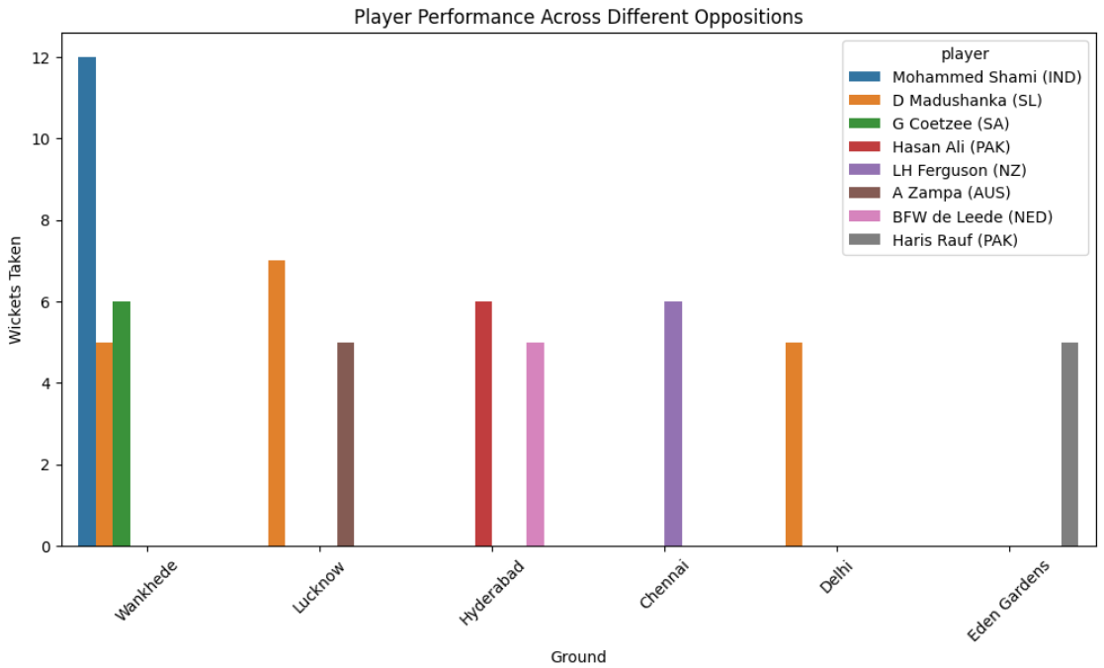
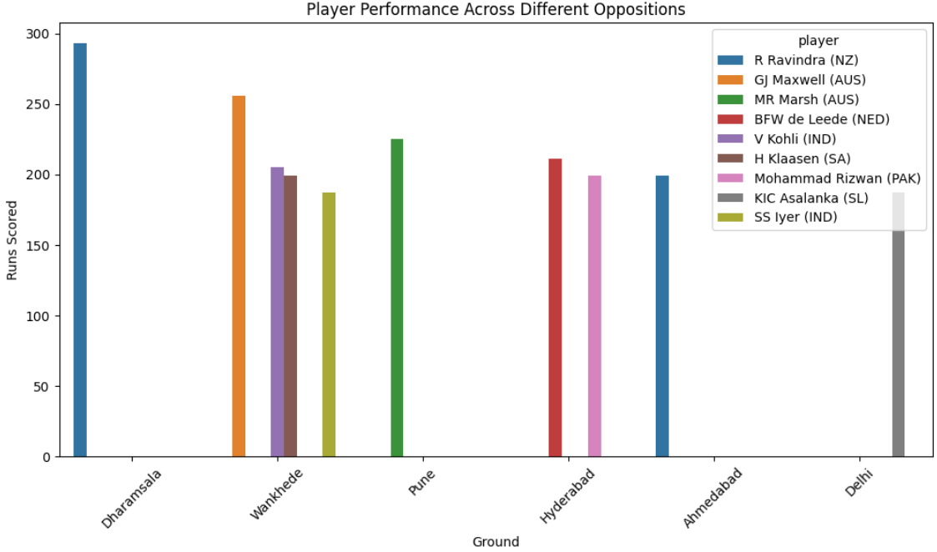

Slide 36
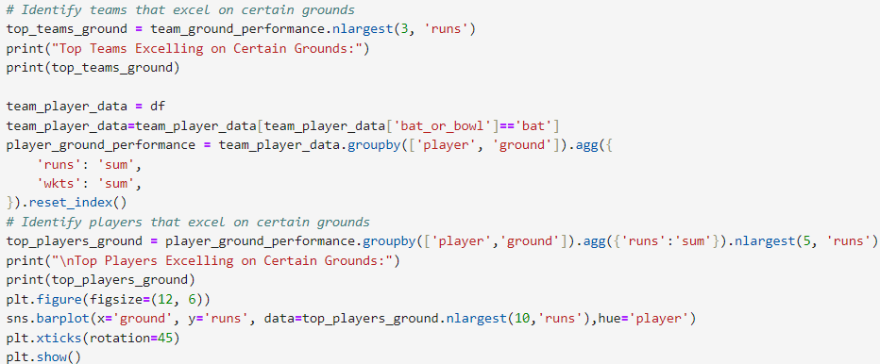
Identify if there are specific teams or players that excel in certain conditions

Slide 37
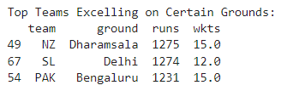
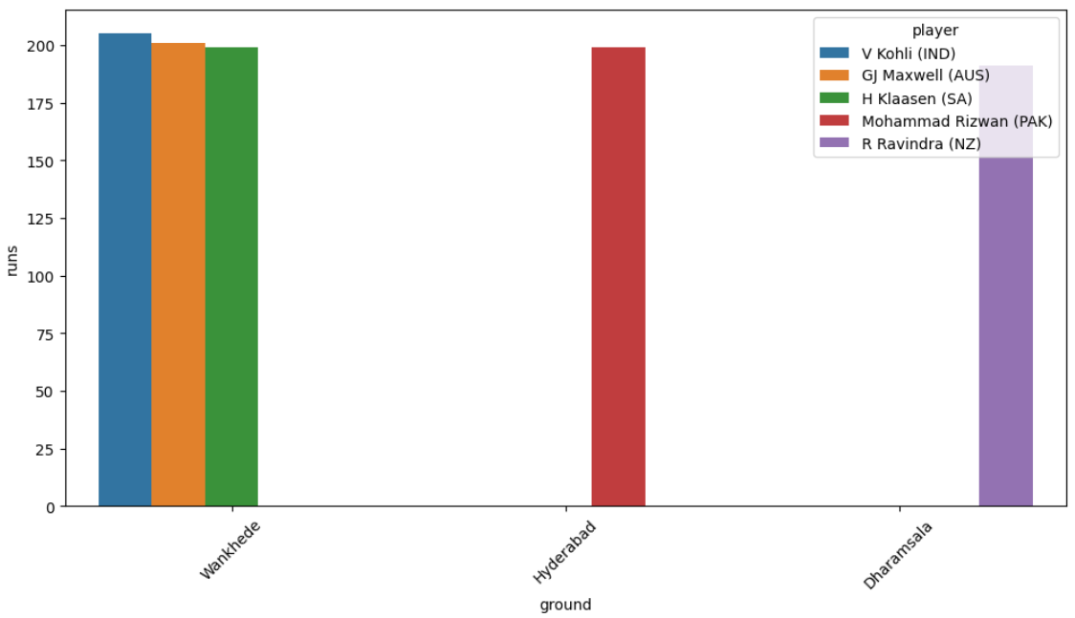
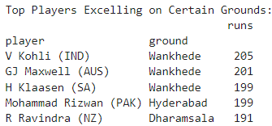
Identify if there are specific teams or players that excel in certain conditions

Slide 38
Temporal analysis
This is our final task to perform, where we'll explore performance trend over time, considering start date and overs played and at last identify any temporal changes in team.

Slide 39
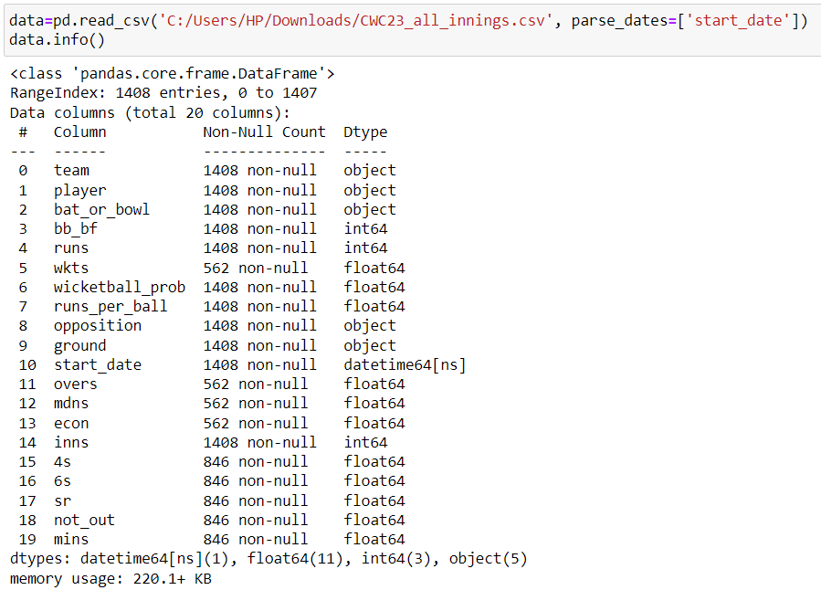
Parsing the dataset
We've to parse the 'start_date' attribute such that its type changes from object to datetime.

Slide 40
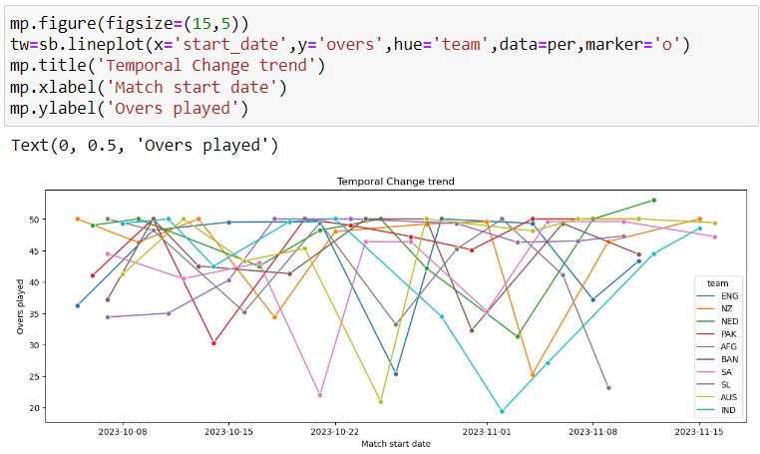
Temporal analysis of all team
Using the lineplot, we observe that various teams like SA, AUS, IND has high temporal changes.

Slide 41
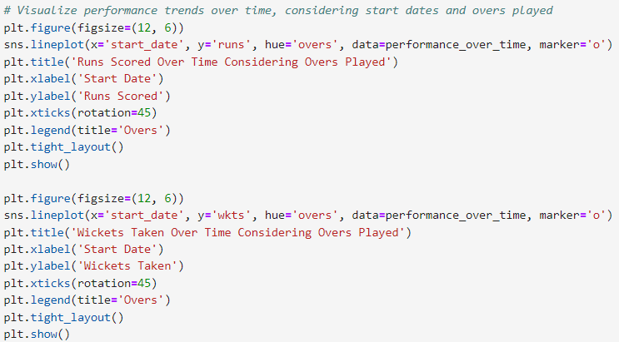
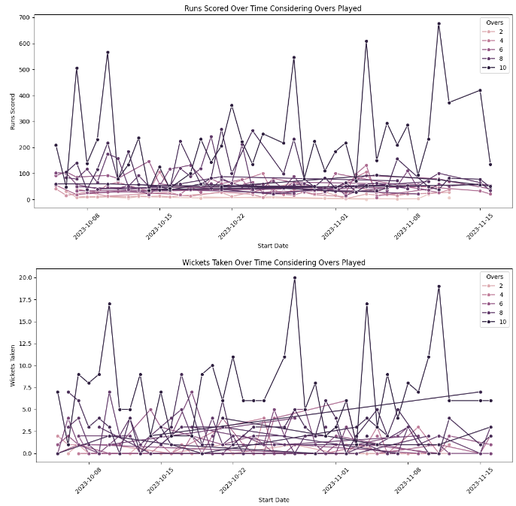
Temporal analysis of all team
Using the lineplot, we observe that various teams like SA, AUS, IND has high temporal changes.

Slide 42

Temporal analysis of team on the basis of runs-scored
Using the lineplot, we observe that teams during final overs are scoring good amount of runs.

Slide 43

Temporal analysis of team on the basis of wickets
Using the lineplot, we observe that teams during final overs taking wickets linearly.

Slide 44


Temporal analysis of team on the basis of Runs

Slide 45

THANK YOU
SOHINI ROY CHOWDHURY
rcsohini.work@gmail.com
MIP-ML-08

