Slide 1
Overview
MyParkingSpaceFiller.py Version1.0
MyDynamicWorldEditor.py Version1.0

Slide 2
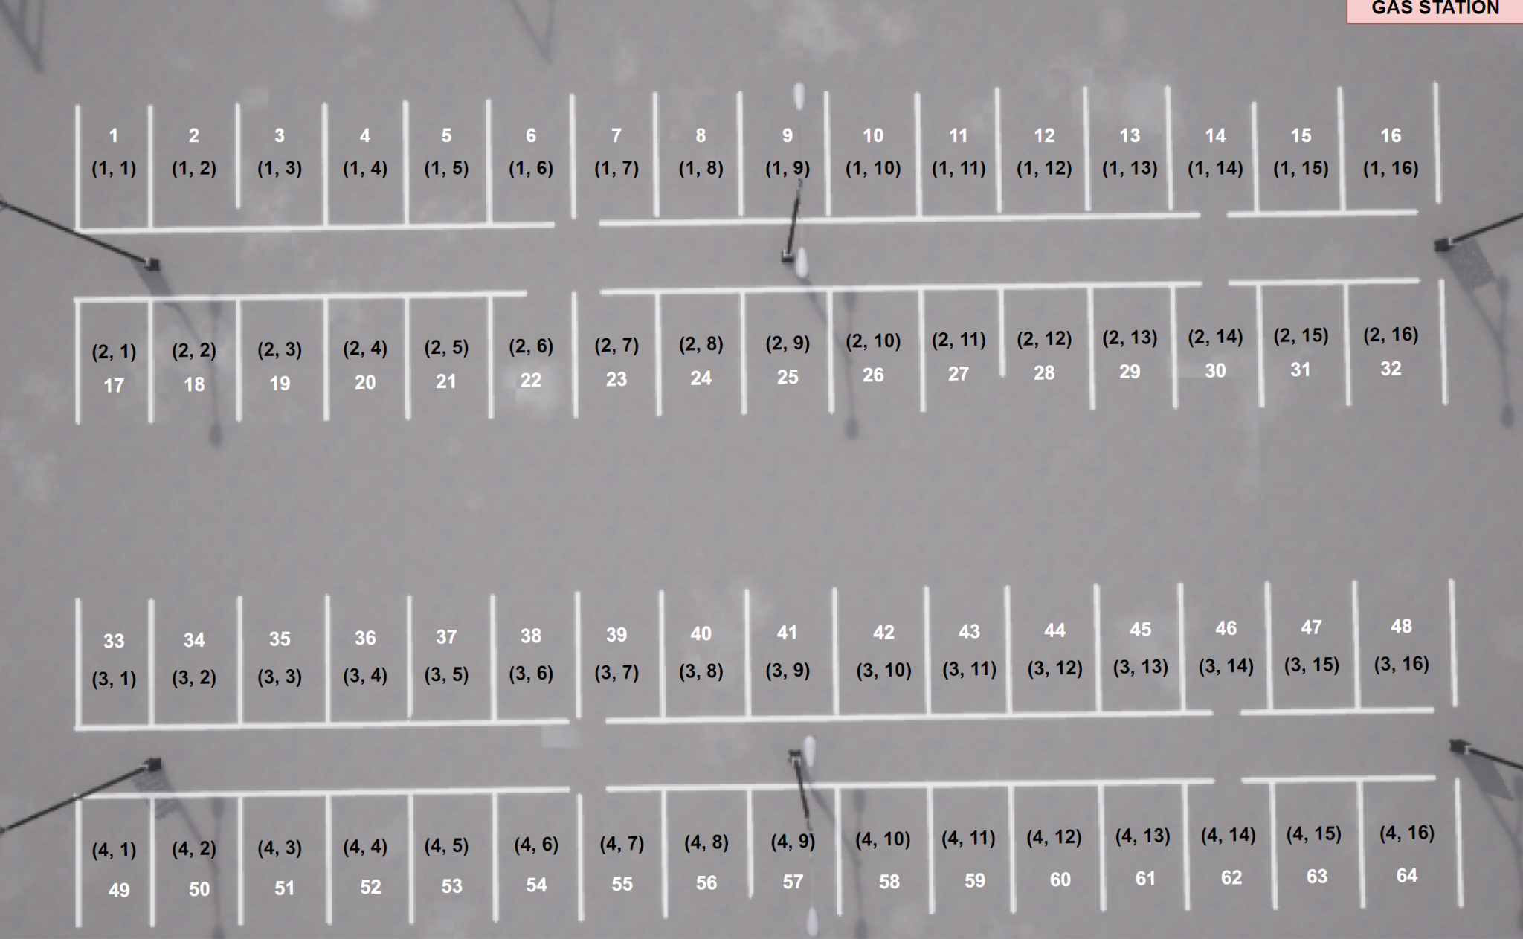
Town04_Opt
General Hints
myDynamicWorldEditor: Script for setting up environment
myParkingSpaceFiller: Script that fills parking space slots according to given configuration file (.csv)
Both scripts mainly focus on Town04_Opt (but are easily extendable)
Parking Space
Each parking slot is identified by unique enumerated number / coordinates
Orientation: Gas Station upper right
Notes
Other Towns could also be used, …
Town05_Opt: Very similar (with less variations)
Town15: Lots of variations but not layered (!)
Town04ParkingSpacePositions.drawio

Slide 3
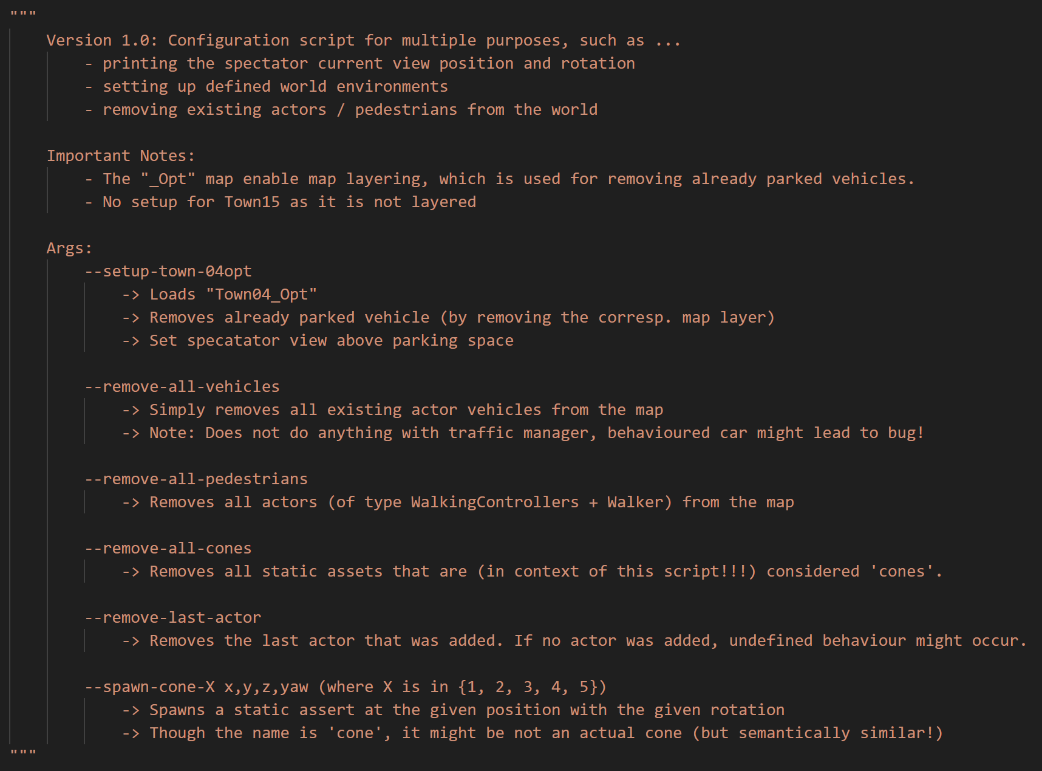
myDynamicWorldEditor.py
py -3.7 myDynamicWorldEditor --setup-town-04opt
… (many other variations)
Basic Features
Showing coordinates + rotation of spectator view
Adding on demand static assets to the environment to given coordinates
Removing all actors (vehicles / pedestrians) or all added static assets
“Undo” (removing last added actor)
Setting up World Environment
Loading Map for Town04
Removing Parked Vehicles
Setting Spectator to correct position

Slide 4
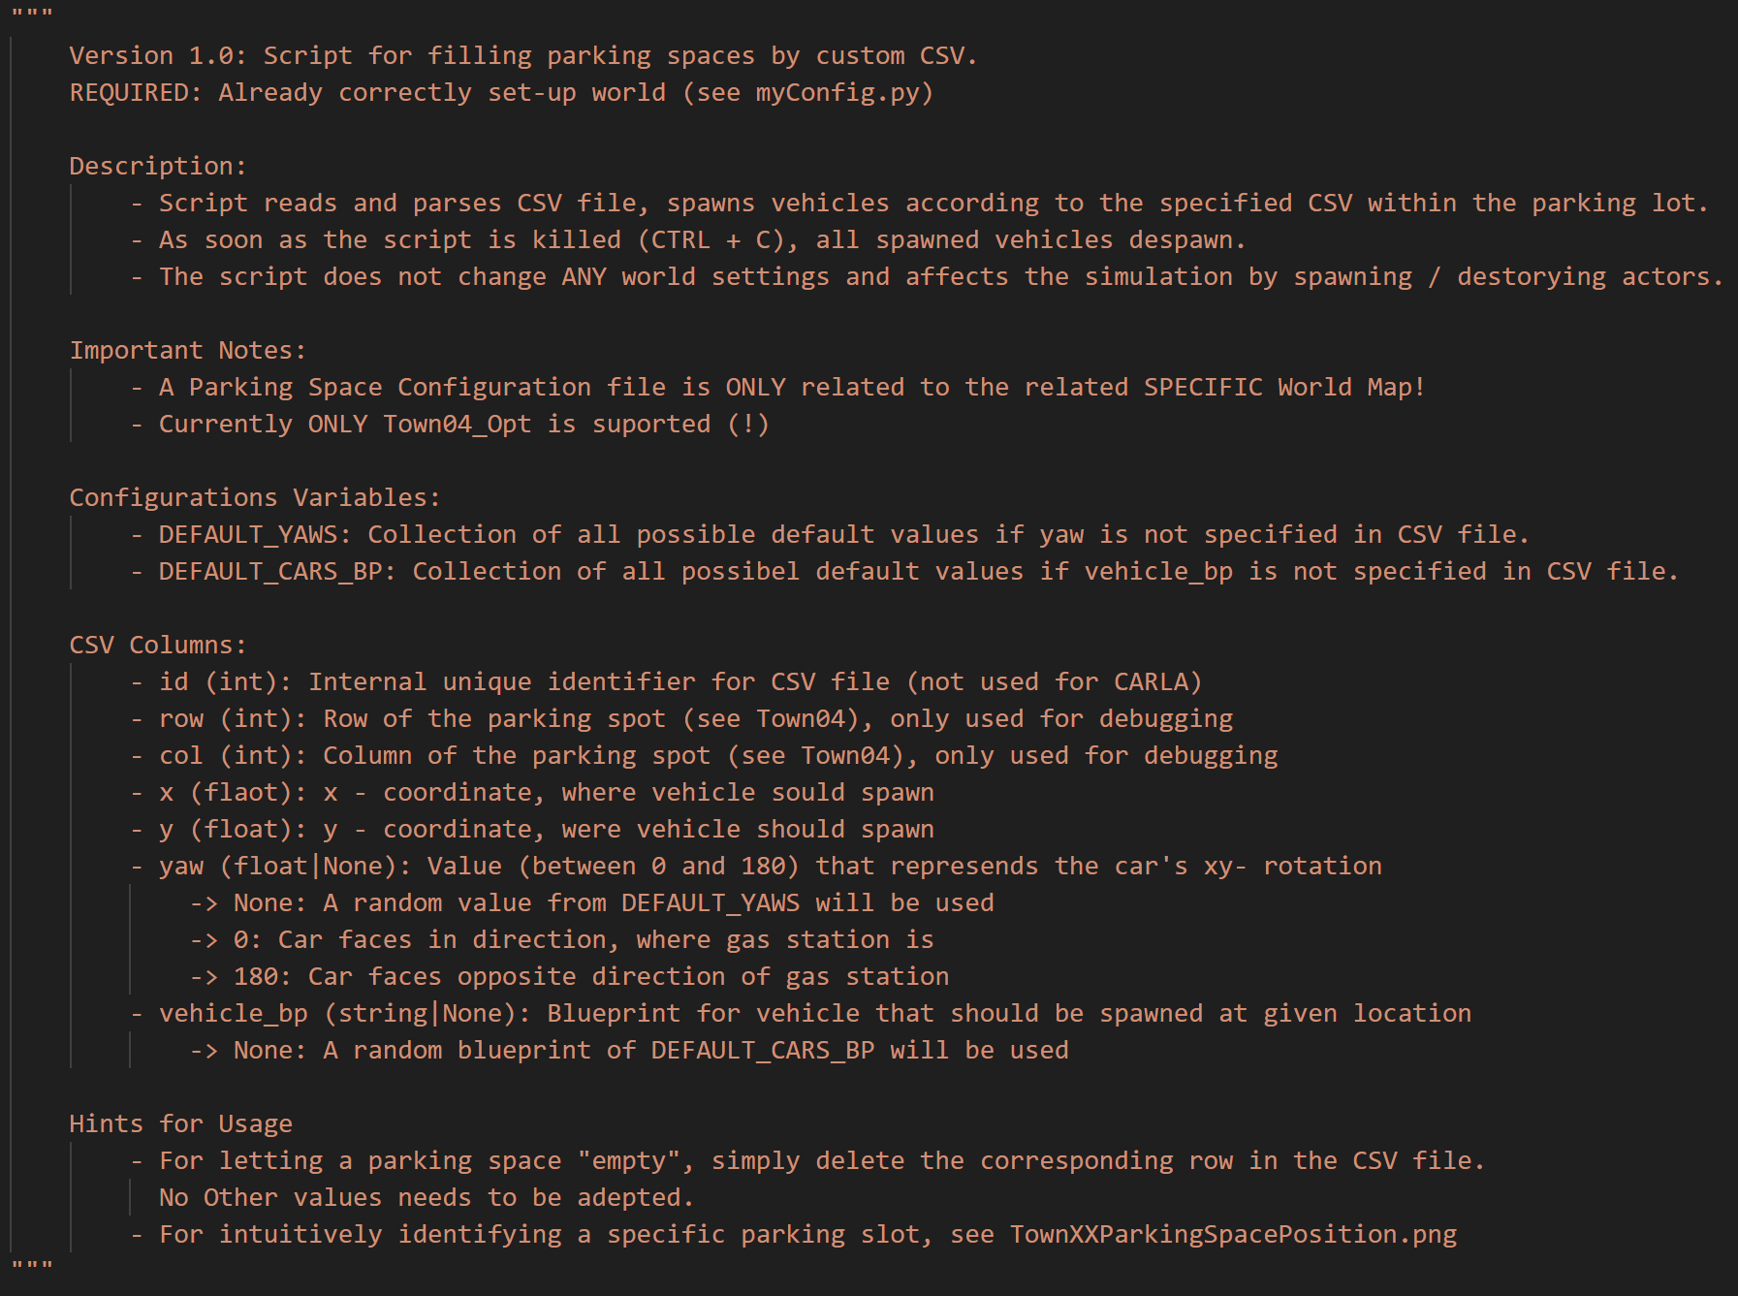

myParkingSpaceFiller.py
py -3.7 myParkingSpaceFiller --config <PATH_TO_CSV_FILE/FILENAME.csv>
Basic Features
Reads CSV File
Spawns vehicles according to CSV file
Color is random of recommended colors
If “vehicle_bp” is None: Random vehicle from DEFAULT_CARS_BP
If “yaw” is None: Random rotation according to DEFAULT_YAWS
CSV File
Each entry corresponds to a parking space slot in a specific Map (currently always Town04_Opt)
Format: id,row,col,x,y,yaw,vehicle_bp
id / row, col correspond to values from picture
yaw can be set to “None”
vehicle_bp can be set to None”

