Slide 1
Weekly Progression Meeting
24.07.2024 - 30.07.2024

Slide 2
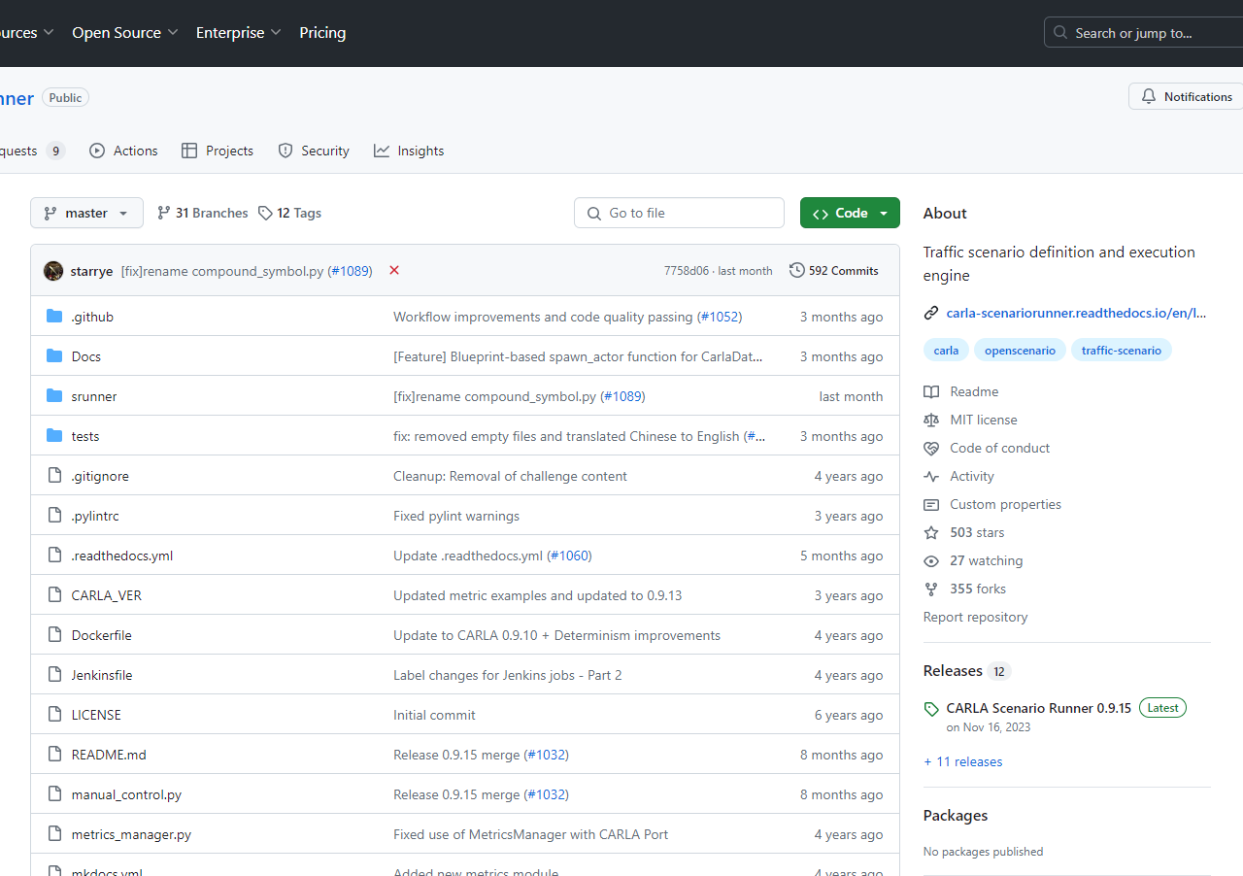
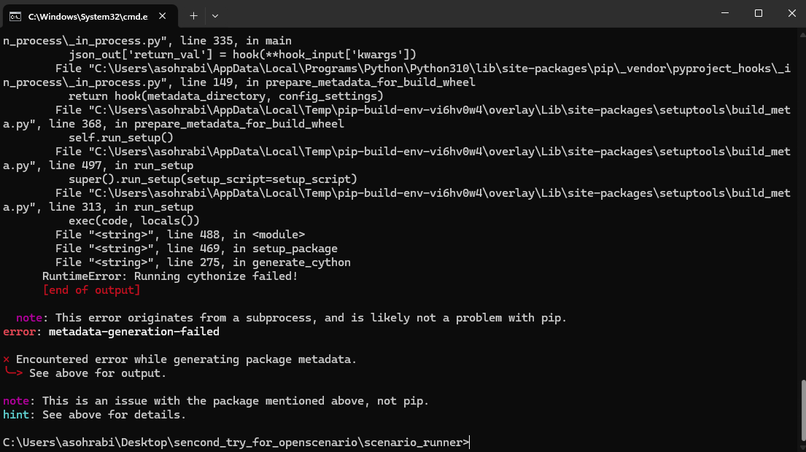
Installation

Slide 3
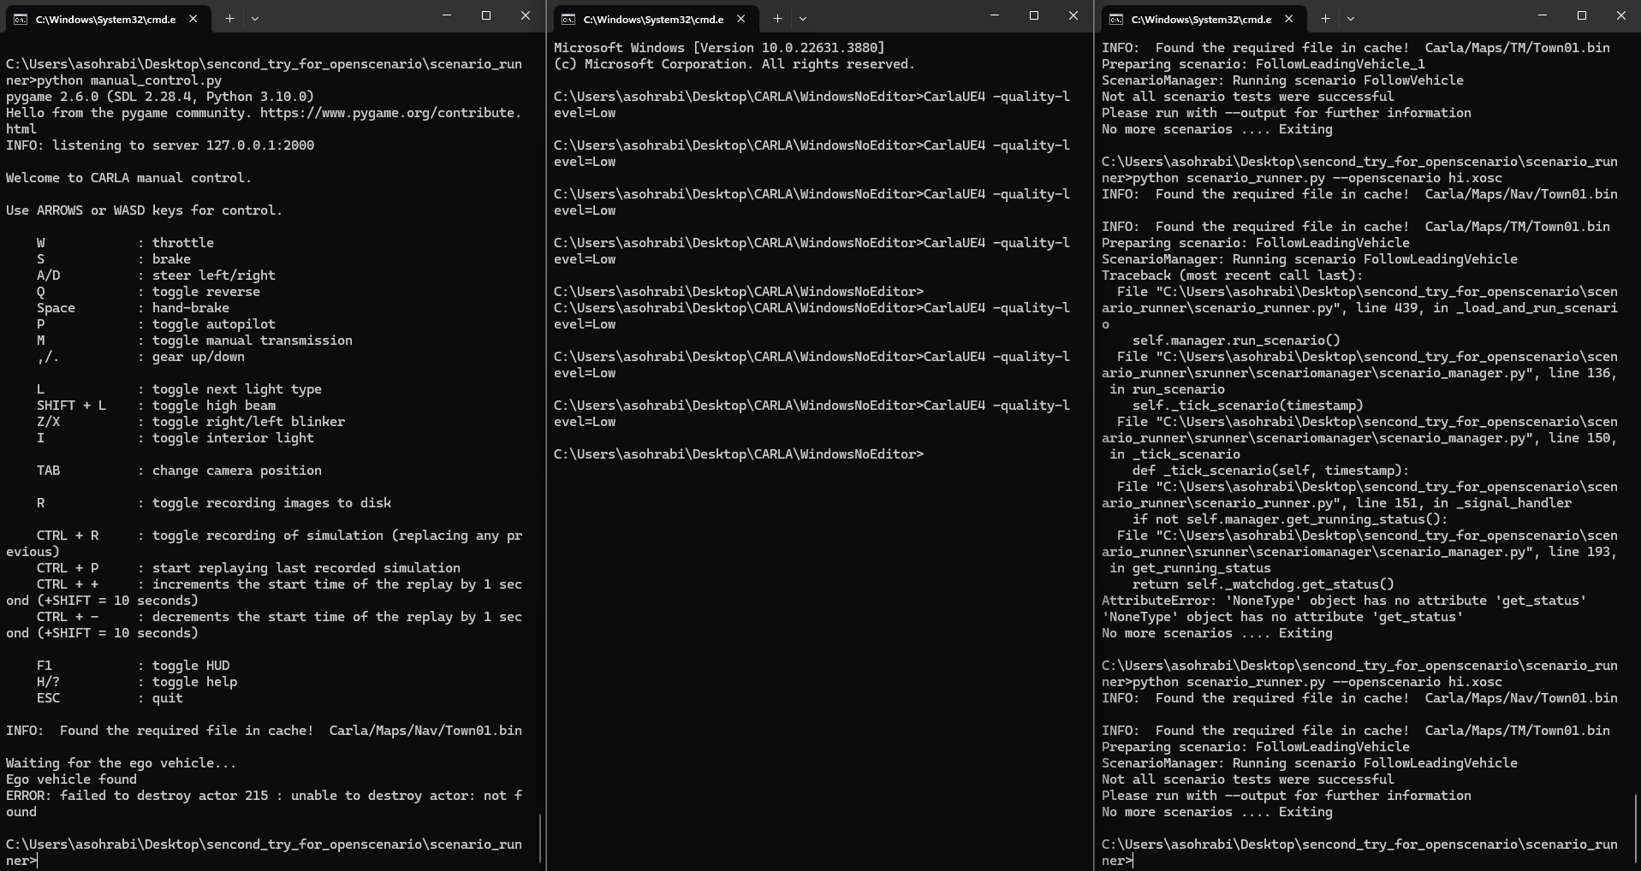
Pipeline
Scenario Runner
(OpenScenario)
Carla Server
Manual Test

Slide 4
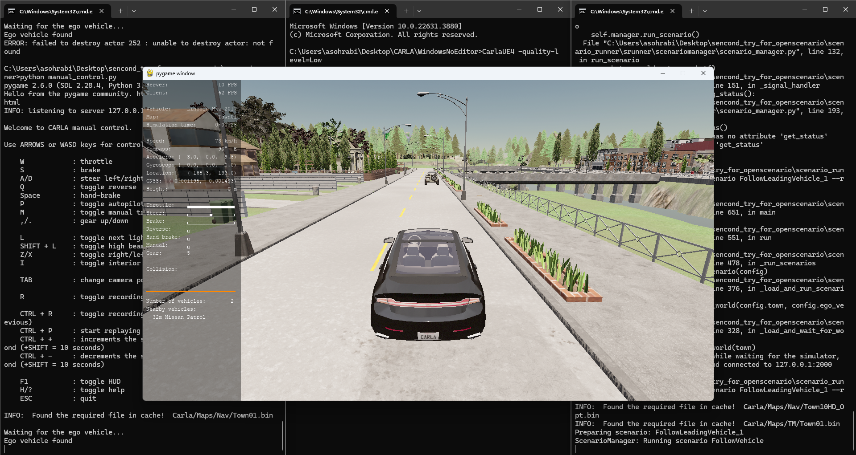
Running the test scenarios

Slide 5
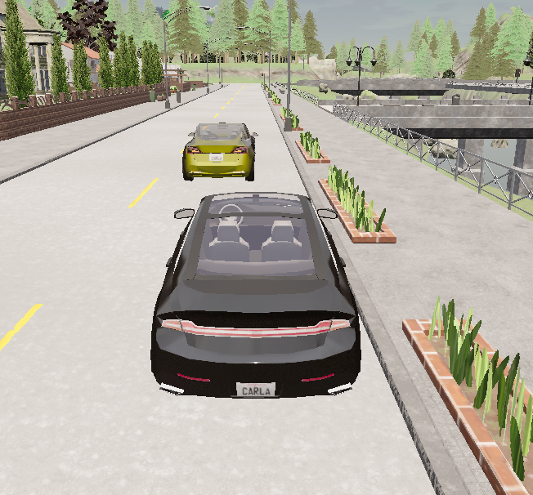
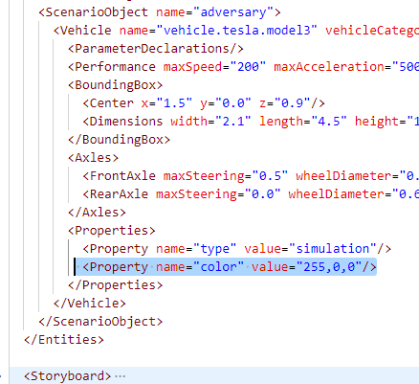
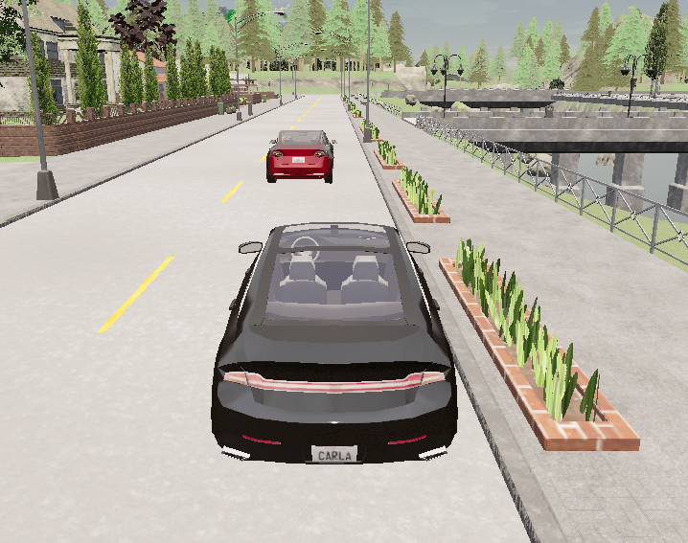
Modifying test scenarios

