Slide 1
Object oriented programming using java
Lab 5

Slide 2
Agenda
Strings
Inheritance
Overriding methods
Super keyword
Final keyword
Abstract classes

Slide 3
Reminder
There will be a practical OOP quiz in sections the week before midterm, in the sections for both group (A & B).
The first hour of each section to quiz Group A of the section and the second hour to quiz group B.

Slide 4
String Example
package practice;
public class B{
public static void main(String[] args) {
String str1 = "Hi";
String str2 = "Hi";
System.out.println(str1==str2);
System.out.println(str1.equals(str2));
String newStr1 = new String("Hi");
String newStr2 = new String("Hi");
System.out.println(newStr1 == newStr2);
System.out.println(newStr1.equals(newStr2));
System.out.println(str1 == newStr1);
System.out.println(newStr2.compareTo(newStr1));
true
true
false
true
false
0

Slide 5
cont
String str = new String("hello World");
str.concat("i'm here");
System.out.println(str);
str = str.concat(",i'm here");
System.out.println(str);
System.out.println(str.length());
System.out.println(str.indexOf("World"));
System.out.println(str.substring(0, 4));
}
}
Hello World
Hello world, I’m here
20
6
hello

Slide 6
Converting Between Numbers and Strings
public class StringToIntExample{
public static void main(String args[]){
String s="200";
int i=Integer.parseInt(s);
System.out.println(s+100);
float a = (Float.valueOf(“10.5”)).floatValue();
System.out.println(a);
String s1=String.valueOf(i);
System.out.println(s1+10); //20010
}}
200100
10.5
20010

Slide 7

Let us practice .. Hands-on 1 (Without Help)
Write a java program that takes an input string from the user and display the number of occurrences of ‘a’ character using String functions
Input: amira
Output: Char 'a' occurred 2 times in the string
15 Minutes

Slide 8
Solution
import java.util.Scanner;
public class Lab3
{
public static void main(String[] args)
{
Scanner input=new Scanner (System.in);
String str = input.next();
//initialized the counter to 0
int counter = 0;
for (int i=0; i<=str.length()-1; i++)
{ if(str.charAt(i) == 'a')
{
//increasing the counter value at each occurrence of 'a'
counter++;
}
} System.out.println("Char 'a' occurred "+counter+" times in the string");
}
}

Slide 9
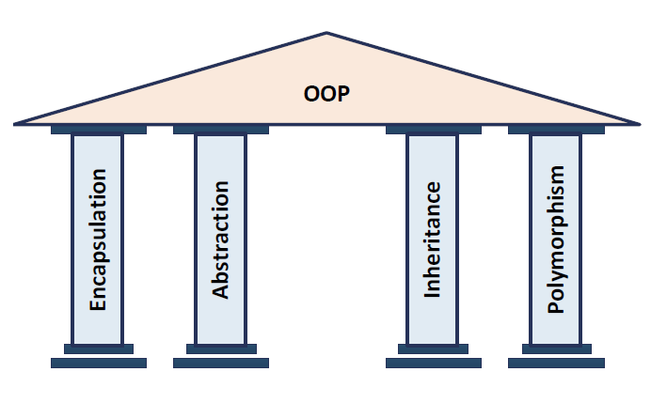

Principles of OOP

Slide 10
Inheritance
Inheritance is the process by which objects of one class extends the properties of objects of another class.
Inheritance implements the “is a” relationship between objects.

Slide 11
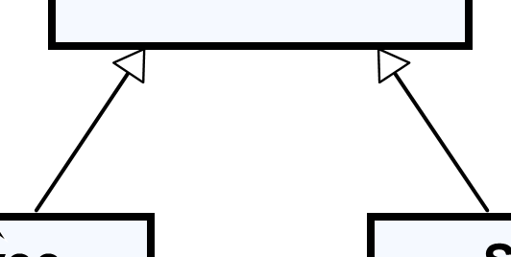
Inheritance - UML Representation
This is a Generalization relationship
“IS-A”
Superclass
(Base Class)
Person
+Name: String
+Address: String
Subclass
(Derived Class)
Subclass
(Derived Class)
Employee
Student
+Company: String
+Salary: double
+School: String
Notes:
Generalization expresses a parent/child relationship among all classes

Slide 12
In Code we apply the inheritance using the extends key word.
class Subclass-name extends Superclass-name
{
//methods and fields
}

Slide 13
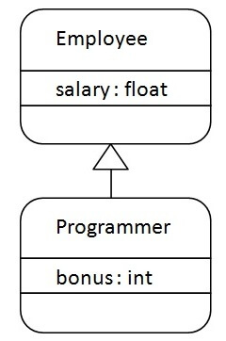
Example
class Employee
{
float salary=40000;
}
class Programmer extends Employee
{
int bonus=10000;
}
public static void main(String args[])
{
Programmer p=new Programmer();
System.out.println(“Salary is:"+p.salary);
System.out.println("Bonus is:"+p.bonus);
}
Output
Salary is: 40000
Bonus is: 10000
Notes:
The relationship between the two classes is Programmer IS-A Employee. It means that Programmer is a type of Employee.
Output:
Programmer salary is:40000.0
Bonus of programmer is:10000

Slide 14
What is inherited and what is not ?!?!
package practice;
class A{
public A() {}
public void publicMethod() {}
protected void protectedMethod() {}
Private void privateMethod(){}
public static void staticMethod() {}
}
public class B extends A{
}
Not inherited
Inherited
Inherited
Not inherited
Inherited

Slide 15
Example on protected access modifier
//save by A.java
package pack;
public class A{
protected void msg(){System.out.println("Hello");}
}
//save by B.java
package mypack;
import pack.*;
class B extends A{
public static void main(String args[]){
B obj = new B();
obj.msg();
}
}
Output
Hello
Notes:
In this example, we have created the two packages pack and mypack. The A class of pack package is public, so it can be accessed from outside the package. But msg method of this package is declared as protected, so it can be accessed from outside the class only through inheritance.
Output:Hello

Slide 16
Example default access modifier
//save by A.java
package pack;
public class A{
void msg(){System.out.println("Hello");}
}
//save by B.java
package mypack;
import pack.*;
class B extends A{
public static void main(String args[]){
B obj = new B();
obj.msg();
}
}
Compile time error
Notes:
In this example, we have created the two packages pack and mypack. The A class of pack package is public, so it can be accessed from outside the package. But msg method of this package is declared as protected, so it can be accessed from outside the class only through inheritance.
Output:Hello

Slide 17
Overriding methods
If subclass (child class) has the same method as declared in the parent class, it is known as method overriding .

Slide 18
Example without method overriding
/Here, we are calling the method of parent class with child //class object.
//Creating a parent class
class Vehicle
{
void run(){System.out.println("Vehicle is running");}
}
//Creating a child class
class Bike extends Vehicle
{
}
public static void main(String args[]){
//creating an instance of child class
Bike obj = new Bike();
//calling the method with child class instance
obj.run();
}
You have to provide a specific implementation of run() method in subclass Bike to display another output, that is why we use method overriding.
Output
Vehicle is running
Notes:
Vehicle is running

Slide 19
With method overriding
//Creating a parent class.
class Vehicle{
//defining a method
void run(){System.out.println("Vehicle is running");}
}
//Creating a child class
class Bike2 extends Vehicle
{
//defining the same method as in the parent class
void run(){System.out.println("Bike is running");}
}
public static void main(String args[]){
Bike2 obj = new Bike2();//creating object
obj.run();//calling method
}
Output
Bike is running
Notes:
Bike is running

Slide 20
Overloading vs Overriding
within one class
in two classes that have IS-A
class Adder{
public int add(int num1, int num2) {return num1+num2;}
public int add(int num1, int num2, int num3) {return num1+num2+num2;}
}
class mainClass{
public static void main(String[] args) {
Adder obj = new Adder();
obj.add(2,4);
obj.add(2,4,6);
}
}
class Vehicle{
void run() {System.out.println("in Vehicle");}
}
class Bike extends Vehicle{
void run() {System.out.println("in Bike");}
}
class mainClass{
public static void main(String[] args) {
Bike obj = new Bike();
obj.run();
}
}

Slide 21
Overloading vs Overriding
parameter must be different
parameter must be same
class Adder{
public int add(int num1, int num2) {return num1+num2;}
public int add(int num1, int num2, int num3) {return num1+num2+num2;}
}
class mainClass{
public static void main(String[] args) {
Adder obj = new Adder();
obj.add(2,4);
obj.add(2,4,6);
}
}
class Vehicle{
void run() {System.out.println("in Vehicle");}
}
class Bike extends Vehicle{
void run() {System.out.println("in Bike");}
}
class mainClass{
public static void main(String[] args) {
Bike obj = new Bike();
obj.run();
}
}

Slide 22
Overloading vs Overriding
Compile time Polymorphism
Runtime Polymorphism
class Adder{
public int add(int num1, int num2) {return num1+num2;}
public int add(int num1, int num2, int num3) {return num1+num2+num2;}
}
class mainClass{
public static void main(String[] args) {
Adder obj = new Adder();
obj.add(2,4);
obj.add(2,4,6);
}
}
class Vehicle{
void run() {System.out.println("in Vehicle");}
}
class Bike extends Vehicle{
void run() {System.out.println("in Bike");}
}
class mainClass{
public static void main(String[] args) {
Bike obj = new Bike();
obj.run();
}
}

Slide 23
Super keyword
Super keyword can be used to:
Refer immediate parent class instance variable.
Invoke immediate parent class method.
super() can be used to invoke immediate parent class constructor.

Slide 24
1) to refer immediate parent class instance variable
We can use super keyword to access the data member or field of parent class. Especially if parent class and child class have same fields, so to resolve the ambiguity.
class Animal
{
String color="white";
}
class Dog extends Animal{
String color="black";
void printColor(){
System.out.println(color); //prints color of Dog class “black”
System.out.println(super.color);//prints color of Animal class ”white”
} }
class TestSuper1{
public static void main(String args[]){
Dog d=new Dog();
d.printColor();
}
}
Notes:
Animal and Dog both classes have a common property color. If we print color property, it will print the color of current class by default. To access the parent property, we need to use super keyword.
Output:
black
white

Slide 25
2) to invoke parent class method
It should be used if subclass contains the same method as parent class.
In other words, it is used if method is overridden.
class Animal{
void eat(){
System.out.println("eating...");
}
}
class Dog extends Animal{
void eat(){System.out.println("eating bread...");}
void bark(){System.out.println("barking...");}
void work(){
super.eat();
bark();
}
}
class TestSuper2{
public static void main(String args[]){
Dog d=new Dog();
d.work();
}}
Output
eating…
barking…
Notes:
eating...
barking...
In the above example Animal and Dog both classes have eat() method if we call eat() method from Dog class, it will call the eat() method of Dog class by default because priority is given to local.
To call the parent class method, we need to use super keyword

Slide 26
3) super is used to invoke parent class constructor
The super keyword can also be used to invoke the parent class constructor.
class Animal{
Animal(){System.out.println(“Animal is created");}
}
class Dog extends Animal{
Dog(){
super();
System.out.println(“Dog is created");
} }
class TestSuper3{
public static void main(String args[]){
Dog d=new Dog();
}}
Output
Animal is created
Dog is created
Notes:
animal is created
dog is created

Slide 27
3) super is used to invoke parent class constructor
super() is added in each class constructor automatically by compiler if there is no super() or this() as the first statement.
class Animal{
Animal(){System.out.println(“Animal is created");}
}
class Dog extends Animal{
Dog(){
System.out.println(“Dog is created");
} }
class TestSuper3{
public static void main(String args[]){
Dog d=new Dog();
}}
Output
Animal is created
Dog is created
Notes:
animal is created
dog is created

Slide 28
Final Keyword
If you defined any variable as final, you cannot change the value of it. (It will be constant).
class Bike9{
final int speedlimit=90;//final variable
void run(){
speedlimit=400;
}
public static void main(String args[]){
Bike9 obj=new Bike9();
obj.run();
}
}//end of class
Compile time error

Slide 29
Final Keyword
If you defined any method as final, you cannot override it.
class Bike{
final void run(){System.out.println("running");}
}
class Honda extends Bike{
void run(){System.out.println("running safely with 100kmph");}
public static void main(String args[]){
Honda honda= new Honda();
honda.run();
}
}
Compile time error

Slide 30
Final Keyword
If you defined any class as final, you cannot extend it.
final class Bike{}
class Honda1 extends Bike{
void run(){System.out.println("running safely with 100kmph");}
public static void main(String args[]){
Honda1 honda= new Honda1();
honda.run();
}
}
Compile time error

Slide 31
Principles of OOP

Slide 32
Abstract Class
Sometimes, the superclass does not have a "meaning" or does not directly relate to a "thing" in the system. “Like class Person or Animal”

Slide 33
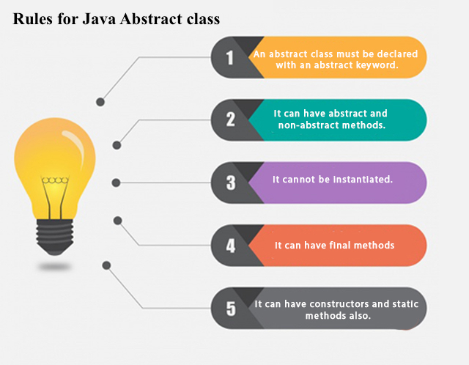

Slide 34
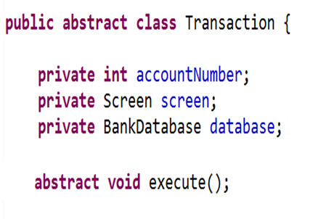
Transaction S;
S = new Transaction();
We can declare a variable of that class
But, no objects can be instantiated from that class

Slide 35
Let us practice .. Hands-on 2 - With Help
Note that:
The classes Dog and Lion inherit the Animal class
Your program should have 3 classes.
An Animal class that has:
A protected string color with default value = “default color”.
A protected bool is_domesticated.
A display_info () method that displays the animal information.
A Dog class that has method update_dog_color() that updates the color value to “Brown or Black”.
A Lion class that has method update_lion_color() that updates the color value to “Brown”.
The two subclasses initializes the is_domesticated field using a parametrized constructor defined in the Animal class
In main:
Create an object from Dog and Lion.
Update their colors and display them.
20 Minutes

Slide 36
package practice;
class Animal {
protected String color ="defaultValue";
protected Boolean is_Demosticated;
Animal(Boolean is_Demosticated){
this.is_Demosticated = is_Demosticated;
}
void displayInfo() {
System.out.println("coor is: "+color+"is_Demosticated: "+is_Demosticated);
}
}
class Dog extends Animal{
Dog(Boolean is_Demosticated)
{
super(is_Demosticated);
}
void update_Dog_Color() {
color = "black";
}
}

Slide 37
class lion extends Animal{
lion(Boolean is_Demosticated)
{
super(is_Demosticated);
}
void update_lion_Color() {
color = "brown";
}
}
public class mainClasss{
public static void main(String[] args) {
Dog d = new Dog(true);
lion l = new lion(true);
d.update_Dog_Color();
l.update_lion_Color();
d.displayInfo();
l.displayInfo();
}
}

Slide 38

questions

