Slide 1
Object Oriented Programming using Java
Lab 4

Slide 2
Content
Methods
Method Types
Overloading
Parameter passing
This keyword
Hands On

Slide 3
Methods Declaration in Java
Modifiers
Method’s Name
Parameter’s list
Return Type
Public static int myMethod(int a, int b){
//body
}
Private
Protected
[Optional]
final
abstract
[Optional]

Slide 4
Methods in java
Types of Methods in Java:
Main Method
Constructors
Instance Method
Class Method

Slide 5
Main method
A Java application is a public Java class with a single main() method.
The main() method is the entry point into the application.
The signature of the method is always:
public static void main(String[] args)
Command-line arguments are passed through the args parameter, which is an array of Strings.

Slide 6
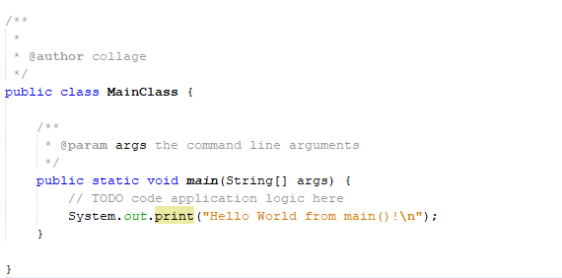
Main method

Slide 7
Constructors
In Java, constructors are like methods that are called when an object is created.
They have no return type, not even void and are called like the class.
They can be public, private, protected. You can also overload them (write several of them with different inputs).

Slide 8
Instance Methods
Instance methods are methods which require an object of its class to be created before it can be called. To invoke a instance method, we have to create an Object of the class in within which it defined.
Every individual Object created from the class has its own copy of the instance method of that class.

Slide 9
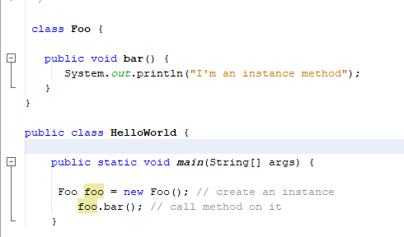
Instance Methods Example

Slide 10
Class Methods (Static Methods)
It is a method which belongs to the class and not to the object(instance)
A static method can access only static data. It can not access non-static data (instance variables)
A static method can call only other static methods and can not call a non-static method from it.
A static method can be accessed directly by the class name and doesn’t need any object
A static method cannot refer to "this" or "super" keywords in anyway
The syntax for invoking static method is:
ClassName.methodName();

Slide 11
Class Method Example
class Calculate{
static int cube(int x){
return x*x*x;
}
public static void main(String args[]){
int result=Calculate.cube(5);
System.out.println(result);
}
}

Slide 12
Class Method Example cont.
public class Example {
int a = 10; // instance variable
static int b = 10; // static variable (belongs to the class)
public void instanceMethod(){
a =a + 10;
b = b+1;
}
public static void staticMethod(){
b = b + 10;
a = a+1;
}
}
//Error .. Because static methods can’t modify non static data members

Slide 13
Class Method vs instance method i
Instance method are methods which require an object of its class to be created before it can be called.
Static methods are the methods in Java that can be called without creating an object of class.
Instance method is not with static keyword.
Static method is declared with static keyword.

Slide 14
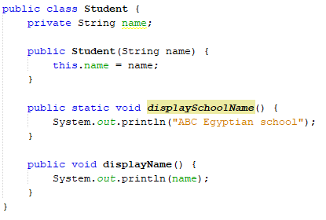
Class Method vs instance method i

Slide 15
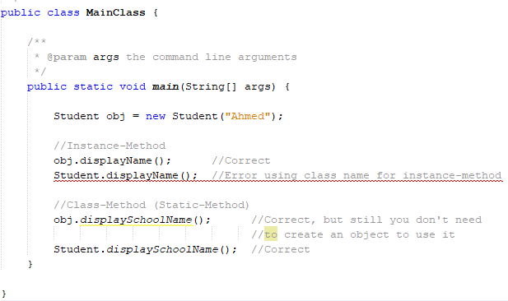
Class Method vs instance method i

Slide 16
Class Method vs instance method ii
Instance methods exist as multiple copies depending on the number of instances created for that class.
Static method means which will exist as a single copy for a class.
Instance or non static methods are invoked by using object reference.
Static methods can be invoked by using class reference.

Slide 17
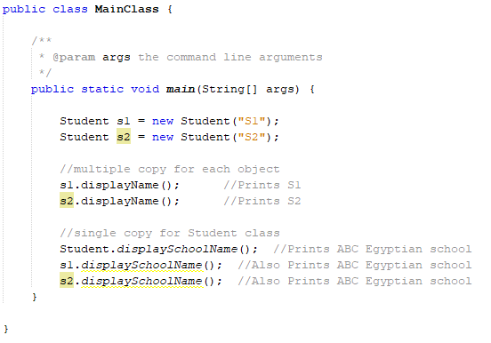
Class Method vs instance method ii

Slide 18
Class Method vs instance method iii
Instance method can access static variables and static methods directly.
Static methods can’t access instance methods and instance variables directly.

Slide 19
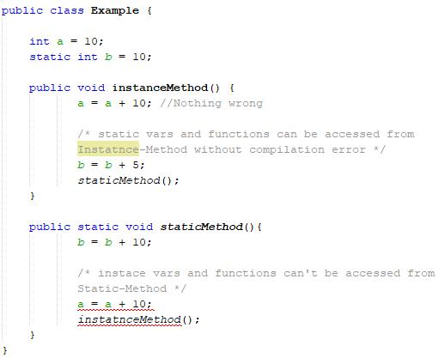
Class Method vs instance method iii

Slide 20
Class Method vs instance method Example
public class Example {
int a = 10;
static int b = 10;
public void instanceMethod()
{
a =a + 10;
}
public static void staticMethod(){
b = b + 10;
}
public static void main(String[] args) {
Example exmp = new Example();
exmp.instanceMethod();
System.out.println(exmp.a);
Example.staticMethod();
System.out.println(Example.b);
exmp.staticMethod();
System.out.println(exmp.b);
}
}
20
20
30

Slide 21

Let us practice .. Hands-on 1 (With Help)
Create a java class called Student that has these attributes:
rollno
name
static college contains the value “ITS”
Implement two methods in the class:
A static method that changes the value of the college to “BBDIT”
A method to display the student’s information.
In main:
Create a new object and display its value
Then change the name of the college using the implemented function and display the value of the object again
20 Minutes

Slide 22
solution
class Student{
int rollno;
String name;
static String college = "ITS";
static void change(){
college = "BBDIT";
}
Student(int r, String n){
rollno = r;
name = n;
}
void display()
{System.out.println(rollno+" "+name+" "+college);}
}
public class TestStaticMethod{
public static void main(String args[]){
Student s1 = new Student(111,“ali");
s1.display();
Student.change();//calling change method
Student s2 = new Student(222,“samy");
Student s3 = new Student(333,“sara");
s2.display();
s3.display();
s1.display();
}
}
111 ali ITS
222 samy BBDIT
333 sara BBDIT
111 ali BBDIT

Slide 23
Methods overloading
If a class has multiple methods having same name but different in parameters, it is known as Method Overloading.
There are two ways to overload a method in java
By changing number of arguments
By changing the data type

Slide 24
Method Overloading: changing no. of arguments
class Adder{
static int add(int a,int b){return a+b;}
static int add(int a,int b,int c){return a+b+c;}
}
class TestOverloading1{
public static void main(String[] args){
System.out.println(Adder.add(11,11));
System.out.println(Adder.add(11,11,11));
}}
//22
//33

Slide 25
Method Overloading: changing data type of arguments
class Adder{
static int add(int a, int b){return a+b;}
static double add(double a, double b){return a+b;}
}
class TestOverloading2{
public static void main(String[] args){
System.out.println(Adder.add(11,11));
System.out.println(Adder.add(12.3,12.6));
}}
//22
//24.9

Slide 26
Constructor overloading
public Rectangle( ) {
len = 0;
width = 0;
color = null;
}
public Rectangle(int l, int w) {
len = l;
width = w;
color = null;
}
public Rectangle(Rectangle r) {
len = r.len;
width = r.width;
color = r.color;
}

Slide 27
Parameters and arguments
Parameters are the list of variables in the method declaration.
Arguments are the actual values that are passed in when the method is invoked.
class Calculate{
static int cube(int x){
return x*x*x;
}
public static void main(String args[]){
int result=Calculate.cube(5);
System.out.println(result);
}
}
Parameter
Argument

Slide 28
Parameters in java
Data types in Java:
Primitive data types, such as doubles, floats, and integers,
Reference data types, such as objects and arrays.
Primitive data types when passed as arguments, they are passed by value.
In case of reference data types, a copy of their references are passed not their actual values.

Slide 29
Passing by value example
public class Main
{
public static void main(String[] args)
{
int x = 5;
change(x);
System.out.println(x);
}
public static void change(int x)
{
x = 10;
}
}
Output = 5

Slide 30
Passing an object example i
class Test
{
int x;
Test(int i) { x = i; }
}
class Main
{
public static void main(String[] args)
{
// t is a reference
Test t = new Test(5);
change(t);
System.out.println(t.x);
}
public static void change(Test ts)
{
ts.x = 10;
}
}
0x100
10
5
t
ts

Slide 31
Passing an object example i
class Test
{
int x;
Test(int i) { x = i; }
}
class Main
{
public static void main(String[] args)
{
// t is a reference
Test t = new Test(5);
change(t);
System.out.println(t.x);
}
public static void change(Test ts)
{
ts = new Test(5);
ts.x = 10;
}
}
0x100
0x200
5
10
t
ts

Slide 32
What is the output?
public class Test {
public static void main(String[] args) {
Balloon red = new Balloon("Red");
Balloon blue = new Balloon("Blue");
System.out.println("red color="+red.getColor());
System.out.println("blue color="+blue.getColor());
foo(blue);
System.out.println("blue color="+blue.getColor());
}
private static void foo(Balloon balloon)
{
balloon.setColor("Red");
balloon = new Balloon("Green");
balloon.setColor("Blue");
}
public class Balloon {
private String color;
public Balloon(String c){ color=c;
}
public String getColor() {
return color;
}
public void setColor(String color) {
this.color = color;
}
}
Notes:
Output:
red color=Red
blue color=Blue
blue color=Red

Slide 33
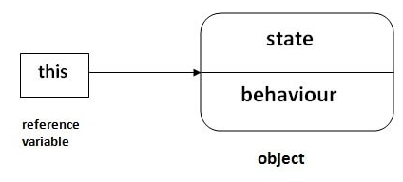
This keyword
There can be a lot of usage of java this keyword. In java, this is a reference variable that refers to the current object.

Slide 34
This keyword usages
Some of the usages of java this keyword:
this can be used to refer current class instance variable.
this can be used to invoke current class method
this() can be used to invoke current class constructor.

Slide 35
1) this: to refer current class instance variable
The this keyword can be used to refer current class instance variable.
If there is ambiguity between the instance variables and parameters, this keyword resolves the problem of ambiguity.
If the name of local variables(formal arguments) and instance variables are different, there is no need to use this keyword

Slide 36
1) this: to refer current class instance variable example
class TestThis1{
public static void main(String args[])
{
Student s1=new Student(111,"ali",5000f);
Student s2=new Student(112,"samy",6000f);
s1.display();
s2.display();
}}
class Student{
int rollno;
String name;
float fee;
Student(int rollno,String name,float fee){
rollno=rollno;
name=name;
fee=fee;
}
void display()
{System.out.println(rollno+" "+name+" "+fee);}
}
0 null 0.0
0 null 0.0

Slide 37
1) this: to refer current class instance variable example
class TestThis1{
public static void main(String args[])
{
Student s1=new Student(111,"ali",5000f);
Student s2=new Student(112,"samy",6000f);
s1.display();
s2.display();
}}
class Student{
int rollno;
String name;
float fee;
Student(int rollno,String name,float fee){
this.rollno=rollno;
this.name=name;
this.fee=fee;
}
void display()
{System.out.println(rollno+" "+name+" "+fee);}
}
111 ali 5000
112 samy 6000

Slide 38
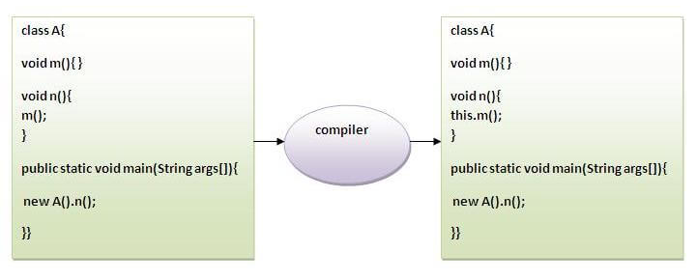
2) this: to invoke current class method
You may invoke the method of the current class by using the this keyword. If you don't use the this keyword, compiler automatically adds this keyword while invoking the method.

Slide 39
2) this: to invoke current class method example
class A{
void m(){System.out.println("hello m");}
void n(){
System.out.println("hello n");
//m(); //same as this.m()
this.m();
}
}
class TestThis4{
public static void main(String args[]){
A a=new A();
a.n();
}
}
hello n
hello m

Slide 40
3) this() : to invoke current class constructor
The this() constructor call can be used to invoke the current class constructor.
It is used to reuse the constructor. In other words, it is used for constructor chaining.

Slide 41
3) this() : to invoke current class constructor example
Calling default constructor from parameterized constructor:
class A{
A(){System.out.println("hello a");}
A(int x){
this();
System.out.println(x);
}
}
class TestThis5{
public static void main(String args[]){
A a=new A(10);
}
}
hello a
10

Slide 42
3) this() : to invoke current class constructor example
Calling parameterized constructor from default constructor:
class A{
A(){
this(5); //calls the parametrizes constructor that takes 1 parameter
System.out.println("hello a");
}
A(int x){
System.out.println(x);
}
}
class TestThis{
public static void main(String args[]){
A a=new A();
}
}
5
hello a

Slide 43
Take care!
Rule: Call to this() must be the first statement in constructor.
class Student{
int rollno;
String name;
float fee;
Student(int rollno,String name){
this.rollno=rollno;
this.name=name;
}
Student(int rollno,String name,float fee){
this.fee=fee;
this(rollno,name); //Error
}

Slide 44
Let us practice .. Hands-on 2 (Without Help)
Create Employee’s class such that:
It contains name , address and salary.
Create a parametrized constructor that has name, salary and address as parameters.
Create a name and salary parametrized constructor that uses the 3-parameter constructor “constructor chaining”
Create a name parametrized constructor that uses the 2-parameter constructor “constructor chaining”
Create default constructor that uses the parametrized constructor with name parameter “constructor chaining”
Implement a method that displays the Employee’s values
In main: create a new object that uses the default constructor and display its values.
30 Minutes

Slide 45
solution
public Employee(String name, int sal, String addr)
{ this.empName=name; this.empSalary=sal; this.address=addr;
}
void disp()
{ System.out.println("Employee Name: "+empName); System.out.println("Employee Salary: "+empSalary); System.out.println("Employee Address: "+address);
}
public static void main(String[] args) {
Employee obj = new Employee();
obj.disp();
}
class Employee
{
public String empName;
public int empSalary;
public String address;
//default constructor of the class
public Employee()
{
//this will call the constructor with //String param
this("Chaitanya");
}
public Employee(String name)
{
//call the constructor with (String, int) param
this(name, 120035);
}
public Employee(String name, int sal)
{
//call the constructor with (String, int, String) param
this(name, sal, "Gurgaon");
}
Employee Name: Chaitanya Employee Salary: 120035 Employee Address: Gurgaon

Slide 46

questions

