Slide 1
Object Oriented Programming using Java
Lab 7

Slide 2
CONTENT
Graphical User Interface (GUI)
Java Application
AWT vs. Swing
Swing Hierarchy
Component classes’ methods
Containers Layout Types
Creating your first GUI App
JOptionPane
GUI Builder

Slide 3
Graphical user interface (GUI)
Computer users today expect to interact with their computers using a graphical user interface (GUI).
Presents a user-friendly mechanism for interacting with an application
Built from GUI components
Often contains title bar, menu bar containing menus, buttons and combo boxes

Slide 4
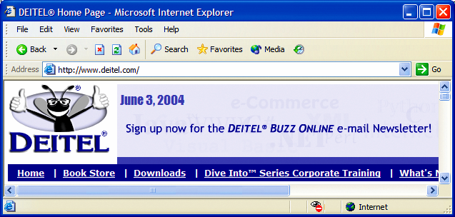
Graphical user interface (GUI) con…
button
menus
title bar
menu bar
combo box
scroll
bars

Slide 5
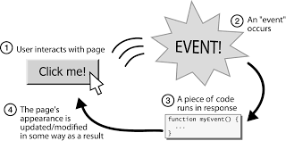
Graphical user interface (GUI) con…
GUI programs are event-driven.
Example:

Slide 6
Java application
Java Application
An Application is a program which runs on an underlying operating system.
Designed to perform a specific task directly for the user.
The application can run with or without GUI.
The application programs like spreadsheets, word processors, web browsers and compilers describe the manners in which computer resources are utilized to resolve users’ computing issues.
There are no security concerns while using an application.

Slide 7
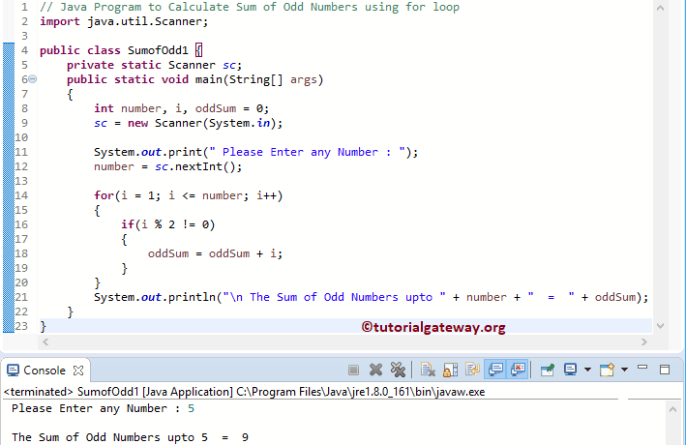
Java Application Con…
Java Application without GUI

Slide 8
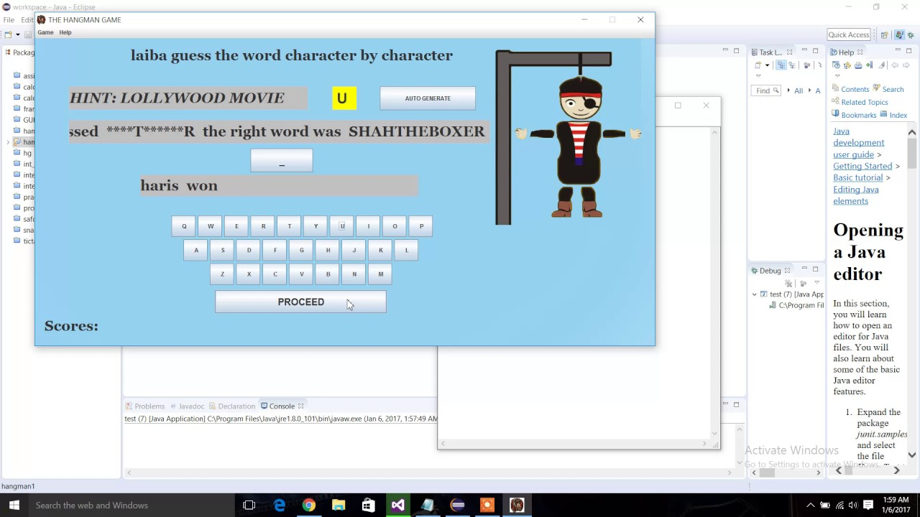
Java Application Con…
Java Application with GUI

Slide 9
AWT vs. Swing
Java AWT (Abstract Window Toolkit) is an API to develop GUI or window-based applications in java.
Java AWT components are platform-dependent
Components are displayed according to the view of operating system.
AWT is heavyweight
Its components are using the resources of OS.
The java.awt package provides classes for AWT api such as:
TextField, Label, TextArea, RadioButton, CheckBox, Choice, List etc.

Slide 10
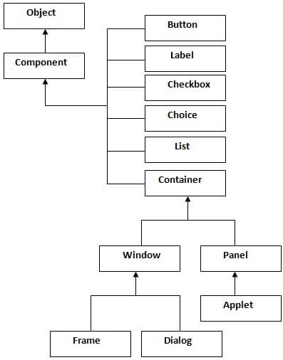
AWT vs. Swing con…
The hierarchy of Java AWT classes is:
All of those are known as components
Component class is an abstract class

Slide 11
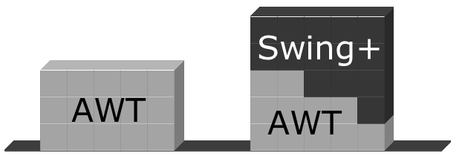
AWT vs. Swing con…
Java Swing is a part of Java Foundation Classes (JFC)
JFC are a set of GUI components which simplify the development of desktop applications.
Unlike AWT, Java Swing provides platform-independent and lightweight components.
The javax.swing package provides classes for java swing API such as:
JButton, JTextField, JTextArea, JRadioButton, JCheckbox, JMenu, JColorChooser etc.
Notes:
Swing is built on the top of AWT API and entirely written in java.

Slide 12
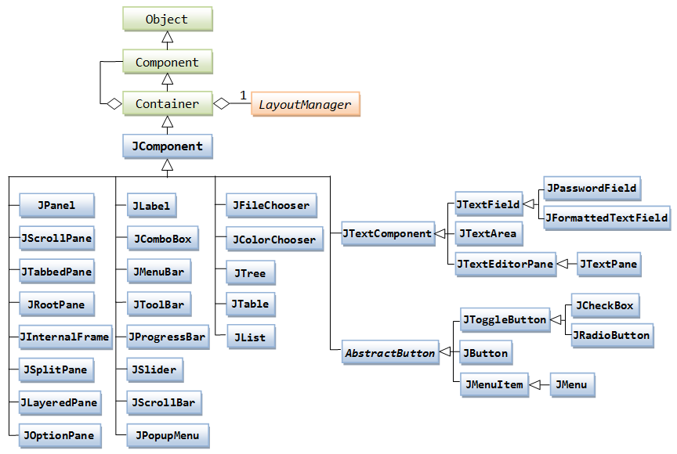
Swing Hierarchy
The hierarchy of Java Swing classes is:

Slide 13
swing Hierarchy Con…
Container
To have everything placed on a screen to a particular position, we have to add them to a container.
It is like a screen wherein we are placing components like buttons, text fields, checkbox etc.
It contains and controls the layout of components.
We can add a container inside container.

Slide 14
swing Hierarchy Con…
JComponent
A JComponent is a base class for all SWING UI components.
JComponent is an abstract class, so it cannot be instantiated directly, but can be subclassed
JWindow
An instance of the Window class has no border and no title.

Slide 15
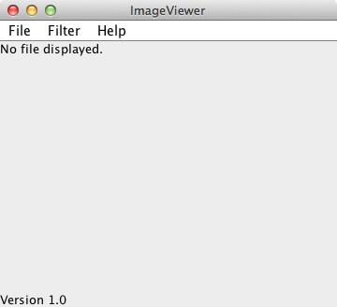
swing Hierarchy con…
JFrame:
Java.Swing.JFrame
A frame has title, border and menu bars.
Usually used as a program's main window.
It can contain several components like buttons, text fields, scrollbars etc.
Window controls
Title
Menu bar
Content pane

Slide 16
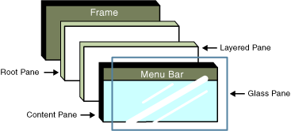
swing Hierarchy con…
JFrame:
Made of several layer
Widgets are added to the Content Pane layer.
Use getContentPane() to obtain it

Slide 17
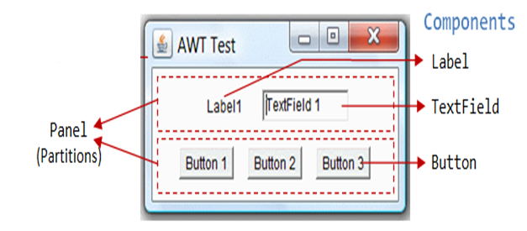
swing Hierarchy con…
JPanel:
Javax.Swing.JPanel
JPanel does not contain title bar, menu bar or border.
It is a generic container for holding components.
An instance of the Panel class provides a container to which to add components.

Slide 18
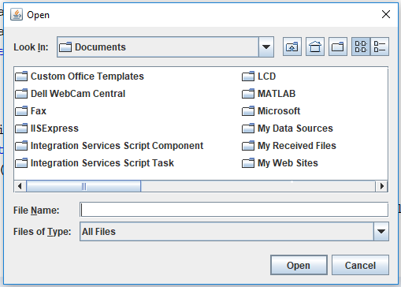
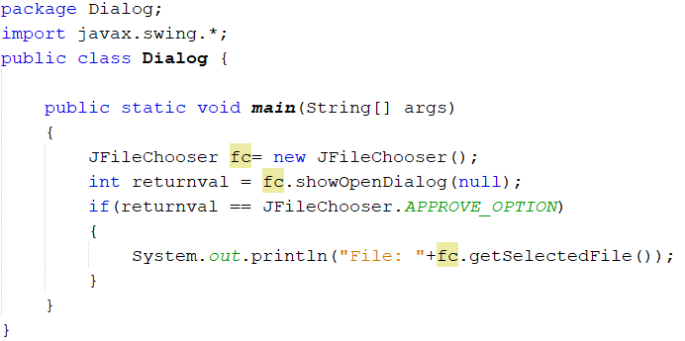
swing Hierarchy Con…
JFileChooser
Allows the user to choose a file
Supports “open” and “save”
showOpenDialog()
showSaveDialog()
Notes:
getSelectedFile() : Return the path of the file you selected.

Slide 19
swing Hierarchy con…
Some GUI Components

Slide 20
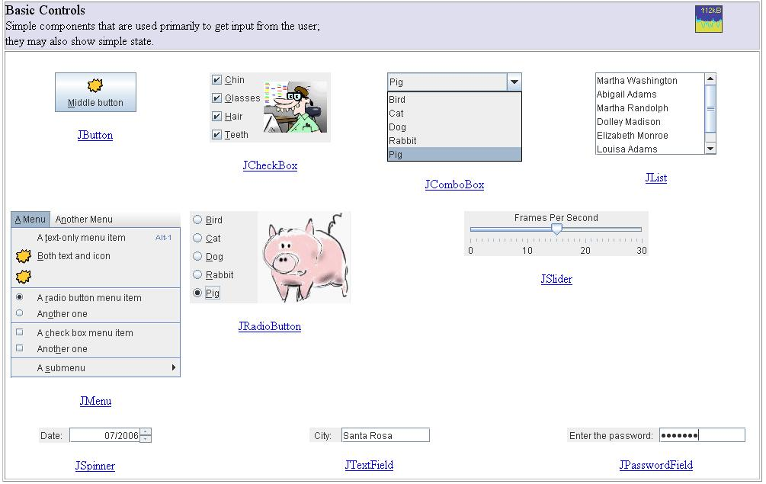
Swing Hierarchy con…
Swing Components

Slide 21
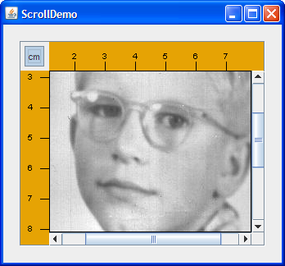
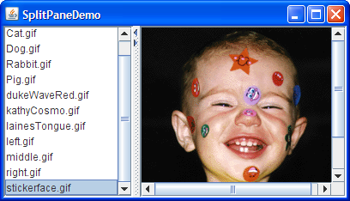
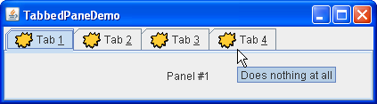
Swing Hierarchy con…
Internal Containers
Not Top level containers
Can contain other non-top level components
Examples:
JScrollPane: Provides a scrollable view of its components
JSplitPane: Separates two components
JTabbedPane: User chooses which component to see

Slide 22
Component classes’ methods
The methods of Component class are widely used in java swing that are:
Method | Description
public void add(Component c) | add a component on another component.
public void setSize(int width,int height) | sets size of the component.
public void setLayout(LayoutManager m) | sets the layout manager for the component.
public void setVisible(boolean b) | sets the visibility of the component. It is by default false.

Slide 23
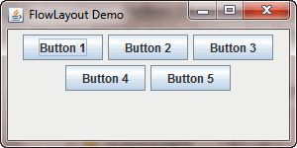
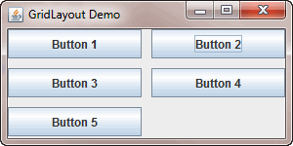
Containers Layout types
FlowLayout
It places components from left to right in a row using preferred component sizes until no space is available in the container.
GridLayout
The GridLayout manages the components in the form of a rectangular grid.
Check other layout types at this link

Slide 24
LET’S CODE!

Slide 25


Creating your first GUI App
Create the following GUI counter program where every time we press the button the counter is incremented by 1.
Frame
(Top-Level Container)
Label
(Component)
Button
(Component)
Source of ActionEvent
TextField
(Component)

Slide 26
Creating your first GUI App con…
Creating a frame:
We need to import JFrame class
Create object of JFrame and give a title.
Or you can import all the classes at once
Import javax.swing.Jframe;
Import javax.swing.*;
JFrame Frame1 = new JFrame(“My First App”) ;

Slide 27
Creating your first GUI App con…
Creating a frame:
Set the Layout of Jframe (FlowLayout, GroupLayout,…)
We will use FlowLayout
Each layout is a class in java.awt package. So, first we need to import this class
Now we can set the layout of the frame
You can set layout with null, but if you do that you have to use setBounds method for all components
Import java.awt.FlowLayout;
Frame1.setLayout(new FlowLayout());

Slide 28
Creating your first GUI App con…
Creating a frame:
Set the size of the Frame
Make the frame visible.
Width
Height
Frame1.setSize(500, 100);
Frame1.setVisible(true);
Any component added after setting visible with true will NOT appear on the frame except after refreshing the frame by calling validate();
If you need to make a frame invisible (false)
Notes:
Important note:
Any component added after setting visible with true will NOT appear on the frame except after refreshing the frame by calling validate();
Else, let setting the frame visibility with true the last line in you design.

Slide 29
Creating your first GUI App con…
Creating a frame:
Note: to close the frame use the following method
Frame1.setDefaultCloseOperation(JFrame.EXIT_ON_CLOSE);

Slide 30
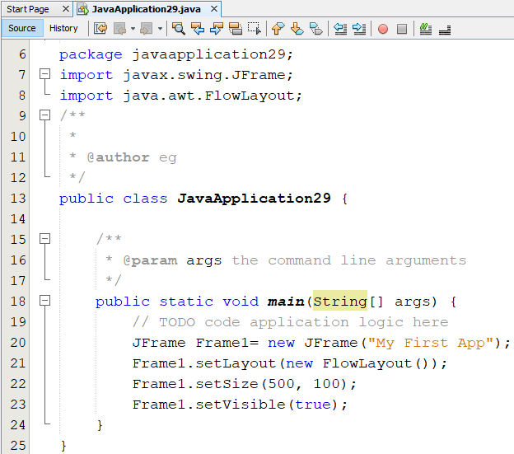

Creating your first GUI App con…
Creating a frame:

Slide 31
Creating your first GUI App con…
Adding Label:
Importing the JLabel class
Create object of JLabel component.
Add the label to the Frame.
import javax.swing.JLabel;
The text that will appear on the label
JLabel Label1= new JLabel("Counter");
Frame1.add(Label1);

Slide 32
Creating your first GUI App con…
Adding TextField:
Import JTextField
Create textfield component
import javax.swing.JTextField;
Constructor | Description
JTextField() | Creates a new TextField
JTextField(String text) | Creates a new TextField initialized with the specified text.
JTextField(String text, int columns) | Creates a new TextField initialized with the specified text and columns.
JTextField(int columns) | Creates a new empty TextField with the specified number of columns.

Slide 33
Creating your first GUI App con…
Adding TextField:
Create textfield component con…
Set text in the text field (Define counter outside the main)
JTextField TextField1 = new JTextField(10);
TextField1.setText(""+counter);
Converts counter(int) to String

Slide 34

Creating your first GUI App con…
Adding TextField:
Because we only display the count every time we press the button, we can make the textfield uneditable using the following function.
Assign the textfield to the frame
Set background color to white
Run
TextField1.setEditable(false);
Frame1.add(TextField1);
import java.awt.Color;
TextField1.setBackground(Color.WHITE);

Slide 35
Creating your first GUI App con…
Add Button
Import JButton
Create JButton component
import javax.swing.JButton;
JButton button1= new JButton("Count");
Constructor | Description
JButton() | It creates a button with no text and icon.
JButton(String s) | It creates a button with the specified text.
JButton(Icon i) | It creates a button with the specified icon object.

Slide 36

Creating your first GUI App con…
Add Button
Assign the button to the frame
Run
Frame1.add(button1);
If we press the button, nothing will happen. So, we need to use
(ActionListener Function)

Slide 37
Creating your first GUI App con…
Adding Button:
As we said before, GUI programs are event-driven.
So, to know if the user press the button or not you need to use the following method
It is used to add the action listener to this object.
The Java ActionListener is notified whenever you click on the button or menu item.
It is notified against ActionEvent.
The ActionListener interface is found in java.awt.event package.
It has only one method: actionPerformed().
void addActionListener(ActionListener a)

Slide 38
Creating your first GUI App con…
Add Button (ActionListener & ActionEvent)
Import ActionListener & ActionEvent
Use ActionListener function
This method is invoked automatically whenever you click on the registered component.
import java.awt.event.ActionEvent;
import java.awt.event.ActionListener;
Set your code inside actionPerformed method
button1.addActionListener(new ActionListener() {
@Override
public void actionPerformed(ActionEvent e) {
counter=counter+1;
TextField1.setText(""+counter);
}
});

Slide 39
Creating your first GUI App con…
Run

Slide 40
Creating your first GUI App con…
To make your code more organized, you can create a new class which extends all the attributes and methods from the JFrame Class.
This new class will be responsible of constructing the form
You can add any additional function in it.

Slide 41
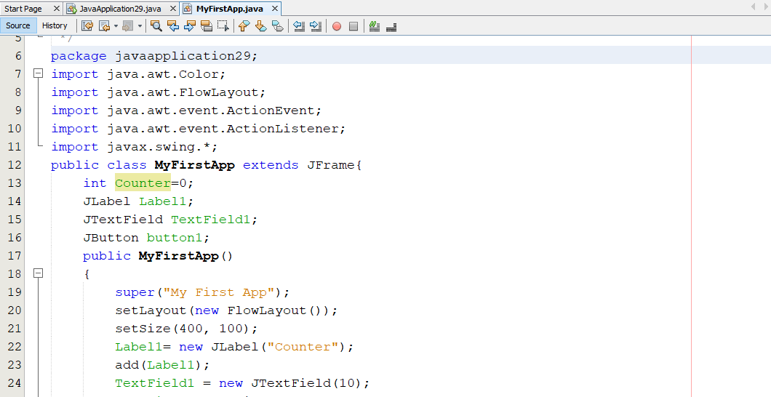
Creating your first GUI App con…

Slide 42
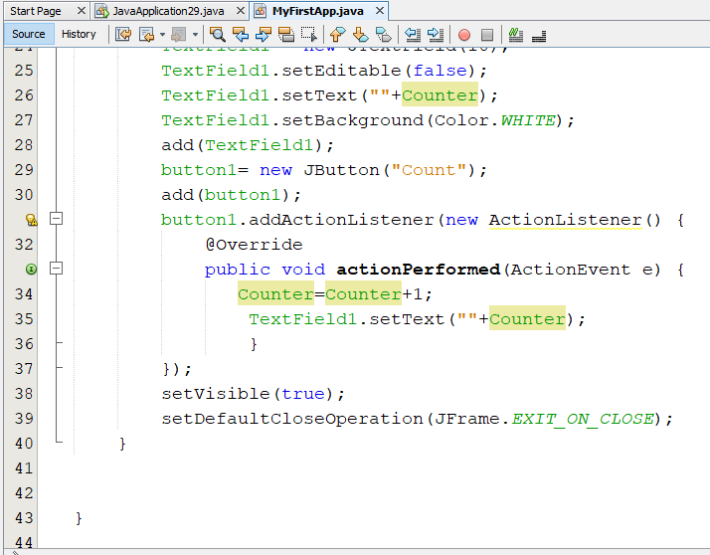
Creating your first GUI App con…

Slide 43
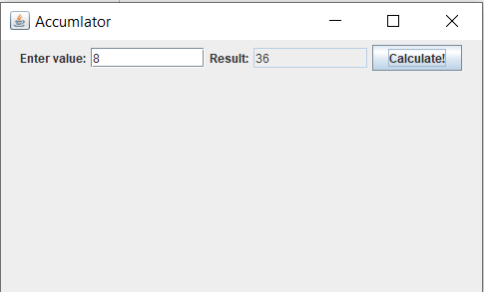

Hands on 1
Note:
To get text, use getText()
To set text, use setText()
Create the following form application which enable the user to enter an integer (n )in textfield and after pressing the button the following process is happen( n+n-1+….+1).
Then display the output on uneditable textfield.
20 minutes
8 + 7 + 6 + …. + 1

Slide 44
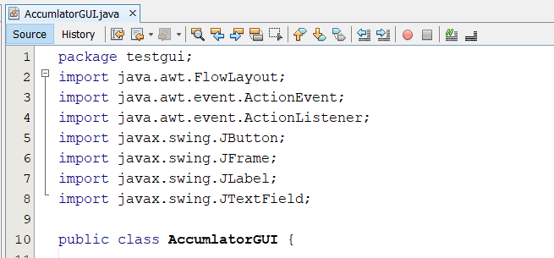
Hands on 1 (solution)

Slide 45
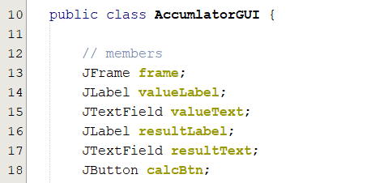
Hands on 1 (solution) con…

Slide 46
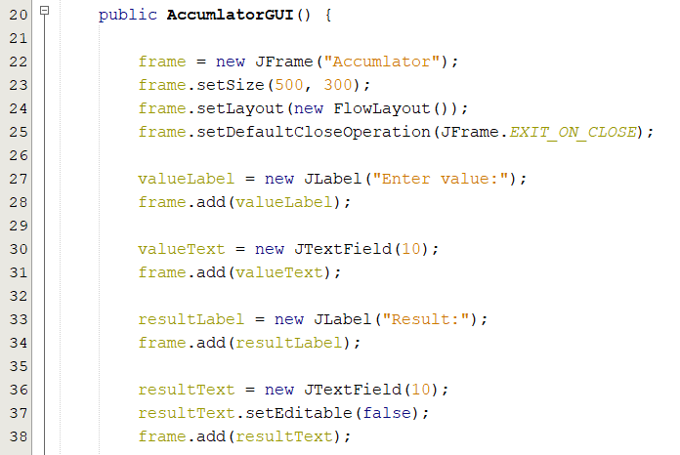
Hands on 1 (solution) con…

Slide 47
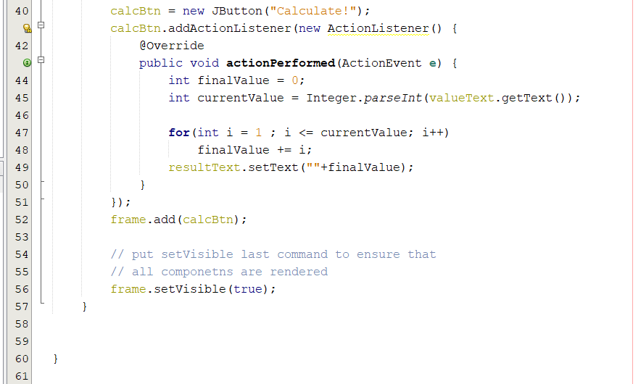
Hands on 1 (solution) con…

Slide 48
JoptionPane
The JOptionPane class is used to provide standard dialog boxes such as:
Message dialog box
Confirm dialog box
Input dialog box.
These dialog boxes are used to display information or get input from the user.
The JOptionPane class inherits JComponent class.

Slide 49
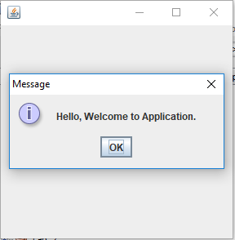
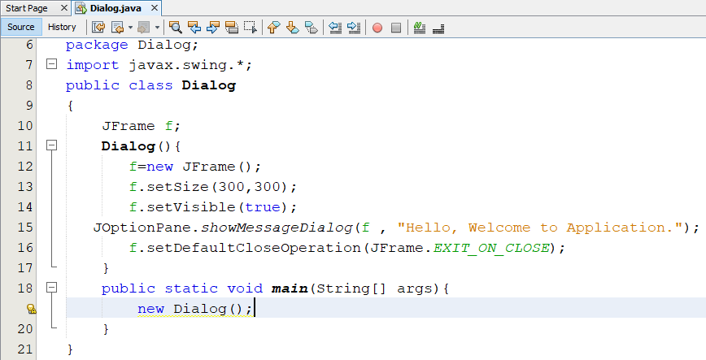
JoptionPane con…
Create Message dialog box using JOptionPane
import javax.swing.JOptionPane
ParentComponent: determines the Frame in which the dialog is displayed
Message: the Object to display
Other icons available
Notes:
determines the Frame in which the dialog is displayed

Slide 50




JoptionPane con…
Message Icons:
Message Dialog Type | Icon | Description
ERROR_MESSAGE |  | A dialog that indicate an error to the user.
INFORMATION_MESSAGE |  | A dialog with information message to the user.
WARNING_MESSAGE |  | a dialog warning the user of a potential problem.
QUESTION_MESSAGE |  | A dialog that poses a question to the user. This dialog normally require a response, such as clicking a Yes or No button.
PLAIN-MESSAGE | No Icon | A dialog that contain a message, but no icon

Slide 51
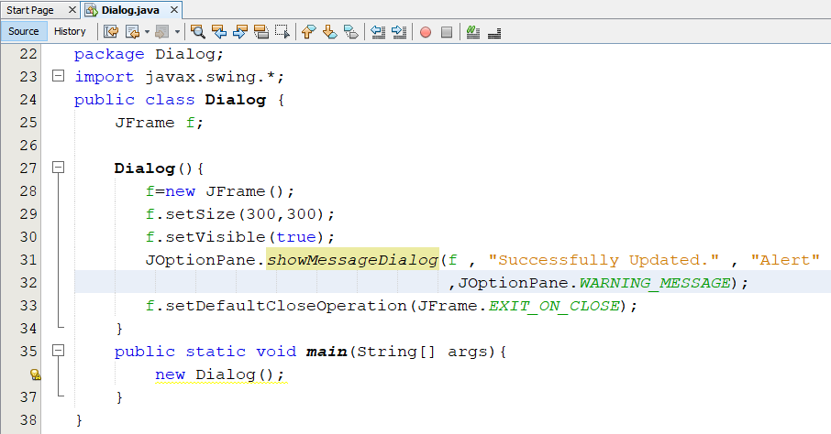
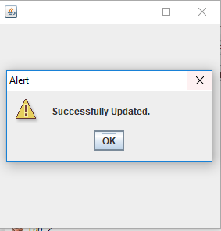
JoptionPane con…
Parent component
Message
Title
Message type

Slide 52
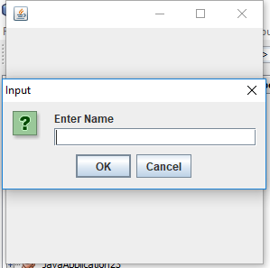
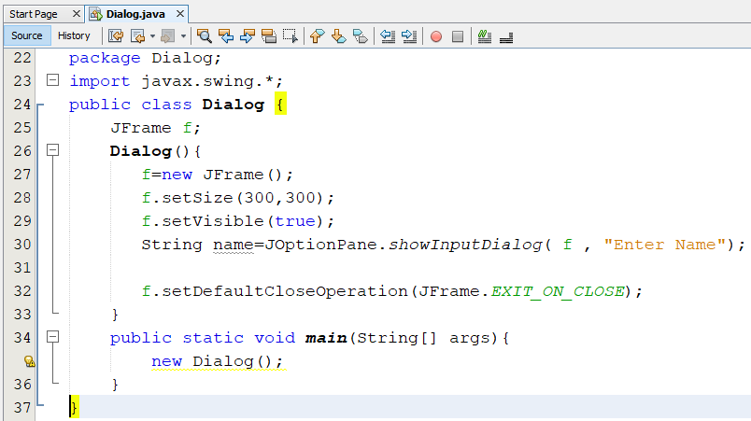
JoptionPane con…
Creating input Dialog box
Parent component
Message

Slide 53
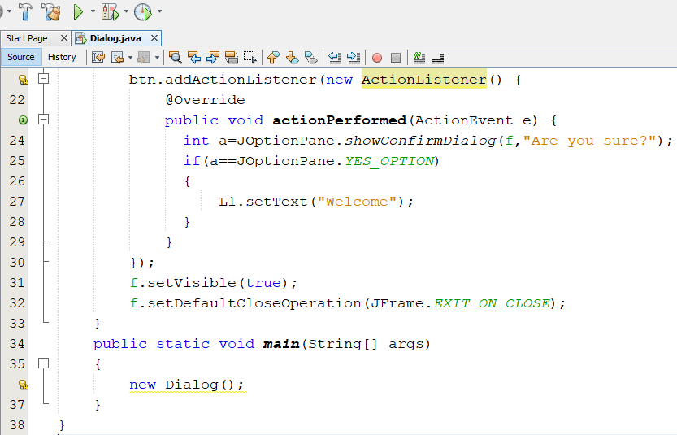
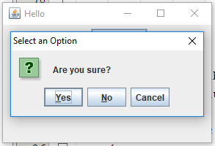
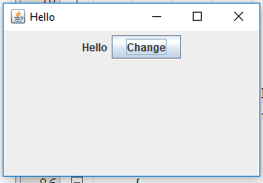
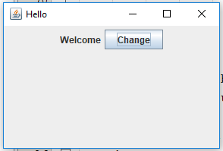
JoptionPane con…
Creating confirm dialog box con…
53

Slide 54
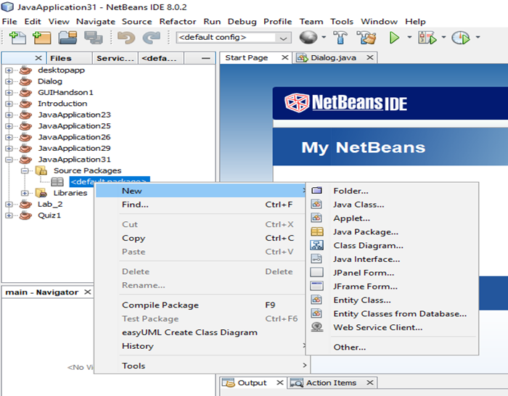
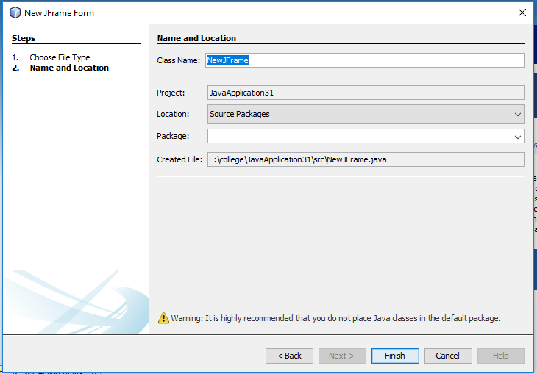
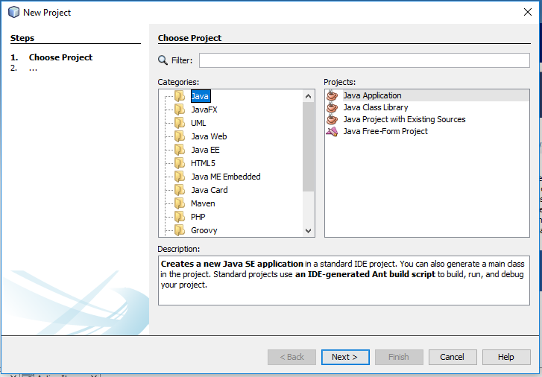
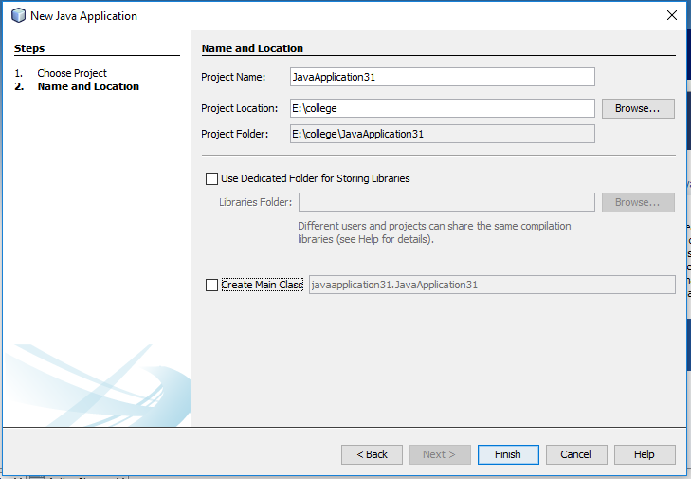
GUI Builder Interface
Create a new project

Slide 55
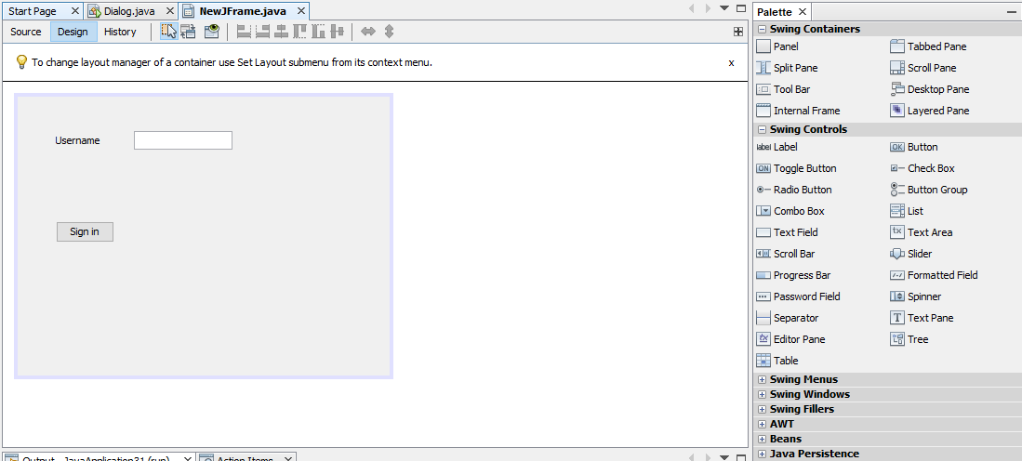
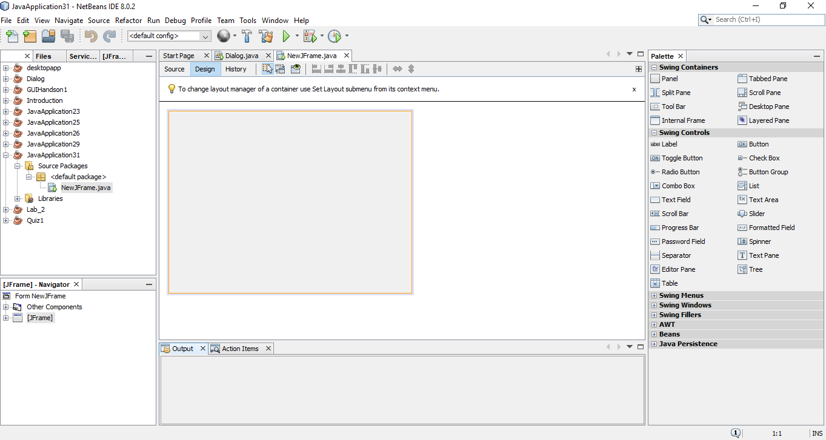
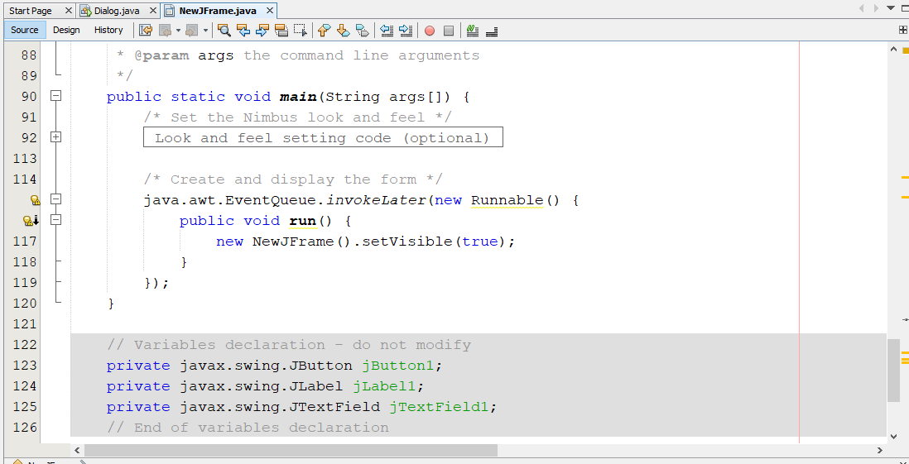
GUI Builder Interface con…
Drag component from palette and drop it in the frame
Source code
Design tab
Auto-Generated Variables

Slide 56
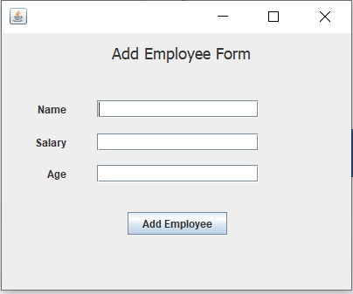
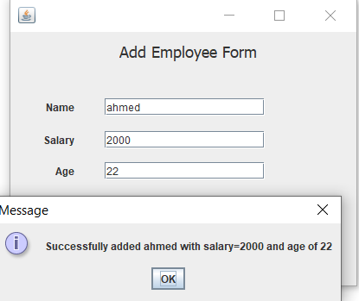
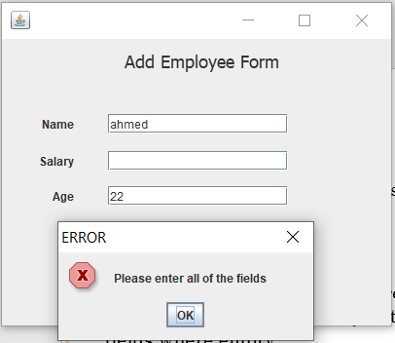
Hands on 2
Person
# name:String
# age:int
Person is abstract class.
Implement getters/setters of classes.
Create GUI Form that inputs Employee data into employee object.
You should display a success message if the user entered correct data, or error message if any of the fields where empty.
+ Person(String,int)
+ Person()
Employee
- salary: int
+ Employee(String,int,int)
+ Employee()

Slide 57
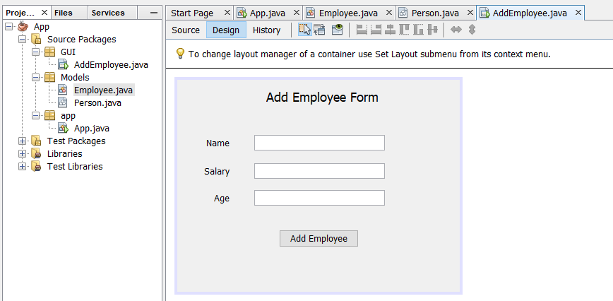
Hands on 2 - Answer

Slide 58
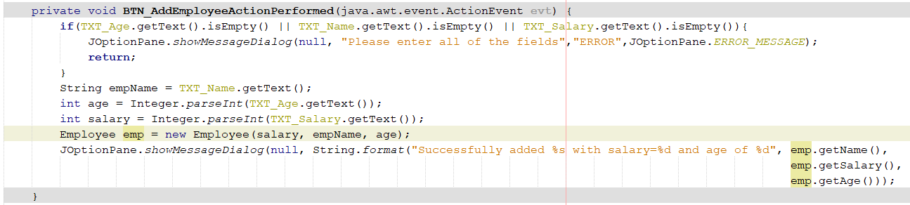
Hands on 2 - Answer

Slide 59

questions

