Slide 1
Object Oriented Programming using Java
Lab 8

Slide 2
What is exception handling?
An exception is an unwanted event, which occurs during the execution of a program (at run time), that interrupts the normal flow of the program’s instructions. (e.g. divide by zero, array access out of bound, etc.).
The core advantage of exception handling is to maintain the normal flow of the application.

Slide 3
What Happens?
When an error occurs within a method; the method creates an object and hands it to the runtime system; This is called throwing an exception
The Runtime system will search the code block for an appropriate handler for the exception, if it doesn’t find one, the program terminates.
If an exception handler is found it is said that it catches the exception, the program will continue execution normally after the exception is handled.

Slide 4
Exception classes in java
The java.lang.Throwable class is the root class of Java Exception hierarchy. Which is inherited by two subclasses: Exception and Error.
Object
Throwable
Error
Exception

Slide 5
Exception classes in java
Object
Exception: can be handled by
the developer and recovered from.
Examples:
Opening a file that does not exist.
Incorrect user input.
Divide by 0.
Throwable
Error
Exception

Slide 6

Exception classes in java
Object
Error: Unnatural conditions
external to the application;
cannot be recovered from.
Examples:
JVM stopped working.
RAM OutOfMemory.
What can a developer do in
these situations? NOTHING!!
Throwable
Error
Exception

Slide 7
When do we need to handle an exception?
Statement
Normal
Critical
int i = 0;
int k = i/j;
Nothing could go wrong; Doesn’t need handling.
Divide by zero error may occur;
Needs to be handled.

Slide 8
What To do after catching an exception?
When you catch an error you can:
Terminate program
Fix error and continue
Log error and continue
Re-throw exception

Slide 9
Exception handling Example 1
public static void main(String[] args) {
int i,j,k;
Scanner scan = new Scanner(System.in);
i = scan.nextInt();
j = scan.nextInt();
k = i/j;
System.out.println(k);
}
Critical statement identified
Critical blocks should always be written within a try block

Slide 10
Exception handling Example 1
public static void main(String[] args) {
int i,j,k = 0;
Scanner scan = new Scanner(System.in);
i = scan.nextInt();
j = scan.nextInt();
try {
k = i/j;
}
System.out.println(k);
}
An exception object is created and thrown but was not handled. Program would still terminate abnormally.

Slide 11
Exception handling Example 1
Execution reference variable leaves the try block and goes to check available catch conditions
try {
k = i/j;
}
catch(ArithmeticException ae) {
System.out.println("Cannot divide by Zero");
}
System.out.println(k);
1
Exception object thrown
2
3
Thrown Exception object type matches catch parameter exception type; catch executes
Program executes rest of statements normally
4

Slide 12
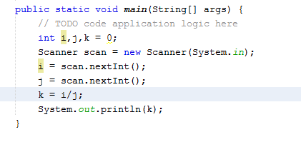
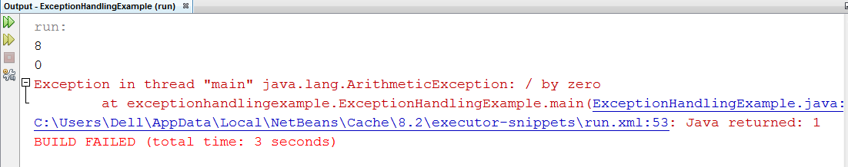
Exception handling Example 1 (Without try..catch)

Slide 13
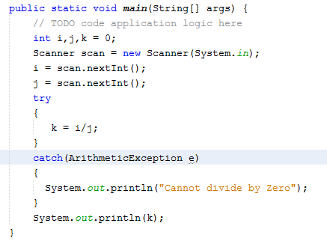
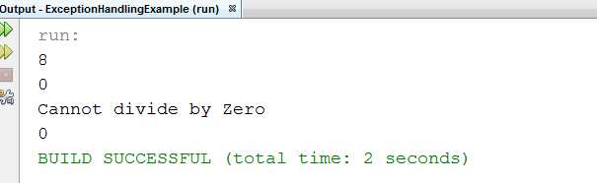
Exception handling Example 1 (With try..catch)

Slide 14
Multiple catch blocks
One try block can be associated with multiple catch blocks
try
{
//try these statements
//If Exception is thrown
}
catch(Exception_type_1){
}
catch(Exception_type_2){
}
catch(Exception_type_3){
//Exception is caught by
suitable catch block
}
When the thrown Exception object type matches catch parameter exception type; catch executes;
Otherwise it checks other catch statements

Slide 15
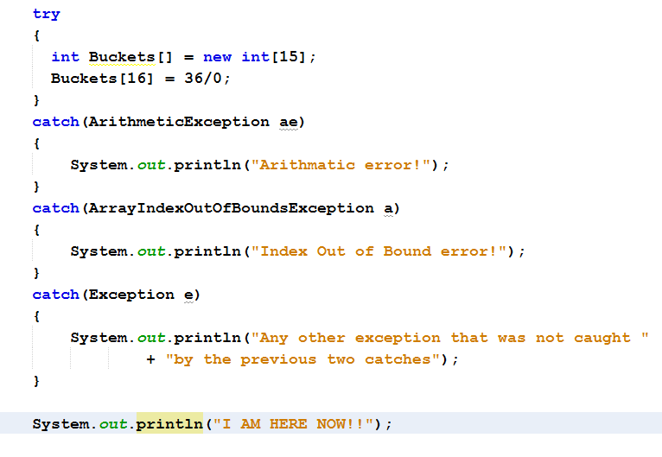
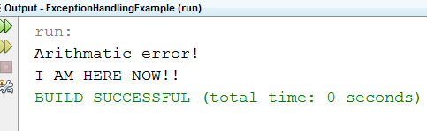
Multiple catch blocks Example

Slide 16
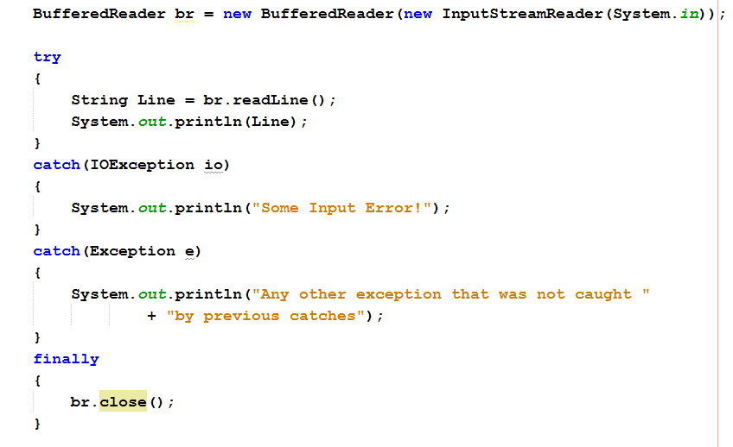
Try..catch..finally
br.close() is guaranteed to be executed even if no exception is thrown.
It is best practice to close any locally used resources in a finally block
A finally block is always executed whether an exception is thrown or not.

Slide 17
Throw keyword
To catch an exception, some code must throw one.
You can do this using the “throw” keyword.
You can use the “throw” keyword in two ways:
To throw a java-defined exception explicitly/manually.
To throw a user defined exception.

Slide 18
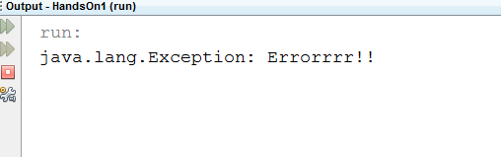
Throw keyword – Java Defined exception
int x = 5;
try
{
if(x < 10)
throw new Exception("Errorrrr!!");
}
catch(Exception e)
{
System.out.println(e);
}

Slide 19
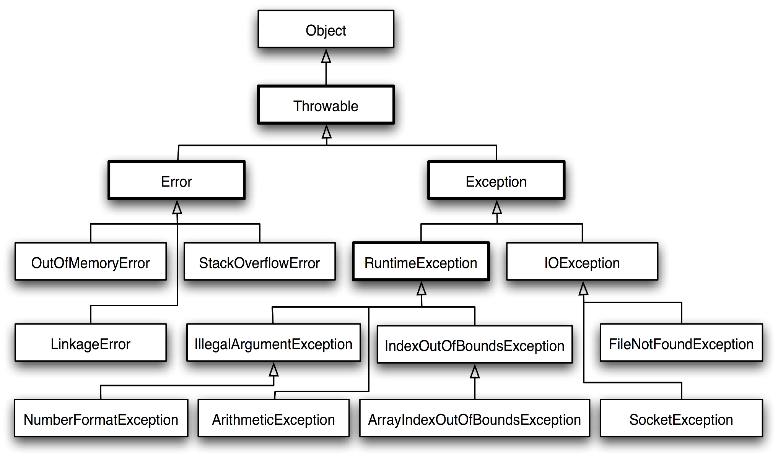
Exception classes in java

Slide 20
Exception classes in java
Checked Exceptions:
The classes which directly inherit Throwable class except RuntimeException and Error are known as checked exceptions e.g. IOException, SQLException. Checked exceptions are checked at compile-time.
Unchecked Exceptions:
The classes which inherit RuntimeException are known as unchecked exceptions (e.g. ArithmeticException, NullPointerException, etc.) Unchecked exceptions are not checked at compile-time, but they are checked at runtime.

Slide 21
Throws keyword
Java insists that checked exceptions(IOException, SQLException) need to be explicitly handled.
If you use an IO or SQL resource without handling it within a try catch block, java will declare it a syntax error. This error can be subdued by using throws keyword.
Throws doesn’t handle the exception but declares that the developer is aware that it may throw that exception

Slide 22
Throws keyword
You don't need to specify a “throws” clause for all classes. Specifically, classes that are either an Error or RuntimeException or any of the subclasses of these two don’t need “throws”.
Since “Exception” class doesn’t extend “Error” or “RuntimeException”; it is considered a checked class.

Slide 23
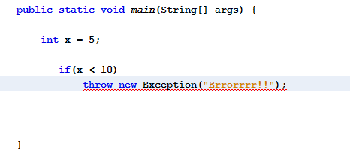
Throws keyword example
Compile time error

Slide 24
Throws keyword example
public class ExceptionHandlingExample {
public static void main(String[] args) throws Exception{
int x = 5;
if(x < 10)
throw new Exception(“Not Compile Error!!");
}
Exception is a checked exception class. Therefore, any code that throws it must handle it (try..catch) or declare it(throws).

Slide 25
Throw vs throws
If a method does not handle a checked exception, the method must declare it using the throws keyword. The throws keyword appears at the end of a method's signature.
You can throw an exception, either a newly instantiated one or an exception that you just caught, by using the throw keyword.
Throws is used to postpone the handling of a checked exception and throw is used to invoke an exception explicitly.

Slide 26
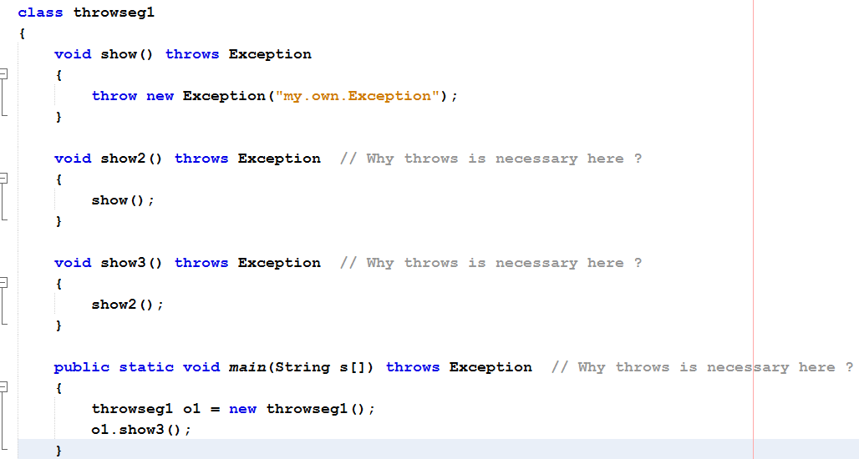
Exception propagation

Slide 27
Answer
In this case Exception is a checked exception and must be specified in the throws clause, if you don't handle that particular exception. That is why you needed the throws clause.
But why does show2() need to use throws keyword even though it doesn’t explicitly throw an exception?
Because of Exception Propagation

Slide 28
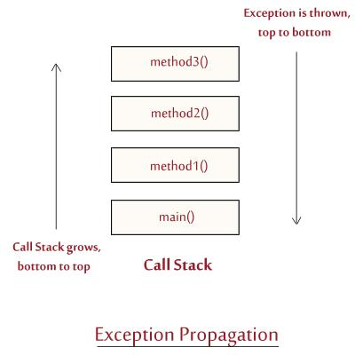
Exception propagation
Considering a scenario, in which your program starts its execution at the main() method, main() calls method1(), method1() calls method2(), method2() calls
method3(),
Now the call stack
looks like this:

Slide 29
Exception propagation
Let's say while executing method3(), an exception is raised/thrown.
Now this exception is thrown down to the next method in the call stack, i.e. method2(),
which in turn throws the exception down to next method in the call stack, i.e. method1(). The process continues until the exception is thrown to the method at the bottom of the call stack, i.e. main() method.
Now, at this time call stack explodes which leads to the abrupt termination of the program.

Slide 30
User- defined exceptions
Java provides us facility to create our own exceptions.
You create your own exceptions if there are conditions or constraints in your code that may cause errors and there are no corresponding java exceptions.
This is done by creating our own exception class which extends from the java defined “Exception” class; since only sub-classes of throwable can be thrown.

Slide 31
User Defined Exceptions Rules
All exceptions must be a child of Throwable.
If you want to write a checked exception that is automatically enforced by the Handle or Declare Rule, you need to extend the Exception class.
If you want to write a runtime exception, you need to extend the RuntimeException class.

Slide 32
User defined exceptions – example 1
class MyException extends Exception
{
public MyException(String s)
{
// Call constructor of parent Exception
super(s);
}
}
public static void main(String args[])
{
try
{
throw new MyException(“YOU ARE WRONG!!");
}
catch (MyException ex)
{
System.out.println(ex.getMessage());
}
}

Slide 33
User defined exceptions – example 2
public class InsufficientFundsException extends Exception {
private double amount;
public InsufficientFundsException(String msg, double amount) {
super(msg);
this.amount = amount;
}
public double getAmount() {
return amount;
}
}

Slide 34
User defined exceptions – example 2
public class CheckingAccount {
private double balance;
public void deposit(double amount) {
balance += amount;
}
public void withdraw(double amount) throws InsufficientFundsException {
if(amount <= balance) {
balance -= amount;
}
else {
double needs = amount - balance;
throw new InsufficientFundsException("Your account balance doesn't"
+ " allow for this amount to be withdrawn“, needs);
}
}
}

Slide 35
Interfaces

Slide 36
Interfaces - When to use Interface and Abstract Class?
Use an abstract class when a template needs to be defined for a group of subclasses
Use an interface when a role needs to be defined for other classes, regardless of the inheritance tree of these classes (i.e. IComparable in C#)
Notes:
An interface is just like Java Class, but it only has static constants and abstract method. Java uses Interface to implement multiple inheritance. A Java class can implement multiple Java Interfaces. All methods in an interface are implicitly public and abstract.

Slide 37
Interfaces
All methods in an interface are implicitly public and abstract (only declaration with no body).
All data fields are implicitly public static final
An interface cannot be instantiated (no constructor is given)
An interface can extend from one or many interfaces.
A class can extend only one solid class but implement any number of interfaces (Multiple inheritance)
Notes:
Interfaces specify what a class must do and not how. It is the blueprint of the class.

Slide 38
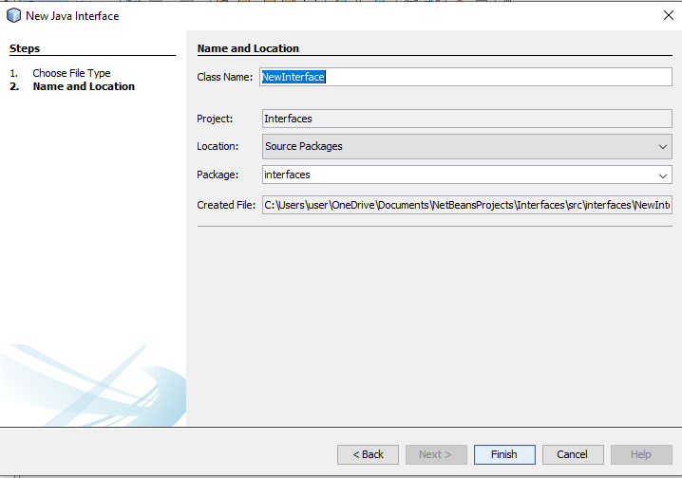
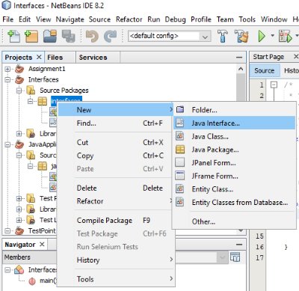
How to add an interface

Slide 39
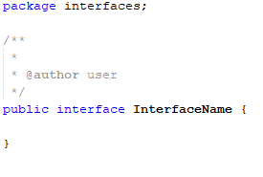
Interface Syntax

Slide 40
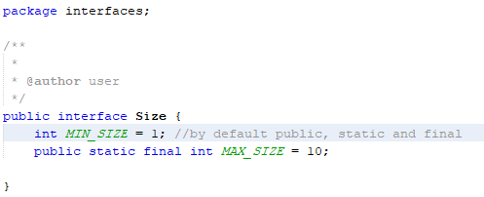
Interface’s Attributes
The attributes’ access modifiers are always public static final so they are Constants

Slide 41
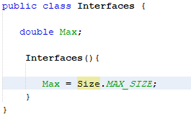
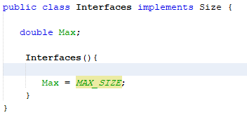
Interface’s Attributes
We can access the interface constants as any Static Attributes either by:
(1) calling by the Interface Name. them
(2) implement this interface

Slide 42
Interface’s Methods
Interface can have only abstract methods. Since Java 8, it can have default and static methods also.
All methods in any interface must have only declaration, except for the default and static methods.
Remember all methods are by default Public.

Slide 43
Interface's Methods (cont.)
Because the methods in an interface are, by definition, public, you must use the public keyword when you define them in your class otherwise, your code does not compile.

Slide 44
Default Methods
Default methods allow the interfaces to have methods with implementation without affecting the classes that implement the interface.
Developers frequently encountered situations where a method's implementation is the same in all classes.
An implementing class can override default methods, but it can’t override the static methods.
Notes:
Default methods can be added to any existing interface and we do not need to implement these methods in the implementation classes mandatorily, thus we can add these default methods to existing interfaces without breaking the code.

Slide 45
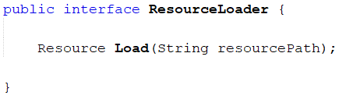
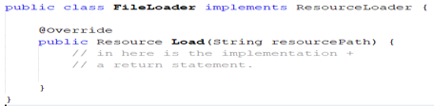
Default Methods (cont.)
Look at this interface and imagine that it is part of e.g. an open source API which many applications are using internally:
Now imagine that a project uses this API and has implemented the ResourceLoader interface like this:
Notes:
Before Java 8 Java interfaces could not contain an implementation of the methods, but only contain the method signatures.
However, this results in some problems when an API needs to add a method to one of its interfaces. If the API just adds the method to the desired interface, all classes that implements the interface must implement that new method. That is fine if all implementing classes are located within the API. But if some implementing classes are located in client code of the API (the code that uses the API), then that code breaks.

Slide 46
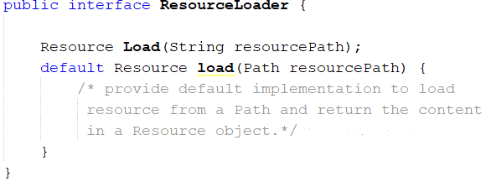
Default Methods (cont.)
If the developer of the API wants to add one more method to the ResourceLoader interface, then the FileLoader class will be broken when that project upgrades to the new version of the API.
To alleviate this Java interface evolution problem, You mark a method in an interface as a default method using the default keyword.
An interface default method can contain a default implementation of that method.
Notes:
Classes that implement the interface but which contain no implementation for the default interface will then automatically get the default method implementation.

Slide 47
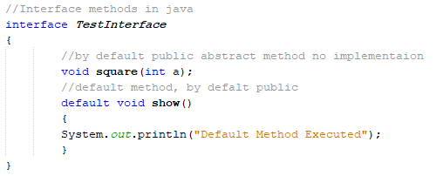
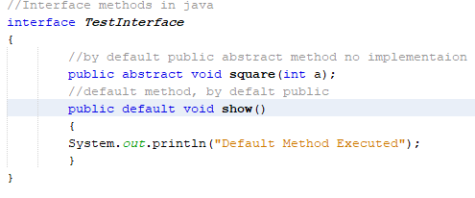
Interface's Methods Example

Slide 48
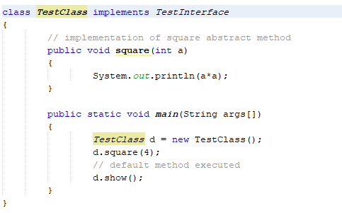
Interface's Methods Example (cont.)
Output
16
Default Method Executed

Slide 49
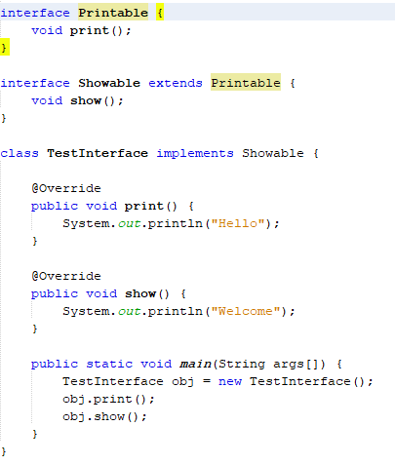
Extending Interfaces
You can define one interface based on another by using the keyword extends to identify the base interface name. so it will extend all members of the base interface.
Notes:
Some care is necessary when you use this capability. If two or more super-interfaces declare a method with
the same signature — that is, with identical names and parameters — the method must have the same return
type in all the interfaces that declare it. If they don't, the compiler reports an error. This is because it would
be impossible for a class to implement both methods, as they have the same signature. If the method is
declared identically in all the interfaces that declare it, then a single definition in the class satisfi es all the
interfaces. As I said in the previous chapter, every method in a class must have a unique signature, and the
return type is not part of it.

Slide 50
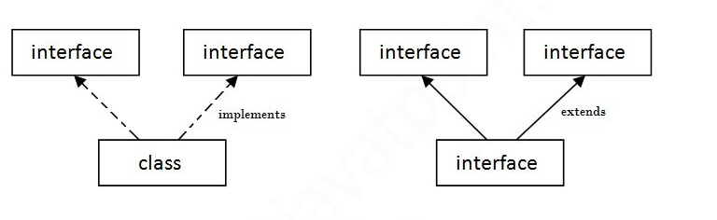
Interfaces Multiple Inheritance
A Java class can only extend one parent class. Multiple inheritance is not allowed in Java. Interfaces are not classes, however, and an interface can extend more than one parent interface.

Slide 51
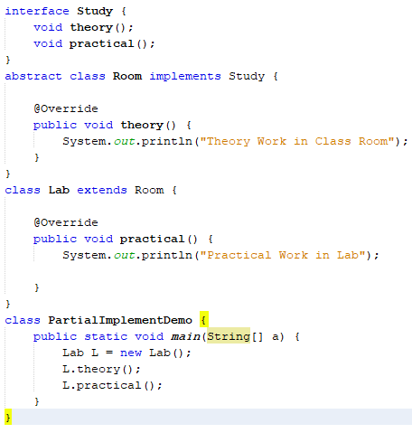
A Partial Interface Implementation
You can omit the implementation of one or more of the methods from an interface in a class that implements the interface.
The class inherits some abstract methods from the interface so you would need to declare the class itself as abstract.
Notes:
If you want to implement only some methods(not all methods) you must declare this class as abstract
Note 1: Why the abstract class needs to implement an interface?
The interface may contain some common features which have to existed in all the subclasses.
Note 2: Why the abstract class keeps some methods which exist in an interface abstract methods?
Because the implementation of those methods is different based on the subclass.

Slide 52
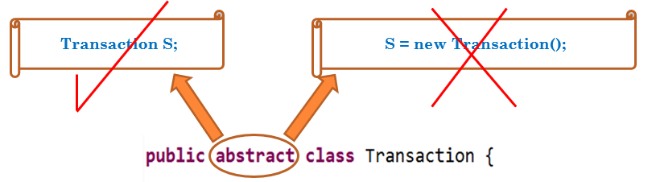
Interfaces Instantiation
Abstract Class
We can’t create object from the interface.
But we can create variable from it that can be reference to any class that implements it.
Study st = null; // Variable of the Study interface type
Notes:
Interface is a complete abstract class

Slide 53
Interfaces and Polymorphism
Using multiple Interfaces.
A class can implement more than one interface.
Write the names of all the interfaces that the class implements separated by commas following the implements keyword.
If you create variable from any interface from them and make it as a reference to object from this class.
Then this reference variable can call only the methods that are implemented from this interface variable.
Notes:
One possibility is to cast the reference to the original class type

Slide 54
Practice– 20 mins
Create an interface (Called Measurable) has a constant float attribute PI = 3.14 and two methods float getArea() and void show() to display the value of area to the user (use getArea()).
Create 2 Classes (Rectangle, Circle) that implementing the Measurable interface:
Rectangle class has two integer attributes: breadth and length.
Circle class has one integer attribute: radius.
The two class Rectangle and Circle should calculate the area as following:
Rectangle:
Area = breadth * length
Circle:
Arear = 2*PI*(radius)²
In the main:
Define an object from Measurable interface and set it to null.
Ask the user to enter character R for Rectangle and C for Circle
If the user enters R make this Measurable object reference to Rectangle object else to Circle object.
Output the values of the area of the selected object.
Hint: use “insert code” to add parameterized constructors to rectangle and circle classes

Slide 55
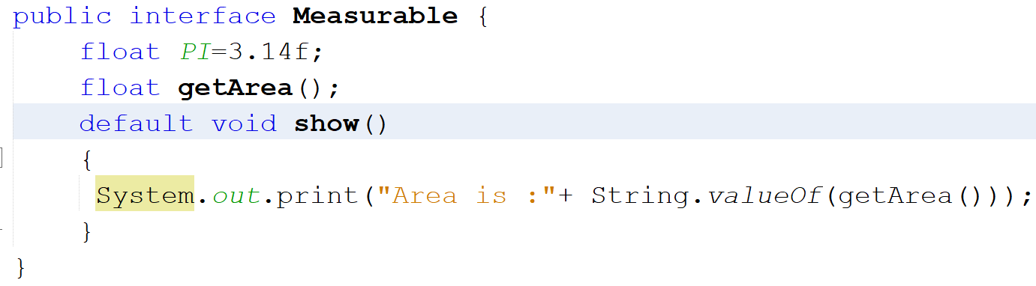
Practice - Solution

Slide 56
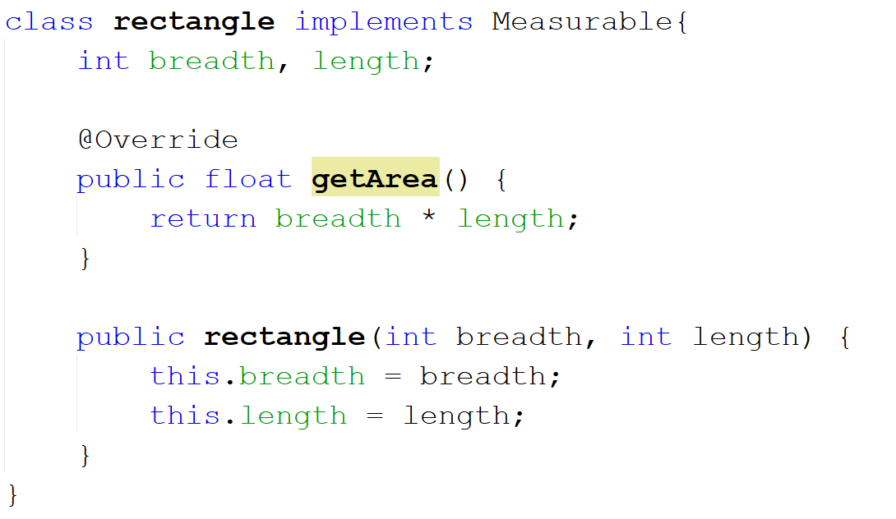
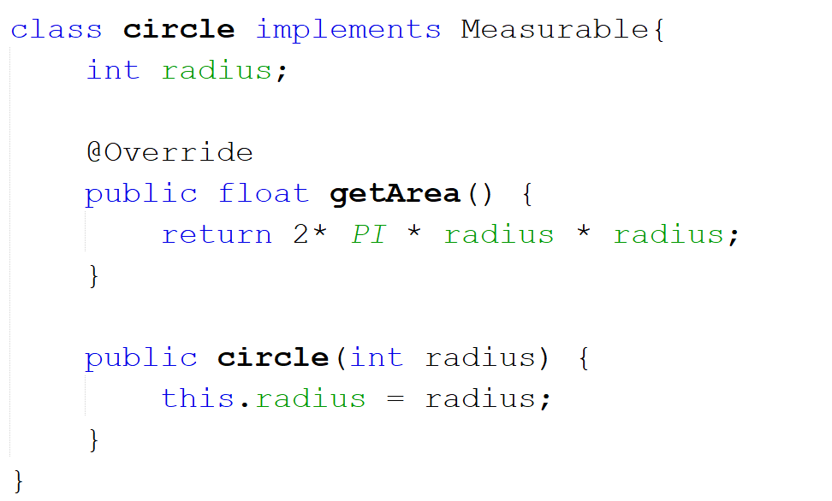

Slide 57
