Slide 1
Performance Analysis of Different MANET Protocols in Wireless Communication
ICE- 4108: Wireless and Mobile Communication (Lab)

Slide 2

Introduction
MANETs (Mobile Ad Hoc Networks): A self-configuring network of mobile devices connected without any centralized infrastructure.
MANETs operate without infrastructure.
Routing is challenging due to dynamic topology and resource constraints.
The experiment evaluates AODV, DSDV, and DSR protocols.
NS2.35 and NSG2.1 are used as simulation tools.
Metrics for evaluation:
Throughput
Packet delivery ratio
End-to-end delay
Goal: Identify the best protocol for various network conditions.

Slide 3
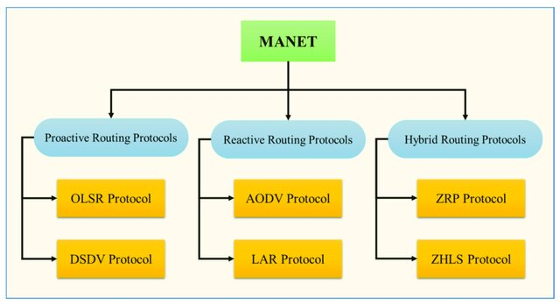
Types of MANET

Slide 4
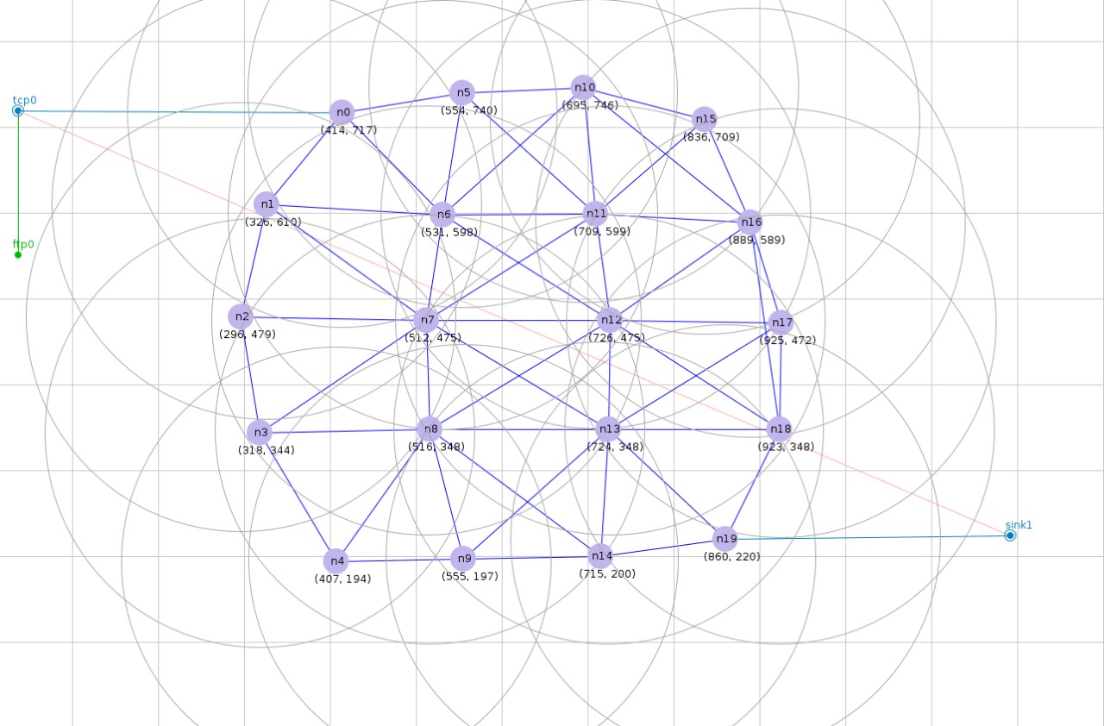
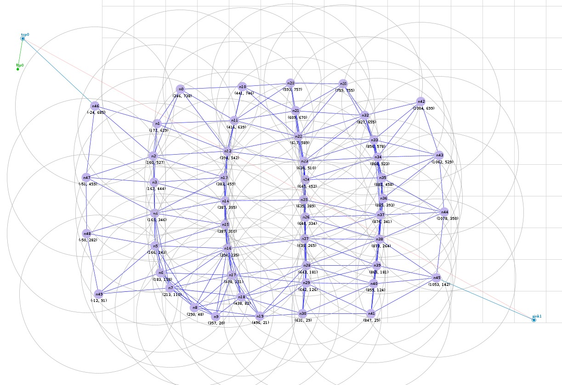
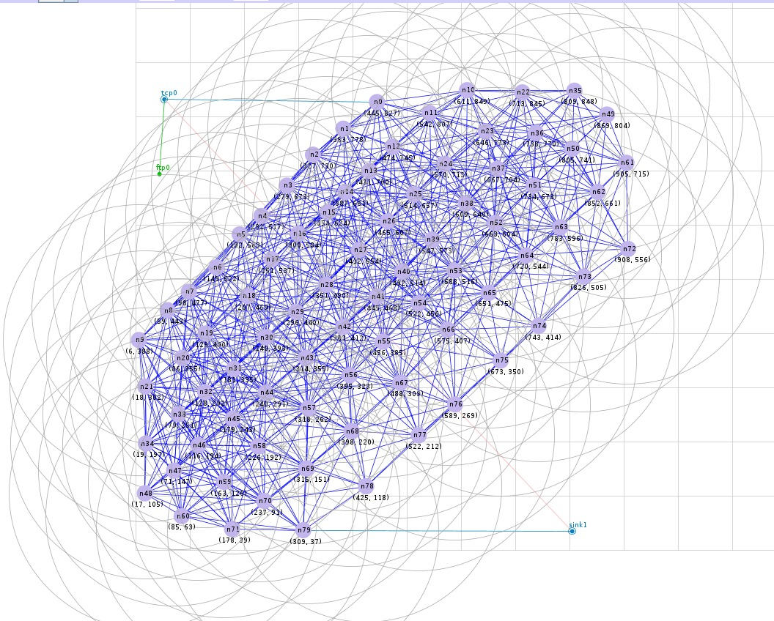
Practicing Nodes
20 Nodes
50 Nodes
80 Nodes

Slide 5
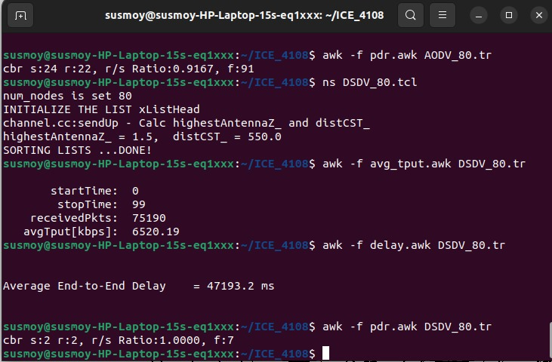

Scenario with Incorporating Commands

Slide 6
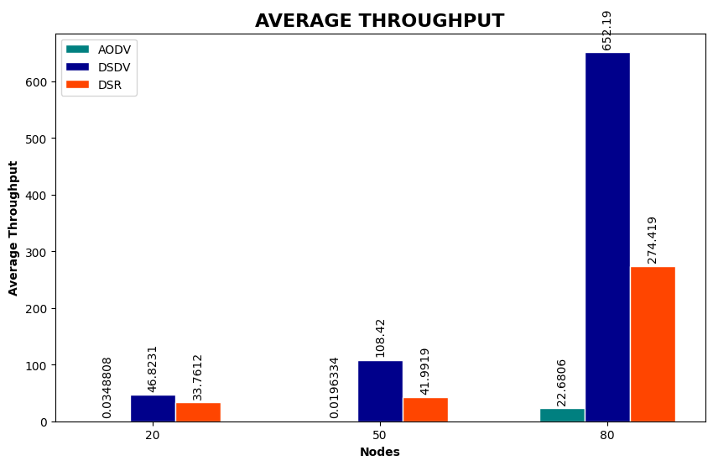
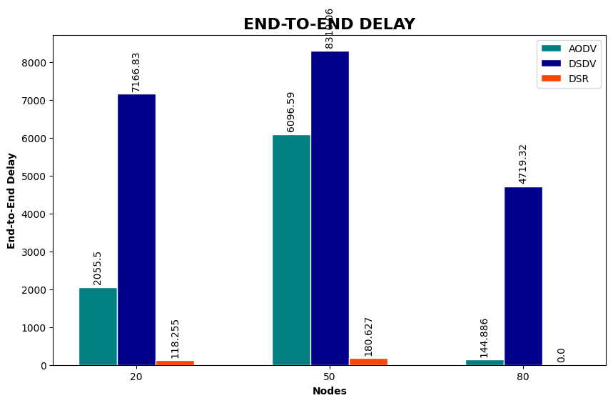
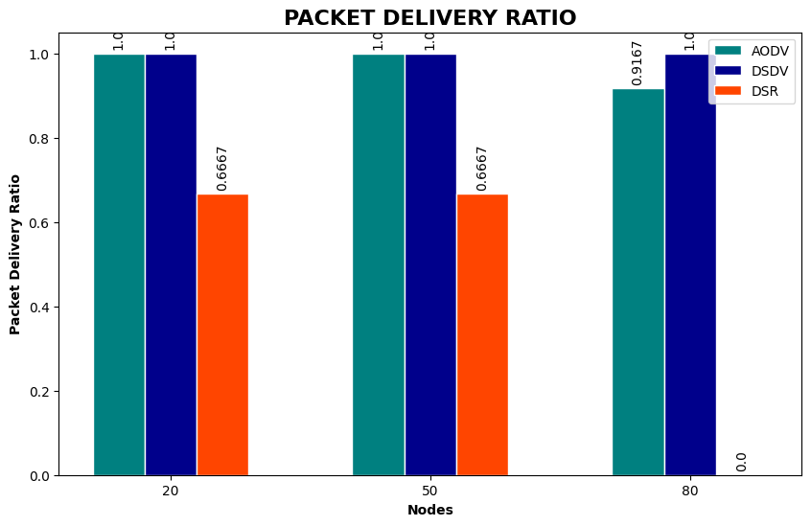
Comparative Analysis
Avarage Throughput
End-to-End Delay
Packet Delivery Ratio

Slide 7
Discussion
Performance analysis of AODV, DSDV, and DSR protocols across varying node densities highlights significant differences in their efficiency. The "best" protocol depends on the specific use case, network size, and mobility patterns. If we are dealing with a dynamic and mobile network, AODV or DSR is often preferred, while for stable environments, DSDV might work better. In contrast, DSR demonstrates poor performance with lower throughput, reduced PDR, and significantly higher delays, particularly in larger networks, due to its proactive routing nature. Overall, DSDV emerges as the most reliable protocol for networks, as per my experimental data.

