Slide 1
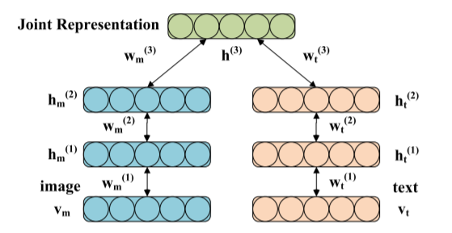
AutoEncoder
radar
KIM
Multimodal
ASOS

