Slide 1
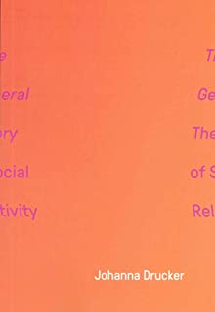
Drucker’s The General Theory of Social Relativity, ‘Phantasmatic’ AND Social Media Covid-19 Memes
Soji Cole
images: http://www.amazon.com & https://www.facebook.com/boredpanda/posts/10158733971959252.

Slide 2
INTRODUCTION
I have crafted the topic for this presentation based on the following reasons: (1) Johanna Drucker’s position in the book The General Theory of Social Relativity directly connects to the aesthetic condition of memes, especially on social media platform (2) “Phantasmatic”, as used in the book can be applied, in strong terms, to the creation and consumption of memes on social media as alternative source of communication (3) The social media can be regarded as one of the biggest arena in the contemporary world where conventional text can readily be converted into non-realist text (digitized format), yet sustaining the thrust of the information inherent in the text (4) the author, in the book, consistently utilized the words “social” “media”, and “meme” in the book, so I found it ideally (and readily) usable to construct my own idea.

Slide 3
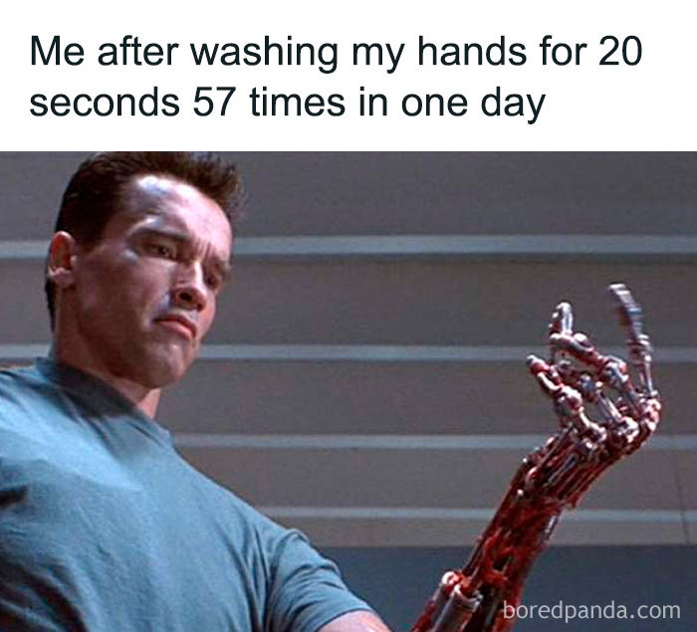
Explaining Drucker’s General Theory of Social Relativity
Drucker’s main argument is that social meaning should be (is) derived from experiential and aesthetic interpretation of many possibilities which are in co-dependence and constitutive relationalities with each other. In this wise, it recognizes that not only are all media social, but that the social itself is a medium
image: www.facebook.com/boredpanda/posts/10158733971959252

Slide 4
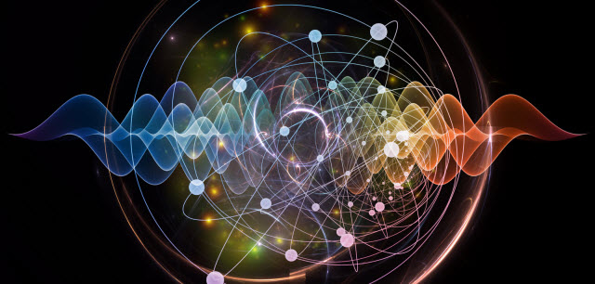
The Quantum Theory Analogy
The Quantum Theory is the branch of physics that explains how the behavior of even the smallest atom works to make up matter that constitute the universe. It means that everything, little or not are important constituent of the universe. The General Theory of Social Relativity addresses the fundamental question of how we should conceive the world, understand and interact with the forces at work in the social world, and engage innovative concepts for thinking about social processes.
image: www.edgy.app/according-to-a-new-quantum-theory-two-way-signaling-may-be-possible.

Slide 5
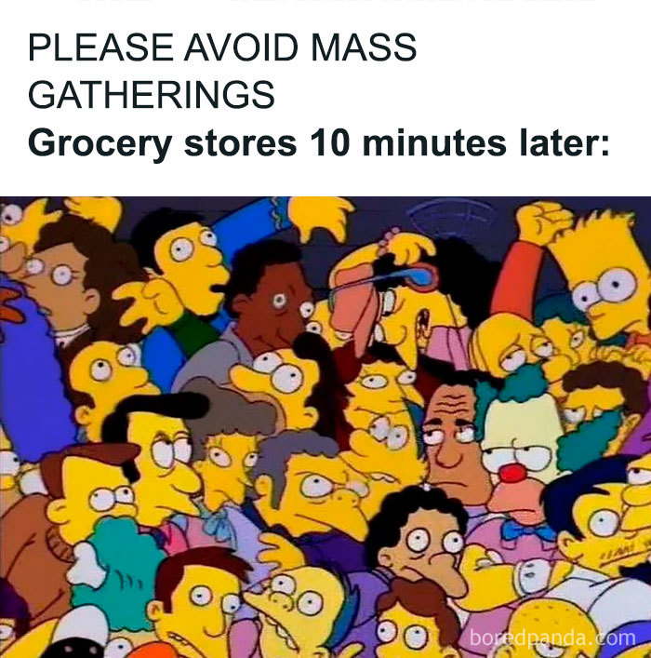
Phantasmatic and Covid-19 Social media memes
“Phantasmatic is the condition of affective engagement with consensual delusion” (Drucker 4).
image: www.facebook.com/boredpanda/posts/10158733971959252

Slide 6
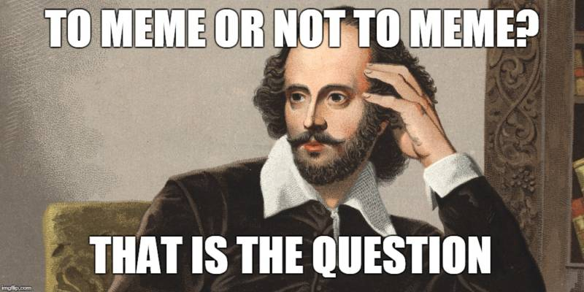
Memes
Limor Shifman describes internet memes as “(a) a group of digital items sharing common characteristics of content, form, and/or stance, which (b) were created with awareness of each other, and (c) were circulated, imitated, and/or transformed via the Internet by many users” (12-13). For the scope of this presentation, Shifman’s description is complemented by an additional criterion; (c) wherein such users are temporarily collected in a digital community by the purpose of their interactions with the digital items in a complexity of agency. Fiona Andreallo has opined that; “… in the context of meme communities, we are dealing with communication among a community that involves more than two people and where the communication flows are far more complex and multidirectional” (83).
Image: https://www.kqed.org/education/531438/to-meme-or-not-to-meme-using-memes-to-teach-media-literacy-skills

Slide 7
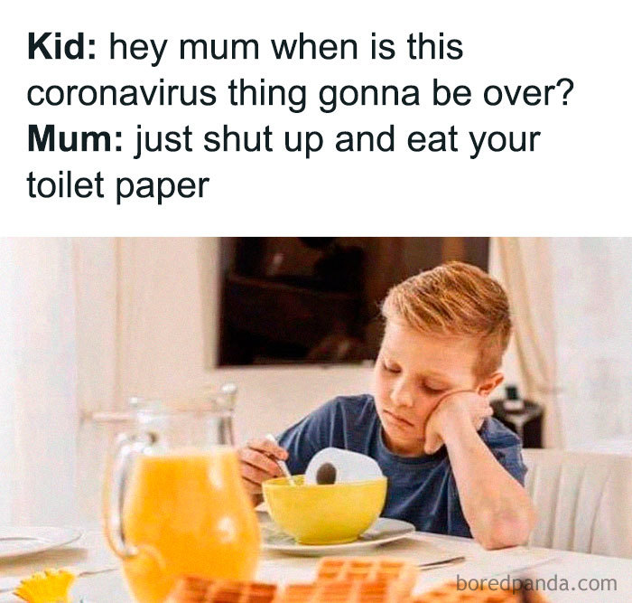
MEME AS ‘non-realist’ mode of communication, which is “phantasmatic’.
Phantasmatic
Converting textual messages into meme images
Phantasmatic
Communicating with meme images
Phantasmatic
Non-realist feedback

Slide 8
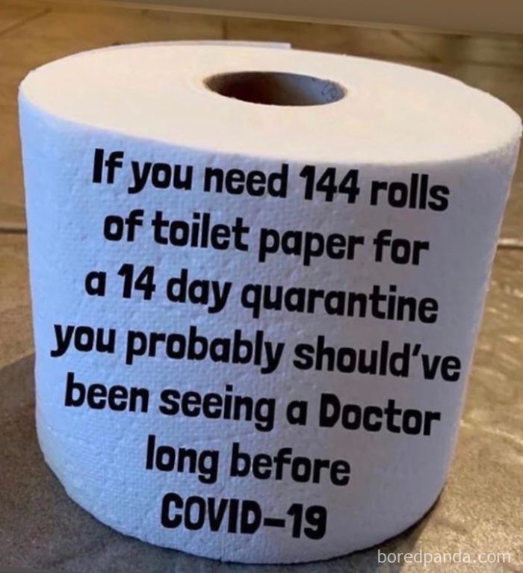
Example 1
This meme came out at the outset of the general lockdown. Thus, the meme is an anecdotal response to the panic buying of toilet paper. The frenetic rush was as a result of anxiety and psychological responses to information in a time of uncertainty. Most people overstocked on the buying and most stores quickly ran out of supplies.

Slide 9
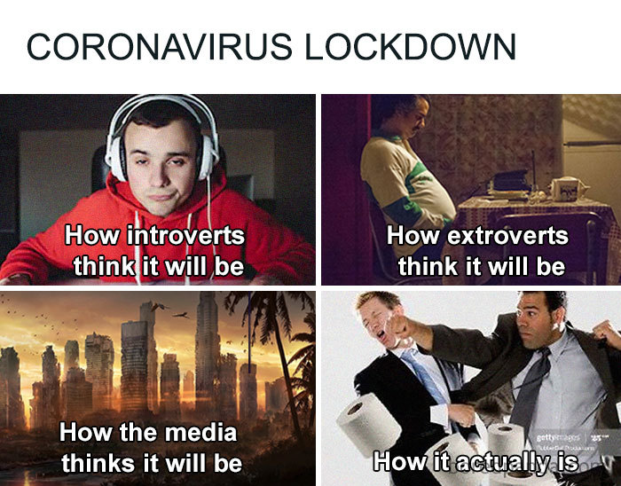
Responses
Many people overstocked on the buying and most stores quickly ran out of supplies. Since the sense of the meme image is “multidirectional” (Andreallo), and can be subjected to divergent social meanings, I will consider two responders’ comments on this image among several others; (1) “They’re gonna wrap themselves in the toilet roll because we’re short of protective gears”. (2) I could have understood it if it was a sickness that made you run to the loo a lot, but it’s a cough!”.

Slide 10
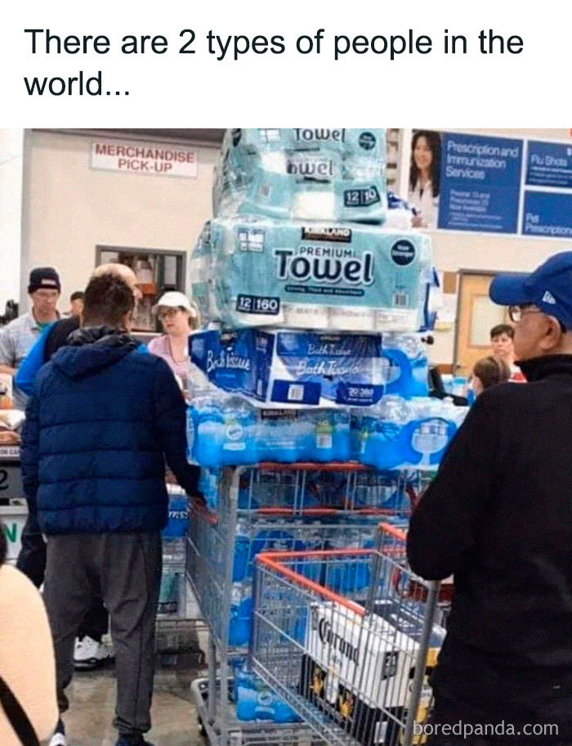
Example 2
In this image, there is a consideration of meaning in a relatively multi-layered and intertextual mix of both image and texts. That is, the image represents a form of meaning which may not be what is constructed in the image (multidimensionality).

Slide 11
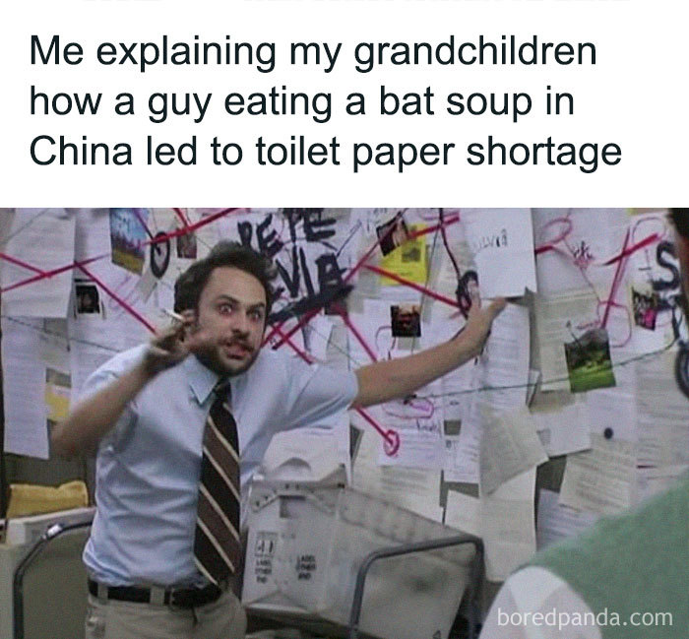
Responses
Let us also consider two responses to this meme image; (1) “The guy with the beer is calling his boss in a minute: “Hey boss, sorry, got a case of Corona. Yep, can’t come to work”. (2) “You can clearly see that Corona is the driving force here”. Though the meme image seems to dominate, the text also adds significantly to the meaning of the image. The image and texts both form co-concepts for interpretation. From the analysis of responses, explication comes from the processing of the image, the texts (There are 2 types of people in the world…) and possible underlying meanings in one or in both. Through the image and the responses, symbolic image and lived experiences have been conflated (see epigraph) in “constitutive relationalities” with each other.

Slide 12
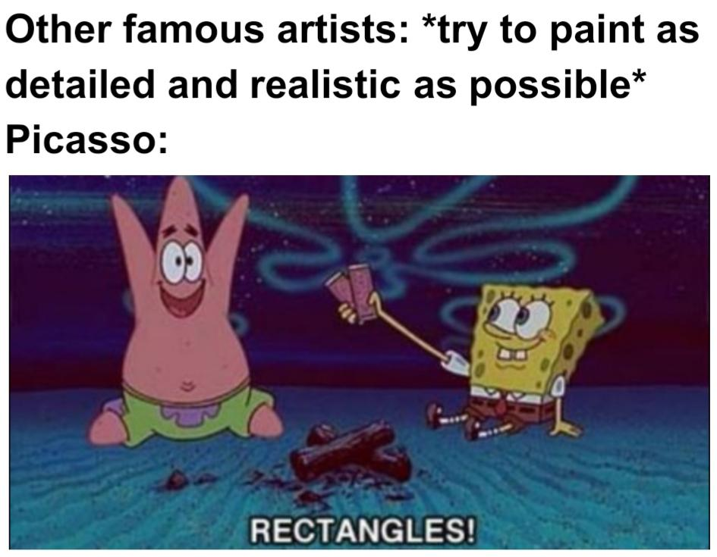
Conclusion
Non-realism is an aesthetic practice in arts. Aesthetic itself is “a process of calling attention— to something, some event, object, sensation, action, some phenomenon. And that act is generative; it produces a critical act of differentiation (Drucker 13-14).
Notes:
All images and online responses in the paper have been retrieved from the Bored Panda Facebook page at https://www.facebook.com/boredpanda/posts/10158733971959252. Accessed 20 October, 2020.
Only responses to the meme contents by users were obtained for this paper. The identities of responders have been removed.

Slide 13
Works Cited
Andreallo, Fiona. “The semeful sociability of digital memes: visual communication as active and interactive conversation”. A thesis submitted in fulfilment of the requirements for the degree of Doctor of Philosophy, Faculty of Arts and Social Sciences, University of Technology Sydney, April 2017.
Drucker, Johanna. The General Theory of Social Relativity. The Elephants Ltd, 2018.
Goertzel, Ben. “Quantum Theory and Consciousness”, The Journal of Mind and Behavior. Vol. 13, no.1, 1992, pp. 29-36. www.jstor.org/stable/43853586. Accessed 22 October 2020.
Latour, Bruno. We have never been Modern (trans. Catherine Porter). Harvard University Press, 1993.
Saussure, Ferdinand Cours de Linguistique Generale/Course in General Linguistics. Duckworth, 1983.
Shifman, Limor. Memes in Digital Culture. MIT Press, 2014.
Wiggins, Bradley. The Discursive Power of Memes in Digital Culture (Ideology, Semiotics and Intertextuality). Routledge, 2019.

Slide 14
Discussion questions
Does it open up our perspective of understanding better when we relay covid-19 communication via memes? What notion of non-realist perspective do we think of this experience?
Can we think of Drucker’s The General Theory of Social Relativity in terms of the objects and subjects of Proust’s Swann’s Way?

