Slide 1
Portfolio management system in Trading
Investment Tracking & analysis for informed decision making
Sojwal Shirke 2124UCSM1025

Slide 2

INTRODUCTION TO PORTFOLIO MANAGEMENT
L.
A tool for managing,tracking,and analyzing investment portfolios.
Helps users maximize returns and minimize risks through informed decisions

Slide 3
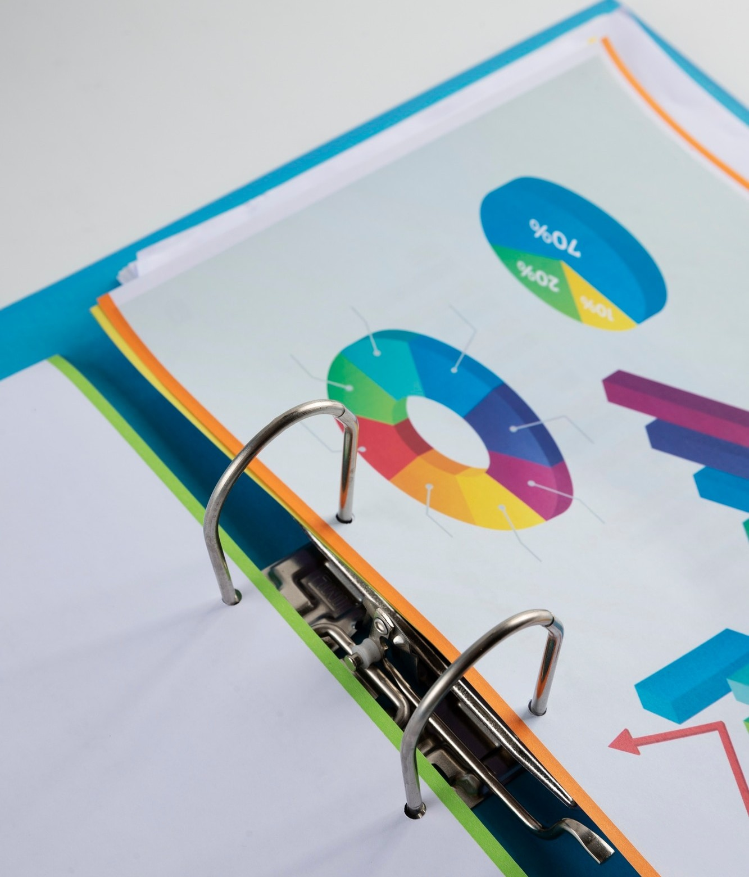
Problem statement
Investors face challenges in tracking multiple assests and optimizing portfolios.
Need for real time insights to respond to market ﬂuctuations.

Slide 4

KEY OBJECTIVES
To enable users to manage investments efﬁciently and effectively
Provide tools for performance analysis and risk assessment
Offer portfolio rebalancing alerts to ensure optimal asset allocation

Slide 5

Project scope
1.Portfolio tracking 2.Asset Allocation 3.Performance analysis 4.Risk management 5.Reporting 6.Investment strategies

Slide 6

KEY FEATURES
Dashboard
Trade management 3.Real time data 4.Analysis tools 5.Rebalancing Alerts 6.Security

Slide 7
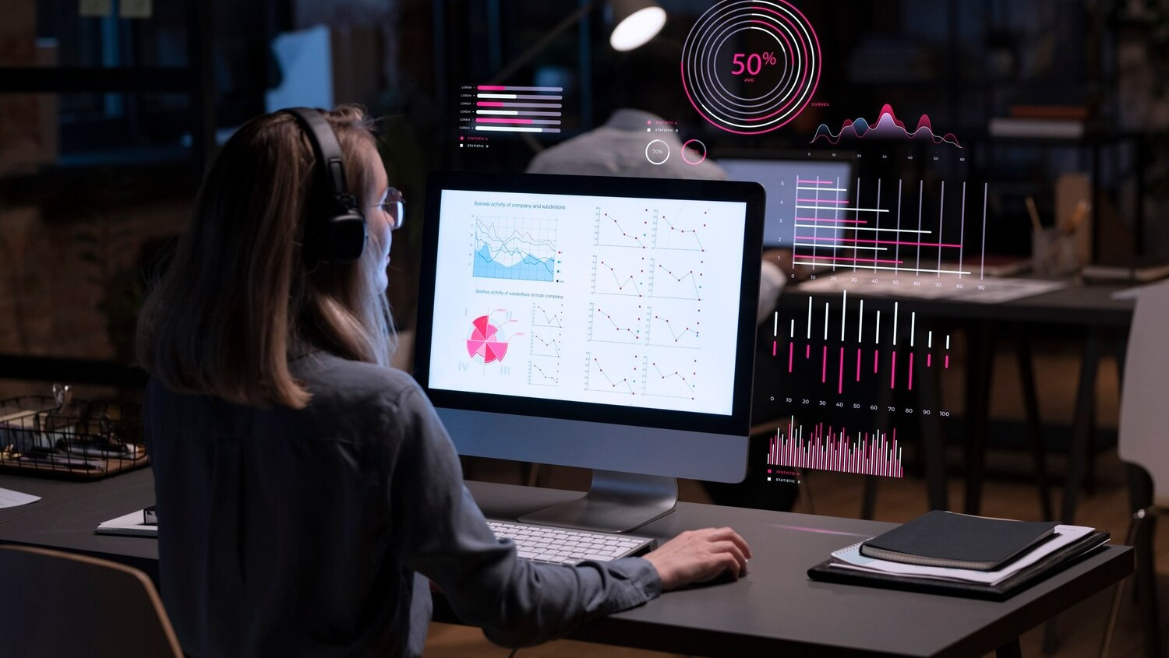
System workﬂow
1.User login 2.Portfolio view 3.Add/Remove Assets
Performance analysis
Rebalancing and reporting

Slide 8

Beneﬁts to users
Informed Decision making
Time efﬁciency 3.Risk control 4.Goal alignment

Slide 9
CONCLUSION AND FUTURE OUTLOOK
In conclusion, optimizing investment strategies through effective portfolio management systems is essential for achieving ﬁnancial success. As technology and market dynamics evolve, staying informed and adaptable will be key to navigating future investment landscapes.

Slide 10

Thanks!

