Slide 1
Task 2
Laravel
Fullname:

Slide 2

EXE 1
Screenshot of root file web.php, replace the image below

Slide 3
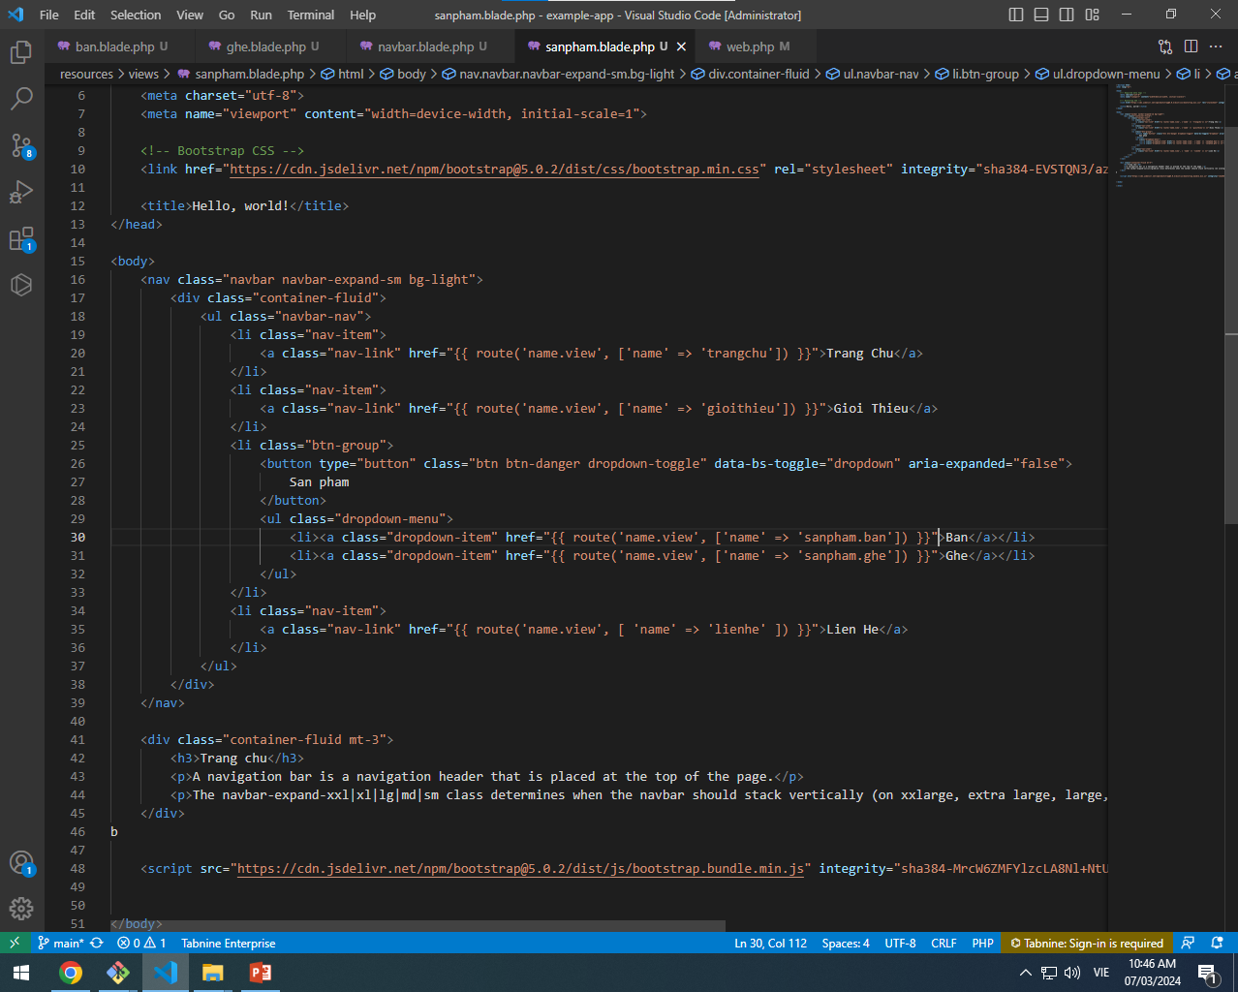
EXE 1
Screenshot of the view blade file, replace the image below

Slide 4
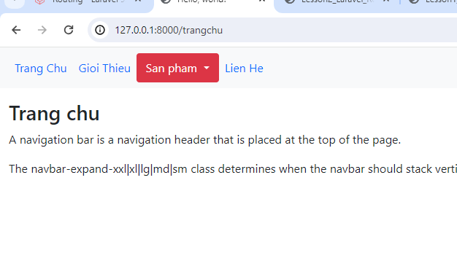
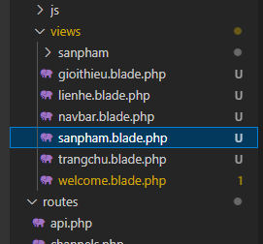
EXE 1
Screenshot of the result, replace the image below

Slide 5
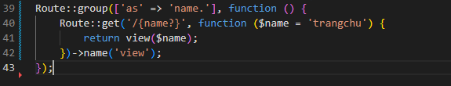
EXE 2
Screenshot of root file web.php, replace the image below

Slide 6
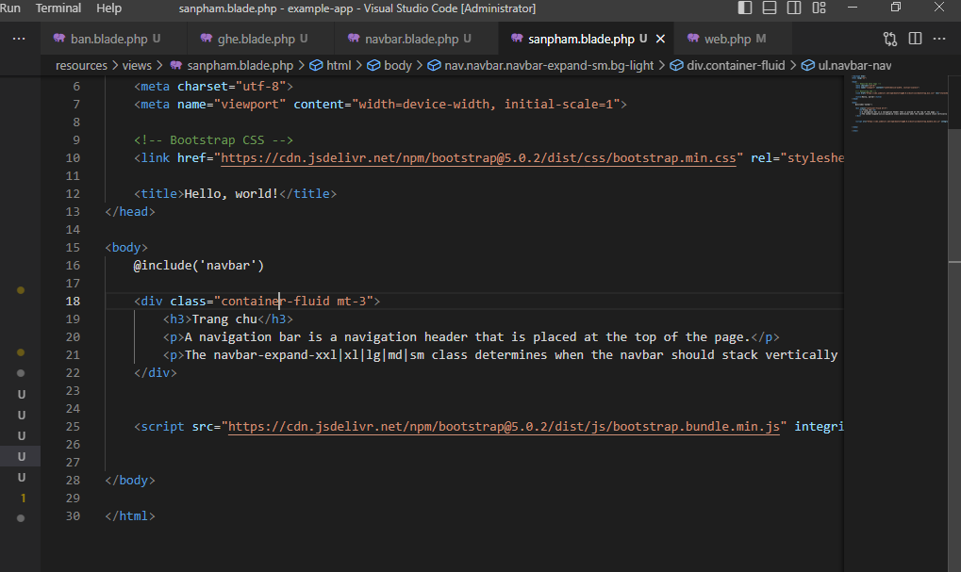

Slide 7
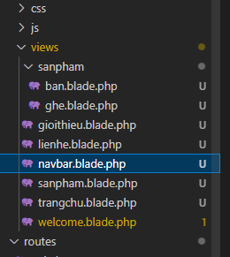
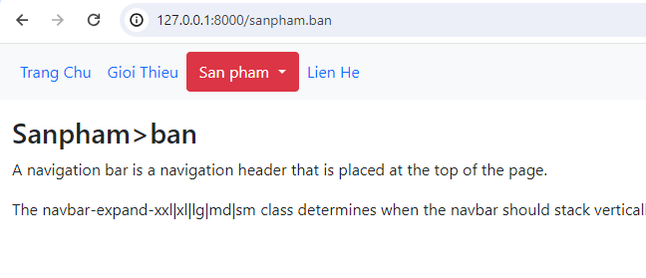
EXE 2
Screenshot of the view blade file, replace the image below

