Slide 1

CSE2PM09A / AID2PM07A
Design and Analysis of Algorithm
DEPARTMENT OF COMPUTER SCIENCE AND ENGINEERING

Slide 2
Unit 2 Syllabus
Unit 2: Divide and Conquer & Greedy strategy:
Divide and Conquer: introduction, Principle, control abstraction, Quick Sort, Merge sort, Large Integer multiplication/ Strassen matrix multiplication,
Greedy strategy:
Graph- Basic Terminology, Graphs (Directed, Undirected), Various Representations, Traversals & Applications of graph- Prim’s and Kruskal’s Algorithms, Dijsktra's Single source shortest path, Analysis complexity of algorithm, topological sorting.
Greedy strategy: Principle, control abstraction, Knapsack problem, Job sequencing with Deadlines, Huffman Encoding

Slide 3
Algorithm Design Techniques/Strategies
Brute force
Divide and conquer
Space and time tradeoffs
Greedy approach
Dynamic programming
Backtracking
Branch and bound

Slide 4
Unit 2: Divide and Conquer
Introduction
Principle control abstraction
Quick Sort
Merge sort
Large Integer multiplication/ Strassen matrix multiplication

Slide 5
Divide & Conquer
Control Abstraction
DANDC (P)
{
if SMALL (P) then return S (p);
else
{
divide p into smaller instances p1, p2, …. Pk, k >= 1;
apply DANDC to each of these sub problems;
return (COMBINE (DANDC (p1) , DANDC (p2),…., DANDC (pk));
}
}
Divide the problem into smaller sub problems
Conquer the sub problems by solving them recursively.
Combine the solutions to the sub problems into the solution of the original problem.
Notes:
sahani

Slide 6
Divide-and-Conquer Technique (cont.)
a problem of size n
(instance)
subproblem 1
of size n/2
subproblem 2
of size n/2
a solution to
subproblem 1
a solution to
subproblem 2
a solution to
the original problem
It general leads to a recursive algorithm!
Notes:
A levitin

Slide 7
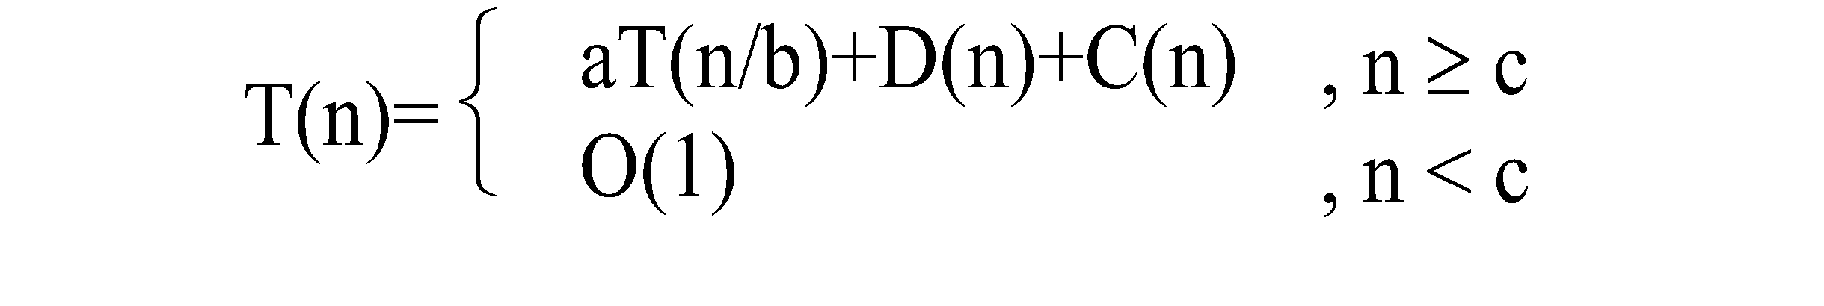
Time complexity of the general algorithm
A Recurrence is an equation or inequality that describes a function in terms of its value on smaller inputs
Special techniques are required to analyze the space and time required
Time complexity (recurrence relation):
where D(n) : time for splitting
C(n) : time for conquer
c : a constant

Slide 8
Divide-and-Conquer Examples
Sorting : Mergesort and Quicksort
Binary tree traversals
Binary search
Multiplication of large integers
Matrix multiplication: Strassen’s algorithm
Closest-pair and convex-hull algorithms
Notes:
A levitin

Slide 9
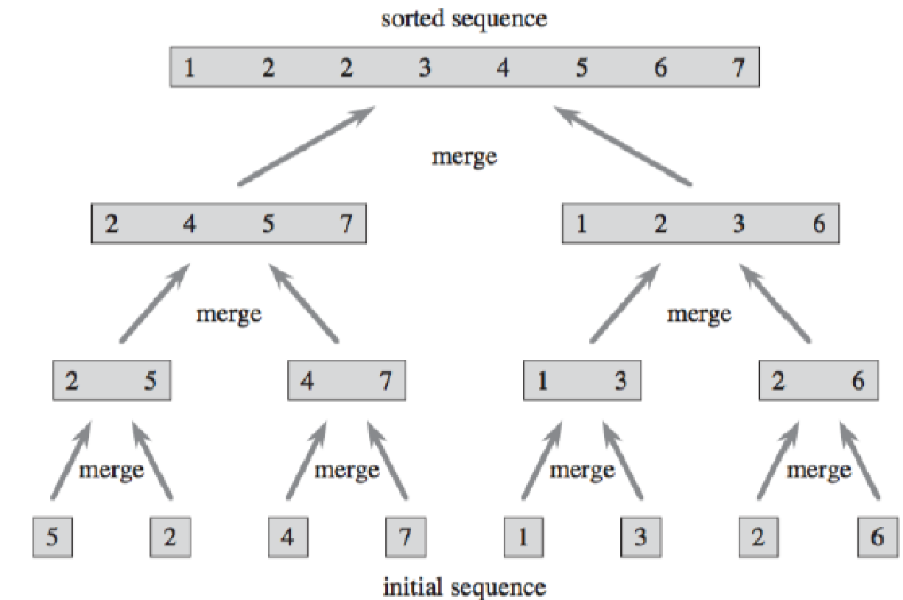
Mergesort
Merge sort is a divide and conquer algorithm for sorting arrays. To sort an array, first you split it into two arrays of roughly equal size. Then sort each of those arrays using merge sort, and merge the two sorted arrays.

Slide 10

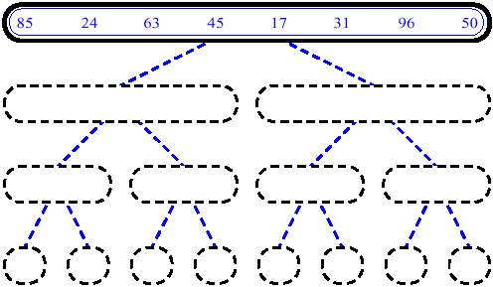
MergeSort (Example) - 1

Slide 11
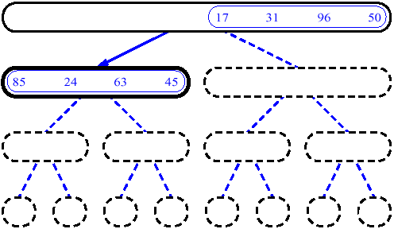
MergeSort (Example) - 2

Slide 12
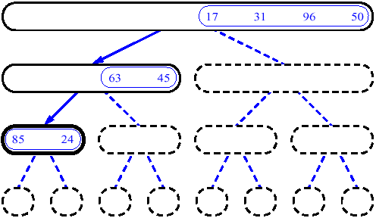
MergeSort (Example) - 3

Slide 13
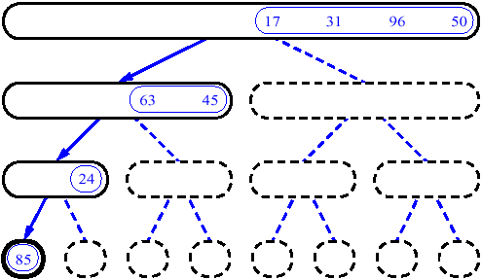
MergeSort (Example) - 4

Slide 14
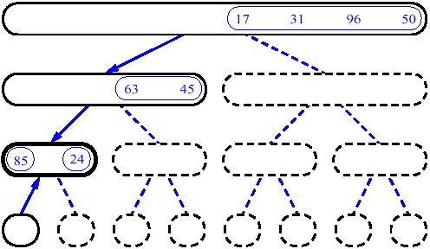
MergeSort (Example) - 5

Slide 15
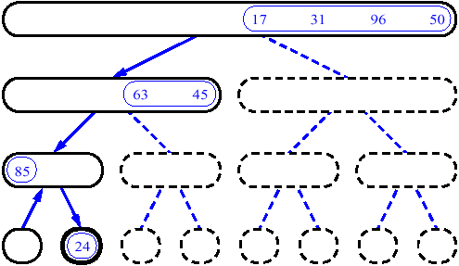
MergeSort (Example) - 6

Slide 16
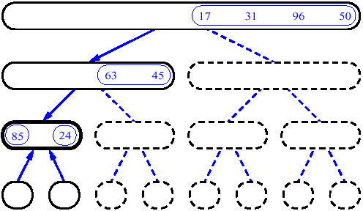
MergeSort (Example) - 7

Slide 17
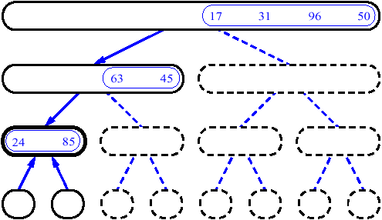
MergeSort (Example) - 8

Slide 18
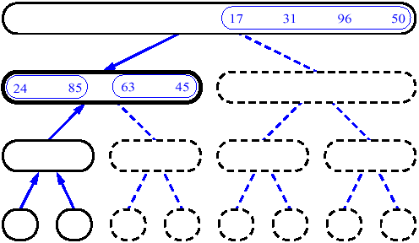
MergeSort (Example) - 9

Slide 19
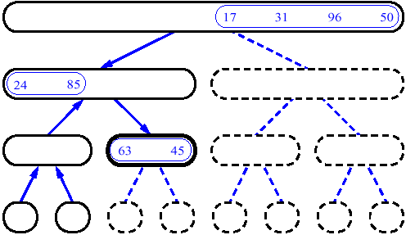
MergeSort (Example) - 10

Slide 20
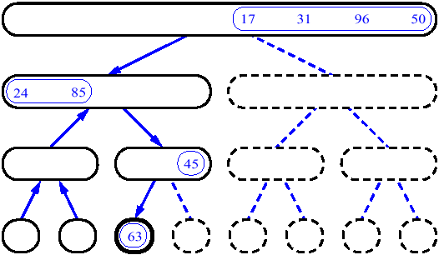
MergeSort (Example) - 11

Slide 21
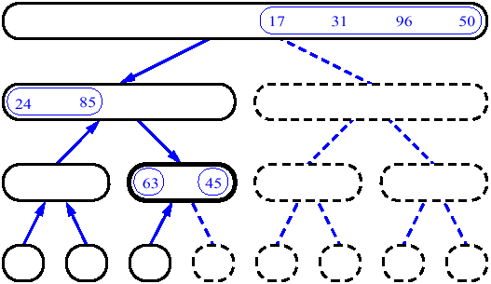
MergeSort (Example) - 12

Slide 22
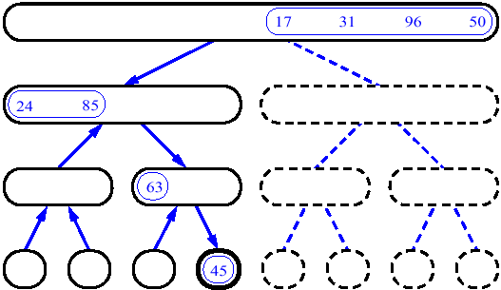
MergeSort (Example) - 13

Slide 23
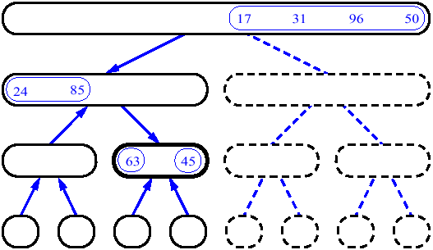
MergeSort (Example) - 14

Slide 24
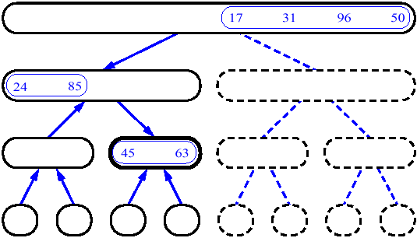
MergeSort (Example) - 15

Slide 25
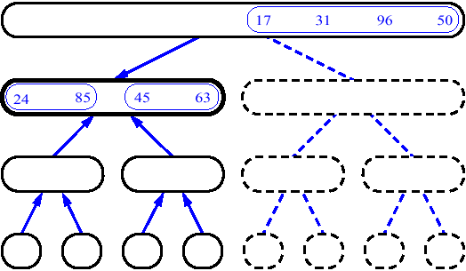
MergeSort (Example) - 16

Slide 26
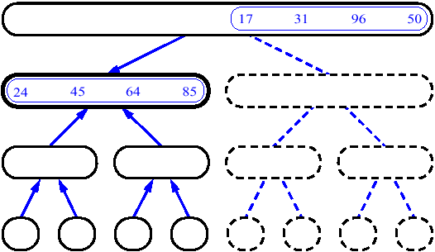
MergeSort (Example) - 17

Slide 27
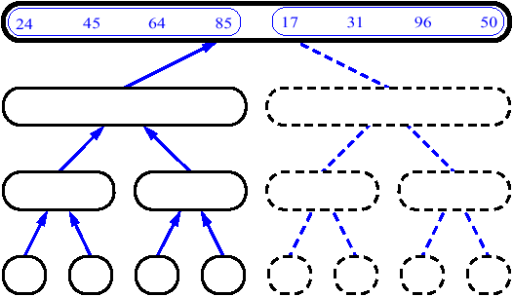
MergeSort (Example) - 18

Slide 28
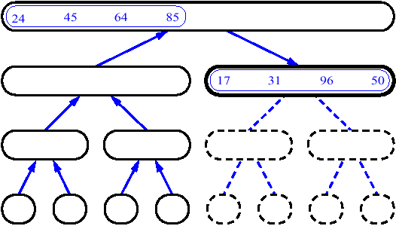
MergeSort (Example) - 19

Slide 29
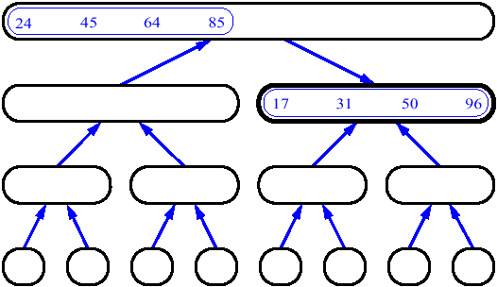
MergeSort (Example) - 20

Slide 30
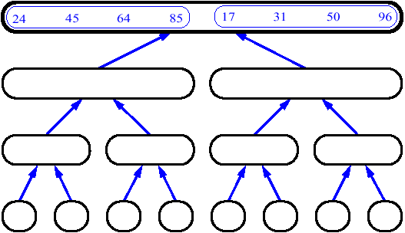
MergeSort (Example) - 21

Slide 31
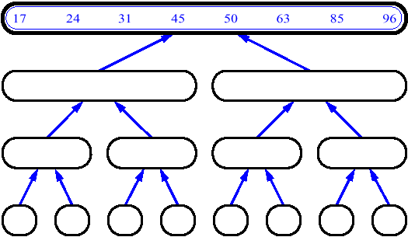
MergeSort (Example) - 22

Slide 32
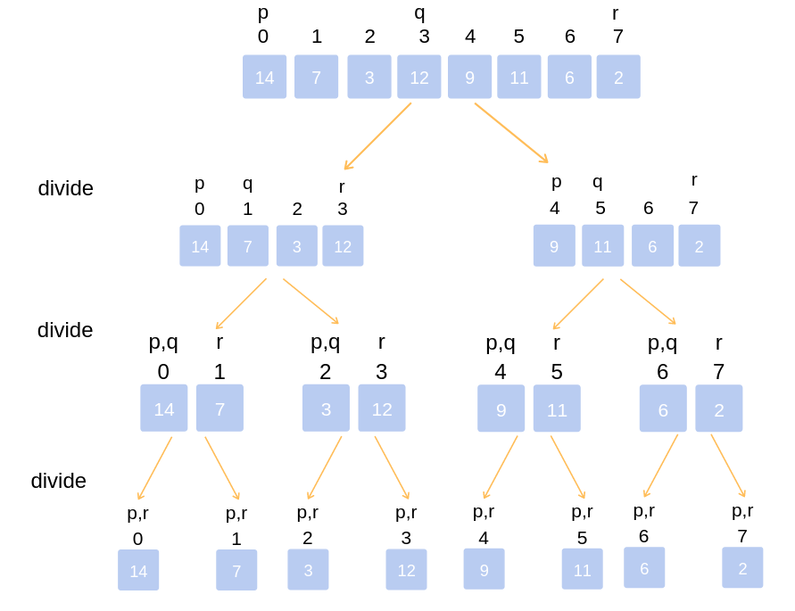
Merge Sort Algorithm
REF BOOK: Horowitz, Salmi & Rajasekaran
Algorithm MergeSort(a,low, high)
{
//a[low : high] array to be sorted
// Small(P) is true if there is only one element to sort. In this case the list is already sorted
if (low < high) // If there are more than one element
{
// Divide P into subproblems. Find where to split the set.
mid := | (low + high)/2|;
// Solve the subproblems.
MergeSort(a,low, mid);
MergeSort(a,mid + 1, high);
// Combine the solutions.
Merge(a,low, mid, high);
}
}

Slide 33
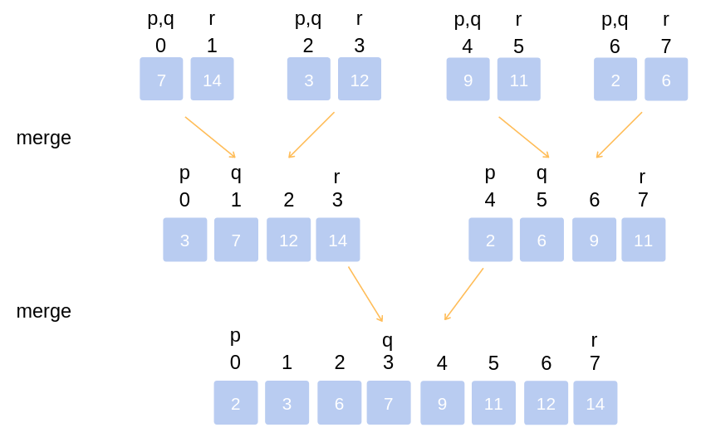
Algorithm Merge(a,low, mid , high)
// a[low : high] is array containing two sorted
/ / subsets in a[ low; : mid] and in a[mid + 1 : high] .
The go is to merge these two sets into a single set residing
// in a[low : high] . b[ ] is an auxiliary global array.
{
h := low ; i := low ; j := mid + 1;
while ( ( h <= mid) and (j <= high)) do
{
if ( a[ h] <= a[j])
{
b[i] := a[h] ;h := h + 1;
}
else
{
b[i ] := a[j ] ; j:= j+ l ;
}
i:= i + 1;
}
if ( h > mid) then
for k := j to high do
{
b[i] := a[ k] ; i:= i + 1;
}
else
for k := h to mid do
{
b[i] := a[ k] ; i:= i+ 1 ;
}
for k := low to high do a[ k] := b[ k] ;
}
REF BOOK: Horowitz, Salmi & Rajasekaran

Slide 34
Analysis of Mergesort
Running time T(n) of Merge Sort:
Divide: computing the middle takes Θ(1)
Conquer: solving 2 sub problems takes 2T(n/2)
Combine: merging n elements takes Θ(n)
Total:
T(n) = Θ(1) if n = 1
T(n) = 2T(n/2) + Θ(n) if n > 1
T(n) = Θ(n lg n)
Space requirement: Θ(n) (not in-place)
Notes:
even if not analyzing in detail, show the recurrence for mergesort in worst case:
T(n) = 2 T(n/2) + (n-1)
worst case comparisons for merge

Slide 35
Quicksort
Ref Book: Thomas Cormen
Divide :
Pick any element (pivot) v in array A[p…r]
Partition array A into two groups
A1[p - - -q-1] , A2 [q+1----r] Compute the index q
A1 element < A[q] < A2 element
Conquer step: recursively sort A1 and A2
Combine step: the sorted A1 (by the time returned from recursion), followed by A[q], followed by the sorted A2 (i.e., nothing extra needs to be done)
v
A
v
A1
A2

Slide 36
Quicksort Pseudo-code
INPUT: a sequence of n numbers stored in array A
OUTPUT: an ordered sequence of n numbers
QuickSort (A, p, r) // sort A[p..r] by divide & conquer
if p < r
then q = Partition (A, p, r)
QuickSort (A, p, q-1)
QuickSort (A, q+1, r)
Initial Call: QuickSort(A, 1, n)

Slide 37
Procedure Partitioning the array
Input: Array containing sorted subarrays A[p..q] and A[q+1..r].
Output: sorted subarray in A[p..r].
Partition(A, p, r)
1 x = A[r]
2 i = p - 1
for j ← p to r-1
if A[j] ≤ x
i= i +1
exchange A[i] with A[j]
exchange A[i+1] with A[j]
Return i + 1

Slide 38
Apply quick sort for the following numbers: 2, 8, 7, 1, 3, 5, 6, 4

Slide 39
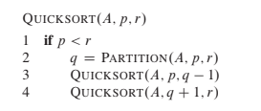
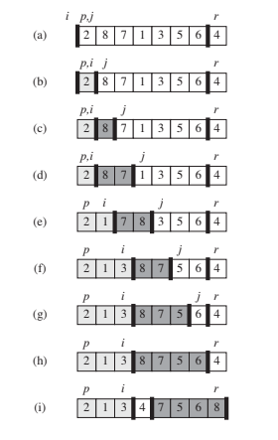
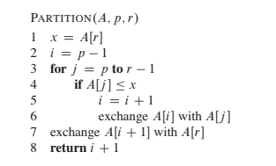

Slide 40
The steps of QuickSort
S
select pivot value
81
43
31
57
13
75
92
0
65
26
S₁
S₂
partition S
0
31
75
13
43
65
92
81
26
57
S₁
S₂
QuickSort(S₁) and
QuickSort(S₂)
0
13
26
31
43
57
65
75
81
92
S
0
13
26
31
43
57
65
75
81
92
Voila! S is sorted

Slide 41
Quicksort Analysis
Assumptions:
A random pivot (no median-of-three partitioning)
No cutoff for small arrays
Running time
pivot selection: constant time, i.e. O(1)
partitioning: linear time, i.e. O(N)
running time of the two recursive calls
T(N)=T(i)+T(N-i-1)+cN where c is a constant
i: number of elements in S1

Slide 42
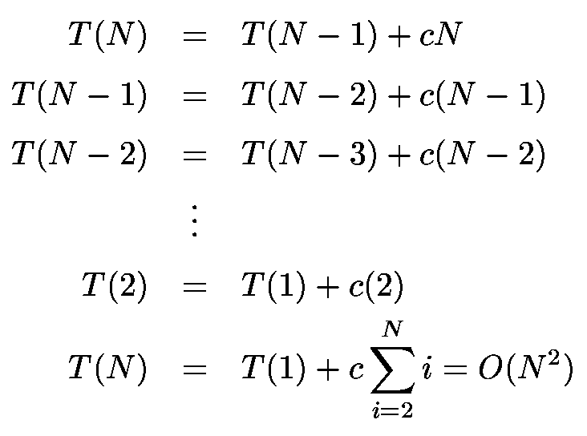
Worst-Case Analysis
worst case Partition?
The pivot is the smallest element, all the time
Partition is always unbalanced

Slide 43
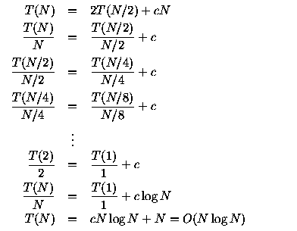
Best-case Analysis
best case Partitioning?
Partition is perfectly balanced.
Pivot is always in the middle (median of the array)

Slide 44
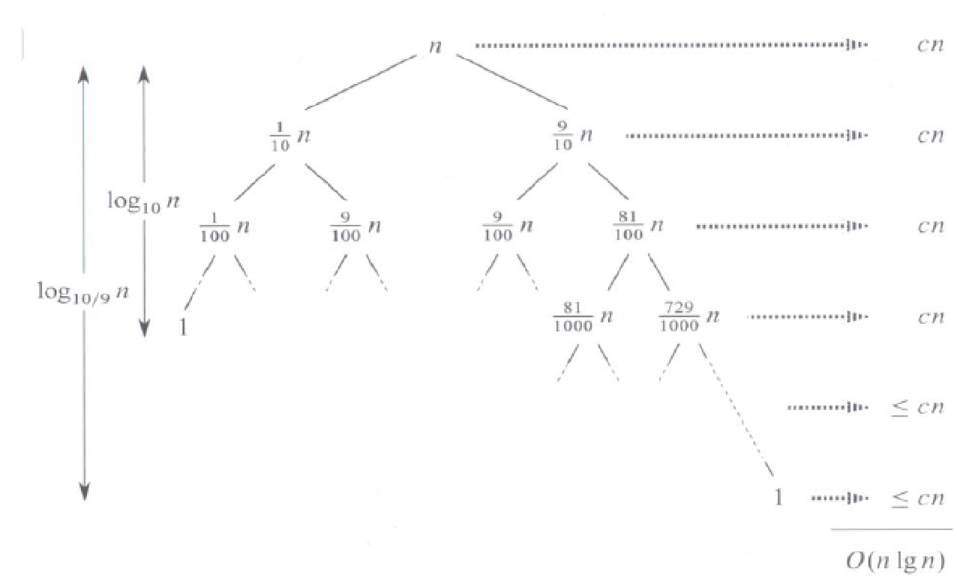
Average-Case Analysis
Intution for Average Case : We can get an idea of average case by considering the case when partition puts O(n/9) elements in one set and O(9n/10) elements in other set.
Following is recurrence for this case.
T(n) = T(n/9) + T(9n/10) + ϴ(n)
Solution of above recurrence is also O(nlogn)

Slide 45
Summary Analysis of Quicksort
Best case: split in the middle — Θ(n log n)
Worst case: sorted array! — Θ(n²)
Average case: random arrays — Θ(n log n)
Improvements:
better pivot selection: median of three partitioning
switch to insertion sort on small subfiles

Slide 46
Multiplication of Large Integers
Consider the problem of multiplying two (large) n-digit integers represented by arrays of their digits such as: A = 12345678901357986429 B = 87654321284820912836 The grade-school algorithm:
a₁ a₂ … a_{n} b₁ b₂ … b_{n} (d₁₀) d₁₁d₁₂ … d_{1n}
(d₂₀) d₂₁d₂₂ … d_{2n}
… … … … … … …
(d_{n0}) d_{n1}d_{n2} … d_{nn}
Efficiency: Θ(n²) single-digit multiplications

Slide 47
First Divide-and-Conquer Algorithm
A small example: A * B where A = 2135 and B = 4014
A = (21·10² + 35), B = (40 ·10² + 14)
So, A * B = (21 ·10² + 35) * (40 ·10² + 14)
= 21 * 40 ·10⁴ + (21 * 14 + 35 * 40) ·10² + 35 * 14
In general, if A = A₁A₂ and B = B₁B₂ (where A and B are n-digit,
A₁, A₂, B₁, B₂ are n/2-digit numbers),
A * B = A₁ * B₁·10^{n} + (A₁ * B₂ + A₂ * B₁) ·10^{n/2} + A₂ * B₂
Recurrence for the number of one-digit multiplications M(n):
M(n) = 4M(n/2), M(1) = 1 Solution: M(n) = n²

Slide 48
Second Divide-and-Conquer Algorithm
A * B = A₁ * B₁·10^{n} + (A₁ * B₂ + A₂ * B₁) ·10^{n/2} + A₂ * B₂
The idea is to decrease the number of multiplications from 4 to 3:
(A₁ + A₂ ) * (B₁ + B₂ ) = A₁ * B₁ + (A₁ * B₂ + A₂ * B₁) + A₂ * B_{2,} I.e., (A₁ * B₂ + A₂ * B₁) = (A₁ + A₂ ) * (B₁ + B₂ ) - A₁ * B₁ - A₂ * B_{2,} which requires only 3 multiplications at the expense of (4-1) extra add/sub.
Recurrence for the number of multiplications M(n): M(n) = 3M(n/2), M(1) = 1 Solution: M(n) = 3^{log 2n} = n^{log 23} ≈ n^{1.585}
What if we count both multiplications and additions?

Slide 49
Example of Large-Integer Multiplication
2135 * 4014
= (21*10^2 + 35) * (40*10^2 + 14)
= (21*40)*10^4 + c1*10^2 + 35*14
where c1 = (21+35)*(40+14) - 21*40 - 35*14, and
21*40 = (2*10 + 1) * (4*10 + 0)
= (2*4)*10^2 + c2*10 + 1*0
where c2 = (2+1)*(4+0) - 2*4 - 1*0, etc.
This process requires 9 digit multiplications as opposed to 16.

Slide 50
References
Thomas H Cormen and Charles E.L Leiserson, "Introduction to Algorithm" PHI Third Edition
Horowitz and Sahani, "Fundamentals of Computer Algorithms", 2ND Edition. University Press, ISBN: 978 81 7371 6126, 81 7371 61262.

Slide 51
Unit 2 : Greedy strategy
Principle, control abstraction
Knapsack problem
Job sequencing with Deadlines
Huffman Encoding
51

Slide 52
Optimization problems
An optimization problem is one in which you want to find, not just a solution, but the best solution
A “greedy algorithm” sometimes works well for optimization problems
A greedy algorithm works in phases. At each phase:
You take the best you can get right now, without regard for future consequences
You hope that by choosing a local optimum at each step, you will end up at a global optimum
52
Notes:
2

Slide 53
Introduction : Greedy Method
A greedy algorithm for an optimization problem always makes the choice that looks best at the moment and adds it to the current subsolution.
Final output is an optimal solution.
Greedy algorithms don’t always yield optimal solutions but, when they do, they’re usually the simplest and most efficient algorithms available.
53

Slide 54
Introduction : Greedy Method
It is used to solve problems that have ‘n’ inputs and require us to obtain a subset that satisfies some constraints.
Any subset that satisfied the constraints is called as a feasible solution.
We need to find the optimum feasible solution i.e. the feasible solution that optimizes the given objective functions.
It works in stages. At each stage, At each stage a decision is made regarding weather or particular input is in the optimum solution.
54

Slide 55
Introduction : Greedy Method
The greedy method suggests that one can divide the algorithm that works in stages. Considering one input at a time.
At each stage a decision is made regarding weather or particular input is in the optimum solution.
For this purpose all the inputs must be arranged in a particular order by using a selection process.
If the inclusion of next input in to the partially constructed solution will result in an infeasible solution then the input will not be considered and will not be added to partially constructed set otherwise it is added.
CHANGE-MAKING PROBLEM (coin changing)
55

Slide 56
Coin Changing
An optimal solution to the coin changing problem is the minimum number of coins whose total value equals a specified amount. For example what is the minimum number of coins (current U.S. mint) needed to total 83 cents.
Objective function: Minimize number of coins returned.
Greedy solution: Always return the largest coin you can
A Greedy Algorithm for
Coin Changing
1. Set remval=initial_value
2. Choose largest coin that
is less than remval.
3. Add coin to set of coins
and set
remval:=revamal-coin_value
4. repeat Steps 2 and 3
until remval = 0;
25
25
83 - 25 = 58
58 - 25 = 33
33 - 25 = 8
8 - 5 = 3
3 - 1 = 2
2 - 1 = 1
1 - 1 = 0
25
25
10
5
5
1
1
1
1
56

Slide 57
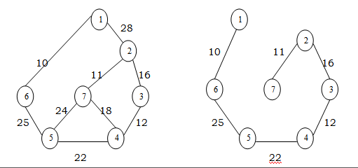
Greedy Method
Feasible Solution:-
Any subset of the solutions that satisfies the constraints of the problem is known as a feasible solution.
Optimal Solution:-
The feasible solution that maximizes or minimizes the given objective function is an optimal solution.
Example : MST
57

Slide 58
Control Abstraction : Greedy Method
Algorithm Greedy (a,n)
//a[1:n] contains the ‘n’ inputs
{
Solution: = 0; //initialize the solution
for i: = 1 to n do
{
x: = select (a);
if Feasible (solution, x) then
solution: = Union (solution, x);
}
return solution;
}
Select is a function which is used to select an input from the set.
Feasible is a function which verifies the constraints and determines weather the resultant solution is feasible or not.
Union is a function which is used to add elements to the partially constructed set.
58

Slide 59
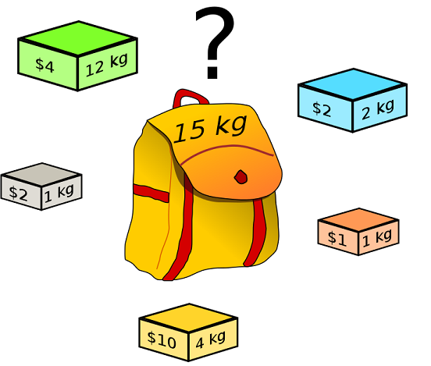
Knapsack Problem
Given :
A knapsack with capacity ‘m’
A set of ‘n’ objects with each item i having
p_{i} - a positive benefit
w_{i} - a positive weight
Goal: Choose items with maximum total benefit but with weight at most m.
If we are allowed to take fractional amounts, then this is the fractional knapsack problem.
Let x_{i} denote the amount we take of item i , 0≤ x_{i} ≤ 1
Objective: maximize ∑ p_{i} x_{i}
1 ≤ i ≤ n
Constraint: ∑ w_{i} x_{i} ≤ m
1 ≤ i ≤ n
and 0 ≤ x_{i} ≤ 1 , 1 ≤ i ≤ n
59

Slide 60
Knapsack Problem : Example
Ex: - Consider following instance of Knapsack Problem with 3 objects whose profits and weights are defined as
(P₁, P₂, P₃) = ( 25, 24, 15 ) (W₁, W₂, W₃) = ( 18, 15, 10 )
n=3 Knapsack Capacity m=20
Determine the optimum strategy for placing the objects in to the knapsack.
The four feasible solutions are :
(1) Greedy about profit: -
(x₁, x₂, x₃) | Profit Order | Weight Order | ∑ xiwi <=20 | ∑ xipi
(1, 2/15, 0) | (p1,p2,p3) (25,24,15) | (w1,w2,w3) (18, 15, 10 ) | 18 x 1+(2/15) x 15 = 20 | 25 x 1+ (2/15) x 24 = 28.2
(2) Greedy about weight: -
(x₁, x₂, x₃) | Profit Order | Weight Order | ∑ xiwi <=20 | ∑ xipi
(0, 2/3, 1) | (p3,p2,p1) (15, 24,25) | (w3,w2,w1) (10,15,18 ) | 18 x 0+(2/3) x 15+10 = 20 | 25 x0+ (2/3) x 24 +25= 31
60

Slide 61
(3) Greedy about profit / unit weight: -
(4) If an additional constraint of including each and every object is placed then the greedy strategy could be
(½, ⅓, ¼ ) ∑ xiwi = ½ x 18+⅓ x15+ ¼ x10 = 16. 5
∑ xipi =½ x 25+⅓ x24+ ¼ x15 = 12.5+8+3.75 = 24.25
(x₁, x₂, x₃) | ∑ xiwi <=20 | ∑ xipi
(0, 1, ½ ) | 18 x 0+1 x 15+(1/2)x10 = 20 | 25 x 0+ 1 x 24+(1/2)x15 = 31.5
(x₁, x₂, x₃) | ∑ xiwi <=20 | ∑ xipi
(½, ⅓, ¼ ) | 16.5 | 24.25
61

Slide 62
Algorithm : Greedy Knapsack
Algorithm Greedy knapsack (m, n)
//p (1:n) and w(1:n) contain the profits and weights resp. of the n objects
//ordered such that p(i)/W(i) ≥ p(i+1)/w (i+1). M is the knapsack size and x (1:n)
// is the solution vector
{
for i: = 1 to n do x(i) = 0.0i// initialize x O(n)
u : = m;
for i: = 1 to n do O(n)
{
if (w(i) > u) then break;
x(i): = 1.0;
u: = u-w(i);
}
if (i≤n) then x(i): = u/w(i);
}
Analysis: - If. we do not consider the time considered for sorting the inputs then the complexity will be O(n).
62

Slide 63
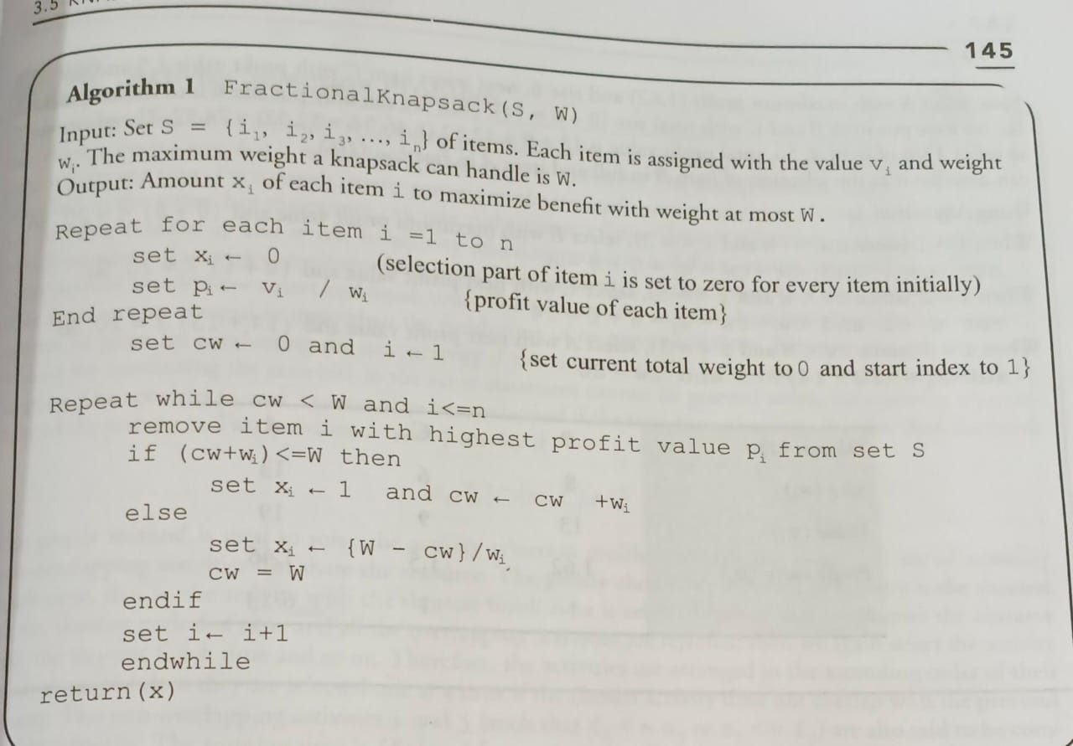
63

Slide 64
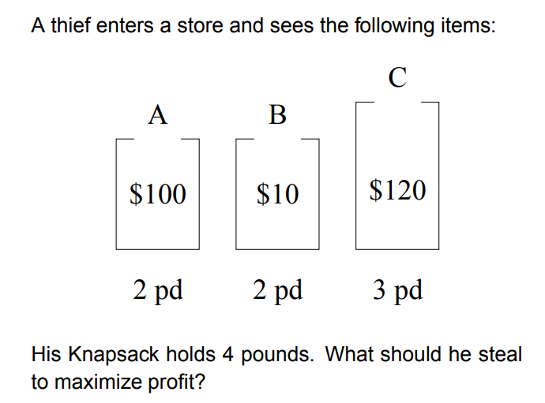
Knapsack : More examples
1) Greedy approach- consider the following instances of knapsack problem n=5, w=100, W (10, 20, 30, 40, 50) , V(20, 30, 66, 40, 60 ), find the optimal solution.
2)
3) Let us consider that the capacity of the knapsack W =60 and the list of provided items are shown in the following table −
Item | A | B | C | D
Profit | 280 | 100 | 120 | 120
Weight | 40 | 10 | 20 | 24
64

Slide 65
Huffman Coding
Huffman codes can be used to compress information
JPEGs do use Huffman as part of their compression process
The basic idea is to store the more frequently occurring characters using fewer bits and less frequently occurring characters using more bits
On average this should decrease the filesize (usually ½)
65
Notes:
65

Slide 66
Huffman Coding
As an example, lets take the string:
“duke blue devils”
We first to a frequency count of the characters:
e:3, d:2, u:2, l:2, space:2, k:1, b:1, v:1, i:1, s:1
Next we use a Greedy algorithm to build up a Huffman Tree
We start with nodes for each character
e,3
d,2
u,2
l,2
sp,2
k,1
b,1
v,1
i,1
s,1
66
Notes:
66

Slide 67
Huffman Coding
We then pick the nodes with the smallest frequency and combine them together to form a new node
The selection of these nodes is the Greedy part
The two selected nodes are removed from the set, but replace by the combined node
This continues until we have only 1 node left in the set
67
Notes:
67

Slide 68
Huffman Coding
e,3
d,2
u,2
l,2
sp,2
k,1
b,1
v,1
i,1
s,1
68
Notes:
68

Slide 69
Huffman Coding
e,3
d,2
u,2
l,2
sp,2
k,1
b,1
v,1
2
i,1
s,1
69
Notes:
69

Slide 70
Huffman Coding
e,3
d,2
u,2
l,2
sp,2
k,1
2
2
b,1
v,1
i,1
s,1
70
Notes:
70

Slide 71
Huffman Coding
e,3
d,2
u,2
l,2
sp,2
3
2
k,1
2
i,1
s,1
b,1
v,1
71
Notes:
71

Slide 72
Huffman Coding
e,3
d,2
u,2
4
3
2
l,2
sp,2
k,1
2
i,1
s,1
b,1
v,1
72
Notes:
72

Slide 73
Huffman Coding
e,3
4
4
3
2
d,2
u,2
l,2
sp,2
k,1
2
i,1
s,1
b,1
v,1
73
Notes:
73

Slide 74
Huffman Coding
e,3
4
4
5
d,2
u,2
l,2
sp,2
2
3
i,1
s,1
k,1
2
b,1
v,1
74
Notes:
74

Slide 75
Huffman Coding
7
4
5
e,3
4
l,2
sp,2
2
3
d,2
u,2
i,1
s,1
k,1
2
b,1
v,1
75
Notes:
75

Slide 76
Huffman Coding
7
9
e,3
4
4
5
d,2
u,2
l,2
sp,2
2
3
i,1
s,1
k,1
2
b,1
v,1
76
Notes:
76

Slide 77
Huffman Coding
16
7
9
e,3
4
4
5
d,2
u,2
l,2
sp,2
2
3
i,1
s,1
k,1
2
b,1
v,1
77
Notes:
77

Slide 78
Huffman Coding
Now we assign codes to the tree by placing a 0 on every left branch and a 1 on every right branch
A traversal of the tree from root to leaf give the Huffman code for that particular leaf character
Note that no code is the prefix of another code
78
Notes:
78

Slide 79
Huffman Coding
e | 00
d | 010
u | 011
l | 100
sp | 101
i | 1100
s | 1101
k | 1110
b | 11110
v | 11111
16
0
1
7
9
0
1
0
1
e,3
4
4
5
0
1
0
1
0
1
d,2
u,2
l,2
sp,2
2
3
0
1
0
1
i,1
s,1
k,1
2
0
1
b,1
v,1
* Using variable length encoding
79
Notes:
79

Slide 80
Huffman Encoding cormen
HUFFMAN (C )
1. n= |C|
//initializes the min-priority queue Q with the characters in C
2. Q = C O(n)
//loop extracts the two nodes x and y of lowest frequency from the queue
3. for i = 1 to n – 1 O(n log n)
//replacing them in the queue with a new node z representing their merger
4. allocate a new node z
5. z.left = x = EXTRACT-MIN(Q) O(log n)
6. z.right = y = EXTRACT-MIN(Q)
7. z.freq = x:freq + y:freq
8. INSERT (Q,z)
//After n-1 mergers, line 9 returns the one node left in the queue,which is the root of the code tree
9. return EXTRACT-MIN(Q) // return the root of the tree
Analysis : Must sort n values before making n choices. Therefore, Huffman is O(n log n) + O(n) = O(n log n)
80

Slide 81
Analysis of Huffman Encoding
To analyze the running time of Huffman’s algorithm, we assume that Q is implemented as a binary min-heap
81

Slide 82
Huffman Coding
These codes are then used to encode the string
Thus, “duke blue devils” turns into:
010 011 1110 00 101 11110 100 011 00 101 010 00 11111 1100 100 1101
When grouped into 8-bit bytes:
01001111 10001011 11101000 11001010 10001111 11100100 1101xxxx
Thus it takes 7 bytes of space compared to 16 characters * 1 byte/char = 16 bytes uncompressed
82
Notes:
82

Slide 83
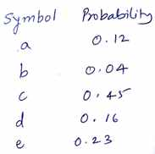
Examples : Huffman Coding
Solve the following using Huffman's code generation algorithm
Huffman Coding Algorithm Example
Construct a Huffman tree by using these nodes
Value | A | B | C | D | E | F
Frequency | 5 | 25 | 7 | 15 | 4 | 12
83

Slide 84
Other greedy algorithms
Dijkstra’s algorithm for finding the shortest path in a graph
Always takes the shortest edge connecting a known node to an unknown node
Kruskal’s algorithm for finding a minimum-cost spanning tree
Always tries the lowest-cost remaining edge
Prim’s algorithm for finding a minimum-cost spanning tree
Always takes the lowest-cost edge between nodes in the spanning tree and nodes not yet in the spanning tree
84

Slide 85
JOB SEQUENCING WITH DEADLINES
The problem is stated as below.
There are n jobs to be processed on a machine.
Each job i has a deadline d_{i}≥ 0 and profit p_{i}≥0 .
Pi is earned iff the job is completed by its deadline.
The job is completed if it is processed on a machine for unit time.
Only one machine is available for processing jobs.
Only one job is processed at a time on the machine.
85
85
Notes:
85

Slide 86
JOB SEQUENCING WITH DEADLINES (contd..)
A feasible solution is a subset of jobs J such that each job is completed by its deadline.
An optimal solution is a feasible solution with maximum profit value.
NO LATER THAN THEIR RESPECTIVE DEADLINES.
Example : Let n = 4, (p₁,p₂,p₃,p₄) = (100,10,15,27), (d₁,d₂,d₃,d₄) = (2,1,2,1)
86
86
Notes:
86

Slide 87
JOB SEQUENCING WITH DEADLINES (contd..)
Example : Let n = 4, (p₁,p₂,p₃,p₄) = (100,10,15,27), (d₁,d₂,d₃,d₄) = (2,1,2,1)
Sr.No. Feasible Processing Profit value
Solution Sequence
(i) (1,2) (2,1) 110
(ii) (1,3) (1,3) or (3,1) 115
(iii) (1,4) (4,1) 127 is the optimal one
(iv) (2,3) (2,3) 25
(v) (3,4) (4,3) 42
(vi) (1) (1) 100
(vii) (2) (2) 10
(viii) (3) (3) 15
(ix) (4) (4) 27
87
87
Notes:
87

Slide 88
Example Explanation
Consider the jobs in the non increasing order of profits subject to the constraint that the resulting job sequence J is a feasible solution.
In the example considered before, the non-increasing profit vector is
(100 27 15 10) (2 1 2 1) p₁ p₄ p₃ p₂ d₁ d₄ d₃ d₂
88
88
Notes:
88

Slide 89
GREEDY ALGORITHM TO OBTAIN AN OPTIMAL SOLUTION (Contd..)
(100 27 15 10) (2 1 2 1)
p₁ p₄ p₃ p₂ d₁ d₄ d₃ d₂
J = { 1} is a feasible one
J = { 1, 4} is a feasible one with processing sequence ( 4,1)
J = { 1, 3, 4} is not feasible
J = { 1, 2, 4} is not feasible
J = { 1, 4} is optimal
89
89
Notes:
89

Slide 90
GREEDY ALGORITHM TO OBTAIN AN OPTIMAL SOLUTION (Contd..)
J(r+1)←i ; k ←k+1
// i is inserted at position r+1 //
// and total jobs in J are increased by one //
repeat
end JS
90
90
Notes:
90

Slide 91
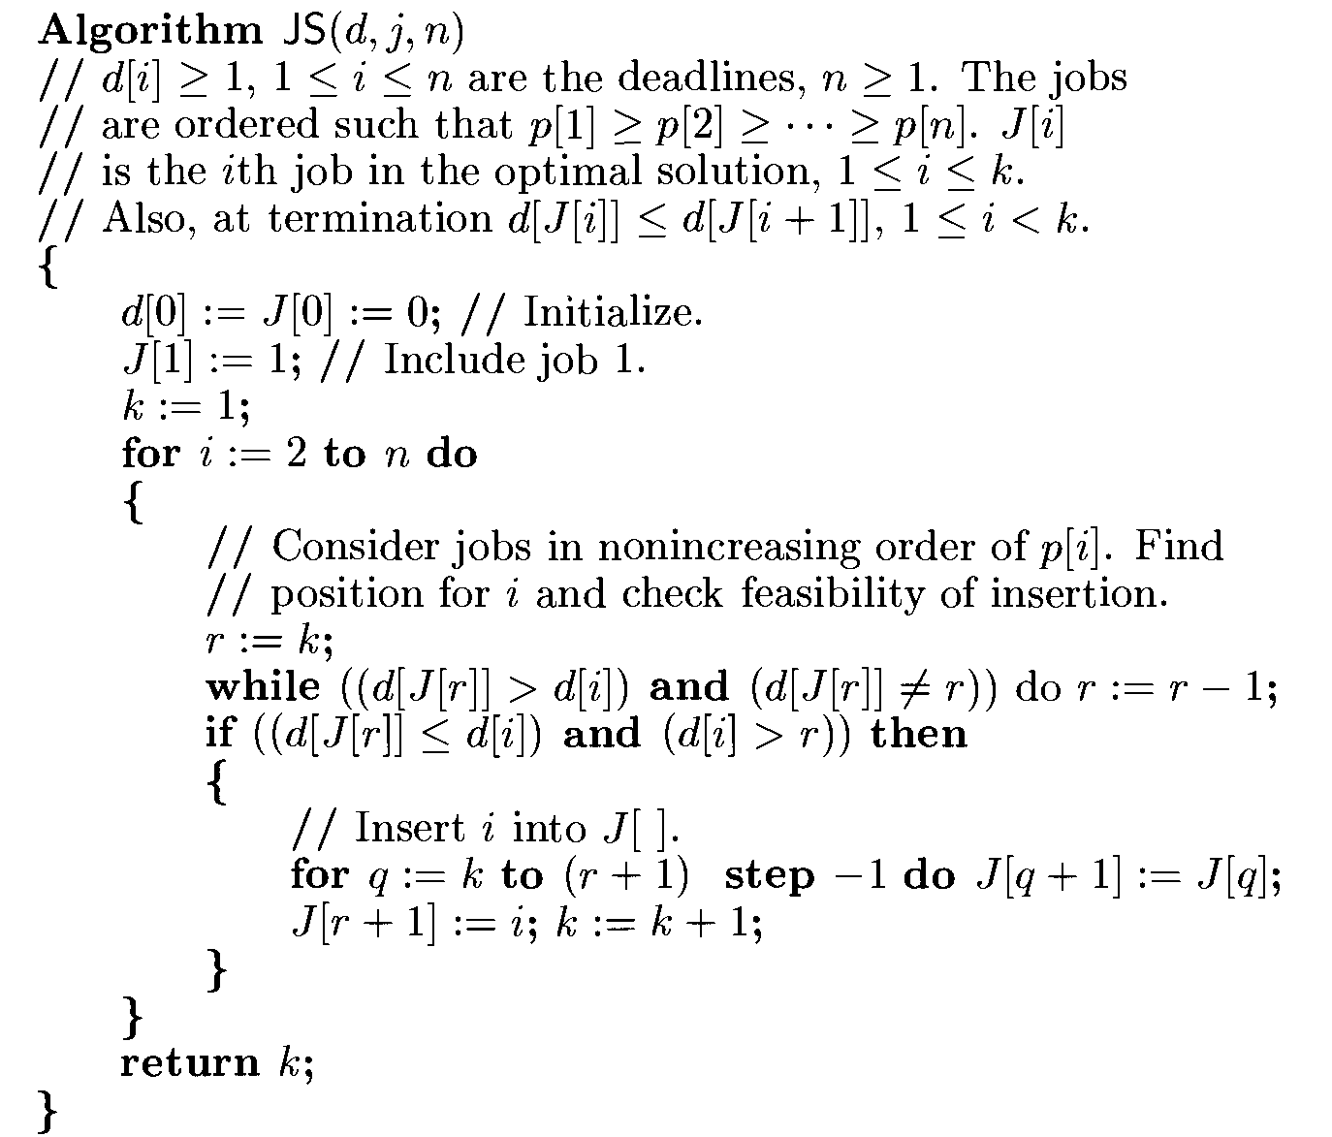
Algorithm for Job sequencing with Deadlines
91

Slide 92
COMPLEXITY ANALYSIS OF JS ALGORITHM
Let n be the number of jobs and s be the number of jobs included in the solution.
The loop between lines 4-15 (the for-loop) is iterated (n-1)times.
Each iteration takes O(k) where k is the number of existing jobs.
The time needed by the algorithm is 0(sn) s ≤ n so the worst case time is 0(n²).
If d_{i} = n - i+1 1 ≤ i ≤ n, JS takes θ(n²) time
D and J need θ(s) amount of space.
92
92
Notes:
92

Slide 93
Examples :Job Sequencing Problems:
1) Write a greedy algorithm for sequencing unit time jobs with deadlines
and profits. Using this algorithm, find the optimal solutions when
n=5,(p1,p2,p3,p4,p5)=(20,15,10,5,1) and (d1,d2,d3,d4,d5)=(2,2,1,3,3).
2) Find the correct sequence for jobs using following instances,
JobID Deadline Profit
1 4 20
2 1 10
3 1 40
4 1 30
3)Find the correct sequence for jobs using following instances,
JobID Deadline Profit
1 2 100
2 1 19
3 2 27
4 1 25
3 15
4)Find the optimum job sequence for the following problem.
n = 7 P₇ J₁ j₂ j₃ j₄ j₅ j₆ j₇
(P₁, P₂, P₃, P₄, P₅, P₆) = (3, 5, 10, 18, 1, 6, 30)
, d₄, d₅, d₆) = (1,3, 4, 3, 2, 1, 2)
Feasible soln. Processing Sequence Value
(1, 2, 3, 4) (1,2,4,3) or (1,4,2,3) 3+5+10+18= 36
93

Slide 94
The End
94
Notes:
12

