Slide 1

CSE2PM09A / AID2PM07A
Design and Analysis of Algorithm
DEPARTMENT OF COMPUTER ENGINEERING
Notes:
Ref : Thomas H Cormen
1

Slide 2
Unit 2 : Greedy strategy
Principle, control abstraction
Knapsack problem
Job sequencing with Deadlines
Huffman Encoding
2

Slide 3
Optimization problems
An optimization problem is one in which you want to find, not just a solution, but the best solution
A “greedy algorithm” sometimes works well for optimization problems
A greedy algorithm works in phases. At each phase:
You take the best you can get right now, without regard for future consequences
You hope that by choosing a local optimum at each step, you will end up at a global optimum
3
Notes:
2

Slide 4
Introduction : Greedy Method
A greedy algorithm for an optimization problem always makes the choice that looks best at the moment and adds it to the current subsolution.
Final output is an optimal solution.
Greedy algorithms don’t always yield optimal solutions but, when they do, they’re usually the simplest and most efficient algorithms available.
4

Slide 5
Introduction : Greedy Method
It is used to solve problems that have ‘n’ inputs and require us to obtain a subset that satisfies some constraints.
Any subset that satisfied the constraints is called as a feasible solution.
We need to find the optimum feasible solution i.e. the feasible solution that optimizes the given objective functions.
It works in stages. At each stage, At each stage a decision is made regarding weather or particular input is in the optimum solution.
5

Slide 6
Introduction : Greedy Method
The greedy method suggests that one can divide the algorithm that works in stages. Considering one input at a time.
At each stage a decision is made regarding whether or particular input is in the optimum solution.
For this purpose all the inputs must be arranged in a particular order by using a selection process.
If the inclusion of next input in to the partially constructed solution will result in an infeasible solution then the input will not be considered and will not be added to partially constructed set otherwise it is added.
CHANGE-MAKING PROBLEM (coin changing)
6

Slide 7
Coin Changing
An optimal solution to the coin changing problem is the minimum number of coins whose total value equals a specified amount. For example what is the minimum number of coins (current U.S. mint) needed to total 83 cents.
Objective function: Minimize number of coins returned.
Greedy solution: Always return the largest coin you can
A Greedy Algorithm for
Coin Changing
1. Set remval=initial_value
2. Choose largest coin that
is less than remval.
3. Add coin to set of coins
and set
remval:=revamal-coin_value
4. repeat Steps 2 and 3
until remval = 0;
25
25
83 - 25 = 58
58 - 25 = 33
33 - 25 = 8
8 - 5 = 3
3 - 1 = 2
2 - 1 = 1
1 - 1 = 0
25
25
10
5
5
1
1
1
1
7

Slide 8
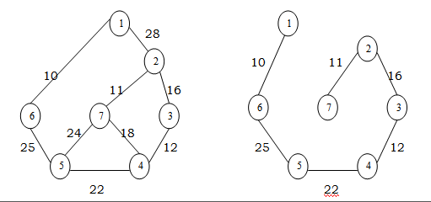
Greedy Method
Feasible Solution:-
Any subset of the solutions that satisfies the constraints of the problem is known as a feasible solution.
Optimal Solution:-
The feasible solution that maximizes or minimizes the given objective function is an optimal solution.
Example : MST
8

Slide 9
Control Abstraction : Greedy Method
Algorithm Greedy (a,n)
//a[1:n] contains the ‘n’ inputs
{
Solution: = 0; //initialize the solution
for i: = 1 to n do
{
x: = select (a);
if Feasible (solution, x) then
solution: = Union (solution, x);
}
return solution;
}
Select is a function which is used to select an input from the set.
Feasible is a function which verifies the constraints and determines weather the resultant solution is feasible or not.
Union is a function which is used to add elements to the partially constructed set.
9

Slide 10
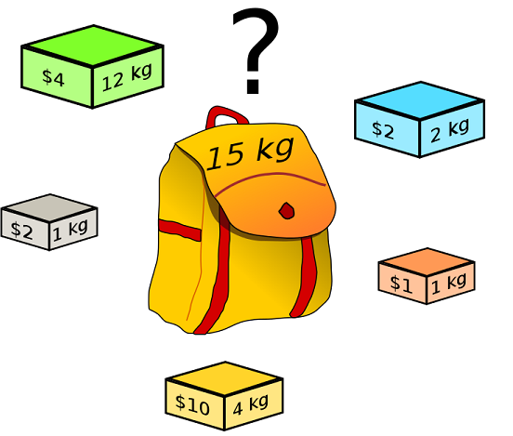
Knapsack Problem
Given :
A knapsack with capacity ‘m’
A set of ‘n’ objects with each item i having
p_{i} - a positive benefit
w_{i} - a positive weight
Goal: Choose items with maximum total benefit but with weight at most m.
If we are allowed to take fractional amounts, then this is the fractional knapsack problem.
Let x_{i} denote the amount we take of item i , 0≤ x_{i} ≤ 1
Objective: maximize ∑ p_{i} x_{i}
1 ≤ i ≤ n
Constraint: ∑ w_{i} x_{i} ≤ m
1 ≤ i ≤ n
and 0 ≤ x_{i} ≤ 1 , 1 ≤ i ≤ n
10

Slide 11
Knapsack Problem : Example
Ex: - Consider following instance of Knapsack Problem with 3 objects whose profits and weights are defined as
(P₁, P₂, P₃) = ( 25, 24, 15 ) (W₁, W₂, W₃) = ( 18, 15, 10 )
n=3 Knapsack Capacity m=20
Determine the optimum strategy for placing the objects in to the knapsack.
The four feasible solutions are :
(1) Greedy about profit: -
(x₁, x₂, x₃) | Profit Order | Weight Order | ∑ xiwi <=20 | ∑ xipi
(1, 2/15, 0) | (p1,p2,p3) (25,24,15) | (w1,w2,w3) (18, 15, 10 ) | 18 x 1+(2/15) x 15 = 20 | 25 x 1+ (2/15) x 24 = 28.2
(2) Greedy about weight: -
(x₁, x₂, x₃) | Profit Order | Weight Order | ∑ xiwi <=20 | ∑ xipi
(0, 2/3, 1) | (p3,p2,p1) (15, 24,25) | (w3,w2,w1) (10,15,18 ) | 18 x 0+(2/3) x 15+10 = 20 | 25 x0+ (2/3) x 24 +25= 31
11

Slide 12
(3) Greedy about profit / unit weight: -
(4) If an additional constraint of including each and every object is placed then the greedy strategy could be
(½, ⅓, ¼ ) ∑ xiwi = ½ x 18+⅓ x15+ ¼ x10 = 16. 5
∑ xipi =½ x 25+⅓ x24+ ¼ x15 = 12.5+8+3.75 = 24.25
(x₁, x₂, x₃) | ∑ xiwi <=20 | ∑ xipi
(0, 1, ½ ) | 18 x 0+1 x 15+(1/2)x10 = 20 | 25 x 0+ 1 x 24+(1/2)x15 = 31.5
(x₁, x₂, x₃) | ∑ xiwi <=20 | ∑ xipi
(½, ⅓, ¼ ) | 16.5 | 24.25
12

Slide 13
Algorithm : Greedy Knapsack
Algorithm Greedy knapsack (m, n)
//p (1:n) and w(1:n) contain the profits and weights resp. of the n objects
//ordered such that p(i)/W(i) ≥ p(i+1)/w (i+1). M is the knapsack size and x (1:n)
// is the solution vector
{
for i: = 1 to n do x(i) = 0.0i// initialize x O(n)
u : = m;
for i: = 1 to n do O(n)
{
if (w(i) > u) then break;
x(i): = 1.0;
u: = u-w(i);
}
if (i≤n) then x(i): = u/w(i);
}
Analysis: - If. we do not consider the time considered for sorting the inputs then the complexity will be O(n).
13

Slide 14
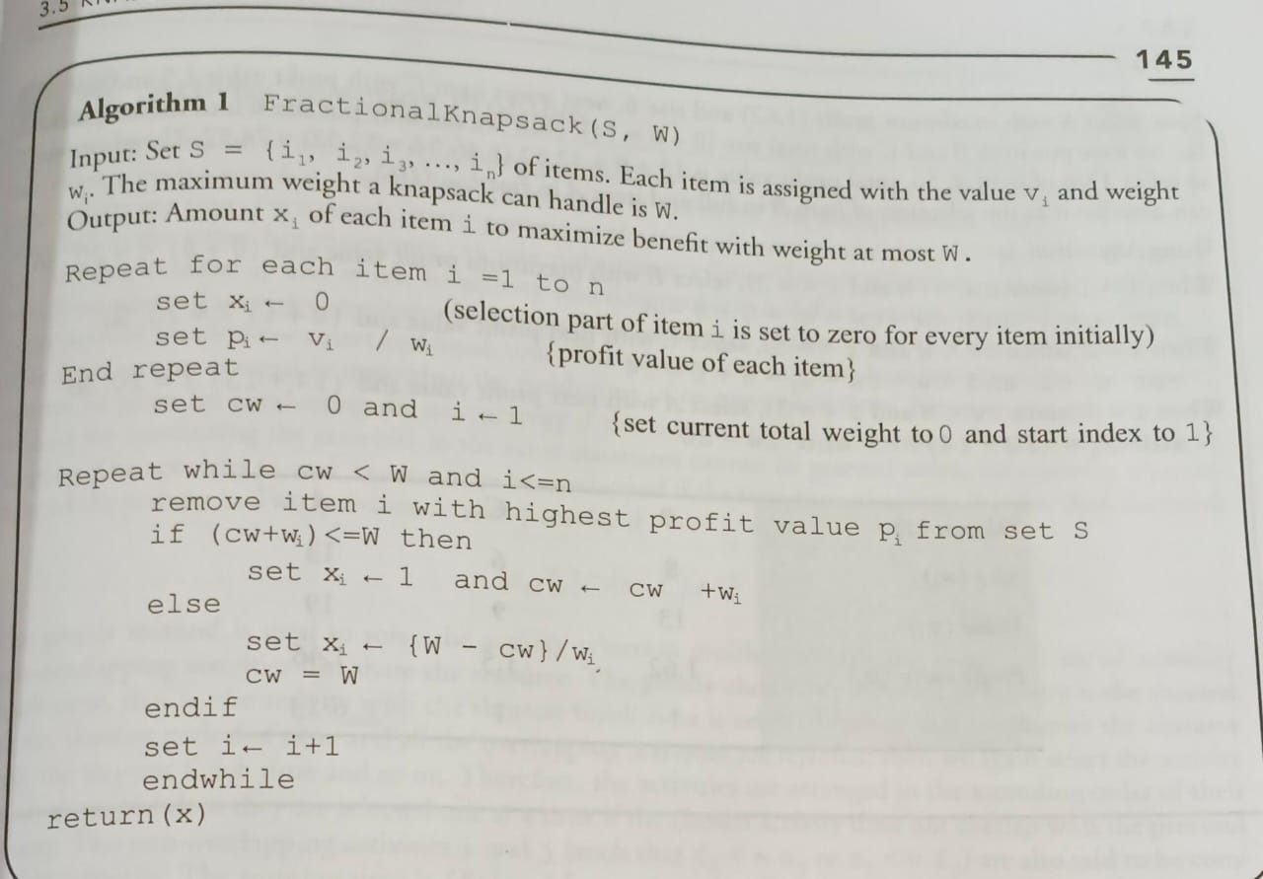
14

Slide 15
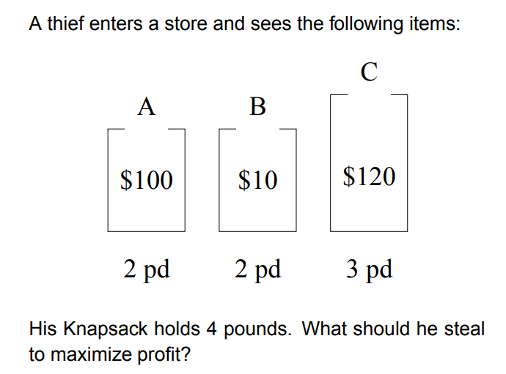
Knapsack : More examples
1) Greedy approach- consider the following instances of knapsack problem n=5, w=100, W (10, 20, 30, 40, 50) , V(20, 30, 66, 40, 60 ), find the optimal solution.
2)
3) Let us consider that the capacity of the knapsack W =60 and the list of provided items are shown in the following table −
Item | A | B | C | D
Profit | 280 | 100 | 120 | 120
Weight | 40 | 10 | 20 | 24
15

Slide 16
Huffman Coding
Huffman codes can be used to compress information
JPEGs do use Huffman as part of their compression process
The basic idea is to store the more frequently occurring characters using fewer bits and less frequently occurring characters using more bits
On average this should decrease the filesize (usually ½)
16
Notes:
16

Slide 17
Huffman Coding
As an example, lets take the string:
“duke blue devils”
We first to a frequency count of the characters:
e:3, d:2, u:2, l:2, space:2, k:1, b:1, v:1, i:1, s:1
Next we use a Greedy algorithm to build up a Huffman Tree
We start with nodes for each character
e,3
d,2
u,2
l,2
sp,2
k,1
b,1
v,1
i,1
s,1
17
Notes:
17

Slide 18
Huffman Coding
We then pick the nodes with the smallest frequency and combine them together to form a new node
The selection of these nodes is the Greedy part
The two selected nodes are removed from the set, but replace by the combined node
This continues until we have only 1 node left in the set
18
Notes:
18

Slide 19
Huffman Coding
e,3
d,2
u,2
l,2
sp,2
k,1
b,1
v,1
i,1
s,1
19
Notes:
19

Slide 20
Huffman Coding
e,3
d,2
u,2
l,2
sp,2
k,1
b,1
v,1
2
i,1
s,1
20
Notes:
20

Slide 21
Huffman Coding
e,3
d,2
u,2
l,2
sp,2
k,1
2
2
b,1
v,1
i,1
s,1
21
Notes:
21

Slide 22
Huffman Coding
e,3
d,2
u,2
l,2
sp,2
3
2
k,1
2
i,1
s,1
b,1
v,1
22
Notes:
22

Slide 23
Huffman Coding
e,3
d,2
u,2
4
3
2
l,2
sp,2
k,1
2
i,1
s,1
b,1
v,1
23
Notes:
23

Slide 24
Huffman Coding
e,3
4
4
3
2
d,2
u,2
l,2
sp,2
k,1
2
i,1
s,1
b,1
v,1
24
Notes:
24

Slide 25
Huffman Coding
e,3
4
4
5
d,2
u,2
l,2
sp,2
2
3
i,1
s,1
k,1
2
b,1
v,1
25
Notes:
25

Slide 26
Huffman Coding
7
4
5
e,3
4
l,2
sp,2
2
3
d,2
u,2
i,1
s,1
k,1
2
b,1
v,1
26
Notes:
26

Slide 27
Huffman Coding
7
9
e,3
4
4
5
d,2
u,2
l,2
sp,2
2
3
i,1
s,1
k,1
2
b,1
v,1
27
Notes:
27

Slide 28
Huffman Coding
16
7
9
e,3
4
4
5
d,2
u,2
l,2
sp,2
2
3
i,1
s,1
k,1
2
b,1
v,1
28
Notes:
28

Slide 29
Huffman Coding
Now we assign codes to the tree by placing a 0 on every left branch and a 1 on every right branch
A traversal of the tree from root to leaf give the Huffman code for that particular leaf character
Note that no code is the prefix of another code
29
Notes:
29

Slide 30
Huffman Coding
e | 00
d | 010
u | 011
l | 100
sp | 101
i | 1100
s | 1101
k | 1110
b | 11110
v | 11111
16
0
1
7
9
0
1
0
1
e,3
4
4
5
0
1
0
1
0
1
d,2
u,2
l,2
sp,2
2
3
0
1
0
1
i,1
s,1
k,1
2
0
1
b,1
v,1
* Using variable length encoding
30
Notes:
30

Slide 31
Huffman Encoding cormen
HUFFMAN (C )
1. n= |C|
//initializes the min-priority queue Q with the characters in C
2. Q = C O(n)
//loop extracts the two nodes x and y of lowest frequency from the queue
3. for i = 1 to n – 1 O(n log n)
//replacing them in the queue with a new node z representing their merger
4. allocate a new node z
5. z.left = x = EXTRACT-MIN(Q) O(log n)
6. z.right = y = EXTRACT-MIN(Q)
7. z.freq = x:freq + y:freq
8. INSERT (Q,z)
//After n-1 mergers, line 9 returns the one node left in the queue,which is the root of the code tree
9. return EXTRACT-MIN(Q) // return the root of the tree
Analysis : Must sort n values before making n choices. Therefore, Huffman is O(n log n) + O(n) = O(n log n)
31

Slide 32
Analysis of Huffman Encoding
To analyze the running time of Huffman’s algorithm, we assume that Q is implemented as a binary min-heap
32

Slide 33
Huffman Coding
These codes are then used to encode the string
Thus, “duke blue devils” turns into:
010 011 1110 00 101 11110 100 011 00 101 010 00 11111 1100 100 1101
When grouped into 8-bit bytes:
01001111 10001011 11101000 11001010 10001111 11100100 1101xxxx
Thus it takes 7 bytes of space compared to 16 characters * 1 byte/char = 16 bytes uncompressed
33
Notes:
33

Slide 34
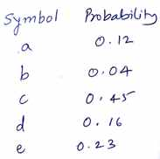
Examples : Huffman Coding
Solve the following using Huffman's code generation algorithm
Huffman Coding Algorithm Example
Construct a Huffman tree by using these nodes
Value | A | B | C | D | E | F
Frequency | 5 | 25 | 7 | 15 | 4 | 12
34

Slide 35
Other greedy algorithms
Dijkstra’s algorithm for finding the shortest path in a graph
Always takes the shortest edge connecting a known node to an unknown node
Kruskal’s algorithm for finding a minimum-cost spanning tree
Always tries the lowest-cost remaining edge
Prim’s algorithm for finding a minimum-cost spanning tree
Always takes the lowest-cost edge between nodes in the spanning tree and nodes not yet in the spanning tree
35

Slide 36
JOB SEQUENCING WITH DEADLINES
The problem is stated as below.
There are n jobs to be processed on a machine.
Each job i has a deadline d_{i}≥ 0 and profit p_{i}≥0 .
Pi is earned iff the job is completed by its deadline.
The job is completed if it is processed on a machine for unit time.
Only one machine is available for processing jobs.
Only one job is processed at a time on the machine.
36
36
Notes:
36

Slide 37
JOB SEQUENCING WITH DEADLINES (contd..)
A feasible solution is a subset of jobs J such that each job is completed by its deadline.
An optimal solution is a feasible solution with maximum profit value.
NO LATER THAN THEIR RESPECTIVE DEADLINES.
Example : Let n = 4, (p₁,p₂,p₃,p₄) = (100,10,15,27), (d₁,d₂,d₃,d₄) = (2,1,2,1)
37
37
Notes:
37

Slide 38
JOB SEQUENCING WITH DEADLINES (contd..)
Example : Let n = 4, (p₁,p₂,p₃,p₄) = (100,10,15,27), (d₁,d₂,d₃,d₄) = (2,1,2,1)
Sr.No. Feasible Processing Profit value
Solution Sequence
(i) (1,2) (2,1) 110
(ii) (1,3) (1,3) or (3,1) 115
(iii) (1,4) (4,1) 127 is the optimal one
(iv) (2,3) (2,3) 25
(v) (3,4) (4,3) 42
(vi) (1) (1) 100
(vii) (2) (2) 10
(viii) (3) (3) 15
(ix) (4) (4) 27
38
38
Notes:
38

Slide 39
Example Explanation
Consider the jobs in the non increasing order of profits subject to the constraint that the resulting job sequence J is a feasible solution.
In the example considered before, the non-increasing profit vector is
(100 27 15 10) (2 1 2 1) p₁ p₄ p₃ p₂ d₁ d₄ d₃ d₂
39
39
Notes:
39

Slide 40
GREEDY ALGORITHM TO OBTAIN AN OPTIMAL SOLUTION (Contd..)
(100 27 15 10) (2 1 2 1)
p₁ p₄ p₃ p₂ d₁ d₄ d₃ d₂
J = { 1} is a feasible one
J = { 1, 4} is a feasible one with processing sequence ( 4,1)
J = { 1, 3, 4} is not feasible
J = { 1, 2, 4} is not feasible
J = { 1, 4} is optimal
40
40
Notes:
40

Slide 41
GREEDY ALGORITHM TO OBTAIN AN OPTIMAL SOLUTION (Contd..)
J(r+1)←i ; k ←k+1
// i is inserted at position r+1 //
// and total jobs in J are increased by one //
repeat
end JS
41
41
Notes:
41

Slide 42
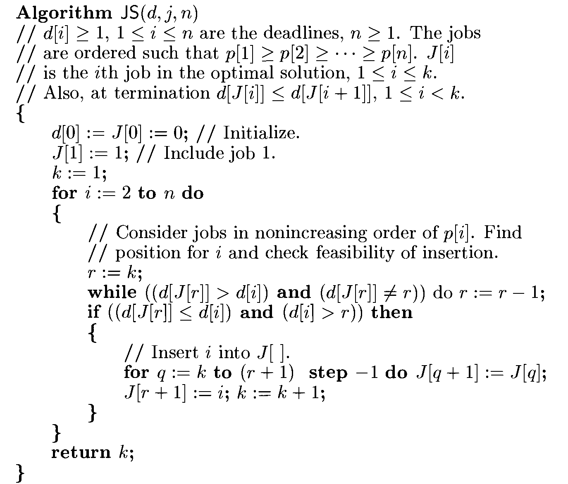
Algorithm for Job sequencing with Deadlines
42

Slide 43
COMPLEXITY ANALYSIS OF JS ALGORITHM
Let n be the number of jobs and s be the number of jobs included in the solution.
The loop between lines 4-15 (the for-loop) is iterated (n-1)times.
Each iteration takes O(k) where k is the number of existing jobs.
The time needed by the algorithm is 0(sn) s ≤ n so the worst case time is 0(n²).
If d_{i} = n - i+1 1 ≤ i ≤ n, JS takes θ(n²) time
D and J need θ(s) amount of space.
43
43
Notes:
43

Slide 44
Examples :Job Sequencing Problems:
1) Write a greedy algorithm for sequencing unit time jobs with deadlines
and profits. Using this algorithm, find the optimal solutions when
n=5,(p1,p2,p3,p4,p5)=(20,15,10,5,1) and (d1,d2,d3,d4,d5)=(2,2,1,3,3).
2) Find the correct sequence for jobs using following instances,
JobID Deadline Profit
1 4 20
2 1 10
3 1 40
4 1 30
3)Find the correct sequence for jobs using following instances,
JobID Deadline Profit
1 2 100
2 1 19
3 2 27
4 1 25
3 15
4)Find the optimum job sequence for the following problem.
n = 7 P₇ J₁ j₂ j₃ j₄ j₅ j₆ j₇
(P₁, P₂, P₃, P₄, P₅, P₆) = (3, 5, 10, 18, 1, 6, 30)
, d₄, d₅, d₆) = (1,3, 4, 3, 2, 1, 2)
Feasible soln. Processing Sequence Value
(1, 2, 3, 4) (1,2,4,3) or (1,4,2,3) 3+5+10+18= 36
44

Slide 45
The End
45
Notes:
12

