Slide 1

CSE 2PM09A /AID 2PM07A - Design and Analysis of Algorithm
Semester - IV
S. Y. B. Tech CSE /AIDS
SCHOOL OF COMPUTER ENGINEERING AND TECHNOLOGY

Slide 2

Graph
Graph- Basic Terminology, Graphs (Directed, Undirected), Various Representations, Traversals & Applications of graph- Prim’s and Kruskal’s Algorithms, Dijsktra's Single source shortest path, Analysis complexity of algorithm, topological sorting.

Slide 3
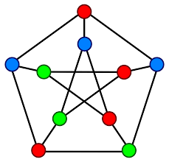
Graph
Basic Terminology
Memory representation
Creation of graph and traversals
Minimum spanning tree
Topological sorting

Slide 4
Basic Terminology
Definition
Complete Graph
Adjacent and Incident
Subgraph and path
Simple path and cycle
Connected components
Degree

Slide 5

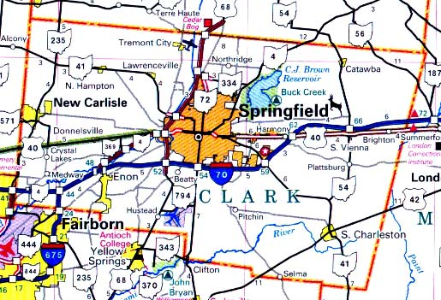

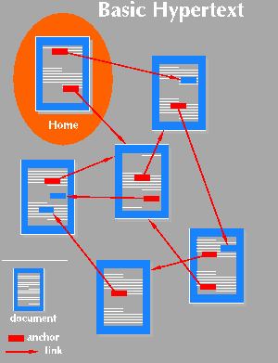

Graph Applications
Social Network
Maps
Computer Network
Hypertext
Circuits

Slide 6
Definition
A graph G consists of two sets
a finite, nonempty set of vertices V(G)
a finite, possible empty set of edges E(G)
G(V,E) represents a graph
0
0
1
2
Graph G1
Graph G2
3
1
2
Vertex Set: V(G1)={0,1,2,3}
Edge Set: E(G1)={(0,1),(0,2),(0,3),(1,2),(1,3),(2,3)}
Vertex Set: V(G2)={0,1,2}
Edge Set: E(G2)={(2,0),(2,1)}

Slide 7
Directed and Undirected Graph
An undirected graph is one in which the pair of vertices in an edge is unordered,
(v0, v1) = (v1,v0)
A directed graph is one in which each edge is a directed pair of vertices,
<v0, v1> != <v1,v0>
0
0
1
2
1
2
3
Undirected Graph
Directed Graph

Slide 8
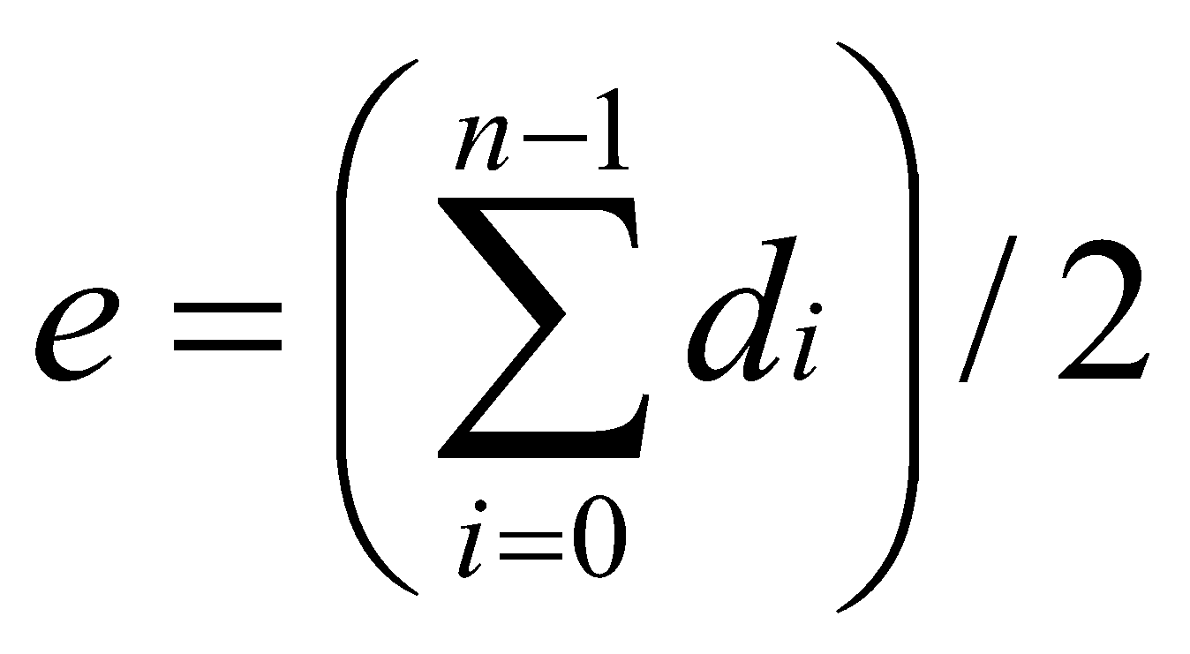
Degree
The degree of a vertex is the number of edges incident to that vertex.
For directed graph,
the in-degree of a vertex v is the number of edges that have v as the head
the out-degree of a vertex v is the number of edges that have v as the tail
If d_{i} is the degree of a vertex i in a graph G with n vertices and e edges,
the number of edges (of undirected graph) are :-

Slide 9
Examples for Degree
0
in:1, out: 1
3
0
1
in: 1, out: 2
3
1
2
3
3
2
in: 1, out: 0
3
Undirected Graph : G1
Directed Graph: G3

Slide 10
Adjacent and Incident
If (v0, v1) is an edge in an undirected graph,
v0 and v1 are adjacent
The edge (v0, v1) is incident on vertices v0 and v1
If <v0, v1> is an edge in a directed graph
v0 is adjacent to v1, and v1 is adjacent from v0
The edge <v0, v1> is incident on v0 and v1

Slide 11
Complete graph
A complete graph is a graph that has the maximum number of edges
for undirected graph with n vertices, the maximum number of edges is n(n-1)/2
for directed graph with n vertices, the maximum number of edges is n(n-1)

Slide 12
Examples for Graph
0
0
0
1
2
1
2
1
3
3
4
5
6
complete graph
G1
G2
incomplete graph
2
V(G1)={0,1,2,3} E(G1)={(0,1),(0,2),(0,3),(1,2),(1,3),(2,3)}
V(G2)={0,1,2,3,4,5,6} E(G2)={(0,1),(0,2),(1,3),(1,4),(2,5),(2,6)}
V(G3)={0,1,2} E(G3)={<0,1>,<1,0>,<1,2>}
G3
Directed graph

Slide 13
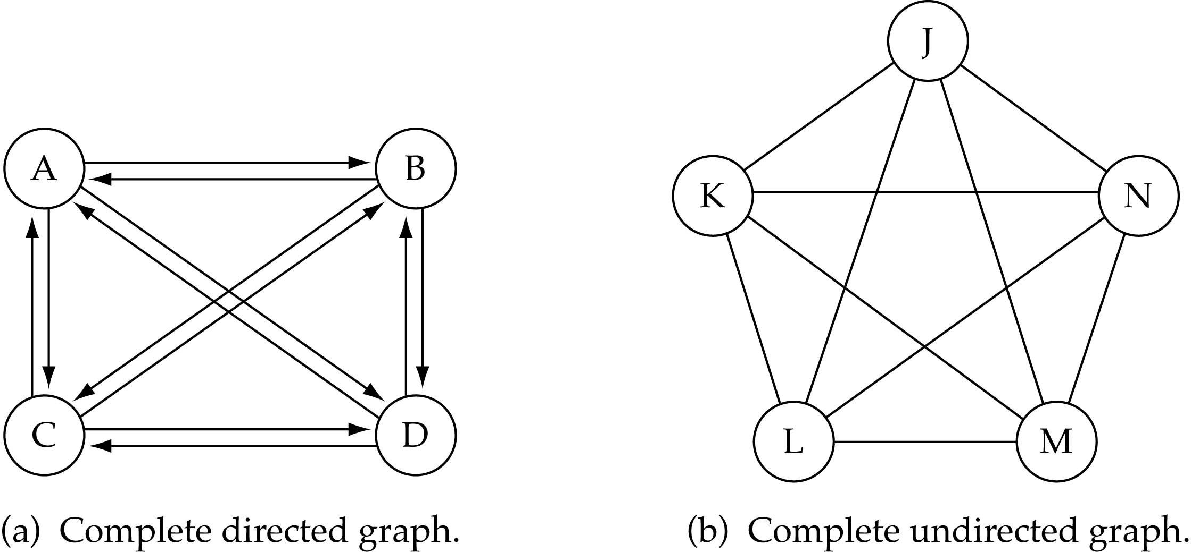
Complete Graph
No. of edges (complete undirected graph) : n(n-1)/2
No. of edges (complete directed graph): n(n-1)

Slide 14
Subgraph and Path
A subgraph of G is a graph G’ such that V(G’) is a subset of V(G) and E(G’) is a subset of E(G)
A path from vertex v_{p} to vertex v_{q} in a graph G, is a sequence of vertices, v_{p}, v_{i1}, v_{i2}, ..., v_{in}, v_{q}, such that (v_{p}, v_{i1}), (v_{i1}, v_{i2}), ..., (v_{in}, v_{q}) are edges in an undirected graph
The length of a path is the number of edges on it

Slide 15
Example for Subgraph
0
0
0
1
2
1
2
1
2
3
3
(i) (ii) (iii)
(a) Some of the subgraph of G₁
G1
0
0
0
0
0
1
1
1
1
2
2
G3
2
(i) (ii) (iii) (iv)
(b) Some of the subgraph of G₃

Slide 16
Simple path and cycle
A simple path is a path in which all the vertices, are distinct.
A cycle is a path, in which the first and the last vertices are same.
In an undirected graph G, two vertices, v0 and v1, are connected if there is a path in G from v0 to v1
An undirected graph is connected if, for every pair of distinct vertices vi, vj, there is a path from vi to vj.

Slide 17
Examples for Graph
0
0
4
0
1
2
1
2
2
1
5
3
3
6
3
4
5
6
G1
G2
7
G3
Connected Graphs: G₁ ,G2
Graph G₃ : (not connected)
CHAPTER 6
17

Slide 18
Connected Component
A connected component of an undirected graph is a maximal connected subgraph.
A tree is a graph that is connected and acyclic.
A directed graph is strongly connected if there is a directed path from vi to vj and also from vj to vi.
A strongly connected component is a maximal subgraph that is strongly connected.

Slide 19
Examples for Connected Component
0
4
H₁
0
H₂
4
2
1
5
5
2
1
3
6
3
6
7
Graph G₄
7
Two Connected Components for Graphs G₄: H₁ and H₂

Slide 20
Examples for Strongly Connected Component
0
0
1
2
1
2
G3 (Not strongly connected)
Strongly connected components of G₃

Slide 21
Graph Representation (Various Representations)
Adjacency Matrix
Adjacency Lists

Slide 22
Adjacency Matrix
Let G=(V,E) be a graph with n vertices.
The adjacency matrix of G is a two-dimensional n × n array, say adj_mat
If the edge (vi, vj) is in E(G), adj_mat[i][j]=1
If there is no such edge in E(G), adj_mat[i][j]=0
The adjacency matrix for an undirected graph is symmetric; the adjacency matrix for a digraph need not be symmetric

Slide 23
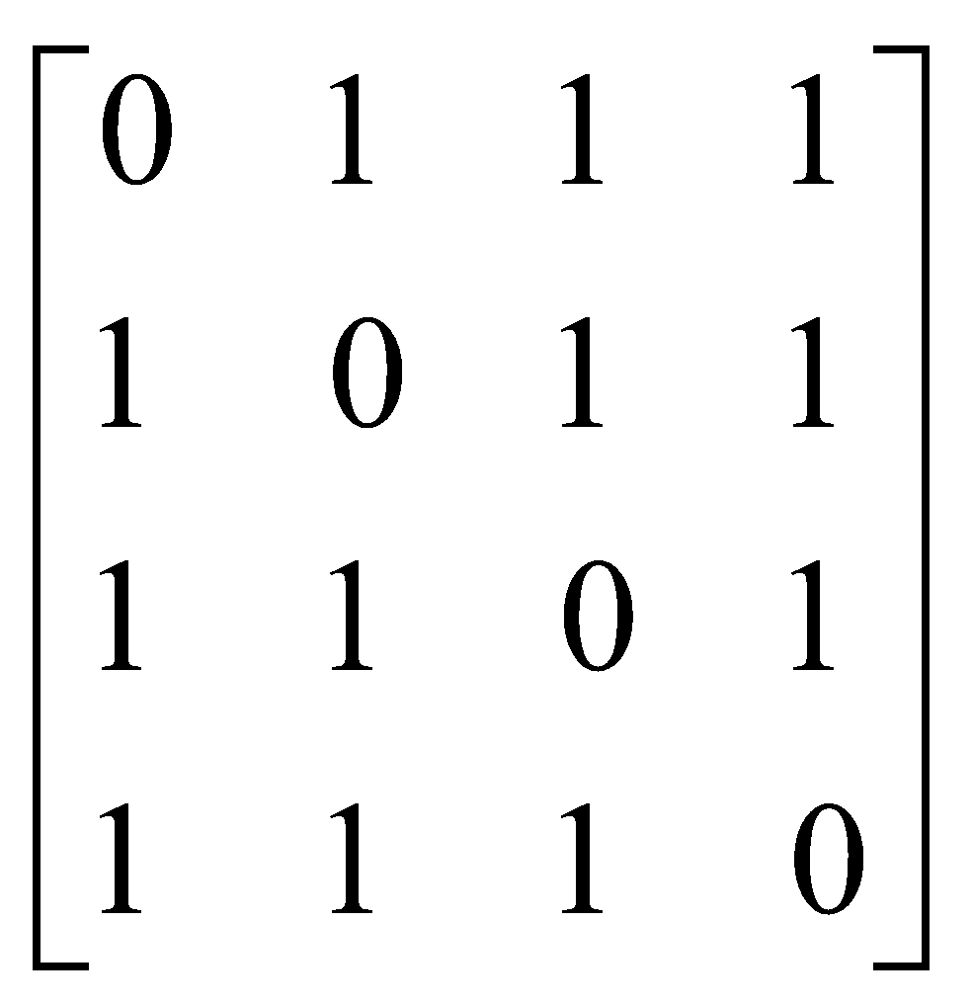
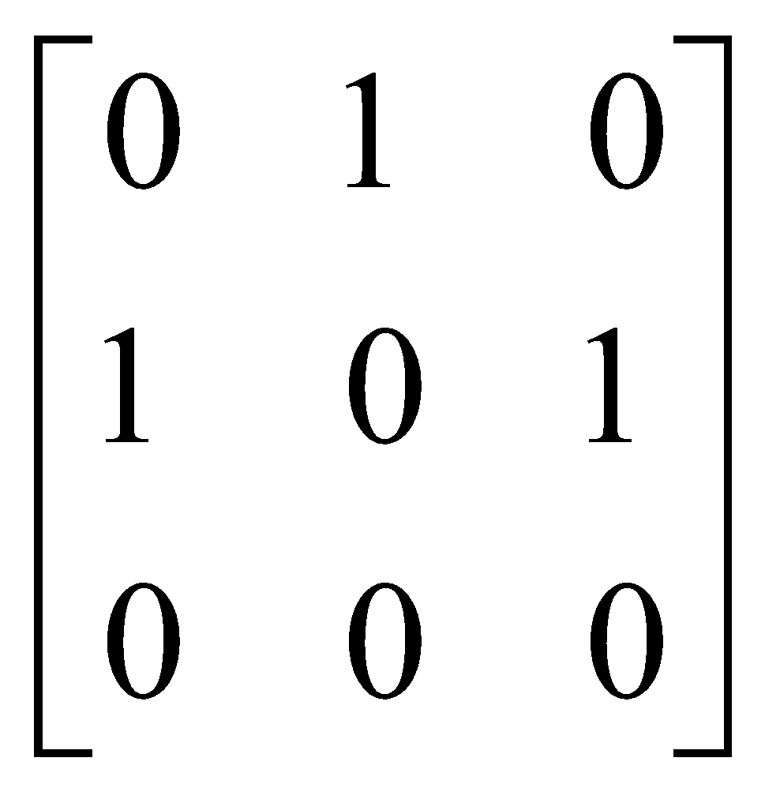
Adjacency Matrix
0
0
1
2
1
3
Graph G1
Adjacency Matrix for Graph G1
2
Adjacency Matrix for Graph G2
Graph G₂

Slide 24
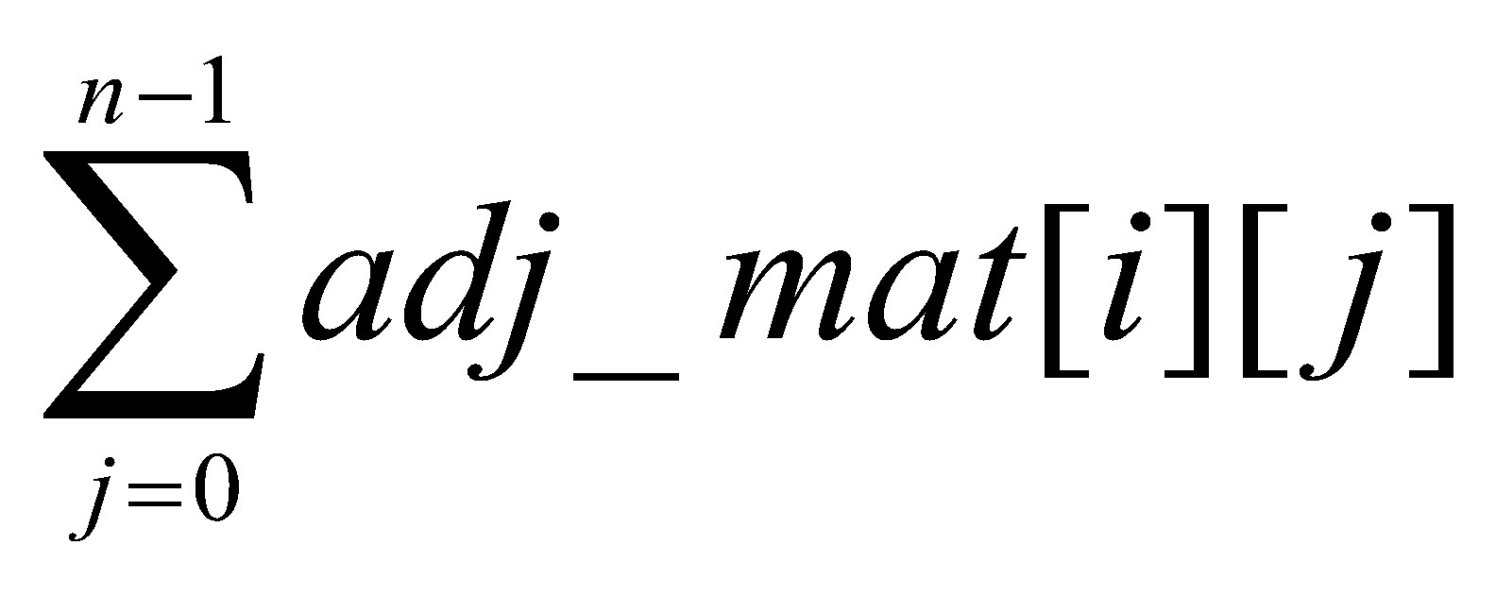
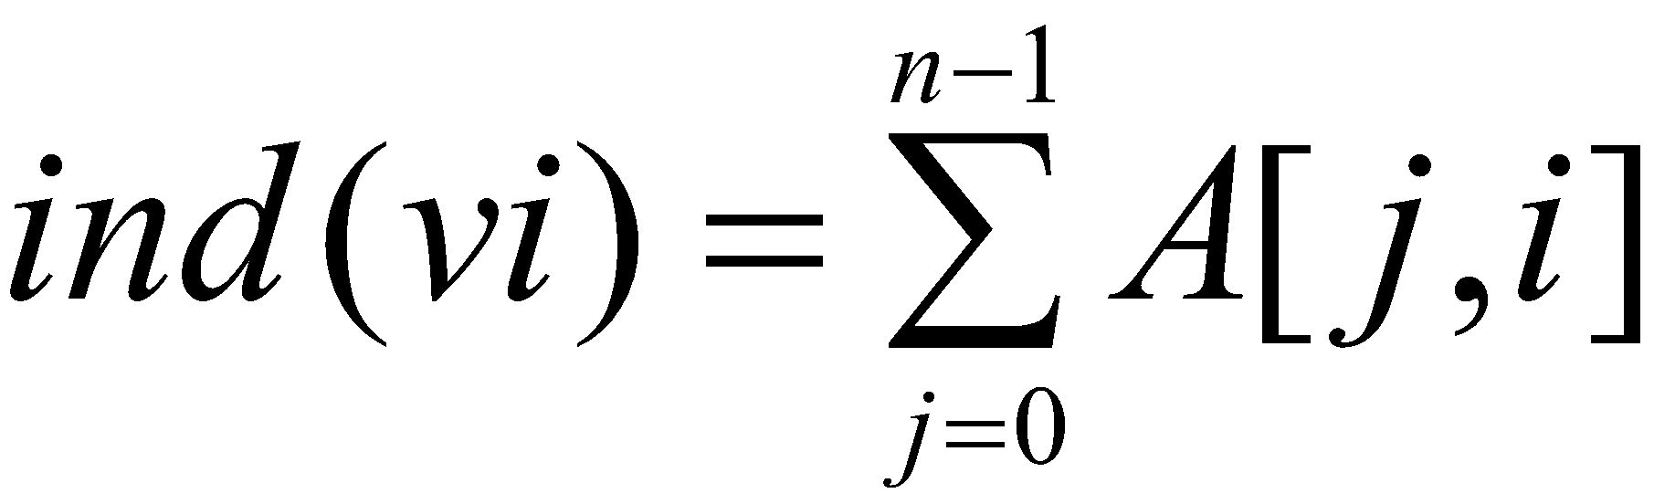
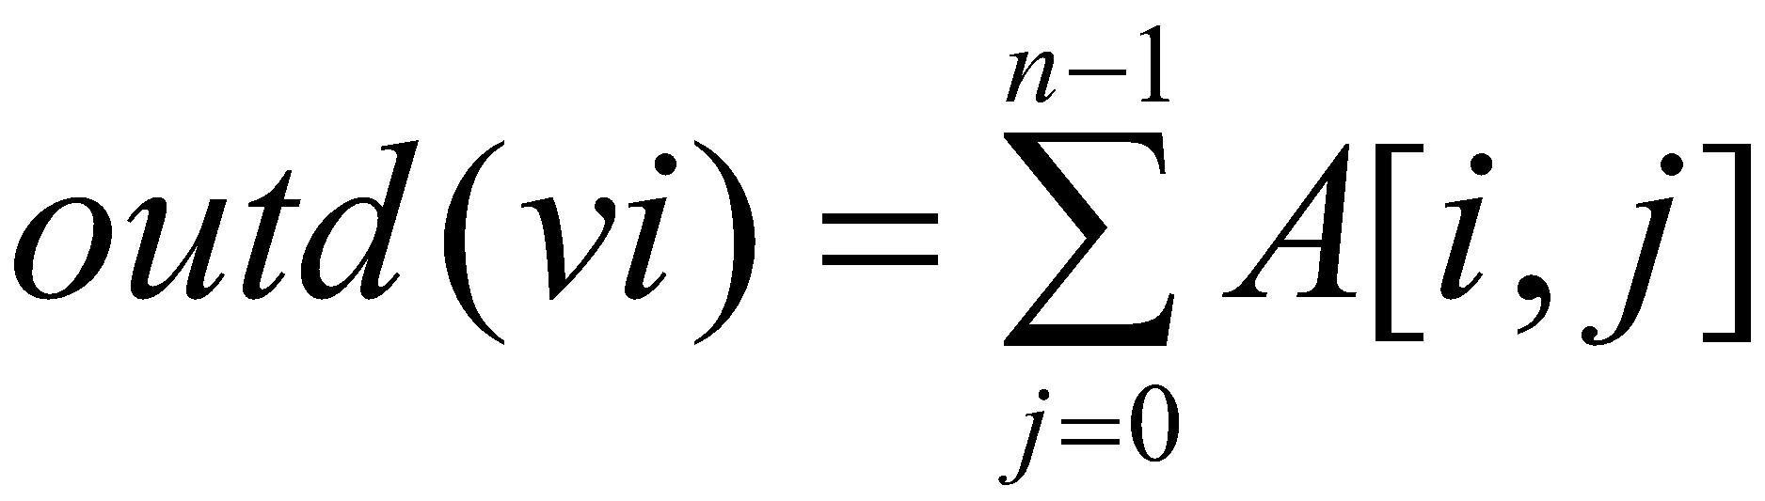
Merits: Adjacency Matrix
From the adjacency matrix, to determine the connection of vertices is easy
The degree of a vertex is
For a digraph, the row sum is the out_degree, while the column sum is the in_degree

Slide 25
Adjacency List: Interesting Operations
The degree of any vertex in an undirected graph is determined by counting the no. of nodes in its adjacency list.
No. of edges in a graph is determined in O(n+e)
Out-degree of a any vertex in a directed graph is determined by counting No. of nodes in its adjacency list.

Slide 26
Adjacency Lists
class gnode
{
int vertex;
node *next;
friend class graph;
};
class graph
{
private:
gnode *head[20];
int n;
public:
graph()
{
create head nodes for n vertices
}
};
0
1
2
Graph G1
3
0
1
2
3
1
2
3
0
2
3
0
1
3
0
1
2
Adjacency List for Graph G1

Slide 27
graph()
{
Accept no of vertices;
for i=0 to n-1
{Allocate a memory for head[i] node (array)
head[i]->vertex=i; }
}
create()
{
for i=0 to n-1
{
temp=head[i];
do
{
Accept adjacent vertex v;
if(v==i)
Print Self loop are not allowed;
else
{
Allocate memory for curr node;
curr->vertex=v;
temp->next=curr;
temp=temp->next;
}
accept the choice ;
}while(ans=='y'||ans=='Y');
}
}
0
•
3 •
1 •
2 NULL
1
2
•
2 •
0 •
3 NULL
•
3 •
0 •
1 NULL
3
•
2 •
1 •
0 NULL

Slide 28
Graph Traversal
Depth First Traversal
Breadth First Traversal

Slide 29
Depth First Traversal (Recursive)
Algorithm DFS()
{
//initially no vertex will be visited
for( int i=0 ; i<n; i++)
visited[i]=0;
//start search at vertex v
accept starting vertex v
DFS(v);
}
Algorithm DFS(int v)
{ print v;
visited[v]=1;
for(each vertex w adjacent to v)
if(!visited[w]) DFS(w);
}

Slide 30
Depth First Search Traversal
Visited Array
F
C
A
B
C
D
E
F
G
H
Algorithm DFS(int v)
{ print v;
visited[v]=1;
for(each vertex w adjacent to v)
if(!visited[w]) DFS(w);
}
A
B
D
H
G
E
Task: Conduct a depth-first search of the graph starting with node D

Slide 31
Depth First SearchTraversal
Visited Array
F
C
A
B
C
D | 1
E
F
G
H
D
Algorithm DFS(int v)
{ print v;
visited[v]=1;
for(each vertex w adjacent to v)
if(!visited[w]) DFS(w);
}
A
B
D
H
G
E
The DFT of nodes in graph :
D
Visit D

Slide 32
Depth First Traversal
Visited Array
F
C
A
B
C
D | 1
E
F
G
H
D
Algorithm DFS(int v)
{ print v;
visited[v]=1;
for(each vertex w adjacent to v)
if(!visited[w]) DFS(w);
}
A
B
D
H
G
E
The DFT of nodes in graph :
D
Consider nodes adjacent to D, decide to visit C first (Rule: visit adjacent nodes in alphabetical order or in order of the adjacancy list)

Slide 33
Depth First Traversal
Visited Array
F
C
A
B
C | 1
D | 1
E
F
G
H
C
D
Algorithm DFS(int v)
{ print v;
visited[v]=1;
for(each vertex w adjacent to v)
if(!visited[w]) DFS(w);
}
A
B
D
H
G
E
The DFT of nodes in graph :
D, C
Visit C

Slide 34
Depth First Traversal
Visited Array
F
C
A
B
C | 1
D | 1
E
F
G
H
C
D
Algorithm DFS(int v)
{ print v;
visited[v]=1;
for(each vertex w adjacent to v)
if(!visited[w]) DFS(w);
}
A
B
D
H
G
E
The DFT of nodes in graph :
D, C
No nodes adjacent to C; cannot continue 🡺 backtrack, i.e., pop stack and restore previous state

Slide 35
Depth First Traversal
Visited Array
F
C
A
B
C | 1
D | 1
E
F
G
H
D
Algorithm DFS(int v)
{ print v;
visited[v]=1;
for(each vertex w adjacent to v)
if(!visited[w]) DFS(w);
}
A
B
D
H
G
E
The DFT of nodes in graph :
D, C
Back to D – C has been visited, decide to visit E next

Slide 36
Depth First Traversal
Visited Array
F
C
A
B
C | 1
D | 1
E | 1
F
G
H
E
D
Algorithm DFS(int v)
{ print v;
visited[v]=1;
for(each vertex w adjacent to v)
if(!visited[w]) DFS(w);
}
A
B
D
H
G
E
The DFT of nodes in graph :
D, C, E
Back to D – C has been visited, decide to visit E next

Slide 37
Depth First Traversal
Visited Array
F
C
A
B
C | 1
D | 1
E | 1
F
G
H
E
D
Algorithm DFS(int v)
{ print v;
visited[v]=1;
for(each vertex w adjacent to v)
if(!visited[w]) DFS(w);
}
A
B
D
H
G
E
The DFT of nodes in graph :
D, C, E
Only G is adjacent to E

Slide 38
Depth First Traversal
Visited Array
F
C
A
B
C | 1
D | 1
E | 1
F
G | 1
H
G
E
D
Algorithm DFS(int v)
{ print v;
visited[v]=1;
for(each vertex w adjacent to v)
if(!visited[w]) DFS(w);
}
A
B
D
H
G
E
The DFT of nodes in graph :
D, C, E, G
Visit G

Slide 39
Depth First Traversal
Visited Array
F
C
A
B
C | 1
D | 1
E | 1
F
G | 1
H
G
E
D
Algorithm DFS(int v)
{ print v;
visited[v]=1;
for(each vertex w adjacent to v)
if(!visited[w]) DFS(w);
}
A
B
D
H
G
E
The DFT of nodes in graph :
D, C, E, G
Nodes D and H are adjacent to G. D has already been visited. Decide to visit H.

Slide 40
Depth First Traversal
Visited Array
F
C
A
B
C | 1
D | 1
E | 1
F
G | 1
H | 1
H
G
E
D
Algorithm DFS(int v)
{ print v;
visited[v]=1;
for(each vertex w adjacent to v)
if(!visited[w]) DFS(w);
}
A
B
D
H
G
E
The DFT of nodes in graph :
D, C, E, G, H
Visit H

Slide 41
Depth First Traversal
Visited Array
F
C
A
B
C | 1
D | 1
E | 1
F
G | 1
H | 1
H
G
E
D
Algorithm DFS(int v)
{ print v;
visited[v]=1;
for(each vertex w adjacent to v)
if(!visited[w]) DFS(w);
}
A
B
D
H
G
E
The DFT of nodes in graph :
D, C, E, G, H
Nodes A and B are adjacent to H. Decide to visit A next.

Slide 42
Depth First Traversal
Visited Array
F
C
A | 1
B
C | 1
D | 1
E | 1
F
G | 1
H | 1
A
H
G
E
D
Algorithm DFS(int v)
{ print v;
visited[v]=1;
for(each vertex w adjacent to v)
if(!visited[w]) DFS(w);
}
A
B
D
H
G
E
The DFT of nodes in graph :
D, C, E, G, H, A
Visit A

Slide 43
Depth First Traversal
Visited Array
F
C
A | 1
B
C | 1
D | 1
E | 1
F
G | 1
H | 1
A
H
G
E
D
Algorithm DFS(int v)
{ print v;
visited[v]=1;
for(each vertex w adjacent to v)
if(!visited[w]) DFS(w);
}
A
B
D
H
G
E
The DFT of nodes in graph :
D, C, E, G, H, A
Only Node B is adjacent to A. Decide to visit B next.

Slide 44
Depth First Traversal
Visited Array
F
C
A | 1
B | 1
C | 1
D | 1
E | 1
F
G | 1
H | 1
B
A
H
G
E
D
Algorithm DFS(int v)
{ print v;
visited[v]=1;
for(each vertex w adjacent to v)
if(!visited[w]) DFS(w);
}
A
B
D
H
G
E
The DFT of nodes in graph :
D, C, E, G, H, A, B
Visit B

Slide 45
Depth First Traversal
Visited Array
F
C
A | 1
B | 1
C | 1
D | 1
E | 1
F
G | 1
H | 1
A
H
G
E
D
Algorithm DFS(int v)
{ print v;
visited[v]=1;
for(each vertex w adjacent to v)
if(!visited[w]) DFS(w);
}
A
B
D
H
G
E
The DFT of nodes in graph :
D, C, E, G, H, A, B
No unvisited nodes adjacent to B. Backtrack (pop the stack).

Slide 46
Depth First Traversal
Visited Array
F
C
A | 1
B | 1
C | 1
D | 1
E | 1
F
G | 1
H | 1
H
G
E
D
Algorithm DFS(int v)
{ print v;
visited[v]=1;
for(each vertex w adjacent to v)
if(!visited[w]) DFS(w);
}
A
B
D
H
G
E
The DFT of nodes in graph :
D, C, E, G, H, A, B
No unvisited nodes adjacent to A. Backtrack (pop the stack).

Slide 47
Depth First Traversal
Visited Array
F
C
A | 1
B | 1
C | 1
D | 1
E | 1
F
G | 1
H | 1
G
E
D
Algorithm DFS(int v)
{ print v;
visited[v]=1;
for(each vertex w adjacent to v)
if(!visited[w]) DFS(w);
}
A
B
D
H
G
E
The DFT of nodes in graph :
D, C, E, G, H, A, B
No unvisited nodes adjacent to H. Backtrack (pop the stack).

Slide 48
Depth First Traversal
Visited Array
F
C
A | 1
B | 1
C | 1
D | 1
E | 1
F
G | 1
H | 1
E
D
Algorithm DFS(int v)
{ print v;
visited[v]=1;
for(each vertex w adjacent to v)
if(!visited[w]) DFS(w);
}
A
B
D
H
G
E
The DFT of nodes in graph :
D, C, E, G, H, A, B
No unvisited nodes adjacent to G. Backtrack (pop the stack).

Slide 49
Depth First Traversal
Visited Array
F
C
A | 1
B | 1
C | 1
D | 1
E | 1
F
G | 1
H | 1
D
Algorithm DFS(int v)
{ print v;
visited[v]=1;
for(each vertex w adjacent to v)
if(!visited[w]) DFS(w);
}
A
B
D
H
G
E
The DFT of nodes in graph :
D, C, E, G, H, A, B
No unvisited nodes adjacent to E. Backtrack (pop the stack).

Slide 50
Depth First Traversal
Visited Array
F
C
A | 1
B | 1
C | 1
D | 1
E | 1
F
G | 1
H | 1
D
Algorithm DFS(int v)
{ print v;
visited[v]=1;
for(each vertex w adjacent to v)
if(!visited[w]) DFS(w);
}
A
B
D
H
G
E
The DFT of nodes in graph :
D, C, E, G, H, A, B
F is unvisited and is adjacent to D. Decide to visit F next.

Slide 51
Depth First Traversal
Visited Array
F
C
A | 1
B | 1
C | 1
D | 1
E | 1
F | 1
G | 1
H | 1
F
D
Algorithm DFS(int v)
{ print v;
visited[v]=1;
for(each vertex w adjacent to v)
if(!visited[w]) DFS(w);
}
A
B
D
H
G
E
The DFT of nodes in graph :
D, C, E, G, H, A, B, F
Visit F

Slide 52
Depth First Traversal
Visited Array
F
C
A | √
B | √
C | √
D | √
E | √
F | √
G | √
H | √
D
Algorithm DFS(int v)
{ print v;
visited[v]=1;
for(each vertex w adjacent to v)
if(!visited[w]) DFS(w);
}
A
B
D
H
G
E
The DFT of nodes in graph :
D, C, E, G, H, A, B, F
No unvisited nodes adjacent to F. Backtrack.

Slide 53
Depth First Traversal
Visited Array
F
C
A | √
B | √
C | √
D | √
E | √
F | √
G | √
H | √
Algorithm DFS(int v)
{ print v;
visited[v]=1;
for(each vertex w adjacent to v)
if(!visited[w]) DFS(w);
}
A
B
D
H
G
E
The order nodes are visited:
D, C, E, G, H, A, B, F
No unvisited nodes adjacent to D. Backtrack.

Slide 54
Depth First Traversal
Visited Array
F
C
A | √
B | √
C | √
D | √
E | √
F | √
G | √
H | √
Algorithm DFS(int v)
{ print v;
visited[v]=1;
for(each vertex w adjacent to v)
if(!visited[w]) DFS(w);
}
A
B
D
H
G
E
The DFT of nodes in graph :
D, C, E, G, H, A, B, F
Stack is empty. Depth-first traversal is done.

Slide 55
Depth First Traversal (Non-recursive)
Algorithm DFS(int v)
{
for all vertices of graph
visited[i]=0;
push(v);
visited[v]=1;
do
{
v=pop();
print(v);
for(each vertex w adjacent to v)
{
if(!visited[w])
{ push(w); visited[w]=1;}
} //end for
} while(stack not empty)
} //end dfs
F
C
A
B
D
H
G
E
Task: Conduct a depth-first search of the graph starting with node D
Adjacency List –
A->B
B->NULL
C->NULL
D->F->E->C
E->G
F->C
G->H->D
H->B->A

Slide 56
Depth First Traversal (Non-recursive)
Visited Array
D
Algorithm DFS(int v)
{
for all vertices of graph
visited[i]=0;
push(v);
visited[v]=1;
do
{
v=pop();
print(v);
for(each vertex w adjacent to v)
{
if(!visited[w])
{ push(w); visited[w]=1;}
} //end for
} while(stack not empty)
} //end dfs
A
B
C
D | 1
E
F
G
H
F
C
A
B
D
H
G
E
Stack
Adjacency List –
A->B
B->NULL
C->NULL
D->F->E->C
E->G
F->C
G->H->D
H->B->A
The DFT of nodes in graph :
D

Slide 57
Depth First Traversal (Non-recursive)
Visited Array
C
E
F
Algorithm DFS(int v)
{
for all vertices of graph
visited[i]=0;
push(v);
visited[v]=1;
do
{
v=pop();
print(v);
for(each vertex w adjacent to v)
{
if(!visited[w])
{ push(w); visited[w]=1;}
} //end for
} while(stack not empty)
} //end dfs
A
B
C | 1
D | 1
E | 1
F | 1
G
H
F
C
A
B
D
H
G
E
Stack
Adjacency List –
A->B
B->NULL
C->NULL
D->F->E->C
E->G
F->C
G->H->D
H->B->A
The DFT of nodes in graph :
D

Slide 58
Depth First Traversal (Non-recursive)
Visited Array
E
F
Algorithm DFS(int v)
{
for all vertices of graph
visited[i]=0;
push(v);
visited[v]=1;
do
{
v=pop();
print(v);
for(each vertex w adjacent to v)
{
if(!visited[w])
{ push(w); visited[w]=1;}
} //end for
} while(stack not empty)
} //end dfs
A
B
C | 1
D | 1
E | 1
F | 1
G
H
F
C
A
B
D
H
G
E
Stack
Adjacency List –
A->B
B->NULL
C->NULL
D->F->E->C
E->G
F->C
G->H->D
H->B->A
The DFT of nodes in graph :
D, C

Slide 59
Depth First Traversal (Non-recursive)
Visited Array
E
F
Algorithm DFS(int v)
{
for all vertices of graph
visited[i]=0;
push(v);
visited[v]=1;
do
{
v=pop();
print(v);
for(each vertex w adjacent to v)
{
if(!visited[w])
{ push(w); visited[w]=1;}
} //end for
} while(stack not empty)
} //end dfs
A
B
C | 1
D | 1
E | 1
F | 1
G
H
F
C
A
B
D
H
G
E
Stack
Adjacency List –
A->B
B->NULL
C->NULL
D->F->E->C
E->G
F->C
G->H->D
H->B->A
The DFT of nodes in graph :
D, C

Slide 60
Depth First Traversal (Non-recursive)
Visited Array
F
Algorithm DFS(int v)
{
for all vertices of graph
visited[i]=0;
push(v);
visited[v]=1;
do
{
v=pop();
print(v);
for(each vertex w adjacent to v)
{
if(!visited[w])
{ push(w); visited[w]=1;}
} //end for
} while(stack not empty)
} //end dfs
A
B
C | 1
D | 1
E | 1
F | 1
G
H
F
C
A
B
D
H
G
E
Stack
Adjacency List –
A->B
B->NULL
C->NULL
D->F->E->C
E->G
F->C
G->H->D
H->B->A
The DFT of nodes in graph :
D, C, E,

Slide 61
Depth First Traversal (Non-recursive)
Visited Array
G
F
Algorithm DFS(int v)
{
for all vertices of graph
visited[i]=0;
push(v);
visited[v]=1;
do
{
v=pop();
print(v);
for(each vertex w adjacent to v)
{
if(!visited[w])
{ push(w); visited[w]=1;}
} //end for
} while(stack not empty)
} //end dfs
A
B
C | 1
D | 1
E | 1
F | 1
G | 1
H
F
C
A
B
D
H
G
E
Stack
Adjacency List –
A->B
B->NULL
C->NULL
D->F->E->C
E->G
F->C
G->H->D
H->B->A
The DFT of nodes in graph :
D, C, E,

Slide 62
Depth First Traversal (Non-recursive)
Visited Array
F
Algorithm DFS(int v)
{
for all vertices of graph
visited[i]=0;
push(v);
visited[v]=1;
do
{
v=pop();
print(v);
for(each vertex w adjacent to v)
{
if(!visited[w])
{ push(w); visited[w]=1;}
} //end for
} while(stack not empty)
} //end dfs
A
B
C | 1
D | 1
E | 1
F | 1
G | 1
H
F
C
A
B
D
H
G
E
Stack
Adjacency List –
A->B
B->NULL
C->NULL
D->F->E->C
E->G
F->C
G->H->D
H->B->A
The DFT of nodes in graph :
D, C, E, G

Slide 63
Depth First Traversal (Non-recursive)
Visited Array
H
F
Algorithm DFS(int v)
{
for all vertices of graph
visited[i]=0;
push(v);
visited[v]=1;
do
{
v=pop();
print(v);
for(each vertex w adjacent to v)
{
if(!visited[w])
{ push(w); visited[w]=1;}
} //end for
} while(stack not empty)
} //end dfs
A
B
C | 1
D | 1
E | 1
F | 1
G | 1
H | 1
F
C
A
B
D
H
G
E
Stack
Adjacency List –
A->B
B->NULL
C->NULL
D->F->E->C
E->G
F->C
G->H->D
H->B->A
The DFT of nodes in graph :
D, C, E, G

Slide 64
Depth First Traversal (Non-recursive)
Visited Array
F
Algorithm DFS(int v)
{
for all vertices of graph
visited[i]=0;
push(v);
visited[v]=1;
do
{
v=pop();
print(v);
for(each vertex w adjacent to v)
{
if(!visited[w])
{ push(w); visited[w]=1;}
} //end for
} while(stack not empty)
} //end dfs
A
B
C | 1
D | 1
E | 1
F | 1
G | 1
H | 1
F
C
A
B
D
H
G
E
Stack
Adjacency List –
A->B
B->NULL
C->NULL
D->F->E->C
E->G
F->C
G->H->D
H->B->A
The DFT of nodes in graph :
D, C, E, G, H

Slide 65
Depth First Traversal (Non-recursive)
Visited Array
A
B
F
Algorithm DFS(int v)
{
for all vertices of graph
visited[i]=0;
push(v);
visited[v]=1;
do
{
v=pop();
print(v);
for(each vertex w adjacent to v)
{
if(!visited[w])
{ push(w); visited[w]=1;}
} //end for
} while(stack not empty)
} //end dfs
A | 1
B | 1
C | 1
D | 1
E | 1
F | 1
G | 1
H | 1
F
C
A
B
D
H
G
E
Stack
Adjacency List –
A->B
B->NULL
C->NULL
D->F->E->C
E->G
F->C
G->H->D
H->B->A
The DFT of nodes in graph :
D, C, E, G, H

Slide 66
Depth First Traversal (Non-recursive)
Visited Array
B
F
Algorithm DFS(int v)
{
for all vertices of graph
visited[i]=0;
push(v);
visited[v]=1;
do
{
v=pop();
print(v);
for(each vertex w adjacent to v)
{
if(!visited[w])
{ push(w); visited[w]=1;}
} //end for
} while(stack not empty)
} //end dfs
A | 1
B | 1
C | 1
D | 1
E | 1
F | 1
G | 1
H | 1
F
C
A
B
D
H
G
E
Stack
Adjacency List –
A->B
B->NULL
C->NULL
D->F->E->C
E->G
F->C
G->H->D
H->B->A
The DFT of nodes in graph :
D, C, E, G, H, A

Slide 67
Depth First Traversal (Non-recursive)
Visited Array
B
F
Algorithm DFS(int v)
{
for all vertices of graph
visited[i]=0;
push(v);
visited[v]=1;
do
{
v=pop();
print(v);
for(each vertex w adjacent to v)
{
if(!visited[w])
{ push(w); visited[w]=1;}
} //end for
} while(stack not empty)
} //end dfs
A | 1
B | 1
C | 1
D | 1
E | 1
F | 1
G | 1
H | 1
F
C
A
B
D
H
G
E
Stack
Adjacency List –
A->B
B->NULL
C->NULL
D->F->E->C
E->G
F->C
G->H->D
H->B->A
The DFT of nodes in graph :
D, C, E, G, H, A

Slide 68
Depth First Traversal (Non-recursive)
Visited Array
F
Algorithm DFS(int v)
{
for all vertices of graph
visited[i]=0;
push(v);
visited[v]=1;
do
{
v=pop();
print(v);
for(each vertex w adjacent to v)
{
if(!visited[w])
{ push(w); visited[w]=1;}
} //end for
} while(stack not empty)
} //end dfs
A | 1
B | 1
C | 1
D | 1
E | 1
F | 1
G | 1
H | 1
F
C
A
B
D
H
G
E
Stack
Adjacency List –
A->B
B->NULL
C->NULL
D->F->E->C
E->G
F->C
G->H->D
H->B->A
The DFT of nodes in graph :
D, C, E, G, H, A, B

Slide 69
Depth First Traversal (Non-recursive)
Visited Array
F
Algorithm DFS(int v)
{
for all vertices of graph
visited[i]=0;
push(v);
visited[v]=1;
do
{
v=pop();
print(v);
for(each vertex w adjacent to v)
{
if(!visited[w])
{ push(w); visited[w]=1;}
} //end for
} while(stack not empty)
} //end dfs
A | 1
B | 1
C | 1
D | 1
E | 1
F | 1
G | 1
H | 1
F
C
A
B
D
H
G
E
Stack
Adjacency List –
A->B
B->NULL
C->NULL
D->F->E->C
E->G
F->C
G->H->D
H->B->A
The DFT of nodes in graph :
D, C, E, G, H, A, B

Slide 70
Depth First Traversal (Non-recursive)
Visited Array
Algorithm DFS(int v)
{
for all vertices of graph
visited[i]=0;
push(v);
visited[v]=1;
do
{
v=pop();
print(v);
for(each vertex w adjacent to v)
{
if(!visited[w])
{ push(w); visited[w]=1;}
} //end for
} while(stack not empty)
} //end dfs
A | 1
B | 1
C | 1
D | 1
E | 1
F | 1
G | 1
H | 1
F
C
A
B
D
H
G
E
Stack
Adjacency List –
A->B
B->NULL
C->NULL
D->F->E->C
E->G
F->C
G->H->D
H->B->A
The DFT of nodes in graph :
D, C, E, G, H, A, B, F

Slide 71
Depth First Traversal (Non-recursive)
Visited Array
Algorithm DFS(int v)
{
for all vertices of graph
visited[i]=0;
push(v);
visited[v]=1;
do
{
v=pop();
print(v);
for(each vertex w adjacent to v)
{
if(!visited[w])
{ push(w); visited[w]=1;}
} //end for
} while(stack not empty)
} //end dfs
A | 1
B | 1
C | 1
D | 1
E | 1
F | 1
G | 1
H | 1
F
C
A
B
D
H
G
E
Stack
Adjacency List –
A->B
B->NULL
C->NULL
D->F->E->C
E->G
F->C
G->H->D
H->B->A
The DFT of nodes in graph :
D, C, E, G, H, A, B, F

Slide 72
Depth First Traversal (Non-recursive)
Visited Array
Algorithm DFS(int v)
{
for all vertices of graph
visited[i]=0;
push(v);
visited[v]=1;
do
{
v=pop();
print(v);
for(each vertex w adjacent to v)
{
if(!visited[w])
{ push(w); visited[w]=1;}
} //end for
} while(stack not empty)
} //end dfs
A | 1
B | 1
C | 1
D | 1
E | 1
F | 1
G | 1
H | 1
F
C
A
B
D
H
G
E
Stack
Adjacency List –
A->B
B->NULL
C->NULL
D->F->E->C
E->G
F->C
G->H->D
H->B->A
The DFT of nodes in graph :
D, C, E, G, H, A, B, F

Slide 73
Depth First Traversal
Find DFT for given graph G1 starting at vertex 0
0
1
2
3
4
5
6
7
Graph G1

Slide 74
Breadth First Traversal
Algorithm BFS(int v) {
for(int i=0;i<n;i++)
visited[i]=0;
Queue q;
q.insert(v);
while(!q.IsEmpty())
{
v=q.Delete();
for(all vertices w adjacent to v)
if(!visited[w])
{
q.insert(w);
visited[w]=1;
}
}
}

Slide 75
Breadth First Traversal
Enqueued Array
F
C
A
B
C
D
E
F
G
H
A
Q:
B
D
H
G
E
How is this accomplished? Simply replace the stack with a queue! Rules: (1) Maintain an enqueued array. (2) Visit node when dequeued.

Slide 76
Breadth First Traversal
Enqueued Array
F
C
A
B
C
D | √
E
F
G
H
A
Q :D
B
D
H
G
E
Nodes visited:
Enqueue D. Notice, D not yet visited.

Slide 77
Breadth First Traversal
Enqueued Array
F
C
A
B
C | √
D | √
E | √
F | √
G
H
A
Q : C , E, F
B
D
H
G
E
Nodes visited: D
Dequeue D. Visit D. Enqueue unenqueued nodes adjacent to D.

Slide 78
Breadth First Traversal
Enqueued Array
F
C
A
B
C | √
D | √
E | √
F | √
G
H
A
Q : E , F
B
D
H
G
E
Nodes visited: D, C
Dequeue C. Visit C. Enqueue unenqueued nodes adjacent to C.

Slide 79
Breadth First Traversal
Enqueued Array
F
C
A
B
C | √
D | √
E | √
F | √
G
H
A
Q : F , G
B
D
H
G
E
Nodes visited: D, C, E
Dequeue E. Visit E. Enqueue unenqueued nodes adjacent to E.

Slide 80
Breadth First Traversal
Enqueued Array
F
C
A
B
C | √
D | √
E | √
F | √
G | √
H
A
Q : G
B
D
H
G
E
Nodes visited: D, C, E, F
Dequeue F. Visit F. Enqueue unenqueued nodes adjacent to F.

Slide 81
Breadth First Traversal
Enqueued Array
F
C
A
B
C | √
D | √
E | √
F | √
G | √
H | √
A
Q : H
B
D
H
G
E
Nodes visited: D, C, E, F, G
Dequeue G. Visit G. Enqueue unenqueued nodes adjacent to G.

Slide 82
Breadth First Traversal
Enqueued Array
F
C
A | √
B | √
C | √
D | √
E | √
F | √
G | √
H | √
A
Q : A , B
B
D
H
G
E
Nodes visited: D, C, E, F, G, H
Dequeue H. Visit H. Enqueue unenqueued nodes adjacent to H.

Slide 83
Breadth First Traversal
Enqueued Array
F
C
A | √
B | √
C | √
D | √
E | √
F | √
G | √
H | √
A
Q : B
B
D
H
G
E
Nodes visited: D, C, E, F, G, H, A
Dequeue A. Visit A. Enqueue unenqueued nodes adjacent to A.

Slide 84
Breadth First Traversal
Enqueued Array
F
C
A | √
B | √
C | √
D | √
E | √
F | √
G | √
H | √
A
Q empty
B
D
H
G
E
Nodes visited: D, C, E, F, G, H, A, B
Dequeue B. Visit B. Enqueue unenqueued nodes adjacent to B.

Slide 85
Breadth First Traversal
Enqueued Array
F
C
A | √
B | √
C | √
D | √
E | √
F | √
G | √
H | √
A
Q empty
B
D
H
G
E
Nodes visited: D, C, E, F, G, H, A, B
Q empty. Algorithm done.

Slide 86
Breadth First Traversal
Find BFT for given graph G1 starting at vertex 0
0
1
2
3
4
5
6
7
Graph G1

Slide 87
Spanning Trees
A spanning tree is any tree that consists solely of edges in G and that includes all the vertices
A spanning tree is a minimal subgraph, G’, of G such that V(G’)=V(G) and G’ is connected.
Either dfs or bfs can be used to create a spanning tree
When dfs is used, the resulting spanning tree is known as a depth first spanning tree
When bfs is used, the resulting spanning tree is known as a breadth first spanning tree

Slide 88
Examples of Spanning Trees
0
0
0
0
1
2
1
2
1
2
1
2
3
3
3
3
Graph G1
Possible spanning trees

Slide 89
DFS VS BFS Spanning Trees
0
0
0
1
2
1
2
1
2
3
4
5
6
3
4
5
6
3
4
5
6
7
7
7
Graph
DFS Spanning Tree
BFS Spanning Tree

Slide 90
Minimum Spanning Tree
The cost of a spanning tree of a weighted undirected graph is the sum of the costs of the edges in the spanning tree
A minimum cost spanning tree is a spanning tree of least cost
n-1 edges from a weighted graph of n vertices with minimum cost.
Two different algorithms can be used
Kruskal
Prim

Slide 91
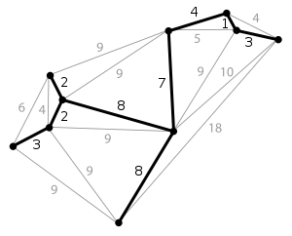
Minimum Spanning Tree
Applications of MST in Network design
Telephone
Electrical
TV cable
Computer
road

Slide 92
Greedy Strategy
An optimal solution is constructed in stages
At each stage, the best decision is made at this time
Since this decision cannot be changed later, we make sure that the decision will result in a feasible solution
Typically, the selection of an item at each stage is based on a least cost or a highest profit criterion

Slide 93
Kruskal’s Algorithm
Build a minimum cost spanning tree T by adding edges to T one at a time
Select the edges for inclusion in T in nondecreasing order of the cost
An edge is added to T if it does not form a cycle
Since G is connected and has n > 0 vertices, exactly n-1 edges will be selected

Slide 94
Kruskal’s Algorithm
T= {};
while (T contains less than n-1 edges && E is not empty)
{
choose a least cost edge (v,w) from E;
delete (v,w) from E;
if ((v,w) does not create a cycle in T)
add (v,w) to T
else
discard (v,w);
}
if (T contains fewer than n-1 edges)
printf(“No spanning tree\n”);

Slide 95
Kruskal’s Algorithm
Consider an undirected, weight graph
F
3
C
10
A
4
3
8
4
5
B
6
D
4
4
H
2
1
3
G
E
3

Slide 96
Kruskal’s Algorithm
Sort the edges by increasing edge weight
edge | d_{v}
(D,E) | 1
(D,G) | 2
(E,G) | 3
(C,D) | 3
(G,H) | 3
(C,F) | 3
(B,C) | 4
edge | d_{v}
(B,E) | 4
(B,F) | 4
(B,H) | 4
(A,H) | 5
(D,F) | 6
(A,B) | 8
(A,F) | 10
F
3
C
10
A
4
3
8
4
5
B
6
D
4
4
H
2
1
3
G
E
3

Slide 97
Kruskal’s Algorithm
Select first |V|–1 edges which do not generate a cycle
F
3
C
10
edge | d_{v}
(D,E) | 1 | √
(D,G) | 2
(E,G) | 3
(C,D) | 3
(G,H) | 3
(C,F) | 3
(B,C) | 4
edge | d_{v}
(B,E) | 4
(B,F) | 4
(B,H) | 4
(A,H) | 5
(D,F) | 6
(A,B) | 8
(A,F) | 10
A
4
3
8
4
5
B
6
D
4
4
H
2
1
3
G
E
3

Slide 98
Kruskal’s Algorithm
Select first |V|–1 edges which do not generate a cycle
F
3
C
10
edge | d_{v}
(D,E) | 1 | √
(D,G) | 2 | √
(E,G) | 3
(C,D) | 3
(G,H) | 3
(C,F) | 3
(B,C) | 4
edge | d_{v}
(B,E) | 4
(B,F) | 4
(B,H) | 4
(A,H) | 5
(D,F) | 6
(A,B) | 8
(A,F) | 10
A
4
3
8
4
5
B
6
D
4
4
H
2
1
3
G
E
3

Slide 99
Kruskal’s Algorithm
Select first |V|–1 edges which do not generate a cycle
F
3
C
edge | d_{v}
(D,E) | 1 | √
(D,G) | 2 | √
(E,G) | 3 | χ
(C,D) | 3
(G,H) | 3
(C,F) | 3
(B,C) | 4
edge | d_{v}
(B,E) | 4
(B,F) | 4
(B,H) | 4
(A,H) | 5
(D,F) | 6
(A,B) | 8
(A,F) | 10
10
A
4
3
8
4
5
B
6
D
4
4
H
2
1
3
G
E
3
Accepting edge (E,G) would create a cycle

Slide 100
Kruskal’s Algorithm
Select first |V|–1 edges which do not generate a cycle
F
3
C
edge | d_{v}
(D,E) | 1 | √
(D,G) | 2 | √
(E,G) | 3 | χ
(C,D) | 3 | √
(G,H) | 3
(C,F) | 3
(B,C) | 4
edge | d_{v}
(B,E) | 4
(B,F) | 4
(B,H) | 4
(A,H) | 5
(D,F) | 6
(A,B) | 8
(A,F) | 10
10
A
4
3
8
4
5
B
6
D
4
4
H
2
1
3
G
E
3

Slide 101

Kruskal’s Algorithm
Select first |V|–1 edges which do not generate a cycle
F
3
C
edge | d_{v}
(D,E) | 1 | √
(D,G) | 2 | √
(E,G) | 3 | χ
(C,D) | 3 | √
(G,H) | 3 | √
(C,F) | 3
(B,C) | 4
edge | d_{v}
(B,E) | 4
(B,F) | 4
(B,H) | 4
(A,H) | 5
(D,F) | 6
(A,B) | 8
(A,F) | 10
10
A
4
3
8
4
5
B
6
D
4
4
H
2
1
3
G
E
3

Slide 102
Kruskal’s Algorithm
Select first |V|–1 edges which do not generate a cycle
F
3
C
10
edge | d_{v}
(D,E) | 1 | √
(D,G) | 2 | √
(E,G) | 3 | χ
(C,D) | 3 | √
(G,H) | 3 | √
(C,F) | 3 | √
(B,C) | 4
edge | d_{v}
(B,E) | 4
(B,F) | 4
(B,H) | 4
(A,H) | 5
(D,F) | 6
(A,B) | 8
(A,F) | 10
A
4
3
8
4
5
B
6
D
4
4
H
2
1
3
G
E
3

Slide 103
Kruskal’s Algorithm
Select first |V|–1 edges which do not generate a cycle
F
3
C
edge | d_{v}
(D,E) | 1 | √
(D,G) | 2 | √
(E,G) | 3 | χ
(C,D) | 3 | √
(G,H) | 3 | √
(C,F) | 3 | √
(B,C) | 4 | √
edge | d_{v}
(B,E) | 4
(B,F) | 4
(B,H) | 4
(A,H) | 5
(D,F) | 6
(A,B) | 8
(A,F) | 10
10
A
4
3
8
4
5
B
6
D
4
4
H
2
1
3
G
E
3

Slide 104
Kruskal’s Algorithm
Select first |V|–1 edges which do not generate a cycle
F
3
C
10
A
4
3
edge | d_{v}
(D,E) | 1 | √
(D,G) | 2 | √
(E,G) | 3 | χ
(C,D) | 3 | √
(G,H) | 3 | √
(C,F) | 3 | √
(B,C) | 4 | √
edge | d_{v}
(B,E) | 4 | χ
(B,F) | 4
(B,H) | 4
(A,H) | 5
(D,F) | 6
(A,B) | 8
(A,F) | 10
8
4
5
B
6
D
4
4
H
2
1
3
G
E
3

Slide 105
Kruskal’s Algorithm
Select first |V|–1 edges which do not generate a cycle
F
3
C
edge | d_{v}
(D,E) | 1 | √
(D,G) | 2 | √
(E,G) | 3 | χ
(C,D) | 3 | √
(G,H) | 3 | √
(C,F) | 3 | √
(B,C) | 4 | √
edge | d_{v}
(B,E) | 4 | χ
(B,F) | 4 | χ
(B,H) | 4
(A,H) | 5
(D,F) | 6
(A,B) | 8
(A,F) | 10
10
A
4
3
8
4
5
B
6
D
4
4
H
2
1
3
G
E
3

Slide 106
Kruskal’s Algorithm
Select first |V|–1 edges which do not generate a cycle
F
3
C
10
edge | d_{v}
(D,E) | 1 | √
(D,G) | 2 | √
(E,G) | 3 | χ
(C,D) | 3 | √
(G,H) | 3 | √
(C,F) | 3 | √
(B,C) | 4 | √
edge | d_{v}
(B,E) | 4 | χ
(B,F) | 4 | χ
(B,H) | 4 | χ
(A,H) | 5
(D,F) | 6
(A,B) | 8
(A,F) | 10
A
4
3
8
4
5
B
6
D
4
4
H
2
1
3
G
E
3

Slide 107
Kruskal’s Algorithm
Select first |V|–1 edges which do not generate a cycle
F
3
C
10
edge | d_{v}
(D,E) | 1 | √
(D,G) | 2 | √
(E,G) | 3 | χ
(C,D) | 3 | √
(G,H) | 3 | √
(C,F) | 3 | √
(B,C) | 4 | √
edge | d_{v}
(B,E) | 4 | χ
(B,F) | 4 | χ
(B,H) | 4 | χ
(A,H) | 5 | √
(D,F) | 6
(A,B) | 8
(A,F) | 10
A
4
3
8
4
5
B
6
D
4
4
H
2
1
3
G
E
3

Slide 108
Kruskal’s Algorithm
Select first |V|–1 edges which do not generate a cycle
3
edge | d_{v}
(D,E) | 1 | √
(D,G) | 2 | √
(E,G) | 3 | χ
(C,D) | 3 | √
(G,H) | 3 | √
(C,F) | 3 | √
(B,C) | 4 | √
edge | d_{v}
(B,E) | 4 | χ
(B,F) | 4 | χ
(B,H) | 4 | χ
(A,H) | 5 | √
(D,F) | 6
(A,B) | 8
(A,F) | 10
F
C
A
3
4
5
B
D
H
}
2
1
not
considered
3
G
E
Done
Total Cost = Σ d_{v} = 21

Slide 109
Prim’s Algorithm
//Assume G has at least one vertex
TV={0}; //start with vertex 0 and no edges
for (T=Ø; T contains less than n-1 edges; add(u,v) to T)
{
let (u,v) be a least cost edge such that u ∈ TV and v ∉ TV;
if (there is no such edge ) break;
add v to TV;
}
if (T contains fewer than n-1 edges)
cout<<“No spanning tree\n”;

Slide 110
Prim’s Algorithm
2
Initialize array
F
3
 | K | d_{v} | p_{v}
A | F | ∞ | −
B | F | ∞ | −
C | F | ∞ | −
D | F | ∞ | −
E | F | ∞ | −
F | F | ∞ | −
G | F | ∞ | −
H | F | ∞ | −
C
10
A
7
3
8
4
4
B
18
D
9
10
H
2
25
3
G
E
7

Slide 111
Prim’s Algorithm
2
Start with any node, say D
F
3
C
 | K | d_{v} | p_{v}
A
B
C
D | T | 0 | −
E
F
G
H
10
A
7
3
8
4
4
B
18
D
9
10
H
2
25
3
G
E
7

Slide 112
Prim’s Algorithm
Update distances of adjacent, unselected nodes
2
F
3
 | K | d_{v} | p_{v}
A
B
C |  | 3 | D
D | T | 0 | −
E |  | 25 | D
F |  | 18 | D
G |  | 2 | D
H
C
10
A
7
3
8
4
4
B
18
D
9
10
H
2
25
3
G
E
7

Slide 113
Prim’s Algorithm
Select node with minimum distance
2
F
3
 | K | d_{v} | p_{v}
A
B
C |  | 3 | D
D | T | 0 | −
E |  | 25 | D
F |  | 18 | D
G | T | 2 | D
H
C
10
A
7
3
8
4
4
B
18
D
9
10
H
2
25
3
G
E
7

Slide 114
Prim’s Algorithm
Update distances of adjacent, unselected nodes
2
F
3
 | K | d_{v} | p_{v}
A
B
C |  | 3 | D
D | T | 0 | −
E |  | 7 | G
F |  | 18 | D
G | T | 2 | D
H |  | 3 | G
C
10
A
7
3
8
4
4
B
18
D
9
10
H
2
25
3
G
E
7

Slide 115
Prim’s Algorithm
Select node with minimum distance
2
F
3
C
 | K | d_{v} | p_{v}
A
B
C | T | 3 | D
D | T | 0 | −
E |  | 7 | G
F |  | 18 | D
G | T | 2 | D
H |  | 3 | G
10
A
7
3
8
4
4
B
18
D
9
10
H
2
25
3
G
E
7

Slide 116
Prim’s Algorithm
Update distances of adjacent, unselected nodes
2
F
3
 | K | d_{v} | p_{v}
A
B |  | 4 | C
C | T | 3 | D
D | T | 0 | −
E |  | 7 | G
F |  | 3 | C
G | T | 2 | D
H |  | 3 | G
C
10
A
7
3
8
4
4
B
18
D
9
10
H
2
25
3
G
E
7

Slide 117
Prim’s Algorithm
Select node with minimum distance
2
F
3
 | K | d_{v} | p_{v}
A
B |  | 4 | C
C | T | 3 | D
D | T | 0 | −
E |  | 7 | G
F | T | 3 | C
G | T | 2 | D
H |  | 3 | G
C
10
A
7
3
8
4
4
B
18
D
9
10
H
2
25
3
G
E
7

Slide 118
Prim’s Algorithm
Update distances of adjacent, unselected nodes
2
3
 | K | d_{v} | p_{v}
A |  | 10 | F
B |  | 4 | C
C | T | 3 | D
D | T | 0 | −
E |  | 2 | F
F | T | 3 | C
G | T | 2 | D
H |  | 3 | G
F
C
10
A
7
3
8
4
4
B
18
D
9
10
H
2
25
3
G
E
7

Slide 119
Prim’s Algorithm
Select node with minimum distance
2
F
3
 | K | d_{v} | p_{v}
A |  | 10 | F
B |  | 4 | C
C | T | 3 | D
D | T | 0 | −
E | T | 2 | F
F | T | 3 | C
G | T | 2 | D
H |  | 3 | G
C
10
A
7
3
8
4
4
B
18
D
9
10
H
2
25
3
G
E
7

Slide 120
Prim’s Algorithm
Update distances of adjacent, unselected nodes
2
 | K | d_{v} | p_{v}
A |  | 10 | F
B |  | 4 | C
C | T | 3 | D
D | T | 0 | −
E | T | 2 | F
F | T | 3 | C
G | T | 2 | D
H |  | 3 | G
F
3
C
10
A
7
3
8
4
4
B
18
D
9
10
H
2
25
3
G
E
7
Table entries unchanged

Slide 121
Prim’s Algorithm
Select node with minimum distance
2
F
3
C
 | K | d_{v} | p_{v}
A |  | 10 | F
B |  | 4 | C
C | T | 3 | D
D | T | 0 | −
E | T | 2 | F
F | T | 3 | C
G | T | 2 | D
H | T | 3 | G
10
A
7
3
8
4
4
B
18
D
9
10
H
2
25
3
G
E
7

Slide 122
Prim’s Algorithm
Update distances of adjacent, unselected nodes
2
F
3
 | K | d_{v} | p_{v}
A |  | 4 | H
B |  | 4 | C
C | T | 3 | D
D | T | 0 | −
E | T | 2 | F
F | T | 3 | C
G | T | 2 | D
H | T | 3 | G
C
10
A
7
3
8
4
4
B
18
D
9
10
H
2
25
3
G
E
7

Slide 123
Prim’s Algorithm
Select node with minimum distance
2
F
3
 | K | d_{v} | p_{v}
A | T | 4 | H
B |  | 4 | C
C | T | 3 | D
D | T | 0 | −
E | T | 2 | F
F | T | 3 | C
G | T | 2 | D
H | T | 3 | G
C
10
A
7
3
8
4
4
B
18
D
9
10
H
2
25
3
G
E
7

Slide 124
Prim’s Algorithm
Update distances of adjacent, unselected nodes
2
3
 | K | d_{v} | p_{v}
A | T | 4 | H
B |  | 4 | C
C | T | 3 | D
D | T | 0 | −
E | T | 2 | F
F | T | 3 | C
G | T | 2 | D
H | T | 3 | G
F
C
10
A
7
3
8
4
4
B
18
D
9
10
H
2
25
3
G
E
7
Table entries unchanged

Slide 125
Prim’s Algorithm
Select node with minimum distance
2
 | K | d_{v} | p_{v}
A | T | 4 | H
B | T | 4 | C
C | T | 3 | D
D | T | 0 | −
E | T | 2 | F
F | T | 3 | C
G | T | 2 | D
H | T | 3 | G
F
3
C
10
A
7
3
8
4
4
B
18
D
9
10
H
2
25
3
G
E
7

Slide 126
Prim’s Algorithm
Cost of Minimum Spanning Tree = Σ d_{v} = 21
2
F
3
 | K | d_{v} | p_{v}
A | T | 4 | H
B | T | 4 | C
C | T | 3 | D
D | T | 0 | −
E | T | 2 | F
F | T | 3 | C
G | T | 2 | D
H | T | 3 | G
C
A
3
4
4
B
D
H
2
3
G
E
Done

Slide 127
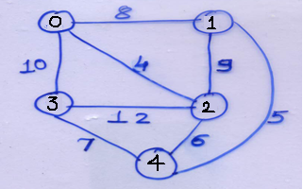
Prim’s Algorithm
for i=1 to n-1 do
{ //find n-1 additional edges for t
min= ∞
for k=0 to n-1
{ // find j : vertex such that;
if (nearest[k]!= -1 and cost[k, nearest[k]] <min)
{ j=k ; min= cost[k, nearest[k]];}
}
//update tree and total cost
t[ r][0]=nearest[j] , t[r][1]=j; t[r][2] = min; r=r+1;
mincost = mincost +cost[j, nearest[j]);
nearest[j]=-1;
//update nearest for remaining vertices
for k=0 to n-1
{ if(nearest[k]!= -1 and (cost[k, nearest[k])> cost[k, j]
nearest[k]=j;
}
} //end for i=1 to n-1
return mincost;
}
Algorithm prims(start_v){
//cost[i][j] is either +ve or infinity.
//A MST is computed & stored as a set of edges in the //array t[n][1]. t[i][0], t[i][1]) is an edge in the MST
//where 0<i<n.
// start_v be the starting vertex {
//Initialize nearest
nearest [start_v] = -1;
for i=0 to n-1 do
{ if(i!=start_v)
nearest[i]= start_v;
}
r=0;

Slide 128
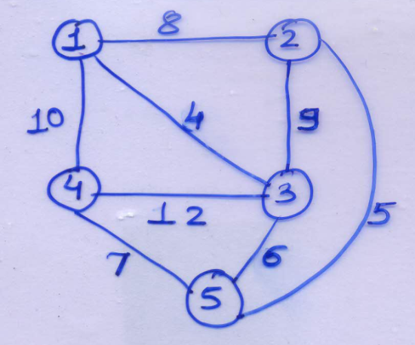
Initial values of Near
For i=1 find minimum edge connecting to v1
Stv=1
Near[1] | = -1
Near[2] | = 1
Near[3] | = 1
Near[4] | = 1
Near[5] | = 1
Stv=1
cost[2,near[2]] | =8
cost[3,near[3]] | =4
cost[4,near[4]] | =10
Cost[5,near[5]] | = ∞
Cost Adjacancy Matrix
 | 1 | 2 | 3 | 4 | 5
1 | ∞ | 8 | 4 | 10 | ∞
2 | 8 | ∞ | 9 | ∞ | 5
3 | 4 | 9 | ∞ | 12 | 6
4 | 10 | ∞ | 12 | ∞ | 7
5 | ∞ | 5 | 6 | 7 | ∞
j=3
Put near[1]= -1 as it has been included in ST

Slide 129
Put near[3]= -1 as it has been included in ST
Update Near matrix i.e. (cost [i][j] < cost[j][near[j]])
 | 1 | 2 | 3 | 4 | 5
1 | ∞ | 8 | 4 | 10 | ∞
2 | 8 | ∞ | 9 | ∞ | 5
3 | 4 | 9 | ∞ | 12 | 6
4 | 10 | ∞ | 12 | ∞ | 7
5 | ∞ | 5 | 6 | 7 | ∞
J=3
cost[2,3] < cost[2,near[2]] | 9 < 8
cost[4,3] < cost[4,near[4]] | 12< 10
cost[5,3] < cost[5,near[5]] | 6 < ∞
j=3
Near[1] | = -1
Near[2] | = 1
Near[3] | = -1
Near[4] | = 1
Near[5] | = 3
Cost Adjacancy Matrix
T | 1 (v1) | 2 (v2) | 3 (cost)
1 | 1 | 3 | 4
2
3
4
5
6

Slide 130
--
For i=2 find minimum edge connecting to v1 / v3
Find next j
j=3
Near[1] | = -1
Near[2] | = 1
Near[3] | = -1
Near[4] | = 1
Near[5] | = 3
j=3
cost[2,near[2]] | =8
cost[4,near[4]] | =10
Cost[5,near[5]] | = 6
Cost Adjacancy Matrix
 | 1 | 2 | 3 | 4 | 5
1 | ∞ | 8 | 4 | 10 | ∞
2 | 8 | ∞ | 9 | ∞ | 5
3 | 4 | 9 | ∞ | 12 | 6
4 | 10 | ∞ | 12 | ∞ | 7
5 | ∞ | 5 | 6 | 7 | ∞
j=5

Slide 131
Put near[5]= -1 as it has been included in ST
Cost Adjacancy Matrix
Update Near matrix i.e. (cost [i][j] < cost[j][near[j]])
 | 1 | 2 | 3 | 4 | 5
1 | ∞ | 8 | 4 | 10 | ∞
2 | 8 | ∞ | 9 | ∞ | 5
3 | 4 | 9 | ∞ | 12 | 6
4 | 10 | ∞ | 12 | ∞ | 7
5 | ∞ | 5 | 6 | 7 | ∞
J=5
cost[2,5] < cost[2,near[2]] | 5 < 8
cost[4,5] < cost[4,near[4]] | 7< 10
j=5
Near[1] | = -1
Near[2] | = 5
Near[3] | = -1
Near[4] | = 5
Near[5] | = -1
T | 1 (v1) | 2 (v2) | 3 (cost)
1 | 1 | 3 | 4
2 | 3 | 5 | 6
3
4
5
6

Slide 132
Find next j
For i=3 find minimum edge connecting to v1 / v3/v5
j=5
Near[1] | = -1
Near[2] | = 5
Near[3] | = -1
Near[4] | = 5
Near[5] | = -1
Cost Adjacancy Matrix
j=5
cost[2,near[2]] | =5
cost[4,near[4]] | =7
 | 1 | 2 | 3 | 4 | 5
1 | ∞ | 8 | 4 | 10 | ∞
2 | 8 | ∞ | 9 | ∞ | 5
3 | 4 | 9 | ∞ | 12 | 6
4 | 10 | ∞ | 12 | ∞ | 7
5 | ∞ | 5 | 6 | 7 | ∞
j=2
Put near[2]= -1 as it has been included in ST

Slide 133
Put near[4]= -1 as it has been included in ST
j=2
Near[1] | = -1
Near[2] | = -1
Near[3] | = -1
Near[4] | = 5
Near[5] | = -1
 | 1 | 2 | 3 | 4 | 5
1 | ∞ | 8 | 4 | 10 | ∞
2 | 8 | ∞ | 9 | ∞ | 5
3 | 4 | 9 | ∞ | 12 | 6
4 | 10 | ∞ | 12 | ∞ | 7
5 | ∞ | 5 | 6 | 7 | ∞
J=2
cost[4,2] < cost[4,near[4]] | ∞ < 7
Cost Adjacancy Matrix
T | 1 (v1) | 2 (v2) | 3 (cost)
1 | 1 | 3 | 4
2 | 3 | 5 | 6
3 | 2 | 5 | 5
4 | 4 | 5 | 7
5
6

Slide 134
Put near[4]= -1 as it has been included in ST
j=2
Near[1] | = -1
Near[2] | = -1
Near[3] | = -1
Near[4] | = 5
Near[5] | = -1
For i=4 find minimum edge connecting to v1 / v3/v5/v2
 | 1 | 2 | 3 | 4 | 5
1 | ∞ | 8 | 4 | 10 | ∞
2 | 8 | ∞ | 9 | ∞ | 5
3 | 4 | 9 | ∞ | 12 | 6
4 | 10 | ∞ | 12 | ∞ | 7
5 | ∞ | 5 | 6 | 7 | ∞
J=2
cost[4,2] < cost[4,near[4]] | ∞ < 7
Cost Adjacancy Matrix
j=4
T | 1 (v1) | 2 (v2) | 3 (cost)
1 | 1 | 3 | 4
2 | 3 | 5 | 6
3 | 2 | 5 | 5
4 | 4 | 5 | 7
5
6

Slide 135
Analysis of Prim’s Algorithm
Run time will be O(n^2).
Unlike Kruskal’s, it doesn’t need to see all of the graph at once. It can deal with it one piece at a time. It also doesn’t need to worry if adding an edge will create a cycle since this algorithm deals primarily with the nodes and not the edges.

Slide 136
Home Assignment
Find MST for given Graph G1 using Prim’s and Kruskal Algorithm
0
28
10
1
14
16
5
6
2
24
25
18
4
12
22
3

Slide 137
Comparison Prim’s and Kruskal’s Algorithm
Kruskal’s has better running times if the number of edges is low, while Prim’s has a better running time if both the number of edges and the number of nodes are low.
So, of course, the best algorithm depends on the graph and if you want to bear the cost of complex data structures.

Slide 138
Shortest Path Problems
Directed weighted graph.
Path length is sum of weights of edges on path.
The vertex at which the path begins is the source vertex.
The vertex at which the path ends is the destination vertex.

Slide 139
Shortest Path Problems
Single source single destination.
Single source all destinations.
All pairs (every vertex is a source and destination).

Slide 140
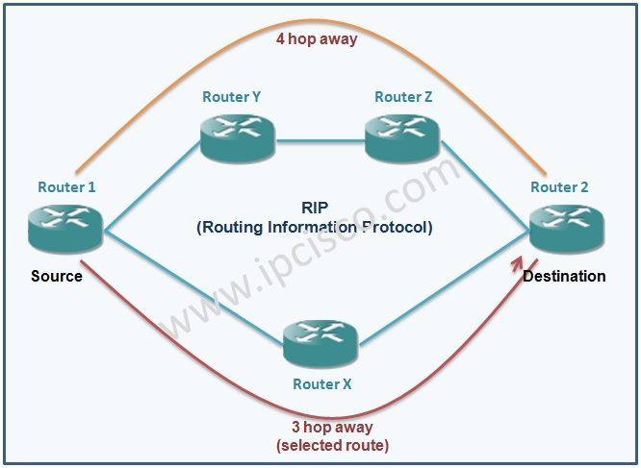
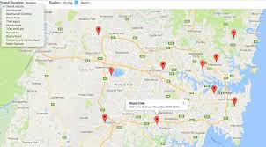
Dijkstra Algorithm
Finds Single source all destination shortest paths
Uses Greedy Method
No negative weights are allowed
Application
Routing protocols in computer networks
Google Maps and many more..
Google Maps
Routing Protocols

Slide 141
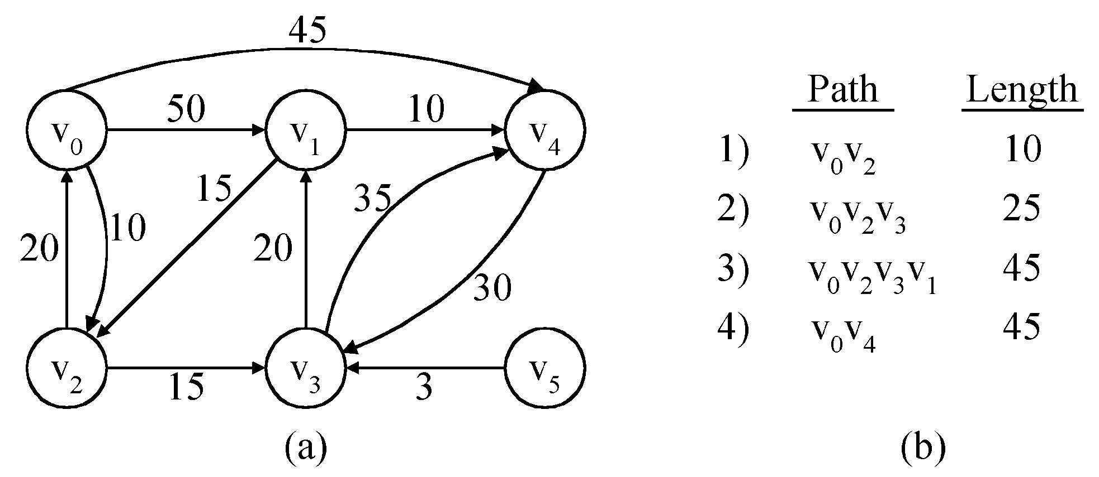
Dijkstra Algorithm
shortest paths from v₀(Single source) to all destinations

Slide 142
Dijkstra Algorithm
Algorithm shortestPath(v)
{ //v is source vertex
for (i=0;i<n; i++)
{
s[i] = 0;
dist[i]=g[v][i];
}
//put v into s
s[v] = 1;
dist[v] =0;
for(j=2;j<n; j++)
{
//choose u from among those vertices not in s such that dist[u] is minimum;
s[u] = 1;
for each(w adjacent to u with s[w] = 0)
{
if(dist[w] > dist[u]+g[u][w] )
dist[w] = dist[u]+cost[u][w];
}
}
}

Slide 143
Dijkstra Algorithm
Dijkstra(G)
for each v ∈ V
d[v] = ∞;
d[s] = 0; S = ∅; Q = V;
while (Q ≠ ∅)
u = ExtractMin(Q);
S = S U {u};
for each v ∈ Adj[u]
if (d[v] > d[u]+w(u,v))
d[v] = d[u]+w(u,v);

Slide 144
Dijkstra Algorithm
8
6
2
1
3
3
3
16
1
6
7
4
5
10
4
2
2
4
4
7
7
5
3
1
14
[1]
[2]
[3]
[4]
[5]
[6]
[7]
d
0
6
2
2
16
-
-
14
p
-
1
1
1
-
-
1

Slide 145
Dijkstra Algorithm
8
6
2
6
1
3
3
16
1
7
5
6
4
5
10
4
2
2
4
7
5
3
1
14
1
3
[1]
[2]
[3]
[4]
[5]
[6]
[7]
d
0
6
2
16
5
5
-
10
-
14
p
-
1
1
1
3
-
3
-
1

Slide 146
Dijkstra Algorithm
8
6
2
1
3
3
16
1
6
7
4
5
10
4
2
4
4
7
7
5
3
1
14
1
3
[1]
[2]
[3]
[4]
[5]
[6]
[7]
d
0
6
2
16
9
5
-
10
1
3
5
6
-
14
p
-
1
1
5
1
3
-
3
-
1

Slide 147
Dijkstra Algorithm
8
6
2
1
3
3
16
1
6
7
4
5
10
4
2
4
4
7
5
3
1
14
1
3
[1]
[2]
[3]
[4]
[5]
[6]
[7]
d
0
6
2
9
5
-
10
1
3
5
9
-
14
p
-
1
1
5
3
-
3
-
1
1
2
-
3
-

Slide 148
Dijkstra Algorithm
8
6
2
1
3
3
16
1
6
7
4
5
10
4
2
4
7
7
5
3
1
14
1
3
[1]
[2]
[3]
[4]
[5]
[6]
[7]
d
0
6
2
9
5
10
-
-
14
1
3
5
12
p
-
1
1
5
3
-
3
-
4
1
1
2
1
3
5
4
-

Slide 149
Dijkstra Algorithm
8
6
2
1
3
3
16
1
6
7
4
5
10
4
2
4
7
7
5
3
14
1
3
6
[1]
[2]
[3]
[4]
[5]
[6]
[7]
d
0
6
2
9
5
10
12
-
-
11
14
p
-
1
1
5
3
3
4
-
-
1
6
-

Slide 150
Dijkstra Algorithm
Path
Length
1
0
1
3
2
1
3
5
5
1
2
6
1
3
5
4
9
[1]
[2]
[3]
[4]
[5]
[6]
[7]
1
3
6
10
0
6
2
9
5
-
10
-
14
12
11
-
1
1
5
3
-
-
3
4
1
6
1
3
6
7
11

Slide 151
Analysis of Dijkstra Algorithm
O(n) to select next destination vertex.
O(out-degree) to update d() and p() values when adjacency lists are used.
O(n) to update d() and p() values when adjacency matrix is used.
Selection and update done once for each vertex to which a shortest path is found.
Total time is O(n² + e) = O(n²).

Slide 152
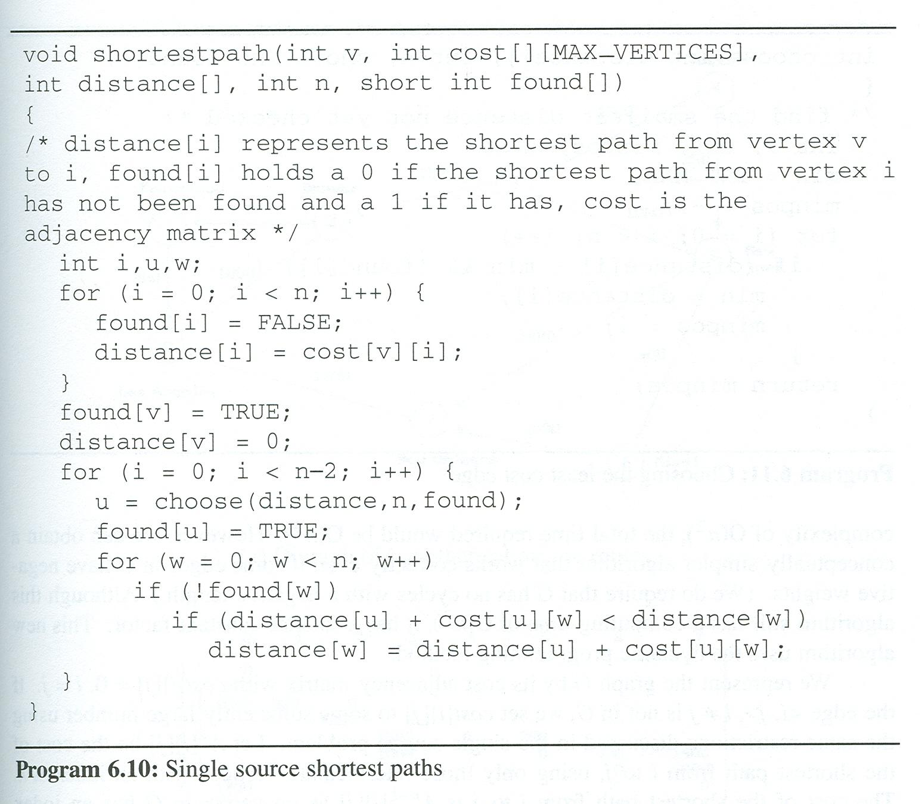
Single Source Shortest Paths Program (v=0)
visited:
[0]
[1]
[2]
[3]
[4]
[5]
cost:
45
V₀
50 10
V₁
V₄
20 10 15 20 35 30
V₂
15 3
V₃
V₅
distance:
0
50
45
10
1000
25
45
1000
i:
1
2
3
0
u:
2
3
1
4
w:
0
1
2
3
4
5

Slide 153
Home Assignment
Find shortest paths from v₀ to all destinations

Slide 154
Topological sort
We have a set of tasks and a set of dependencies (precedence constraints) of form “task A must be done before task B”
Topological sort: An ordering of the tasks that conforms with the given dependencies
Goal: Find a topological sort of the tasks or decide that there is no such ordering

Slide 155
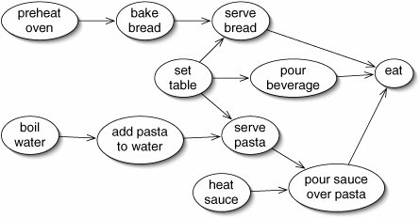
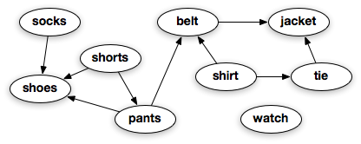
Topological sort
Applications
Assembly lines in industries
Courses arrangement in schools
Life related applications: Dressing order

Slide 156
Activity on vertex (AOV) network
Activity on vertex (AOV) network
An activity on vertex(AOV)network, is a digraph G in which the vertices represent tasks or activities and the edges represent precedence relations between tasks.
Predecessor :
Vertex i in an AOV network G is a predecessor of vertex j iff there is a directed path from vertex i to vertex j
Vertex i is an immediate predecessor of vertex j iff <i, j> is an edge in G
Successor :
If i is a predecessor of j, then j is a successor of i.
If i is an immediate predecessor of j, then j is an immediate successor of i

Slide 157
Activity on vertex (AOV) network
Example 1:
Prerequisites define precedence relations between courses. The relationship defined may be more clearly represented using a directed graph in which the vertices represent courses & the directed edges represent prerequisites.
Each edge <i,j> implies that course i is a perquisite of course j

Slide 158
Activity on vertex (AOV) network
Course number | Course name | Prerequisites
C1 | Programming I | None
C2 | Discrete Mathematics | None
C3 | Data Structures | C1, C2
C4 | Calculus I | None
C5 | Calculus II | C4
C6 | Linear Algebra | C5
C7 | Analysis of Algorithms | C3, C6
C8 | Assembly Language | C3
C9 | Operating Systems | C7, C8
C10 | Programming Languages | C7
C11 | Compiler Design | C10
C12 | Artificial Intelligence | C7
C13 | Computational Theory | C7
C14 | Parallel Algorithms | C13
C15 | Numerical Analysis | C5

Slide 159
Activity on vertex (AOV) network
AOV n/w representing courses as vertices & prerequisites as edges
Possible Topological orders:
c1, c2, c4, c5, c3, c6, c8, c7, c10, c13, c12, c14, c15, c11, c9
c4, c5, c2, c1, c6, c3, c8, c15, c7, c9, c10, c11, c12, c13, c14
C9
C10
C11
C1
C8
C12
C2
C3
C7
C13
C14
C4
C5
C6
C15

Slide 160
Topological sort
void topological_sort()
{ for (i = 0; i <n; i++) { if every vertex has a predecessor { fprintf(stderr, “Network has a cycle. \n “ ); exit(1); } pick a vertex v that has no predecessors; output v; delete v and all edges leading out of v from the network; }

Slide 161
Topological Sorts
Topological sort Algorithm
for (i = 0; i <n; i++) {
if every vertex has a predecessor {
fprintf (stderr, “Network has a cycle. \n “ );
exit(1);
}
pick a vertex v that has no predecessors;
output v;
delete v and all edges leading out of v from the network;
}
V₁
V₀
V₂
V₄
V₃
V₅
Topological order generated:
v₀
v₃
v₂
v₅
v₁
v₄

Slide 162
Internal representation used by topological sorting algorithm
count
first
data
link
[0]
0
1
2
3
0
[1]
1
4
0
[2]
1
4
5
0
[3]
1
5
4
0
[4]
3
0
[5]
2
0
1
0
2
4
3
5

Slide 163
An AOV network
1
1
1
0
2
4
2
4
2
4
3
5
3
5
5
(a) Initial
(b) Vertex 0 deleted
(c) Vertex 3 deleted
1
1
4
4
4
5
(e) Vertex 5 deleted
(f) Vertex 1 deleted
(d) Vertex 2 deleted

