Slide 1
Uncertain knowledge and Reasoning

Slide 2

CS 332 Artificial Intelligence
Teaching Scheme Credits: 2 + 1 = 3
Theory: 3 Hrs / Week Practical: 2 Hrs / Week
Course Objectives:
To understand the concept of Artificial Intelligence (AI)
To learn various peculiar search strategies for AI
To develop a mind to solve real world problems unconventionally with optimality
Course Outcomes:
Identify and apply suitable Intelligent agents for various AI applications
Design smart system using different informed search / uninformed search or heuristic approaches.
Identify knowledge associated and represent it by ontological engineering to plan a strategy to solve given problem.

Slide 3
Syllabus
Acting under Uncertainty, Basic Probability Notation, Inference Using Full Joint Distributions, Independence,
Bayes’ Rule and Its Use, Representing Knowledge in an Uncertain Domain,
The Semantics of Bayesian Networks, Efficient Representation of Conditional Distributions, Exact Inference in Bayesian Networks. Approximate inference in Bayesian Networks,
Other Approaches to Uncertain reasoning-Fuzzy sets and Fuzzy logic.

Slide 4
Acting under uncertainty
Agents may need to handle uncertainty, due to
partial observability, nondeterminism, or a combination of the two.
An agent may never know for certain what state it’s in or where it will end up after a sequence of actions.
To act rationally under uncertainty we must be able to evaluate how likely are certain things.
With FOL a fact F is only useful if it is known to be true or false.
But we need to be able to evaluate how likely it is that F is true.
By weighing likelihoods of events (probabilities) we can develop mechanisms for acting rationally under uncertainty.

Slide 5
Motivation
Uncertainty arises through:
Noisy measurements
Finite size of data sets
Ambiguity: The word bank can mean (1) a financial institution, (2) the side of a river, or (3) tilting an airplane. Which meaning was intended, based on the words that appear nearby?
Limited Model Complexity
Probability theory provides a consistent framework for the quantification and manipulation of uncertainty
Allows us to make optimal predictions given all the information available to us, even though that information may be incomplete or ambiguous

Slide 6
Sample Space
In probability theory, the sample space is also called as a sample description space or possibility space.
The sample space (Ω) is the set of possible outcomes of an experiment or random trial. Sample Points ω in Ω are called sample outcomes, realizations, or elements. Subsets of Ω are called Events.
Example. If we toss a coin twice then
Sample space (Ω) = {HH,HT, TH, TT}.
The event that the first toss is heads is A = {HH,HT}
We say that events A1 and A2 are disjoint (mutually exclusive) if Ai ∩ Aj = {}
Example: first flip being heads and first flip being tails

Slide 7
A set Ω with outcomes S₁,S₂…..S_{n}, must meet some conditions in order to be a sample space:
The outcomes must be mutually exclusive, i.e. if S_{j} occurs, then no other S_{i} will take place,
The outcomes must be collectively exhaustive, i.e. on every experiment (or random trial) there will always take place some outcome for The sample space Ω must have the right granularity depending on what the experimenter is interested in relevant information must be removed from the sample space and the right abstraction must be chosen

Slide 8
Probability
A probability is a number that reflects the chance or likelihood that a particular event will occur.
Probabilities can be expressed as proportions that range from 0 to 1, and they can also be expressed as percentages ranging from 0% to 100%.
A probability of 0 indicates that there is no chance that a particular event will occur, whereas a probability of 1 indicates that an event is certain to occur.
A probability of 0.45 (45%) indicates that there are 45 chances out of 100 of the event occurring.

Slide 9


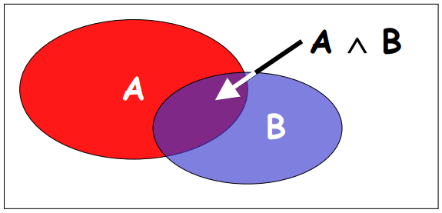
Axioms of Probability
We will assign a real number P(A) to every event A, called the probability of A.
To qualify as a probability, P must satisfy three axioms:
Axiom 1: P(A) ≥ 0 for every A
Axiom 2: P(Ω) = 1
Axiom 3: If A1,A2, . . . are disjoint then
The probability of disjunction is:

Slide 10
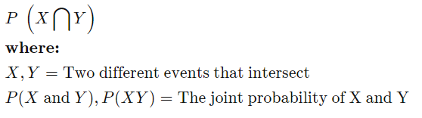
Joint and Conditional Probabilities
Joint Probability:
Joint probability is a statistical measure that calculates the likelihood of two events occurring together and at the same point in time.
Joint probability is the probability of event Y occurring at the same time that event X occurs.
P(X,Y)
Probability of X and Y
The Formula for Joint Probability:
Notation for joint probability can take a few different forms. The following formula represents the probability of events intersection:

Slide 11
Independent and Conditional Probabilities
Assuming that P(B) > 0, the conditional probability of A given B:
P(A|B)=P(AB)/P(B)
P(AB) = P(A|B)P(B) = P(B|A)P(A)
Product Rule
Two events A and B are independent if
P(AB) = P(A)P(B)
Joint = Product of Marginals
Two events A and B are conditionally independent given C if they are independent after conditioning on C
P(AB|C) = P(B|AC)P(A|C) = P(B|C)P(A|C)

Slide 12
Unconditional Probability
If we select a child at random (by simple random sampling), then each child has the same probability (equal chance) of being selected, and the probability is 1/N, where N=the population size.
Thus, the probability that any child is selected is 1/5,290 = 0.0002.
In most sampling situations we are generally not concerned with sampling a specific individual but instead we concern ourselves with the probability of sampling certain types of individuals.
For example, what is the probability of selecting a boy or a child 7 years of age? The following formula can be used to compute probabilities of selecting individuals with specific attributes or characteristics.

Slide 13
Conditional Probability:
One can be interested in the probability of an event given the occurrence of another event.
The probability of one event given the occurrence of another event is called the conditional probability. The conditional probability of one to one or more random variables is referred to as the conditional probability distribution.
P(X|Y)
The above statement can be interpreted as:
Probability of X given Y

Slide 14
Example
60% of ML students pass the final and 45% of ML students pass both the final and the midterm
What percent of students who passed the final also passed the midterm?

Slide 15
Example
60% of ML students pass the final and 45% of ML students pass both the final and the midterm
What percent of students who passed the final also passed the midterm?
Reworded: What percent of students passed the midterm given they passed the final?
P(M|F) = P(M,F) / P(F)
• = 0.45 / 0.60
• = 0.75

Slide 16


Marginalization and Law of Total Probability
Marginalization (Sum Rule)
Law of Total Probability

Slide 17
Inference using full joint distribution
Probabilistic inference: The computation of posterior probabilities for query propositions given observed evidence.
We use the full joint distribution as the “knowledge base” from which answers to all questions may be derived.
The full joint probability distribution specifies the probability of each complete assignment of values to random variables.
It is usually too large to create or use in its explicit form,
However, when it is available it can be used to answer queries simply by adding up entries for the possible worlds corresponding to the query propositions.

Slide 18
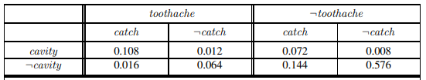
Example: A domain consisting of just the three Boolean variables Toothache, Cavity, and Catch (the dentist’s nasty steel probe catches in my tooth).

Slide 19

Marginalization / summing out: The process of extracting the distribution over some subset of variables or a single variable (to get the marginal probability), by summing up the probabilities for each possible value of the other variables, thereby taking them out of the equation.
The general marginalization rule for any sets of variables Y and Z:
EX: The marginal probability of cavity is P(cavity) = 0.108+0.012+0.072+0.008

Slide 20

The conditioning rule:
Ex:Just to check, we can also compute the probability that there is no cavity, given a toothache:
P(¬cavity |toothache) = P(¬cavity ∧ toothache) P(toothache) = 0.016 + 0.064 0.108 + 0.012 + 0.016 + 0.064 = 0.4
Normalization constant (α): 1/P(evidence) can be viewed as a normalization constant for the distribution P(event | evidence), ensuring that it adds up to 1.

Slide 21

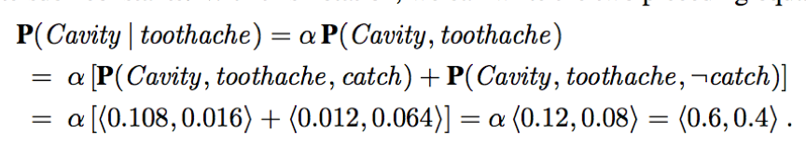
X (Cavity) is a single variable. Let E (Toothache) be the list of evidence variables, e be the list of observed values for them, Y (Catch) be the remaining unobserved variables. The query P(X|e) can be evaluated as:
Ex:

Slide 22
Drawbacks of inference by enumeration:
The worst-case time complexity is O(d^{n}),
where d is the number of values in domains of each random variable
To store full joint probability distribution we need O(d^{n}) space

Slide 23
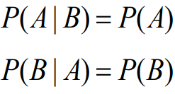
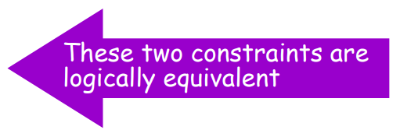
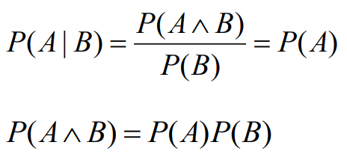
Independence
A and B are independent iff:
Therefore, if A and B are independent:

Slide 24
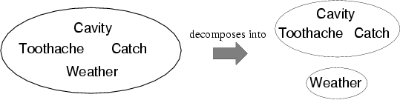
Independence assertions can dramatically reduce the amount of information necessary to specify the full joint distribution.
If the complete set of variables can be divided into independent subsets, then the full joint distribution can be factored into separate joint distributions on those subsets.
Absolute independence between subsets of random variables allows the full joint distribution to be factored into smaller joint distributions, greatly reducing its complexity. Absolute independence seldom occurs in practice.
Weather is independent of Cavity, Toothache, catch

Slide 25
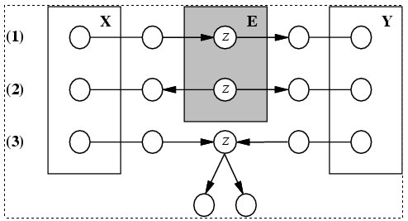
Conditional independence and D-separation(Direction-dependent)
Two sets of nodes, X and Y, are conditionally independent given an evidence set of nodes, E if every undirected path from a node in X to a node in Y is d-seperated by E.
A set of nodes, E d-separates to sets of nodes, X and Y, if every undirected path from a node in X to a node in Y is blocked by E
A path is blocked given E if there is a node Z on the path for which one of the following holds:

Slide 26
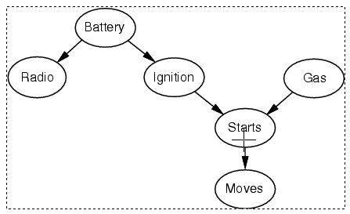
Conditional independence and D-separation - example

Slide 27
Power of Cond. Independence
Conditional independence reduces the storage complexity of the joint distribution from exponential to linear!!
Conditional independence is the most basic & robust form of knowledge about uncertain environments.

Slide 28


Bayes’ Rule
It is a mathematical formula for determining conditional probability
P(A|B) = P(AB) /P(B)
P(A|B) = P(B|A)P(A) /P(B)
P(A|B) = P(B|A)P(A) / Σ P(B|A)P(A)
(Conditional Probability) (Product Rule)
(Law of Total Probability)

Slide 29
Key terms in Bayes Rule
Prior Probability:
The prior probability of a random event is the unconditional probability that is assigned before any relevant evidence is taken into account.
Posterior Probability:
A posterior probability, in Bayesian statistics, is the revised or updated probability of an event occurring after taking into consideration new information. The posterior probability is calculated by updating the prior probability using Bayes' theorem.
Likelihood: Likelihood refers to finding the best distribution of the data given a particular value of some feature or some situation in the data.

Slide 30


Bayes’ Rule

Slide 31
Example
Suppose you have tested positive for a disease; what is the probability that you actually have the disease?
It depends on the accuracy and sensitivity of the test, and on the background (prior) probability of the disease.
P(T=1|D=1) = 0.95
P(T=1|D=0) = 0.10
P(D=1) = 0.01
(true positive) (false positive) (prior)
P(D=1|T=1) = ?

Slide 32
Example
P(T=1|D=1) = .95
P(T=1|D=0) = .10
P(D=1) = .01
(true positive) (false positive) (prior)
Bayes’ Rule
P(D|T) = P(T|D)P(D) / P(T)
= .95 * .01 / .1085
= .087
Law of Total Probability
P(T) = Σ P(T|D)P(D)
= P(T|D=1)P(D=1) + P(T|D=0)P(D=0)
= .95*.01 + .1*.99
= .1085
The probability that you have the disease given you tested positive is 8.7%

Slide 33
Bayes Theorem
In probability theory and statistics, Bayes' theorem (alternatively Bayes' law or Bayes' rule), named after Thomas Bayes.
Bayes Theorem describes the probability of an event, based on prior knowledge of conditions that might be related to the event.
For example, if the risk of developing health problems is known to increase with age, Bayes' theorem allows the risk to an individual of a known age to be assessed more accurately (by conditioning it on their age) than simply assuming that the individual is typical of the population as a whole.

Slide 34
Applying Bayes’ rule: The simple case
It allows us to compute the single term P(b | a) in terms of three terms: P(a | b), P(b), and P(a).
That seems like two steps backwards, but Bayes’ rule is useful in practice because there are many cases where we do have good probability estimates for these three numbers and need to compute the fourth.
Often, we perceive as evidence the effect of some unknown cause and we would like to determine that cause.
In that case, Bayes’ rule becomes
P(cause | effect) = (P(effect | cause)P(cause) )/P(effect) .

Slide 35
The conditional probability P(effect | cause) quantifies the relationship in the causal direction, whereas P(cause | effect) describes the diagnostic direction.
Ex: A doctor knows that the disease meningitis causes the patient to have a stiff neck, say, 70% of the time. The doctor also knows some unconditional facts: the prior probability that a patient has meningitis is 1/50,000, and the prior probability that any patient has a stiff neck is 1%. Letting s be the proposition that the patient has a stiff neck and m be the proposition that the patient has meningitis, we have
P(s | m)=0.7, P(m)=1/50000, P(s)=0.01, P(m | s) =(P(s | m)P(m) ) /P(s) = 0.7 × 1/50000 /0.01 = 0.0014 .
That is, we expect less than 1 in 700 patients with a stiff neck to have meningitis.

Slide 36
Use of Bayes Rule: Combining evidence
We have seen that Bayes’ rule can be useful for answering probabilistic queries conditioned on one piece of evidence
What happens when we have two or more pieces of evidence?
For example, what can a dentist conclude if her nasty steel probe catches in the aching tooth of a patient? If we know the full joint distribution (Figure 13.3), we can read off the answer: P(Cavity |toothache ∧ catch) = α <0.108, 0.016> ==<0.871, 0.129>
We know, however, that such an approach does not scale up to larger numbers of variables. We can try using Bayes’ rule to reformulate the problem:
P(Cavity |toothache ∧ catch) = α P(toothache ∧ catch | Cavity) P(Cavity) .

Slide 37
For the previous reformulation to work, there is the need to know the conditional probabilities of the conjunction (toothache ∧catch) for each value of Cavity.

Slide 38
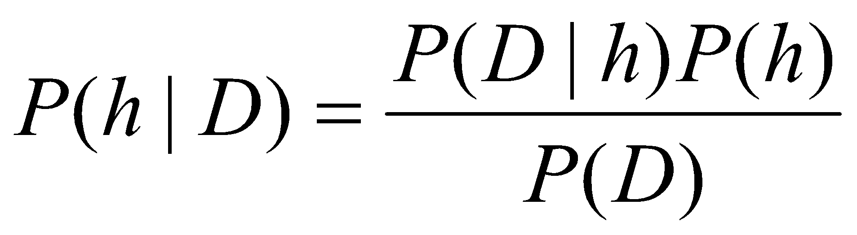
Bayes Theorem
Given a hypothesis h and data D which bears on the hypothesis:
P(h): independent probability of h: prior probability
P(D): independent probability of D
P(D|h): conditional probability of D given h: likelihood
P(h|D): conditional probability of h given D: posterior probability

Slide 39
Random Variable
How do we link sample spaces and events to data?
A random variable is a mapping that assigns a real number X(ω) to each outcome ω
Example: Flip a coin ten times. Let X(ω) be the number of heads in the sequence ω. If ω = HHTHHTHHTT, then X(ω) = 6.

Slide 40


Discrete vs Continuous Random Variables
Discrete: can only take a countable number of values
Example: number of heads
Distribution defined by probability mass function (pmf)
Marginalization:
Continuous: can take infinitely many values (real numbers)
Example: time taken to accomplish task
Distribution defined by probability density function (pdf)
Marginalization:

Slide 41


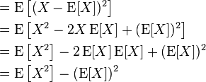

Probability Distribution Statistics
Mean: E[x] = μ = first moment =
Univariate continuous random variable
=
Univariate discrete random variable
Variance: Var(X) =
Nth moment =

Slide 42
Representing Knowledge in an Uncertain Domain
We have learned knowledge representation using first-order logic and propositional logic with certainty, which means we were sure about the predicates. With this knowledge representation, we might write A→B, which means if A is true then B is true,
Consider a situation where we are not sure about whether A is true or not then we cannot express this statement, this situation is called uncertainty.
So to represent uncertain knowledge, where we are not sure about the predicates, we need uncertain reasoning or probabilistic reasoning.

Slide 43
Causes of uncertainty:
Following are some leading causes of uncertainty to occur in the real world.
Information occurred from unreliable sources.
Experimental Errors
Equipment fault
Temperature variation
Climate change.

Slide 44
Probabilistic reasoning:
Probabilistic reasoning is a way of knowledge representation where we apply the concept of probability to indicate the uncertainty in knowledge.
In probabilistic reasoning, we combine probability theory with logic to handle the uncertainty.
We use probability in probabilistic reasoning because it provides a way to handle the uncertainty that is the result of someone's laziness and ignorance.
In the real world, there are lots of scenarios, where the certainty of something is not confirmed, such as "It will rain today," "behavior of someone for some situations," "A match between two teams or two players." These are probable sentences for which we can assume that it will happen but not sure about it, so here we use probabilistic reasoning.

Slide 45
Need of probabilistic reasoning in AI:
When there are unpredictable outcomes.
When specifications or possibilities of predicates becomes too large to handle.
When an unknown error occurs during an experiment.
In probabilistic reasoning, there are two ways to solve problems with uncertain knowledge:
Bayes' rule
Bayesian Statistics

Slide 46
Introduction to Bayesian Network:
A method to represent dependencies among variables and specify more concisely any full joint probability distribution is another data structure, called Bayesian network.
This is another method of reducing the complexity of certainty factors. It is a directed graph in which each node is annotated with quantitative probability information.

Slide 47
Bayesian network
A Bayesian network is a directed graph in which each node is annotated with quantitative probability information. The full specification is as follows:
Each node corresponds to a random variable, which may be discrete or continuous.
A set of directed links or arrows connects pairs of nodes. If there is an arrow from node X to node Y , X is said to be a parent of Y. The graph has no directed cycles (and hence is a directed acyclic graph, or DAG.
Each node X_{i} has a conditional probability distribution P(X_{i} | Parents(X_{i}))that quantifies the effect of the parents on the node.

Slide 48
Introduction to BN Contd..
The topology of the network—the set of nodes and links, specifies the conditional independence relationships which hold in the domain.
The intuitive meaning of an arrow in a properly constructed network is usually that X has a direct influence on Y.
After the topology of the Bayesian network is laid down
we need to specify a conditional probability distribution for each variable, given its parents.
Then, the combination of the topology and the conditional distributions suffices to specify (implicitly) the full joint distribution for all the variables

Slide 49
Bayesian networks
A simple, graphical notation for conditional independence assertions and hence for compact specification of full joint distributions
Syntax:
a set of nodes, one per variable
a directed, acyclic graph (link ≈ "directly influences")
a conditional distribution for each node given its parents:
P (X_{i} | Parents (X_{i}))
In the simplest case, conditional distribution represented as a conditional probability table (CPT) giving the distribution over X_{i} for each combination of parent values
A node is independent of its nondescendents given its parents.

Slide 50
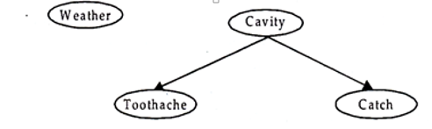
Example
Take the world consisting of simple variables Toothache, Cavity, Catch and Weather. Assuming that weather has no influence on toothache, weather is independent of the other variables; toothache and catch are conditionally independent, given a cavity.
Topology of network encodes conditional independence assertions:
Bayesian Network: Weather variable is independent from other three variables. Toothache and catch are conditional independent given cavity.

Slide 51
Example
I'm at work, neighbor Jhon calls to say my alarm is ringing, but neighbor Mary doesn't call. Sometimes it's set off by minor earthquakes. Is there a burglar?
Variables: Burglary, Earthquake, Alarm, MaryCalls, JhonCalls
Network topology reflects "causal" knowledge:
A burglar can set the alarm off
An earthquake can set the alarm off
The alarm can cause Mary to call
The alarm can cause John to call

Slide 52
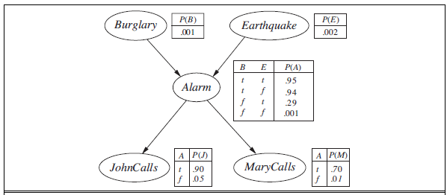
Example contd.
A typical Bayesian network, showing both the topology and the conditional probability tables (CPTs). In the CPTs, the letters B, E, A, J, and M stand for Burglary, Earthquake, Alarm, JohnCalls, and MaryCalls , respectively.

Slide 53
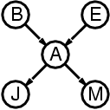
Compactness
A CPT for Boolean X_{i} with k Boolean parents has 2^{k} rows for the combinations of parent values
Each row requires one number p for X_{i} = true (the number for X_{i} = false is just 1-p)
If each variable has no more than k parents, the complete network requires O(n · 2^{k}) numbers
I.e., grows linearly with n, vs. O(2^{n}) for the full joint distribution
For burglary net, 1 + 1 + 4 + 2 + 2 = 10 numbers (vs. 2⁵-1 = 31)

Slide 54
Semantics of Bayesian Networks:
There are two ways in which we can understand Semantics of Bayesian networks:
1. See the network as representation of the joint probability distribution. This is useful in understanding how to construct networks.
2. See the networks as an encoding of a collection of conditional independence statements. This is useful in designing inference procedures. However, the two ways are equivalent.

Slide 55


Representing the Full Joint Distribution:
We explain it, by calculating the probability that the alarm has sounded, but neither the burglary nor an earthquake has occurred, and both Mary and Jhon telephone you.
We can generalize the example by writing:

Slide 56
Where parents (x) denotes the specific values of the variables in the parents (x).
If the Bayesian network is a representation of the joint distribution then it too can be used to answer any query, as earlier in the case of inference through probabilities. This does it really so and that too more efficiently. An extension of Bayesian net work is called Decision Net Work or Influence Diagram.

Slide 57
Constructing Bayesian networks
1. Choose an ordering of variables X₁, … ,X_{n}
2. For i = 1 to n
add X_{i} to the network
select parents from X₁, … ,X_{i-1} such that
P (X_{i} | Parents(X_{i})) = P (X_{i} | X₁, ... X_{i-1})
This choice of parents guarantees:
P (X₁, … ,X_{n}) = π_{i =1} P (X_{i} | X₁, … , X_{i-1}) (chain rule)
= π_{i =1}P (X_{i} | Parents(X_{i})) (by construction)
n
n

Slide 58
The process of creating Network structure
Adding MaryCalls: No parents.
Adding JohnCalls: If Mary calls, that probably means the alarm has gone off, which of course would make it more likely that John calls. Therefore, JohnCalls needs MaryCalls as a parent.
Adding Alarm: Clearly, if both call, it is more likely that the alarm has gone off than if just one or neither calls, so we need both MaryCalls and JohnCalls as parents.
Adding Burglary: If we know the alarm state, then the call from John or Mary might give us information about our phone ringing or Mary’s music, but not about burglary:
P(Burglary | Alarm, JohnCalls ,MaryCalls) = P(Burglary | Alarm) .
Hence we need just Alarm as parent.
Adding Earthquake: If the alarm is on, it is more likely that there has been an earthquake.
(The alarm is an earthquake detector of sorts.) But if we know that there has been a burglary, then that explains the alarm, and the probability of an earthquake would be only slightly above normal. Hence, we need both Alarm and Burglary as parents

Slide 59
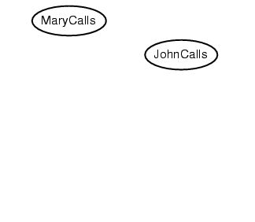
Example
Suppose we have MaryCalls, JohnCalls, Alarm, Burglary, Earthquake attributes
Suppose we choose the ordering M, J, A, B, E
P(J | M) = P(J)?

Slide 60
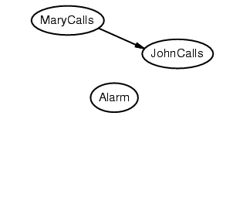
Example
Suppose we choose the ordering M, J, A, B, E
P(J | M) = P(J) No
P(A | J, M) = P(A | J)? P(A | J, M) = P(A)?

Slide 61
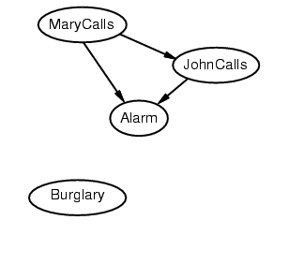
Example
Suppose we choose the ordering M, J, A, B, E
P(J | M) = P(J) No
P(A | J, M) = P(A | J)? P(A | J, M) = P(A)? No
P(B | A, J, M) = P(B | A)?
P(B | A, J, M) = P(B)?

Slide 62
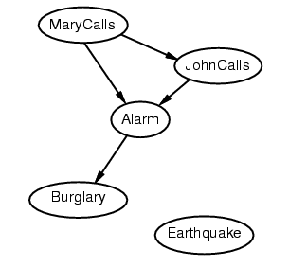
Example
Suppose we choose the ordering M, J, A, B, E
P(J | M) = P(J) No
P(A | J, M) = P(A | J)? P(A | J, M) = P(A)? No
P(B | A, J, M) = P(B | A)? Yes
P(B | A, J, M) = P(B)? No
P(E | B, A ,J, M) = P(E | A)?
P(E | B, A, J, M) = P(E | A, B)?

Slide 63
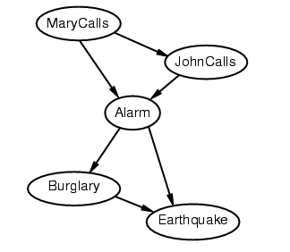
Example
Suppose we choose the ordering M, J, A, B, E
P(J | M) = P(J) No
P(A | J, M) = P(A | J)? P(A | J, M) = P(A)? No
P(B | A, J, M) = P(B | A)? Yes
P(B | A, J, M) = P(B)? No
P(E | B, A ,J, M) = P(E | A)? No
P(E | B, A, J, M) = P(E | A, B)? Yes

Slide 64
Example contd.
Deciding conditional independence is hard in noncausal directions
(Causal models and conditional independence seem hardwired for humans!)
Network is less compact: 1 + 2 + 4 + 2 + 4 = 13 numbers needed

Slide 65
Some Applications of BN
Medical diagnosis
Troubleshooting of hardware/software systems
Fraud/uncollectible debt detection
Data mining
Analysis of genetic sequences
Data interpretation, computer vision, image understanding

Slide 66
EFFICIENT REPRESENTATION OF CONDITIONAL DISTRIBUTIONS
Even if the maximum number of parents k is smallish, filling in the CPT for a node requires up to O(2^{k}) numbers and perhaps a great deal of experience with all the possible conditioning cases.
In fact, this is a worst-case scenario in which the relationship between the parents and the child is completely arbitrary. Usually, such relationships are describable by a canonical distribution that fits some standard pattern. In such cases, the complete table can be specified by naming the pattern and perhaps supplying a few parameters—much easier than supplying an exponential number of parameters.

Slide 67
The simplest example is provided by deterministic nodes. A deterministic node has its value specified exactly by the values of its parents, with no uncertainty.
Uncertain relationships can often be characterized by so-called noisy logical relation ships.
A conditional distribution is a probability distribution for a sub-population. In other words, it shows the probability that a randomly selected item in a sub-population has a characteristic you’re interested in.
For example, if you are fever (the population) you might want to know how many people have Malaria (the sub-population).

Slide 68
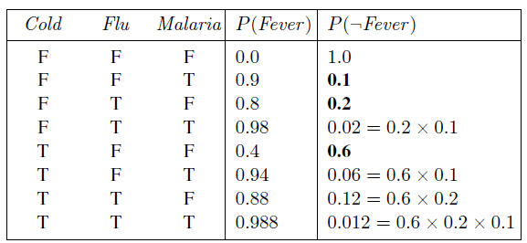

Let us suppose these individual inhibition probabilities are as follows:
qcold = P(￢fever | cold,￢flu,￢malaria) = 0.6 ,
qflu = P(￢fever | ￢cold, flu,￢malaria) = 0.2 ,
qmalaria = P(￢fever | ￢cold,￢flu, malaria) = 0.1 .
Then, from this information and the noisy-OR assumptions, the entire CPT can be built. The
general rule is that
where the product is taken over the parents that are set to true for that row of the CPT. The following table illustrates this calculation:

Slide 69
Bayesian nets with continuous variables
Many real-world problems involve continuous quantities, such as height, mass, temperature, and money; in fact, much of statistics deals with random variables whose domains are continuous.
Continuous variables have an infinite number of possible values, so it is impossible to specify conditional probabilities explicitly for each value.
One possible way to handle continuous variables is to avoid them by using discretization i.e. dividing up possible values into a fixed set of intervals.

Slide 70
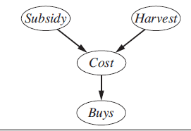
For example, temperatures could be divided into (<0oC), (0oC−100oC), and (>100oC). Discretization is sometimes an adequate solution, but often results in a considerable loss of accuracy and very large CPTs.
A network with both discrete and continuous variables is called a hybrid Bayesian HYBRID BAYESIAN network.
In the example, Subsidy and Harvest is discrete variable and Cost and Buys are the continuous variable.
For the Cost variable, we need to specify P(Cost | harvest, Subsidy).
The discrete parent is handled by enumeration—that is, by specifying both P(Cost | Harvest, subsidy)
and P(Cost | Harvest,￢subsidy).

Slide 71
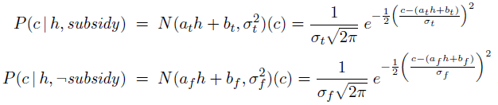
We need two distributions, one for subsidy and one for ￢subsidy, with different parameters:
For this example, then, the conditional distribution for Cost is specified by naming the linear Gaussian distribution and providing the parameters

Slide 72
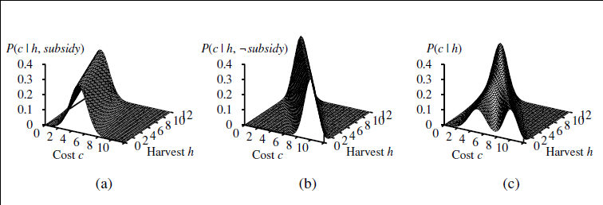
The graphs in (a) and (b) show the probability distribution over Cost as a function of Harvest size, with Subsidy true and false, respectively. Graph (c) shows the distribution P(Cost |Harvest), obtained by summing over the two subsidy cases.
Notice that in each case the slope is negative, because
cost decreases as supply increases.

Slide 73
The linear Gaussian conditional distribution has some special properties. A network containing only continuous variables with linear Gaussian distributions has a joint distribution that is a multivariate Gaussian distribution over all the. Furthermore, the posterior distribution given any evidence also has this property.
When discrete variables are added as parents (not as children) of continuous variables, the network defines a conditional Gaussian, or CG, distribution: given any assignment to the discrete variables, the distribution over the continuous variables is a multivariate Gaussian.

Slide 74


Now we turn to the distributions for discrete variables with continuous parents. Consider, for example, the Buys node in previous Figure. It seems reasonable to assume that the customer will buy if the cost is low and will not buy if it is high and that the probability of buying varies smoothly in some intermediate region.
In other words, the conditional distribution is like a “soft” threshold function. One way to make soft thresholds is to use the integral of the standard normal distribution:
Then the probability of Buys given Cost might be
which means that the cost threshold occurs around μ, the width of the threshold region is proportional to σ, and the probability of buying decreases as cost increases.

Slide 75

Conditional discrete distributions
For discrete random variables, the conditional probability mass function of Y given X=x can be written according to its definition as:
Due to the occurrence of P(X=x) in the denominator, this is defined only for non-zero (hence strictly positive) P(X=x).
The relation with the probability distribution of X given Y is:

Slide 76
Example
Consider the roll of a fair die and let X=1 if the number is even (i.e., 2, 4, or 6) and X=0}otherwise. Furthermore, let Y=1 if the number is prime (i.e., 2, 3, or 5) and Y=0 otherwise.
Then the unconditional probability that X=1 is 3/6 = 1/2 (since there are six possible rolls of the dice, of which three are even), whereas the probability that X=1 conditional on Y=1 is 1/3 (since there are three possible prime number rolls—2, 3, and 5—of which one is even).
D | 1 | 2 | 3 | 4 | 5 | 6
X | 0 | 1 | 0 | 1 | 0 | 1
Y | 0 | 1 | 1 | 0 | 1 | 0

Slide 77

Conditional continuous distributions
For continuous random variables, the conditional probability density function of Y given the occurrence of the value x of X can be written as:
where f_{X,Y}(x,y) gives the joint density of X and Y, while f_{X}(x) gives the marginal density for X. Also in this case it is necessary that f_{X}(x)>0
The relation with the probability distribution of X given Y is given by:

Slide 78

Example
Sample question: Calculate the conditional distribution of pet preference among women.
Solution: Step 1: Count the total number of women. In this case the total is in the right hand column (10 women). Step 2: Count the number of women who prefer each pet type. Turn the ratio into a probability:
Women who prefer cats: 5/10 = .5
Women who prefer fish: 3/10 = .3
Women who prefer dogs: 2/10 = .2

Slide 79
Inference in Bayesian Networks
Now that we know what the semantics of Bayes nets are; what it means when we have one, we need to understand how to use it. Typically, we’ll be in a situation in which we have some evidence, that is, some of the variables are instantiated, and we want to infer something about the probability distribution of some other variables.
Inference in graphical models, in which some of the nodes in a graph are clamped to observed values, and we wish to compute the posterior distributions of one or more subsets of other nodes

Slide 80
The basic task for any probabilistic inference system is to compute the posterior probability EVENT distribution for a set of query variables, given some observed event—that is, some assignment of values to a set of evidence variables.
In the burglary network, we might observe the event in which JohnCalls =true and MaryCalls =true. We could then ask for, say, the probability that a burglary has occurred:
P(Burglary | JohnCalls =true,MaryCalls =true) = 0.284, 0.716 .

Slide 81
Inference in Bayesian Nets
Objective: calculate posterior prob of a variable x conditioned on evidence Y and marginalizing over Z (unobserved vars)
Exact methods:
Enumeration
Factoring
Variable elimination
Approximate Methods: sampling

Slide 82

Inference by enumeration
Start with the joint probability distribution:
For any proposition a, sum the atomic events where it is true: P(a) = Σ_{ω s.t. a=true} P(ω)
P(a)=1/7 + 1/7 + 1/7 = 3/7

Slide 83
Algorithm
function ENUMERATION-ASK(X, e, bn) returns a distribution over X
inputs: X, the query variable
e, observed values for variables E
bn, a Bayes net with variables {X} ∪ E ∪ Y /* Y = hidden variables */
Q(X)←a distribution over X, initially empty
for each value xi of X do
Q(xi)←ENUMERATE-ALL(bn.VARS, exi )
where exi is e extended with X = xi
return NORMALIZE(Q(X))
function ENUMERATE-ALL(vars, e) returns a real number
if EMPTY?(vars) then return 1.0
Y ←FIRST(vars)
if Y has value y in e
then return P(y | parents(Y )) × ENUMERATE-ALL(REST(vars), e)
else returny P(y | parents(Y )) × ENUMERATE-ALL(REST(vars), ey)
where ey is e extended with Y = y

Slide 84

Inference by enumeration
Start with the joint probability distribution:
For any proposition a, sum the atomic events where it is true: P(a) = Σ_{ω:ω s.t. a=true} P(ω)
P(toothache) = 0.108 + 0.012 + 0.016 + 0.064 = 0.2

Slide 85

Inference by enumeration
Start with the joint probability distribution:
Can also compute conditional probabilities:
P(¬cavity | toothache) = P(¬cavity ∧ toothache) / P(toothache)
= (0.016+0.064 ) / (0.108 + 0.012 + 0.016 + 0.064)
= 0.4
Calculate (i) P(cavity) (ii) P(cavity | toothache)

Slide 86
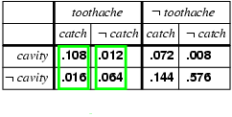
Inference by enumeration
Denominator can be viewed as a normalization constant α
P(Cavity | toothache) = α x P(Cavity,toothache)
= α x [P(Cavity,toothache,catch) + P(Cavity,toothache,¬ catch)]
= α x [<0.108,0.016> + <0.012,0.064>]
= α x <0.12,0.08> = <0.6,0.4>
General idea: compute distribution on query variable by fixing evidence variables and summing over hidden variables

Slide 87
Inference by enumeration
Typically, we are interested in
the posterior joint distribution of the query variables Y
given specific values e for the evidence variables E
Let the hidden variables be H = X - Y - E
Then the required summation of joint entries is done by summing out the hidden variables:
P(Y | E = e) = αP(Y,E = e) = αΣ_{h}P(Y,E= e, H = h)
The terms in the summation are joint entries because Y, E and H together exhaust the set of random variables
Obvious problems:
Worst-case time complexity O(d^{n}) where d is the largest arity
Space complexity O(d^{n}) to store the joint distribution
How to find the numbers for O(d^{n}) entries

Slide 88
Factors
A factor is a multi-dimensional table, like a CPT
f_{AJM}(B,E)
2x2 table with a “number” for each combination of B,E
Specific values of J and M were used
A has been summed out
f(J,A)=P(J|A) is 2x2:
f_{J}(A)=P(j|A) is 1x2: {p(j|a),p(j|¬a)}
p(j|a) | p(j|¬a)
p(¬j|a) | p(¬j|¬a)

Slide 89
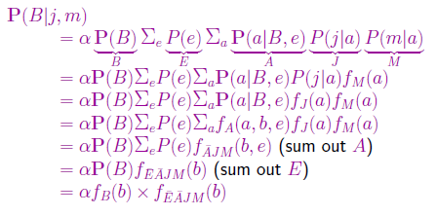
Use of factors in variable elimination:
The enumeration algorithm can be improved substantially by eliminating repeated calculations.
The idea is simple: do the calculation once and save the results for later use.
Variable elimination works by evaluating expressions in right-to-left order
Intermediate results are stored, and summations over
each variable are done only for those portions of the expression that depend on the variable.
Let us illustrate this process for the burglary network.

Slide 90
Algorithm variable elimination
function ELIMINATION-ASK(X, e, bn) returns a distribution over X
inputs: X, the query variable
e, observed values for variables E
bn, a Bayesian network specifying joint distribution P(X1, . . . , Xn)
factors ←[ ]
for each var in ORDER(bn.VARS) do
factors ←[MAKE-FACTOR(var , e)|factors]
if var is a hidden variable then factors ←SUM-OUT(var, factors )
return NORMALIZE(POINTWISE-PRODUCT(factors))

Slide 91
Pointwise product
The pointwise product of two factors f1 and f2 yields a new factor f whose variables are the union of the variables in f1 and f2 and whose elements are given by the product of the corresponding elements in the two factors.
given 2 factors that share some variables:
f1(X1..Xi,Y1..Yj), f2(Y1..Yj,Z1..Zk)
Resulting table has dimensions of union of variables, f1*f2=F(X1..Xi,Y1..Yj,Z1..Zk)
each entry in F is a truth assignment over vars and can be computed by multiplying entries from f1 and f2
A | B | f1(A,B)
T | T | 0.3
T | F | 0.7
F | T | 0.9
F | F | 0.1
B | C | f2(B,C)
T | T | 0.2
T | F | 0.8
F | T | 0.6
F | F | 0.4
A | B | C | F(A,B,C)
T | T | T | 0.3x0.2
T | T | F | 0.3x0.8
T | F | T | 0.7x0.6
T | F | F | 0.7x0.4
F | T | T | 0.9x0.2
F | T | F | 0.9x0.8
F | F | T | 0.1x0.6
F | F | F | 0.1x0.4

Slide 92
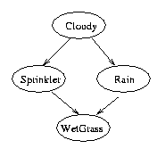
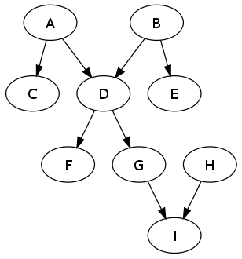
Computational Complexity
Belief propagation is linear in the size of the BN for polytrees
Belief propagation is NP-hard for trees with “cycles”

Slide 93
Approximate Inference
Given the intractability of exact inference in large, multiply connected networks, it is essential to consider approximate inference methods.
Simple Sampling: logic sample
Use BayesNetwork as a generative model
Eg. generate million or more models, via topological order.
Generates examples with appropriate distribution.
Now use examples to estimate probabilities.

Slide 94
Direct sampling
Create an independent atomic event
for each var in topological order, choose a value conditionally dependent on parents
sample from p(Cloudy)=<0.5,0.5>; suppose T
sample from p(Sprinkler|Cloudy=T)=<0.1,0.9>, suppose F
sample from P(Rain|Cloudy=T)=<0.8,0.2>, suppose T
sample from P(WetGrass|Sprinkler=F,Rain=T)=<0.9,0,1>, suppose T
event: <Cloudy,¬Sprinkler,Rain,WetGrass>
repeat
in the limit, each event occurs with frequency proportional to its joint probability, P(Cl,Sp,Ra,Wg)= P(Cl)*P(Sp|Cl)*P(Ra|Cl)*P(Wg|Sp,Ra)
averaging: P(Ra,Cl) = Num(Ra=T&Cl=T)/|Sample|

Slide 95
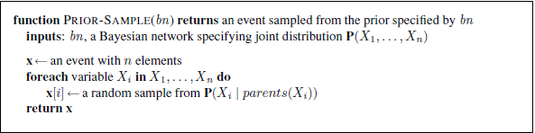
Algorithm for sampling

Slide 96
Rejection sampling
Rejection sampling is a general method for producing samples from a hard-to-sample distribution given an easy-to-sample distribution.
it can be used to compute conditional probabilities—that is, to determine P(X | e).
To condition upon evidence variables e, average over samples that satisfy e
P(j,m|¬e,¬b)
<e,b,-a,-j,m>
<e,-b,a,-j,-m>
<-e,b,a,j,m>
<-e,-b,-a,-j,m>
<-e,-b,a,-j,-m>
<e,b,a,j,m>
<-e,-b,a,j,-m>
<e,-b,a,j,m>
...

Slide 97

First, it generates samples from the prior distribution specified by the network. Then, it rejects all those that do not match the evidence.
Finally, the estimate
N_{PS} (x₁, . . . , x_{n}) be the number of times the specific event x₁, . . . , x_{n} occurs in the set of samples.
That is, rejection sampling produces a consistent estimate of the true probability.

Slide 98
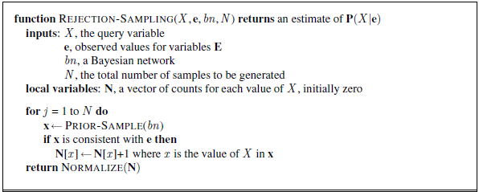
Algorithm for Rejection sampling

Slide 99
Likelihood weighting
Likelihood weighting avoids the inefficiency of rejection sampling by generating only events that are consistent with the evidence e.
It is a particular instance of the general statistical technique of importance sampling, tailored for inference in Bayesian networks.
LIKELIHOOD-WEIGHTING fixes the values for the evidence variables E and samples only the nonevidence variables. This guarantees that each event generated is consistent with the evidence.
P(j|e) – earthquakes only occur 0.2% of the time, so can only use ~2/1000 samples to determine frequency of JohnCalls
During sample generation, when reach an evidence variable e_{i}, force it to be known value accumulate weight w=Π p(e_{i}|parents(e_{i})) now every sample is useful (“consistent”)
when calculating averages over samples x, weight them: P(j|e) = αΣ_{consistent} w(x)=<Σ_{J=T} w(x), Σ_{J=F} w(x)>

Slide 100
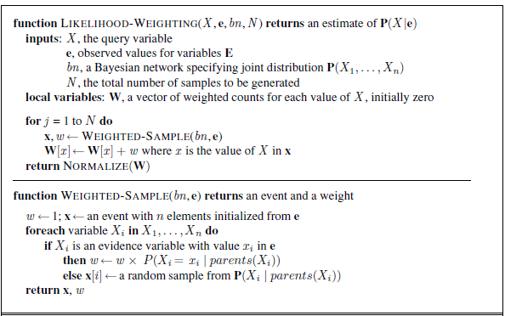
Algorithm for Likelihood weighting

Slide 101
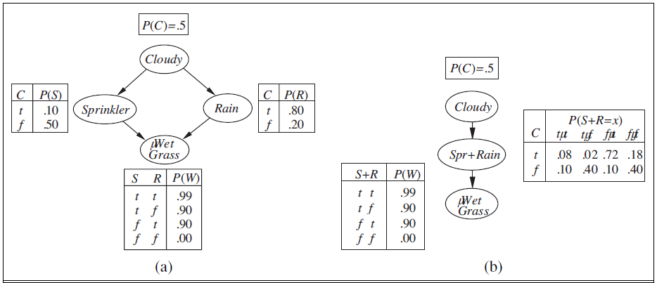
Example

Slide 102
Let us apply the algorithm to , with the query P(Rain |Cloudy =true, WetGrass =true) and the ordering Cloudy, Sprinkler, Rain, WetGrass. (Any topological ordering will do.) The process goes as follows: First, the weight w is set to 1.0. Then an event is generated:
1. Cloudy is an evidence variable with value true. Therefore, we set w ← w×P(Cloudy =true) = 0.5 .
2. Sprinkler is not an evidence variable, so sample from P(Sprinkler |Cloudy =true) =
0.1, 0.9; suppose this returns false.
3. Similarly, sample from P(Rain |Cloudy =true) = 0.8, 0.2; suppose this returns true.
4. WetGrass is an evidence variable with value true. Therefore, we set
w ← w×P(WetGrass =true | Sprinkler =false, Rain =true) = 0.45 .
Here WEIGHTED-SAMPLE returns the event [true, false, true, true] with weight 0.45, and this is tallied under Rain =true.

Slide 103
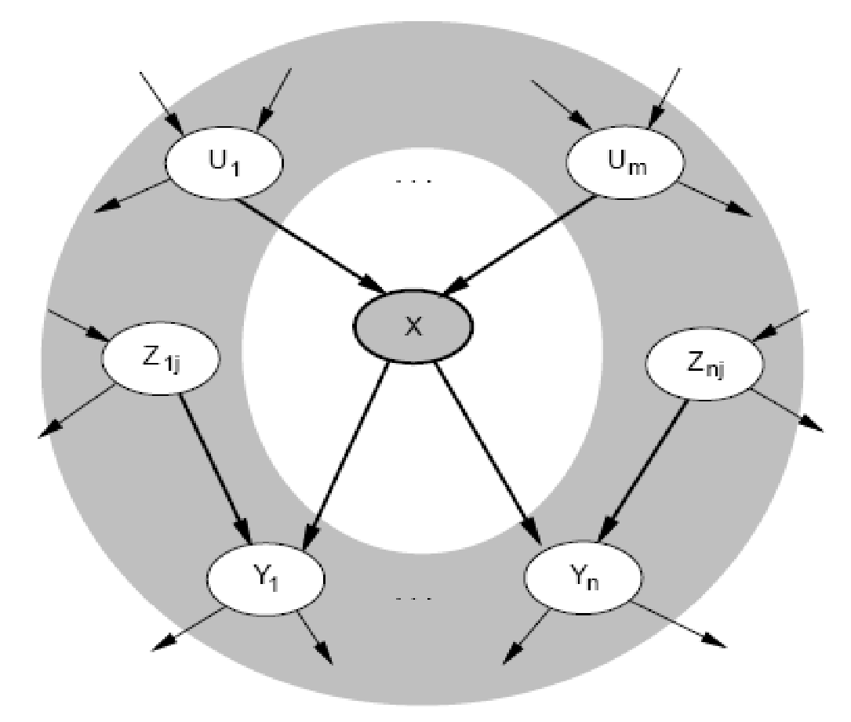
Gibbs sampling (MCMC)
Start with a random assignment to vars
set evidence vars to observed values
Iterate {
pick a non-evidence variable, X
define Markov blanket of X, mb(X)
parents, children, and parents of children
re-sample value of X from conditional distrib.
P(X|mb(X))=αP(X|parents(X))*Π P(y|parents(X)) for y∈children(X)
}
The Markov blanket of a variable consists of its parents, children, and children’s parents.
Generates a large sequence of samples, where each might “flip a bit” from previous sample
In the limit, this converges to joint probability distribution (samples occur for frequency proportional to joint PDF)

Slide 104
Example
Consider the query P(Rain | Sprinkler =true, WetGrass =true) applied to the network in previous graph.
The evidence variables Sprinkler and WetGrass are fixed to their observed values and the non evidence variables Cloudy and Rain are initialized randomly—
let us say to true and false respectively. Thus, the initial state is [true, true, false, true].
Now the non evidence variables are sampled repeatedly in an arbitrary order. For example:
1. Cloudy is sampled, given the current values of its Markov blanket variables: in this case, we sample from P(Cloudy | Sprinkler =true, Rain =false). (Shortly, we will show how to calculate this distribution.) Suppose the result is Cloudy =false. Then the new current state is [false, true, false, true].
2. Rain is sampled, given the current values of its Markov blanket variables: in this case, we sample from P(Rain |Cloudy =false, Sprinkler =true, WetGrass =true). Suppose this yields Rain =true. The new current state is [false, true, true, true].

Slide 105
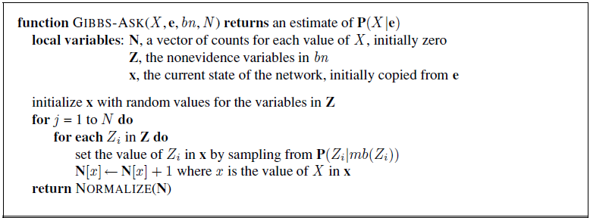
Algorithm for Gibbs sampling

Slide 106
Other Approaches to Uncertain reasoning-Fuzzy sets and Fuzzy logic.

Slide 107
Fuzzy set
Fuzzy set theory is a means of specifying how well an object satisfies a vague description.
For example, consider the proposition “Nate is tall.” Is this true if Nate is 5 10? Most people would hesitate to answer “true” or “false,” preferring to say, “sort of.” Note that this is not a question of uncertainty about the external world—we are sure of Nate’s height.
The issue is that the linguistic term “tall” does not refer to a sharp demarcation of objects into two classes—there are degrees of tallness.
For this reason, fuzzy set theory is not a method for uncertain reasoning at all.
Rather, fuzzy set theory treats Tall as a fuzzy predicate and says that the truth value of Tall (Nate) is a number between 0 and 1, rather than being just true or false.
The name “fuzzy set” derives from the interpretation of the predicate as implicitly defining a set of its members—a set that does not have sharp boundaries.

Slide 108
What is Fuzzy Logic?
The inventor of fuzzy logic is Lotfi Zadeh
Fuzzy Logic (FL) is a method of reasoning that resembles human reasoning. The approach of FL imitates the way of decision making in humans that involves all intermediate possibilities between digital values YES and NO.
The conventional logic block that a computer can understand takes precise input and produces a definite output as TRUE or FALSE, which is equivalent to human’s YES or NO.

Slide 109
Inventor of Fuzzy logic, observed that unlike computers, the human decision making includes a range of possibilities between YES and NO, such as −
The fuzzy logic works on the levels of possibilities of input to achieve the definite output.
CERTAINLY YES
POSSIBLY YES
CANNOT SAY
POSSIBLY NO
CERTAINLY NO

Slide 110
Fuzzy logic is a method for reasoning with logical expressions describing membership in fuzzy sets. For example, the complex sentence Tall (Nate) ∧ Heavy(Nate) has a fuzzy truth value that is a function of the truth values of its components. The standard rules for evaluating the fuzzy truth, T, of a complex sentence are
T(A ∧ B) = min(T(A), T(B))
T(A ∨ B) = max(T(A), T(B))
T(￢A) = 1 − T(A) .

Slide 111
Fuzzy logic is therefore a truth-functional system—a fact that causes serious difficulties.
For example, suppose that T(Tall (Nate))=0.6 and T(Heavy(Nate))=0.4. Then we have T(Tall (Nate) ∧ Heavy(Nate))=0.4, which seems reasonable, but we also get the result
T(Tall (Nate) ∧ ￢Tall (Nate))=0.4, which does not. Clearly, the problem arises from the inability of a truth-functional approach to take into account the correlations or anti-correlations among the component propositions.

Slide 112
Fuzzy control is a methodology for constructing control systems in which the mapping between real-valued input and output parameters is represented by fuzzy rules.
Fuzzy control has been very successful in commercial products such as automatic transmissions, video cameras, and electric shavers.

Slide 113
Fuzzy predicates can also be given a probabilistic interpretation in terms of random sets—that is, random variables whose possible values are sets of objects.
For example, Tall is a random set whose possible values are sets of people. The probability P(Tall =S1),
where S1 is some particular set of people, is the probability that exactly that set would be identified as “tall” by an observer. Then the probability that “Nate is tall” is the sum of the probabilities of all the sets of which Nate is a member.

Slide 114
Both the hybrid Bayesian network approach and the random sets approach appear to capture aspects of fuzziness without introducing degrees of truth.

Slide 115
Why Fuzzy Logic?
Fuzzy logic is useful for commercial and practical purposes.
It can control machines and consumer products.
It may not give accurate reasoning, but acceptable reasoning.
Fuzzy logic helps to deal with the uncertainty in engineering.

Slide 116
Fuzzy Logic Systems Architecture
Fuzzy Logic Systems (FLS) produce acceptable but definite output in response to incomplete, ambiguous, distorted, or inaccurate (fuzzy) input.
FSL has four main parts as shown −
Fuzzification Module − It transforms the system inputs, which are crisp numbers, into fuzzy sets. It splits the input signal into five steps such as −
LP | x is Large Positive
MP | x is Medium Positive
S | x is Small
MN | x is Medium Negative
LN | x is Large Negative

Slide 117
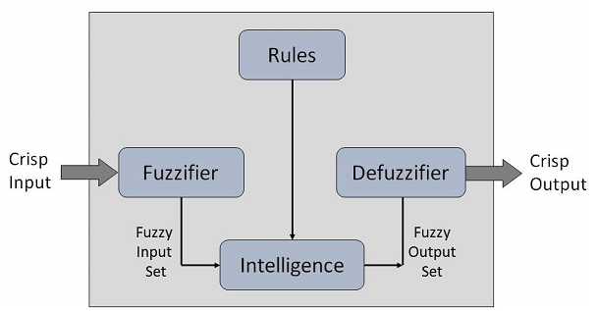
Knowledge Base − It stores IF-THEN rules provided by experts.
Inference Engine − It simulates the human reasoning process by making fuzzy inference on the inputs and IF-THEN rules.
Defuzzification Module − It transforms the fuzzy set obtained by the inference engine into a crisp value.
The membership functions work on fuzzy sets of variables

Slide 118
Membership Function
Membership functions allow you to quantify linguistic term and represent a fuzzy set graphically. A membership function for a fuzzy set A on the universe of discourse X is defined as μ_{A}:X → [0,1].
Here, each element of X is mapped to a value between 0 and 1. It is called membership value or degree of membership. It quantifies the degree of membership of the element in X to the fuzzy set A.
x axis represents the universe of discourse.
y axis represents the degrees of membership in the [0, 1] interval.
There can be multiple membership functions applicable to fuzzify a numerical value. Simple membership functions are used as use of complex functions does not add more precision in the output.

Slide 119
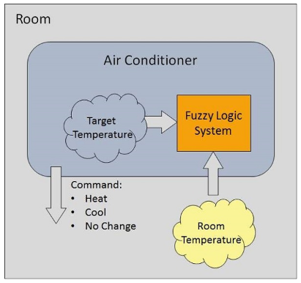
Example of a Fuzzy Logic System
Let us consider an air conditioning system. This system adjusts the temperature of air conditioner by comparing the room temperature and the target temperature value

Slide 120
Algorithm
Define linguistic Variables and terms (start)
Construct membership functions for them. (start)
Construct knowledge base of rules (start)
Convert crisp data into fuzzy data sets using membership functions. (fuzzification)
Evaluate rules in the rule base. (Inference Engine)
Combine results from each rule. (Inference Engine)
Convert output data into non-fuzzy values. (defuzzification)

Slide 121
Development of Fuzzy logic system
Step 1 − Define linguistic variables and terms
Linguistic variables are input and output variables in the form of simple words or sentences. For room temperature, cold, warm, hot, etc., are linguistic terms.
Temperature (t) = {very-cold, cold, warm, very-warm, hot}
Every member of this set is a linguistic term and it can cover some portion of overall temperature values.
Step 2 − Construct membership functions for them
Membership functions are represented by graphical forms.
The membership functions of temperature variable are as shown −

Slide 122
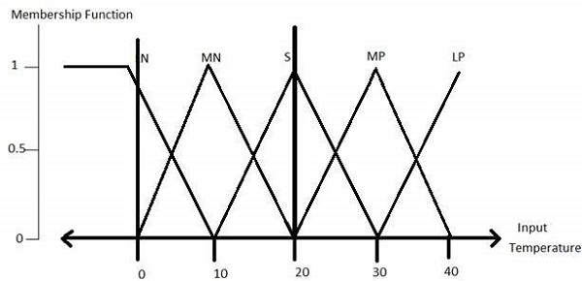
Step3 − Construct knowledge base rules
Create a matrix of room temperature values versus target temperature values that an air conditioning system is expected to provide.

Slide 123
RoomTemp. /Target | Very_Cold | Cold | Warm | Hot | Very_Hot
Very_Cold | No_Change | Heat | Heat | Heat | Heat
Cold | Cool | No_Change | Heat | Heat | Heat
Warm | Cool | Cool | No_Change | Heat | Heat
Hot | Cool | Cool | Cool | No_Change | Heat
Very_Hot | Cool | Cool | Cool | Cool | No_Change

Slide 124
Build a set of rules into the knowledge base in the form of IF-THEN-ELSE structures.
Step 4 − Obtain fuzzy value
Fuzzy set operations perform evaluation of rules. The operations used for OR and AND are Max and Min respectively. Combine all results of evaluation to form a final result. This result is a fuzzy value.
Sr. No. | Condition | Action
1 | IF temperature=(Cold OR Very_Cold) AND target=Warm THEN | Heat
2 | IF temperature=(Hot OR Very_Hot) AND target=Warm THEN | Cool
3 | IF (temperature=Warm) AND (target=Warm) THEN | No_Change

Slide 125
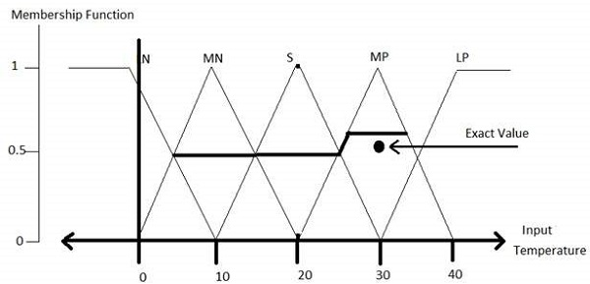
Step 5 − Perform defuzzification:
Defuzzification is then performed according to membership function for output variable.

Slide 126
Application Areas of Fuzzy Logic
The key application areas of fuzzy logic are as given −
Automotive Systems
Automatic Gearboxes, Four-Wheel Steering, Vehicle environment control,etc
Consumer Electronic Goods
Hi-Fi Systems, Photocopiers, Still and Video Cameras, Television,etc
Domestic Goods
Microwave Ovens, Refrigerators, Toasters, Vacuum Cleaners, Washing Machines, etc
Environment Control
Air Conditioners/Dryers/Heaters, Humidifiers, etc

Slide 127
Advantages and Disadvantages of FLSs
Advantages of FLSs
Mathematical concepts within fuzzy reasoning are very simple.
You can modify a FLS by just adding or deleting rules due to flexibility of fuzzy logic.
Fuzzy logic Systems can take imprecise, distorted, noisy input information.
FLSs are easy to construct and understand.
Fuzzy logic is a solution to complex problems in all fields of life, including medicine, as it resembles human reasoning and decision making.
Disadvantages of FLSs
There is no systematic approach to fuzzy system designing.
They are understandable only when simple.
They are suitable for the problems which do not need high accuracy.

