Slide 1
MYCIN
Introduction:
MYCIN was an early backward chaining expert system that used artificial intelligence to identify bacteria causing severe infections and to recommend antibiotics, with the dosage adjusted for patient’s body weight.
MYCIN was developed over five or six years in the early 1970s at Stanford University.
It was written in Lisp
MYCIN operated using fairly simple inference engine, and a knowledge base of approximately 600 rules.

Slide 2
MYCIN
Introduction:
MYCIN is a computer program designed to provide attending physicians with advice comparable to that which they would otherwise get from a consulting physician specializing in bacteremia and meningitis infections.
When the MYCIN program is evoked, it initiates a dialogue. The physician types answers in response to various questions. Eventually MYCIN provides a diagnosis and a detailed drug therapy recommendation.

Slide 3
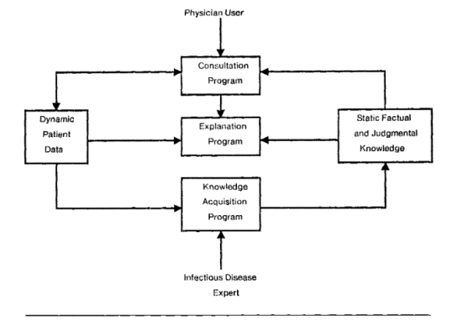
Structure of Mycin Program:
MYCIN
Introduction:

Slide 4
The MYCIN system comprises three major subprograms, as depicted in Figure above.
The Consultation Program
Explanation Program
Knowledge Acquisition Program
The Consultation Program is the core of the system; it interacts with the physician to obtain information about the patient, generating diagnoses and therapy recommendations.
The Explanation Program provides explanations and justifications for the program’s actions.
The Knowledge-Acquisition Program is used by experts to update the system’s knowledge base.

Slide 5
Backward Chaining with Uncertainty:
An expert system shell, called Clam, which supports backward chaining with uncertainty. The use of uncertainty changes the inference process from that provided by pure Prolog, so Clam has its own rule format and inference engine.
Certainty Factors:
The inference engine automatically updates and maintains the certainty factors as the inference proceeds.
Let's first look at an example using Clam. The certainty factors (preceded by cf) are integers from –100 (for definitely false) to +100 (for definitely true).
The following is a small knowledge base in Clam that is designed to diagnose a car which will not start. It illustrates some of the behavior of one scheme for handling uncertainty.

Slide 6
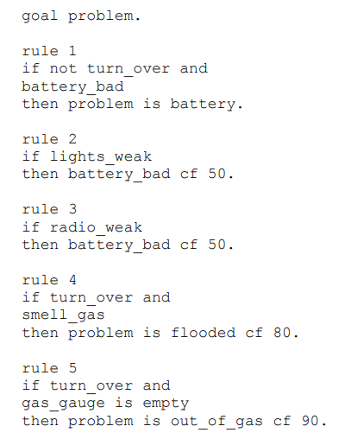
Backward Chaining with Uncertainty:

Slide 7
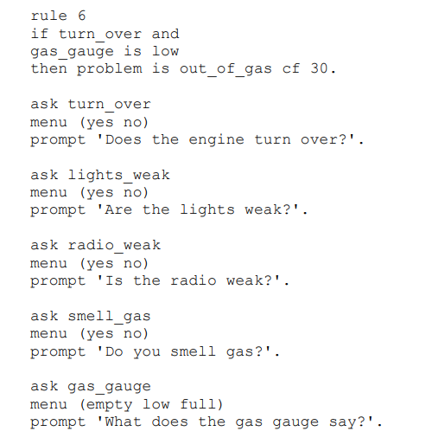
Backward Chaining with Uncertainty:

Slide 8
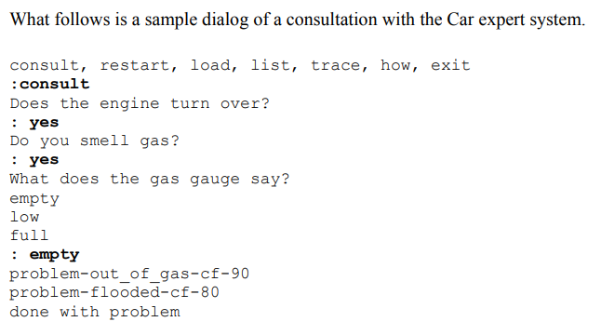
Backward Chaining with Uncertainty:
Rule Uncertainty:

Slide 9
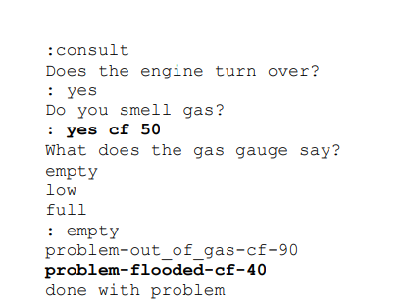
Backward Chaining with Uncertainty:
User Uncertainty:
In this case that the user was only certain to a degree of 50 that there was a gas smell. This results in the system only being half as sure that the problem is flooded

Slide 10
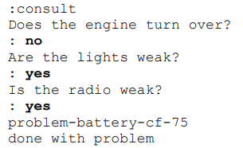
Backward Chaining with Uncertainty:
Combining Certainties:
Finally consider the following consultation, which shows how the system combines evidence for a bad battery.
In this case the system combined the two rules to determine that the battery was weak with certainty factor 75.

Slide 11
Properties of Certainty Factors:
Combining Certainties:
Finally consider the following consultation, which shows how the system combines evidence for a bad battery.
rules whose conclusions are uncertain;
• rules whose premises are uncertain;
• user entered data which is uncertain;
• combining uncertain premises with uncertain conclusions;
• updating uncertain working storage data with new, also uncertain information;
• establishing a threshold of uncertainty for when a premise is considered known.

