Slide 1

B Tech CSE TY Sem V
Course : Data Engineering [ CET3005B]
Disclaimer:
Information included in this slides came from multiple sources. We have tried our best to cite the sources. Please refer to the References to learn about the sources, when applicable.
The slides should be used only for academic purposes (e.g., in teaching a class), and should not be used for commercial purposes.
Flagship University of MIT Group of Institutions
MIT-WPU is recognized by UGC and Approved by AICTE
M. Tech. (Computer Science & Engineering)
Notes:
© Copyright Showeet.com – Free PowerPoint Templates

Slide 2
Course : Data Engineering [ CET3005B]
TEAM: DE Panels : A,B,C,D,E,F,G,H,I,J
Dr.Prashant Lahane (CC)
Panel-A,G
Prof. Jayshree Aher(Ghorpade)
Panel-E,F
Dr.Vrushali Kulkarni
Panel-B
Dr. Nitin Pise
Panel- H
Prof.Varsha Powar
Panel-C, J
Dr. Shilpa Sonawani
Panel- I
Dr. Siddhivinayak Kulkarni
Panel- D

Slide 3
Course : Data Engineering [ CET3005B]
Course Objectives:
1. Knowledge
(i) To study the concepts of data engineering
(ii) To understand classification, clustering and association rule mining.
2. Skills
(i) To learn the concepts and techniques of data warehousing
(ii) To understand the various data mining techniques for classification and clustering
3. Attitude
(i) To implement data pre-processing on any dataset.
(ii) To perform predictive analysis for any live data.
Course Outcomes:
On completion of course, students should be able to
1. Understand and apply data engineering concepts
2. Apply data pre-processing techniques on real world data
3. Apply the appropriate data warehousing architecture and tools for systematically organizing database
4. Analyse algorithms for classification and clustering for solving real world problems in data engineering

Slide 4
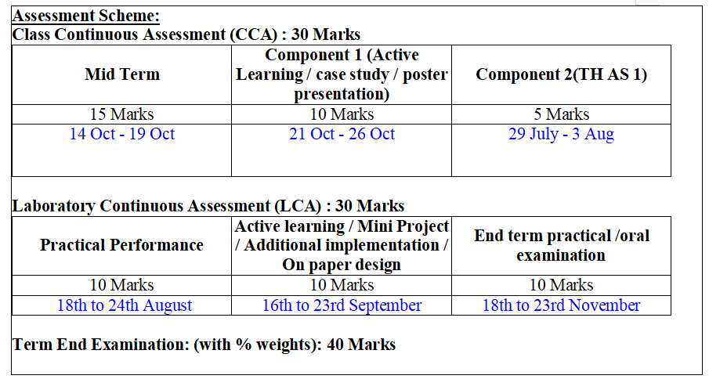
Course : Data Engineering [ CET3005B]

Slide 5
UNIT I - AN OVERVIEW
Introduction to Data Engineering
Defining Data Engineering, Overview of the Data Engineering Ecosystem, Data Engineering Lifecycle
Data objects and attribute types, Data Characteristics, Types of Data, Structured, Unstructured, Semi-structured, Discrete, Continuous, Ordinal, Nominal, Qualitative, Quantitative, Time series data, Geographical data.
Measures of Central Tendency: Mean, Median, Mode
Measures of Dispersion: Range, Variance, Standard Deviation.

Slide 6
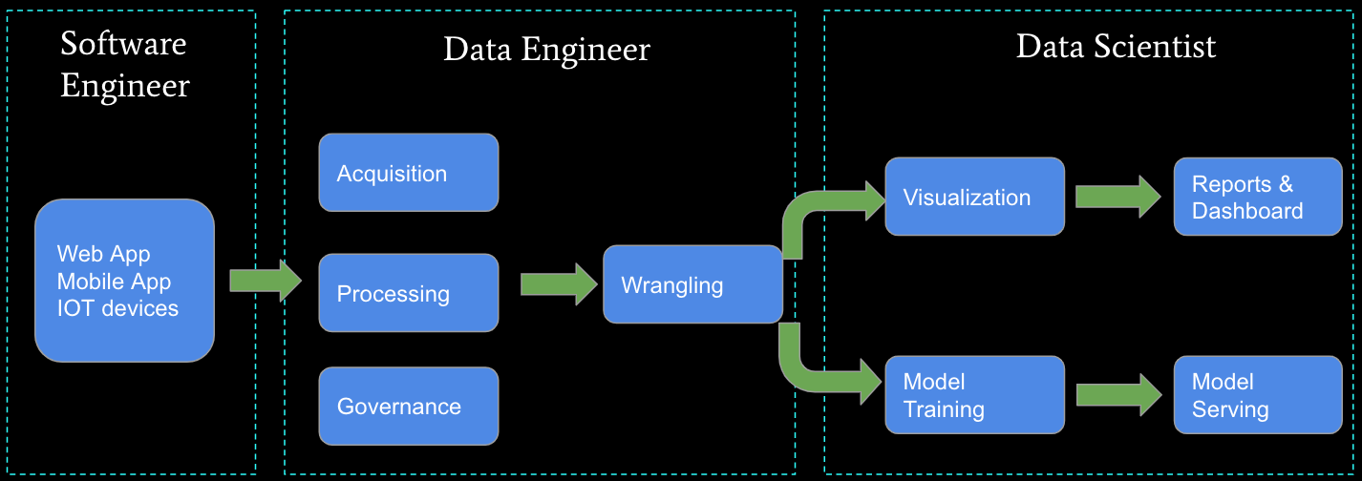
Introduction to Data Engineering

Slide 7
Introduction to Data Engineering
Data engineering: The development, implementation, and maintenance of systems and processes that take in raw data and produce high-quality, consistent information and knowledge that supports downstream use cases, such as analysis and machine learning.
Data engineering is the intersection of data management, data architecture ,software engineering.
Data engineers Manage the data engineering lifecycle beginning with ingestion and ending with serving data for use cases, such as analysis or machine learning.

Slide 8

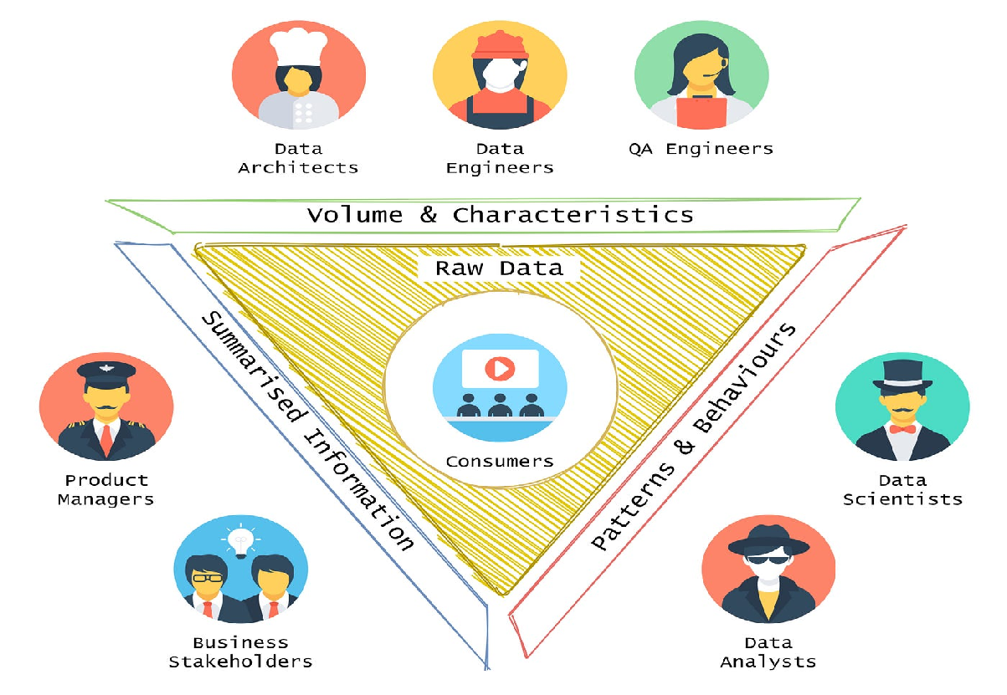
Data Engineering Ecosystem

Slide 9
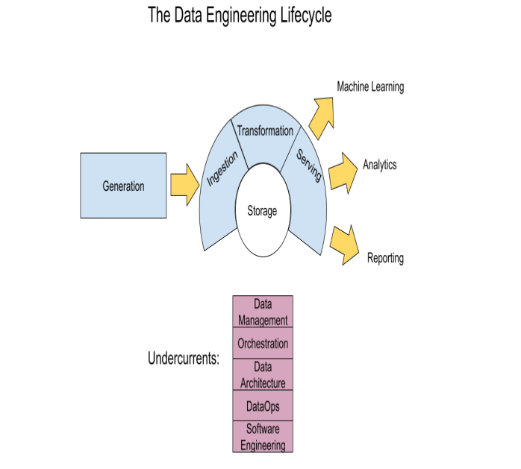
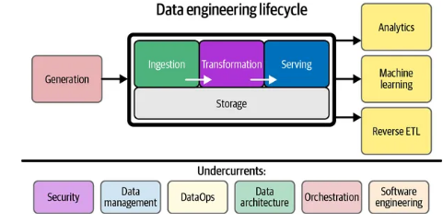
Data Engineering Lifecycle

Slide 10
Evolution of Database Technology
1960s: Data collection, database creation, IMS and network DBMS
1970s: Relational data model, relational DBMS implementation
1980s:
RDBMS, advanced data models (extended-relational, OO, deductive, etc.)
Application-oriented DBMS (spatial, scientific, engineering, etc.)
1990s: Data mining, data warehousing, multimedia databases, and Web databases
2000s
Stream data management and data mining
Data mining, applications and Web technology
Notes:
Two slides should be added after this one
1. Evolution of machine learning
2. Evolution of statistics methods

Slide 11
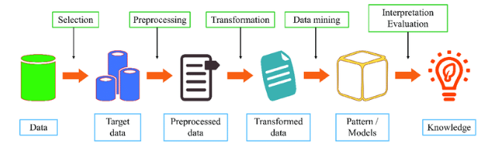
What is Data Mining?
Data mining is also called knowledge discovery and data mining(KDD)
Data mining is
Extraction of useful patterns from data sources, e.g.- Databases, texts, web, image
Patterns must be:
Valid, novel, potentially useful, understandable

Slide 12


What Is Data Mining?
Data mining (knowledge discovery from data)
Extraction of interesting (non-trivial, implicit, previously unknown and potentially useful) patterns or knowledge from huge amount of data
Data mining: a misnomer?
Alternative names
Knowledge discovery (mining) in databases (KDD), knowledge extraction, data/pattern analysis, data archeology, data dredging, information harvesting, business intelligence, etc.
Watch out: Is everything “data mining”?
Simple search and query processing
(Deductive) expert systems

Slide 13
Why is Data Mining important?
Rapid computerization of businesses produce huge amount of data
How to make best use of data?
It is used to discover patterns and relationships in the data in order to help make better business decisions
Data mining technology can generate new business opportunities by:
Automated prediction of trends and behaviors
Automated discovery of previously unknown patterns

Slide 14
Why Data Mining?
The Explosive Growth of Data: from terabytes to petabytes
Data and storage predictions for the year 2025(zettabytes)
The storage industry will ship 42ZB of capacity over the next seven years.
90ZB of data will be created on IoT devices by 2025.
By 2025, 49 percent of data will be stored in public cloud environments.
Nearly 30 percent of the data generated will be consumed in real-time by 2025.

Slide 15
Why Data Mining?
The Explosive Growth of Data: from terabytes to zettabytes
Data collection and data availability
Automated data collection tools, database systems, Web, computerized society
Major sources of abundant data
Business: Web, e-commerce, transactions, stocks, …
Science: Remote sensing, bioinformatics, scientific simulation, …
Society and everyone: news, digital cameras, YouTube
We are drowning in data, but starving for knowledge!
“Necessity is the mother of invention”—Data mining—Automated analysis of massive data sets

Slide 16
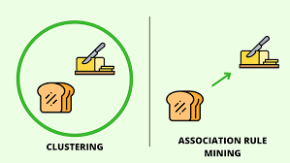
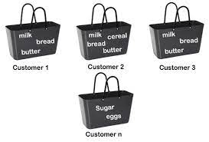
Example of Discovered Patterns
Association rules:
“80% of customers who buy cheese and milk also buy bread, and 5% of customers buy all of them together”
Cheese, Milk→ Bread

Slide 17
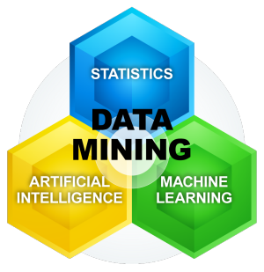
Data mining Algorithms: can be characterized as consisting of three parts
Model: is to be fit on data.
Preference: criteria to select one model over other
Search: techniques to evaluate data point or searching of data.

Slide 18
Goal of Data Mining
Goal of Data Mining is to provide
efficient tools and techniques for KDD

Slide 19
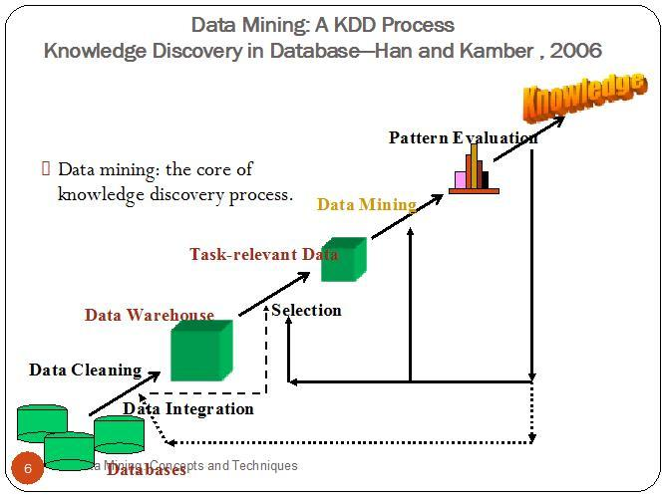
Knowledge Discovery (KDD) Process
This is a view from typical database systems and data warehousing communities
Data mining plays an essential role in the knowledge discovery process

Slide 20
Knowledge Discovery (KDD) Process
Developing an understanding of:
The application domain
The relevant prior knowledge
The goals of the end-user
Creating a target data set: selecting a data set, or focusing on a subset of variables, or data samples, on which discovery is to be performed.
2. Data cleaning and preprocessing.
Removal of noise or outliers.
Collecting necessary information to model or account for noise.
Strategies for handling missing data fields.
Accounting for time sequence information and known changes.
Data reduction and projection
Finding useful features to represent the data depending on the goal of the task.
Using dimensionality reduction or transformation methods to reduce the effective number of variables under consideration or to find invariant representations for the data.

Slide 21
Knowledge Discovery (KDD) Process
4. Choosing the data mining task.
Deciding whether the goal of the KDD process is classification, regression, clustering, etc.
5. Choosing the data mining algorithm(s)
Selecting method(s) to be used for searching for patterns in the data.
Deciding which models and parameters may be appropriate.
Matching a particular data mining method with the overall criteria of the KDD process.
6. Data mining.
Searching for patterns of interest in a particular representational form or a set of such representations as classification rules or trees, regression, clustering, and so forth.
7. Interpreting mined patterns.
8. Consolidating discovered knowledge.

Slide 22
Sequence of the steps
Data Cleaning: To remove noise and inconsistent data.
Data Integration: where multiple data sources may be combined.
Data Selection: Where data relevant to the analysis task are retrieved from the database.
Data Transformation: where data transformed and consolidated into forms appropriate for mining by performing summary or aggregation operations.
Data Mining: An essential process where intelligent methods are applied to extract data patterns.
Pattern evaluation: To identify the truly interesting pattern representing knowledge based on interesting measures.
Knowledge Presentation: where visualization and knowledge representation tech. are used to present mined knowledge to users.

Slide 23
Applications of Data Mining
Data mining applications are widely used in
Direct marketing
Health industry
E-commerce
Customer relationship management (CRM)
Telecommunication industry and financial sector, etc..
Data mining is available in various forms
Text mining
Web mining
Audio & video data mining
Pictorial data mining
Relational databases data mining
Social networks data mining

Slide 24
Data Warehouse and Data Mining
Introduction to KDD
Data Preprocessing: An Overview
Data Quality
Major Tasks in Data Preprocessing
Data Cleaning
Data Integration
Data Reduction
Data Transformation and Data Discretization
Summary

Slide 25
Why Is Data Preprocessing Important?
No quality data, no quality mining results!
Quality decisions must be based on quality data
e.g., duplicate or missing data may cause incorrect or even misleading statistics.
Data preparation, cleaning, and transformation comprises the majority of the work in a data mining application (90%).

Slide 26
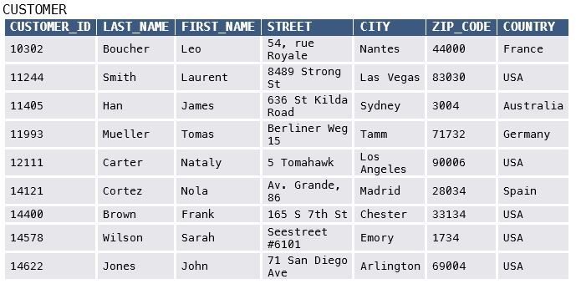
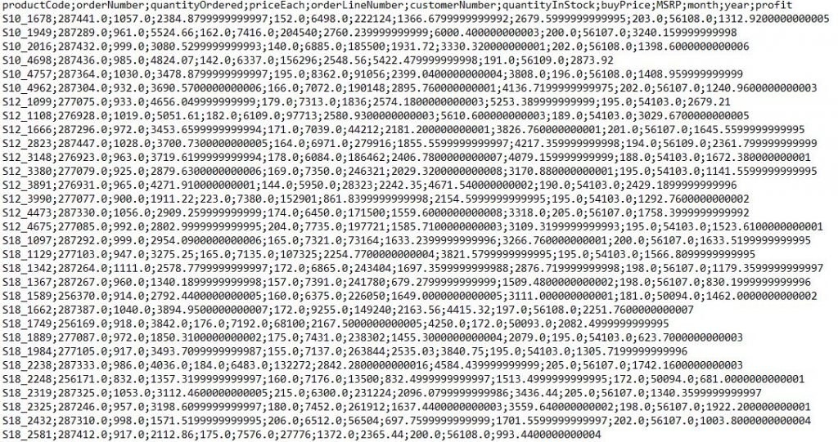
Types of Data :Structured
Structured data is data with a high degree of organization, usually stored in some sort of spreadsheet. Excel sheet, which is a prime example of structured data.

Slide 27
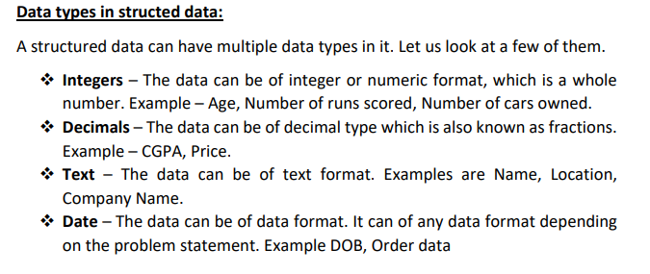
Data Types of Structured Data

Slide 28
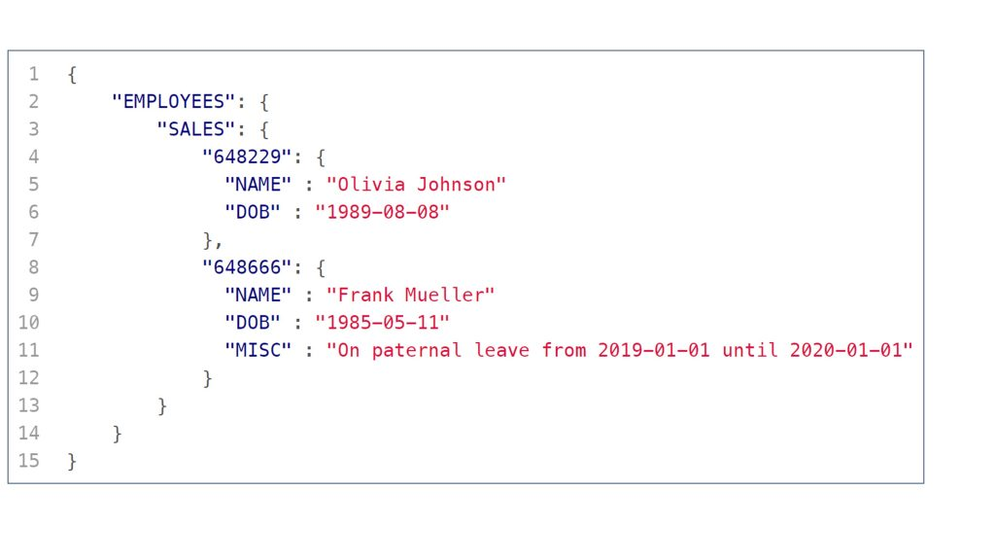
Semi structured Data
Semi-structured is data which has some degree of organization in it.
It is not as rigorously structured as structured data, but also not as messy as unstructured data.
This degree of organization is typically achieved with some sort of tags or other elements with defined properties which introduce a hierarchy and system into a file.
However, the order and amount of such structuring tags and elements may vary.
Therefore, the structure imposed on a dataset it not as rigorous as in structured datasets where all data has to conform to the structure of the data table (spreadsheet).

Slide 29
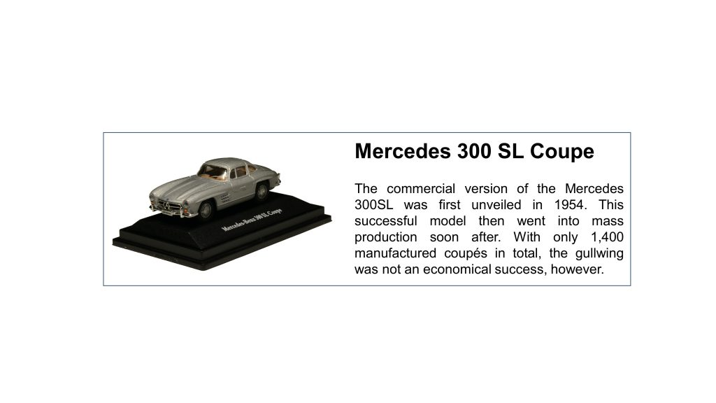
Unstructured data
Unstructured data is data with no pre-defined organizational form or specific format. Or in other words, unstructured data is any data which is not structured or semi-structured.

Slide 30
Difference
 | Structured data | Semi-structured data | Unstructured data
What is it? | Data with a high degree of organization, typically stored in a spreadsheet-like manner | Data with some degree of organization | Data with no predefined organizational form and no specific format
To put it simply | Think of a spreadsheet (e.g. Excel) or data in a tabular format | Think of a TXT file with text that has some structure (headers, paragraphs, etc.) | Essentially anything that is not structured or semi-structured data (which is a lot)
Example formats | Excel spreadsheets Comma-separated value file (.csv) Relational database tables | Hypertext Markup Language (HTML) files JavaScript Object Notation (JSON) files Extensible Markup Language (XML) files | Images such as .jpeg or .png files Videos such as .mp4 or m4a files Sound files such as .mp3 or .wav files Plain text files Word files PDF files
Characteristics | Data is structured in a spreadsheet-like manner (e.g. in a table) Within that table, entries have the same format and a predefined length and follow the same order Is easily machine-readable and can therefore be analysed without major pre-processing of the data It is commonly said that around 20% of the world’s data is structured | Data is stored in files that have some degree of organization and structure Tags or other markers separate elements and enforce hierarchies, but the size of elements can vary and their order is not important Needs some pre-processing before it can be analysed by a computer Has gained importance with the emergence of the World Wide Web | Data that can take any form and thus be stored as any kind of file (formless) Within that file, there is no structure of content Typically needs major pre-processing before it can be analysed by a computer, but often easily consumable for humans (e.g. pictures, videos, plain texts) Most of the data that is created today is unstructured

Slide 31
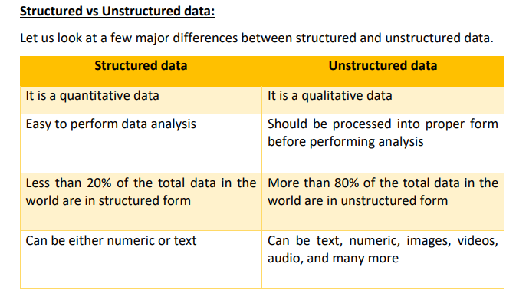

Slide 32
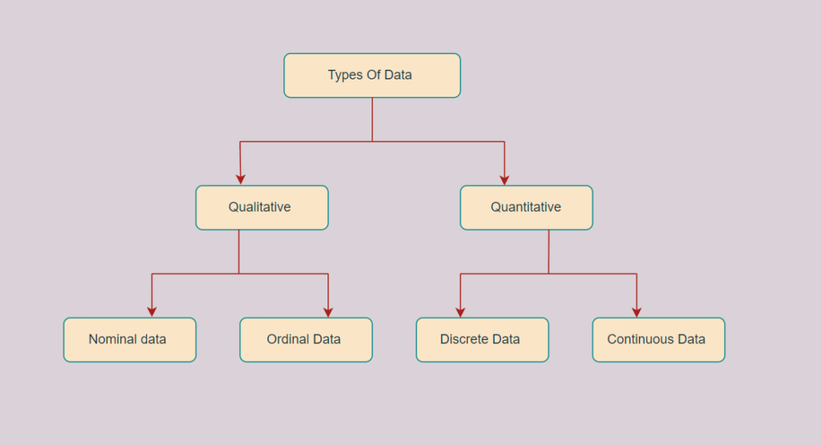
Discrete, Continuous, Ordinal, Nominal, Qualitative, Quantitative , Time series data, Geographical data.

Slide 33
Discrete, Continuous, Ordinal, Nominal, Qualitative, Quantative , Time series data, Geographical data.
Qualitative or Categorical Data Qualitative or Categorical Data is data that can’t be measured or counted in the form of numbers. These types of data are sorted by category, not by number. These data consist of audio, images, symbols, or text. The gender of a person, i.e., male, female, or others, is qualitative data. Qualitative data tells about the perception of people. This data helps market researchers understand the customers’ tastes and then design their ideas and strategies accordingly.
Nominal Data Nominal Data is used to label variables without any order or quantitative value. The color of hair can be considered nominal data, as one color can’t be compared with another color. The name “nominal” comes from the Latin name “nomen,” which means “name.” With the help of nominal data, we can’t do any numerical tasks or can’t give any order to sort the data. These data don’t have any meaningful order; their values are distributed into distinct categories.
Ordinal Data Ordinal data have natural ordering where a number is present in some kind of order by their position on the scale. These data are used for observation like customer satisfaction, happiness, etc., but we can’t do any arithmetical tasks on them.
Quantitative Data Quantitative data can be expressed in numerical values, making it countable and including statistical data analysis. These kinds of data are also known as Numerical data. It answers the questions like “how much,” “how many,” and “how often.” Quantitative data can be used for statistical manipulation. These data can be represented on a wide variety of graphs and charts, such as bar graphs, histograms, scatter plots, boxplots, pie charts, line graphs, etc.
Q1: Discrete Data The term discrete means distinct or separate. The discrete data contain the values that fall under integers or whole numbers. The total number of students in a class is an example of discrete data. These data can’t be broken into decimal or fraction values. The discrete data are countable and have finite values; their subdivision is not possible. These data are represented mainly by a bar graph, number line, or frequency table. Examples of Discrete Data : Total numbers of students present in a class Cost of a cell phone
Q2:Continuous Data Continuous data are in the form of fractional numbers. It can be the version of an android phone, the height of a person, the length of an object, etc. Continuous data represents information that can be divided into smaller levels. The continuous variable can take any value within a range. Examples of Continuous Data : Height of a person

Slide 34
Discrete Vs Continuous Data
Discrete Data | Continuous Data
Discrete data are countable and finite; they are whole numbers or integers | Continuous data are measurable; they are in the form of fractions or decimal
Discrete data are represented mainly by bar graphs | Continuous data are represented in the form of a histogram
The values cannot be divided into subdivisions into smaller pieces | The values can be divided into subdivisions into smaller pieces
Discrete data have spaces between the values | Continuous data are in the form of a continuous sequence
Examples: Total students in a class, number of days in a week, size of a shoe, etc | Example: Temperature of room

Slide 35
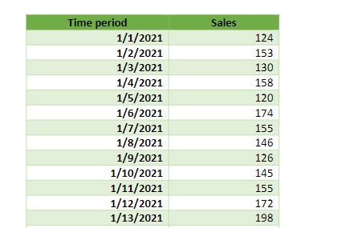
Time Series Data
When the data is collected over equal intervals of time, it is called as time series data.
The time intervals can be as small as seconds to as large as years. The only condition is the time-period should be of equal intervals and it should be clearly defined.
A few examples of time series data are the stock prices of a company throughout the year, the sales data of a company for the past three years, the daily expenses a company has incurred over the past 6 months.
Characteristics of a time series data: Time series data has 4 characteristics, let us look at them one by one. 1) Equal interval – As mentioned above, the time series data should be collected in equal interval of time and should not be uneven. 2) Seasonality – When the time series data is influenced by seasonal factors such as rainfall, temperature, etc. 3) Cyclicity - When the time series data is rising and falling in intervals those are not at fixed periods such as business cycles. 4) Trend - When there is a long tern increase or decrease in the data. Based on the movement of data it can be called either an uptrend or a downtrend.
Notes:
https://www.mygreatlearning.com/blog/types-of-data/

Slide 36
Understanding Data Attribute Types with
For a customer object, attributes can be customer-id, address, etc
First step before Data pre-processing - differentiate between different types of attributes and then pre-process the data.
Data attribute Types
Qualitative
Nominal
Ordinal
Binary
Quantitative
Numeric

Slide 37
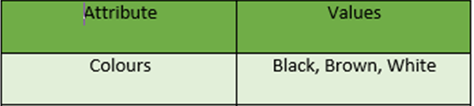
Qualitative Attributes
Nominal Attributes –
Values are name of things or some kind of symbols
Values of Nominal attributes represents some category or state and that’s why nominal attribute also referred as categorical attributes and
There is no order (rank, position) among values of nominal attribute

Slide 38

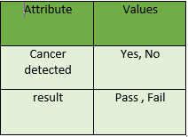
Qualitative Attributes
2. Binary Attributes : Binary data has only 2 values/states.
For Example yes or no, true or false.
Symmetric : Both values are equally important (Gender). No preference on which should be coded as 0 or 1
Asymmetric : Both values are not equally important. Most important outcome is coded as 1

Slide 39
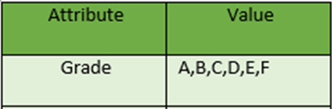
Qualitative Attributes
3. Ordinal Attributes :
Values that have a meaningful sequence or ranking(order) between them
But magnitude of values is not actually known

Slide 40
Quantitative Attributes
Numeric :
A numeric attribute is quantitative because, it is a measurable quantity, represented as integer or real values.
Numerical attributes are of 2 types, interval and ratio.
Interval-scaled attributes
Have order
Values can be added and subtracted but cannot be multiplied or divided
Eg. Temperature of 10 degree Celsius should not be considered as twice hot as 5 degree Celsius since 10 degree Celsius is 50 degree Fahrenheit and 5 degree Celsius is 41 degree Fahrenheit which isn’t twice

Slide 41
Quantitative Attributes(Contd..)
Interval data always appears in the form of numbers or numerical values where the distance between the two points is standardized and equal
Eg. difference between 100 degrees Fahrenheit and 90 degrees Fahrenheit is the same as 60 degrees Fahrenheit and 70 degrees Fahrenheit.
Don’t have a true zero
ii) Ratio-scaled attributes
Has all properties of interval-scaled
Have a true zero
Values can be added , subtracted , multiplied & divided
Eg. Weight, height,etc

Slide 42
Geographical data
Geographical data is a type of information that captures the physical features of a place.
This can include things like the location of a city or town, the layout of its streets and highways, and its natural features such as rivers and mountains
Geographical data can be used for a variety of purposes, including mapping out areas for planning purposes.
Geographical data is often used by social media networks to provide information about users’ location.
Construction companies may use geographical data to map out the locations of roads and highways
Geographical data is often presented in a two-dimensional format on a paper map or globe. However, geographical data can also be represented in three dimensions through digital means such as virtual globes.
Geographic information systems (GIS) are software applications that allow users to view, edit, and analyze geographical data in three dimensions.

Slide 43
Exercise
Classify the following attributes as discrete, or continuous. Also classify them as qualitative (nominal or ordinal) or quantitative (interval or ratio). Some cases may have more than one interpretation, so briefly indicate your reasoning if you think there may be some ambiguity.
Number of telephones in your house
Size of French Fries (Medium or Large or X-Large)
Ownership of a cell phone
Number of local phone calls you made in a month
Length of longest phone call
Length of your foot
Price of your textbook
Zip code
Temperature in degrees Fahrenheit
Temperature in degrees Celsius
Temperature in Kelvin

Slide 44
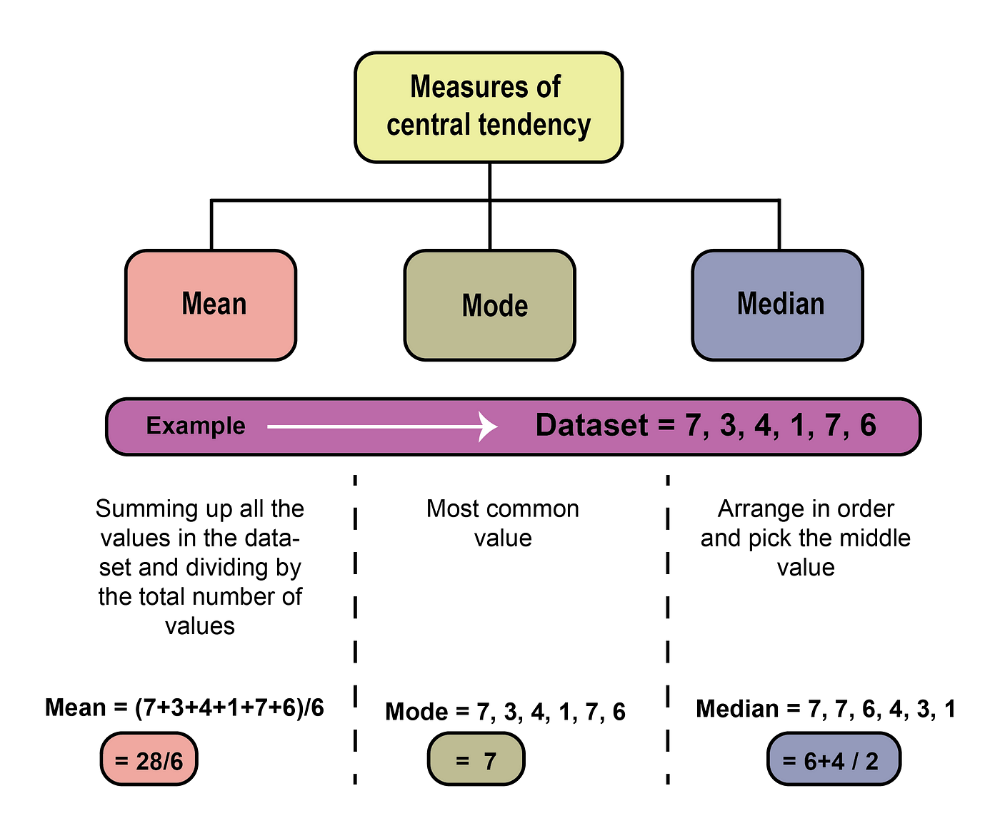
Measures of Central Tendency: Mean, Median, Mode, Mid-range
Measures of central tendency are used to numerically summarize data by identifying the central position within that set of data. They are also called as summary statistic.

Slide 45
Mean
Mean: The mean represents the average value of the dataset.
Mean is calculated by taking the sum of the values and dividing with the numbers of values in a dataset
The mean (or average) is the most popular and well-known measure of central tendency.
It can be used with both discrete and continuous data, although its use is most often with continuous data
An important property of the mean is that it includes every value in your data set as part of the calculation.
Limitations of mean: The mean has one main disadvantage: it is particularly susceptible to the influence of outliers. These are values that are unusual compared to the rest of the data set by being especially small or large in numerical value

Slide 46
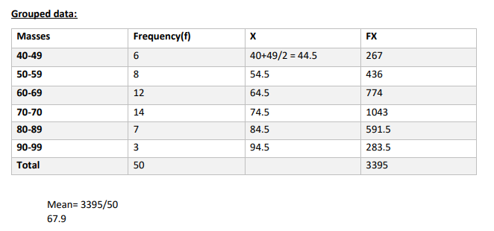
Example
Ungrouped data: - 0 1 2 3 4 5 6 7 8 9 10 Mean = 5
For grouped data

Slide 47
Median
Median is the middle value of the dataset in which the dataset is arranged in the ascending order or in descending order.
When the dataset contains an even number of values, then the median value of the dataset can be found by taking the mean of the middle two values
Consider the given dataset with the odd number of observations arranged in ascending order 2, 5, 6, 7, 9, 10, 12, 13, 15, 16, 18, 21, 23
Here 12 is the middle or median number that has 6 values above it and 6 values below it
Advantages of median: The median is less affected by outliners and skewed data than the mean and usually the preferred measure of central tendency when the distribution is not symmetrical
Limitations of median: Unsuitable for fractions and percentage , it is not suitable for further algebraic calculation

Slide 48
Mode
The mode represents the frequently occurring value in the dataset.
Sometimes the dataset may contain multiple modes, and in some cases, it does not contain any mode at all.
Consider the given dataset 5, 4, 2, 3, 2, 1, 5, 4, 5 Since the mode represents the most common value. Hence, the most frequently repeated value in the given dataset is 5.
Advantages of mode: The mode has an advantage over the median and the mean as it can be found for both numerical and categorical (non-numerical) data.
Limitations of mode: In some distributions, the mode may not reflect the center of the distribution very well.

Slide 49
How to select measure
Based on the properties of the data, the measures of central tendency are selected.
If you have a symmetrical distribution of continuous data, all the three measures of central tendency hold good. But most of the times, the analyst uses the mean because it involves all the values in the distribution or dataset.
If you have skewed distribution, the best measure of finding the central tendency is the median.
If you have the original data, then both the median and mode are the best choice of measuring the central tendency.
If you have categorical data, the mode is the best choice to find the central tendency

Slide 50
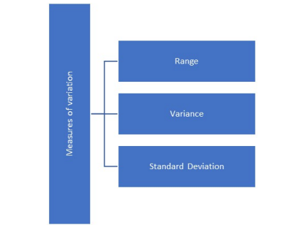
Measures of Dispersion: Range, Variance, Standard Deviation
Measures of variation give information on the spread or variability or dispersion of the data values
Finding the central value of the observations is important in this descriptive analysis.
It is also important to find out the extent of variation near the center.
There maybe two sets of data that may exhibit same position of the center, but that could differ with respect to their variability.

Slide 51
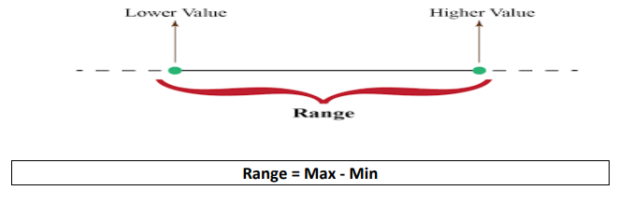
Range
Range is referred to as the difference between the highest value and the lowest value in a data set.
The range is extremely sensitive to outliers and can be a very coarse measurement of the spread of data.
This means a single data value can greatly affect the analysis of the problem when using range and this can be a limitation to the statisticians who work using range.
The below image is the pictorial representation of range

Slide 52
Range Example
Example 1:
Participants in a race had the following finishing times in seconds: 16, 21, 28, 12, 30, 21, and 24. Compute the range.
The maximum value is 30 and minimum value is 12,
Hence the range is 30 – 12 = 18.
Example 2:
The following is the data of measurements taken in meters. Find the range for the
data. {10.2, 9.5, 12.6, 13, 7.9, 11.7, 8.1, 9, 11.8}.
The range for the above data will be 13 – 7.9 = 5.1

Slide 53
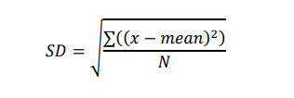
Standard Deviation:
Standard Deviation: It gives us how spread out the observed values are from the mean. We can calculate the standard deviation using the below formula
Standard Deviation is always a positive value. Standard deviation is the square root of the variance. Variance is the sum of the squared difference of the observed value from the mean.
Standard deviation is a measure of the dispersion of a set of data from its mean.
If the data points are farther from the mean, there is higher deviation within the data set.
Standard deviation is calculated as the square root of variance by determining the variation between each data point relative to the mean.

Slide 54
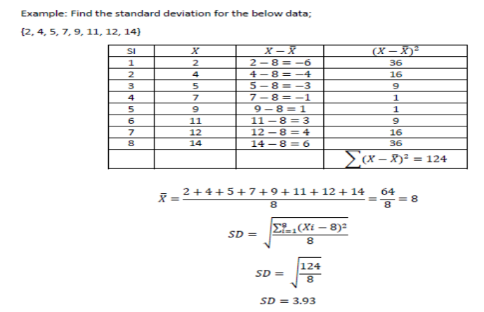
Example

Slide 55
Variance
Variance: The average deviation of all data values from the mean.
The square of standard deviation is called variance.
The difference between standard deviation and variance is only in terms of unit of measurement.
For Example: If height is measured in meters and SD is 0.67 the unit of standard deviation is 0.67 meter, but the unit of variance is 0.45-meter square

Slide 56
Reference
Data Mining: Concepts and Techniques, Jiawei Han, Micheline Kamber, and Jian Pei, 3rd edition
https://towardsdatascience.com/tagged/data-engineering
https://www.coursera.org/articles/
https://www.nptel.org/

