Slide 1

Data Engineering
UNIT II
SCHOOL OF COMPUTER ENGINEERING & TECHNOLOGY

Slide 2

Syllabus
Data Preprocessing: An Overview, Methods: Data Cleaning, Data Integration, Data Reduction, Data Transformation, Data Discretization.
Data Cleaning: Handling Missing Values, Noisy Data, Data Cleaning as a Process, Data Integration: Entity Identification Problem, Redundancy and Correlation Analysis, Tuple Duplication, Data Value Conflict Detection and Resolution, Data Reduction: Attribute Subset
Selection, Histograms, Sampling, Data discretization – binning, histogram analysis, decision tree and correlation analysis, concept hierarchy for nominal data.

Slide 3
Data Pre-processing: An Overview
Data preprocessing is the process of transforming raw data into an understandable format.
It is also an important step in data mining as we cannot work with raw data.
The quality of the data should be checked before applying machine learning or data mining algorithms.
The goal of data preprocessing is to improve the quality of the data and to make it more suitable for the specific data mining task.
Data preprocessing is a process of preparing the raw data and making it suitable for a machine learning model and it is the first and crucial step while creating a machine learning model.

Slide 4
Why is Data Preprocessing Important?
A real-world data generally contains noises, missing values, and maybe in an unusable format which cannot be directly used for machine learning models.
Data preprocessing is required tasks for cleaning the data and making it suitable for a machine learning model which also increases the accuracy and efficiency of a machine learning model.
“How can the data be preprocessed in order to help improve the quality of the data and, consequently, of the mining results? How can the data be preprocessed so as to improve the efficiency and ease of the mining process?”

Slide 5
Why is Data Preprocessing Important?
Preprocessing of data is mainly to check the data quality and it can be checked with the following parameters:
Accuracy: To check whether the data entered is correct or not.
Completeness: To check whether the data is available or not recorded.
Consistency: To check whether the same data is kept in all the places that do or do not match.
Timeliness: The data should be updated correctly.
Believability: The data should be trustable.
Interpretability: The understandability of the data.

Slide 6
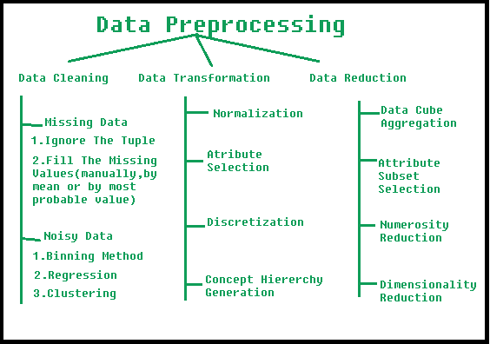
Why is Data Preprocessing Important?
There are a number of data preprocessing techniques:
Data cleaning can be applied to remove noise and correct inconsistencies in the data.
Data integration merges data from multiple sources into a coherent data store, such as a data warehouse.
Data reduction can reduce the data size by aggregating, eliminating redundant features, or clustering, for instance.
Data transformations, such as normalization, may be applied, where data are scaled to fall within a smaller range like 0.0 to 1.0. This can improve the accuracy and efficiency of mining algorithms involving distance measurements.

Slide 7
Why is Data Preprocessing Important?

Slide 8
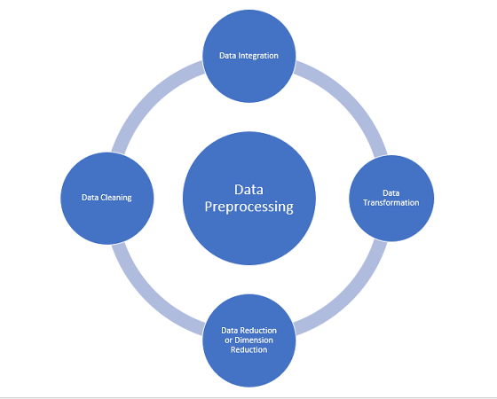
Major Tasks in Data Preprocessing
There are 4 major tasks in data preprocessing –
Data cleaning,
Data integration,
Data reduction, and
Data transformation.

Slide 9
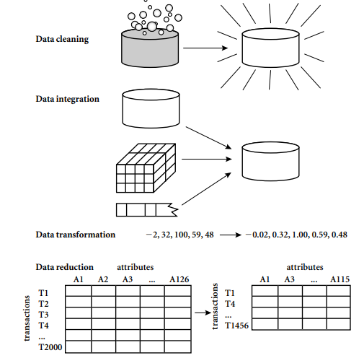
Major Tasks in Data Preprocessing

Slide 10
Data Cleaning
Real-world data tend to be incomplete, noisy, and inconsistent. Data cleaning (or data cleansing) routines attempt to fill in missing values, smooth out noise while identifying outliers, and correct inconsistencies in the data.
Data cleaning is the process of removing incorrect data, incomplete data, and inaccurate data from the datasets, and it also replaces the missing values.
Topics under Data Cleaning are: Handling missing values, Noisy data, Data cleaning as a process.

Slide 11
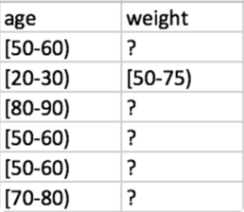
Data Cleaning
Missing or incomplete records: Missing data sometimes appears as empty cells, values (e.g., NULL or N/A), or a particular character, such as a question mark

Slide 12
Data Cleaning
Missing data may be due to:
Equipment malfunction
Inconsistent with other recorded data and thus deleted
Data not entered due to misunderstanding
Certain data may not be considered important at the time of entry
Not register history or changes of the data.
It is important to note that, a missing value may not always imply an error. (for example, Null-allow attri. )

Slide 13
Data Cleaning
How can you go about filling in the missing values for this attribute? Let’s look at the following methods:
1. Ignore the tuple: This is usually done when the class label is missing (assuming the mining task involves classification).
This method is not very effective, unless the tuple contains several attributes with missing values.
It is especially poor when the percentage of missing values per attribute varies considerably.
By ignoring the tuple, we do not make use of the remaining attributes values in the tuple.
2. Fill in the missing value manually: In general, this approach is time consuming and may not be feasible given a large data set with many missing values.

Slide 14
Data Cleaning
3. Use a global constant to fill in the missing value: Replace all missing attribute values by the same constant, such as a label like “Unknown” or −∞.
If missing values are replaced by, say, “Unknown,” then the mining program may mistakenly think that they form an interesting concept, since they all have a value in common—that of “Unknown.”
4. Use a measure of central tendency for the attribute (such as the mean or median) to fill in the missing value: measures of central tendency, which indicate the “middle” value of a data distribution.
For normal (symmetric) data distributions, the mean can be used, while skewed data distribution should employ the median.

Slide 15
Data Cleaning
5. Use the attribute mean or median for all samples belonging to the same class as the given tuple: For example, if classifying customers according to credit risk, we may replace the missing value with the average income value for customers in the same credit risk category as that of the given tuple.
If the data distribution for a given class is skewed, the median value is a better choice.
6. Use the most probable value to fill in the missing value: This may be determined with regression, inference-based tools using a Bayesian formalism, or decision tree induction.
For example, using the other customer attributes in your data set, you may construct a decision tree to predict the missing values for income.

Slide 16
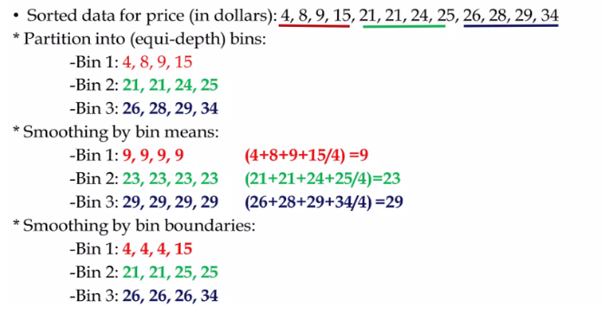
Data Cleaning: Noisy Data
Binning: Binning methods smooth a sorted data value by consulting its “neighborhood,” that is, the values around it. The sorted values are distributed into a number of “buckets,” or bins

Slide 17
Data Cleaning
In this example, the data for price are first sorted and then partitioned into equal-frequency bins of size 3 (i.e., each bin contains three values).
In smoothing by bin means, each value in a bin is replaced by the mean value of the bin. For example, the mean of the values 4, 8, and 15 in Bin 1 is 9.
Therefore, each original value in this bin is replaced by the value 9.
Similarly, smoothing by bin medians can be employed, in which each bin value is replaced by the bin median.
In smoothing by bin boundaries, the minimum and maximum values in a given bin are identified as the bin boundaries.
Each bin value is then replaced by the closest boundary value.

Slide 18
Data Cleaning
Regression: Data smoothing can also be done by conforming data values to a function, a technique known as regression.
Linear regression involves finding the “best” line to fit two attributes (or variables), so that one attribute can be used to predict the other.
Multiple linear regression is an extension of linear regression, where more than two attributes are involved and the data are fit to a multidimensional surface.

Slide 19
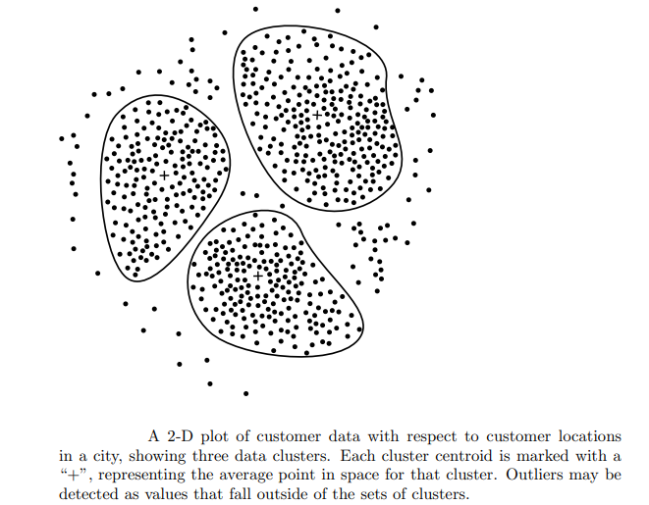
Data Cleaning
Outlier analysis: Outliers may be detected by clustering, for example, where similar values are organized into groups, or “clusters.” Intuitively, values that fall outside of the set of clusters may be considered outliers

Slide 20
Data Cleaning as a Process
Missing values, noise, and inconsistencies contribute to inaccurate data. So far, we have looked at techniques for handling missing data and for smoothing data. “But data cleaning is a big job. What about data cleaning as a process? How exactly does one proceed in tackling this task? Are there any tools out there to help?”
The first step in data cleaning as a process is discrepancy (inconsistency) detection.
Discrepancies can be caused by several factors, including poorly designed data entry forms that have many optional fields, human error in data entry, deliberate errors (e.g., respondents not wanting to disclose information about themselves), and data decay (e.g., outdated addresses).
Discrepancies may also arise from inconsistent data representations and the inconsistent use of codes.
Errors in instrumentation devices that record data, and system errors, are another source of discrepancies.
Errors can also occur when the data are (inadequately) used for purposes other than originally intended and there may also be inconsistencies due to data integration (e.g., where a given attribute can have different names in different databases).

Slide 21
Data Cleaning as a Process
“So, how to proceed with discrepancy detection?” As a starting point, use any knowledge you may already have regarding properties of the data. Such knowledge or “data about data” is referred to as metadata.
For example, what are the data type and domain of each attribute? What are the acceptable values for each attribute? The basic statistical data descriptions those are useful here to grasp data trends and identify anomalies.
For example, find the mean, median, and mode values.
Are the data symmetric or skewed? What is the range of values? Do all values fall within the expected range? What is the standard deviation of each attribute?
Values that are more than two standard deviations away from the mean for a given attribute may be flagged as potential outliers.
Are there any known dependencies between attributes?

Slide 22
Data Cleaning as a Process
Field overloading is another source of errors that typically results when developers squeeze new attribute definitions into unused (bit) portions of already defined attributes (e.g., using an unused bit of an attribute whose value range uses only, say, 31 out of 32 bits).
The data should also be examined regarding unique rules, consecutive rules, and null rules.
A unique rule says that each value of the given attribute must be different from all other values for that attribute.
A consecutive rule says that there can be no missing values between the lowest and highest values for the attribute, and that all values must also be unique (e.g., as in check numbers).
A null rule specifies the use of blanks, question marks, special characters, or other strings that may indicate the null condition (e.g., where a value for a given attribute is not available), and how such values should be handled.

Slide 23
Data Cleaning as a Process
There are a number of different commercial tools that can aid in the step of discrepancy detection.
Data scrubbing tools use simple domain knowledge (e.g., knowledge of postal addresses, and spell-checking) to detect errors and make corrections in the data.
These tools rely on parsing and fuzzy matching techniques when cleaning data from multiple sources.
Data auditing tools find discrepancies by analyzing the data to discover rules and relationships, and detecting data that violate such conditions.
They are variants of data mining tools. For example, they may employ statistical analysis to find correlations, or clustering to identify outliers.

Slide 24
Data Cleaning as a Process
ETL (extraction/transformation/loading) tools allow users to specify transforms through a graphical user interface (GUI).
These tools typically support only a restricted set of transforms so that, often, we may also choose to write custom scripts for this step of the data cleaning process.
The two-step process of discrepancy detection and data transformation (to correct discrepancies) iterates.
This process, however, is error-prone and time consuming and some transformations may introduce more discrepancies while some nested discrepancies may only be detected after others have been fixed.

Slide 25
Data Cleaning as a Process
New approaches to data cleaning emphasize increased interactivity.
Potter’s Wheel, for example, is a publicly available data cleaning tool that integrates discrepancy detection and transformation.
Users gradually build a series of transformations by composing and debugging individual transformations, one step at a time, on a spreadsheet-like interface.
The transformations can be specified graphically or by providing examples.
Results are shown immediately on the records that are visible on the screen.
The user can choose to undo the transformations, so that transformations that introduced additional errors can be “erased.”
The tool performs discrepancy checking automatically in the background on the latest transformed view of the data.
Users can gradually develop and refine transformations as discrepancies are found, leading to more effective and efficient data cleaning.
Another approach to increased interactivity in data cleaning is the development of declarative languages for the specification of data transformation operators.
Such work focuses on defining powerful extensions to SQL and algorithms that enable users to express data cleaning specifications efficiently.

Slide 26
Exercise
Suppose a group of 12 sales price records has been sorted as follows: 5, 10, 11, 13, 15, 35, 50, 55, 72, 92, 204, 215 Partition them into three bins solve it by each of the following methods:
Equi-depth partitioning
Smoothing by bin boundaries

Slide 27
Exercise
Solution:
equi-depth partitioning -Bin-1: 5, 10, 11, 13, Bin-2: 15, 35, 50, 55, Bin-03: 72, 92, 204, 215
Smoothing by bin boundaries-Smoothing by bin boundaries: Bin-1: 5,13,13,13 , Bin-2: 15,15,55,55, Bin-3:72,72,215,215

Slide 28
Data Integration
Data integration:
Combines data from multiple sources into a coherent store
Careful integration can help reduce & avoid redundancies and inconsistencies
This helps to improve accuracy & speed of subsequent data mining
Heterogeneity & structure of data pose great challenges
Issues that need to be addressed:
How to match schema & objects from different sources? (Entity identification problem)
Are any attributes correlated?
Tuple duplication
Detection & resolution of data value conflicts
‹#›

Slide 29
Data Integration
Data integration techniques:
Schema matching
Instance conflict resolution
Source selection
Result merging
Quality composition
Entity Identification Problem, Redundancy and Correlation Analysis, Tuple Duplication, Data Value Conflict Detection and Resolution
‹#›

Slide 30
Issues during Data Integration(Contd..)
Schema integration:
Integrate metadata from different sources
e.g. customer_id in one database and cust_number in another
Entity identification problem: Identify real world entities from multiple data sources,
e.g., Bill Clinton = William Clinton
Redundancy:
An attribute may be redundant if it can be derived or obtaining from another attribute or set of attribute.
Inconsistencies in attribute can also cause redundancies in the resulting data set.
Some redundancies can be detected by correlation analysis.
Detecting and resolving data value conflicts
For the same real world entity, attribute values from different sources are different
Possible reasons: different representations, different scales, e.g., metric vs. British units

Slide 31
Data Integration(Contd..)
Data integration:
Combines data from multiple sources into a coherent store
Schema integration: e.g., A.cust-id ≡ B.cust-#
Integrate metadata from different sources
Entity identification problem:
Identify real world entities from multiple data sources, e.g., Bill Clinton = William Clinton
Redundancy:
Inconsistencies in attribute or dimensions naming can cause redundancy
Detecting and resolving data value conflicts
For the same real world entity, attribute values from different sources are different Possible reasons: different representations, different scales, e.g., metric vs. British units
‹#›

Slide 32
Data Integration
Entity identification problem
How can equivalent real-world entities from multiple data sources be matched up?
Schema integration: e.g., A.cust-id ≡ B.cust-number
Integrate using metadata(meaning, data type, range of values,etc.) from different sources
Ensure that any attribute functional dependencies & referential constraints in source system match those in target system
‹#›

Slide 33
Handling Redundancy in Data Integration
Redundancy & Correlation Analysis:
Redundant data occur often when integration of multiple databases
Object identification: The same attribute or object may have different names in different databases
Derivable data: One attribute may be a “derived” attribute in another table, e.g., annual revenue
Redundant attributes may be able to be detected by correlation analysis and covariance analysis
Careful integration of the data from multiple sources may help reduce/avoid redundancies and inconsistencies and improve mining speed and quality
‹#›

Slide 34
Detection of Data Redundancy-Correlation
Redundancies can be detected using following methods:
χ2Test (Used for nominal Data or categorical or qualitative data)
Correlation coefficient and covariance (Used for numeric Data or quantitative data)
The term "correlation" refers to a mutual relationship or association between quantities.
In almost any business, it is useful to express one quantity in terms of its relationship with others.
For example, sales might increase when the marketing department spends more on TV advertisements,
Customer's average purchase amount on an e-commerce website might depend on a number of factors related to that customer.
Often, correlation is the first step to understanding these relationships and subsequently building better business and statistical models.

Slide 35
Why is correlation a useful metric?
Correlation can help in predicting one quantity from another
Correlation can (but often does not, as we will see in some examples below) indicate the presence of a causal relationship
Correlation is used as a basic quantity and foundation for many other modeling techniques
More formally, correlation is a statistical measure that describes the association between random variables.
There are several methods for calculating the correlation coefficient, each measuring different types of strength of association

Slide 36
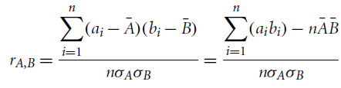
Correlation Analysis (Numeric data )
Evaluate correlation between 2 attributes, A & B, by computing correlation coefficient(Pearson’s product moment coefficient)
Where n is the number of tuples, a_{i} and b_{i} are the respective values of A and B in tuple i,
are the respective mean values of A and B,
are the respective standard deviations of A and B
is the sum of the AB cross-product (i.e., for each tuple, the value for A is multiplied by the value for B in that tuple)

Slide 37

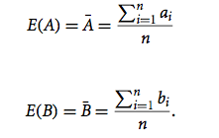
Correlation- Pearson Correlation Coefficient
Pearson is the most widely used correlation coefficient.
Pearson correlation measures the linear association between continuous variables.
Pearson correlation coefficient
The Correlations coefficient is a statistic and it can range between +1 and -1

Slide 38
Correlation Analysis (Numeric data )
Note that
If resulting value is greater than 0, then A and B are positively correlated, meaning that the values of A increase as the values of B increase
Higher the value, the stronger the correlation
Higher value may indicate that A (or B) may be removed as a redundancy
If the resulting value is equal to 0, then A and B are independent and there is no
correlation between them
If the resulting value is less than 0, then A and B are negatively correlated, where the values of one attribute increase as the values of the other attribute decrease

Slide 39
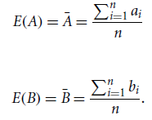

Covariance Analysis(Numeric Data)
Correlation and covariance are two similar measures for assessing how much two attributes change together
Consider two numeric attributes A and B, and a set of n observations
Mean values of A and B, respectively, are also known as the expected values on A and B, that is
covariance between A and B is defined as

Slide 40


Covariance Analysis(Numeric Data)
Also, for simplified calculations
For two attributes A and B that tend to change together,
if A is larger than , then B is likely to be larger than . Hence, the covariance between A and B is positive
if one of the attributes tends to be above its expected value when the other attribute is below its expected value, then the covariance of A and B is negative
covariance value is 0 means attributes are independent

Slide 41

Correlation
Positive covariance: If CovA,B > 0, then A and B both tend to be larger than their expected values
Negative covariance: If CovA,B < 0 then if A is larger than its expected value, B is likely to be smaller than its expected value
Independence: CovA,B = 0 but the converse is not true:
Some pairs of random variables may have a covariance of 0 but are not independent. Only under some additional assumptions (e.g., the data follow multivariate normal distributions) does a covariance of 0 imply independence

Slide 42
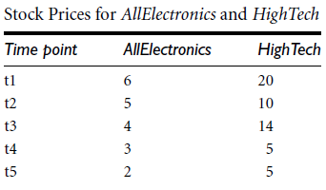
Covariance Analysis(Numeric Data)
Table shows stock prices of two companies at five time points. If the stocks are affected by same industry trends, determine whether their prices rise or fall together?

Slide 43
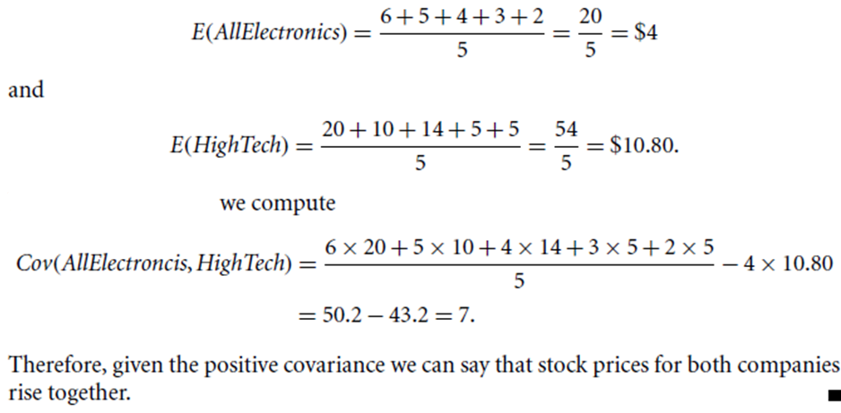
Covariance Analysis(Numeric Data)

Slide 44
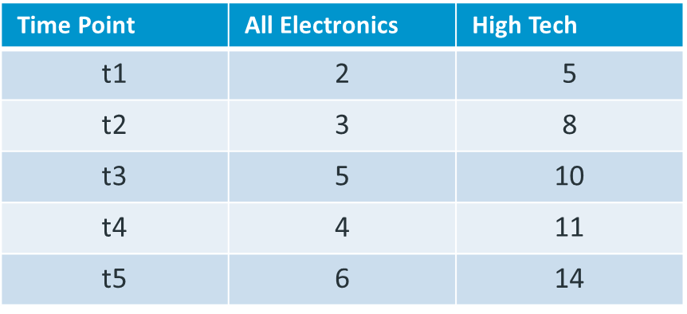
Correlation: example
An example of stock prices observed at five time points for AllElectronics and HighTech, a high-tech company. If the stocks are affected by the same industry trends, will their prices rise or fall together?
Suppose two stocks A and B have the following values in one week: (2, 5), (3, 8), (5, 10), (4, 11), (6, 14).
Question: If the stocks are affected by the same industry trends, will their prices rise or fall together?
E(A) = (2 + 3 + 5 + 4 + 6)/ 5 = 20/5 = 4
E(B) = (5 + 8 + 10 + 11 + 14) /5 = 48/5 = 9.6
Cov(A,B) = (2×5+3×8+5×10+4×11+6×14)/5 − 4 × 9.6 = 4
Thus, A and B rise together since Cov(A, B) > 0.

Slide 45
Data Value Conflict Detection and Resolution
For the same real-world entity, attribute values from different sources may differ
Eg. Prices of rooms in different cities may involve different currencies
Attributes may also differ on the abstraction level, where an attribute in one system is recorded at, say, a lower abstraction level than the “same” attribute in another.
Eg. total sales in one database may refer to one branch of All_Electronics, while an attribute of the same name in another database may refer to the total sales for All_Electronics stores in a given region.
To resolve, data values have to be converted into consistent form

Slide 46
Data Transformation
Smoothing: remove noise from data (binning, clustering, regression)
Aggregation: summarization, data cube construction
Generalization: concept hierarchy climbing
Normalization: scaled to fall within a small, specified range
Min-max normalization
Z-score normalization
Normalization by decimal scaling
Attribute/feature construction
New attributes constructed from the given ones
E.g. add attribute area based on the attributes height and width
‹#›

Slide 47
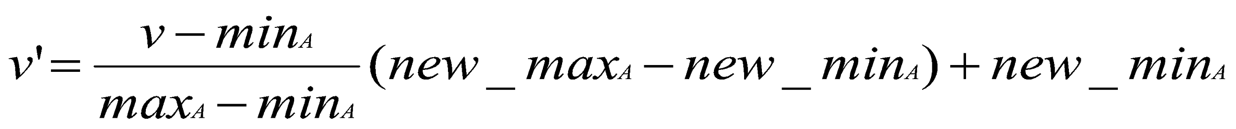
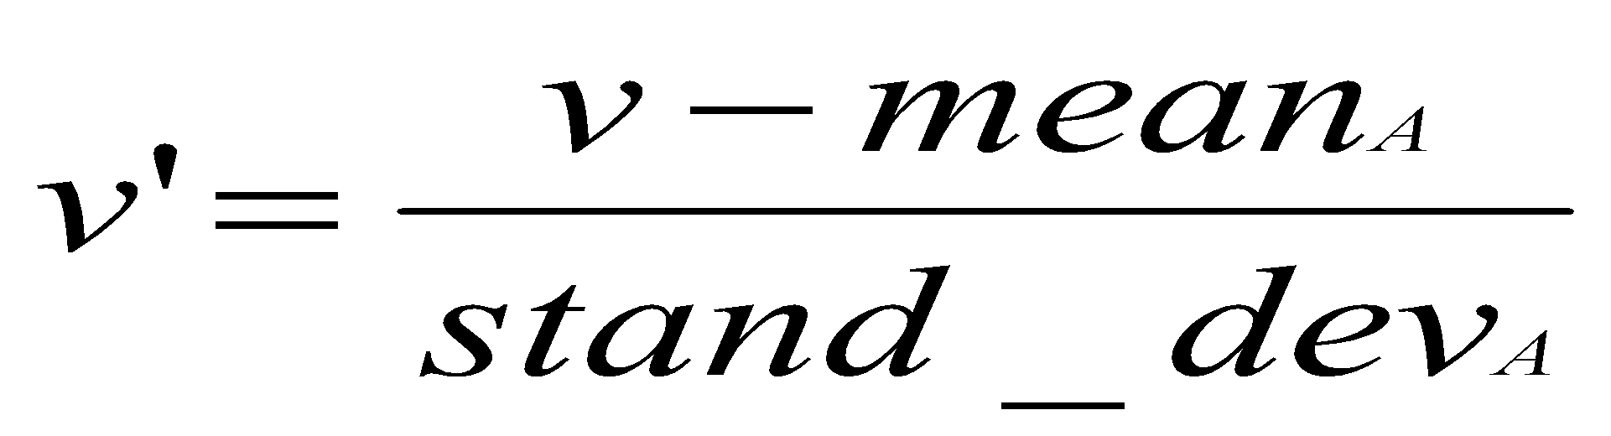
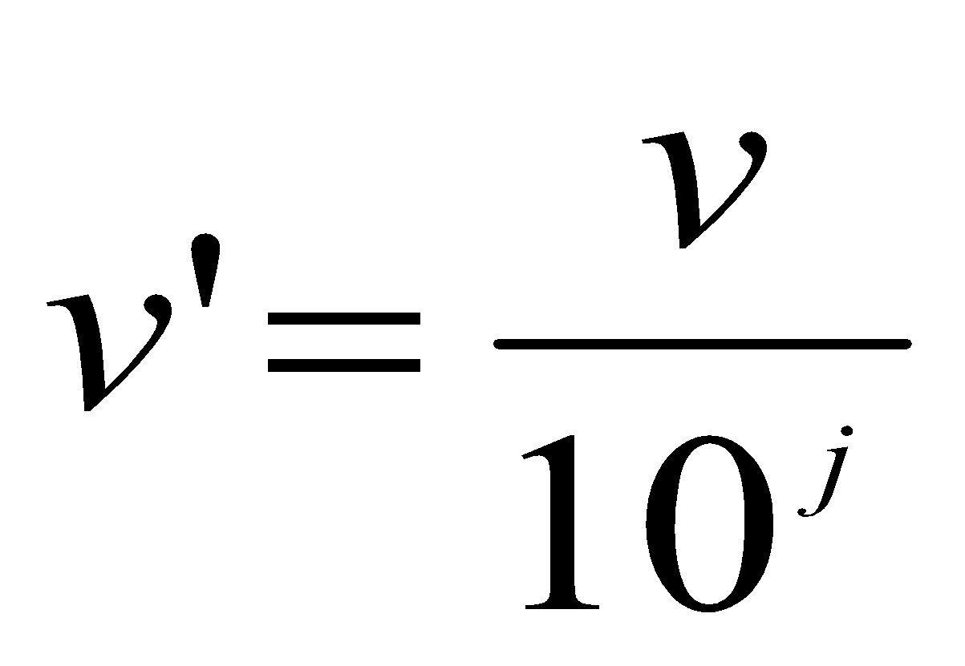
Data Transformation: Normalization
Min-max normalization
Z-score normalization
Normalization by decimal scaling
Where j is the smallest integer such that Max(| |)<1

Slide 48
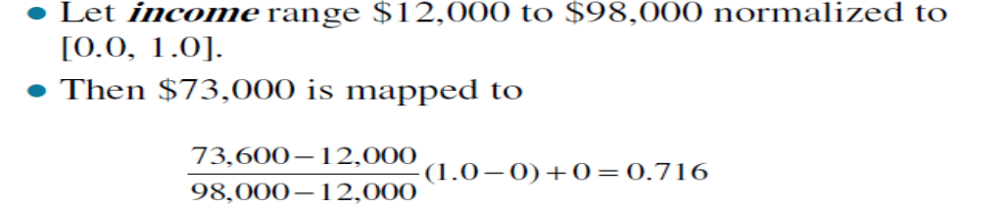
Data Transformation: Min Max-Normalization
Min-max normalization: to [new_minA, new_maxA]
Performs a linear transformation on the original data.
Suppose that min_{a} and max_{a} are the minimum and maximum values of an attribute, a.
Min-max normalization maps a value, v_{i} , of a to the range [new_min_{a}, new_max_{a}] by computing
Eg. Suppose that the minimum and maximum values for the attribute income are $12,000 and $98,000, respectively. We would like to map income to the range [0.0, 1.0]. By min-max normalization, a value of $73,600 for income is transformed to 0.716

Slide 49

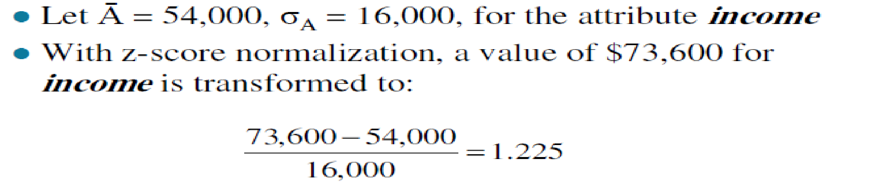
Data Transformation: Z-score Normalization
Z-score normalization (uses mean & σ: standard deviation):
Values for an attribute, A, are normalized based on the mean (i.e., average) and standard deviation of A
Eg. Suppose that the mean and standard deviation of the values for the attribute income are $54,000 and $16,000, respectively.

Slide 50
Data Transformation: Decimal scaling Normalization
Suppose that the recorded values of A ranges from -986 to 917
The maximum absolute value of A is 986
To normalize by decimal scaling, we therefore divide each value by 1000
So that -986 normalize to -0.986 and
917 normalize to -0.917

Slide 51
Data Warehouse and Data Mining
Introduction to KDD
Data Preprocessing: An Overview
Data Quality
Major Tasks in Data Preprocessing
Data Cleaning
Data Integration
Data Reduction
Data Transformation and Data Discretization
Summary

Slide 52
Exercise
Define Normalization.
What is the value range of min-max. Use min-max normalization to normalize the following group of data: 8,10,15,20.
Solution:
Marks | Marks after Min-Max normalization
8 | 0
10 | 0.16
15 | 0.58
20 | 1

Slide 53
Data Reduction Strategies
Data is too big to work with
Data reduction
Obtain a reduced representation of the data set that is much smaller in volume but yet produce the same (or almost the same) analytical results
Why data reduction? — A database/data warehouse may store terabytes of data. Complex data analysis may take a very long time to run on the complete data set.
Data reduction strategies
Dimensionality reduction — remove unimportant attributes
Aggregation and clustering
Sampling

Slide 54
Data Reduction Strategies
Obtains a reduced representation of the data set that is much smaller in volume but yet produces the same (or almost the same) analytical results
Data reduction strategies
Data cube aggregation
Dimensionality reduction
Data compression
Numerosity reduction-Parametric and Non-Parametric methods
Discretization and concept hierarchy generation

Slide 55
Data Cube Aggregation
Multiple levels of aggregation in data cubes
Further reduce the size of data to deal with
Reference appropriate levels
Use the smallest representation capable to solve the task
Queries regarding aggregated information should be answered using data cube, when possible

Slide 56
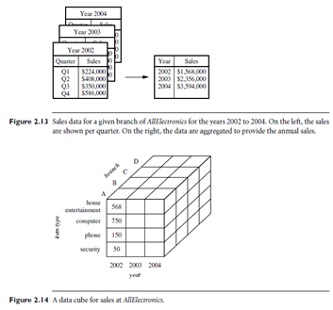
Data Cube Aggregation

Slide 57
Data Reduction Strategies
Data reduction strategies:
Dimensionality reduction, e.g., remove unimportant attributes
Wavelet transforms
Principal Components Analysis (PCA)
Feature subset selection, feature creation
Numerosity reduction (some simply call it: Data Reduction)
Regression and Log-Linear Models
Histograms, clustering, sampling
Data cube aggregation
Data compression

Slide 58
Data Reduction 1- Dimensionality Reduction
Problem: Feature selection (i.e., attribute subset selection):
Select a minimum set of features such that the probability distribution of different classes given the values for those features is as close as possible to the original distribution given the values of all features
Nice side-effect: reduces # of attributes in the discovered patterns (which are now easier to understand)
Solution: Heuristic methods (due to exponential # of choices) usually greedy:
step-wise forward selection
step-wise backward elimination
combining forward selection and backward elimination
decision-tree induction
E.g. Decision Tree

Slide 59
Dimensionality reduction :Attribute Subset Selection
Reduces the data set size by removing irrelevant or redundant attributes (or dimensions)
Goal of attribute subset selection is to ﬁnd a minimum set of attributes
Improves speed of mining as dataset size is reduced
Mining on a reduced data set also makes the discovered pattern easier to understand
Duplicate information contained in one or more attributes
E.g., purchase price of a product and the amount of sales tax paid
Irrelevant attributes
Contain no information that is useful for the data mining task at hand
E.g., students' telephone number is often irrelevant to the task of predicting students' CGPA

Slide 60
Attribute Subset Selection
Best and worst attributes are determined using tests of statistical significance
A test of significance is a formal procedure for comparing observed data with a claim (also called a hypothesis), the truth of which is being assessed
Claim is a statement about a parameter
Results of a significance test are expressed in terms of a probability that measures how well the data and the claim agree

Slide 61
Heuristic (Greedy) methods for attribute subset selection
Stepwise Forward Selection:
Starts with an empty set of attributes as the reduced set
Best of the relevant attributes is determined and added to the reduced set
In each iteration, best of remaining attributes is added to the set
Stepwise Backward Elimination:
Here all the attributes are considered in the initial set of attributes
In each iteration, worst attribute remaining in the set is removed
Combination of Forward Selection and Backward Elimination:
Stepwise forward selection and backward elimination are combined
At each step, the procedure selects the best attribute and removes the worst from among the
remaining attributes

Slide 62
Heuristic (Greedy) methods for attribute subset selection(cont)
4. Decision Tree Induction:
This approach uses decision tree for attribute selection.
It constructs a flow chart like structure having nodes denoting a test on an attribute.
Each branch corresponds to the outcome of test and leaf nodes is a class prediction.
The attribute that is not the part of tree is considered irrelevant and hence discarded

Slide 63
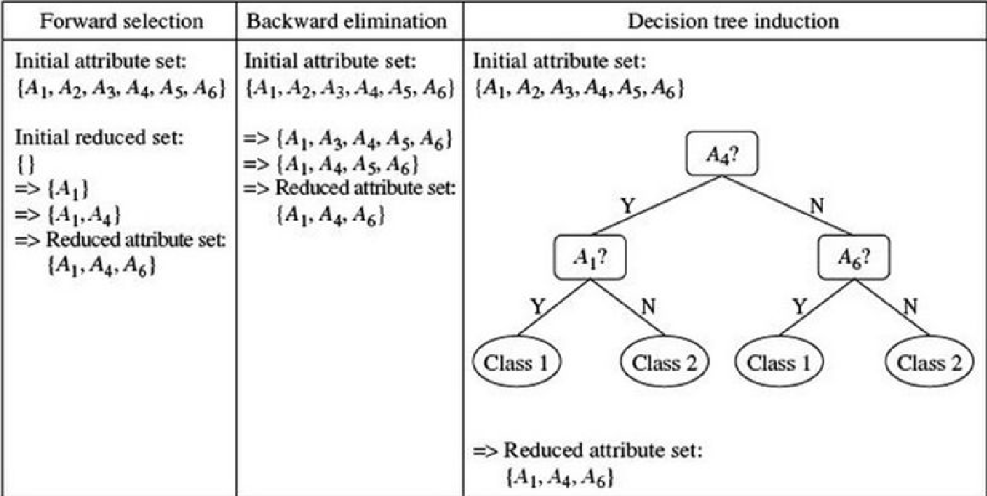
Example of Decision Tree Induction

Slide 64
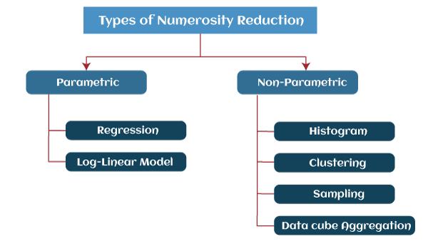
Data Reduction 2: Numerosity Reduction
Parametric methods
Assume the data fits some model, estimate model parameters, store only the parameters, and discard the data (except possible outliers)
E.g.: Log-linear models: obtain value at a point in m-D space as the product on appropriate marginal subspaces
Non-parametric methods
Do not assume models
Major families: histograms, clustering, sampling

Slide 65
Data Reduction 2: Numerosity Reduction

Slide 66
Regression and Log-Linear Models
Linear regression: Data are modeled to fit a straight line: Y = α + β X
Often uses the least-square method to fit the line
Multiple regression: allows a response variable y to be modeled as a linear function of multidimensional feature vector (predictor variables) Y = b0 + b1 X1 + b2 X2.
Log-linear model: approximates discrete multidimensional joint probability distributions p(a, b, c, d) = αab βacχad δbcd

Slide 67
Histograms
Histograms (or frequency histograms) are at least a century old and are widely used.
Plotting histograms is a graphical method for summarizing the distribution of a given attribute, X.
Height of the bar indicates the frequency (i.e., count) of that X value
Range of values for X is partitioned into disjoint consecutive subranges.
Subranges, referred to as buckets or bins, are disjoint subsets of the data distribution for X.
Range of a bucket is known as the width
Typically, the buckets are of equal width.
Eg. a price attribute with a value range of $1 to $200 can be partitioned into subranges 1 to 20, 21 to 40, 41 to 60, and so on.
For each subrange, a bar is drawn with a height that represents the total count of items observed within the subrange

Slide 68
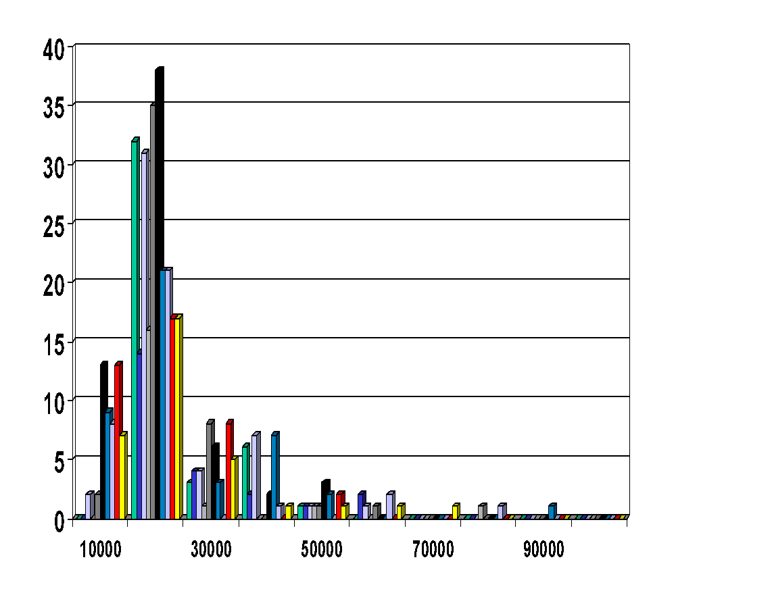
Histograms
Approximate data distributions
Divide data into buckets and store average (sum) for each bucket
A bucket represents an attribute-value/frequency pair
Can be constructed optimally in one dimension using dynamic programming
Related to quantization problems.

Slide 69
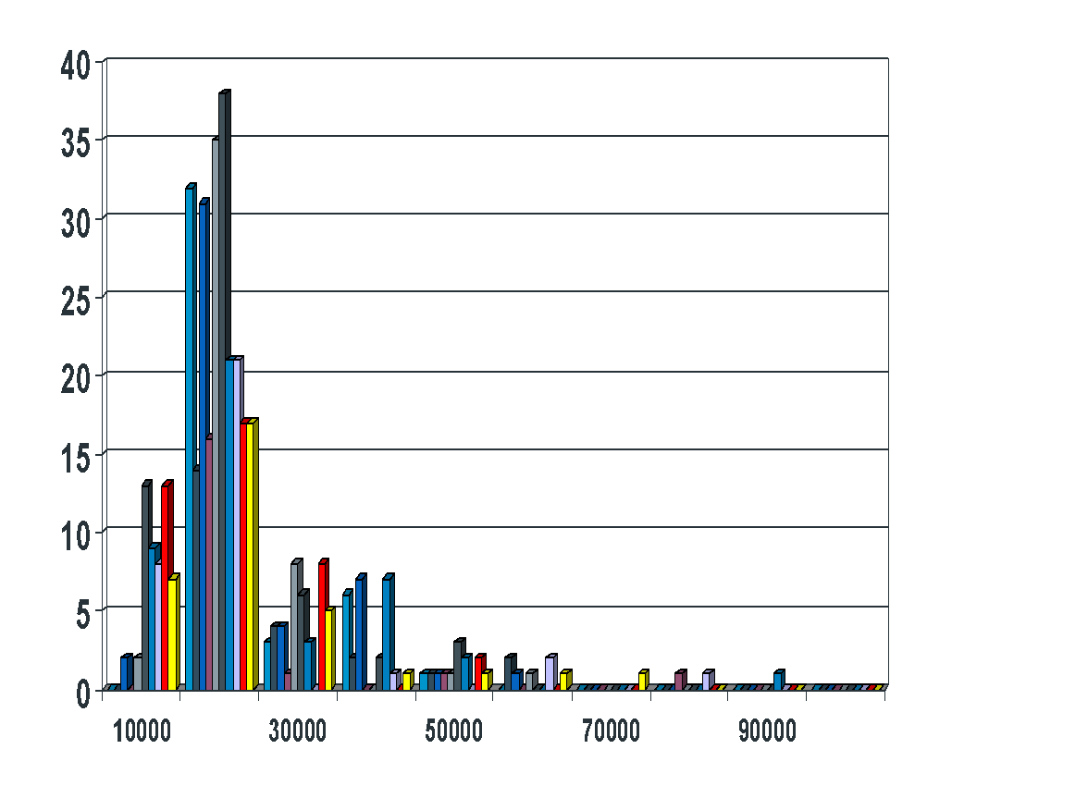
Histogram
Divide data into buckets and store average (sum) for each bucket
Partitioning rules:
Equal-width: equal bucket range
Equal-frequency (or equal-depth)

Slide 70
Histogram Analysis- Explanation & Example
Plotting histograms, or frequency histograms, is a graphical method for summarizing the distribution of a given attribute.
A histogram for an attribute A partitions the data distribution of A into disjoint subsets, or buckets. Typically, the width of each bucket is uniform.
Each bucket is represented by a rectangle whose height is equal to the count or relative frequency of the values at the bucket.
The following data are a list of AllElectronics prices for commonly sold items (rounded to the nearest dollar).

Slide 71
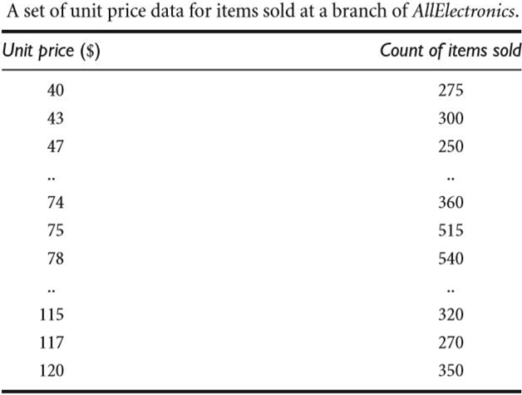
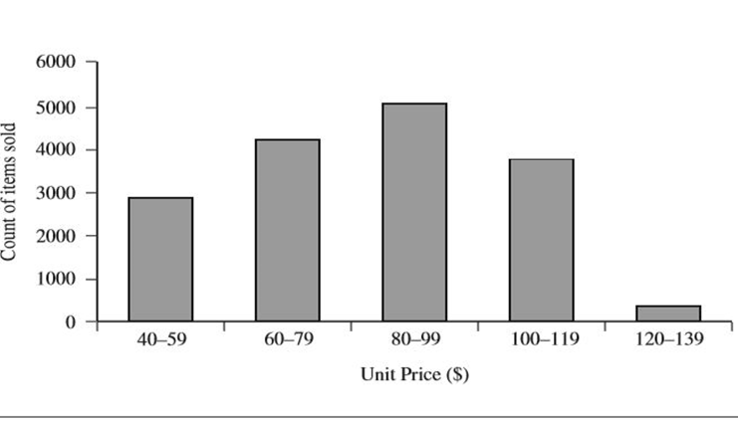
Histogram Analysis- Explanation & Example

Slide 72
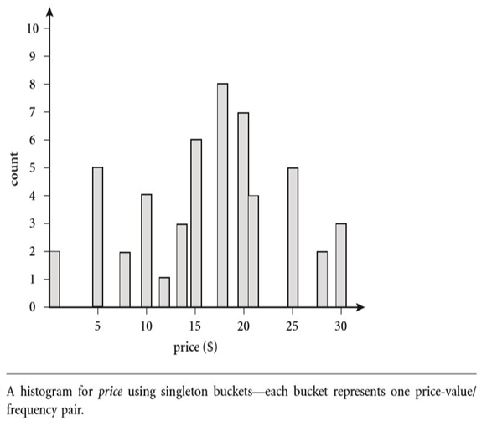
Histogram Analysis- Explanation & Example
The following data are a list of prices of commonly sold items at AllElectronics (rounded to the nearest dollar).
The numbers have been sorted:
1, 1, 5, 5, 5, 5, 5, 8, 8, 10, 10, 10, 10, 12, 14, 14, 14, 15, 15, 15, 15, 15, 15, 18, 18, 18, 18, 18, 18, 18, 18, 20, 20, 20, 20, 20, 20, 20, 21, 21, 21, 21, 25, 25, 25, 25, 25, 28, 28, 30, 30, 30.

Slide 73
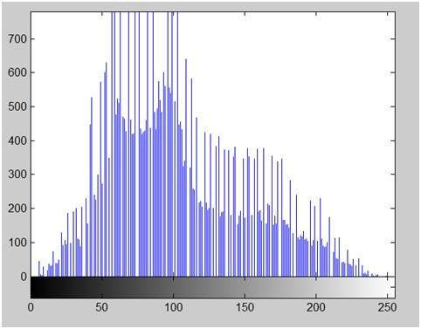
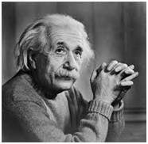
Histogram of an image : Application
As you can see from the graph, that most of the bars that have high frequency lies in the first half portion which is the darker portion. That means that the image we have got is darker

Slide 74
Data Compression
String compression
There are extensive theories and well-tuned algorithms
Typically lossless
But only limited manipulation is possible without expansion
Audio/video, image compression
Typically lossy compression, with progressive refinement
Sometimes small fragments of signal can be reconstructed without reconstructing the whole
Time sequence is not audio
Typically short and vary slowly with time

Slide 75
Data Compression
Original Data
Compressed
Data
lossless
Original Data
Approximated
lossy

Slide 76
Clustering
Partition data set into clusters, and store cluster representation only
Quality of clusters measured by their diameter (max distance between any two objects in the cluster) or centroid distance (avg. distance of each cluster object from its centroid)
Can be very effective if data is clustered but not if data is “smeared”
Can have hierarchical clustering (possibly stored in multi-dimensional index tree structures (B+-tree, R-tree, quad-tree, etc))
There are many choices of clustering definitions and clustering algorithms (further details later)

Slide 77
Sampling
Sampling: obtaining a small sample s to represent the whole data set N
Allow a mining algorithm to run in complexity that is potentially sub-linear to the size of the data
Key principle: Choose a representative subset of the data
Simple random sampling may have very poor performance in the presence of skew
Develop adaptive sampling methods, e.g., stratified sampling:
In stratified sampling, researchers divide subjects into subgroups called strata based on characteristics that they share (e.g., race, gender, educational attainment). Once divided, each subgroup is randomly sampled using another probability sampling method.
Note: Sampling may not reduce database I/Os (page at a time)

Slide 78
Sampling
Allow a mining algorithm to run in complexity that is potentially sub-linear to the size of the data
Cost of sampling: proportional to the size of the sample, increases linearly with the number of dimensions
Choose a representative subset of the data
Simple random sampling may have very poor performance in the presence of skew
Develop adaptive sampling methods
Stratified sampling:
Approximate the percentage of each class (or subpopulation of interest) in the overall database
Used in conjunction with skewed data
Sampling may not reduce database I/Os (page at a time).
Sampling: natural choice for progressive refinement of a reduced data set.

Slide 79
Types of Sampling
Simple random sampling
There is an equal probability of selecting any particular item
Sampling without replacement
Once an object is selected, it is removed from the population
Sampling with replacement
A selected object is not removed from the population
Stratified sampling:
Partition the data set, and draw samples from each partition (proportionally, i.e., approximately the same percentage of the data)
Used in conjunction with skewed data

Slide 80
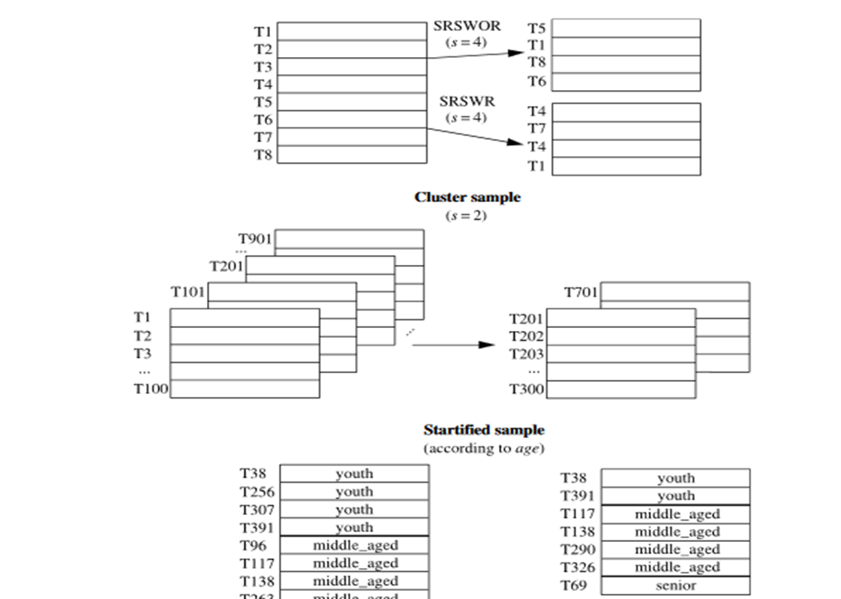
Types of Sampling
SRSWOR
(simple random
sample without
replacement)
SRSWR
Raw Data

Slide 81
Sampling
Raw Data
Cluster/Stratified Sample

Slide 82
Discretization
Three types of attributes
Nominal—values from an unordered set, e.g., color, profession
Ordinal—values from an ordered set, e.g., military or academic rank
Numeric—real numbers, e.g., integer or real numbers
Discretization: Divide the range of a continuous attribute into intervals
Discretization is one form of data transformation technique. It transforms numeric values to interval labels of conceptual labels. Ex. age can be transformed to (0-10,11-20….) or to conceptual labels like youth, adult, senior
Interval labels can then be used to replace actual data values
Reduce data size by discretization
Supervised vs. unsupervised
Split (top-down) vs. merge (bottom-up)
Discretization can be performed recursively on an attribute
Prepare for further analysis, e.g., classification

Slide 83
Data Discretization
Three types of attributes:
Nominal — values from an unordered set
Ordinal — values from an ordered set
Continuous — real numbers
Discretization/Quantization:
divide the range of a continuous attribute into intervals
Some classification algorithms only accept categorical attributes.
Reduce data size by discretization
Prepare for further analysis
x1
x2
x3
x4
x5
y1
y2
y3
y4
y5
y6

Slide 84
Discretization and Concept Hierarchies
Discretization
reduce the number of values for a given continuous attribute by dividing the range of the attribute into intervals. Interval labels can then be used to replace actual data values.
Concept Hierarchies
reduce the data by collecting and replacing low level concepts (such as numeric values for the attribute age) by higher level concepts (such as young, middle-aged, or senior).

Slide 85
Discretization and Concept Hierarchies : Numerical data
Hierarchical and recursive decomposition using:
Binning (data smoothing)
Histogram analysis (numerosity reduction)
Clustering analysis (numerosity reduction)
Segmentation by natural partitioning

Slide 86
Data Discretization Methods
Typical methods: All the methods can be applied recursively
Binning
Top-down split, unsupervised
Histogram analysis
Top-down split, unsupervised
Clustering analysis (unsupervised, top-down split or bottom-up merge)
Decision-tree analysis (supervised, top-down split)
Correlation (e.g., χ²) analysis (unsupervised, bottom-up merge)
‹#›
Notes:
‹#›

Slide 87
Concept of Hierarchy in Nominal Data
In data mining, the concept of a concept hierarchy refers to the organization of data into a tree-like structure, where each level of the hierarchy represents a concept that is more general than the level below it.
This hierarchical organization of data allows for more efficient and effective data analysis, as well as the ability to drill down to more specific levels of detail when needed.
The concept of hierarchy is used to organize and classify data in a way that makes it more understandable and easier to analyze.
The main idea behind the concept of hierarchy is that the same data can have different levels of granularity or levels of detail and that by organizing the data in a hierarchical fashion, it is easier to understand and perform analysis.

Slide 88
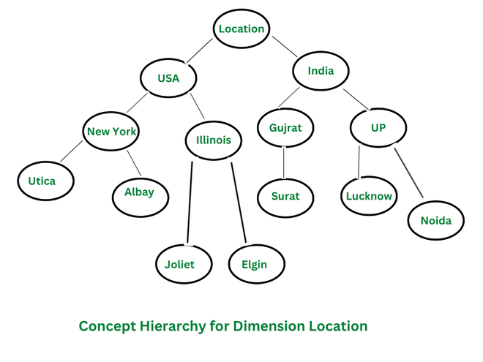
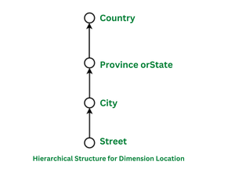
Concept of Hierarchy in Nominal Data
The top of the tree consists of the main dimension location and further splits into various sub-nodes. The root node is located, and it further splits into two nodes countries i.e. USA and India. These countries are further then splitted into more sub-nodes, that represent the province states ie. New York, Illinois, Gujarat, UP.

Slide 89
Need of Concept Hierarchy in Data Mining
Improved Data Analysis: A concept hierarchy can help to organize and simplify data, making it more manageable and easier to analyze. By grouping similar concepts together, a concept hierarchy can help to identify patterns and trends in the data that would otherwise be difficult to spot.
Improved Data Visualization and Exploration: A concept hierarchy can help to improve data visualization and data exploration by organizing data into a tree-like structure, allowing users to easily navigate and understand large and complex data sets.

Slide 90
Need of Concept Hierarchy in Data Mining
Improved Algorithm Performance: The use of a concept hierarchy can also help to improve the performance of data mining algorithms. By organizing data into a hierarchical structure, algorithms can more easily process and analyze the data, resulting in faster and more accurate results.
Data Cleaning and Pre-processing: A concept hierarchy can also be used in data cleaning and pre-processing, to identify and remove outliers and noise from the data.
Domain Knowledge: A concept hierarchy can also be used to represent the domain knowledge in a more structured way, which can help in a better understanding of the data and the problem domain.

Slide 91
Applications of Concept Hierarchy
Data Warehousing: Concept hierarchy can be used in data warehousing to organize data from multiple sources into a single, consistent and meaningful structure. This can help to improve the efficiency and effectiveness of data analysis and reporting.
Business Intelligence: Concept hierarchy can be used in business intelligence to organize and analyze data in a way that can inform business decisions. For example, it can be used to analyze customer data to identify patterns and trends that can inform the development of new products or services.
Online Retail: Concept hierarchy can be used in online retail to organize products into categories, subcategories and sub-subcategories, it can help customers to find the products they are looking for more quickly and easily.
Healthcare: Concept hierarchy can be used in healthcare to organize patient data, for example, to group patients by diagnosis or treatment plan, it can help to identify patterns and trends that can inform the development of new treatments or improve the effectiveness of existing treatments.
Natural Language Processing: Concept hierarchy can be used in natural language processing to organize and analyze text data, for example, to identify topics and themes in a text, it can help to extract useful information from unstructured data.
Fraud Detection: Concept hierarchy can be used in fraud detection to organize and analyze financial data, for example, to identify patterns and trends that can indicate fraudulent activity.

Slide 92
Summary
Data quality: accuracy, completeness, consistency, timeliness, believability, interpretability
Data cleaning: e.g. missing/noisy values, outliers
Data integration from multiple sources:
Entity identification problem
Remove redundancies
Detect inconsistencies
Data reduction
Dimensionality reduction
Numerosity reduction
Data compression
Data transformation and data discretization
Normalization
Concept hierarchy generation

Slide 93
Reference
Data Mining: Concepts and Techniques, Jiawei Han, Micheline Kamber, and Jian Pei, 3rd edition

