Slide 1

(Computer Engineering and Technology) (TYB.Tech)

Slide 2
UNIT III-Syllabus on Data Warehouse
Unit III: DATA WAREHOUSE
Introduction to Data Warehouse
OLTP and OLAP
Data Warehouse architecture
Data Warehouse Modeling: A Multidimensional Data Model
Data Warehouse Design: Stars, Snowflakes, and Fact Constellations Schemas
Dimensions: The Role of Concept Hierarchies
Measures: Their Categorization and Computation
Typical OLAP Operations, ROLAP, MOLAP,
Materialized views
Integration of Data Warehouse with other technologies

Slide 3

Scenario:A producer wants to know….
Which are our lowest/highest margin customers ?
Who are my customers and what products are they buying?
What is the most effective distribution channel?
What product prom- -otions have the biggest impact on revenue?
Which customers are most likely to go to the competition ?
What impact will new products/services
have on revenue and margins?

Slide 4


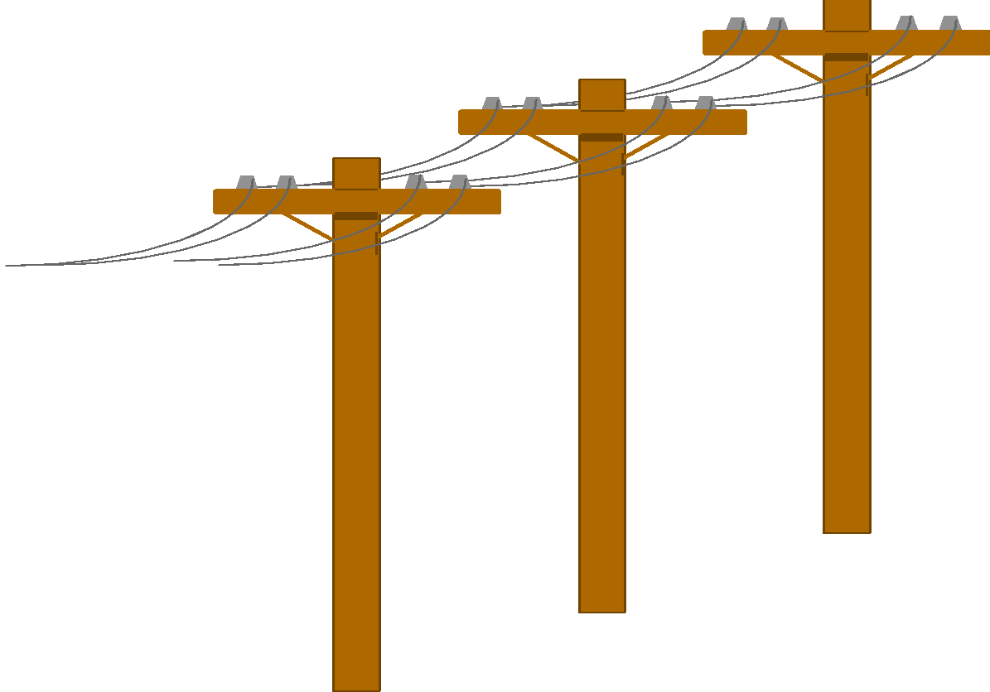
Problem: Heterogeneous Information Sources
“Heterogeneities are everywhere”
Personal
Databases
World
Wide
Web
Scientific Databases
Digital Libraries
Different interfaces
Different data representations
Duplicate and inconsistent information

Slide 5


Unified Access to Data
Integration System
World
Wide
Web
Personal
Databases
Digital Libraries
Scientific Databases
Collects and combines information
Provides integrated view, uniform user interface
Supports sharing

Slide 6
Data, Data everywhere yet ...
Can’t find the data needed
data is scattered over the network
many versions, subtle differences
Can’t get the data needed
need an expert to get the data
Can’t understand the data found
available data poorly documented
Can’t use the data found
results are unexpected
data needs to be transformed from one form to other

Slide 7
What is Data Warehouse?
A single, complete and consistent store of data obtained from a variety of different sources, made available to end users in a way they can understand and use in a business context. [Barry Devlin]
A decision support database that is maintained separately from the organization’s operational databases.
Support information processing by providing a solid platform of consolidated, historical data for analysis
“A data warehouse is a subject-oriented, integrated, time-variant, and nonvolatile collection of data in support of management’s decision-making process.”—W. H. Inmon

Slide 8
Data Warehouse Subject-Oriented
Organized around major subjects, such as customer, product, sales
Focusing on the modeling and analysis of data for decision makers, not on daily operations or transaction processing
Provide a simple and concise view around particular subject issues by excluding data that are not useful in the decision support process

Slide 9
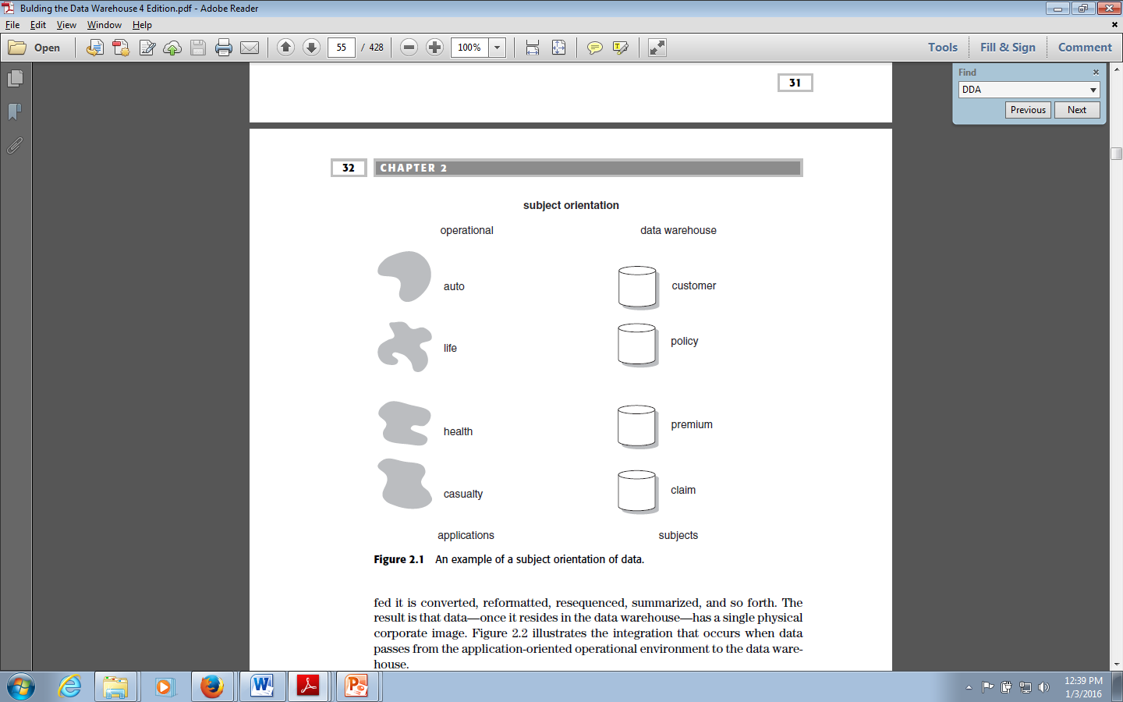
Data Warehouse -Subject-Oriented

Slide 10
. Example : Subject area—customer
There is a base table for customer information as defined from 1985 to 1987.
There is another for the definition of customer data between 1988 and 1990.
There is a cumulative customer activity table for activities between 1986 and 1989.
Each month a summary record is written for each customer record based on customer activity for the month.
There are detailed activity files by customer for 1987 through 1989 and another one for 1990 through 1991.
The definition of the data in the files is different, based on the year.
All of the physical tables for the customer subject area are related by a common key.
Figure shows that the key—customer ID—connects all of the data

Slide 11
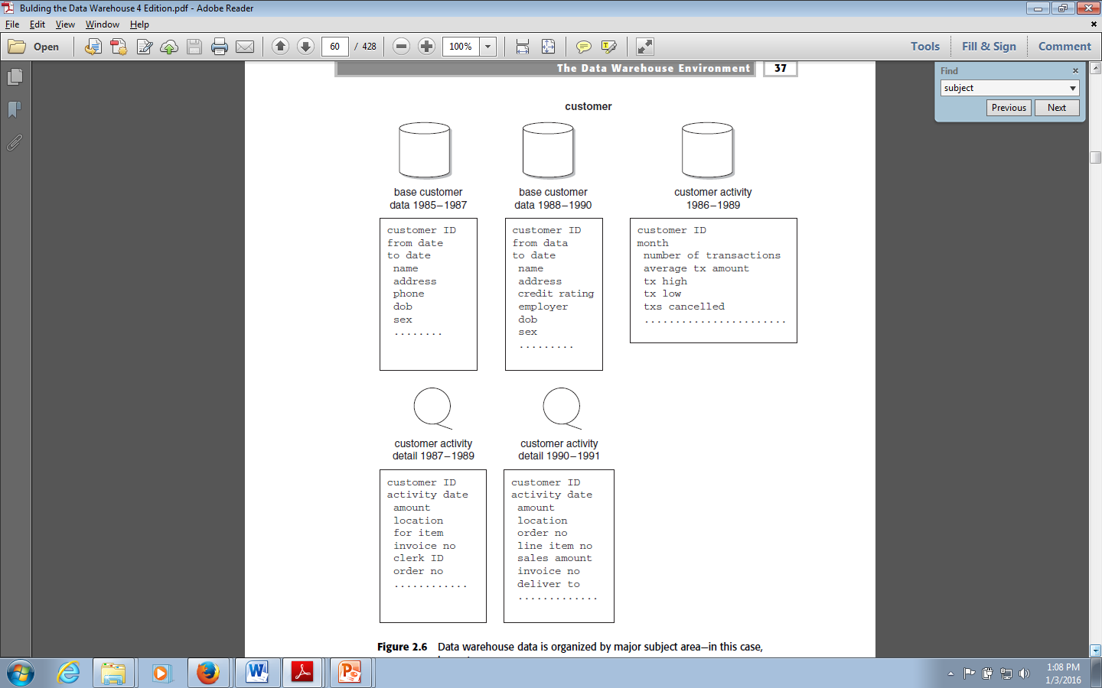
Example : Subject area—customer

Slide 12
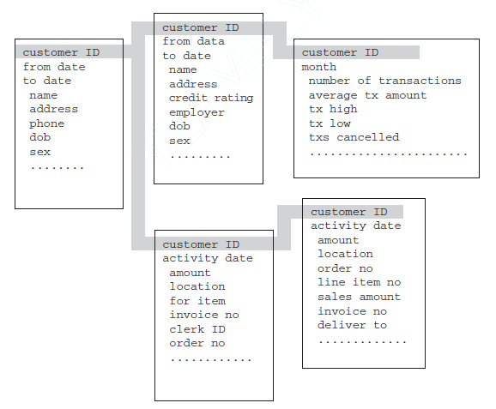
Example : Subject area—customer

Slide 13
Data Warehouse—Integrated
Constructed by integrating multiple, heterogeneous data sources
relational databases, flat files, on-line transaction records
Data cleaning and data integration techniques are applied.
Ensure consistency in naming conventions, encoding structures, attribute measures, etc. among different data sources
E.g., Hotel price: currency, tax, breakfast covered, etc.
When data is moved to the warehouse, it is converted.

Slide 14
Data Warehouse—Integrated
Across multiple applications there is no application consistency in encoding, naming conventions, physical attributes, measurement of attributes, and so forth.
Each application designer has had free rein to make his or her own design decisions.

Slide 15
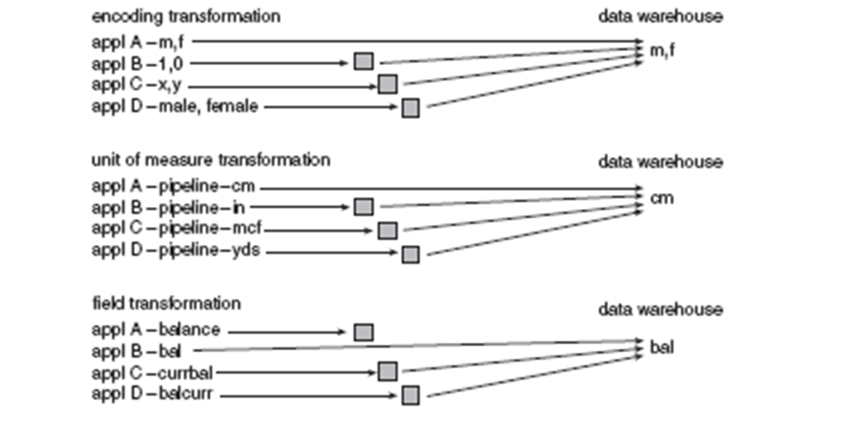
Data Warehouse—Integrated

Slide 16
Data Warehouse—Time Variant
The time horizon for the data warehouse is significantly longer than that of operational systems
Operational database: current value data
Data warehouse data: provide information from a historical perspective (e.g., past 5-10 years)
Every key structure in the data warehouse
Contains an element of time, explicitly or implicitly
But the key of operational data may or may not contain “time element”

Slide 17
Data Warehouse—Time Variant
Different environments have different time horizons. A time horizon is the parameters of time represented in an environment.
The collective time horizon for the data found inside a data warehouse is significantly longer than that of operational systems.
A 60-to-90-day time horizon is normal for operational systems;
A 5-to-10-year time horizon is normal for the data warehouse.
As a result of this difference in time horizons, the data warehouse contains much more history than any other environment

Slide 18
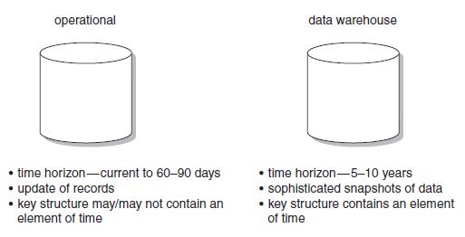
Data Warehouse—Time Variant

Slide 19
Data Warehouse—Nonvolatile
A physically separate store of data transformed from the operational environment
Operational update of data does not occur in the data warehouse environment
Does not require transaction processing, recovery, and concurrency control mechanisms
Requires only two operations in data accessing:
initial loading of data and access of data

Slide 20
Data Warehouse—Nonvolatile
Operational data is regularly accessed and manipulated one record at a time.
Data is updated in the operational environment as a regular matter of course, but data warehouse data exhibits a very different set of characteristics.
Data warehouse data is loaded (usually en masse) and accessed, but it is not updated (in the general sense).
Instead, when data in the data warehouse is loaded, it is loaded in a snapshot, static format.
When subsequent changes occur, a new snapshot record is written.
In doing so a history of data is kept in the data warehouse.

Slide 21
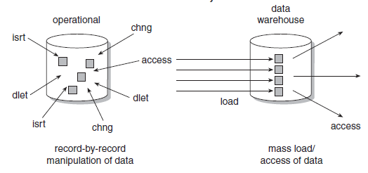
Data Warehouse—Nonvolatile

Slide 22
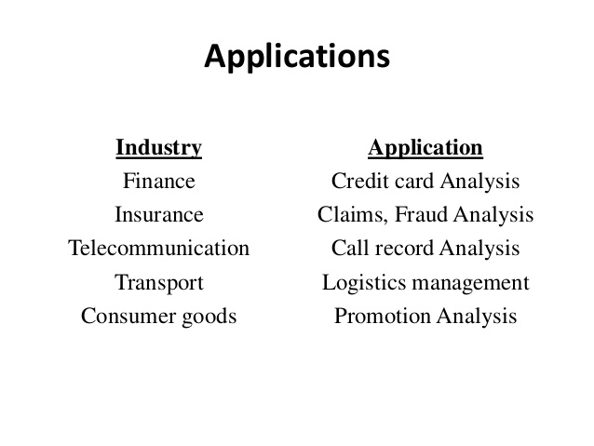
Data Warehouse

Slide 23
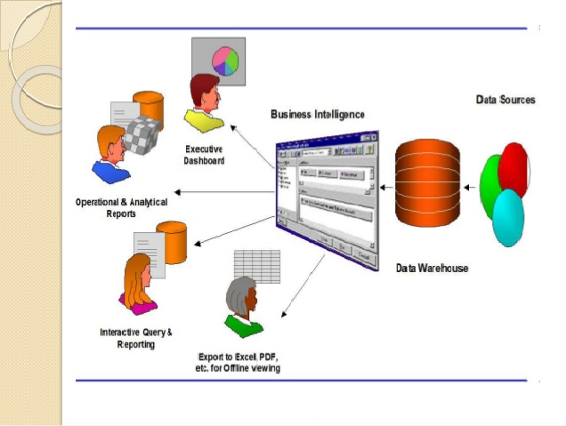
Data Warehouse:Users

Slide 24
Data Warehouse vs. Heterogeneous DBMS
Traditional heterogeneous DB integration: A query driven approach
Build wrappers/mediators on top of heterogeneous databases
When a query is posed to a client site, a meta-dictionary is used to translate the query into queries appropriate for individual heterogeneous sites involved, and the results are integrated into a global answer set.
Complex information filtering, compete for resources.
Data warehouse: update-driven, high performance
Information from heterogeneous sources is integrated in advance and stored in warehouses for direct query and analysis.

Slide 25
Data Warehouse vs. Operational DBMS
OLTP (on-line transaction processing)
Major task of traditional relational DBMS
Day-to-day operations: purchasing, inventory, banking, manufacturing, payroll, registration, accounting, etc.
OLAP (on-line analytical processing)
Major task of data warehouse system
Data analysis and decision making
Distinct features (OLTP vs. OLAP):
User and system orientation: customer vs. market
Data contents: current, detailed vs. historical, consolidated
Database design: ER + application vs. star + subject
View: current, local vs. evolutionary, integrated
Access patterns: update vs. read-only but complex queries

Slide 26
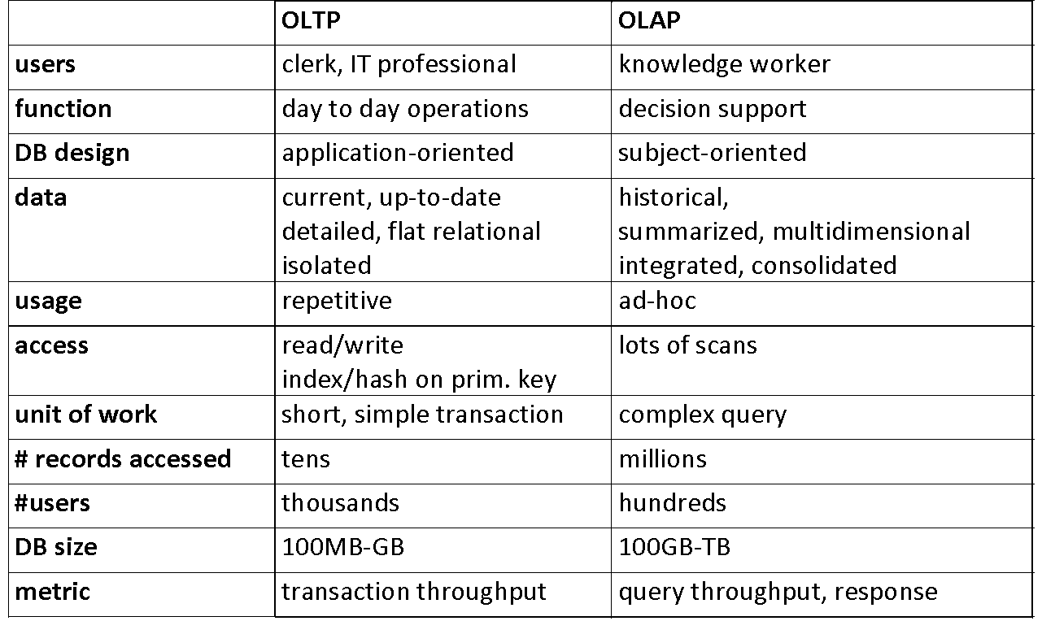
OLTP vs. OLAP

Slide 27
Why Separate Data Warehouse?
High performance for both systems
DBMS— tuned for OLTP: access methods, indexing, concurrency control, recovery
Warehouse—tuned for OLAP: complex OLAP queries, multidimensional view, consolidation
Different functions and different data:
missing data: Decision support requires historical data which operational DBs do not typically maintain
data consolidation: DS requires consolidation (aggregation, summarization) of data from heterogeneous sources
data quality: different sources typically use inconsistent data representations, codes and formats which have to be reconciled
Note: There are more and more systems which perform OLAP analysis directly on relational databases

Slide 28
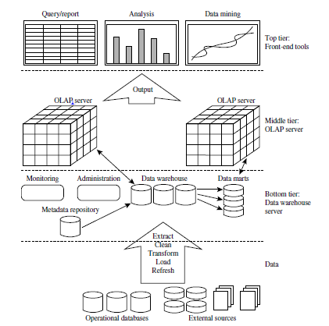
DataWarehousing: A Three-tire Architecture

Slide 29
Data Warehouse Models
Enterprise warehouse
collects all of the information about subjects spanning the entire organization
Data Mart
a subset of corporate-wide data that is of value to a specific groups of users. Its scope is confined to specific, selected groups, such as marketing data mart
Independent vs. dependent (directly from warehouse) data mart
Virtual warehouse
A set of views over operational databases
Only some of the possible summary views may be materialized
Cloud-based data warehouse
They can typically perform complex analytical queries much faster because they are massively parallel processing (MPP).

Slide 30
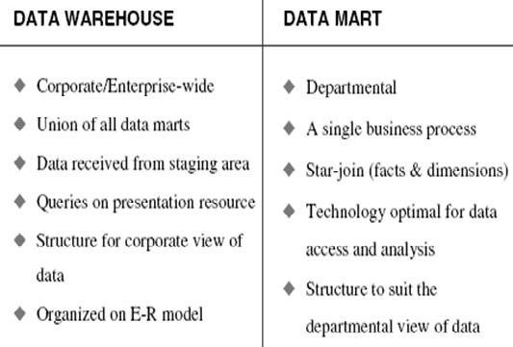
DW vs Data Mart

Slide 31
Data Warehouse: A Multi-Tiered Arhitecture
Monitor
&
Integrator
OLAP Server
Other
sources
Metadata
Analysis
Query
Reports
Data mining
Operational
DBs
Extract
Transform
Load
Refresh
Data
Warehouse
Serve
Data Marts
Data Sources
Data Storage
OLAP Engine
Front-End Tools

Slide 32
Data Warehouse Back-End Tools and Utilities
Data extraction
get data from multiple, heterogeneous, and external sources
Data cleaning
detect errors in the data and rectify them when possible
Data transformation
convert data from legacy or host format to warehouse format
Load
sort, summarize, consolidate, compute views, check integrity, and build indicies and partitions
Refresh
propagate the updates from the data sources to the warehouse

Slide 33
Metadata Repository
Meta data is the data defining warehouse objects. It stores:
Description of the structure of the data warehouse
schema, view, dimensions, hierarchies, derived data defn, data mart locations and contents
Operational meta-data
data lineage (history of migrated data and transformation path), currency of data (active, archived, or purged), monitoring information (warehouse usage statistics, error reports, audit trails)
The algorithms used for summarization
The mapping from operational environment to the data warehouse
Data related to system performance
warehouse schema, view and derived data definitions
Business data
business terms and definitions, ownership of data, charging policies

Slide 34
From Tables and Spreadsheets to Data Cubes
A data warehouse is based on a multidimensional data model which views data in the form of a data cube
A data cube, such as sales, allows data to be modeled and viewed in multiple dimensions
Dimension tables, such as item (item_name, brand, type), or time(day, week, month, quarter, year)
Fact table contains measures (such as dollars_sold) and keys to each of the related dimension tables
In data warehousing literature, an n-D base cube is called a base cuboid. The top most 0-D cuboid, which holds the highest-level of summarization, is called the apex cuboid. The lattice of cuboids forms a data cube.

Slide 35
A Sample Data Cube
Date
Total annual sales
of TV in U.S.A.
1Qtr
2Qtr
3Qtr
4Qtr
sum
Product
TV
PC
U.S.A
VCR
sum
Canada
Country
Mexico
sum
All, All, All

Slide 36
Multidimensional Data
Sales volume as a function of product, month, and region
Dimensions: Product, Location, Time
Region
Product
Month

Slide 37
Cuboids Corresponding to the Cube
all
0-D(apex) cuboid
product
date
country
1-D cuboids
product,date
product,country
date, country
2-D cuboids
3-D(base) cuboid
product, date, country

Slide 38
Cube: A Lattice of Cuboids
all
0-D(apex) cuboid
time
item
location
supplier
1-D cuboids
time,location
item,location
location,supplier
time,item
2-D cuboids
time,supplier
item,supplier
time,location,supplier
3-D cuboids
time,item,location
time,item,supplier
item,location,supplier
4-D(base) cuboid
time, item, location, supplier

Slide 39
ER Modelling
A logical design technique that seeks to eliminate data redundancy
Illuminates the microscopic relationships among data elements
Perfect for OLTP systems
Responsible for success of transaction processing in Relational Databases

Slide 40
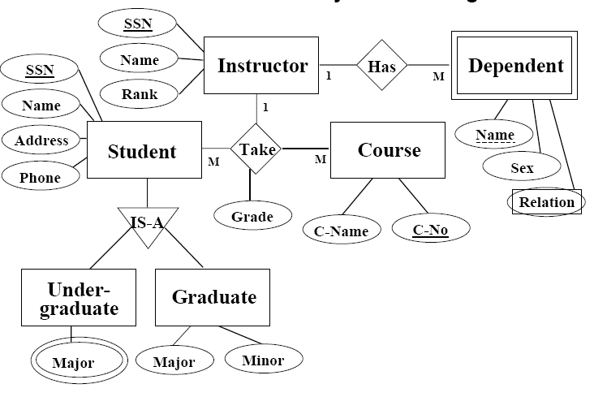
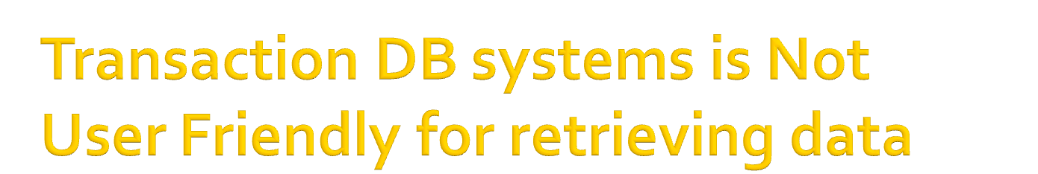
Transactional ER system is not user friendly for retrieving data

Slide 41
Problems with ER Model
ER models are NOT suitable for DW?
End user cannot understand or remember an ER Model
Many DWs have failed because of overly complex ER designs
Not optimized for complex, ad-hoc queries
Data retrieval becomes difficult due to normalization
Browsing becomes difficult

Slide 42
Design Requirements
Design of the DW must directly reflect the way the managers look at the business
Should capture the measurements of importance along with parameters by which these parameters are viewed
Must facilitate data analysis, i.e., answering business questions

Slide 43
Dimensional nature of business data
Managers think of business in terms of business dimensions
Marketing vice president is interested in revenue numbers broken down by
-month
-division
-customer
-demographic
-sales office
-product version
-plan.
These are the business dimensions

Slide 44
Dimensional nature of business data
Marketing Manager business dimensions are
-product
-product category
-time(day,week,month)
-sale district
-distribution channel

Slide 45
Dimensional nature of business data
Financial Controller business dimensions are
-budget line
-time(month,quarter,year)
-district
-division

Slide 46
Modeling of Data Warehouses
Modeling data warehouses: dimensions & measures
Star schema: A fact table in the middle connected to a set of dimension tables
Snowflake schema: A refinement of star schema where some dimensional hierarchy is normalized into a set of smaller dimension tables, forming a shape similar to snowflake
Fact constellations: Multiple fact tables share dimension tables, viewed as a collection of stars, therefore called galaxy schema or fact constellation

Slide 47
Star Schema
A single fact table and a single table for each dimension
Every fact points to one tuple in each of the dimensions and has additional attributes
Does not capture hierarchies directly
Generated keys are used for performance and maintenance reasons

Slide 48
Example of Star Schema
time
time_key
day
day_of_the_week
month
quarter
year
item
item_key
item_name
brand
type
supplier_type
Sales Fact Table
time_key
item_key
branch_key
branch
location
location_key
branch_key
branch_name
branch_type
location_key
street
city
state_or_province
country
units_sold
dollars_sold
avg_sales
Measures

Slide 49
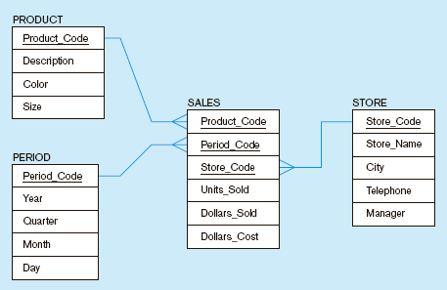
Star schema example
Fact table provides statistics for sales broken down by product, period and store dimensions

Slide 50
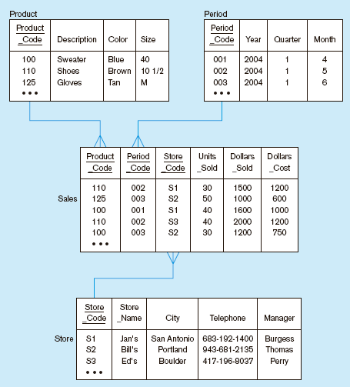
Star schema with sample data

Slide 51
STAR Schema keys
Primary Keys-Uniquely identifies a a record in dimension table
Surrogate Keys- System generated sequence numbers
Do not have any built in meanings.
Operational system keys are stored as additional attributes

Slide 52
Pros & Cons of STAR Schema
Star schema pros
simple design;
fast read and queries;
easy data aggregation
easy integration with OLAP systems and data cubes.
Star schema cons
redundant data makes for larger storage on disk;
potential for data abnormalities, errors and inconsistencies;
slower queries;
limited flexibility on non-dimensional data.

Slide 53
Snowflake Schema
A snowflake schema database is similar to a star schema in that it has a single fact table and many dimension tables.
For a snowflake schema, each dimension table might have foreign keys that relate to other dimension tables.
A snowflake schema is more normalized.
To manage the size of derived table.

Slide 54
Example of Snowflake Schema
time
item
time_key
day
day_of_the_week
month
quarter
year
Sales Fact Table
item_key
item_name
brand
type
supplier_key
supplier
supplier_key
supplier_type
time_key
item_key
branch_key
branch
location
location_key
location_key
street
city_key
branch_key
branch_name
branch_type
units_sold
dollars_sold
city
city_key
city
state_or_province
country
avg_sales
Measures

Slide 55
Snowflake Schema
Advantages
Memory save
Normalized structures easier to update and maintain
Disadvantages
Increases complexity
Browsing difficult
Degrades performance because of additional joins

Slide 56
Fact Constellation Schema
Some applications are complex in nature and require multiple fact tables or sharing of dimension tables.
This schema is one of the widely used data warehouse design methodology and is also called Galaxy schema.

Slide 57
Example of Fact Constellation
time
time_key
day
day_of_the_week
month
quarter
year
item
Shipping Fact Table
item_key
item_name
brand
type
supplier_type
Sales Fact Table
time_key
time_key
item_key
shipper_key
item_key
branch_key
from_location
branch
location_key
location
to_location
branch_key
branch_name
branch_type
units_sold
location_key
street
city
province_or_state
country
dollars_cost
dollars_sold
units_shipped
avg_sales
shipper
Measures
shipper_key
shipper_name
location_key
shipper_type

Slide 58
Pros & Cons of Fact Constellation Schema
Pros:
It fact constellation schema offers more flexibility.
Multiple fact tables are explicitly assigned to dimension tables.
Cons:
The structure is more complex and sophisticated.
It is difficult to maintain.
The number of aggregations are high in constellation.

Slide 59
Role of Metadata
Metadata in a data warehouse is data that describes and contextualizes other data. It can provide information about the content, format, structure, and other characteristics of data. Metadata can help improve the organization, discoverability, and accessibility of data, and is considered the backbone of effective data management
Data understanding : Metadata can help users understand the data stored within the system. For example, structural metadata can describe how different elements of a compound data object are assembled, such as the page layout of a document or the chapter structure of an ebook.

Slide 60
Role of Metadata
Data governance : Metadata can help ensure data accuracy and compliance, and enforce the definition of business terms to business end-users.
Data integration : Metadata can help validate data transformation and ensure the accuracy of calculations.
Data accessibility : Metadata can help improve the accessibility of data. For example, a data catalog can combine metadata with data management and search tools to help analysts and other data users find data.

Slide 61
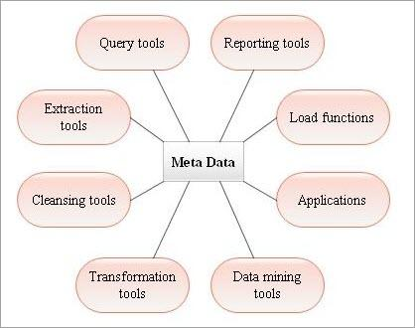
Role of Metadata

Slide 62
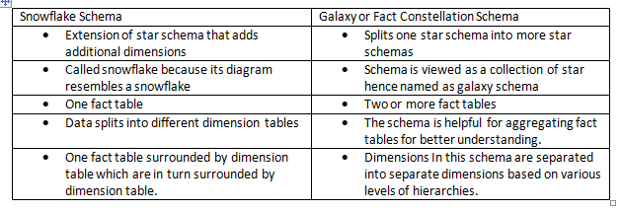
Datawarehouse : business dimensions
Identify dimensions for building a DW for claim analysis of insurance business.

Slide 63
Example of business dimensions
Agent
Time
claim
claims
Insured party
policy
status

Slide 64
Datawarehouse : business dimensions
Identify dimensions for building a DW for flyer flight analysis of Airline Company

Slide 65
Example of business dimensions
customer
Time
flight
Flyer flight
Fare class
airport
status

Slide 66
Exercise
Suppose that a data warehouse consists of the three dimensions time, doctor, and patient and the two measures count and charge, where change is that a doctor charges a patient for a visit.

Slide 67
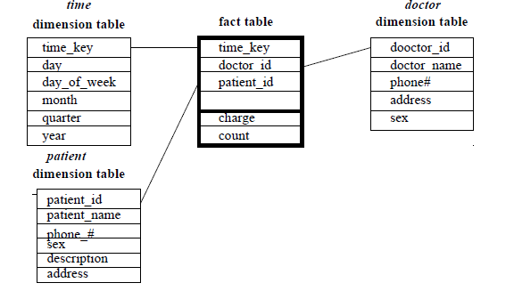
STAR Schema

Slide 68

Exercise

Slide 69
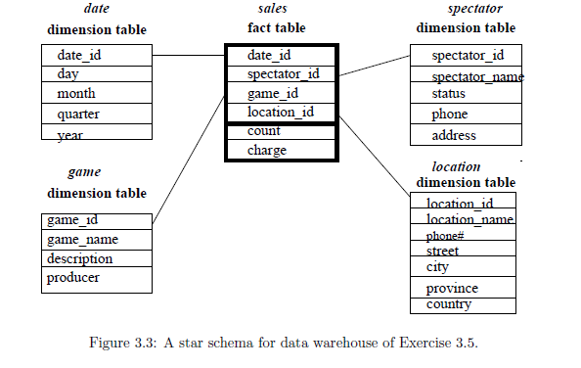
STAR Schema

Slide 70
Measures of Data Cube: Three Categories
Distributive: if the result derived by applying the function to n aggregate values is the same as that derived by applying the function on all the data without partitioning
E.g., count(), sum(), min(), max()
Algebraic: if it can be computed by an algebraic function with M arguments (where M is a bounded integer), each of which is obtained by applying a distributive aggregate function
E.g., avg(), min_N(), standard_deviation()
Holistic: if there is no constant bound on the storage size needed to describe a sub aggregate.
E.g., median(), mode(), rank()

Slide 71
A Concept Hierarchy: Dimension (location)
all
all
region
Europe
...
North_America
country
Germany
...
Spain
Canada
...
Mexico
city
Frankfurt
...
Vancouver
...
Toronto
office
L. Chan
...
M. Wind

Slide 72
Multidimensional Data
Sales volume as a function of product, month, and region
Dimensions: Product, Location, Time
Hierarchical summarization paths
Region
Industry Region Year
Category Country Quarter
Product City Month Week
Office Day
Product
Month

Slide 73
Typical OLAP Operations
Roll up (drill-up): summarize data
by climbing up hierarchy or by dimension reduction
Drill down (roll down): reverse of roll-up
from higher level summary to lower level summary or detailed data, or introducing new dimensions
Slice and dice: project and select
Pivot (rotate):
reorient the cube, visualization, 3D to series of 2D planes
Other operations
drill across: involving (across) more than one fact table
drill through: through the bottom level of the cube to its back-end relational tables (using SQL)

Slide 74
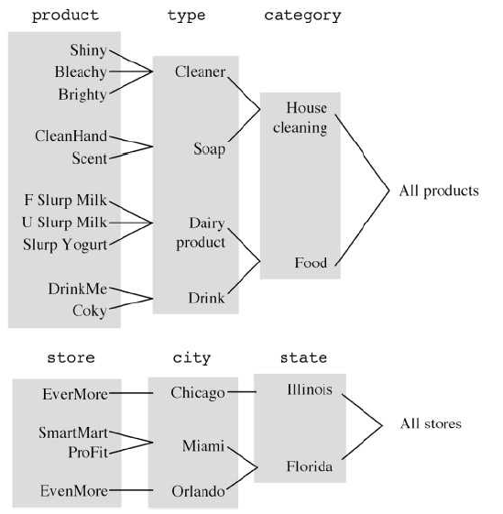
Roll up (drill-up):

Slide 75
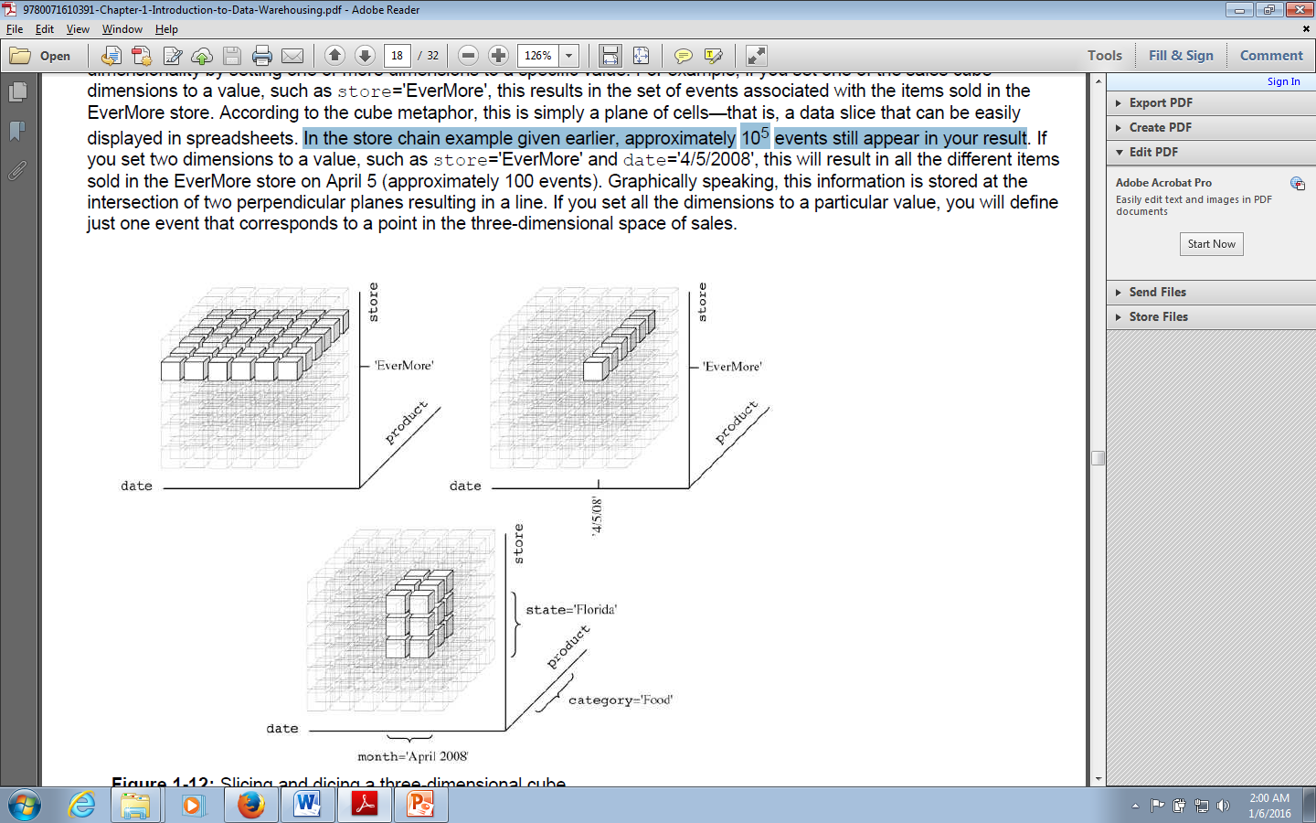
Slice and dice

Slide 76
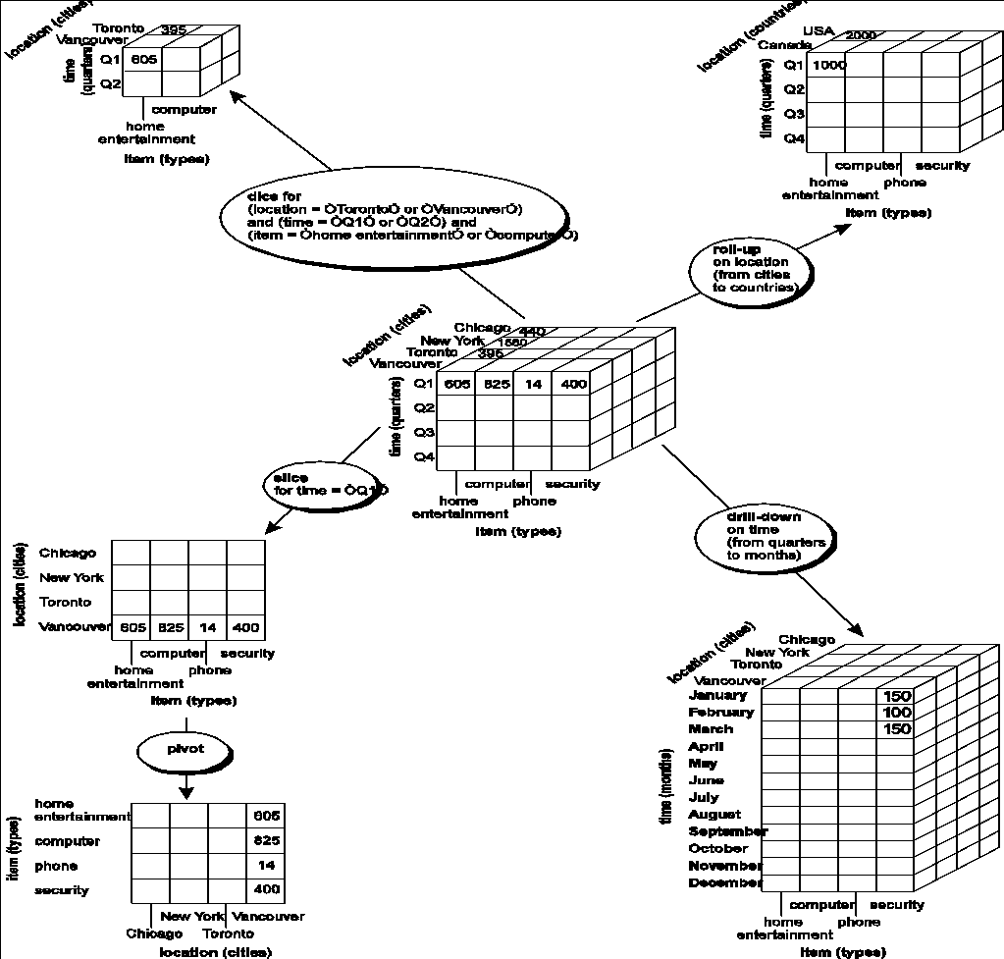

Slide 77
Design of Data Warehouse: A Business Analysis Framework
Four views regarding the design of a data warehouse
Top-down view
allows selection of the relevant information necessary for the data warehouse
Data source view
exposes the information being captured, stored, and managed by operational systems
Data warehouse view
consists of fact tables and dimension tables
Business query view
sees the perspectives of data in the warehouse from the view of end-user

Slide 78
Data Warehouse Design Process
Top-down, bottom-up approaches or a combination of both
Top-down: Starts with overall design and planning (mature)
Bottom-up: Starts with experiments and prototypes (rapid)
From software engineering point of view
Waterfall: structured and systematic analysis at each step before proceeding to the next
Spiral: rapid generation of increasingly functional systems, short turn around time, quick turn around
Typical data warehouse design process
Choose a business process to model, e.g., orders, invoices, etc.
Choose the grain (atomic level of data) of the business process
Choose the dimensions that will apply to each fact table record
Choose the measure that will populate each fact table record

Slide 79
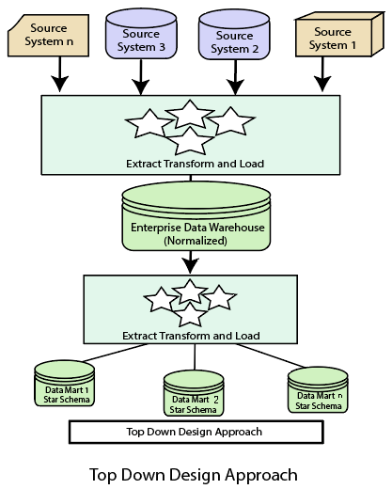
Top Down Approach

Slide 80
Top Down Approach
Advantages Of Top Down Design :
It is easier to maintain Top Down Design
Provides consistent dimensional views of data across data marts, as all data marts are loaded from the data warehouse.
This approach is robust against business changes. Creating a new data mart from the data warehouse is very easy.
Initial cost is high but subsequent project development cost is lower
Disadvantages Of Top Down Design :
It represents a very large project and the cost of implementing the project is significant.
It is time consuming and more time required for initial set up
Highly skilled people required for set up

Slide 81
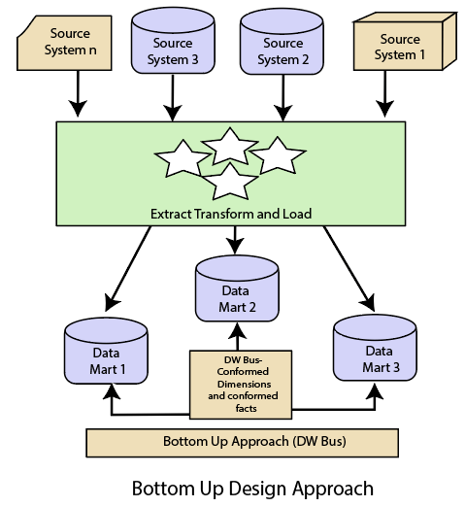
Bottom Up Approach

Slide 82
Bottom Up Approach:
Advantages Of Bottom Up Design :
This model contains consistent data marts and these data marts can be delivered quickly.
The data marts are created first to provide reporting capability
It is easier to extend the data warehouse as it can easily accommodate new business units. It is just creating new data marts and then integrating with other data marts.
This Approach take less time. Initial set up is very quickly
Disadvantage of Bottom Up Design :
Initial cost is low but each subsequent phase will cost same
The positions of the data warehouse and the data marts are reversed in the bottom-up approach design.
It is difficult to maintain and often redundant and subject to revisions

Slide 83
Data Warehouse Usage
Three kinds of data warehouse applications
Information processing
supports querying, basic statistical analysis, and reporting using crosstabs, tables, charts and graphs
Analytical processing
multidimensional analysis of data warehouse data
supports basic OLAP operations, slice-dice, drilling, pivoting
Data mining
knowledge discovery from hidden patterns
supports associations, constructing analytical models, performing classification and prediction, and presenting the mining results using visualization tools

Slide 84
OLAP Server Architectures
Relational OLAP (ROLAP)
Multidimensional OLAP (MOLAP)
Hybrid OLAP (HOLAP) (e.g., Microsoft SQLServer)
Specialized SQL servers (e.g., Redbricks)
Specialized support for SQL queries over star/snowflake schemas

Slide 85
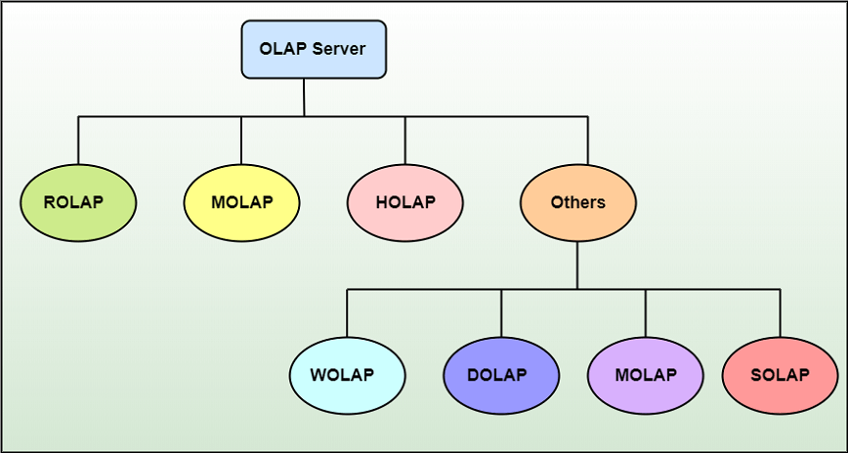
OLAP Server Architectures

Slide 86
Relational OLAP (ROLAP)
Use relational or extended-relational DBMS to store and manage warehouse data and OLAP middle ware
Include optimization of DBMS backend, implementation of aggregation navigation logic, and additional tools and services
Greater scalability
ROLAP supports RDBMS products through the use of a metadata layer, thus avoiding the requirement to create a static multi-dimensional data structure.
This facilitates the creation of multiple multi-dimensional views of the two-dimensional relation.
To improve performance, some ROLAP products have enhanced SQL engines to support the complexity of multi-dimensional analysis, while others recommend, or require, the use of highly denormalized database designs such as the star schema.

Slide 87
Relational OLAP (ROLAP)
The development issues associated with ROLAP technology:
Performance problems associated with the processing of complex queries that require multiple passes through the relational data.
Development of middleware to facilitate the development of multi-dimensional applications.
Development of an option to create persistent multi-dimensional structures, together with facilities o assist in the administration of these structures.

Slide 88
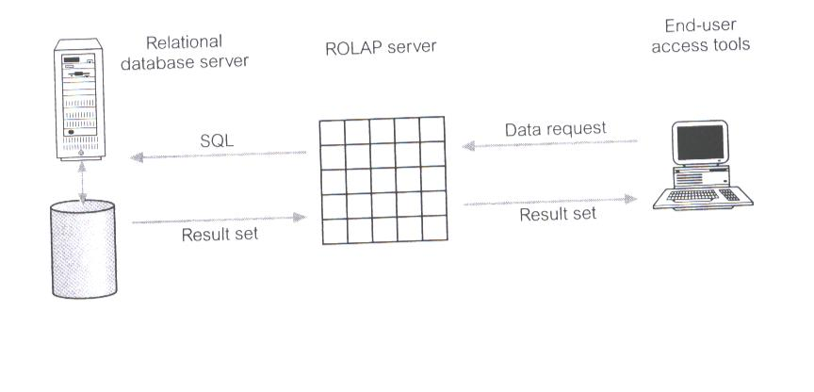
Relational OLAP (ROLAP)

Slide 89
Multidimensional OLAP (MOLAP)
MOLAP tools use specialized data structures and multi-dimensional database management systems (MDDBMS) to organize, navigate, and analyze data.
Sparse array-based multidimensional storage engine that minimize the disk space requirements through sparse data management.
Fast indexing to pre-computed summarized data
The development issues associated with MOLAP:
Only a limited amount of data can be efficiently stored and analyzed.
Navigation and analysis of data are limited because the data is designed according to previously determined requirements.
MOLAP products require a different set of skills and tools to build and maintain the database.

Slide 90
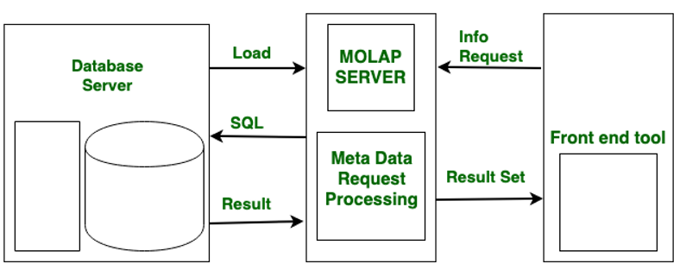
Multidimensional OLAP (MOLAP)

Slide 91
Hybrid OLAP (HOLAP)
HOLAP tools provide limited analysis capability, either directly against RDBMS products, or by using an intermediate MOLAP server.
HOLAP tools deliver selected data directly from DBMS or via MOLAP server to the desktop (or local server) in the form of data cube, where it is stored, analyzed, and maintained locally is the fastest-growing type of OLAP tools.
Flexibility, e.g., low level: relational, high-level: array
The issues associated with HOLAP tools:
The architecture results in significant data redundancy and may cause problems for networks that support many users.
Ability of each user to build a custom data cube may cause a lack of data consistency among users.
Only a limited amount of data can be efficiently maintained.

Slide 92
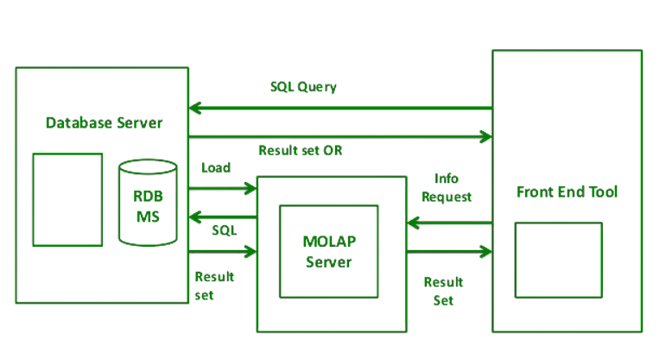
Hybrid OLAP (HOLAP)

Slide 93
Other Types
Web-Enabled OLAP (WOLAP) Server
WOLAP pertains to OLAP application which is accessible via the web browser. Unlike traditional client/server OLAP applications, WOLAP is considered to have a three-tiered architecture which consists of three components: a client, a middleware, and a database server.
Desktop OLAP (DOLAP) Server
DOLAP permits a user to download a section of the data from the database or source, and work with that dataset locally, or on their desktop.
Mobile OLAP (MOLAP) Server
Mobile OLAP enables users to access and work on OLAP data and applications remotely through the use of their mobile devices.
Spatial OLAP (SOLAP) Server
SOLAP includes the capabilities of both Geographic Information Systems (GIS) and OLAP into a single user interface. It facilitates the management of both spatial and non-spatial data.

Slide 94
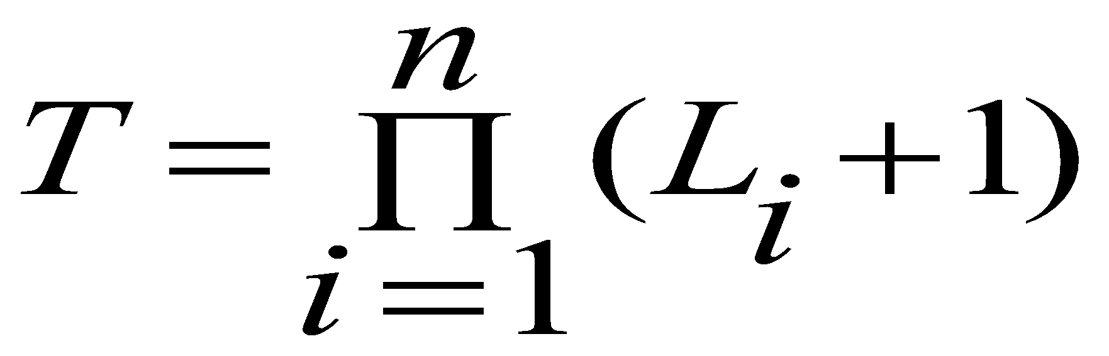
Efficient Data Cube Computation
Data cube can be viewed as a lattice of cuboids
The bottom-most cuboid is the base cuboid
The top-most cuboid (apex) contains only one cell
How many cuboids in an n-dimensional cube with L levels?
Materialization of data cube
Materialize every (cuboid) (full materialization), none (no materialization), or some (partial materialization)
Selection of which cuboids to materialize
Based on size, sharing, access frequency, etc.

Slide 95
Efficient Processing OLAP Queries
Determine which operations should be performed on the available cuboids
Transform drill, roll, etc. into corresponding SQL and/or OLAP operations, e.g., dice = selection + projection
Determine which materialized cuboid(s) should be selected for OLAP op.
Let the query to be processed be on {brand, province_or_state} with the condition “year = 2004”, and there are 4 materialized cuboids available:
1) {year, item_name, city}
2) {year, brand, country}
3) {year, brand, province_or_state}
4) {item_name, province_or_state} where year = 2004
Which should be selected to process the query?

Slide 96
Case Study
Suppose that a data warehouse for Big University consists of the following four dimensions: student, course, semester, and instructor , and two measures count and avg grade . When at the lowest conceptual level (e.g.,for a given student, course, semester, and instructor combination), the avg grade measure stores the actualcourse grade of the student. At higher conceptual levels, avg grade stores the average grade for the givencombination.
(a) Draw a snowﬂake schema diagram for the data warehouse.
(b) Starting with the base cuboid [ student,course,semester,instructor ], what speciﬁc OLAP operations (e.g., roll-up from semester to year ) should one perform in order to list the average grade of CS coursesfor each Big University student.
(c) If each dimension has ﬁve levels (including all ), such as “ student < major < status < university < all ”,how many cuboids will this cube contain (including the base and apex cuboids)?

Slide 97
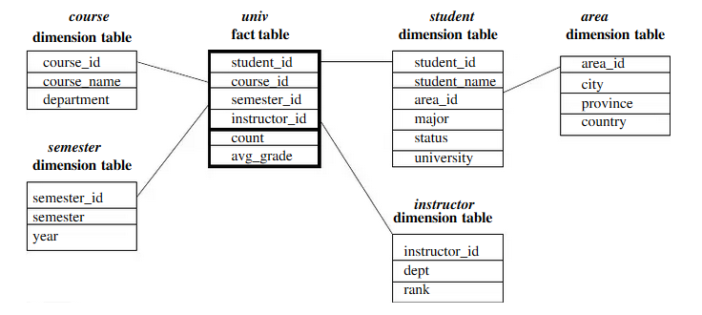
Snowﬂake Schema diagram

Slide 98
Starting with the base cuboid [ student,course,semester,instructor], what speciﬁc OLAP operations (e.g., roll-up from semester to year ) should one perform in order to list the average grade of CS courses for each Big University student. The speciﬁc OLAP operations to be performed are:
• Roll-up on course from course id to department .
• Roll-up on student from student id to university.
• Dice on course, student with department=“CS” and university = “Big University”.
• Drill-down on student from university to student name
(c) If each dimension has ﬁve levels (including all), such as student < major < status < university < all,how many cuboids will this cube contain (including the base and apex cuboids)
This cube will contain 54= 625 cuboids

