Slide 1

(Computer Engineering and Technology)
(TYB.Tech)
‹#›

Slide 2
U UNIT II- Data Warehouse
DATA WAREHOUSE
Introduction to Data Warehouse
OLTP and OLAP
Data Warehouse architecture
Data Warehouse Modeling: A Multidimensional Data Model
Data Warehouse Design: Stars, Snowflakes, and Fact Constellations Schemas
Dimensions: The Role of Concept Hierarchies
Measures: Their Categorization and Computation
Typical OLAP Operations, ROLAP, MOLAP,
Materialized views
Integration of Data Warehouse with other technologies
‹#›

Slide 3

Scenario:A manager wants to know….
Which are our
lowest/highest margin
customers ?
Who are my customers
and what products
are they buying?
What is the most
effective distribution
channel?
What product prom-
-otions have the biggest
impact on revenue?
Which customers
are most likely to buy?
What impact will
new products/services
have on revenue?
‹#›

Slide 4
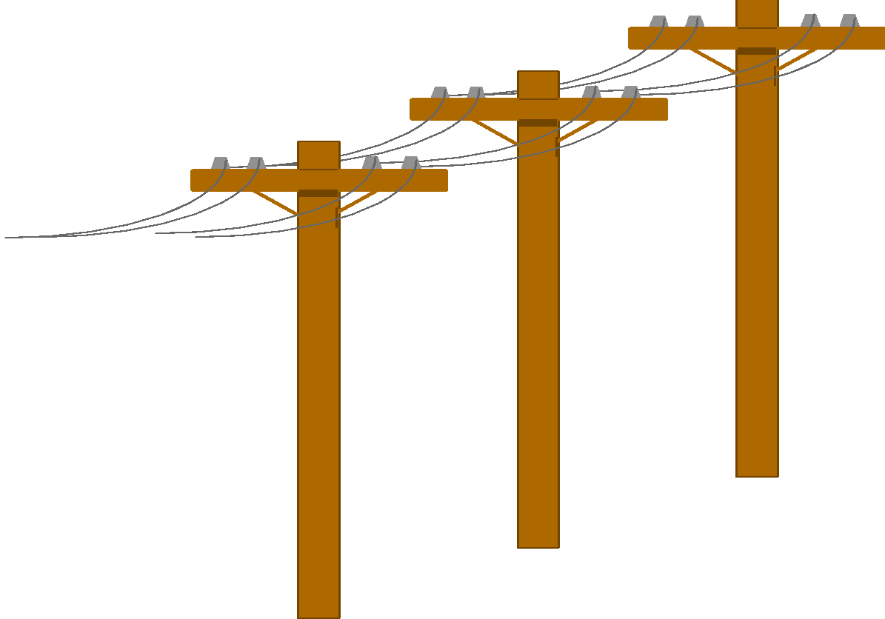

Problem: Heterogeneous Information Sources
Personal
Databases
“Heterogeneities are everywhere”
World
Wide
Web
Scientific Databases
Digital Libraries
Different interfaces
Different data representations
Duplicate and inconsistent information
‹#›

Slide 5


Unified Access to Data
Integration System
World
Wide
Web
Personal
Databases
Digital Libraries
Scientific Databases
Collects and combines information
Provides integrated view, uniform user interface
‹#›

Slide 6
Data, Data everywhere
yet ...
Can’t find the data needed
data is scattered over the network
many versions, subtle differences
Can’t get the data needed
need an interface to get the data
Can’t understand the data found
available data poorly documented
Can’t use the data found
data needs to be transformed from one form to other
‹#›

Slide 7
What is Data Warehouse?
A single, complete and consistent store of data obtained from a variety of different sources, made available to end users in a way they can understand and use in a business context. [Barry Devlin]
A decision support database that is maintained separately from the organization’s operational databases.
Support information processing by providing a solid platform of consolidated, historical data for analysis
“A data warehouse is a subject-oriented, integrated, time-variant, and nonvolatile collection of data in support of management’s decision-making process.”—W. H. Inmon
‹#›
Notes:
‹#›

Slide 8
Data Warehouse
-Subject-Oriented
Organized around major subjects, such as customers, products, sales, revenue, etc
Focusing on the modeling and analysis of data for decision makers, not on daily operations or transaction processing
Provide a simple and concise view around particular subject issues by excluding data that are not useful in the decision support process
‹#›

Slide 9
.
Example :
Subject area—customer
There is a base table for customer information as defined from 1985 to 1987.
There is another for the definition of customer data between 1988 and 1990.
There is a cumulative customer activity table for activities between 1986 and 1989.
Each month a summary record is written for each customer record based on customer activity for the month.
There are detailed activity files by customer for 1987 through 1989 and another one for 1990 through 1991.
Definition of data in the files is different, based on the year.
All of the physical tables and files for the customer subject area are related by a common key.
Figure shows that the key—customer ID—connects all of the data
‹#›

Slide 10
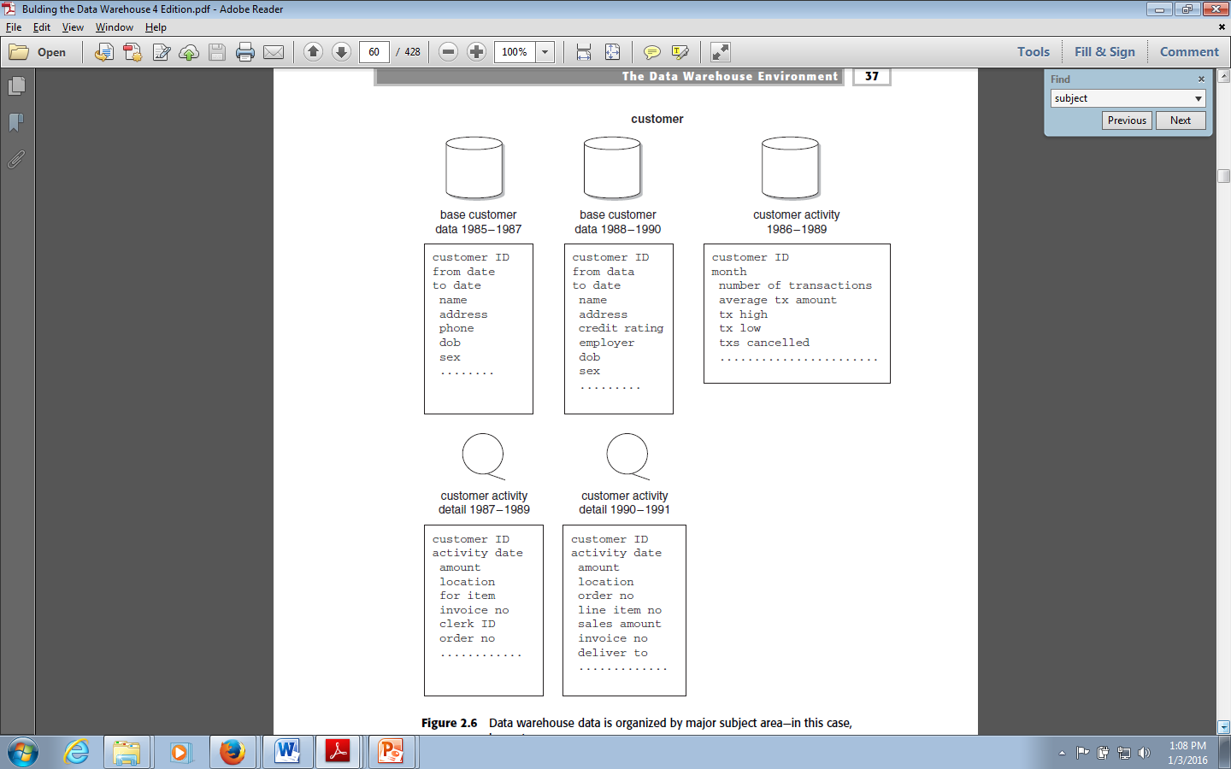
Example :
Subject area—customer
‹#›

Slide 11
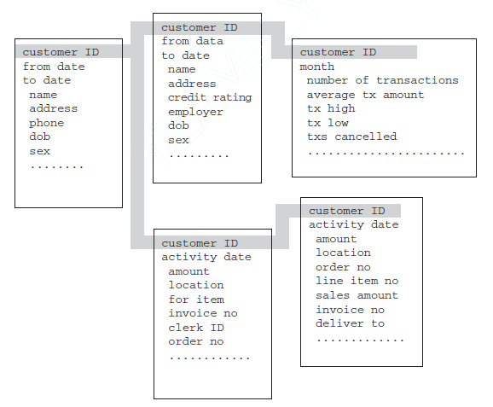
Example :
Subject area—customer
‹#›

Slide 12
Data Warehouse—Integrated
Constructed by integrating multiple, heterogeneous data sources
relational databases, flat files, etc
Data cleaning and data integration techniques are applied.
Ensure consistency in naming conventions, encoding structures, measurement units, etc. among different data sources
E.g., Hotel price: currency, tax, breakfast covered, etc.
When data is to be moved to the warehouse, it is converted.
‹#›

Slide 13
Data Warehouse—Integrated
Across multiple applications there is no application consistency in encoding, naming conventions, physical attributes, measurement of attributes, and so forth.
Each application designer has had free rein to make his or her own design decisions.
‹#›

Slide 14
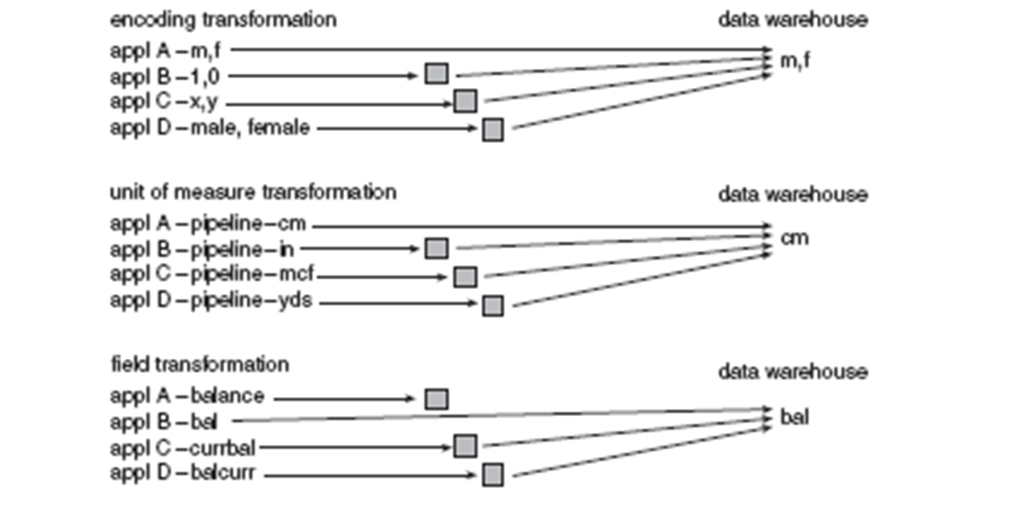
Data Warehouse—Integrated
‹#›

Slide 15
Data Warehouse—Time Variant
The time horizon for the data warehouse is significantly longer than that of operational systems
Operational database: current value data
Data warehouse : provide information from a historical perspective (e.g., past 5-10 years)
Every key structure in the data warehouse
Contains an element of time, explicitly or implicitly
But the key of operational data may or may not contain “time element”
‹#›

Slide 16
Data Warehouse—Time Variant
Different environments have different time horizons
Collective time horizon for the data found inside a data warehouse is significantly longer than that of operational systems.
60-to-90-day time horizon is normal for operational systems
5-to-10-year time horizon is normal for the data warehouse
As a result of this difference in time horizons, the data warehouse contains much more history than any other environment
‹#›

Slide 17
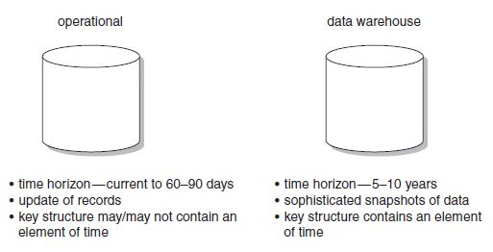
Data Warehouse—Time Variant
‹#›

Slide 18
Data Warehouse—Nonvolatile
A physically separate store of data transformed from the operational environment
Operational update of data does not occur in the data warehouse environment
Does not require transaction processing, recovery, and concurrency control mechanisms
Requires only two operations in data accessing:
initial loading of data and access of data
‹#›

Slide 19
Data Warehouse—Nonvolatile
Operational data is regularly accessed and manipulated one record at a time.
Data is updated in the operational environment as a regular matter of course, but data warehouse data exhibits a very different set of characteristics.
Data warehouse data is loaded and accessed, but it is not modified
Instead, when data in the data warehouse is loaded, it is loaded in a snapshot, static format
When subsequent changes occur, a new snapshot record is written
In doing so a history of data is kept in the data warehouse.
‹#›

Slide 20
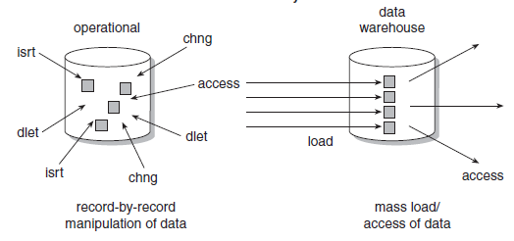
Data Warehouse—Nonvolatile
‹#›

Slide 21
Data Warehouse: Summary
Stores the information an enterprise needs to make strategic decisions
Viewed as an architecture, constructed by integrating data from multiple heterogeneous sources
Supports complex queries, analytical reporting and decision making
Allows “knowledge workers” (e.g., managers, analysts and executives) to use the warehouse
‹#›

Slide 22
Data Warehouse: Summary
How are organizations using the information from data warehouses?
To support business decision-making activities, including
(1) increasing customer focus, which includes the analysis of customer buying patterns (such as buying preference, buying time, budget cycles, and appetites for spending)
(2) repositioning products and managing product portfolios by comparing
the performance of sales by quarter, by year, and by geographic regions in order to fine-tune production strategies
(3) analyzing operations and looking for sources of profit
(4) managing customer relationships, making environmental corrections,
and managing the cost of corporate assets
‹#›

Slide 23
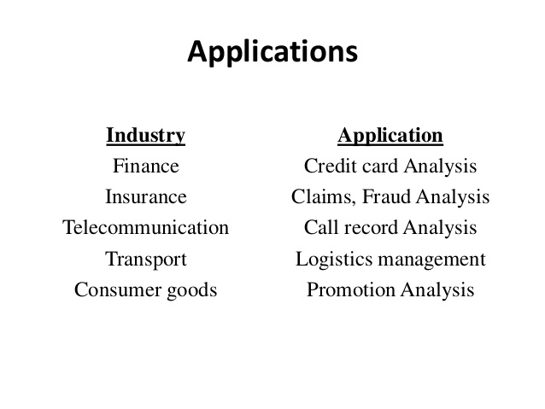
Data Warehouse
‹#›

Slide 24
Data Warehouse vs. Traditional DBMS
Traditional heterogeneous DB integration: A query driven approach
Build wrappers/mediators on top of heterogeneous databases
When a query is posed, a meta-dictionary is used to translate the query into queries appropriate for individual heterogeneous sites involved, and the results are integrated into a global answer set
Complex information filtering, integration processes & competes with local sites for processing resources
Inefficient and potentially expensive for frequent queries, especially queries requiring aggregations (complex queries)
‹#›

Slide 25
Data Warehouse vs. Traditional DBMS
Data warehouse: An update-driven approach in which
Information from multiple, heterogeneous sources is integrated in advance and stored in warehouse for direct querying and analysis
Data warehouse don’t contain most current information
Brings high performance to the integrated heterogeneous database system because data are copied, preprocessed, integrated, annotated,
summarized, and restructured into single data store.
Query processing in data warehouses does not interfere with the processing at local sources
Moreover, data warehouses can store and integrate historic information and support complex multidimensional queries
‹#›

Slide 26
Data Warehouse vs. Operational DBMS
OLTP (on-line transaction processing)
Major task of online operational database systems is to perform online transaction and query processing
Such systems are called OLTP systems
Covers day-to-day operations: purchasing, inventory, banking, manufacturing, payroll, registration, accounting, etc.
OLAP (on-line analytical processing)
Serves knowledge workers in the role of data analysis and decision making
Such systems are known as OLAP systems
‹#›

Slide 27
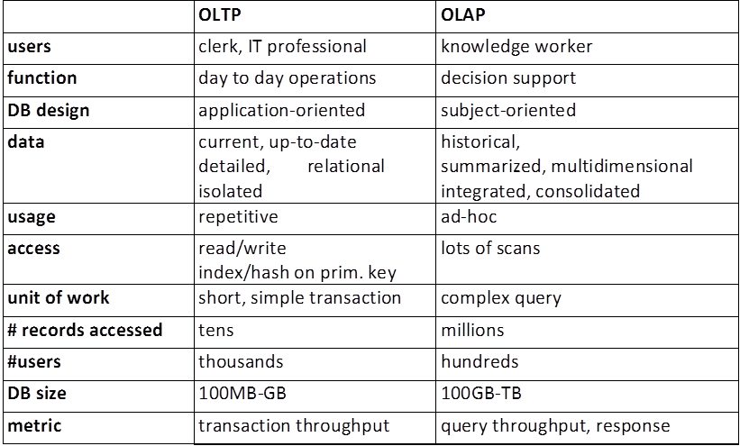
OLTP vs OLAP
‹#›

Slide 28
Why Separate Data Warehouse?
To promote High performance for both systems
DBMS— tuned for OLTP: access methods, indexing, concurrency control, recovery
Warehouse—tuned for OLAP: complex OLAP queries, multidimensional view, consolidation
Processing OLAP queries in operational databases would substantially degrade the performance of operational tasks
Different functions and different data:
missing data: Decision support requires historical data which operational DBs do not typically maintain
data consolidation: Decision support requires consolidation (aggregation, summarization) of data from heterogeneous sources
data quality: different sources typically use inconsistent data representations, codes and formats which have to be reconciled
‹#›

Slide 29
Performance: Data warehouses are designed for analytical workloads, which are typically very different from the transactional workloads that operational systems support. By separating the data warehouse from operational systems, we can ensure that both systems can perform optimally.
Scalability: Data warehouses are often very large and complex systems. By separating the data warehouse from operational systems, we can make it easier to scale the data warehouse to meet the needs of the business.
Security: Data warehouses often contain sensitive data. By separating the data warehouse from operational systems, we can make it more difficult for unauthorized users to access the data.
Data quality: Data warehouses typically contain data from a variety of sources, some of which may be of poor quality. By separating the data warehouse from operational systems, we have a chance to clean and transform the data before it is loaded into the data warehouse.
Flexibility: Data warehouses are designed to be flexible and adaptable to changing business needs. By separating the data warehouse from operational systems, we can make it easier to make changes to the data warehouse without impacting operational systems.

Slide 30
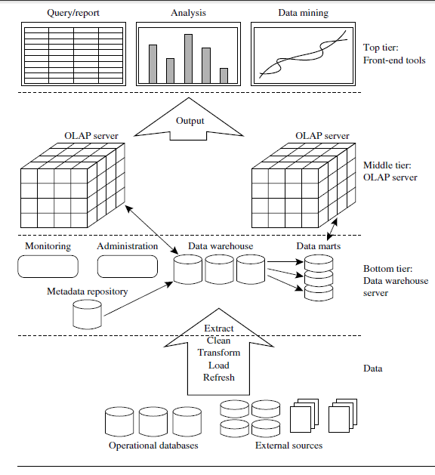
DataWarehousing: A Three-tier Architecture
‹#›

Slide 31
The three-tier architecture of a data warehouse is a logical model that divides the data warehouse into three layers:
Bottom tier: The bottom tier is the data storage layer. It is responsible for storing the raw data that is extracted from operational systems and external data sources. The bottom tier is typically implemented using a relational database management system (RDBMS).
Middle tier: The middle tier is the data processing layer. It is responsible for transforming the raw data into a format that is suitable for analysis. This includes tasks such as cleaning the data, removing duplicates, and aggregating the data. The middle tier is typically implemented using an online analytical processing (OLAP) server.

Slide 32
Top tier: The top tier is the presentation layer. It is responsible for providing users with access to the data and for displaying the results of data analysis. The top tier is typically implemented using a variety of tools, such as reporting tools, data mining tools, and analytical dashboards.
Data flow: The data flows through the three tiers as follows:
Data is extracted from operational systems and external data sources.
The data is loaded into the bottom tier, where it is stored in a raw format.
The data is transformed in the middle tier into a format that is suitable for analysis.
The data is loaded into the top tier, where it is accessible to users for analysis and reporting.

Slide 33
Benefits of three-tier architecture:
Improved performance: The three-tier architecture separates the data storage, data processing, and data presentation layers. This allows each tier to be optimized for its specific purpose. This can lead to improved performance for data analysis and reporting.
Scalability: The three-tier architecture is scalable. This means that it can be easily expanded to accommodate more data and more users.
Security: The three-tier architecture can improve data security. This is because the data is only accessible to users who have authorized access to the top tier.

Slide 34
Data Warehouse Models
Enterprise warehouse
Collects all of the information about subjects spanning the entire organization
Has greater size
Implemented on traditional mainframes, computer superservers, or parallel architecture platforms
It is a centralized data repository that stores data from all of an organization's operational systems. EDWs are typically used for complex analytics and reporting across the entire organization.
Data Mart
A subset of corporate-wide data that is of value to a specific groups of users. Its scope is confined to specific, selected groups, such as marketing data mart
Implemented on low-cost departmental servers
Independent vs. dependent (directly from warehouse) data mart
‹#›

Slide 35
Depending on the source of data, data marts can be categorized as independent or dependent. Independent data marts are sourced from data captured from one or more operational systems or external information providers, or from data generated locally within a particular department or geographic area. Dependent data marts are sourced directly from enterprise data warehouses.
A data mart is a subset of an EDW that is focused on a specific business area, such as sales or marketing. Data marts are typically used for more focused analytics and reporting within a specific business unit.

Slide 36
Data Warehouse Models
Virtual warehouse
Set of views over operational databases
Only some of the possible summary views may be materialized
Easy to build but requires excess capacity on operational database servers
A virtual data warehouse is a logical data warehouse that does not physically store data. Instead, it creates a unified view of data from multiple underlying data sources. Virtual data warehouses are typically used for businesses that need to access data from a variety of sources, such as cloud-based applications and on-premises databases.
Cloud-based data warehouse
They can typically perform complex analytical queries much faster because they are massively parallel processing (MPP).
There is no need to purchase physical hardware.
It’s quicker and cheaper to set up and scale cloud data warehouses
‹#›

Slide 37
Data Warehouse Back-End Tools and Utilities
Data extraction
get data from multiple, heterogeneous, and external sources
Data cleaning
detect errors in the data and rectify them when possible
Data transformation
convert data from legacy or host format to warehouse format
Load
sort, summarize, consolidate, compute views, check integrity, and build indicies and partitions
Refresh
propagate the updates from the data sources to the warehouse
‹#›

Slide 38
Metadata Repository
Metadata is the data defining warehouse objects.
Created for the data names and definitions of the given warehouse
Also for timestamping any extracted data, the source of the extracted data, and missing fields that have been added by data cleaning or integration processes
A metadata repository in a data warehouse is a centralized database that stores information about the data in the data warehouse. This information includes the data's structure, lineage, and business context. The metadata repository is used by a variety of tools and applications to access and manage the data in the data warehouse.
‹#›

Slide 39
Benefits of Data Repository
Improved data quality: The metadata repository can help to ensure that the data in the data warehouse is consistent, accurate, and complete.
Reduced development time: The metadata repository can help to reduce the time it takes to develop new data warehouse applications and reports.
Improved data governance: The metadata repository can help to improve data governance by providing a central repository for all data-related information.

Slide 40
Metadata Repository
Contains following
Description of the structure of the data warehouse
schema, view, dimensions, hierarchies, derived data definition, data mart locations and contents
Operational metadata
data lineage (history of migrated data and sequence of transformations performed), currency of data (active, archived, or purged), monitoring information (warehouse usage statistics, error reports, etc)
Algorithms used for summarization(which include measure and dimension,definition algorithms, data on granularity, partitions, subject areas, aggregation,summarization, and predefined queries and reports.)
Mapping from operational environment to the data warehouse(which includes source databases and their contents, gateway descriptions, data partitions, data extraction, cleaning, transformation rules and security (user authorization and access control)
Data related to system performance
Improve data access and retrieval performance, in addition to rules for the scheduling of refresh, etc
Business data
business terms and definitions, ownership of data, charging policies
‹#›

Slide 41
From Tables and Spreadsheets to Data Cubes
A data warehouse is based on a multidimensional data model which views data in the form of a data cube (n-dimensional)
A data cube, such as sales, allows data to be modeled and viewed in multiple dimensions
Defined by dimensions and facts
Dimensions are the perspectives or entities with respect to which an organization wants to keep records.These dimensions allow the store to keep track of things like monthly sales of items and the branches and locations at which the items were sold.
Each dimension may have a table associated with it, called a dimension table, which further describes the dimension
Eg. AllElectronics may create a sales data warehouse in order to keep records of the store’s sales with respect to the dimensions time, item, location and supplier
Eg. dimension table for item may contain the attributes item_name, brand, and type
‹#›
Notes:
‹#›

Slide 42
From Tables and Spreadsheets to Data Cubes
Multidimensional data model is typically organized around a central theme such as sales.
This theme is represented by a fact table. Facts are numeric measures.
Facts are the quantities by which we want to analyze relationships between dimensions
Fact table contains the names of the facts, or measures, as well as keys to each of the related dimension tables.
Eg of facts for a sales data warehouse includes dollars_ sold (sales amount in dollars), units_ sold (number of units sold), etc
Eg. of keys to each of the related dimension tables like time_key, item_key, etc
‹#›
Notes:
‹#›

Slide 43
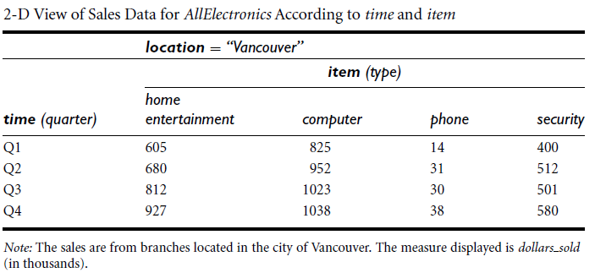
2-D Data Cube
2-D data cube is like a table or spreadsheet
Eg. AllElectronics sales data for items sold per quarter in the city of Vancouver
Sales for Vancouver are shown with respect to the time dimension (organized in quarters) and the item dimension (organized according to the types of items sold)
Fact or measure displayed is dollars_sold (in thousands)
‹#›
Notes:
‹#›

Slide 44
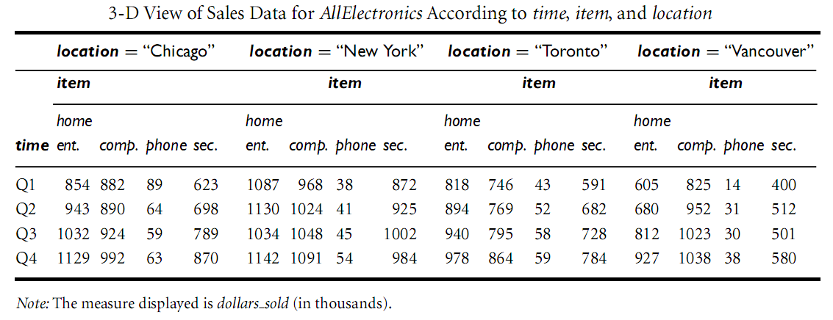
3-D Data Cube
To view the data according to time and item, as well as location, for the cities Chicago, New York, Toronto, and Vancouver
3-D data in the table are represented as a series of 2-D tables.
Conceptually, we may also represent the same data in the form of a 3-D data cube
‹#›
Notes:
‹#›

Slide 45
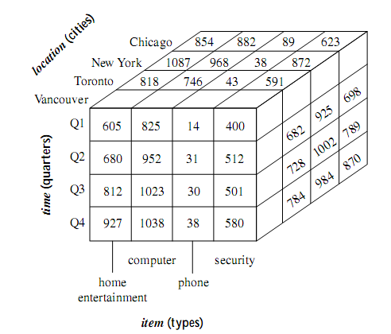
3-D Data Cube
‹#›
Notes:
‹#›

Slide 46
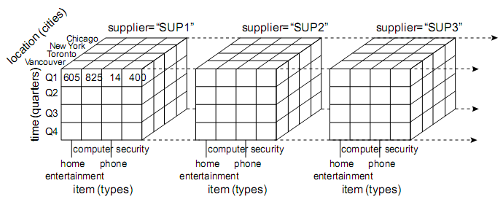
4-D Data Cube
To view our sales data with an additional fourth dimension such as supplier
we can think of a 4-D cube as being a series of 3-D cubes
Any n-dimensional data can be viewed as a series of (n-1)-dimensional cubes
Its a logical representation & physical storage may differ
‹#›
Notes:
‹#›

Slide 47
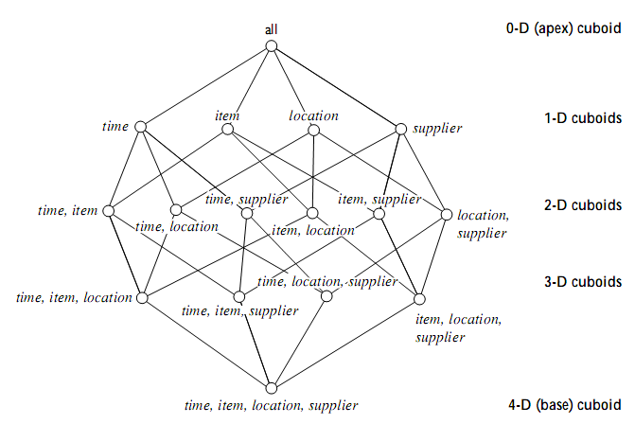
Cuboids corresponding to the Cube
In data warehousing research literature, a data cube is often referred to as a cuboid
Cuboid can be generated for each possible subsets of the given dimensions
This would form a lattice of cuboids, each showing the data at a different level of summarization
‹#›
Notes:
‹#›

Slide 48
Cuboids corresponding to the Cube
Cuboid that holds the lowest level of summarization is called the base cuboid
0-D cuboid, which holds the highest level of summarization, is called the apex cuboid
In our eg., this is the total_sales, or dollars_sold, summarized over all four dimensions
Apex cuboid is typically denoted by all
‹#›
Notes:
‹#›

Slide 49
Dimensional nature of business data
Managers think of business in terms of business dimensions
Marketing vice president is interested in revenue numbers broken down by
-month
-division
-customer
-demographic
-sales office
-product version
These are the business dimensions
‹#›
Notes:
‹#›

Slide 50
Dimensional nature of business data
Marketing Manager business dimensions are
-product
-product category
-time(day,week,month)
-sale district
-distribution channel
‹#›
Notes:
‹#›

Slide 51
Datawarehouse : business dimensions
Identify dimensions for building a DW for claim analysis of insurance business.
‹#›

Slide 52
Example of business dimensions
Agent
Time
Claim
claims
Insured party
policy
status
‹#›
Notes:
‹#›

Slide 53
Datawarehouse : business dimensions
Identify dimensions for building a DW for flyer analysis of Airline Company
‹#›

Slide 54
Example of business dimensions
customer
Time
flight
Flyer
Fare class
airport
status
‹#›
Notes:
‹#›

Slide 55
ER Modelling
Logical design technique that seeks to eliminate data redundancy
Focusses on the microscopic relationships among data elements
Emphasis on Normalization -- a technique of minimizing the insertion, deletion and update anomalies through eliminating the redundant data
Perfect for OLTP systems
Responsible for success of transaction processing in Relational Databases
‹#›
Notes:
‹#›

Slide 56
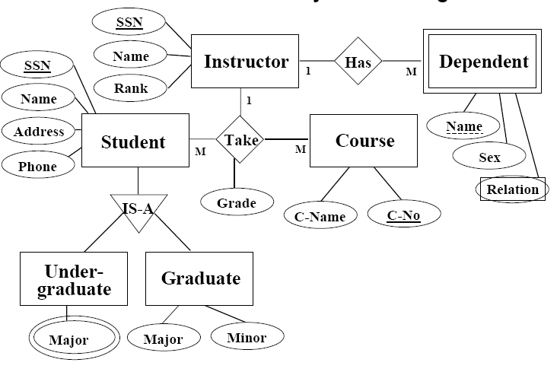
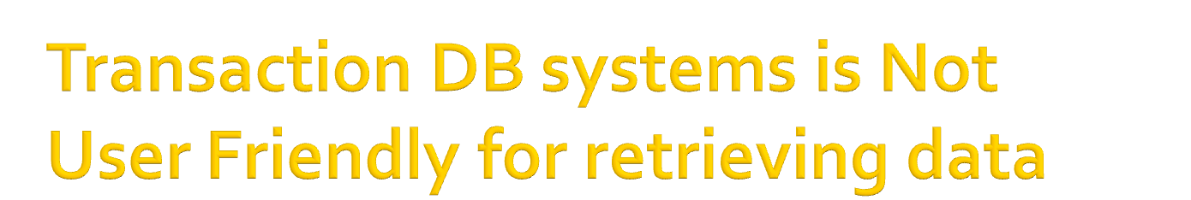
Transactional ER system is not user friendly for retrieving data
‹#›
Notes:
‹#›

Slide 57
Problems with ER Model
ER models are NOT suitable for DW?
Difficult to understand or remember an ER Model since there are lot of details
Many DWs have failed because of overly complex ER designs
Denormalization required--To achieve the faster execution of the queries redundancy is added to the data
Data retrieval becomes difficult due to normalization
Making the search and analysis faster
Not optimized for complex, ad-hoc queries
Browsing becomes difficult
‹#›
Notes:
‹#›

Slide 58
Design Requirements
Design of the DW must directly reflect the way the managers look at the business
Should capture the measurements of importance
Must facilitate data analysis, i.e., answering business questions
DW requires a subject-oriented schema that facilitates online data analysis
Data model for a data warehouse is a multidimensional model, which can exist in the form of a star schema, a snowﬂake schema, or a fact constellation schema
‹#›
Notes:
‹#›

Slide 59
Modeling of Data Warehouses
Modeling data warehouses: dimensions & measures
Star schema: A fact table in the middle connected to a set of dimension tables
Snowflake schema: A refinement of star schema where some dimensional hierarchy is normalized into a set of smaller dimension tables, forming a shape similar to snowflake
Fact constellations: Multiple fact tables share dimension tables, viewed as a collection of stars, therefore called galaxy schema or fact constellation
‹#›
Notes:
‹#›

Slide 60
Star Schema
Most common modeling paradigm is the star schema
Contains
(1) a large central table (fact table) containing the bulk of
the data and points to each dimension
(2) a set of smaller attendant tables (dimension tables), one for each dimension and contains a set of attributes
‹#›
Notes:
‹#›

Slide 61
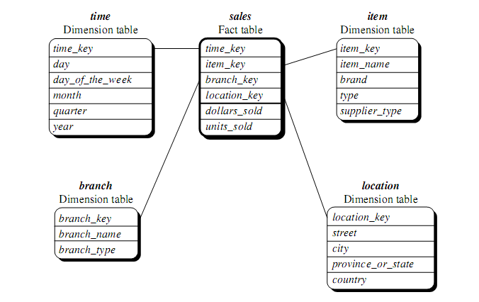
Star schema example
Sales are considered along four dimensions: time, item, branch, and location. Schema contains a central fact table for sales that contains keys to each of the four dimensions, along with two measures: dollars sold and units sold
‹#›
Notes:
‹#›

Slide 62
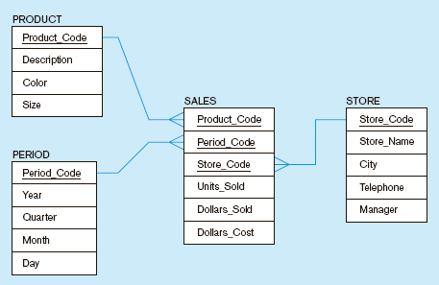
Star schema example
Fact table provides statistics for sales broken down by product, period and store dimensions
‹#›
Notes:
‹#›

Slide 63
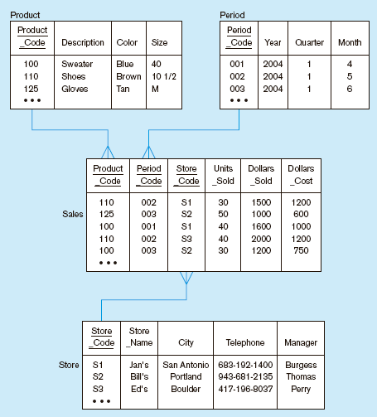
Star schema with sample data
‹#›
Notes:
‹#›

Slide 64
STAR Schema keys
Primary Keys-Uniquely identifies a record in dimension table
Surrogate Keys-
System generated sequence numbers
Do not have any built in meanings.
‹#›
Notes:
‹#›

Slide 65
Advantages of STAR Schema
Easy for users to understand
Optimizes navigation
Most suitable for complex query processing
‹#›
Notes:
‹#›

Slide 66
Exercise
Suppose that a data warehouse consists of the three dimensions time, doctor, and patient, and the two measures count and charge, where charge is the fee that a doctor charges a patient for a visit.
Draw a schema diagram for the above data warehouse
‹#›
Notes:
‹#›

Slide 67
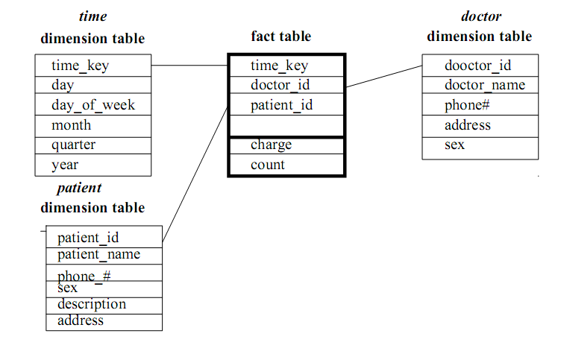
Exercise
‹#›
Notes:
‹#›

Slide 68
Snowflake Schema
Variant of the star schema model, where some dimension tables are normalized
Further splitting the data into additional tables
Resulting schema graph forms a shape similar to a snowﬂake
Eg. location dimension table contains the attribute set {location_ key, street, city, province_or_state, country}.
For instance, “Pune” is a city in the state of Maharashtra, India.
Entries for such different streets in same city will create redundancy among the attributes province_or_state and country; i.e, (...., Pune, Maharashtra, India) and (...., Pune, Maharashtra, India)
‹#›

Slide 69
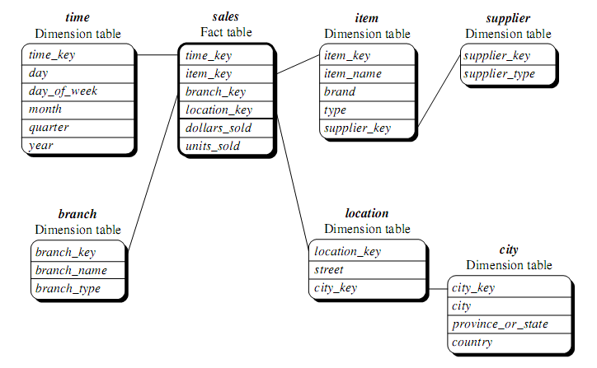
Snowflake Schema
‹#›

Slide 70
Snowflake Schema
Advantages
Saves storage space
Reduces redundancies
Disadvantages
Degrades performance because more joins needed to execute a query
System performance adversely affected
‹#›

Slide 71
Fact Constellation
Sophisticated applications may require multiple fact tables to share dimension tables
This kind of schema can be viewed as a collection of stars, and hence is called a galaxy schema or a fact constellation schema
Eg. two fact tables, sales and shipping
Fact constellation schema allows dimension tables to be shared between fact tables.
Eg. the dimensions tables for time, item, and location are shared between the sales and shipping fact tables.
‹#›

Slide 72
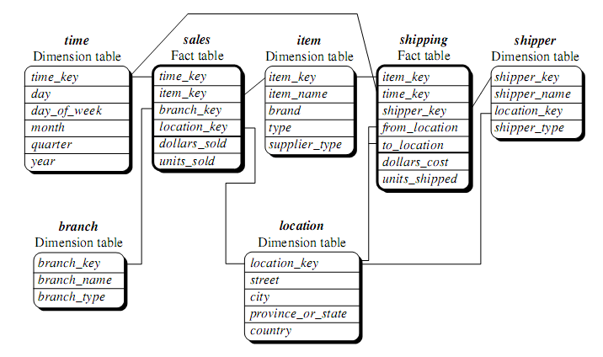
Example of Fact Constellation
‹#›

Slide 73
Modeling of Data Warehouses
Modeling data warehouses: dimensions & measures
Star schema: A fact table in the middle connected to a set of dimension tables
Snowflake schema: A refinement of star schema where some dimensional hierarchy is normalized into a set of smaller dimension tables, forming a shape similar to snowflake
Fact constellations: Multiple fact tables share dimension tables, viewed as a collection of stars, therefore called galaxy schema or fact constellation
‹#›
Notes:
‹#›

Slide 74
Modeling of Data Warehouses
Enterprise-wide data warehouses, the fact constellation schema is commonly used, since it can model multiple, interrelated subjects
For data marts, the star or snowﬂake schema is commonly used, since both are geared toward modeling selected subjects
Star schema is more popular and efﬁcient
‹#›
Notes:
‹#›

Slide 75
Concept Hierarchy: Dimensions
Sequence of mappings from a set of low-level concepts to higher-level, more general concepts
Concept hierarchies allow data to be handled at varying levels of abstraction
Eg. suppose that the dimension location is described by the attributes street, city, province_or_state and country.
These attributes are related by a total order, forming a concept hierarchy such as
“street < city < province or state < country”
‹#›
Notes:
‹#›

Slide 76
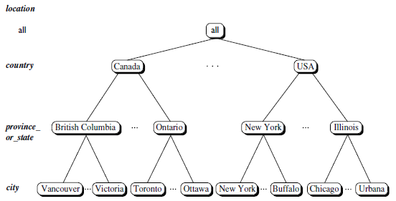
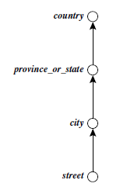
Concept Hierarchy: Dimension (location)
‹#›
Notes:
‹#›

Slide 77
Measures of Data Cube
Measure is a numeric function that can be evaluated at each point in the data cube space
Measure value is computed for a given point by aggregating the data corresponding to the respective dimension–value pairs defining the given point
Three Categories: based on the kind of aggregate functions used
Distributive
Can be computed in a distributed manner
Suppose the data are partitioned into n sets.
We apply the function to each partition, resulting in n aggregate values.
If the result derived by applying the function to the n aggregate values is the same as that derived by applying the function to the entire data set (without partitioning), the function can be computed in a distributed manner
E.g., count(), sum(), etc
‹#›

Slide 78
Measures of Data Cube: Three Categories
2. Algebraic:
Can be computed by an algebraic function with M arguments, each of which is obtained by applying a distributive aggregate function
avg() can be computed by sum()/count(), where both sum() and count() are distributive aggregate functions
3. Holistic:
Cannot be described with an algebraic function with M arguments
Eg. median() function, which cannot be described by an algebraic expression or calculated in a distributive manner
Result of any holistic function cannot be computed using pre-aggregated sub-parts and instead generally requires access to all the individual elements
‹#›

Slide 79
Typical OLAP Operations
Roll-up (drill-up):
Performs aggregation on a data cube, either by climbing up a concept hierarchy for a dimension or by dimension reduction
Eg. roll-up operation shown aggregates the data by ascending the location hierarchy from the level of city to the level of country
i.e. grouping the data by city to grouping the data by country
When roll-up is performed by dimension reduction, one or more dimensions are removed from the given cube.
Eg. consider a sales data cube containing only the location and time dimensions. Roll-up may be performed by removing, say, the time dimension, resulting in an aggregation of the total sales by location, rather than by location and by time.
‹#›

Slide 80
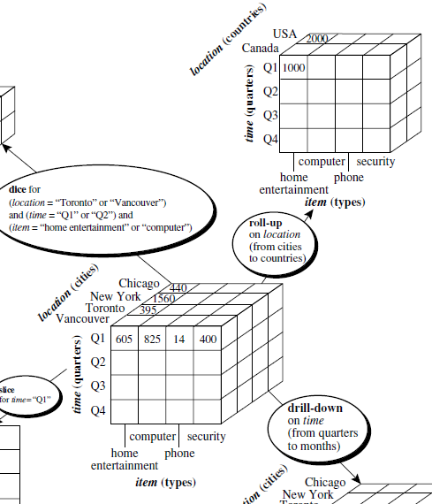
Typical OLAP Operations
‹#›

Slide 81
Typical OLAP Operations
Drill-down:
Drill-down is the reverse of roll-up
Navigates from less detailed data to more detailed data.
Drill-down can be realized by either stepping down a concept hierarchy for a dimension or introducing additional dimensions.
Drill-down operation performed on the central cube by stepping down a concept hierarchy for time defined as “day < month < quarter < year.”
Drill-down occurs by descending the time hierarchy from the level of quarter to the more detailed level of month i.e. resulting data cube details the total sales per month rather than summarizing them by quarter.
Because a drill-down adds more detail to the given data, it can also be performed by adding new dimensions to a cube. Eg. a drill-down on the cube can occur by introducing an additional dimension, such as customer group.
‹#›

Slide 82
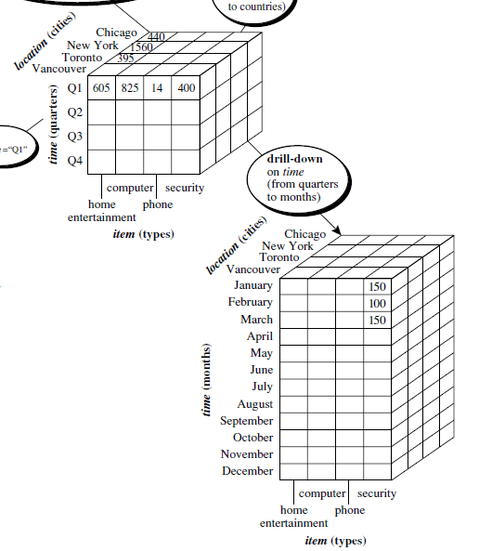
Typical OLAP Operations
‹#›

Slide 83
Typical OLAP Operations
Slice :
Performs a selection on one dimension of the given cube, resulting in a subcube
Eg. a slice operation where the sales data are selected from the central cube for the dimension time using the criterion time = “Q1.”
Dice:
Dice operation defines a subcube by performing a selection on two or more dimensions
Eg. Dice operation on the central cube based on the following selection criteria that involve three dimensions: (location =“Toronto” or “Vancouver”) and
(time = “Q1” or “Q2”) and (item = “home entertainment” or “computer”)
‹#›

Slide 84
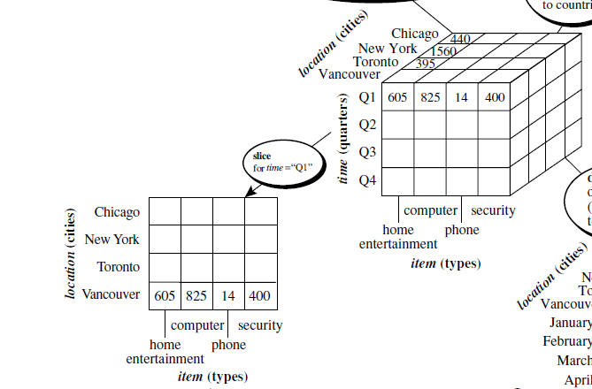
Typical OLAP Operations
‹#›

Slide 85
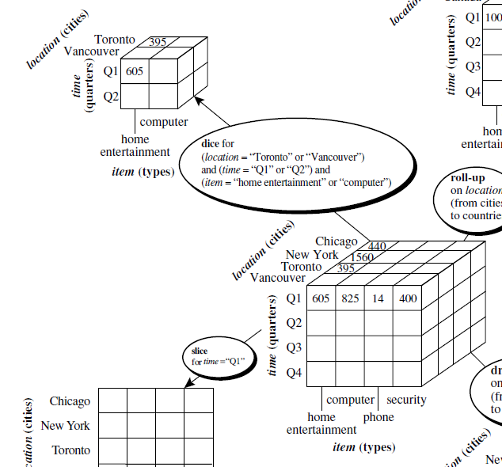
Typical OLAP Operations
‹#›

Slide 86
Typical OLAP Operations
Pivot (rotate):
Pivot is a visualization operation that rotates the data axes in view to provide an alternative data presentation.
Eg. Pivot operation where the item and location axes in a 2-D slice are rotated.
Other examples include rotating the axes in a 3-D cube
‹#›

Slide 87
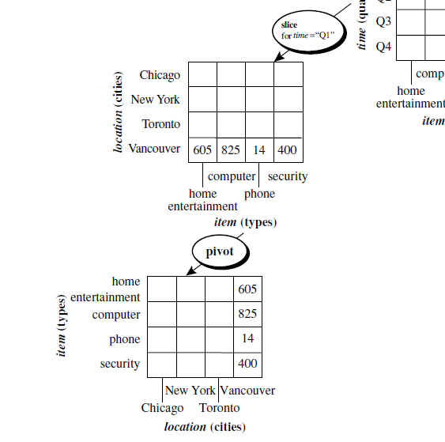
Typical OLAP Operations
‹#›

Slide 88
Typical OLAP Operations
Roll up (drill-up): summarize data
by climbing up hierarchy or by dimension reduction
Drill down (roll down): reverse of roll-up
from higher level summary to lower level summary or detailed data, or introducing new dimensions
Slice and dice: project and select
Pivot (rotate):
reorient the cube, visualization
Other operations
drill across: involving (across) more than one fact table
drill through: through the bottom level of the cube to its back-end relational tables (using SQL)
‹#›

Slide 89
Exercise
Suppose that a data warehouse consists of the three dimensions time, doctor, and patient, and the two
measures count and charge, where charge is the fee that a doctor charges a patient for a visit.
(a) Starting with the base cuboid [day, doctor, patient], what specific OLAP operations should be performed in order to list the total fee collected by each doctor in 2004?
‹#›

Slide 90
Exercise
Starting with the base cuboid [day, doctor, patient], what specific OLAP operations should be performed in order to list the total fee collected by each doctor in 2004?
The operations to be performed are:
Roll-up on time from day to year
Roll-up on patient from individual patient to all
Slice for time=2004.
‹#›

Slide 91
Exercise
Suppose that a data warehouse consists of the four dimensions, date, spectator, location, and game, and the two measures, count and charge, where charge is the fare that a spectator pays when watching a game on a given date. Spectators may be students, adults, or seniors, with each category having its own charge rate.
Draw a star schema diagram for the data warehouse
‹#›

Slide 92
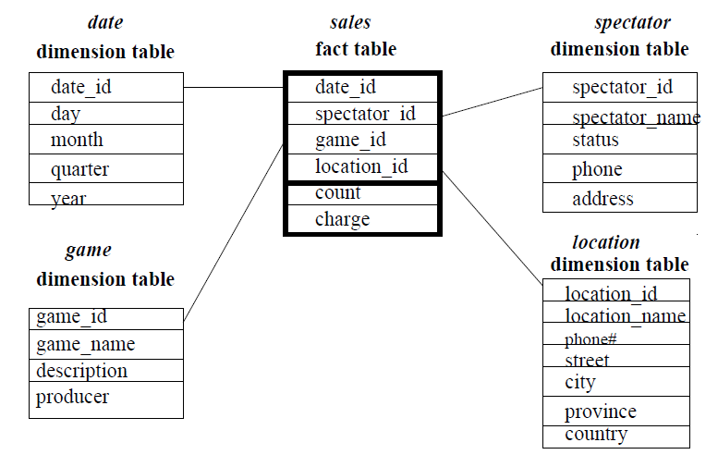
STAR Schema
‹#›

Slide 93
Exercise
Suppose that a data warehouse consists of the four dimensions, date, spectator, location, and game, and the two measures, count and charge, where charge is the fare that a spectator pays when watching a game on a given date. Spectators may be students, adults, or seniors, with each category having its own charge rate.
(a) Starting with the base cuboid [date, spectator, location, game], what specific OLAP operations should one perform in order to list the total charge paid by student spectators at GM_Place in 2004?
‹#›

Slide 94
Exercise
Starting with the base cuboid [date, spectator, location, game], what specific OLAP operations should one perform in order to list the total charge paid by student spectators at GM_Place in 2004?
1. Roll-up on date from date_id to year.
2. Roll-up on game from game_id to all.
3. Roll-up on location from location_id to location_name.
4. Roll-up on spectator from spectator_id to status.
5. Dice with status=“students", location_name=“GM_Place", and year=2004.
‹#›

Slide 95
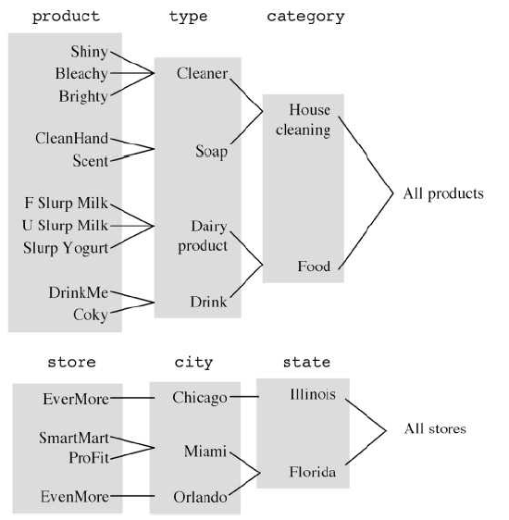
Roll up (drill-up):
‹#›

Slide 96
Design of Data Warehouse: A Business Analysis Framework
Four views regarding the design of a data warehouse
Top-down view
allows selection of the relevant information necessary for the data warehouse
Data source view
exposes the information being captured, stored, and managed by operational systems
Data warehouse view
consists of fact tables and dimension tables
Business query view
sees the perspectives of data in the warehouse from the view of end-user
‹#›

Slide 97
Data Warehouse Design Process
Top-down, bottom-up approaches or a combination of both
Top-down: Starts with overall design and planning (mature)
Bottom-up: Starts with experiments and prototypes (rapid)
From software engineering point of view
Waterfall: structured and systematic analysis at each step before proceeding to the next
Spiral: rapid generation of increasingly functional systems, short turn around time, quick turn around
Typical data warehouse design process
Choose a business process to model, e.g., orders, invoices, etc.
Choose the grain (atomic level of data) of the business process
Choose the dimensions that will apply to each fact table record
Choose the measure that will populate each fact table record
‹#›

Slide 98
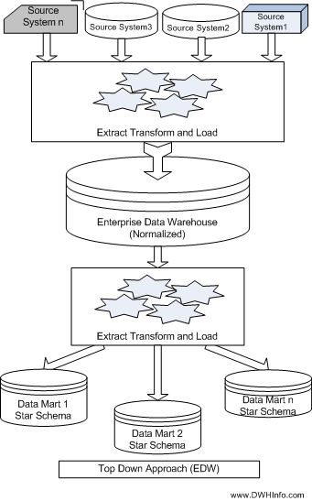
Top Down Approach
‹#›

Slide 99
Top Down Approach
Advantages Of Top Down Design :
It is easier to maintain Top Down Design
Provides consistent dimensional views of data across data marts, as all data marts are loaded from the data warehouse.
This approach is robust against business changes. Creating a new data mart from the data warehouse is very easy.
Initial cost is high but subsequent project development cost is lower
Disadvantages Of Top Down Design :
It represents a very large project and the cost of implementing the project is significant.
It is time consuming and more time required for initial set up.
This technique is inflexible to changing departmental needs.
Highly skilled people required for set up
‹#›

Slide 100
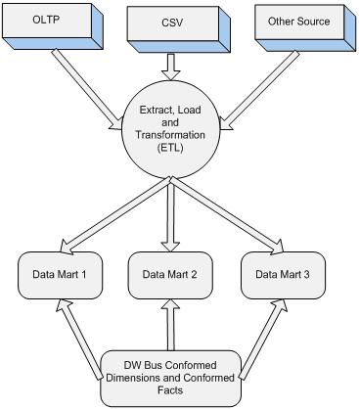
Bottom Up Approach
‹#›

Slide 101
Advantages Of Bottom Up Design :
This model contains consistent data marts and these data marts can be delivered quickly.
The data marts are created first to provide reporting capability
It is easier to extend the data warehouse as it can easily accommodate new business units. It is just creating new data marts and then integrating with other data marts.
This Approach take less time. Initial set up is very quickly
Disadvantage of Bottom Up Design :
Initial cost is low but each subsequent phase will cost same
The positions of the data warehouse and the data marts are reversed in the bottom-up approach design.
It is difficult to maintain and often redundant and subject to revisions
‹#›

Slide 102
Top-Down Design Approach | Bottom-Up Design Approach
Breaks the vast problem into smaller subproblems. | Solves the essential low-level problem and integrates them into a higher one.
Inherently architected- not a union of several data marts. | Inherently incremental; can schedule essential data marts first.
Single, central storage of information about the content. | Departmental information stored.
Centralized rules and control. | Departmental rules and control.
It includes redundant information. | Redundancy can be removed.

Slide 103
Data Warehouse Usage
Three kinds of data warehouse applications
Information processing
supports querying, basic statistical analysis, and reporting using crosstabs, tables, charts and graphs
Analytical processing
multidimensional analysis of data warehouse data
supports basic OLAP operations, slice-dice, drilling, pivoting
Data mining
knowledge discovery from hidden patterns
supports associations, constructing analytical models, performing classification and prediction, and presenting the mining results using visualization tools
‹#›

Slide 104
OLAP Server Architectures
Relational OLAP (ROLAP)
Multidimensional OLAP (MOLAP)
Hybrid OLAP (HOLAP) (e.g., Microsoft SQLServer)
Specialized SQL servers (e.g., Redbricks)
Specialized support for SQL queries over star/snowflake schemas
‹#›

Slide 105
Relational OLAP (ROLAP)
Use relational or extended-relational DBMS to store and manage warehouse data and OLAP middle ware
Include optimization of DBMS backend, implementation of aggregation navigation logic, and additional tools and services
Greater scalability
ROLAP supports RDBMS products through the use of a metadata layer, thus avoiding the requirement to create a static multi-dimensional data structure.
This facilitates the creation of multiple multi-dimensional views of the two-dimensional relation.
To improve performance, some ROLAP products have enhanced SQL engines to support the complexity of multi-dimensional analysis, while others recommend, or require, the use of highly denormalized database designs such as the star schema.
‹#›

Slide 106
Relational OLAP (ROLAP)
The development issues associated with ROLAP technology:
Performance problems associated with the processing of complex queries that require multiple passes through the relational data.
Development of middleware to facilitate the development of multi-dimensional applications.
Development of an option to create persistent multi-dimensional structures, together with facilities o assist in the administration of these structures.
‹#›

Slide 107
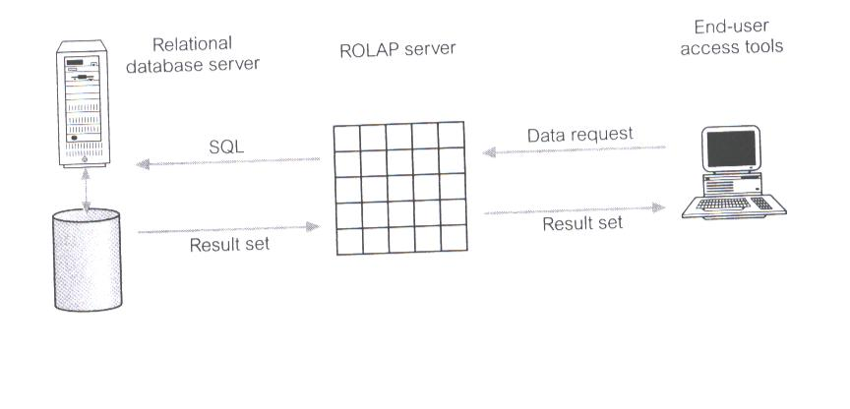
Relational OLAP (ROLAP)
‹#›

Slide 108
Multidimensional OLAP (MOLAP)
MOLAP tools use specialized data structures and multi-dimensional database management systems (MDDBMS) to organize, navigate, and analyze data.
Sparse array-based multidimensional storage engine that minimize the disk space requirements through sparse data management.
Fast indexing to pre-computed summarized data
The development issues associated with MOLAP:
Only a limited amount of data can be efficiently stored and analyzed.
Navigation and analysis of data are limited because the data is designed according to previously determined requirements.
MOLAP products require a different set of skills and tools to build and maintain the database.
‹#›

Slide 109
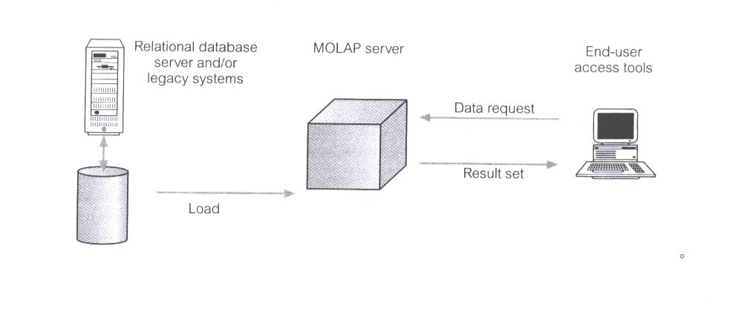
Multidimensional OLAP (MOLAP)
‹#›

Slide 110
Hybrid OLAP (HOLAP)
HOLAP tools provide limited analysis capability, either directly against RDBMS products, or by using an intermediate MOLAP server.
HOLAP tools deliver selected data directly from DBMS or via MOLAP server to the desktop (or local server) in the form of data cube, where it is stored, analyzed, and maintained locally is the fastest-growing type of OLAP tools.
Flexibility, e.g., low level: relational, high-level: array
The issues associated with HOLAP tools:
The architecture results in significant data redundancy and may cause problems for networks that support many users.
Ability of each user to build a custom data cube may cause a lack of data consistency among users.
Only a limited amount of data can be efficiently maintained.
‹#›

Slide 111
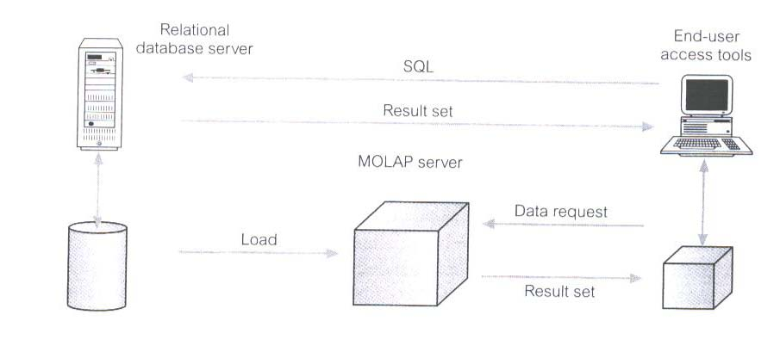
Hybrid OLAP (HOLAP)
‹#›

Slide 112
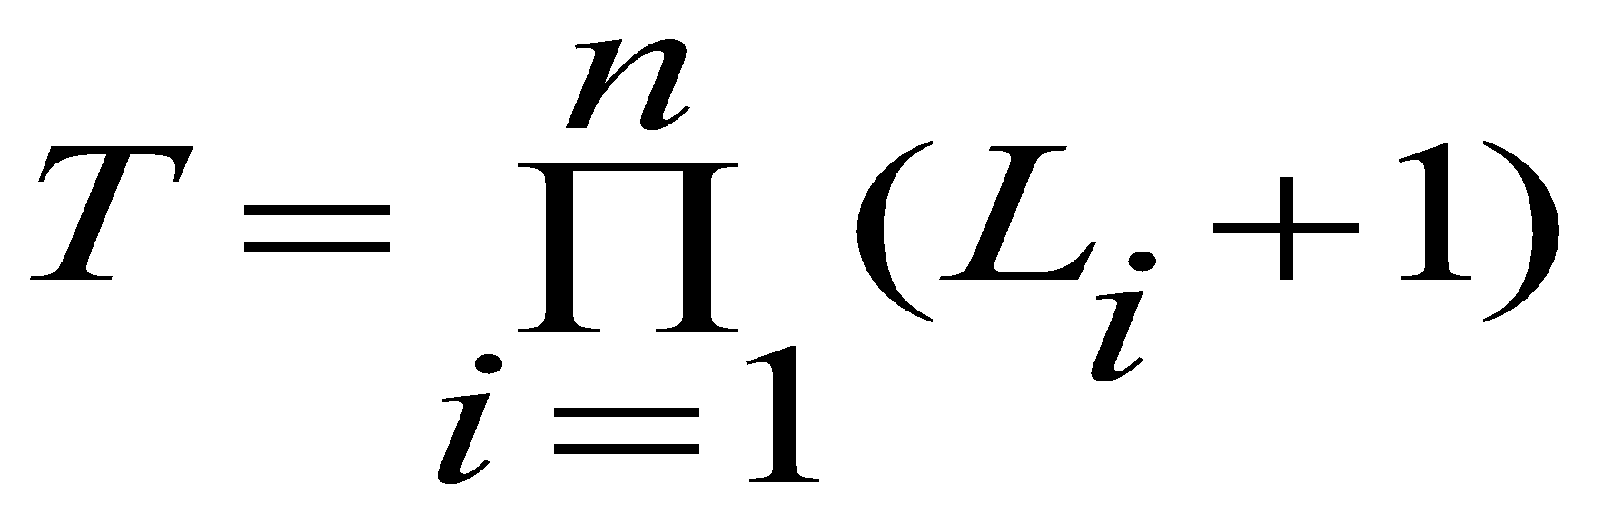
Efficient Data Cube Computation
Data cube can be viewed as a lattice of cuboids
The bottom-most cuboid is the base cuboid
The top-most cuboid (apex) contains only one cell
How many cuboids in an n-dimensional cube with L levels?
Materialization of data cube
Materialize every (cuboid) (full materialization), none (no materialization), or some (partial materialization)
Selection of which cuboids to materialize
Based on size, sharing, access frequency, etc.
‹#›

Slide 113
This approach involves pre-computing and storing the data cube in a database. This can be done using a materialized view, which is a pre-computed table that is based on a SELECT statement.
Advantage: The advantage of this approach is that data cube queries can be answered quickly since the data is already pre-computed and stored in the database.
Disadvantage: The disadvantage is that the materialized view needs to be updated regularly to reflect changes in the underlying data.

Slide 114
Efficient Processing OLAP Queries
Determine which operations should be performed on the available cuboids
Transform drill, roll, etc. into corresponding SQL and/or OLAP operations, e.g., dice = selection + projection
Determine which materialized cuboid(s) should be selected for OLAP op.
Let the query to be processed be on {brand, province_or_state} with the condition “year = 2004”, and there are 4 materialized cuboids available:
1) {year, item_name, city}
2) {year, brand, country}
3) {year, brand, province_or_state}
4) {item_name, province_or_state} where year = 2004
Which should be selected to process the query?
‹#›
Notes:
‹#›

Slide 115
Full materialization refers to the computation of all of the cuboids in the lattice defining a data cube. It typically requires an excessive amount of storage space,particularly as the number of dimensions and size of associated concept hierarchies grow. This problem is known as the curse of dimensionality. Alternatively, partial materialization is the selective computation of a subset of the cuboids or subcubes in the lattice. For example, an iceberg cube is a data cube that stores only those cube cells that have an aggregate value (e.g., count ) above some minimum support
threshold.

Slide 116
OLAP query processing can be made more efficient with the use of indexing techniques. In bitmap indexing, each attribute has its own bitmap index table.
Bitmap indexing reduces join, aggregation, and comparison operations to bit arithmetic.
Join indexing registers the joinable rows of two or more relations from a relational database, reducing the overall cost of OLAP join operations. Bitmapped join index-
ing, which combines the bitmap and join index methods, can be used to furtherspeed up OLAP query processing

Slide 117
Case Study
Suppose that a data warehouse for Big University consists of the following four dimensions: student, course, semester, and instructor , and two measures count and avg grade . When at the lowest conceptual level (e.g.,for a given student, course, semester, and instructor combination), the avg grade measure stores the actualcourse grade of the student. At higher conceptual levels, avg grade stores the average grade for the givencombination.
(a) Draw a snowﬂake schema diagram for the data warehouse.
(b) Starting with the base cuboid [ student,course,semester,instructor ], what speciﬁc OLAP operations (e.g., roll-up from semester to year ) should one perform in order to list the average grade of CS coursesfor each Big University student.
(c) If each dimension has ﬁve levels (including all ), such as “ student < major < status < university < all ”,how many cuboids will this cube contain (including the base and apex cuboids)?
‹#›

Slide 118
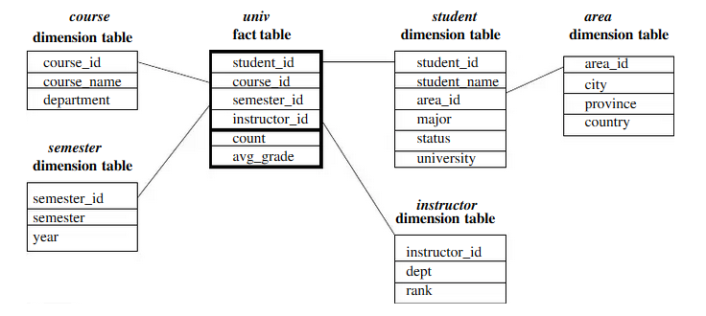
Snowﬂake Schema diagram
‹#›

Slide 119
Starting with the base cuboid [ student,course,semester,instructor], what speciﬁc OLAP operations (e.g., roll-up from semester to year ) should one perform in order to list the average grade of CS courses for each Big University student. The speciﬁc OLAP operations to be performed are:
• Roll-up on course from course id to department .
• Roll-up on student from student id to university.
• Dice on course, student with department=“CS” and university = “Big University”.
• Drill-down on student from university to student name
(c) If each dimension has ﬁve levels (including all), such as student < major < status < university < all,how many cuboids will this cube contain (including the base and apex cuboids)
This cube will contain 54= 625 cuboids
‹#›

