Slide 1
Behavioural Pattern: State
By Paul Sohns

Slide 2
Content
1
2
3
Behavioural Patterns
If? States?
Apples
4
Tasks

Slide 3
1. Behavioural Patterns
What Are Behavioral Patterns?
Manage how objects collaborate and communicate within a system
Manage the interactions between objects
Help make code more readable and structured
State Pattern?
Alter an object's behaviour when its internal state changes
Useful for managing complex logic based on different states

Slide 4
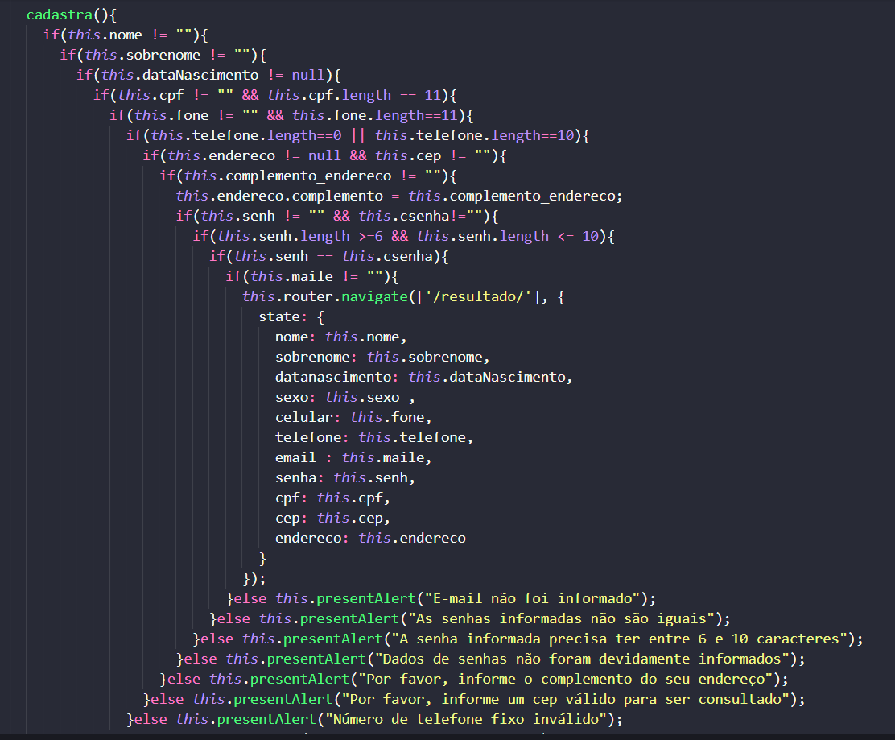

2. If? States?

Slide 5
2. If? States?
State
W
State
X
Object
State
Y
State
Z

Slide 6
2. If? States?
Growing
Grown
Apple Tree
Dead
Apples

Slide 7
2. If? States?
BaseClass
virtual OnWatered();
virtual OnShook();
Dead
Growing
Grown
Apples

Slide 8
2. If? States?
Growing
Grown
Apple Tree
Dead
Apples

Slide 9
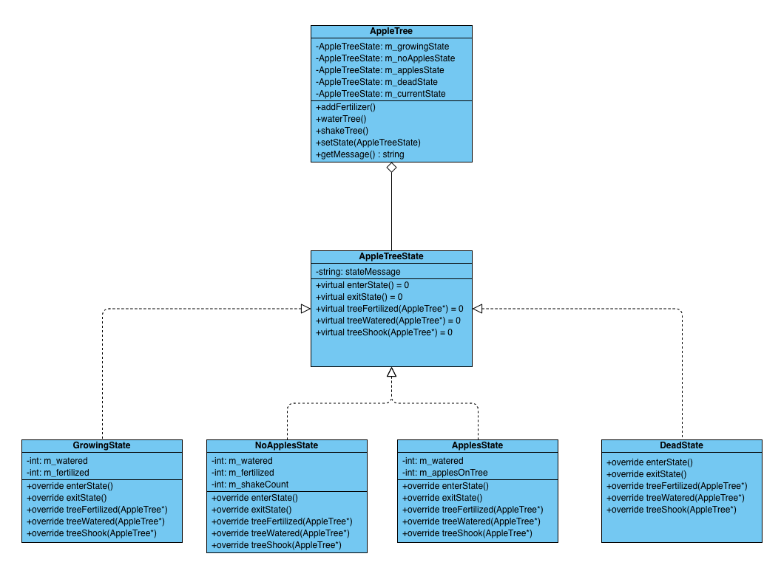
2. If? States?

Slide 10
3. Apples Showcase

Slide 11
4. Tasks
Feel free to ask questions at any time!
Easy
Intermediate
Expert
Create a class diagram of a for a class „human“ with at least 2 states for ist movement (e.g. running, swimming, etc.)
Add one more state to the AppleTree example from before. If you currently cant run a c++ project on your machine, recreate the example with atleast 2 states in a language of your choice
Write the software described by the class diagram from the first task.
Make sure the states have transitions and dont remember their previous values.
https://online.visual-paradigm.com/
https://github.com/Sokkero/schoolThing

Slide 12
Thank you for your time!
Feel free to ask questions now if there are any left

