Slide 1
Behavioural Pattern: State
By Paul Sohns

Slide 2
Content
1
3
2
4
Behavioural Patterns
Apples
If? States? Machines?
A tree’s lifetime

Slide 3
1. Behavioural Patterns
What Are Behavioral Patterns?
Manage how objects collaborate and communicate within a system
Manage the interactions between objects
Help make code more readable and structured
State Pattern?
Alter an object's behaviour when its internal state changes
Useful for managing complex logic based on different states

Slide 4
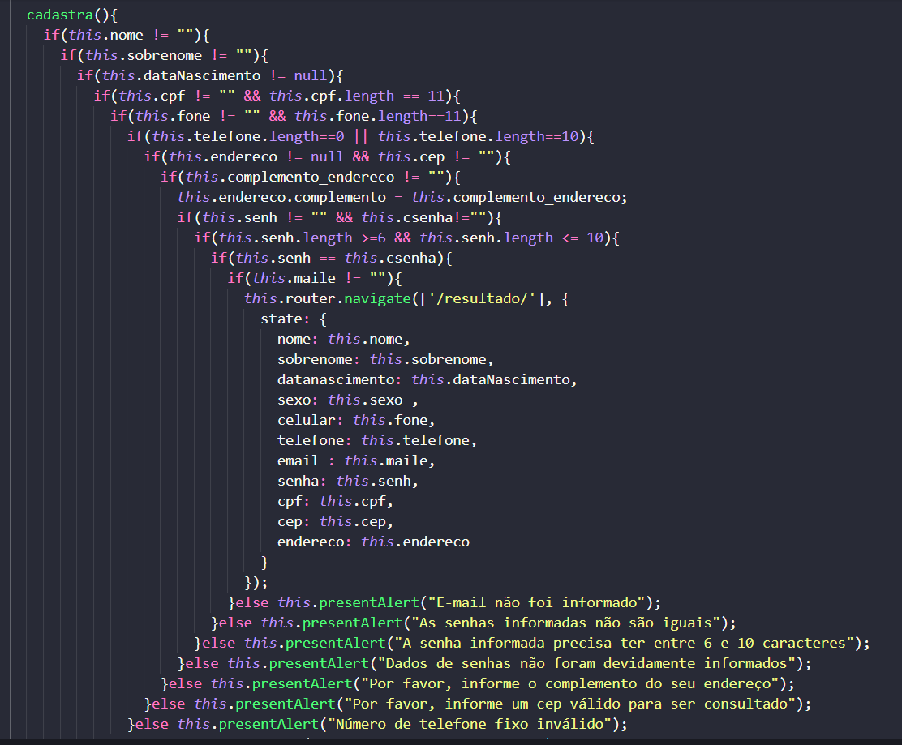

2. If? States? Machines?

Slide 5
2. If? States? Machines?
State
W
State
X
Object
State
Y
State
Z

Slide 6
2. If? States? Machines?
Growing
Grown
Apple Tree
Dead
Apples

Slide 7
2. If? States? Machines?
BaseClass
virtual OnWatered();
virtual OnShook();
Dead
Growing
Grown
Apples

Slide 8
2. If? States? Machines?
Growing
Grown
Apple Tree
Dead
Apples

Slide 9
3. Apples Showcase

Slide 10
4. A tree’s lifetime Code analysis

Slide 11
Thank you for your time!
Feel free to ask questions now if you have some

