Slide 1
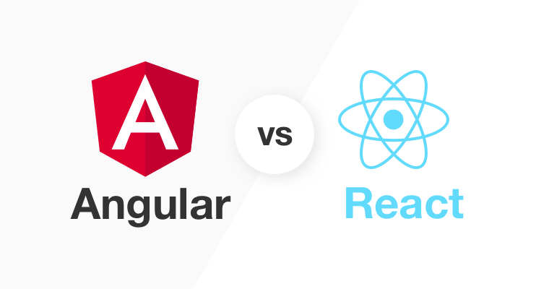

Slide 2
Outline
React
What’s react
History
Type of software by react
Angular
What’s Angular
History
Type of software by Angular
React vs Angular

Slide 3

I. React
What’s react
React is a JavaScript library for building user interfaces.
2. History
Created by Facebook by Jordan Walke on May 29, 2013.React is a User Interface (UI) library.
3. Type software of React
base in the development of single-page or mobile applications.

Slide 4

II. Angular
What’s react
Angular is a JavaScript framework written in TypeScript.
History
It was developed and is maintained by Google by two developers, Misko Hevery and Adam Abrons on October 20, 2010.
Type software of Angular
web designers to interact with both the
frontend and the backend.

Slide 5
III. React vs Angular
Companies using:
React:
Facebook
Airbnb
Uber
Netflix
Instagram
WhatsApp
Dropbox
Angular:
Google
Nike
Forbes
Upwork
General Motors
HBO
Sony

Slide 6
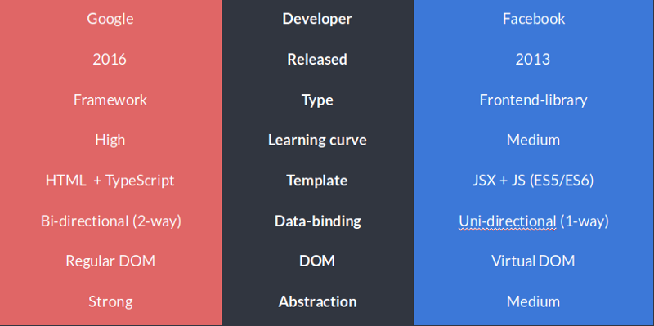
III. React vs Angular
Angular
React

Slide 7
Reference
https://en.wikipedia.org/wiki/AngularJS#AngularJS
https://en.wikipedia.org/wiki/React_(JavaScript_library)#Notable_features
https://medium.freecodecamp.org/a-comparison-between-angular-and-react-and-their-core-languages-9de52f485a76
https://programmingwithmosh.com/react/react-vs-angular/

