Slide 1
Joul
From the Khmer word for "rent."
Cambodia's room rental, simplified.
A free, Khmer-first marketplace connecting room renters and room owners across Cambodia.
PITCH DECK | GRANT APPLICATION | 2026

Slide 2
Finding a room in Cambodia is broken.
Both sides of the market are wasting time, money, and trust.
FOR RENTERS
FOR LANDLORDS
FOR THE MARKET
Hours of scrolling. No real answers.
Expensive agencies. Paper signs that fade.
No central place. No real-time data. No trust.
Students and young workers spend days searching Facebook groups for room listings. Most posts are outdated. Many are scams. Tenants often physically travel just to find out the room was rented weeks ago.
Small landlords pay agencies one month's rent in commission or print signs that fade in the rain. Facebook posts disappear within hours under newer content. There is no way to manage multiple rooms in one place.
Cambodia has no purpose-built rental platform for ordinary rooms. Pricing is opaque. Inventory is invisible. Rooms sit empty while renters can't find them. The whole market runs on guesswork.
Joul
2 / 13

Slide 3
Joul is the answer.
A purpose-built, Khmer-first rental marketplace for Cambodia.
Joul connects room renters and room owners in one place — for free.
✓
Free for everyone
No listing fees, no commissions, no subscription. Always.
Landlords list their rooms once. Renters find them with smart search and real-time availability — no ghost listings, no agency fees, no wasted trips.
Every user on Joul can be both a renter and a landlord, reflecting how small Cambodian property owners actually behave.
✓
Real-time availability
Every listing is clearly marked Available or Occupied. Occupied rooms are hidden from renters.
✓
Khmer-first by default
Built in Khmer. Designed for mobile. Made for how Cambodians actually browse and rent.
Joul
3 / 13

Slide 4
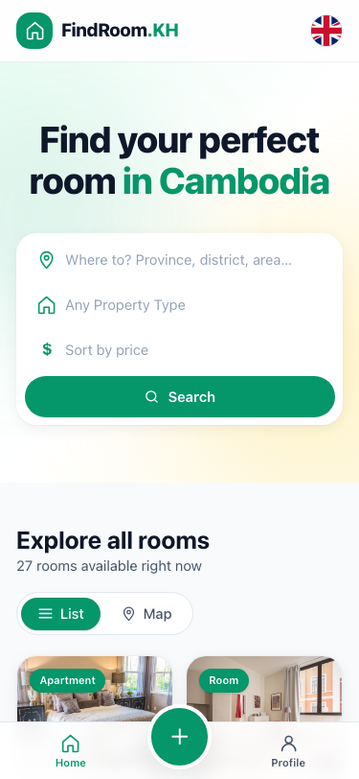
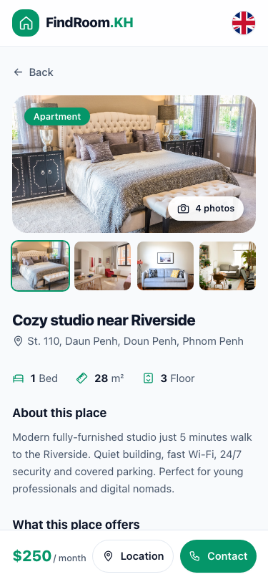
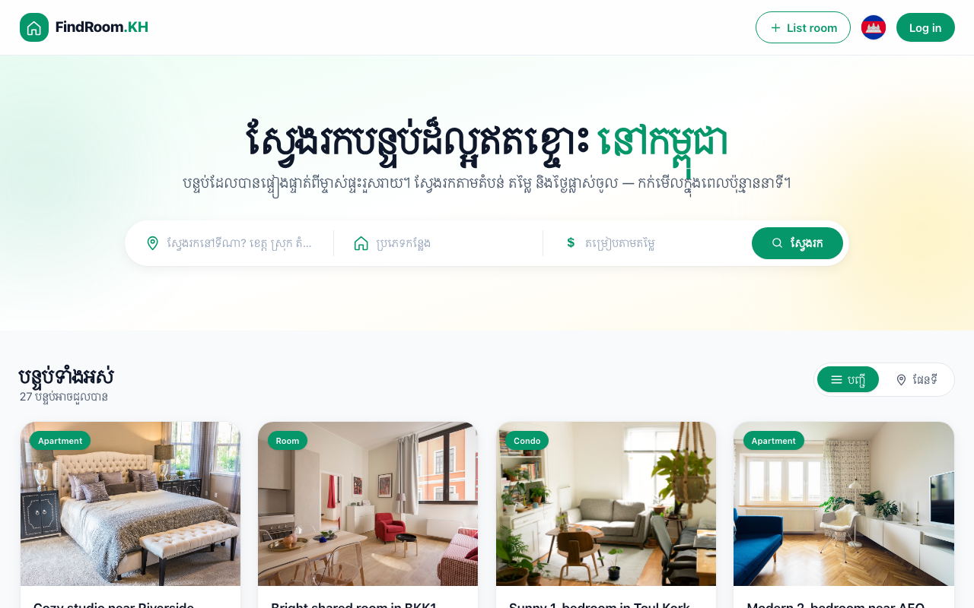
Built, tested, ready to launch.
Working prototype with 16 screens, multi-language UI, and full landlord and renter flows.
Khmer-first UI
Explore
Room Detail
Khmer is the default language for Cambodian users; English available
Search and filter
Full info + contact
Note: prototype currently shows 'FindRoom.KH' branding; rebranding to Joul ahead of public launch.
Joul
4 / 13

Slide 5
Real impact for real Cambodians.
Who Joul helps, why it matters, and what changes when it works.
50,000+
200,000+
10,000+
Students relocating to Phnom Penh each year
Young workers and migrants in Phnom Penh
Small landlords across Cambodia
Joul gives them a faster, safer way to find a room before they arrive — without depending on relatives or Facebook scams.
Factory workers, NGO staff, and first-time professionals all need affordable rooms. Joul makes that search transparent and free.
Most own just 1-5 rooms. Joul replaces expensive agencies and paper signs with a free, permanent digital listing.
Figures are rough estimates derived from National Institute of Statistics data and university enrollment trends; figures will be refined as Joul launches and gathers real usage data.
Joul
5 / 13

Slide 6
A real market, still unowned.
Estimated PropTech opportunity in Cambodia.
How the numbers break down
TAM ~$2.4B
Total Addressable Market — Southeast Asia PropTech rental segment
Cambodia urban population: ~4.25M
Phnom Penh population: ~2.5M, growing
Avg room rent: $60-$250/month
Youth median age: ~27
Internet users: 9M+ (53%+ penetration)
Smartphone penetration: 70%+
SAM ~$320M
Serviceable Available Market — Cambodia urban rental (all types)
SOM ~$18M
Phnom Penh room rental
(Year 1-3 target)
Numbers are estimates based on National Institute of Statistics data, regional PropTech benchmarks, and primary research. Will be refined through validation.
Joul
6 / 13

Slide 7
Three forces. One window.
Why this is the right moment to launch a Cambodian rental marketplace.
01
02
03
Digital adoption is accelerating
Urban migration keeps rising
The market is still unowned
Cambodia has 9M+ internet users, 70%+ smartphone penetration, and one of the highest Facebook penetration rates in Asia per capita. Cambodian youth are mobile-first and comfortable with digital platforms.
Phnom Penh is growing at an accelerating rate. Tens of thousands of students, workers, and migrants relocate to the capital every year, creating sustained, growing demand for rental rooms.
No purpose-built rental platform exists for Cambodia's affordable room segment. Facebook and Telegram aren't designed for it. The window to become Cambodia's default rental platform is open — for now.
Joul
7 / 13

Slide 8
Free now. Sustainable later.
A two-stage model designed for marketplace adoption, then revenue.
STAGE 1
STAGE 2
Year 1 — Build the audience
Year 2+ — Add sustainable revenue
100% Free
Optional Paid Tools
Free listings for landlords. Free search for renters. No fees, no commissions, no subscriptions. The goal is trust and habit — not revenue.
Once Joul is the trusted default, introduce paid tools that landlords with bigger operations will naturally want. The free marketplace stays free.
Free unlimited listings
Free search and filters
Free Khmer-first UI
Free direct contact
Featured listings ($2-10 / period)
SaaS for multi-unit landlords ($15-50 / month)
In-app payments (1-2% transaction fee)
Verified-listing badge
Same playbook as Airbnb, Zillow, and OLX: trust and audience first, monetization second.
Joul
8 / 13

Slide 9
Launch in 8 weeks.
Public launch: Saturday, July 25, 2026 — timed to the August student migration into Phnom Penh.
W1
W2
W3
W4
W5
W6
W7
W8
Foundation
First Listings
Cold Outreach
Mid-Point Review
Students
Soft Launch
Prep
LAUNCH
Week 1-2
Real backend live. 3-5 warm landlords listed with photos.
Week 3-4
Cold-door outreach begins near RUPP. Mid-point review on June 28.
Week 5-6
Student-side activation (Facebook groups, Telegram). Soft launch with 30-50 users.
Week 7-8
Final polish. 22-25 active landlords. Public launch July 25 to catch August intake.
LAUNCH DAY TARGETS: 20+ active landlord listings • 200+ engaged students • joul.kh live with HTTPS • Khmer + English UI
Joul
9 / 13

Slide 10
Why nothing else works.
Cambodia's rental market is currently served by general-purpose tools that weren't designed for it.
 | Facebook Groups | realestate.com.kh | Khmer24 / BongLoy | Paper Posters | JOUL
Free to list | ✓ | ✗ | ✓ | ✓ | ✓
Permanent listings | ✗ | ✓ | Partial | ✗ | ✓
Real-time availability | ✗ | ✗ | ✗ | ✗ | ✓
Search & filter | ✗ | ✓ | Partial | ✗ | ✓
Built for rooms | ✗ | Partial | ✗ | ✓ | ✓
Khmer-first | ✓ | Partial | ✓ | ✓ | ✓
Only Joul is purpose-built for Cambodia's affordable room rental market — free, permanent, searchable, and availability-aware.
Joul
10 / 13

Slide 11
Built by Cambodians, for Cambodians.
A local team with founder-market fit and shipping velocity.
“
B
Bobe
Co-founder — Business
I built Joul because I lived the problem. Months of scrolling Facebook for a room. Trips across town to see places already rented. Time and money wasted on a system that doesn't work.
If I needed this, every student, worker, and migrant in Cambodia needs it too.
Product scope, go-to-market, landlord outreach, brand, partnerships. Cambodian, based in Phnom Penh, lived the rental problem firsthand.
T
Tech Team
Co-founder — Engineering
Built the full working prototype: Next.js + Firebase, 16 screens, Khmer/English UI, mobile-first design. Currently expanding for production launch.
— Bobe, Co-founder
Joul
11 / 13

Slide 12
What this grant enables.
Every dollar maps to a launch deliverable in our 8-week plan. Total ask: $10,000 USD.
$2,500
Marketing & outreach
Targeted Facebook ads to Phnom Penh students, printed cards and flyers, university partnerships.
$4,000
Backend engineer
3-month part-time hire to harden Firebase backend, security rules, and image handling for production scale.
$1,500
Legal & compliance
Local Cambodian lawyer review of Terms of Service and Privacy Policy; company registration.
$1,000
Infrastructure
Domain (.kh), Firebase Blaze plan overflow, error monitoring, daily backups for the first year.
$1,000
Operations & contingency
Transportation for door-to-door landlord outreach, communication costs, 10% buffer.
Joul
12 / 13

Slide 13
OUR VISION
To become the rental operating system for Cambodia.
Within 5 years, every step of the Cambodian rental lifecycle runs through Joul — finding, listing, contracting, paying, managing. Beyond Cambodia, the same model applies in Laos, Myanmar, and Vietnam.
THE ASK
Non-dilutive grant funding to support the 8-week pre-launch push, a critical part-time engineering hire, and the first 90 days of operation post-launch.
$10,000
Contact: [your name] · [your email] · [your phone] · joul.kh

