Slide 1
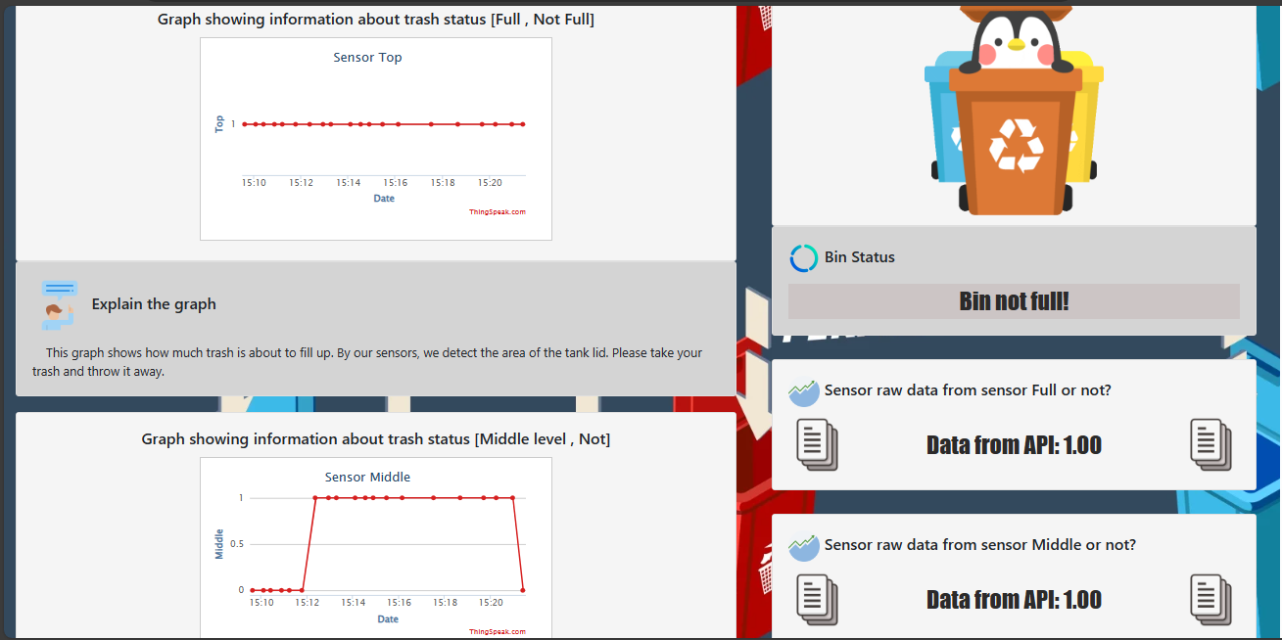
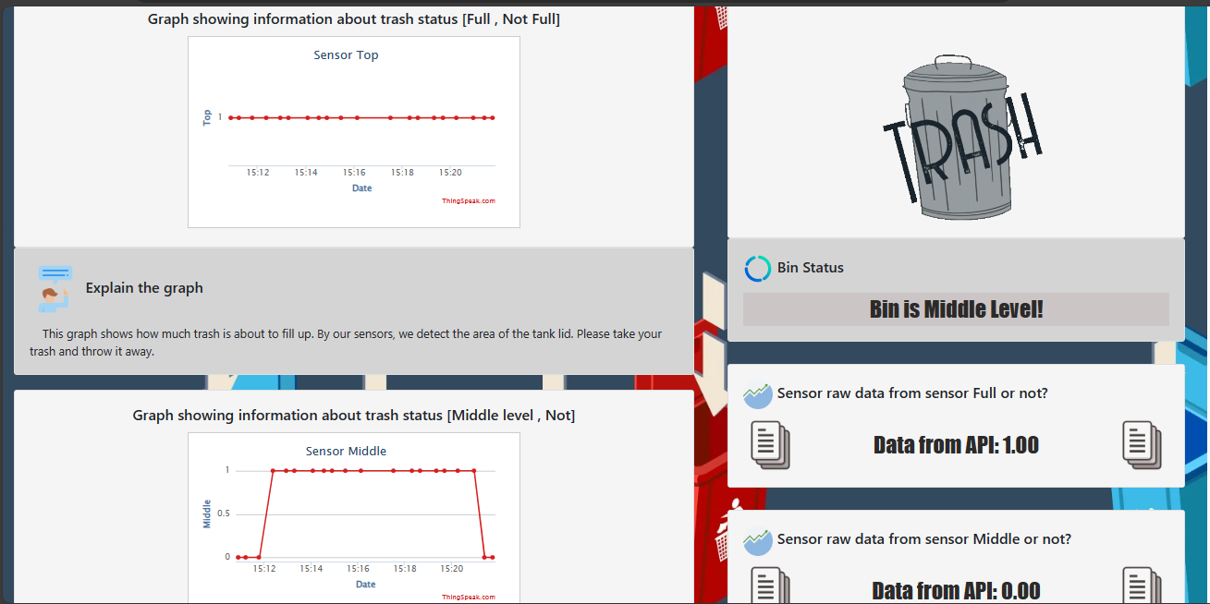
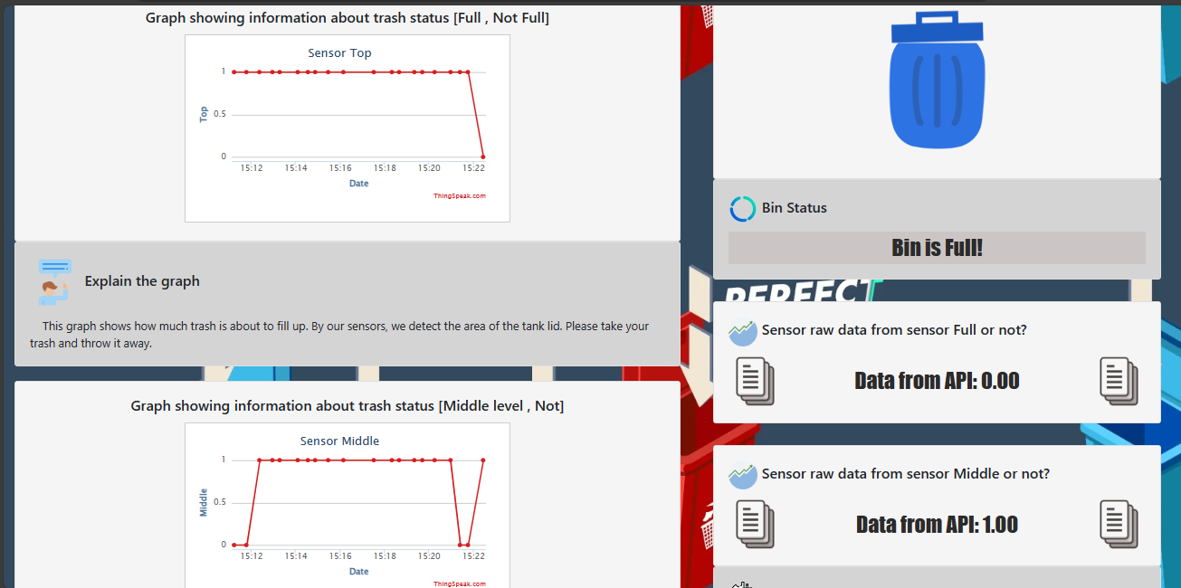
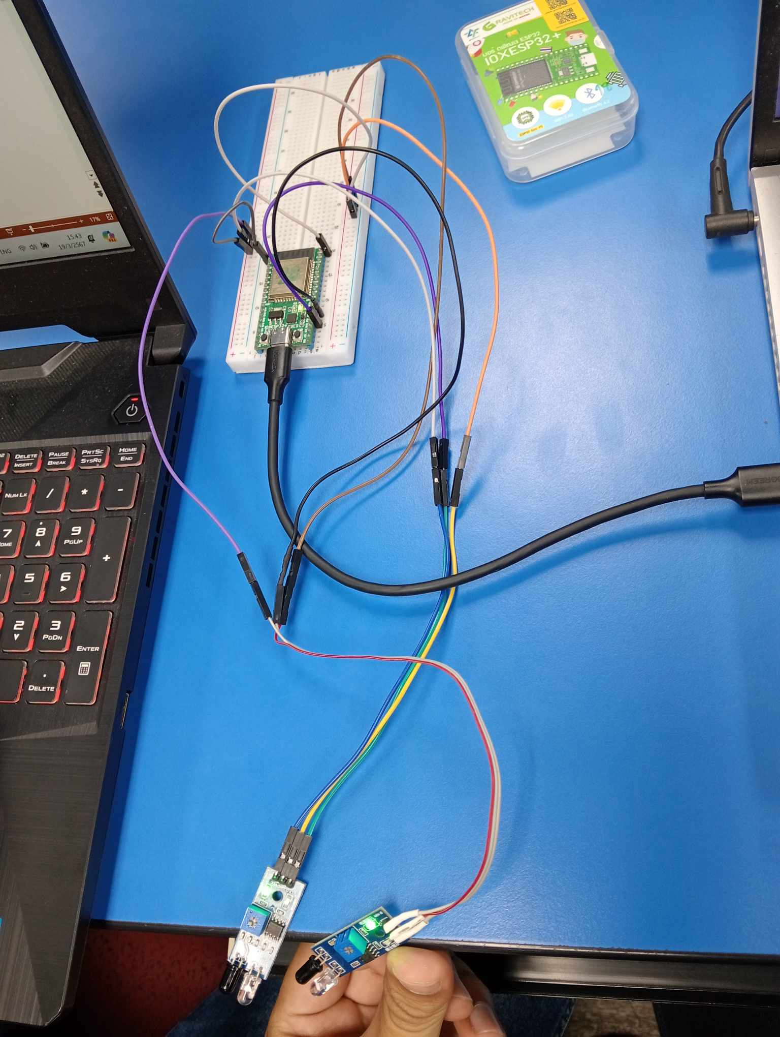
Smart Waste Management System
Group Member
1.Teeranai Sangtaera 65125056
2.Thanaphat Tenghirun 65126955
3.Basirin Saman 65127367
System Interfacing, Integration and Internet of things
Abstract
Methodology
Results
Conclusion
The project "Detects the amount of garbage in the bin and notifies the Website." aims to monitor the trash level in the bin by using an Infared Sensor, an effective device for measuring distance. The collected data is sent to Thingspeak, an IoT platform, where it is displayed in graphs and values on user-generated website pages. So that users can receive information about the amount of waste in the bin immediately and conveniently for example, cleaning the trash can in a timely manner or checking the trash level in the trash can to prevent it from filling up. The results are displayed on the website so that users can access information anywhere, anytime. And there is a notification via the internet when the trash level in the tank exceeds a pre-determined limit.
1.Study various paragraphs about waste management and technology used to measure waste volume.
2.System design by specifying requirements and selecting appropriate technology and tools.
3.Development of a program for measuring the amount of waste and connecting to sensors and sending data to Thingspeak and display it on the website.
4.Testing and evaluating systems to verify correctness and performance.
5.Analysis of data obtained from experiments and
Not Full
This project is to analyze and manage the amount of waste in tanks. By using Infered Sensor technology to detect the amount of waste. and send the data to Thingspeak for analysis and display. The results help in planning waste management and effectively evaluating activities on the environment. Using this technology simplifies waste detection and analysis. and is an effective tool for managing waste more efficiently Further investigation into data collection and evaluation is important to make the project more effective in the future.
Middle
Introduction
The project " Smart Waste Management System" was born out of the need to solve problems related to waste management at the individual or corporate level. The main problem is the lack of a system that can effectively detect and track the amount of waste in the tank. This functionality is preferred because of the benefits it provides for example, saving time in waste management and reducing risks related to health and the environment. Detection and notification through Thingspeak and display it on the created website page. It allows users to access information instantly and conveniently. The goal of this project is to develop an efficient system for managing waste and increasing efficiency in the sustainable use of resources. and reduce problems arising from the accumulation of waste in society and the environment quickly and efficiently.
Full
Acknowledgements
1. Study and data analysis
2.System design
3. Development and testing
4.Evaluation
5. Summary and learning

