Slide 1

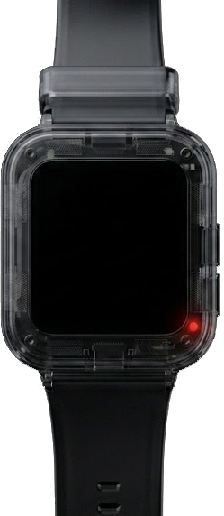
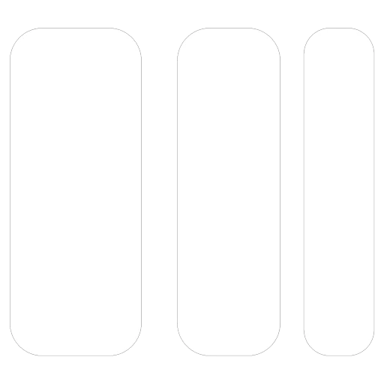
SOLWEAR
Your Crypto. On Your Wrist.
Notes:
Your crypto wallet should not live in your pocket.
It should live on your wrist.
Your Crypto. On Your Wrist
Tap to approve. Keys stay off your phone

Slide 2
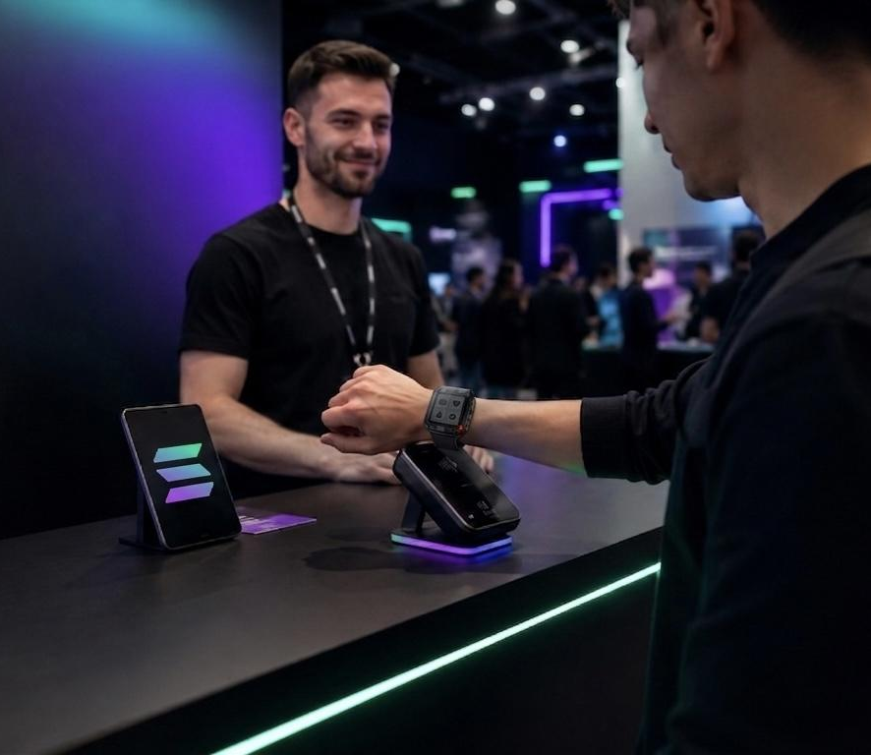
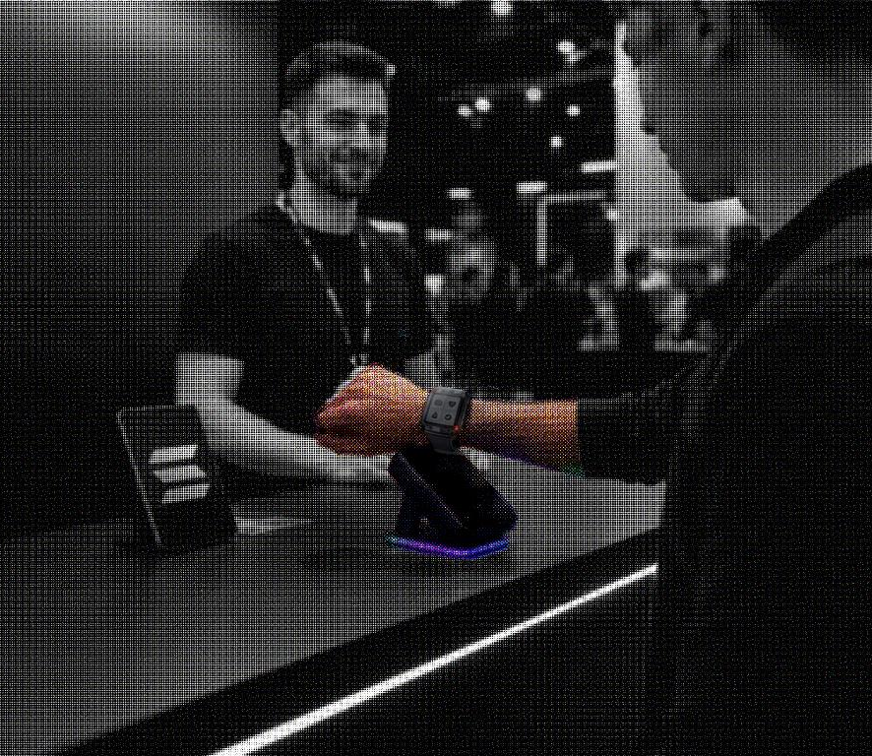
Secure crypto payments should be as easy as tapping your wrist.

Slide 3


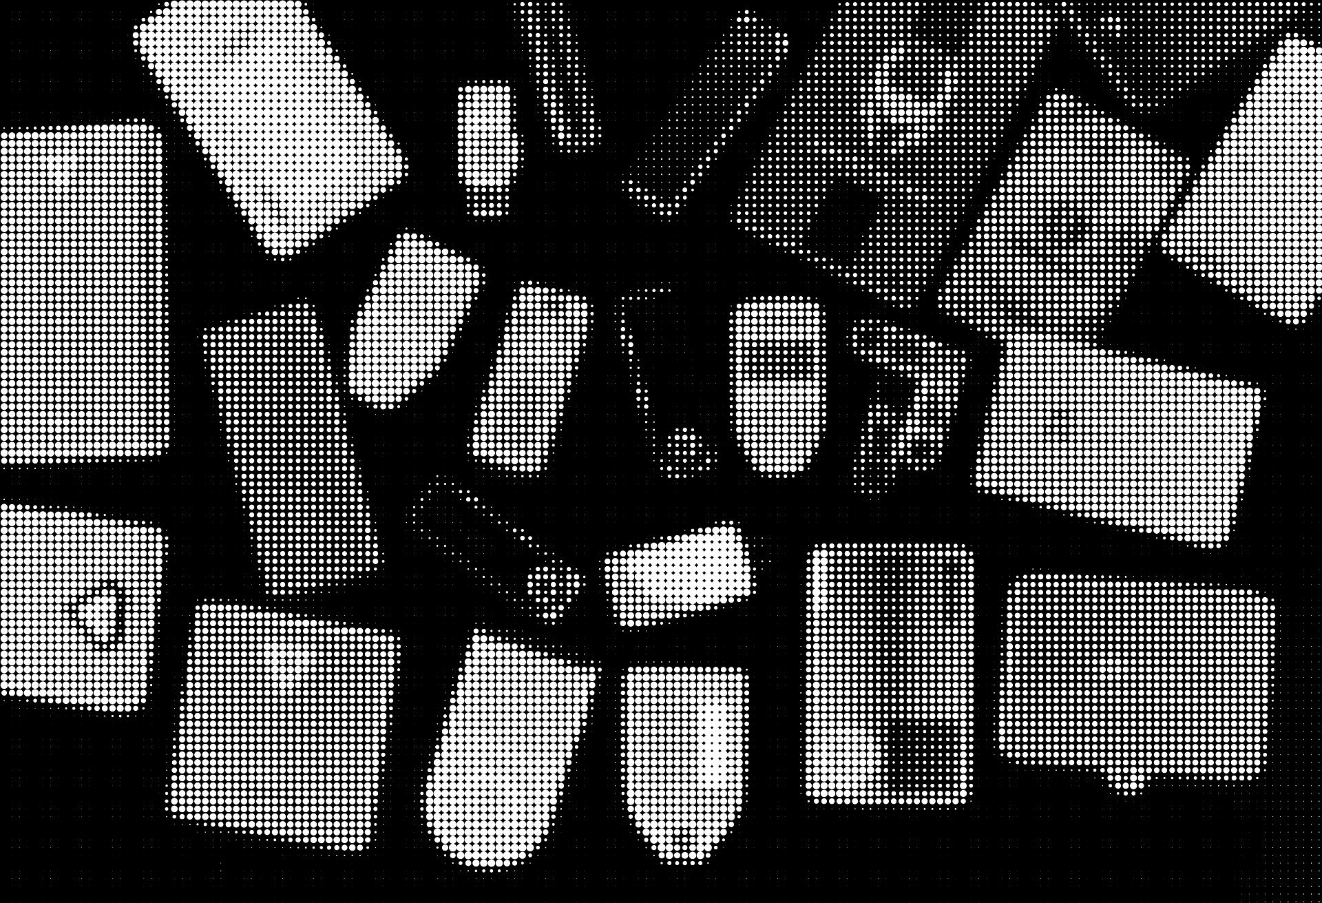
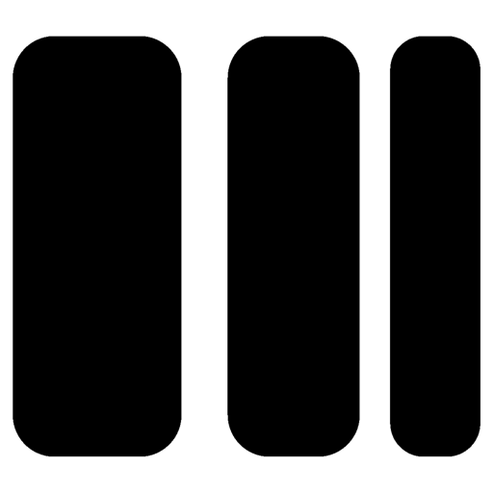
the PROBLEM
Hot wallets are fast, but risky.
Cold wallets are secure, but inconvenient.
Hardware wallets are safe, but not built for daily payments.

Slide 4
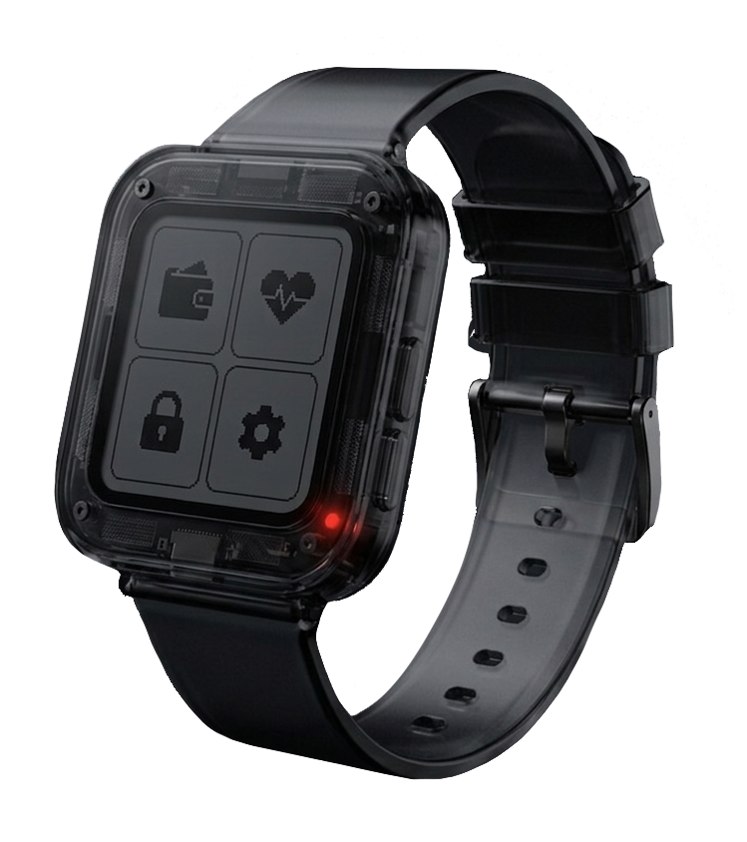
Meet SOLWEAR
SolWear combines cold-wallet level security with the convenience of a wearable payment device.
Designed for fast Solana payments, offline transaction signing, and real-world crypto usage - without sacrificing privacy or control.

Slide 5

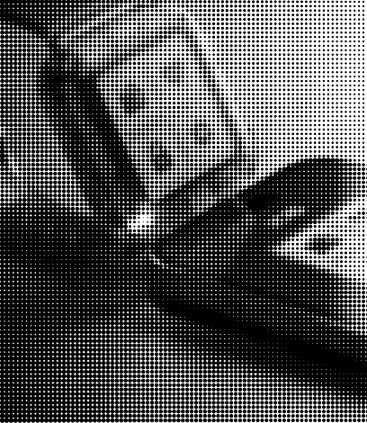
how it works?
The phone prepares the transaction.
SolWear shows what is being signed.
The user confirms on the device.
The phone broadcasts the signed transaction.
The private key never leaves SolWear.

Slide 6
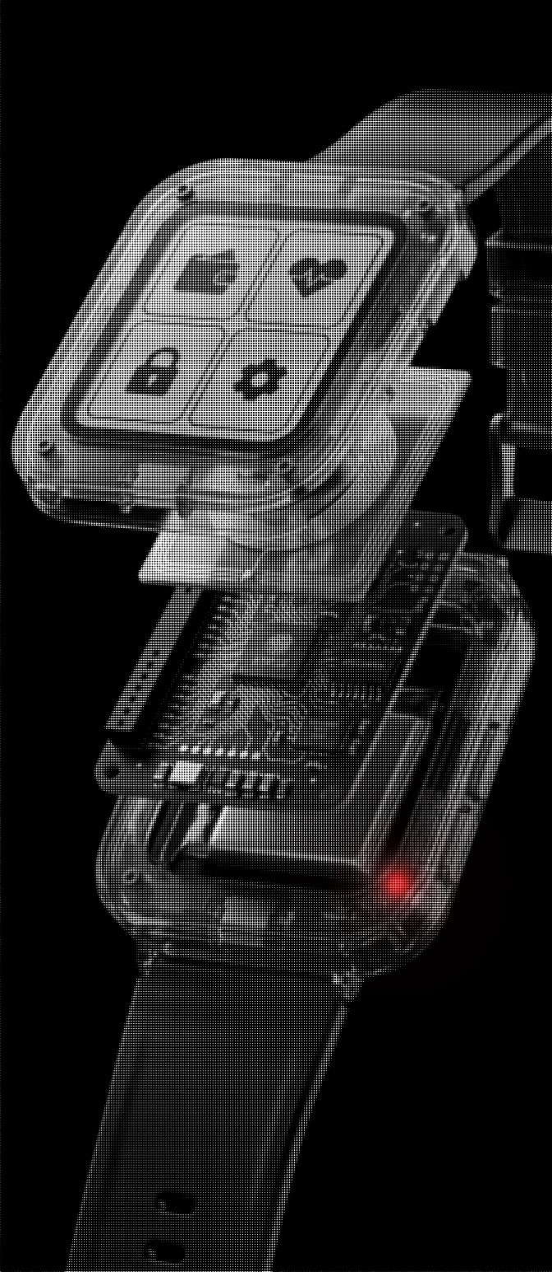
the
SECURITY
No internet connection.
No remote access.
No private key on the phone.
Offline signing only.
Own unique secure algorithms.
Full transaction preview before approval.

Slide 7

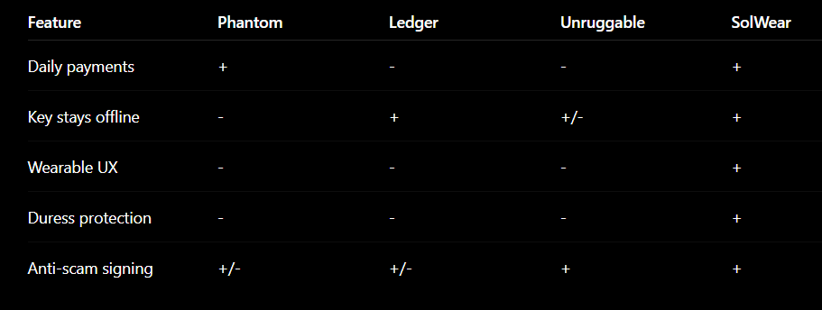

competitors comparison

Slide 8
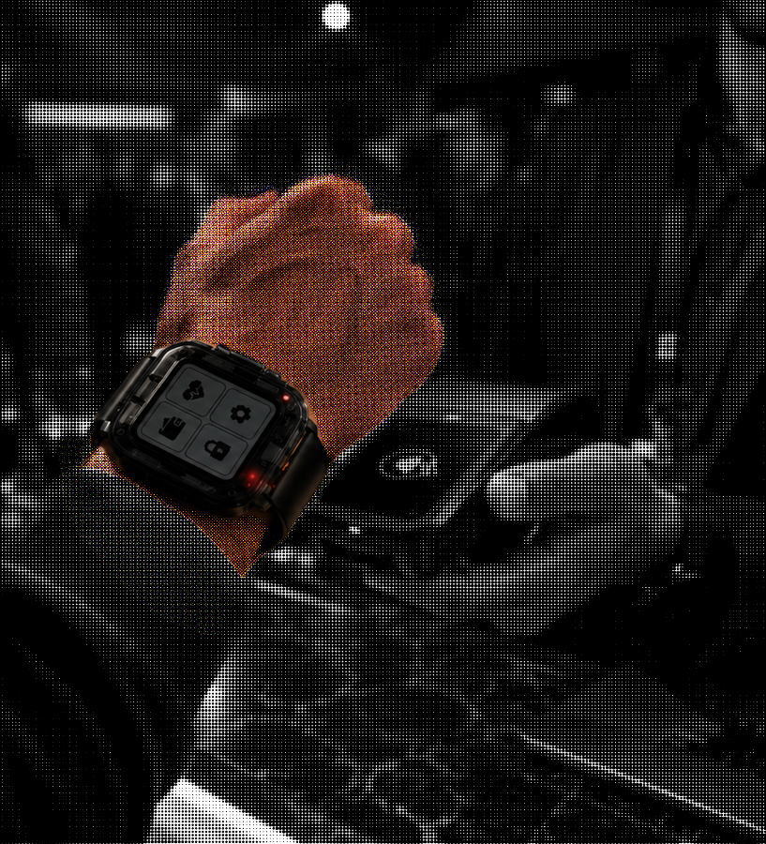
target Audience
For people who actually use crypto daily.
Solana users
Builders and event attendees
DeFi and NFT users
Privacy-focused users
People who want self-custody without carrying a USB wallet

Slide 9
business MODEL
DEVICE SALES
Who pays: end users and self-custody Solana adopters
Price: $99 MSRP per device
Margin: 40-45% pilot; 55%+ target at scale
EVENT / MERCHANT KITS
Who pays: organizers, merchants and communities
Price: $250 kit + $3-5 band + $49/mo
Use case: payments, access control and loyalty
PREMIUM SECURITY
Who pays: power users who need more than basic signing
Price: $4.99/mo or $39/yr
Value: scam alerts, decoded tx, limits, duress controls
SDK / API + INTEGRATIONS
Who pays: wallets, dApps and payment partners
Price: $500-1,500/mo + setup fee
Value: POS SDK, white-label and merchant integrations

Slide 10

traction & roadMAP
BUILT TODAY
NEXT MILESTONES
Core product milestones
Working prototype completed
End-to-end Solana transaction signing
NFC / Blinks payment flow in place
Wallet generation and import implemented
Human-readable approval screen on device
Offline signing: the key never leaves SolWear
0–3 months
Duress PIN
Panic mode
Scam-address alerts
Improved wearable design
3–6 months
Beta with Solana users
Security review
dApp integrations
Merchant integrations
6–9 months
Small production batch
Event payment pilots
Loyalty / identity use cases
Real-world pilot readiness

Slide 11
market Opportunity
236M
50M
12M
SAM:
8.3M weekly active Solana addresses → ≈2.4M engaged user-equivalent
≈$236M serviceable device market + ≈$143M app ARR
TAM:
50M monthly active Solana addresses → ≈14.3M active user-equivalent
≈$1.4B device TAM + ≈$857M premium app ARR
SOM:
5% SAM capture in 24 months → ≈120K devices
≈$12M hardware revenue + ≈$2.1M premium app ARR
Core insight: Solana has the users and payment infrastructure. Solwear turns secure self-custody into a daily payment experience.

Slide 12

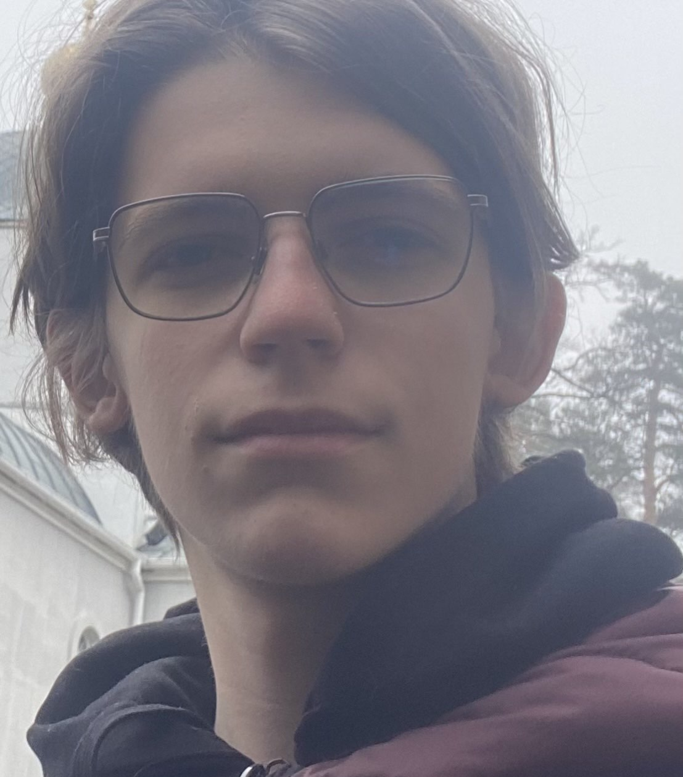
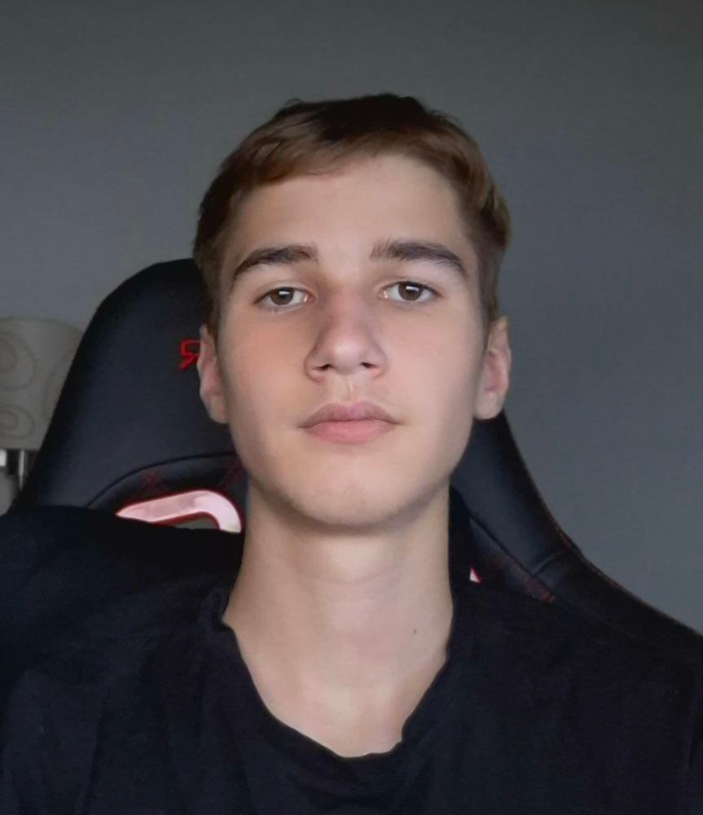

the TEAM
Khabib
CEO
Product, Design & Systems
Turns emerging tech into scalable products
Vitalii
CTO
Cybersecurity & Hardware
Finds vulnerabilities and builds secure architecture
Denis
Software Engineer
Serial builder behind multiple startups
Delivers reliable production systems
Serhii
Mentor | Software Engineer
15+ years in development
Builds execution and investor-ready positioning

Slide 13
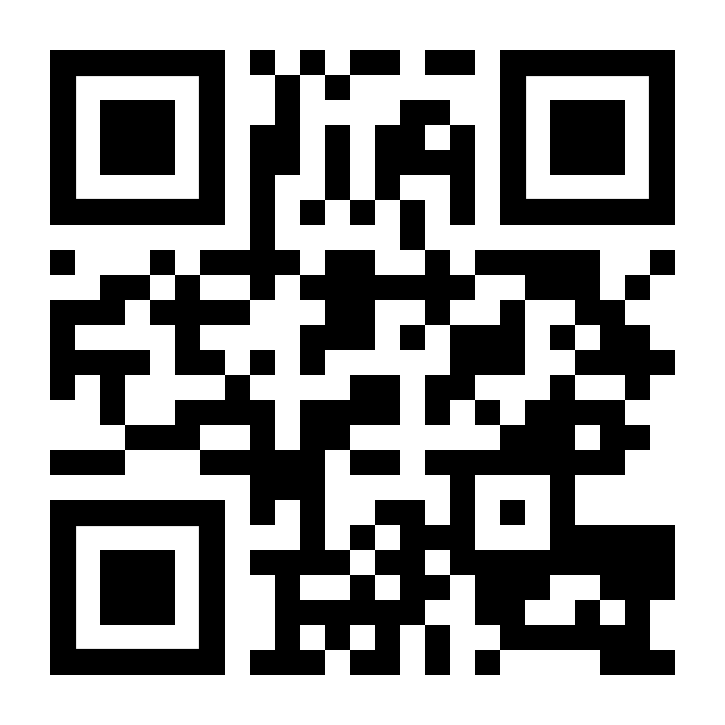
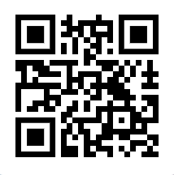
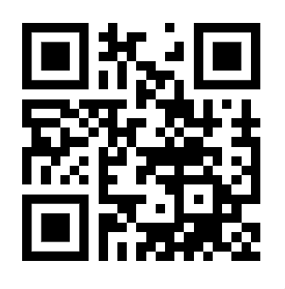
and thats the
SOLWEAR
x.com
github
site

