Slide 1



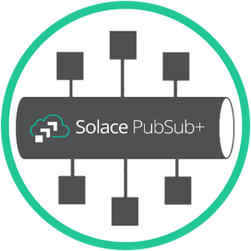







SQS Queue
SNS Topic
Lambda
Function
S3 bucket
w/ objects

Slide 2

Open/Messaging
Protocols
PubSub+
event broker
REST
Delivery
Point (RDP)
Web Hook
Interface
PubSub+
Queue
AWS Resource
AWS API Gateway

Slide 3





IAM Role generated
Allowing specific resource access
Can be across AWS account
Broker Access
Security Group
VPC
API Security Group
Data written to SQS
for example
…
Application
send/receive
JMS for example
VPC Endpoint
Invoke Lambda as another example
PubSub+ event broker
w/ REST Delivery Point (RDP) to API GW
Internal API Gateway
w/ VPC Endpoint in
closed security group, for each AWS resource

Slide 4
Lambda Authorizer, checks Token
Context
with Token
IAM Role generated
Allowing Lambda authorizer access
Can be across AWS account
IAM Role generated
Allowing specific resource access
Can be across AWS account
Policy
Data written to SQS
for example
…
Application
send/receive
JMS for example
PubSub+ event broker
w/ REST Delivery Point (RDP) to API GW, configured to send Token in HTTP Header
Invoke Lambda as another example
Public API Gateway
Secured with Token, for each AWS resource

