Slide 1

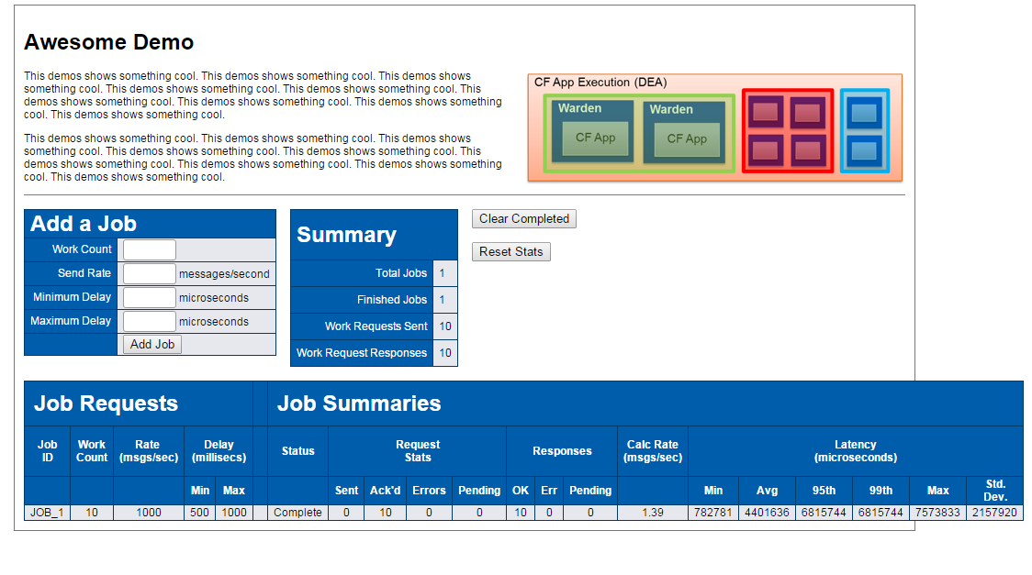








6
Cloud Controller
CF
Admin
CLI
1
Aggregator
5
Router
3
Solace
Service
Broker
Spring Cloud
Demo UI
2
IaaS
4

