Slide 1
Monitoring Solace using Nagios Core
Shrikanth Rajgopalan
3rd Nov 2015

Slide 2
Agenda
What is Nagios
How Nagios monitors “stuff”
Solace plugin for Nagios
Demo

Slide 3
Nagios Core is an Open source network monitoring framework
Nagios watches objects that have been configured for monitoring and sends alerts when things go down and when they get better
The Nagios Core framework is a monitoring and alerting engine
Does not include internal mechanisms to monitor stuff
Delegates the dirty work to Plugins
Plugins are executables that can be run from the command line to check the status of an object being monitored
Nagios calls these plugins at configurable intervals to determine the status of the object being monitored and take necessary actions
Notes:
The official Nagios Plugins package is open source
It consists of over 50 plugins for monitoring basic services (disk, cpu, http…) and helps you get started
Plugins have been developed by the Nagios commuity and over 4000 are available for download

Slide 4
Nagios terminology
Hosts
physical devices on the network with a uniquely identifiable address (IP/MAC)
Have one or more services running on them
Services
Attributes of a host (CPU load, disk usage, etc)
Services on a host (SSH, HTTP, etc)
Command
Format for invoking a plugin (script/executable) with command line parameters

Slide 5
Active Checks (=polling)
Monitoring Logic
Monitoring Abstraction Layer
Monitored Entities
Nagios Process
Plugins
Hosts and sevices
Core plugins
check_ping
localhost
check_disk
Check Logic
randomHost
Custom plugins
check_alarm
Solace-vmr
check_env
Notes:
The upside of this type of plugin architecture is that you can monitor just about anything you can think of. If you can automate the process of checking something, you can monitor it with Nagios.
The downside to this type of plugin architecture is the fact that Nagios has absolutely no idea what it is that you're monitoring. You could be monitoring network traffic statistics, data error rates, room temperate, CPU voltage, fan speed, processor load, disk space, or the ability of your super-fantastic toaster to properly brown your bread in the morning... Nagios doesn't understand the specifics of what's being monitored - it just tracks changes in the state of those resources. Only the plugins themselves know exactly what they're monitoring and how to perform the actual checks.

Slide 6
Passive Checks (=async push)
Nagios Process
Useful for monitoring services which cannot be monitored effectively by polling
Check Logic
External command logic
External applications
External command file
Notes:
The external command file is implemented as a named pipe (FIFO)
An external application checks the status of a host or service.
The external application writes the results of the check to the external command file.
The next time Nagios reads the external command file it will place the results of all passive checks into a queue for later processing. The same queue that is used for storing results from active checks is also used to store the results from passive checks.
Nagios will periodically execute a check result reaper event and scan the check result queue. Each service check result that is found in the queue is processed in the same manner - regardless of whether the check was active or passive. Nagios may send out notifications, log alerts, etc. depending on the check result information.

Slide 7
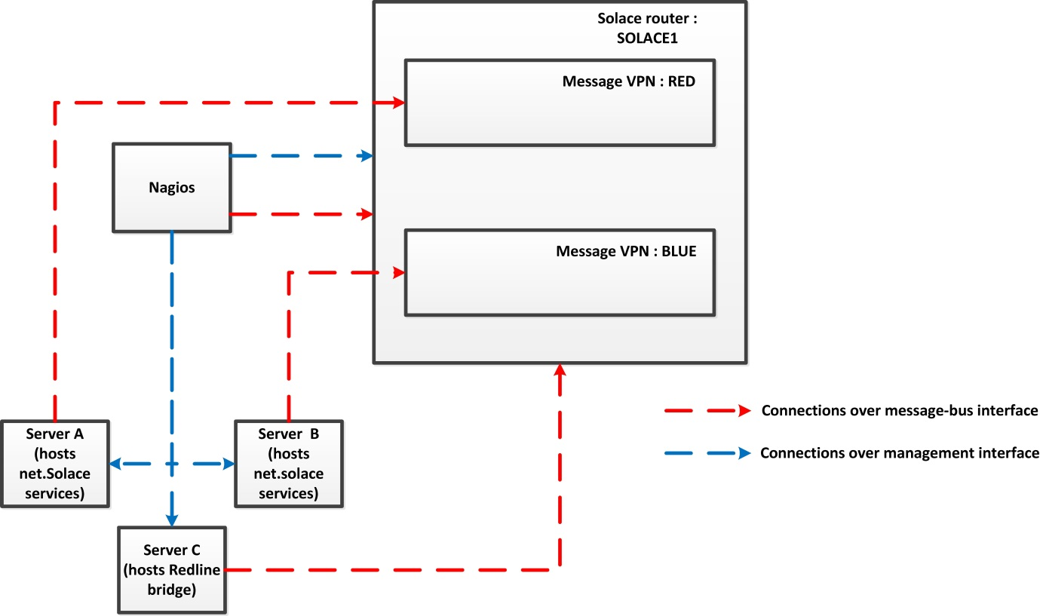
Solace Plugin for Nagios
The Solace plugins are a set of Perl scripts which use SEMP to retrieve statistics from Solace appliances
A C binary was developed for GBM for performing passive checks
Notes:
Switch to demo!

Slide 8
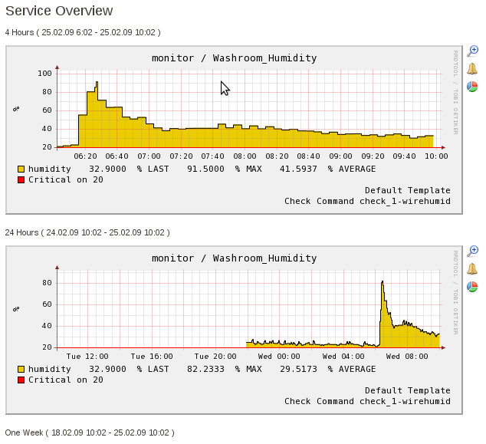
Addons – nagiosgraph
Plugins can return performance data as part of their checks
Nagiosgraph parses the performance data and displays it on graphs
Stores data in RRD files
Creates graphs and reports
Allows in place graph zooming
Notes:
Nagios will execute the check_nrpe plugin and tell it what service needs to be checked
– The check_nrpe plugin contacts the NRPE daemon on the remote host over an (optionally) SSL-protected
connection
– The NRPE daemon runs the appropriate Nagios plugin to check the service or resource
– The results from the service check are passed from the NRPE daemon back to the check_nrpe plugin, which
then returns the check results to the Nagios process.

Slide 9
Demo

Slide 10
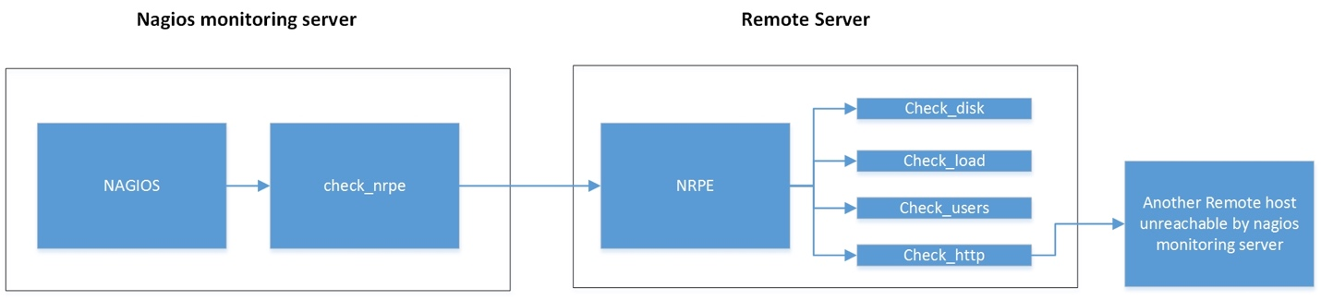
Addons – Nagios Remote Plugin Executor (NRPE)
Plugins are installed and executed on the server running Nagios
Can be executed over SSH to monitor remote servers but this imposes a large CPU pverhead
NRPE allows the remote execution of these plugins
Runs as a daemon service on the remote server
Locally checks resources when contacted by Nagios
Notes:
Nagios will execute the check_nrpe plugin and tell it what service needs to be checked
– The check_nrpe plugin contacts the NRPE daemon on the remote host over an (optionally) SSL-protected
connection
– The NRPE daemon runs the appropriate Nagios plugin to check the service or resource
– The results from the service check are passed from the NRPE daemon back to the check_nrpe plugin, which
then returns the check results to the Nagios process.

Slide 11
Summary – Nagios Core
Pros
Modularity of plugin architecture
Scalability using parallel checking and forking
Fast response times
Cons
Text file configs are diffucult to manage and do not scale
No inbuilt HA
Not effective for monitoring log files
Open source alternative:Icinga
Fork from the Nagios project
offers better maintainability
configuration rules similar to Puppet
Built in HA
Paid alternatives
Nagios XI: GUI for managing configuration, Advanced reports and graphs, built in HA
Nagios Log Server

Slide 12
Further Reading
Nagios Server in PSG: http://192.168.1.81/nagios
PSG projectware: svn://192.168.1.202/svn/pro-serv/trunk/ internal/projectware/NagiosPlugin
NagiosCookBook
Nagios Solace plugin
NRPE setup document (coming soon!)
Product Doco: https://assets.nagios.com/downloads/nagioscore/docs/nagioscore/4/en/

