Slide 1
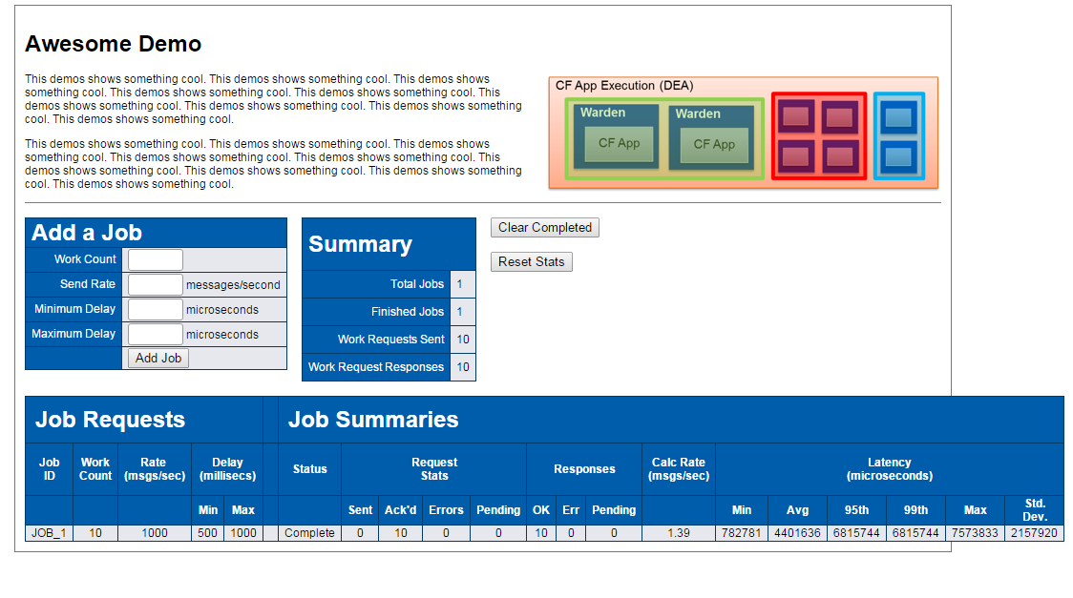




1
Aggregator
3
Spring Cloud
Demo UI
2
4

