Slide 1
Internet of Things
IOT

Slide 2
Our Team Members :
Md. Solaimanur Rahman
ID: 193-15-2951
PC-A
Md. Al Amin Miah
ID: 193-15-2965
PC-A
Mahabub Hossan Emon
ID: 193-15-2950
PC-A
Course tittle : Big Data and IoT (CSE412)

Slide 3
Outline:
> What is iot?
> Why iot?
> About
> Applications
> Conclusion

Slide 4


What is IOT?
The Internet of Things (IoT) describes the network of physical objects—“things”—that are embedded with sensors, software, and other technologies for the purpose of connecting and exchanging data with other devices and systems over the internet.
> Improves the resource utilization ratio.
> Control everything remotely.
> See data in real-time.
> Flexible configuration.
> Universal inter-networking

Slide 5
About:
Sensors are fitted everywhere across every devices collecting real-time data consistently.
Every device has its unique id which makes the communication possible among them.

Slide 6
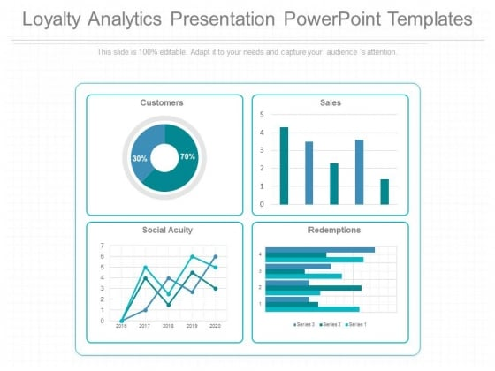
Other part is Analytics.
Analytics deals with the extraction of meaningful information from big data. Organizations apply analytics to business data to describe, predict, and improve business performance.

Slide 7
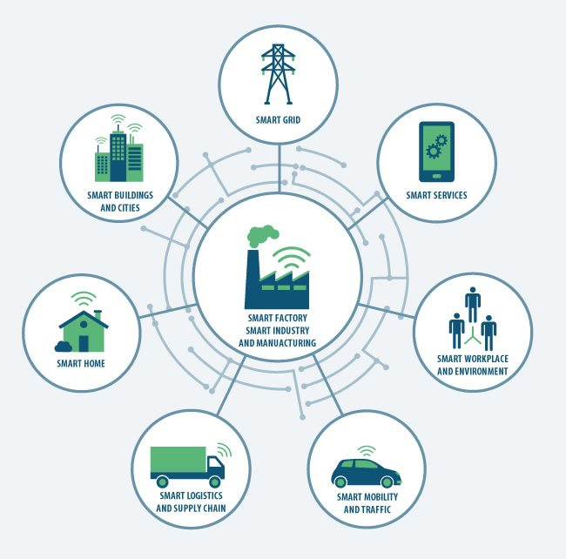
Application:
> Smart Manufacturing

Slide 8
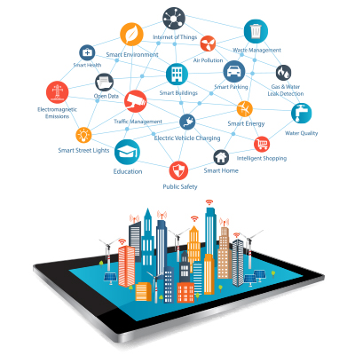
> Environment monitoring
Environmental monitoring is the most beneficial IoT application. It uses advanced sensor devices to identify the presence of pollutants in the air and water and promotes better sustainability

Slide 9
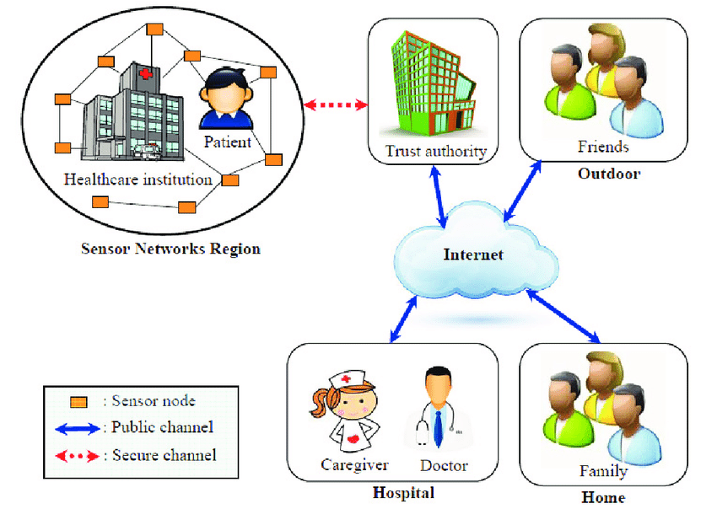
> Medical and Healthcare systems
IoT has applications in healthcare that benefit patients, families, physicians, hospitals and insurance companies

Slide 10
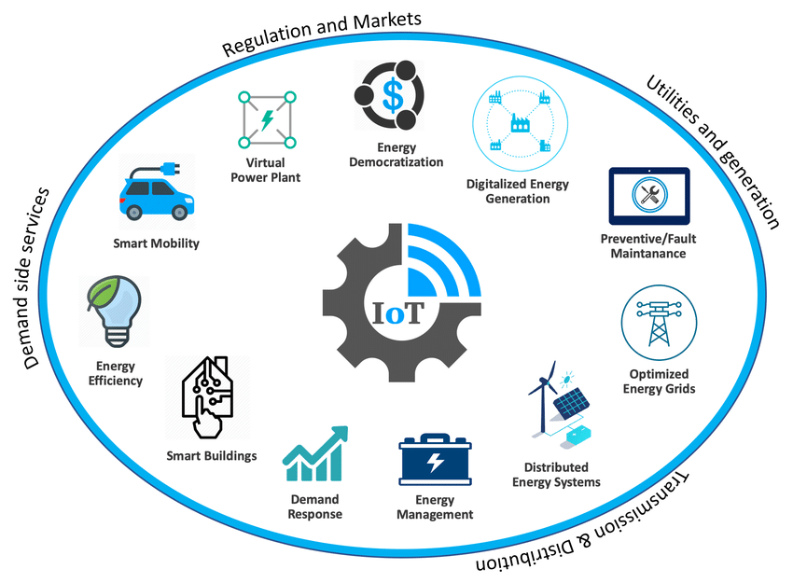
> Energy resource management
One type of process that includes planning & management of your energy consumption patterns in commercial & industrial sectors.

Slide 11
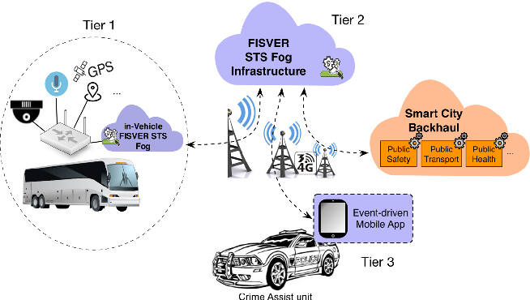
> Smart Transportation
Integrated application of modern technology and management strategies into transportation systems

Slide 12
Conclusion:
Though IOT is complex and poses some risks and is still evolving, many pioneers have started adopting this technology. IoT can help innovate new process and initiatives that could transform businesses, lives and the world

Slide 13
Thank You

