Slide 1

Automated Verification of Network Function Binaries
Solal Pirelli,
Akvilė Valentukonytė, Katerina Argyraki, George Candea
Notes:
*Automatically* verify *binaries*

Slide 2



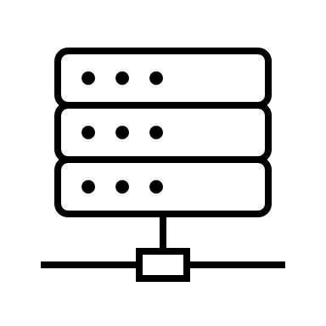





Context
e.g., IEEE 802.1D
Notes:
AUTOMATICALLY

Slide 3
Network Functions
NF code
Data struct 1
Data structures
Too complex for automated verification

Slide 4
Hard part
Contracts
Flow table
Hash map
Invariants
NF code
Cache
Array
…
Automatically prove the code obeys contracts by inferring the necessary invariants
Notes:
IMPLICIT invariant

Slide 5
Requirements
Vigor SOSP’19 | Gravel NSDI’20 | This work
◐ | ◐ | ●
◌ | ◌ | ●
NFs need automated verification, but:
Developers use many data structures
Operators deploy binaries

Slide 6
Describing data structures with maps enables the automated verification of network function binaries
Notes:
Regardless of how they’re implemented

Slide 7
Outline
Intro
Abstracting data structures
Handling binaries
Implementation
Evaluation & Limitations

Slide 8
Map
Map
Hash(K)
Map
Map
Notes:
USING diff DS

Slide 9
Contract example: LRU.evict()
State: map M (value → age)
Pre: M.length() > 0
Post: M.contains(result) ∧
M’ = M.remove(result) ∧
∀ (v,a) ∈ M: a ≤ M.get(result)
void* LRU_expire(struct LRU* lru)
// assert len(lru.items) > 0 // age = lru.items[result] // assume(lru.items.forall(lambda v, a: a <= age)) // del lru.items[result]
Notes:
More interesting

Slide 10
Translation
Map operations → decidable solver queries
Problem: map size is unknown
Insight: few operations per packet

Slide 11
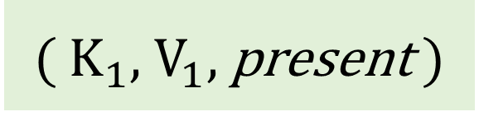

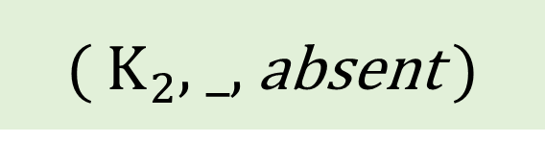
Translation
Track known items explicitly, and unknown items as an invariant
$V_{1}$ = get(M, $K_{1}$)
remove(M, $K_{2}$)
( $K_{1}$, $V_{1}$, present )
( $K_{2}$, _, absent )
others: λk,v,p. …

Slide 12

Finding invariants
Use known items as templates:
“Values in M are > X”
“Values in $M_{1}$ are keys in $M_{2}$”
…

Slide 13
Outline
Intro
Abstracting data structures
Handling binaries
Implementation
Evaluation & Limitations

Slide 14
Network Functions
NF code
Data structures

Slide 15
Source code
Data structures
Network primitives

Slide 16
Exhaustive symbolic execution
pkt_is_ipv4 ∧ …
!pkt_is_ipv4 ∧ …
…
…

Slide 17
Binaries
map_get(...)
map_get
Data struct 1
Data structures
Network primitives
Dynamic linking

Slide 18
Outline
Intro
Abstracting data structures
Handling binaries
Implementation
Evaluation & Limitations

Slide 19


Klint
NF binary
Invariant inference
angr
Contracts
Translation
Data structs
Spec
Verification
✅ | ❌
Paths

Slide 20
Outline
Intro
Abstracting data structures
Handling binaries
Implementation
Evaluation & Limitations

Slide 21
Verified NFs
C: Bridge Firewall Maglev NAT Policer Router
Rust: Policer

Slide 22
Verification performance
< 2 min / NF
Single-threaded prototype

Slide 23
Verified NF performance
Prototyping new data structures is now quick (then verify manually, as previous work)
Faster than previous verified NFs

Slide 24
Why only NFs?
Few and shallow “networking” operations
Explicitly modeled by our tool
Not feasible for e.g. Linux

Slide 25
Map limitations
Good fit for most data structures
Not applicable to all complex code: regex, ...

Slide 26
Summary
We verify network function binaries that use any data structure with map-based contracts
We translate maps by separating known/unknown items, which scales and enables invariant inference
dslab.epfl.ch/research/klint solal.pirelli@epfl.ch

